Slide 1
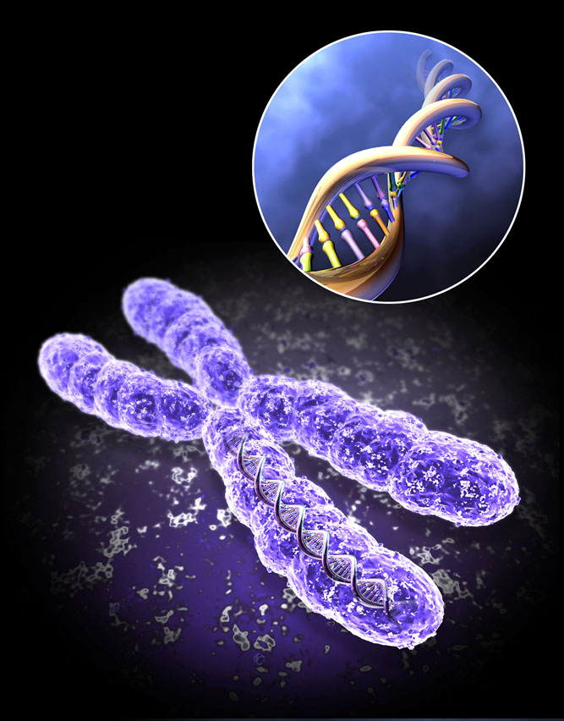
Genes and genetic disease
Dr. Priyanka N. Sharma
Associate Professor
Dept. of Anatomy

Slide 2
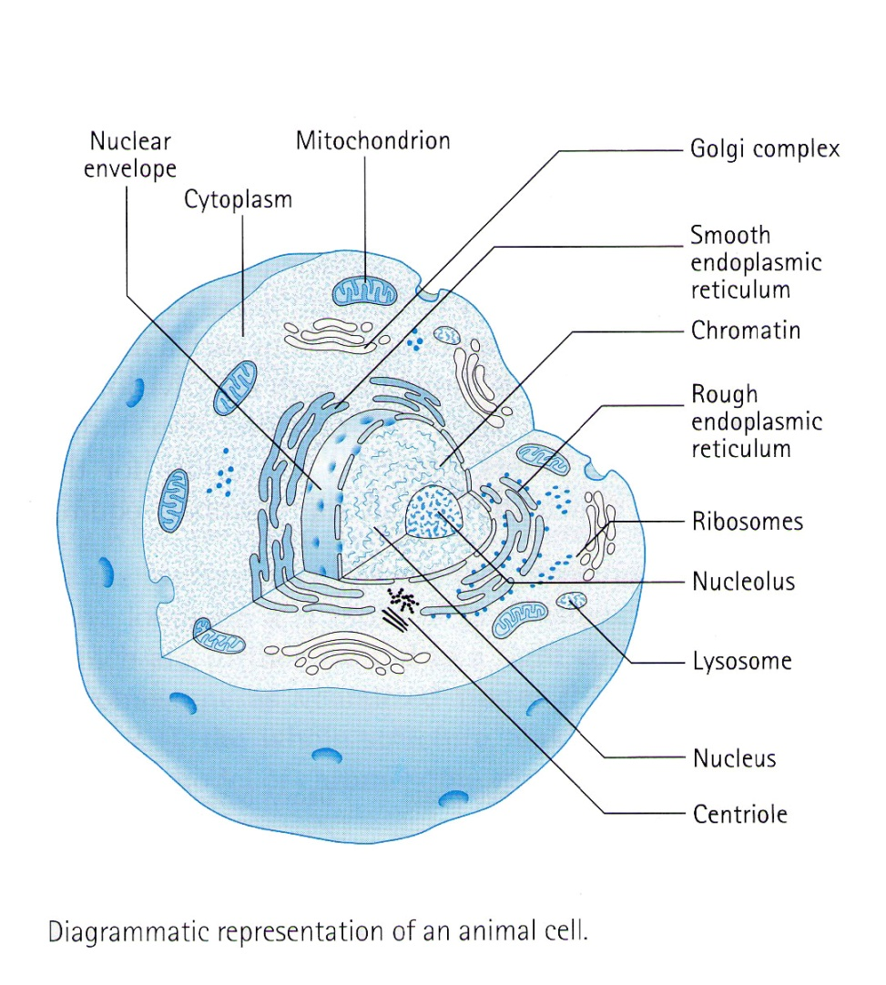
Human Chromosome
Chroma means colour & soma means body . Appear like coloured (Stained) rod –shaped structure
Reside in nucleus
Chief chemical constituent is DNA

Slide 3
Autosomes & Sex Chromosomes
46 Chromosomes, 44 Autosomes & 2 Sex Chromosomes
44 Autosomes, 22 pairs
Sex chromosomes , X & Y
Human Female – 44 + X X
Human Male – 44 + X Y

Slide 4
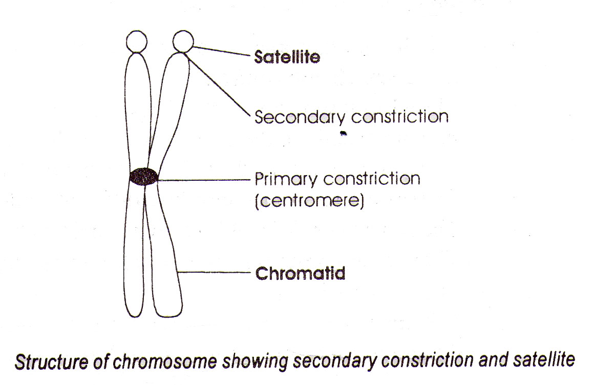
Structure of Chromosome
Two symmetrical halves , Chromatids
Centromere ,Light staining constricted area
Short arm p & long arm q
Secondary constriction , nucleolar organizer region , satellite
Position of centromere is different in different chromosomes

Slide 5
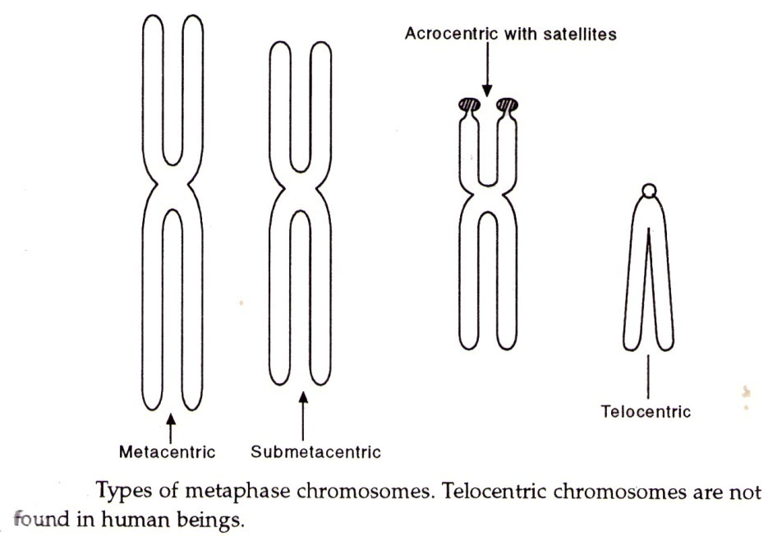
Classification based on position of centromere

Slide 6
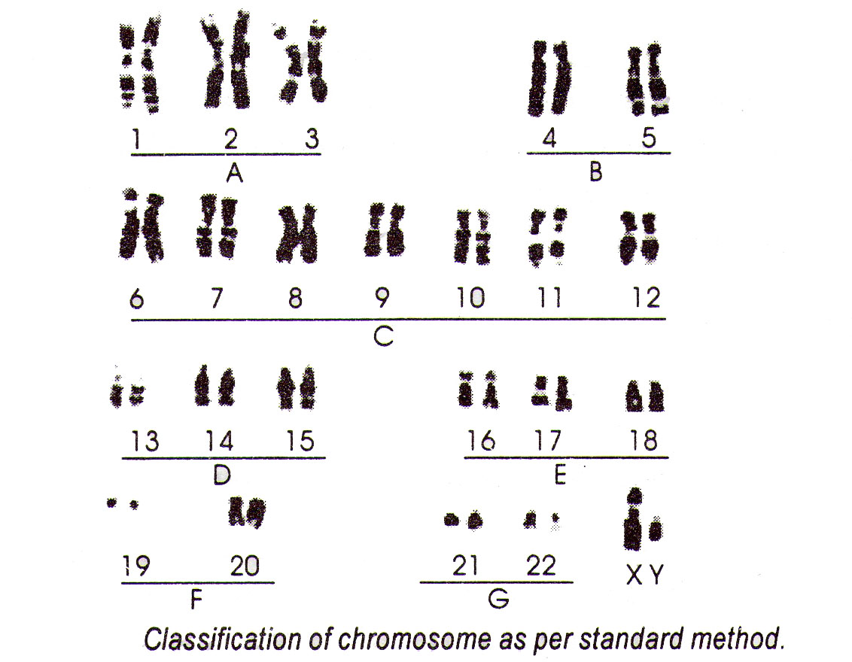
Denver Classification (Standard Classification)

Slide 7
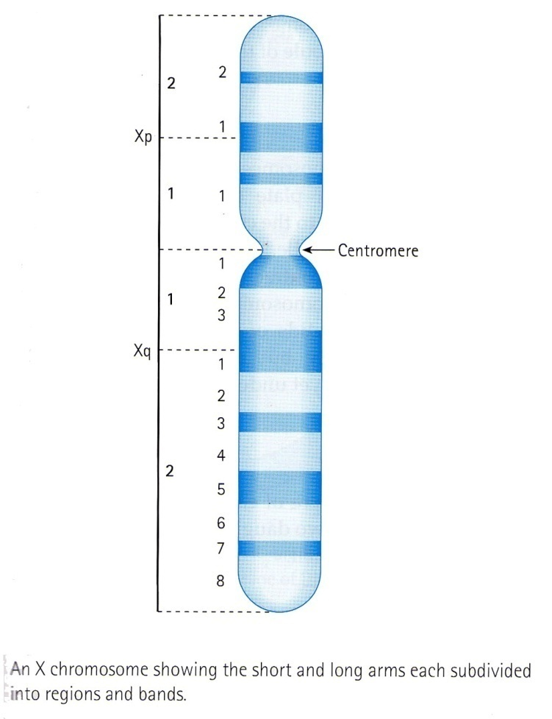
Paris Nomenclature
More accurate
p & q arms,regions numbered 1,2 ,3 starting from centromere
Further subdivided into bands

Slide 8
Genes
It refers to a combination of DNA subunits which together constitute a unit of inheritance
Genes are on Chromosomes
Genes may encode proteins or enzymes
About 50,000 to 100,000 genes in the human cell

Slide 9
Structure of genes
A gene: DNA sequence that is needed to encode amino acid sequence of a protein
Composed of exons, introns and different control elements
Exon – protein coding sequence
Intron – intervening sequence

Slide 10
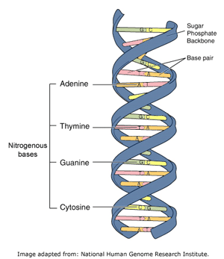
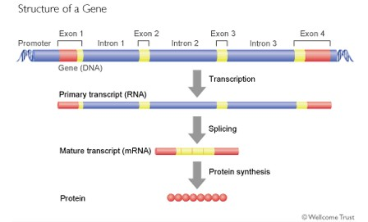
Structure of genes

Slide 11
Function of genes
Maintain the genetic specificity of an individual
Transmission of traits from the parents to the offspring
Synthesize various proteins and enzymes of the cell

Slide 12
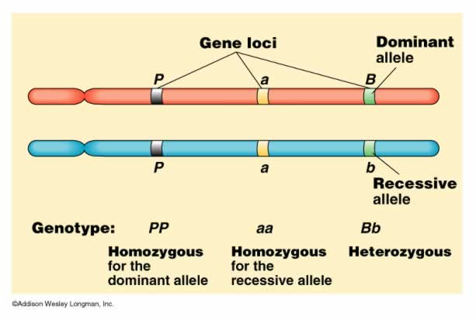
Location of genes
Each gene occupies a specific locus on a chromosome
The 2 choromosomes of a pair are homologus and genes occupying the same locus on homologus chromosomes are called alleles

Slide 13
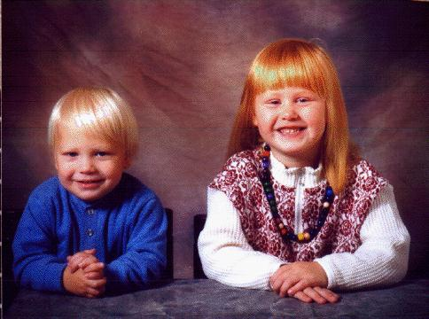
Two important terms...
Phenotype: The outlook of an organism
Genotype: The genetic information written in DNA
Phenotypes
Genotype
Genotype
GCCAAGAATGGCTCCCACCT
GGCTCTCAGACATTCCCCTGGTCCAACCCCCAGGCCATCAAGATGTCTCAGAGAGGCGGCTAGACACCCAGAGACCTCAAGTGACCATGTGGGAACGGGATGTTTCCAGTGACAGGCA
ATGTTTCCACCTTCAGGTTCC
ACTGGGCTGATTCCCCCCTCC
CACTTTCAAGCTCGGCCCCTT
TCAACTCAGAGAGGCGGCTA
GACACCCAGAGACCTCAAGT
GACCATGTGGGAACGGGATG
TTTCCAGTGACAGGCAG

Slide 14
Dominant character: only one allele needed
to cause the phenotype (heterozygous)
Recessive character: both allels needed to
cause the phenotype (homozygous)

Slide 15
TYPES
Structural genes- which code for specific amino acid sequence in a protein
Operation genes- which allow transcription
Regulator genes- which inhibit protein synthesis
Dominant genes- which are able to express their traits
Recessive genes- which are able to express only in homozygous state
Sex-linked genes- abnormal genes located on X- or Y- chromosome
Jumping genes- jump to and fro within single choromosome or an adjacent one

Slide 16

Mutations
Alterations in DNA sequence
Some are part of normal DNA variation
Caused by chemical and physiological agents
and errors in DNA replication
Cells can repaire some mistakes
If not repaired changes in DNA sequence
are made permanent by DNA replication

Slide 17
Classification of genetic disease
Single gene disorder
Multifactorial disorder
Chromosomal abnormality
Acquired somatic genetic disease

Slide 18
There are 4 types of Genetic Diseases
1. Single Gene:
  Disorders caused by abnormality or mutation in the sequence of one gene
2. Multifactorial:
  caused by a combination of environmental as well as mutations in multiple genes
3. Chromosomal:
  Abnormalities in chromosome structure such as missing or extra copies
4. Mitochondrial:
  caused by a mutation in the non chromosomal DNA of the mitochondria.

Slide 19
1. Single gene disorders
Autosomal dominant
Autosomal recessive
X- linked- dominant
- recessive

Slide 20
Autosomal dominant disorders
Both males and females are equally affected
Gene responsible for the trait is present on autosome
Transmission from one generation to the other without skipping

Slide 21
Autosomal dominant disorders
Common baldness
Ear pits
Congenital ptosis
ABO blood group
Rh blood group
brachydactyly
Huntington’s disease
Hypercholesterolaemia
Achondroplasia
Polycystic kidney
Marfan syndrome
Diabetes insipidus

Slide 22
Autosomal recessive disease
Expressed only when mutant allele is present in a double dose(homozygous state)
An heterozygous individual for an autosomal recessive trait is called carrier
Trait is seen in same generation
Male and females are equally affected

Slide 23
Autosomal recessive disease
Microcephaly
Alkaptonuria
Phenylketonuria
Microphthalmia
Schizophrenia
Absence of sweat gland
Scikle cell anemia
Cyctic fibrosis
Albinism

Slide 24
X- linked inheritance: Dominant
Recessive
Diabetes mellitus
Haemophilia
Colour blindness
Haemophilia
Vit.-D resistant
Hypophosphatemia

Slide 25
2. MULTIFACTORIAL INHERITANCE
Multi-”FACTORIAL”, not just multi-GENIC
Common phenotypic expressions governed by “multifactorial” inheritance
  Hair color
  Eye color
  Skin color
  Height
  Intelligence
  Diabetes, type II
Notes:
We are now moving the discussion up from ONE gene→ MULTI-genes→ Parts of chromosomes→ WHOLE chromosomes.

Slide 26
FEATURES of multifactorial inheritance
Expression determined by NUMBER of genes
Overall 5% chance of 1st degree relatives having it
Identical twins >>>5%, but WAY less than 100%
This 5% is increased if more children have it
Expression of CONTINUOUS traits (e.g., height) vs. DISCONTINUOUS traits (e.g., diabetes)
Notes:
If a disease or condition is scalable, rather than on or off, it is probably multigenic, or multifactorial, just part of the spectrum of HOMO-zygous diseases being HOMO-geneous, and HETERO-zygous diseases being VARIABLE.

Slide 27
“MULTIFACTORIAL” DISORDERS
Cleft lip, palate
Congenital heart disease
Coronary heart disease
Hypertension
Gout
Diabetes
Pyloric stenosis
MANY MORE…..
Notes:
You might imagine that the list of “multifactorial” disorders blends in with the entire list of human diseases. Hence are “all” diseases “genetic”? This is almost an UNFAIR list, therefore
NO single gene mutation can be indicted as being the cause of any of these diseases..

Slide 28
3. Chromosomal abnormality
Due to increase or decrease in the normal number of chromosome
E.g.- Trisomy 21( Down’s syndrome)
Turner’s syndrome
Kleinfelter syndrome
Cell cycle arrested in metaphase (colchicin) - staining by Giemsa method (G-bands) - photographing – karyotype
To determine the abnormality in the structure of chromosomes by invention of banding and FISH

Slide 29
4. Acquired somatic genetic disease
Somatic cell division occur during the life time
During cell division change in the structure of a gene may take place- mutation
Sometimes error in chromosome separation occur, these are responsible for various cancers seen in adult life

Slide 30
THANK YOU

Slide 31
Radhika Varma* and Priya PrathapTrivandrum Medical College Thrissur, Kerala, India*Corresponding Author: Radhika Varma MBBS, Trivandrum Medical College Thrissur, Palakkad, Kerala,received Date: May 28, 2017 / Accepted Date: Jun 26, 2017 / Published Date: Jul 03, 2017
Radhika Varma* and Priya Prathap | Keratoacanthoma in Xeroderma Pigmentosum: An Entity Beyond Guess | occurrence of KA of the nose with an unusual morphology in a 12 year old boy with XP where, such an association of the disease in young age is exceedingly rare. | autosomal recessive disorder, characterized by photosensitivity, pigmentary changes, premature skin aging and increase in risk of developing malignant neoplasms of both skin and eyes. Keratoacanthoma (KA) is a rapidly growing benign skin tumor, occurring primarily in elderly light skinned individuals. | Possibility of a Keratoacanthoma should be borne in mind for any patient with Xeroderma Pigmetosum having a skin tumor especially in sun exposed site, irrespective of the age. Histopathology has immense role in confirming the diagnosis, because clinical presentation at instances, may be perplexing as in our case. Regular medical follow up in these patients is crucial for an early diagnosis and treatment of tumors at a curable stage before they spread out or turn malignant

