Slide 1
PHARYNX AND DEGLUTITION
Dr Manoj Kulkarni
Professor & Head
Department of Anatomy

Slide 2
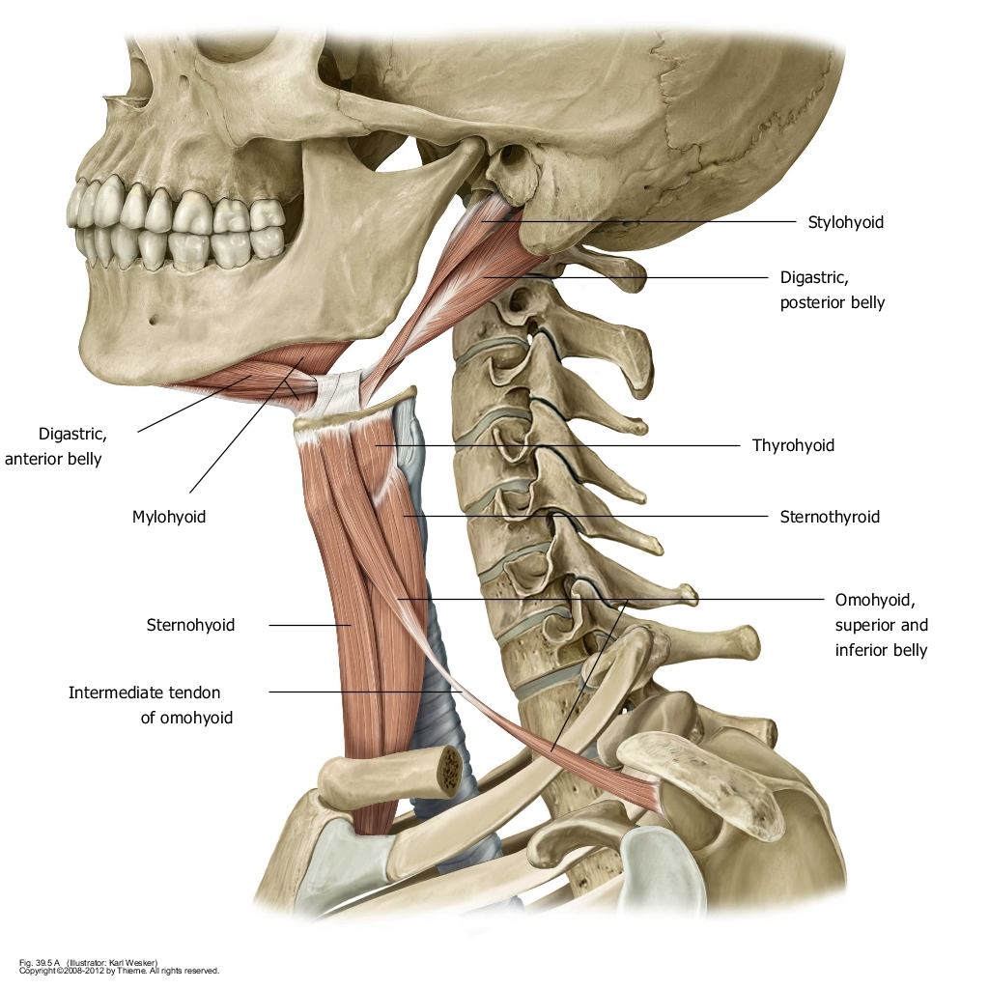

Slide 3
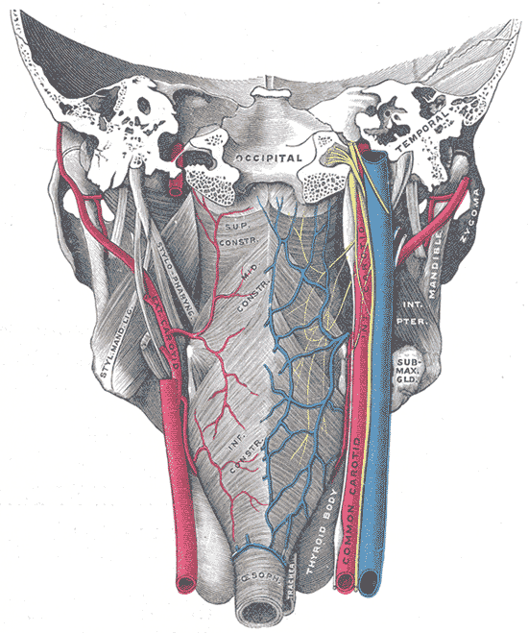
Shape
Irregular Fibro-muscular tube lined by mucous membrane
Length: 15 cm
Extends from the base of the skull to level of the 6th cervical vertebra

Slide 4
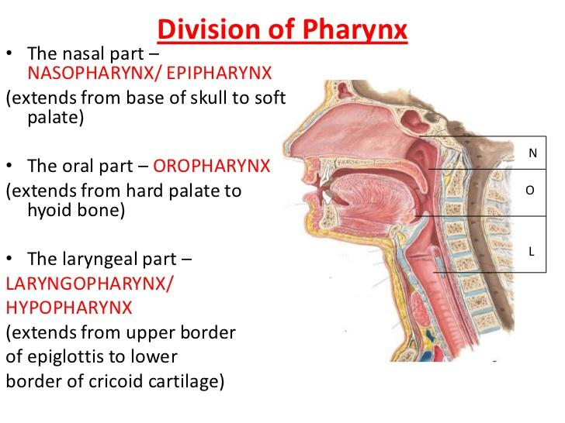

Slide 5
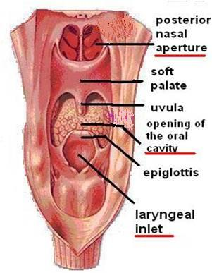
Pharynx
The anterior wall is deficient and shows the following
  Posterior nasal apertures
  Opening of the oral cavity
  Laryngeal inlet
N
OC
L

Slide 6
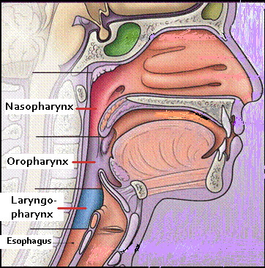
Pharynx is divided into three parts:
  Nasopharynx:
    Superior part, communicates with the nasal cavity through posterior nasal apertures
  Oropharynx:
    Middle part, communicates with the oral cavity through the oropharyngeal isthmus
  Laryngopharynx:
    Inferior part, communicates with the larynx through the laryngeal inlet

Slide 7
Nasopharynx
Boundaries:
Roof: body of sphenoid & basal part of the occipital bone. Pharyngeal tonsils (adenoids) present in the submucosa
Floor: upper surface of soft palate & the pharyngeal isthmus (opening between the free margin of soft palate and posterior pharyngeal wall

Slide 8
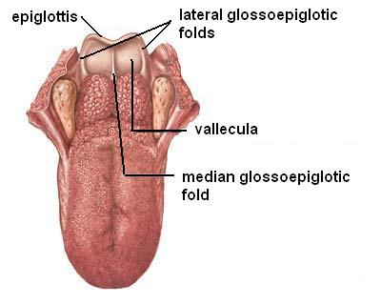
Oropharynx
Lies behind the mouth
Extends from soft palate to upper border of epiglottis
Boundaries:
Roof: soft palate and pharyngeal isthmus
Floor: posterior one third of tongue, median & lateral glossoepiglottic folds, and the vallecula

Slide 9
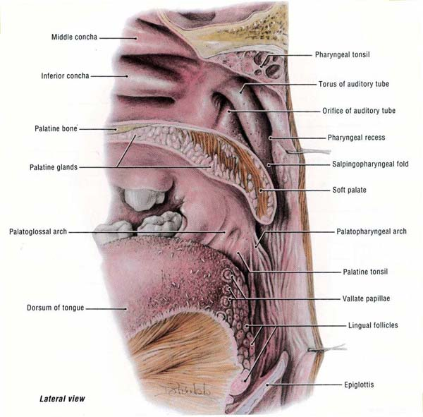
Oropharynx
Anterior wall: opening of the oral cavity
Posterior wall: supported by body of C2 and upper part of body of C3 vertebra
Lateral wall shows:
  Palatopharyngeal folds posterior to the palatoglossal folds.
  Palatine tonsil located between them in the
  Tonsillar fossa

Slide 10
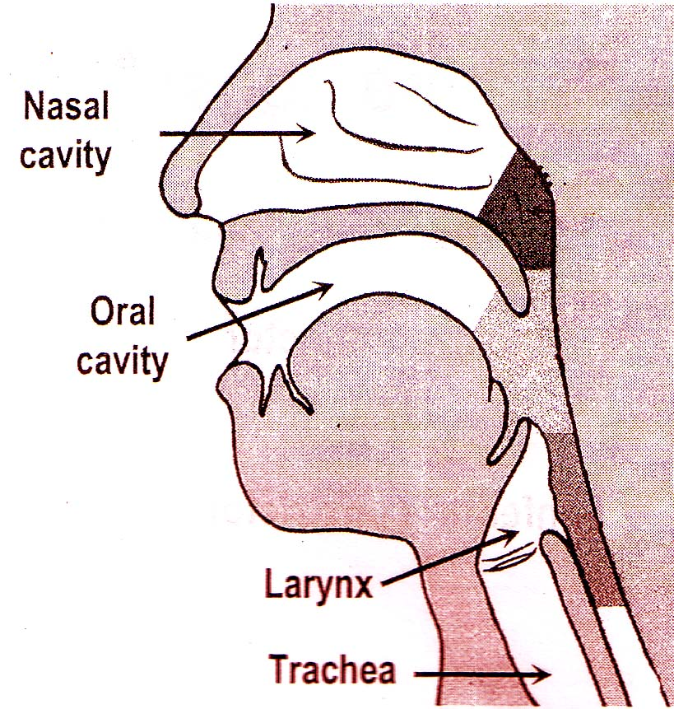
Laryngopharynx
Behind the Larynx (in front of 3rd to 6th Cervical vertebra)
From the tip of epiglottis superiorly to the lower border of cricoid cartilage Inferiorly
Communicates:
Anteriorly with the Larynx
Superiorly with the oropharynx
Inferiorly with the esophagus

Slide 11
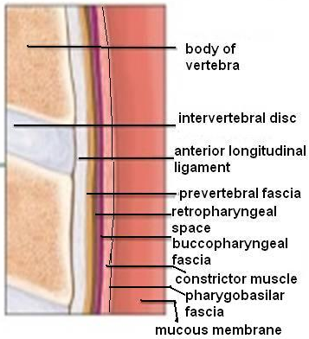
Pharyngeal Wall
It is a musculo-membranous wall, composed of:
  Mucosa & submucosa
  Pharyngobasilar fascia
  Muscles: circular & longitudinal
  Buccopharyngeal fascia
The buccopharyngeal fascia is separated from the prevertebral fascia by the retropharyngeal space.

Slide 12
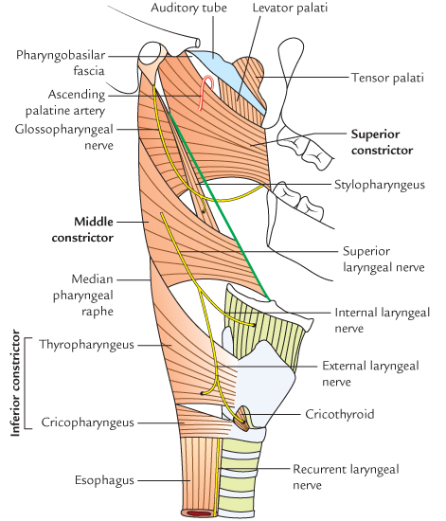
Constrictor Muscles
Three in number: Superior, Middle & Inferior
Extend around the pharynx and are inserted posteriorly into a fibrous raphe that extends from the pharyngeal tubercle on the occipital bone to the esophagus
The three muscles overlap each other
The gap between the superior border of the superior constrictor and the occipital bone is filled by thickened pharyngo-basilar fascia

Slide 13
Superior constrictor
  Origin: medial pterygoid plate, pterygoid Hamulus, pterygomandibular ligament, mylohyoid line
  Insertion: pharyngeal tubercle, pharyngeal raphe
Middle constrictor
  Origin: lower part of stylohyoid ligament, greater & lesser cornu of hyoid bone
  Insertion: pharyngeal raphe

Slide 14
Inferior constrictor
  Origin: lamina of thyroid cartilage, cricoid cartilage
  Insertion: pharyngeal raphe
Functions:
The constrictor muscles propel the bolus of food down into the esophagus
Cricopharygeus (lower fibers of the inferior constrictor) act as a sphincter, preventing the entry of air into the esophagus between the acts of swallowing

Slide 15
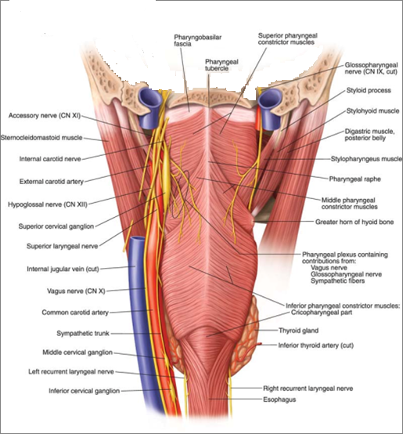

Slide 16
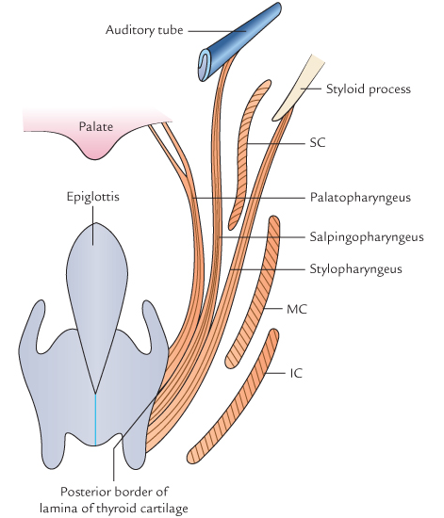
Longitudinal Muscles
Stylopharyngeus
Salpingopharyngeus
Palatopharyngeus
Function:
Elevate the larynx & pharynx during swallowing

Slide 17
Stylopharyngeus
  Origin: styloid process
  Insertion: posterior border of thyroid cartilage
Salpingopharyngeus
  Origin: auditory tube
  Insertion: blends with palatoglossus
Palatopharyngeus
  Origin: palatine aponeurosis
  Insertion: posterior border of thyroid cartilage

Slide 18
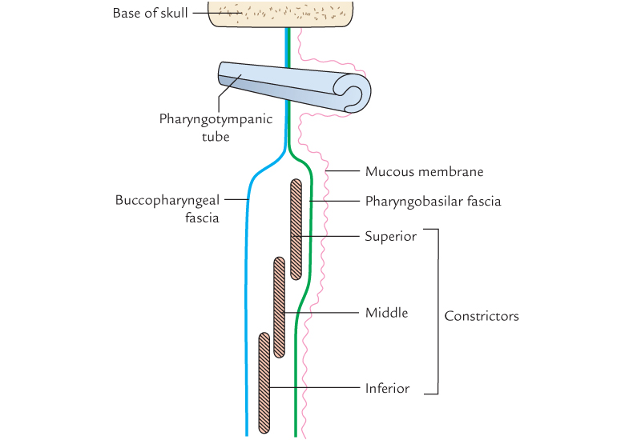

Slide 19
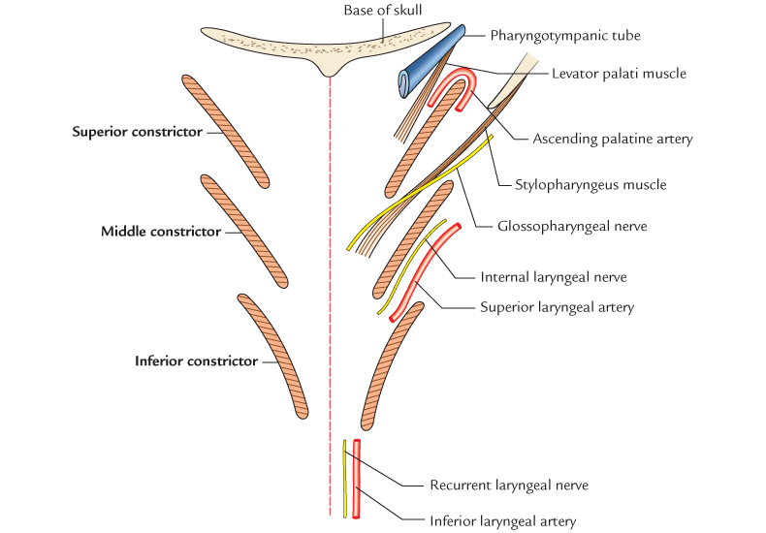

Slide 20
Nerve Supply
Motor ---► X Except :
Stylopharyngeus --►IX
Sensory --►
Nasopharynx: V
Oropharynx: IX
Laryngopharynx: X
Autonomic:
sympathetic: SCG
Parasympathetic: through VII

Slide 21
Blood supply
From the External Carotid Artery & its branches
1- Tonsillar artery (from Facial Artery)
2-Ascending palatine artery (from Facial Artery)
3-Ascending pharyngeal Artery (from external carotid)
4-Descending palatine artery ( from Maxillary artery.
5-Dorsalis linguae artery (from Lingual artery)

Slide 22
Stages of Swallowing (Deglutition)
Oral stage (voluntary)
Pharyngeal stage
Esophageal stage

Slide 23
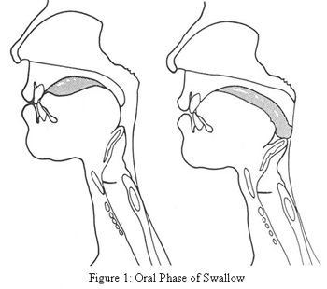
Oral stage (voluntary)
Food lies between tongue
and hard palate
Mylohyoid raises the floor,
food pushed into
oropharynx

Slide 24
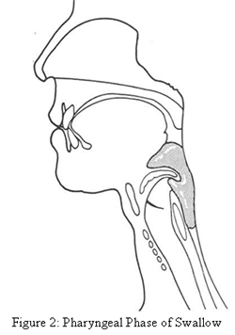
Pharyngeal stage
Oropharyngeal isthmus closed by stylo and palatoglossus
2. Ph. Isthmus closed by levator and
tensor veli palatini
3. Changes in larynx: raised by
thyrohyoid, stylo, palato and
Salpingopharyngeus. Laryngeal
inlet closed.
Bolus enters pharynx

Slide 25
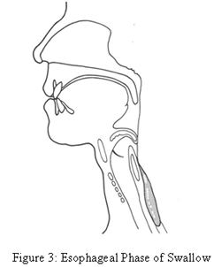
Esophageal stage
Successive contraction of superior
and middle constrictor
Shortening and elevation of
pharynx by Palatopharyngeus
Contraction of thyropharyngeus
and relaxation of cricopharyngeus
Thus food enters oesophagus and is carried to stomach by peristalsis

Slide 26
MCQ
Q. 1 Stylopharyngeus muscle is supplied by which nerve?
Vagus
Glossopharyngeal
Chorda tympani
Lingual

Slide 27
MCQ
Q. 2 Which one of these is the longitudinal muscle of
pharynx?
Palatopharyngeus
Superior constrictor
Middle constrictor
Inferior constrictor

Slide 28
MCQ
Q. 3 Which structure passes between middle and inferior
constrictor of pharynx.
Glossopharyngeal nerve
Superior laryngeal nerve
Recurrent laryngeal nerve
Internal laryngeal nerve

Slide 29
MCQ
Q. 4 Laryngopharynx does not communicate with
Oropharynx
Larynx
Oesophagus
Nasopharynx

Slide 30
MCQ
Q. 5 Which nerve does not give sensory fibbers to pharynx?
Trigeminal
Facial
Glossopharyngeal
Vagus

Slide 31
MCQ ANSWERS
Q. 1 b
Q. 2 a
Q. 3 d
Q. 4 d
Q. 5 b

