Slide 1
Ocular Infections
Dr. Saurabh Norris
Assistant Professor
Dept. of Microbiology

Slide 2
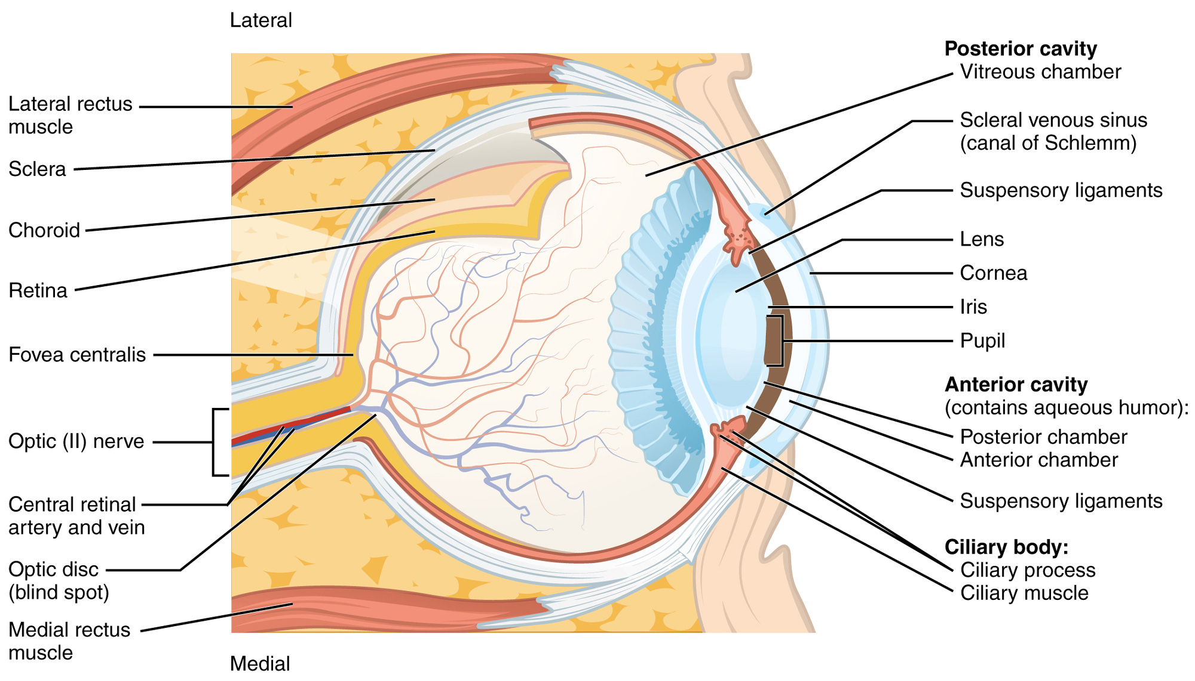
Anatomy of the eye

Slide 3
External eye infection | External eye infection | Internal eye infection
Blepharitis | Conjunctivitis | Uveitis: choroiditis
Hordeolum | Keratitis | Uveitis: chorioretinitis
Dacryocystis | Keratoconjunctivitis | Retinitis
Dacryoadenitis |  | Endophthalmitis

Slide 4
Transmission & predisposing factors
Transmission :
  Direct or indirect contact through fingers, cloths, fomites, contact lens...
  Oculo-genital transmission
  Hematogenous spread
  From adjacent structures
Predisposing factors:
  poor hygienic condition,
  hot dry climate,
  poor sanitation and dirty habits
  Organic matter trauma
  Excess use of antibiotics,
  Patients on immunosuppressive therapies

Slide 5
Conjunctivitis
Inflammation of the conjunctiva
Bacteria | Streptococcus pneumoniae, Haemophilus influenzae, S. aureus, (mc cause) Chlamydia trachomatis, Neisseria gonorrhoeae, Streptococcus pyogenes, Moraxella spp., (mcc of angular conjunctivitis) Corynebacterium spp.
Virus | Adenovirus, Herpes simplex (HSV), Varicella zoster. Epstein-Barr virus (EBV) Influenza virus, Paramyxovirus, Rubella, HIV Enterovirus, Coxsackie A

Slide 6
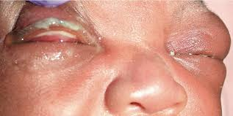
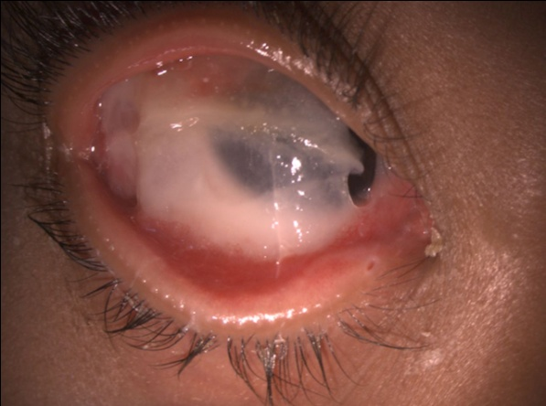
  Bacterial conjunctivitis
Neisseria gonorrhoeae:
  Ophthalmia neonatrum; Acute purulent discharge &
  crusted lesions within 12-48 hours of birth
Haemophilus aegypticus (Koch weeks bacillus):
  causes epidemics of mucopurulent conjunctivitis.
Corynebacterium diphtheriae:
  Acute pseudomembranous conjunctivitis

Slide 7
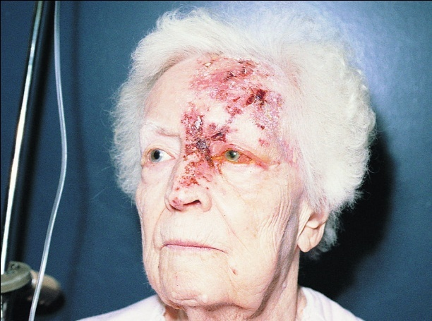
Viral conjunctivitis
Adenovirus
  Ocular involvement is a part of respiratory pharyngeal syndrome.
  At children’s summer camp (swimming pool conjunctivitis) ; type 3 & 7
  Epidemic keratoconjunctivitis; by type 8, 19, 37
Herpes simplex virus
  Characterized by Dendritic ulcer and geographical ulcer
Varicella zoster virus
  Following the reactivation of latent endogenous varicella
  zoster virus.
  Involves the ophthalmic division of the trigeminal nerve
  with associated conjunctivitis and involvement of the side
  of the nose.

Slide 8
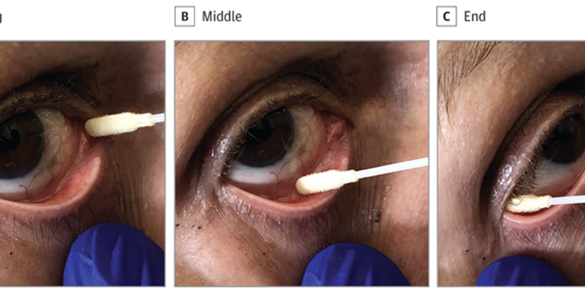
Lab diagnosis
Sample collection & transport :
  Purulent material from surface of the lower conjunctiva sac & inner canthus of the eye is collected in a sterile swab for culture.
  Both eyes should be cultured separately.
  Chlamydial culture: specimen should be taken with a dry calcium alginate swab and placed in a 2-SP (2 sucrose phosphate) transport medium.

Slide 9
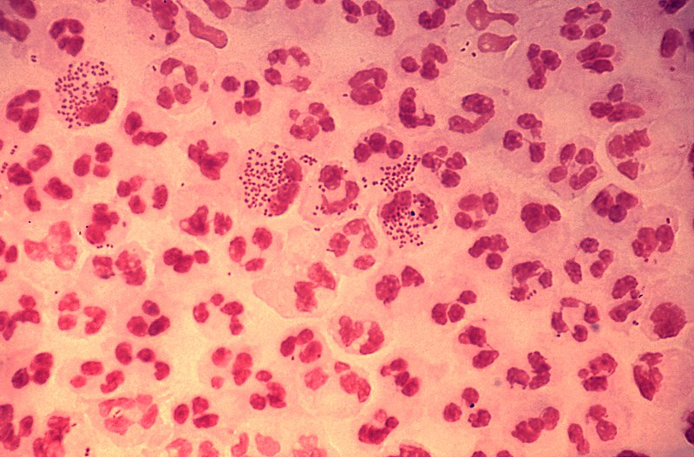
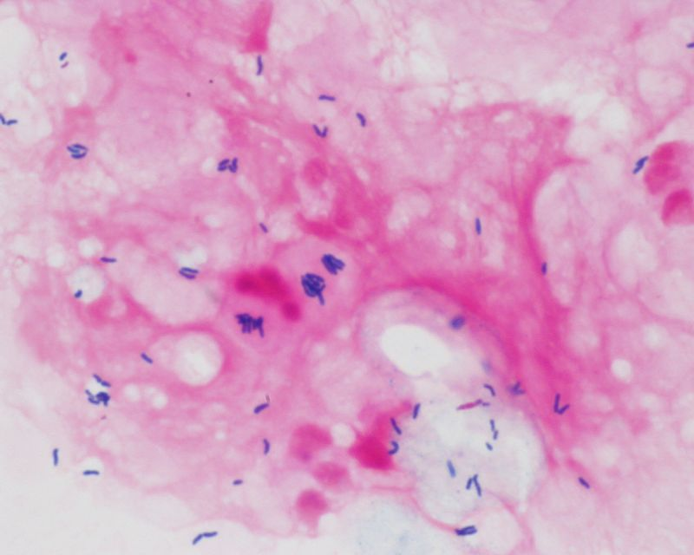
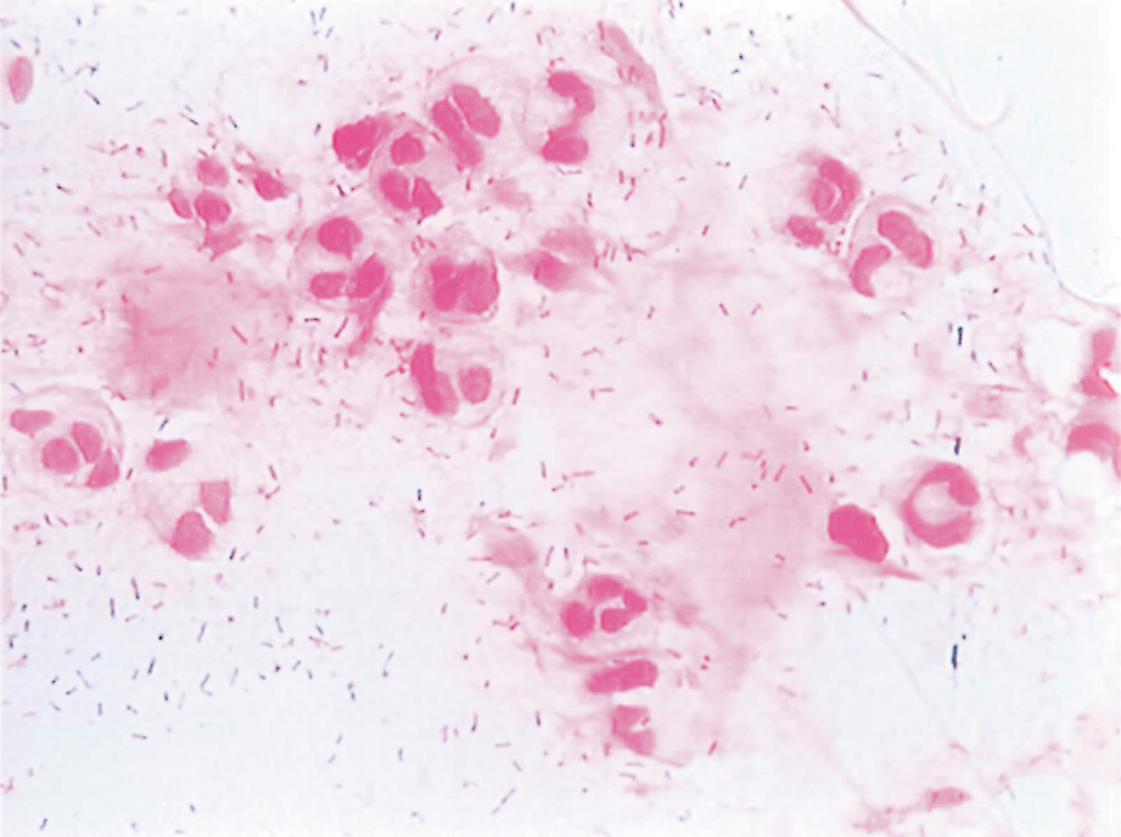
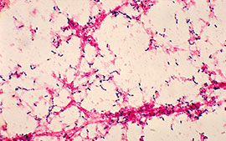
Diptheriodes in clusters, in singles & pairs.
Gram stained smear showing polymorphonuclear cells and typical intracellular diplococci.
Moraxella lacunata
S. pneumoniae

Slide 10
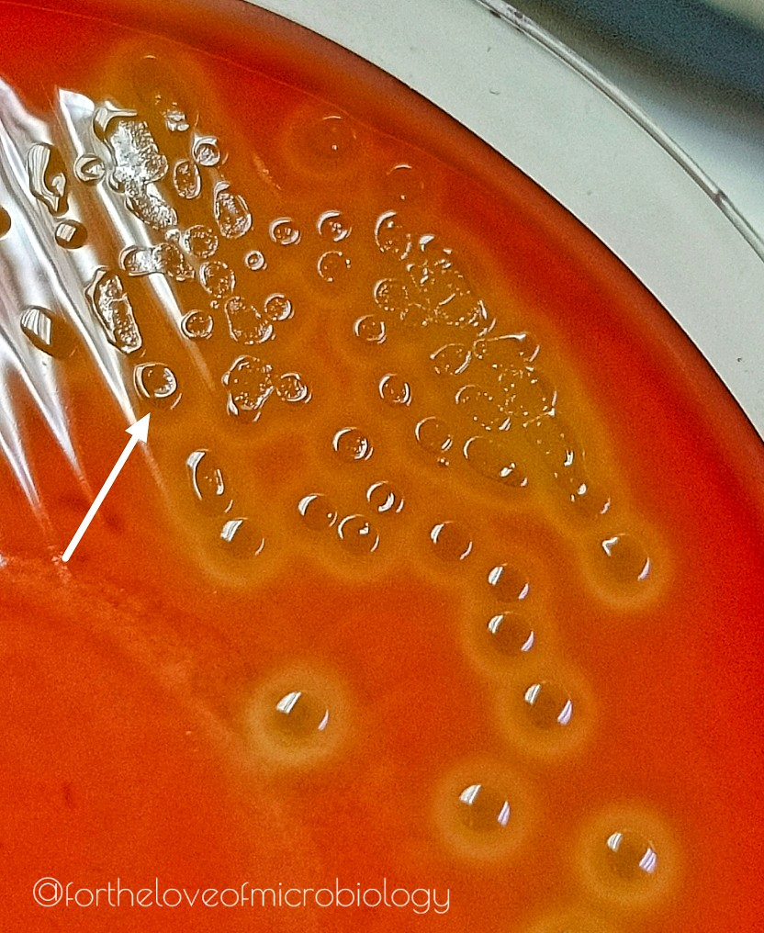
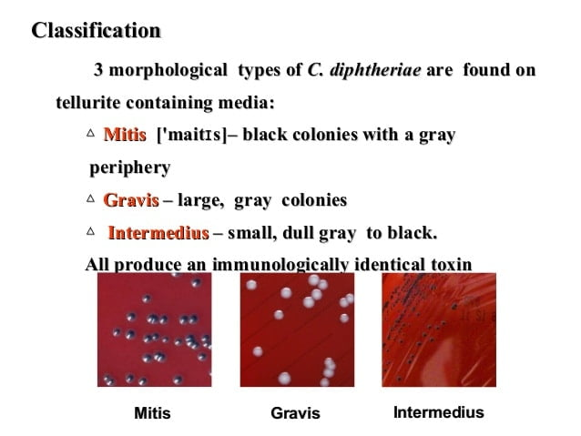
Cultures
C. diphtheriae colony on tollurite containing agar
Colony of S. pneumoniae on blood agar

Slide 11
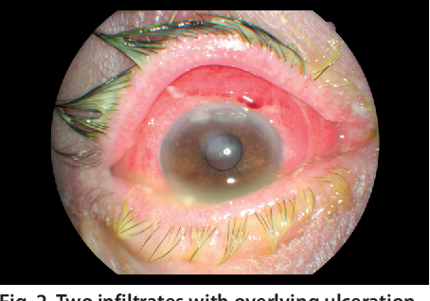
Case report
A 36 year old woman presented to the ophthalmology team with right eye redness, pain, thick, yellowish discharge. Her condition was worsening despite antibiotic eye drops that were prescribed by doctors from 3 different clinics. Further H/O patient revealed that her husband had multiple sexual partners previously. She also had yellowish, smelly vaginal discharge over the past 3 months A/W pain on urination and vaginal itchiness.
Right eye and vaginal swab were sent for gram stain and culture and sensitivity.
The gram stain revealed the presence of intracellular
gram negative diplococci.
The infection was diagnosed to be a cause of
Neisseria gonorrhoeae.
Rx: IM Ceftriaxone 1 gm + Azithromycin 1 gm immediately.
Contact tracing was done.

Slide 12
Diagnosis of viral causes
  Direct demonstration of virus by electron microscopy, fluorescent microscopy
  Tzanck smear for inclusion bodies
  Antemortem diagnosis for rabies virus:
    Direct taking up a corneal smear for intracytoplasmic Negri bodies
  Isolation of virus by Animal inoculation, Embryonated egg inoculation and Tissue culture

Slide 13
Keratitis
Inflammation of the cornea
Bacteria | S. aureus, S. pneumoniae, Pseudomonas aeruginosa Moraxella lacunata, Bacillus spp.
Viral | HSV, adenoviruses, varicella zoster
Fungal | Fusarium solani, Aspergillus spp., Candida spp., Acremonium, Curvularia
Parasitic | Acanthamoeba spp.

Slide 14
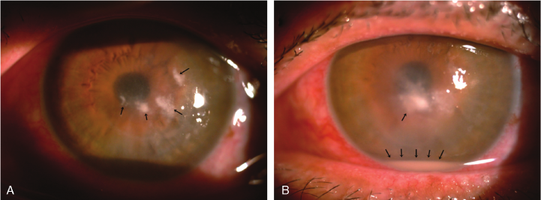
Fungal keratitis
Aspergillus and Fusarium are responsible for 70% cases.
Affect young, immunocompetent healthy adults, more often from rural areas.
Presents with the typical history of trauma with organic matter.
Typical characteristics
  Moderate or cheesy hypopyon
  Satellite lesion and immune ring

Slide 15
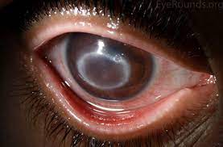
Case presentation of
Acanthamoeba keratitis
39-year-old male is referred to the ophthalmology clinic with cloudy vision, photophobia, and a red, painful right eye. The patient is a contact lens wearer who had used disposable soft contact lenses for the past 3 months. Three weeks prior to presentation, the patient began to develop cloudy vision, photophobia and increasingly exquisite pain in the right eye (OD). Pain increased to 8 out of 10 on a pain scale, despite topical antibiotic therapy at an outside facility. When the patient presented to the clinic, he was on Gatifloxacin and Tobramycin drops every hour and cyclopentolate 1% twice a day (BID), OD. Despite this therapy, the ulcer in the right eye persisted and was worsening.
Slit lamp examination showed dense infiltrate or classic "ring infiltrate“.
Confocal Microscopy revealed bright trophozoites with pseudopodia in the basal epithelium and double-walled cyst forms.
The corneal scrapings were sent to the lab for histopathology, which showed double-walled cysts on an H&E.

Slide 16
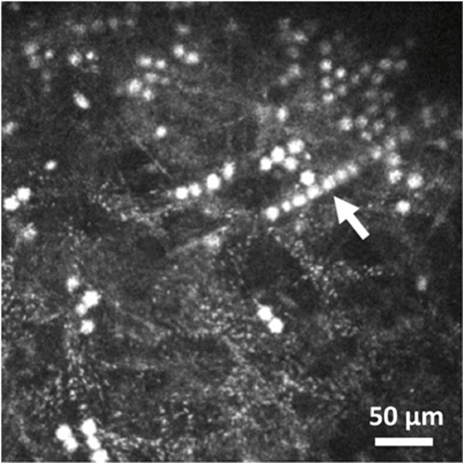
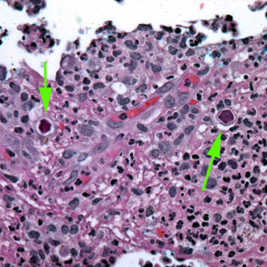
H&E staining
Depending on confocal microscopy on living cornea and light microscopy in histologic specimen, showing the Acanthamoeba organism, the diagnosis was made to be Acanthamoeba keratitis spread through contact lens.
Rx: Oral Itraconazole or Ketoconazole 200-600mg/day
Epithelial debridement, other supportive treatment.

Slide 17
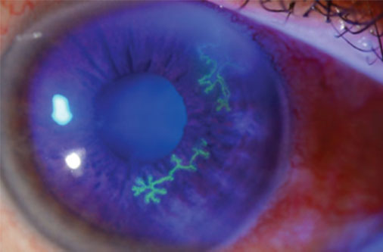
Viral keratitis
HSV 1
  Herpetic keratitis is misdirected reactivation of HSV-1.
  Characteristically, branched or opaque corneal ulcer
Herpes Zoster Ophthalmicus
  Reactivation of varicella zoster virus infection which persist after primary varicella infection.
  Zoster dendrite are coarse, ropy, stellate and terminal bulbs are absent.

Slide 18

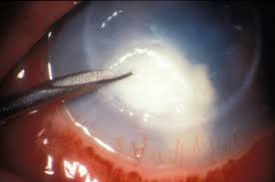

Lab diagnosis
Sample collection & transport :
  Scraping of cornea: done with No.15 Bark-Parker surgical blade or Kimura’s platinum spatula from base and margins of ulcer aseptically using local anesthetics (4% xylocaine).
  2 corneal scraps should be taken; one for gram stain and other to be transported in Brain Heart Infusion medium for culture.

Slide 19
Keratoconjuctivitis
Inflammation of both conjunctiva and cornea
Parasites | Toxoplasma gondii, Toxocara

Slide 20
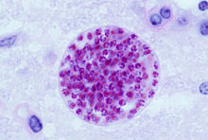
Toxoplasmosis
  This protozoan has life cycle in cat; sexual life cycle in intestine of man and other animals; asexual life cycle in tissue including eyes.
Diagnosis:
  Tissue smear + Giemsa stain: shows Bradyzoites
  Antigen detection in body fluids by ELISA
  PCR for Toxoplasma Gondii DNA detection
  Animal inoculation, Tissue inoculation
  Serodiagnosis:
    Compliment fixation test: Sabin-Feldman Dye test
    Latex agglutination test
    Indirect hemagglutination test
Tissue cyst containing bradyzoites

Slide 21
Uveitis & Choreoretinitis
Inflammation of retina and choroid or uvea.
Bacteria | Mycobacterium tuberculosis Treponema pallidum, Borrelia burgdorferi
Viruses | Cytomegalovirus, HSV
Fungus | Candida spp.
Parasites | Toxoplasma gondii, Toxocara Treponema pallidum Brucella spp.

Slide 22
Endophthalmitis
Inflammation of the aqueous and vitreous humor.
Bacteria | S. aureus, S. epidermidis, S. pneumoniae, other streptococcal spp., P. aeruginosa, other gram-negative organisms, Nocardia spp.
Viruses | HSV Varicella zoster
Fungus | Candida spp., Aspergillus spp., Volutella spp., Acremonium spp.
Parasites | Toxocara, Onchocerca volvulus

Slide 23
Exogenous endophthalmitis
  Microorganisms are introduced into the eye from environment damaging cornea
Endogenous endophthalmitis
  Hematogenous spread
  Post surgical or post operative (mc)
  Post traumatic
Bacterial endophthalmitis is most severe form of vision threatening ocular infection.
  Staphylococcus epidermidis (60%), S. aureus (5-10%), Streptococcus, Enterococcus, Pseudomonas, Pneumococci, Corynebacterium, Propionibacterium acne, Actinomyces

Slide 24
Toxocariasis
  Round worm; Toxocara canis; normally occurs in intestine of dogs.
  The egg liberated is passed into feces; if men ingest this egg, larvae liberated from it in intestine, may pass into circulation and lodge itself into other organs including eyes.
  Diagnosis is done by finding antibody in the serum against toxocara larval antigen.

Slide 25
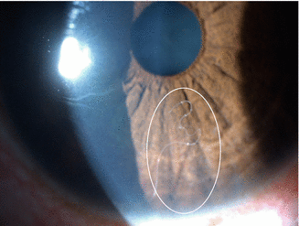
Onchocerca volvulus (River blindness)
  Tissue nematodes transmitted by vector black flies
  Onchocerca larvae are deposited into a bite wound and develop into adults in immediate subcutaneous tissue, within 1 to 2 years after initial contact disfiguring nodules form.
  Microfilariae given off by adult female migrate via bloodstream to many locations, specially to the eyes.
Diagnosis:
  Demonstration of microfilariae by slit lamp
  Diethylcarbamazine provocation test
  Skin snips from iliac crest, calves, shoulder,..
  PCR of skin snip specimen
  ELISA

Slide 26
Lab diagnosis
Specimen collection
  Aqueous humour: aqueous tap is obtained by a paracentesis by using a 26 or 27 gauge half an inch needle mounted on a tuberculin syringe. About
  0.1 ml of fluid is withdrawn.
  Vitreous humour: vitreous tap is done by insertion of a 22 to 27 gauge needle attached to a 1ml tuberculin syringe through the limbus or parsplana region into the cavity and aspiration of 0.1 ml fluid.
  Vitreous biopsy: This consists of removal of 0.2-0.3 ml of vitreous humour with a vitrectomy aspiration cutter inserted through a pars plana incision.

Slide 27
Specimen transport
  After the collection of the specimen, a sterile disposable needle is immediately fixed to the syringe containing the sample. The needle is then capped with a sterile rubber bung and placed in a sterile test tube container and is sent to the laboratory, preferably within half an hour of collection. The specimens is then processed immediately first by inoculating onto culture media and then direct smear examination by Gram’s Stain to avoid contamination.

Slide 28
Blepharitis
Inflammation of the margins of the eyelid.
Bacteria | Staphylococcus aureus
Viruses | Herpes simplex virus
Fungus | Malassezia furfur

Slide 29
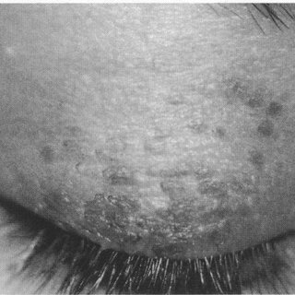
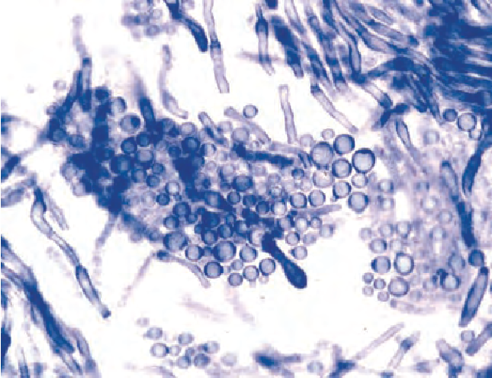
Case report of Malassezia furfur
A woman aged 22 underwent perforating keratoplasty. The postoperative period was uneventful. Prednisolone acetate eyedrops were applied postoperatively five times daily, and later at reduced frequency, without other therapy. At follow up 6 months later, she exhibited a slightly pigmented scaling lesion of the upper and margins of the eyelid on the side of surgery, without itching or discharge. The skin was not inflamed or ulcerated. There was no evidence of conjunctival infection, and the transplanted cornea was clear. No skin lesions were seen elsewhere.
For lab diagnosis, the eyelid scraping was sent for KOH mount,
gram stain, culture and sensitivity.
The LPCB mount preparation of the specimen
showed a spherical yeast characteristic of M. furfur.
Local antifungal ointment (clotrimazole) was prescribed.
3 weeks later she reported that she was asymptomatic. When
seen 6 months later the condition had resolved.

Slide 30
Lab diagnosis
Sample collection
  Lid margin swabs are collected
  Sterile cotton tip swab or calcium alginate swab moistened in Hank’s balanced salt solution or brain heart infusion broth or normal saline is rubbed over the lid margin.
Sample is observed in wet mount, KOH mount and gram stain,
Sample is inoculated directly on Blood agar, Chocolate agar, MacConkey agar and Sabouraud dextrose agar

Slide 31
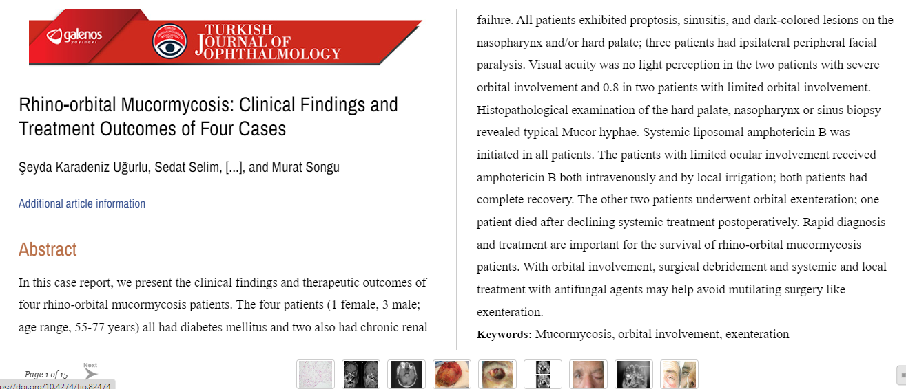

Slide 32
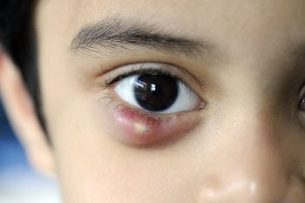
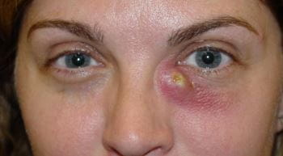
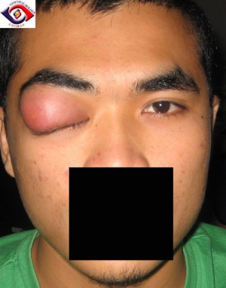
Hordeolum | Dacryocystitis | Dacryoadenitis
Acute infection of eyelash follicle. | Infection of lacrimal sac. | Inflammation of lacrimal gland.
S. Aureus children and young adults with habitual rubbing of the eyes | streptococcus pyogenes, pneumococcus, staphylococcus spp. | Local infections: trauma, erysipelas of face, conjunctivitis, orbital cellulitis Systemic infections: mumps, influenza, infectious mononucleosis, measles

Slide 33
References..
J. Chander. Textbook of Medical Mycology. 4th Edition
P. M. Tillie. Bailey & Scott’s Diagnostic Microbiology
Graff JM, Goins KM, Syed NA, Sutphin JE. Acanthamoeba Keratitis. EyeRound.org. posted December 4, 2006
D. R. Arora. Medical Parasitology. 5th Edition.
Karadeniz Ugurlu s, Selim S, Kopar A, Songu M. Rhino-orbital Mucormycosis: Clinical Findings and Treatment Outcomes of Four Cases. Turk J Ophthalmol. 2015 Aug;45(4):169-174. doi: 10.4274/tjo.82474. Epub 2015 Aug 5. PMID: 27800226; PMCID: PMC5082276.

Slide 34
MCQs
1. Which of the following organism can penetrate intact corneal epithelium?
Strept pyogenes
Staph aureus
Pseudomonas pyocyanaea
Corynebacterium diphtheriae

Slide 35
2. A young child suffering from fever and sore throat began to complain of lacrimation. On examination, follicles were found in the lower palpebral conjunctiva with tender preauricular lymph nodes. The most probable diagnosis is:
Trachoma
Staphylococal conjunctivitis
Adenoviral conjunctivitis
Phlyctenular conjunctivitis

Slide 36
3. Ten years old boy complains of itching. On examination, there are mucoid nodules with smooth rounded surface on the limbus, and mucous white ropy mucopurulent conjunctival discharge. He most probably suffers from:
Trachoma
Mucopurulent conjunctivitis
Bulbar spring catarrh
Purulent conjunctivitis

Slide 37
4. Bacteria, which can attack normal corneal epithelium:
Neisseria gonorrhea.
Staphylococcal epidermidis
Moraxella lacunata
Staphylococcal aureus

Slide 38
5. Organisms causing angular conjunctivitis are:
Moraxella Axenfeld bacilli
Pneumococci
Gonococci
Adenovirus

Slide 39
Thank you

