Slide 1
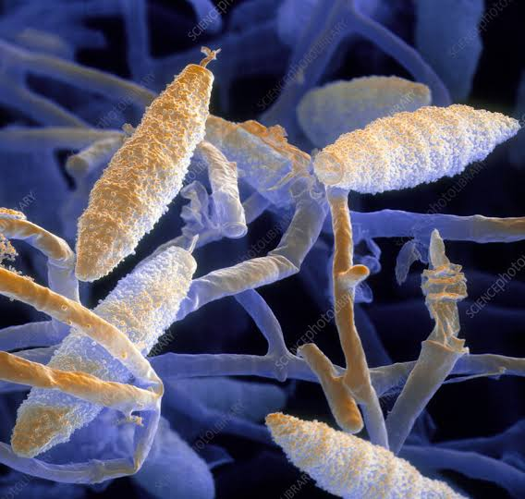
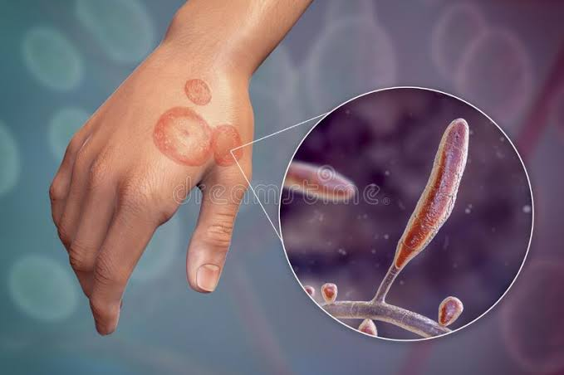
DERMATOPHYTES
Dr. Himani Pandya
Department of Microbiology

Slide 2
Outline
Clinical case
Overview
Classification
Clinical view
Diagnosis
Treatment

Slide 3
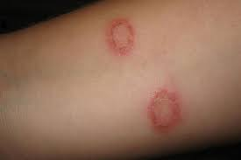
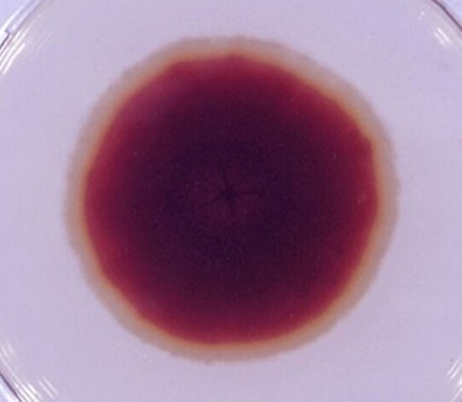
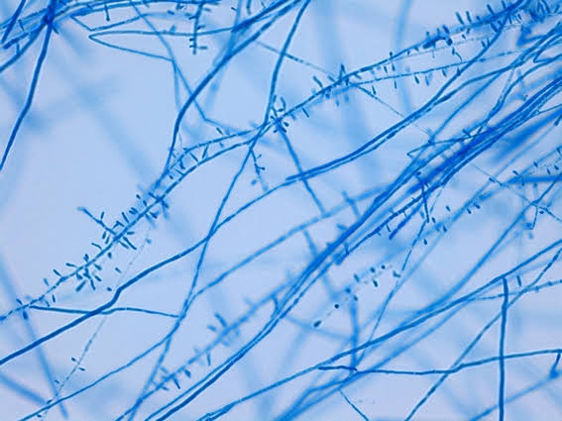
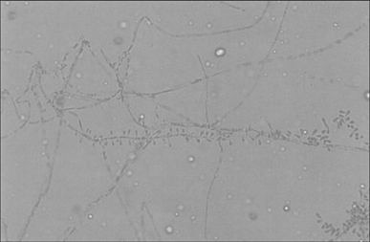
Case Study
A 27 year old male presented at the dermatology OPD with complaints of itching and a rash at his forearm which is annular in shape, erythematous lesion, itchy, scaly, raised above the skin, with sharp border and central clearing, no complaints of fever, no family history.
Dermatologist was suspecting some fungal infection. To find out the causative organism they sent the skin scrapping sample at the Microbiology lab.

Slide 4
Overview
Dermatophytes are group of closely related cutaneous, keratinophilic fungi, which are capable of invading keratinized tissues like stratum corneum of skin, hair, nails by liberating keratinase enzyme.
They include three mycelial fungal genera:
Trichophyton
Microsporum
Epidermophyton

Slide 5
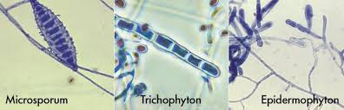
Classification
Trichophyton | Microsporum | Epidermophyton
T. rubrum | M. canis | E. floccosum
T. tonsurans | M. gypseum
T. mentagrophytes | M. gallinae
 | M. nanum

Slide 6
Classification
Anthropophilic | Zoophilic | Geophillic
T. tonsurans | T. mentagrophytes | M. gypseum
T. rubrum | M. gallinae | M. nanum
T. mentagrophytes
E. floccosum

Slide 7
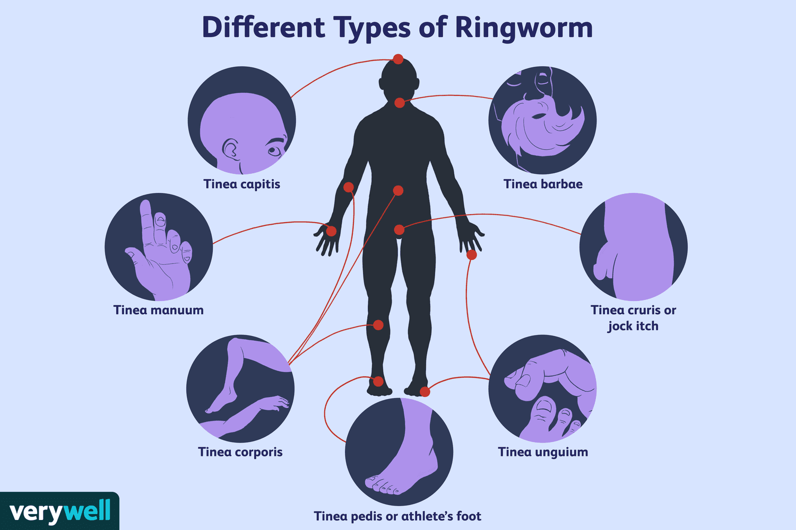
Clinical features
Dermatophytosis is infection of hair, skin and nails by dermatophyte, which is most commonly of Trichophyton genus and less commonly of the Microsporum and Epidermophyton genera.

Slide 8
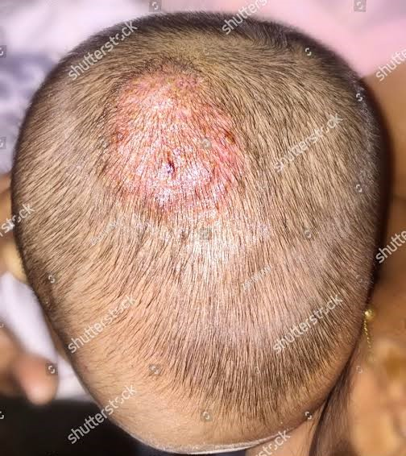
Tinea Capitis
This is infection of shaft of scalp hairs.
Caused by Trichophyton spp. or Microsporum spp.
present as:
- Inflammatory: Kerion,
Favus
- Non-inflammatory: Black dot,
Grey patch

Slide 9
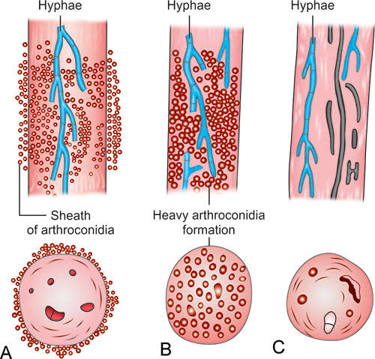
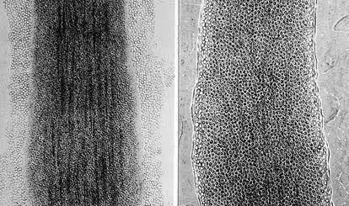
Ectothrix : Grey patch- The arthrospores appear as mosaic sheath around hair or as chains on surface of hair shaft. Caused by Microsporum spp..
Endothrix : Black dot- Hyphae produce arthrospores within the hair shaft. Trichophyton are responsible for endothrix type hair invasion.
Hair become weakened; break easily at the follicle opening.

Slide 10
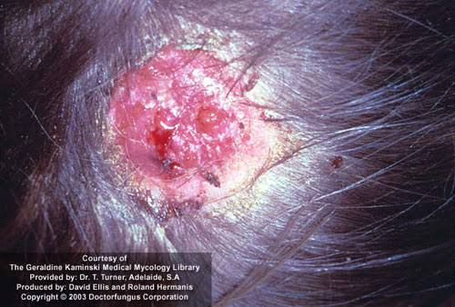
Kerion :
It is caused by Zoophilic dermatophytes like T.verrucosum and T.mentagrophytes.
It is severe form of dermatophytosis.
Severely painful inflammatory reaction producing raised, circumscribed boggy mass on scalp, usually suppurating at multiple points.
Follicles with discharging pus, sinus formation, thick crusting with matting.
Followed by scarring and permanent alopecia.
Kerion celsi- clinical form of tinea infection of scalp that involves children.

Slide 11
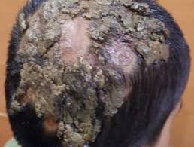
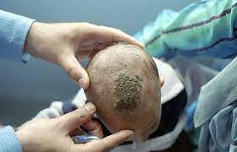
Favus :
Caused by T.schoenleinii
It is acute inflammatory reaction of hair follicle leading to formation of scutula (cup like crust).
Intense fungal growth within and around hair follicle produce waxy, honeycomb like crust on scalp.
It may lead to alopecia and scarring.

Slide 12
Tinea Corporis
Also known as tinea glabrosa/ tinea glabrata due to involvement of non hairy skin of human body.
Erythematous scaly lesion, annular, sharply marginated plaques with raised borders, which may be single, multiple or confluent. Also there is partial central clearing of lesions with few pustules.
It is the most common type of ringworm in India and usually caused by T.rubrum.
Infection of hair follicle can lead to deep dermal inflammatory reaction; this perifollicular pustular or well circumscribed, elevated crusted granulomatous lesion is called Majocchi’s granuloma.

Slide 13
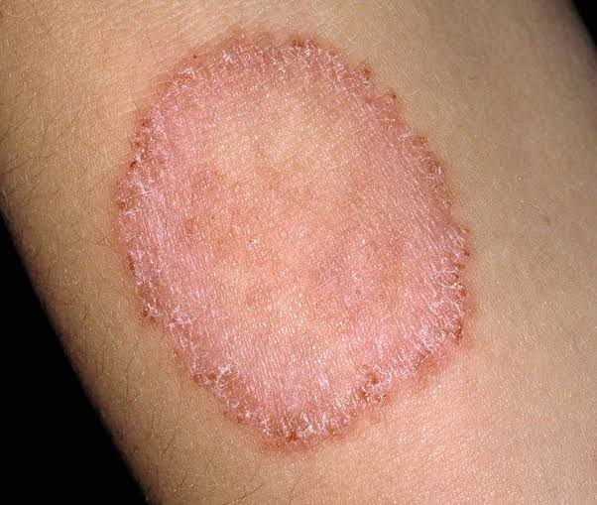
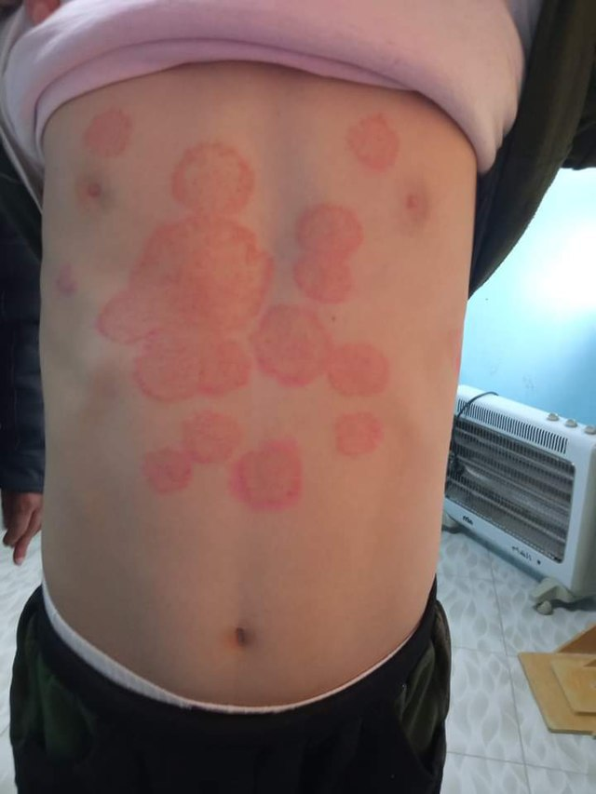
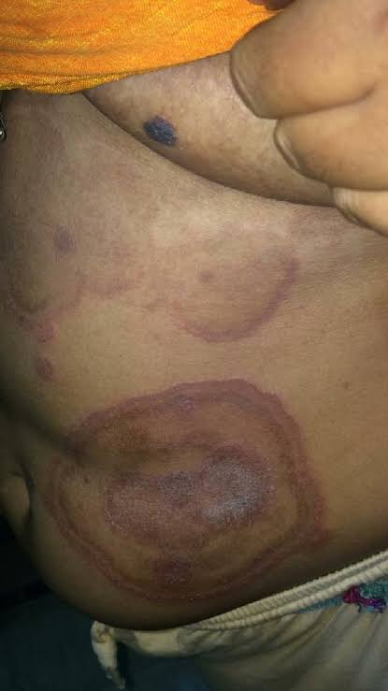
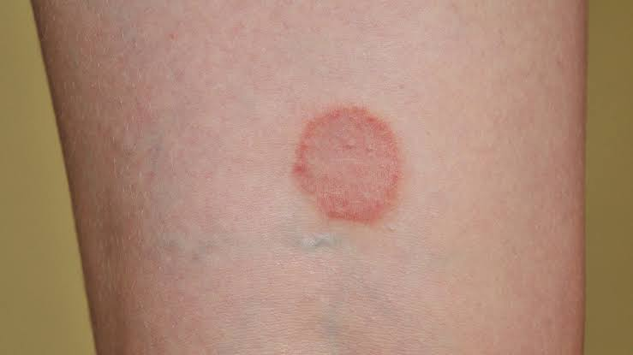
https://www.google.com/url?sa=i&url=https%3A%2F%2Fcommons.wikimedia.org%2Fwiki%2FFile%3ATinea_corporis.jpg&psig=AOvVaw3ymNDCD2ju5EnXMYQFUqsJ&ust=1675147003001000&source=images&cd=vfe&ved=0CBEQjhxqFwoTCJCI3pXX7vwCFQAAAAAdAAAAABAS
https://www.google.com/url?sa=i&url=https%3A%2F%2Fcommons.wikimedia.org%2Fwiki%2FFile%3ATinea_corporis.png&psig=AOvVaw3ymNDCD2ju5EnXMYQFUqsJ&ust

Slide 14
Tinea Imbricata
Tokelau; unusual form of tinea corporis.
Cause- T.concentricum; strickly anthropophilic dermatophyte.
Predisposing condition- humidity, inheritance and immunologic factor.
Clinical presentation- concentric and lamellar plaques of scales, which spread out peripherally over many years.
Covers all hairless skin.
Chronic and highly relapsing disease.

Slide 15
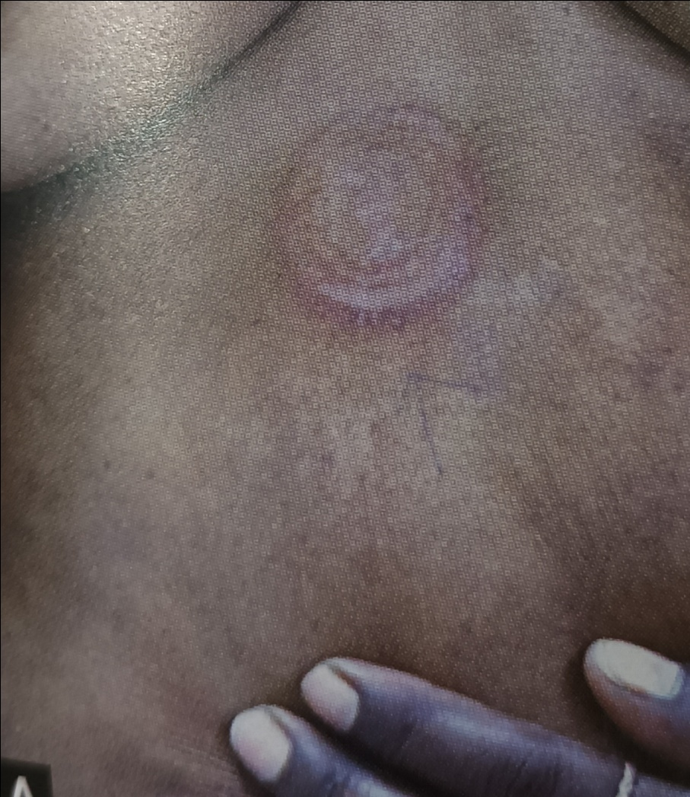

Slide 16
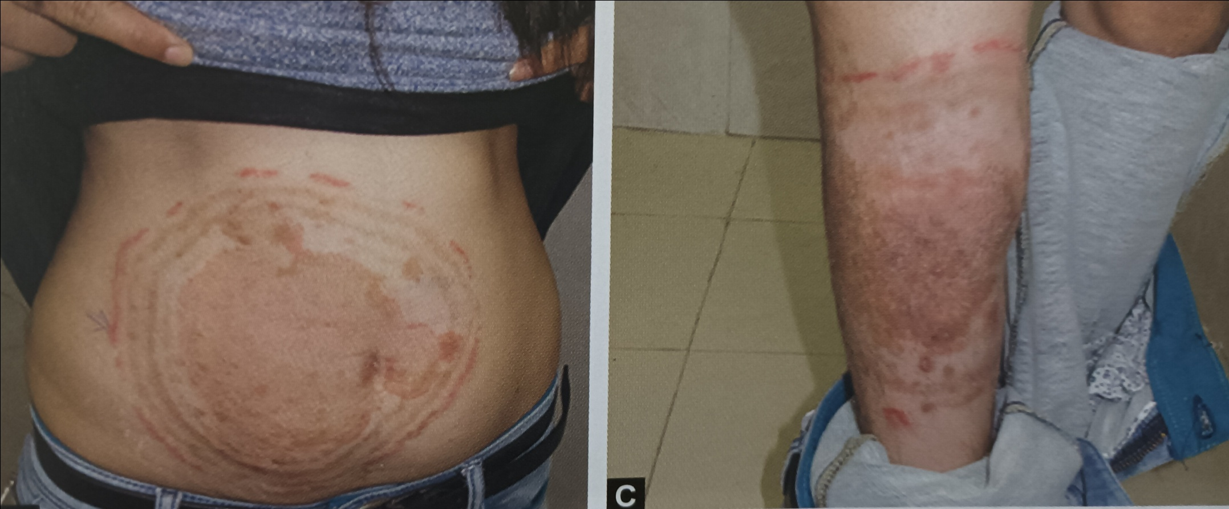
Tinea Indecisiva/ Pseudoimbricata
Concentric scaly rings or ‘rings within the ring’
By non-concentric trichophyton.

Slide 17
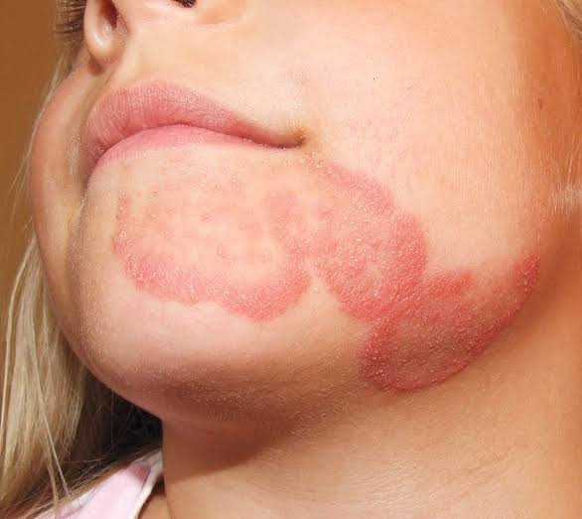
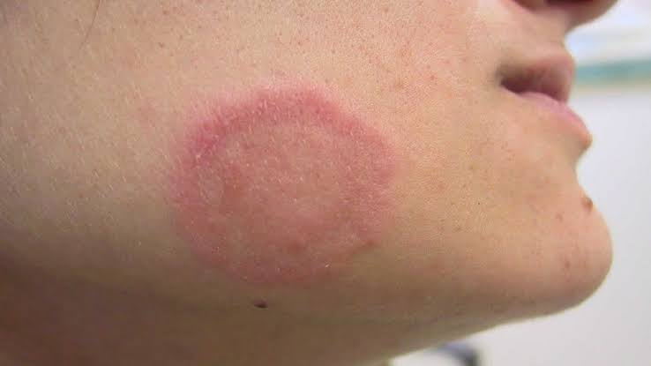
Tinea Faciei
Dermatophytic infection of skin occur on non-bearded region of face.
Clinically lesions show erythematous annular plaques with central clearing and also patient presents with history of photosensitivity.

Slide 18
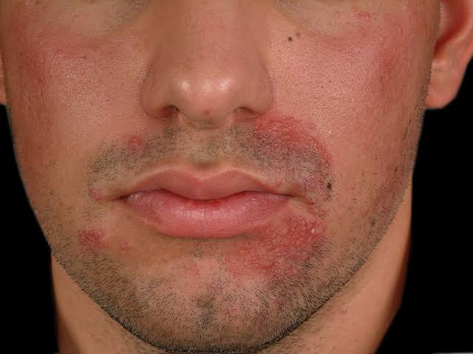
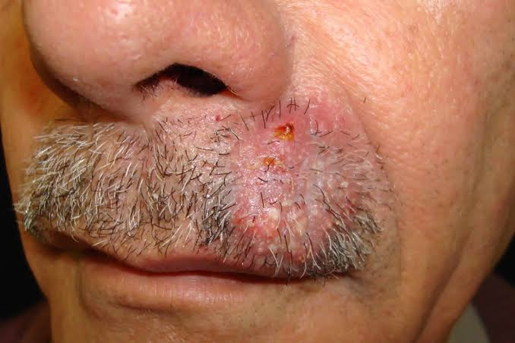
Tinea Barbae
Ringworm infection of beard and moustache area of face with invasion of coarse hair and is also called ‘Barber’s itch’ or ‘Tinea sycosis’.
2 variants-
Superficial crusted type shows less inflamed pustular folliculitis associated with T.violeceum and T.rubrum.
Deep type produces nodular thickening and kerion like swelling usually caused by T.verrucosum and T.mentagrophytes.

Slide 19
Tinea Cruris
Dermatophytic infection of skin pertaining to groin area.
It is mostly seen in men with an underlying predisposing factors such as long term use of tight filling garments.
It involves perineum, scrotum, perianal area and may spread to inner third of buttocks and occasionally to thigh.
The appearance of tinea cruris can be seen in other intertriginous area such as under pendulous breasts, axilla, around umbilicus of obese patients.
Caused by T.rubrum and E.floccosum.

Slide 20
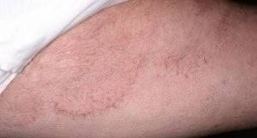
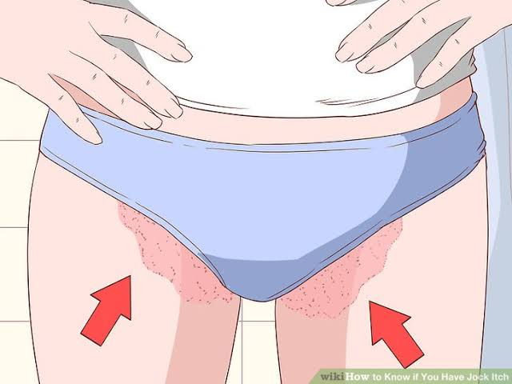
The borders of lesion are well delineated.
In early stage, there are erythematous plaques, arciform with sharp margins extending from groin down to thigh.
Scaling is variable, vesiculation is rare, dermal nodule forming beading along edge are commonly found in older lesions.
It is also called ‘jock itch’ as itching is predominant feature.

Slide 21

Tinea Gladiatorum
It is an emerging infection in wrestlers, found as a result of direct skin to skin contact rather than via fomites such as wrestling mats.
Most of the lesions are on arms, trunk, head, neck, corresponding to area of maximum contact between wrestlers.
T.tonsurans is the commonest isolate.

Slide 22
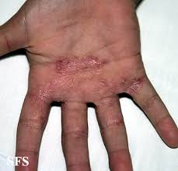
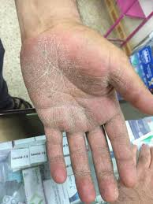
Tinea Manuum
This is dermatophytic infection of skin of palmar aspect of hands.
Clinical manifestation is diffuse hyperkeratosis of palms and fingers.
Caused by anthropophilic species like T.rubrum, T.mentagrophytes, E.floccosum.

Slide 23
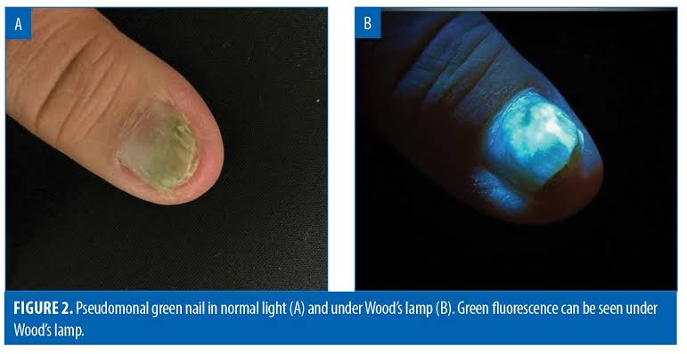
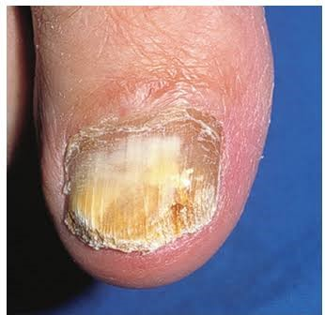
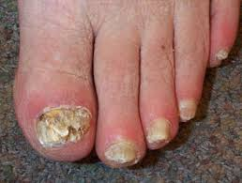
Tinea Unguium
It is an infection of nail plates and is largely a disease of adults.
Caused by T.rubrum, T.mentagrophytes, E.floccosum.
Clinically there is destruction of nail plates, accumulation of subungual debris in an opaque, chalky or yellowish thickened nail.

Slide 24
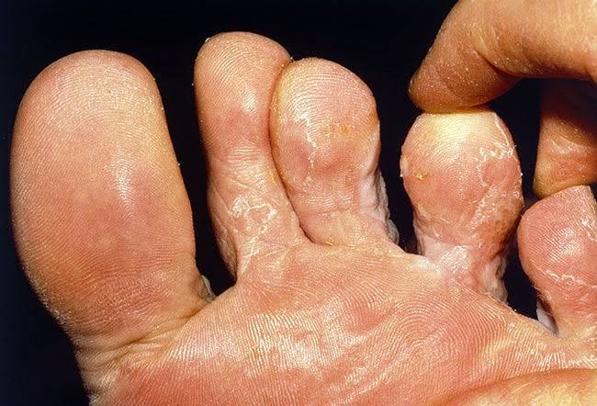
Tinea Pedis
Infection of planter aspect of foot, toes and interdigital web spaces.
Predisposing factor - warmth and moisture - ‘Athlete’s foot’.
Cause- anthropophilic species- T.rubrum, T.mentagrophytes, E.floccosum.
Clinical presentation- toe webs, scaling, fissuring, maceration, erythema, usually associated with an itching or burning sensation.
The small vesicles rupture and discharge thin fluid.
Due to maceration and peeling, cracks appear which are prone to secondary bacterial infection.

Slide 25
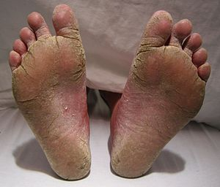
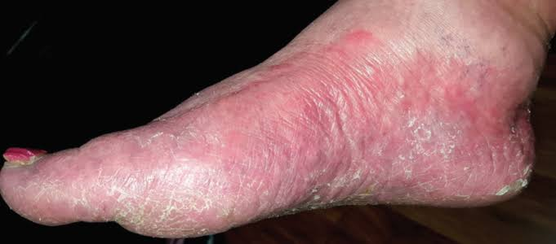
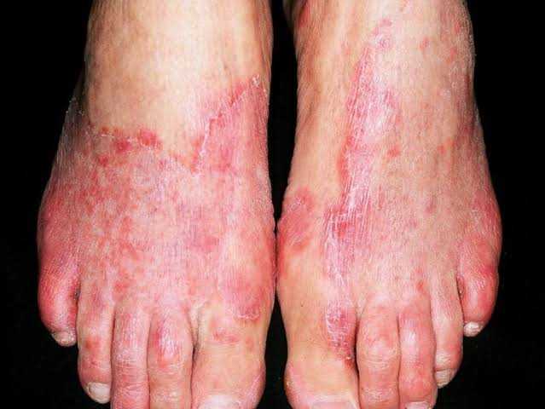
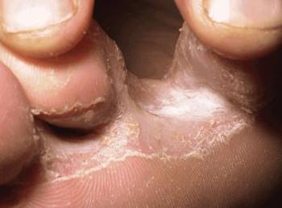
Moccasin or sandal ringworm

Slide 26
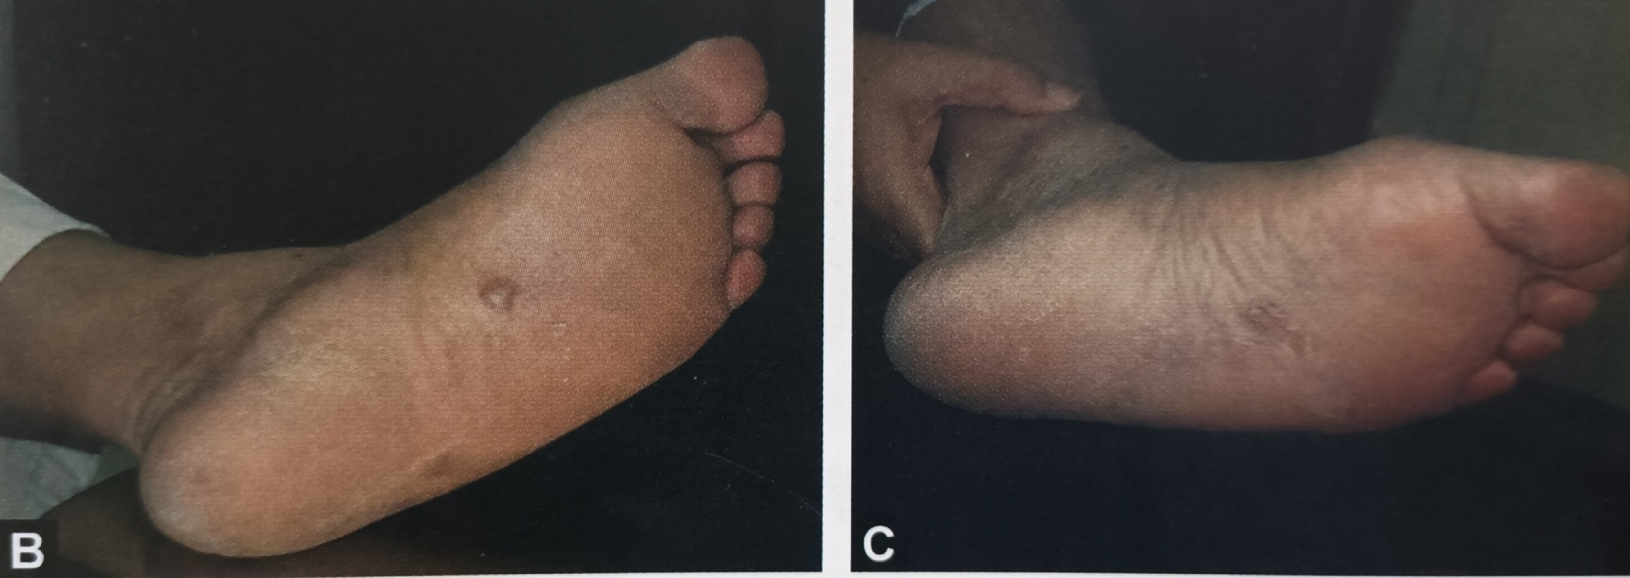
Based on clinical presentation
Interdigitalis – simple/complex
Hyperkeratotic
Ulcerative
Vesicular

Slide 27
‘Id’ reaction
Dermatophytid is secondary eruption occurring in sensitized tinea patients because of circulation of allergic products from primary site of infection.
Found in patients with absence of delayed reaction to dermatophytic antigen –Trichophytin.
Fever, anorexia, generalized lymphadenopathy, splenomegaly and leukocytosis.
2 types of Id reaction- Lichen scrofulosorum like
- Pompholyx like

Slide 28
Diagnosis
Done by clinical features,
use of wood’s lamp where applicable, and
laboratory investigations.

Slide 29
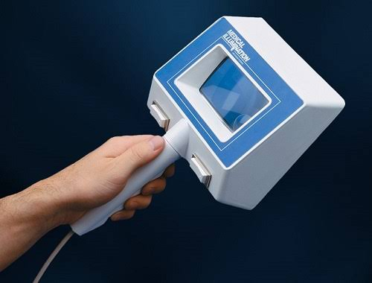
Wood’s Lamp Examination
Wood’s lamp consist of barium silicate with 9% nickel oxide.
Wood’s filter is florescent to a band between 320 and 400 nm with a peak at 365 nm.
Fluorescence- pteridine pigment in cell wall.
Microsporum species - bright greenish yellow
Trichophyton schoenleinii – dull green

Slide 30
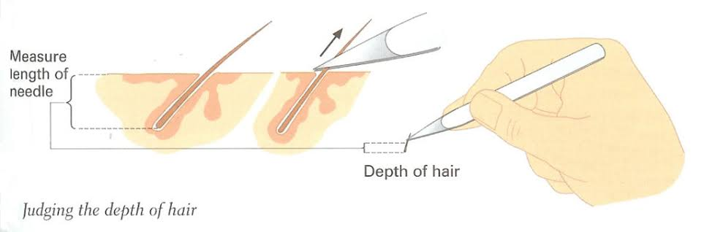
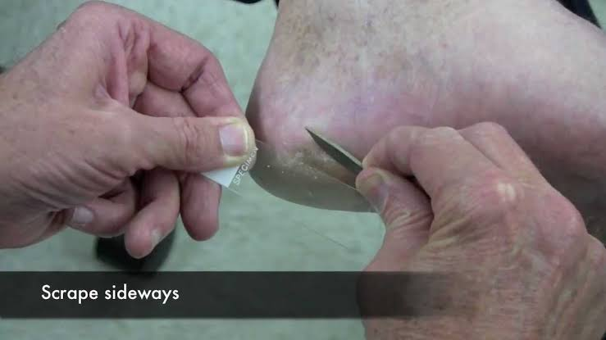
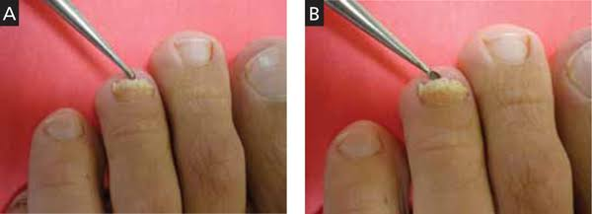
Laboratory Diagnosis
Specimens:- skin scrapping
- nail clipping
- hair stubs

Slide 31
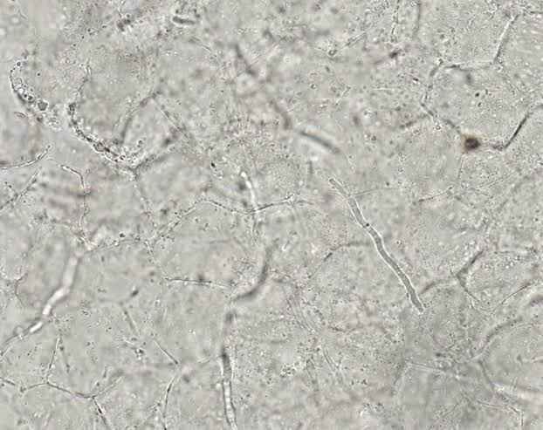
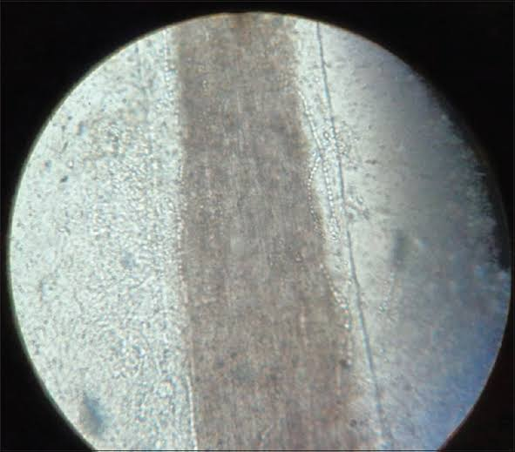
Direct Examination
KOH wet mount :
fungus is seen as branching septate hyaline mycelia, which frequently shows arthrospores production.
Ectothrix and endothrix

Slide 32
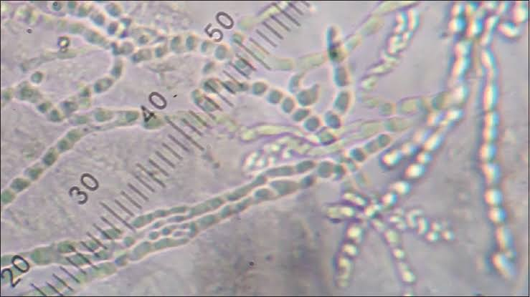
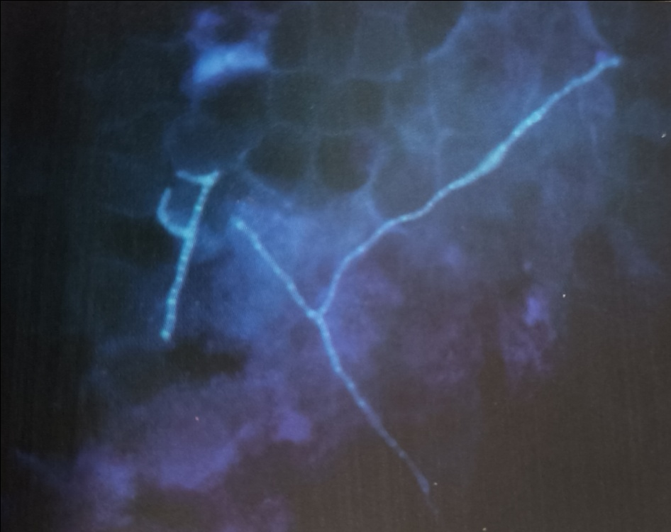
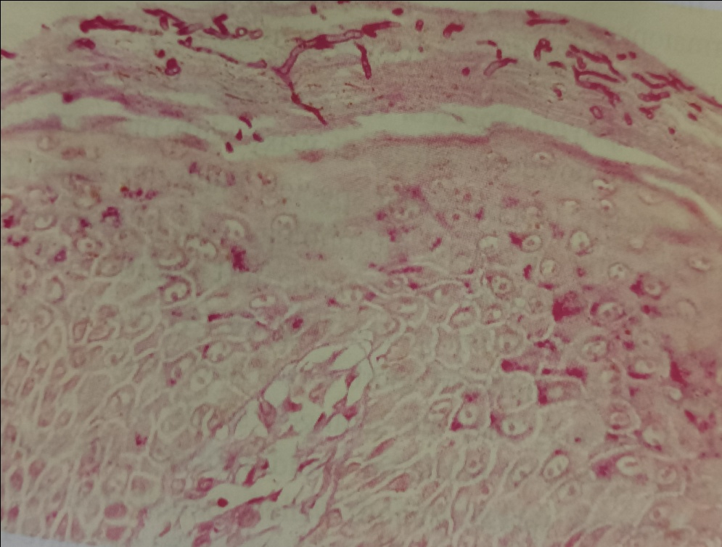
PAS or GMS stain : nails clippings
calcofluor white stain
HPE of skin biopsy may be stained with PAS
to delineate the hyphae.

Slide 33
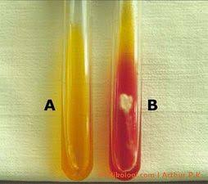
Fungal Culture
Sabouraud Dextrose Agar(SDA) with antibiotic and cycloheximide
Dermatophyte test medium (DTM) – turn medium red due to change in color of indicator phenol red by increased pH through their metabolic activity .

Slide 34
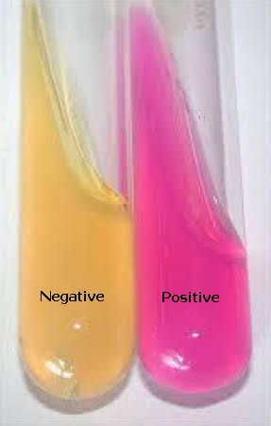
SDA with Thiamine (1 mg%) – for sporulation
Urease test- done on Christensen’s medium.
- T.mentagrophytes : deep red
- T.rubrum : negative

Slide 35
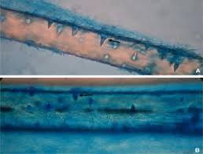
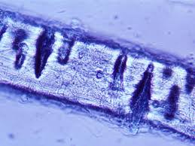

Hair perforation test : wedge shaped perforation in hair
- T.mentagrophytes, M.canis : positive
- T.rubrum, M.equinum : negative

Slide 36

Trichophyton species
Colony – powdery, velvety or waxy with pigmentation of a particular species.
Microscopy – Microconidia are
predominant spore form
and found in abundance.
- Macroconidia are sparse
smooth walled, pencil
shape with blunt ends.

Slide 37

T.rubrum – typical red pigment on reverse,
teardrop shaped microconidia along sides of hyphae.

Slide 38



T. mentagrophytes – spiral hyphae

Slide 39



T.tonsurans

Slide 40




T.verrucosum – chains of chlamydospore
T.schoenleinii -

Slide 41

Microsporum species
Macroscopy- colony – cottony, velvety or powdery with white to
brown pigmentation.
Microscopy- Macroconidia are predominant, large rough-walled,
multicellular, spindle shaped, forms at the ends of
hyphae.

Slide 42



M.canis- thick walled macroconidia, curved or hooked spiny tips,
yellow orange pigment on reverse view.

Slide 43


M.gypseum-

Slide 44



Epidermophyton species
Macroscopy- colony- slow growing, powdery, greenish brown, suede
like surface, raised & folded in center.
Microscopy- one to nine celled, smooth, thin walled, pear or club
shaped macroconidia, arranged in clusters.

Slide 45
Immunodiagnosis
Skin test with dermatophytic antigen, trichophytin
- delayed type hypersensitivity
Reactive component of antigen- galactomannan peptide
Serological tests- immunodiffusion

Slide 46
Molecular tools
PCR- nested or multiplex PCR
- conventional and real time formats
MALDI-TOF
PCR finger printing
Chitin synthase 1(CHS1) gene analysis

Slide 47
TREATMENT
Terbinafine 250 mg/d for 1-2 weeks
Itraconazole 200 mg/d for 1 week
Fluconazole 150 – 200 mg once a week for 2-4 weeks
Griseofulvin microsize 500 – 1000 mg/d or
Griseofulvin ultramicrosize 375 -500 mg/d for 2-4 weeks.

Slide 48


Slide 49
References
Chander J. Textbook of Medical Mycology, 4th edition.
Ananthnarayan and paniker’s textbook of Microbiology.
https://pubmed.ncbi.nlm.nih.gov/16282753
https://basu.org.in/wp-content/uploads/2020/07/2nd_Professional_year_Dermatophytes__FInal_.pdf
https://www.google.com/url?sa=i&url=https%3A%2F%2Fcommons.wikimedia.org%2Fwiki%2FFile%3ATinea_corporis.jpg&psig=AOvVaw3ymNDCD2ju5EnXMYQFUqsJ&ust=1675147003001000&source=images&cd
https://www.google.com/url?sa=i&url=https%3A%2F%2Fcommons.wikimedia.org%2Fwiki%2FFile%3ATinea_corporis.png&psig=AOvVaw3ymNDCD2ju5EnXMYQFUqsJ&ust

Slide 50
MCQS
1. Which of these is not the causal organism for ringworm
(a) Epidermophyton
(b) Microsporum
(c) Macrosporum
(d) Trichophyton

Slide 51
2. In children, this leads to epidemic ringworm of the scalp
(a) Epidermophyton floccosum
(b) Candida albicans
(c) Trichophyton rubrum
(d) Microsporum audouinii

Slide 52
3. Which dermatophyte fungus has a spiral hyphae?
T. rubrum
T. mentagrophytes
T. verrucosum
T. schoenleinii

Slide 53
4. What is the ringworm of the scalp called?
(a) onychomycosis
(b) tinea unguium
(c) tinea pedis
(d) tinea capitis

Slide 54
5. Which dermatophytes fungus gives urease test positive?
T. rubrum
T. mentagrophytes
T. verrucosum
T. schoenleinii

Slide 55
Thank you

