Slide 1
Sexually transmitted disease
Dr.Rachana Patel
Associate Professor
Department of Microbiology
SBKS MI & RC

Slide 2
Case 1
History: A 20- year-old male college student presents with the main complaints of dysuria & urethral discharge. He denies a history of fever, chills, nausea, or abdominal pain. He has never had a urinary tract infection. He had Neisseria gonorrhoea treated 6 months ago with an unknown antibiotic. he has no significant past medical history. The only remarkable findings are urethral meatus erythema, a small amount of urethral discharge with milking, but no epididymal tenderness.
Urethral swabs are obtained. Gram stain of expressible discharge reveals polymorphonuclear leukocytes without any identifiable Gram negative cocci. Culture were sent.
Identify the condition.

Slide 3
Post- Gonococcal Urethritis
1. What is urethritis?
Answer: Urethritis is a lower urinary tract infection causing inflammation of the urethra, a fibromuscular tube through which urine exits the body in both males and females and through which semen exits the body in males.

Slide 4
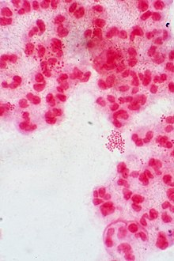
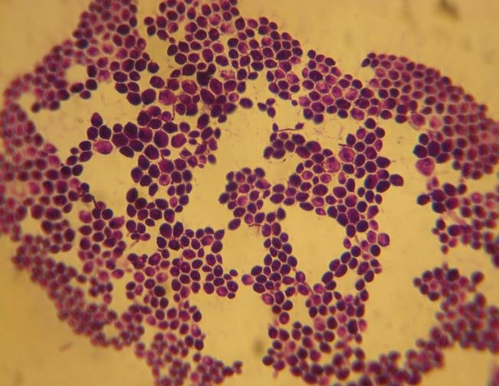
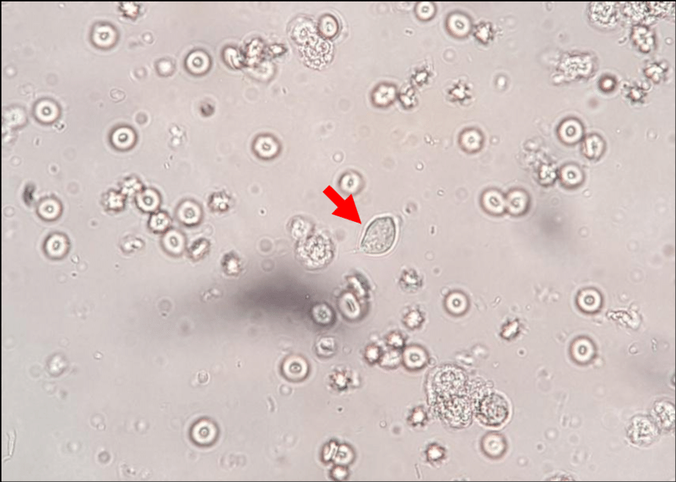
2. What are the major causes of urethritis?
Bacterial: Neisseria gonorrhoeae, Chlamydia trachomatis, Urogenital Mycoplasma( Ureaplasma urealyticum and Mycoplasma hominis)
Viruses: Herpes simplex virus- genital herpes
Fungi: Candida albicans
Parasites: Trichomonas vaginalis
N. gonorrhoeae
Candida albicans
Trichomonas vaginalis

Slide 5
3.Can gonococcal infection be excluded on the basis of the information given?
Gonococcal infection cannot be completely excluded on the basis of information given.
There can be recurrent gonococcal infection.
It should be confirmed after the culture report.

Slide 6
4.Non- Gonococcal urethritis
5. Post – Gonococcal urethritis
Chronic urethritis where gonococci cannot be demonstrated has been labelled as non-gonococcal urethritis.
Urethral discharge is mucous to mucopurulent.
Urethritis develops in men 2-3 weeks after recovery from Gonococcal urethritis.
This occurs when patients with GU are treated with penicillin or cephalosporin alone without adding any anti-chlamydial drugs(such as azithromycin).
C. trachomatis is most common cause of PGU.

Slide 7
6. Describe the general characteristics of chlamydia species.
They possess both DNA and RNA
Their cell wall is similar to that of gram-negative bacteria(although they lack peptidoglycan layer)
Multiply by binary fission
Susceptible to wide range of antibacterial agents.
Produce intracytoplasmic inclusions.

Slide 8
7.What other sites can be involved with sexually transmitted chlamydia trachomatis?
Cervicitis
Endometritis
Salpingitis
Pelvic inflammatory disease
Pelvic peritonitis
Proctitis
Epididymitis

Slide 9
8.List the sero-varieties, the diseases they cause & how each is transmitted.
Trachoma serovars A, B, Ba and C are associated with ocular disease called trachoma-a form of chronic keratoconjunctivitis. It is spread through hand to eye touch.
Oculo-genital serovars D-K are associated with-1) genital tract infection, 2)infant pneumonia and 3) ocular disease called inclusion conjunctivitis. It spreads via birth canal.
LGV serovars L1-L3 causes a sexually transmitted infection, lymphogranuloma venereum. It is an ulcerative genital disease.

Slide 10
Lab diagnosis of C. trachomatis
1. Specimen collection: It depends on the site of lesion. In our case it is urethral swab.
As chlamydia are intracellular the sample must contain cells. Hence firm scraping or swabbing of the site is required.
First catch urine samples in the morning contain greatest amount of urethral secretions hence, preferred for urethritis.

Slide 11
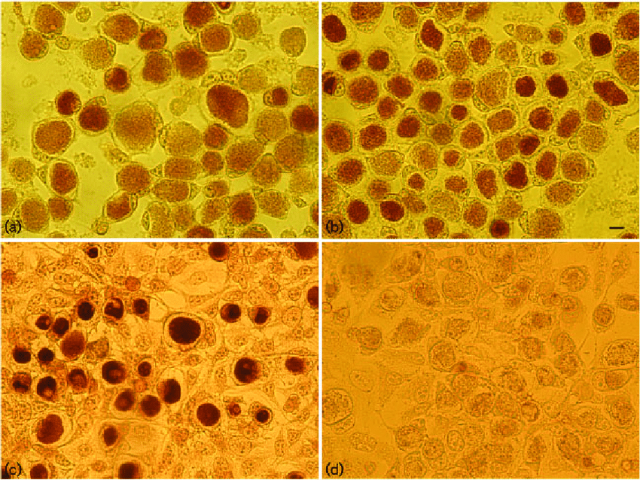
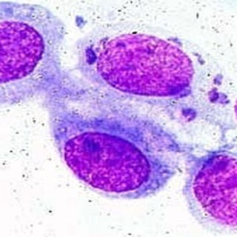
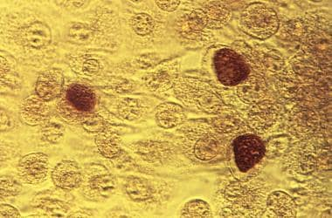
2. Microscopy:
Gram stain: chlamydia are gram negative they are poorly stained.
Gram staining will reveal sterile pyuria. So other diagnostic test should be performed.
Other stain: such as Castaneda, Machiavello or Gimenez stains are better methods to detect chlamydiae from samples. The inclusion bodies can be detected in cytoplasm.
Lugol’s Iodine: the inclusion body of C. trachomatis can be stained with Lugol’s Iodine because of presence of glycogen matrix.

Slide 12
3.Direct Immunofluorescence Test(DIF): it is used for detection of inclusion bodies in clinical material, particularly from the genital tract and eye or can also be used for culture confirmation.
4.Enzyme Immunoassays(Antigen Detection): It detects chlamydial group specific antigens(LPS) from the samples by using specific monoclonal antibodies.

Slide 13
5.Culture:
They can grow only in embryonated egg(yolk sac), animal(mice) and cell line.
Cell line culture was the traditional method of diagnosis in the past, was considered as the gold standard method
Though highly specific, it is less sensitive(90% compared with NAATs), time consuming, technically demanding and labor intensive.
Choice of the cell line depends on the species:
C. trachomatis: McCoy, HeLa are the recommended cell lines
C. pneumoniae can be isolated from HEp2 or human fibroblast cell line
C. psittaci although grow well in cell culture, isolation should not be attempted in routine laboratory because of the risk of laboratory acquired infection.

Slide 14
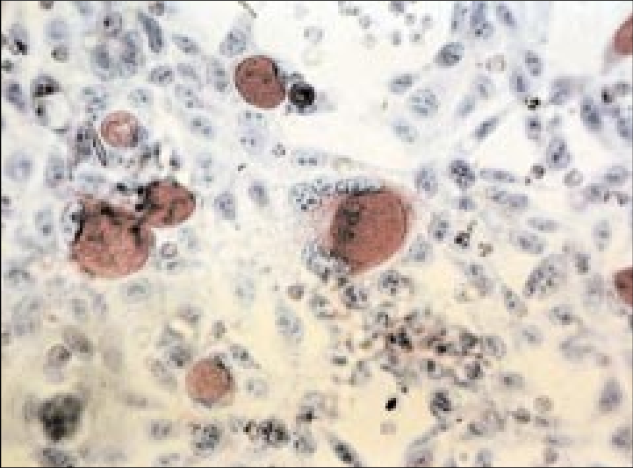
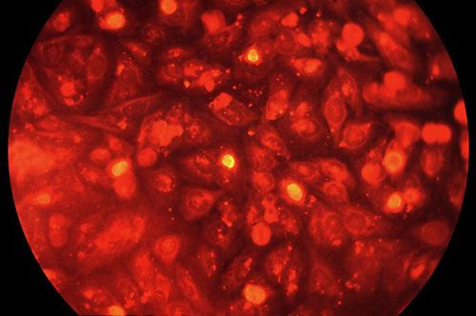
Cont..
Promote contact: pre-treatment of cell lines with diethylaminoethanol(DEAE) dextran or centrifugation after inoculation of specimen should be done to promote contact between chlamydia and the cells, thus increasing the chance of isolation.
Incubation and growth detection: Cell lines are incubated in 10% CO2 for 48-72 hours, and growth is detected by the presence of inclusions under microscopy, after staining.

Slide 15
6. Nucleic Acid Amplification Tests(NAAT):
Advantages: NAAT is highly sensitive and specific, takes less time, and detects even few copies of DNA from the sample. It can also differentiate the species and serovars.
NAATs are currently the diagnostic assays of choice for chlamydial infection as recommended by the CDC, replacing the so called gold standard culture methods
Genes targeted are C. trachomatis specific genes such as opacity protein gene or 16S or 23S rRNA
Various methods available are:
Polymerase Chain Reaction(PCR)
Real time PCR
FilmArray respiratory panel.

Slide 16
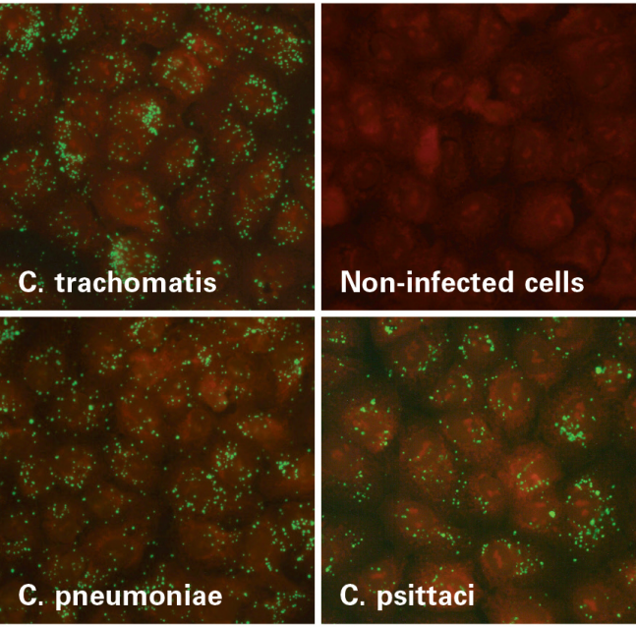
7.Serology(Antibody Detection)
Serological tests are useful for LGV, infant pneumonia and psittacosis(systemic infections).
Complement fixation test(CFT) using LPS antigen was used in the past, now obsolete.
ELISA based formats are also available using recombinant LPS antigen.
Micro-immunofluorescence (MIF) test: it uses the species and serovar specific MOMP(Major outer membrane protein) antigen
Serovars and species-specific antigens are spotted onto slides and incubated with serial dilutions of patients serum.
After incubation and washing, antigen-antibody complex is detected by fluorescein tagged anti-human globulin.

Slide 17
Case 2
A 22 year old woman is admitted in active labour. She had not received any prenatal care. Two months ago she had developed low grade fever, headache & generalised maculopapular rash . The rash subsided after 2 weeks. She reported that her husband had a similar rash , which also involved his palms & soles. She delivered a male infant who has weight 1.8kg.Physical examination of the baby revealed marked hepatosplenomegaly . The examination of the skin was significant for a haemorrhagic bullous rash distributed mostly on palms and soles of the feet .Identify the clinical condition and plan investigations.

Slide 18
Congenital Syphilis
1. How is the bacteria transmitted?
Transmission occurs trans-placentally or during birth from the mother to child.

Slide 19
2. Describe the pathogenesis of congenital syphilis.
After T. pallidum penetrates the host, the organism subsequently invades the bloodstream and spreads to other body sites.
The mechanisms associated with disease pathology to the host are unclear. Molecular studies have not identified a T. pallidum protein that binds to host fibronectin and laminin receptors on various human cells. Binding to different host cells is apparent in cells that produce fibronectin.
The organism has an inherent ability to cross the endothelial, blood-brain, and placental barriers. T. pallidum has been shown to activate platelets to aid in movement and dissemination throughout the host.
As a result, T. pallidum has a remarkable tropism (attraction) to arterioles; infection ultimately leads to endarteritis (inflammation of the lining of arteries) and subsequent progressive tissue destruction.

Slide 20
3. How is the diagnosis of syphilis made?
Specimen Collection: samples collected from ulcers and lesions should not be contaminated with blood, microorganisms or tissue debris.
The site should be cleansed with sterile gauze moistened with saline.
The sample should be placed on a clean glass slide and cover slipped.
PCR samples should be collected on a sterile Dacron or cotton swab and placed in a cryotube containing nucleic acid transport medium or universal transport medium.

Slide 21
To test for congenital syphilis, a small section of the umbilical cord is collected and fixed in 10% buffered formalin at room temperature until processed.
A 3-4cm section of umbilical cord distal from placenta for the detection of congenital syphilis should be collected immediately following delivery and processed as a tissue.
Serum is specimen of choice for serology; however plasma may be used in some assays.
Plasma should be tested within 24 hours to avoid false positive results.
Maternal serum may also be used for screening of congenital syphilis.
Infants serum should be used for immunoglobulin IgM specific tests because cord blood specimens may be contaminated with maternal blood.

Slide 22
Direct Microscopy(Demonstration of Treponemes)
It can be demonstrated from the superficial lesions of primary, secondary and congenital syphilis.
Surface of chancre is cleaned with saline, gentle pressure is applied at the base of the lesion and drop of exudate is collected on a slide.
Dark Ground Microscopy(DGM): Treponemes cannot be visualized by light microscope but can be seen by examining the wet film of specimen under darg ground (DGM) or phase contrast microscope.
Under DGM: T. pallidum appears as slender, flexible, spirally coiled bacilli with tapering ends, measuring 6-20um in length and contains 6-20 spirals.
Motility: T. pallidum shows typical: (i) slow to rapid flexion-extension type of movement with (ii) rotation around its longitudinal axis (corkscrew motility), (iii) rotation may be accompanied by a soft bending at right angle to midpoint.

Slide 23
Multiple specimens should be examined on three consecutive days before declaring DGM to be negative.
Direct Fluorescent Antibody Staining for T. pallidum(DFA-TP): smear made from the exudate or tissue sections is stained with fluorescent-labelled monoclonal antibody targeted against T. pallidum surface antigens.
T. pallidum appears as distinct, sharply outlined, apple green fluorescent coloured bacilli.
Sensitivity of DFA-TP test approaches 100% when smear made from fresh lesions are examined.

Slide 24
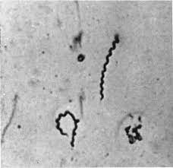
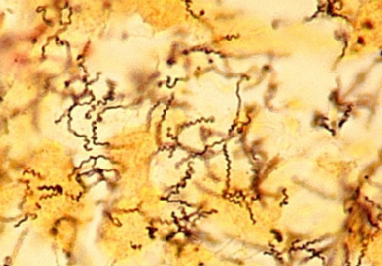
Silver Impregnation Staining: Treponema do not take up ordinary stains as they are extremely thin and delicate
Silver impregnation methods can be used to increase their thickness.
Treponemes reduce silver nitrate to metallic silver that is deposited on surface making them thicker.
Levaditi stain is used for staining tissue section and Fontana stain is used for staining smears made from exudates.

Slide 25
Cultivation: Pathogenic treponemes including T. pallidum cannot be grown in artificial culture media but are maintained by subcultures in susceptible animals such as rabbit testes (e.g. Nichols stain)
Serology (Antibody Detection): Depending upon the type of antigen used, three types of tests are available to detect antibodies in patients sera:
Non- Treponemal tests: Detect non-specific regain antibody by using cardiolipin antigen derived from bovine heart
Treponemal tests: Detect species-specific antibody by using T. pallidum specific antigen; which is polysaccharide in nature.

Slide 26
Non- Treponemal or Lipoidal Tests or STS(Standard Tests for syphilis): Non-treponemal tests detect a characteristic non-specific antibody in the sera of syphilitic patients by using cardiolipin antigen extracted from beef heart.
Cardiolipin antigen is chemically a diphosphatidyl glycerol. Similar lipid haptens have been detected on the surface T. pallidum
Such reagin antibodies are IgG or rarely IgM type and are distinct from the IgE class of reagin antibodies seen in type I hypersensitivity reactions.

Slide 27
Examples of non-treponemal tests:
Venereal Disease Research Laboratory(VDRL) is used as quantitative test and may be performed on serum or CSF in suspected cases of neurosyphilis.
Rapid Plasma Reagin (RPR) uses charcoal particles to detect antibodies in serum or plasma.
Unheated Serum Reagin (USR)
Toluidine Red Unheated Serum Test(TRUST) is similar to RPR but utilizes toluidine red in place of charcoal and is macroflocculation.

Slide 28
Treponemal or Specific Tests: this tests aim at detecting T. pallidum specific antibodies in patients sera by using either live or killed T. pallidum or their antigenic extract.
TPI (T. pallidum immobilization test): uses live actively motile T. pallidum(Nichols strain); which become immobilized after they combine with specific antibodies.
FTA-ABS(Fluorescent treponemal antibody absorption test): Patients serum is layered on a slide which is previously coated with killed T. pallidum. Fluorescent labelled anti-human immunoglobulin is added and then slide is examined under fluorescent microscope.
IgM-FTA-ABS test is modification that detects only IgM antibodies and therefore is useful for congenital syphilis.
TPHA, TPPA, western blot and enzyme immunoassay are tests that use extract of T. pallidum.

Slide 29
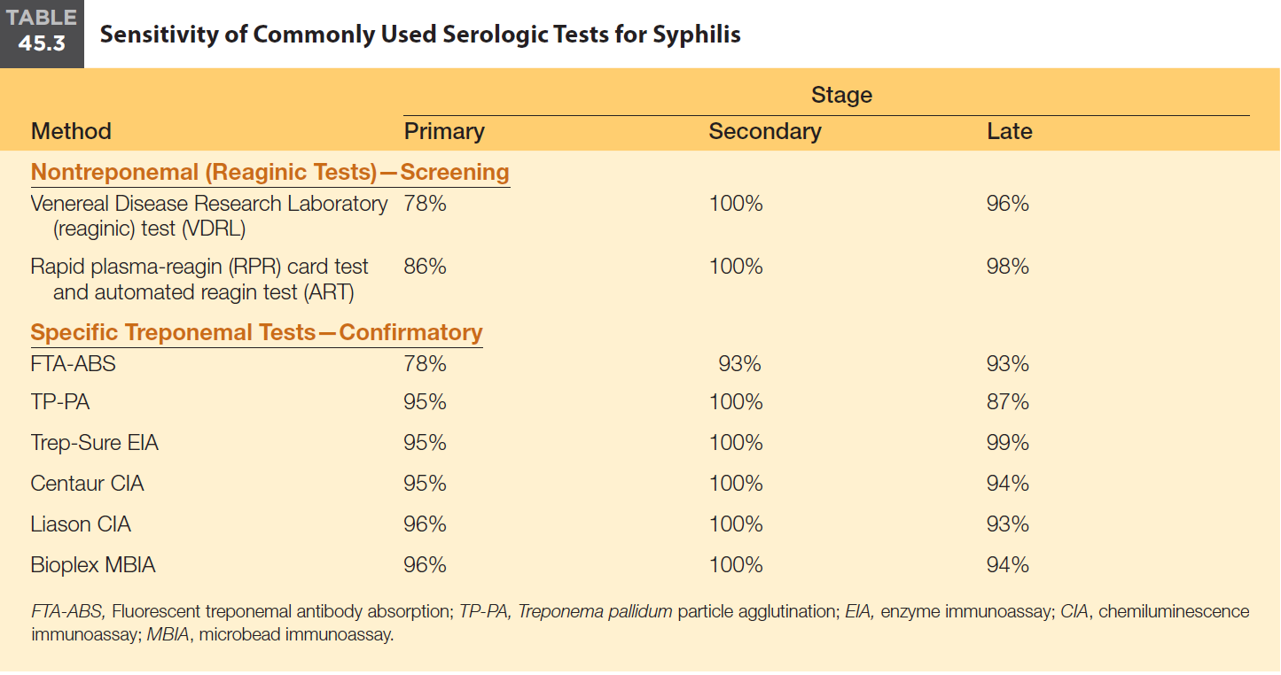

Slide 30
Molecular Methods: PCR-based techniques are available to amplify T. pallidum specific genes, such as gene coding for 47-kD a surface antigen(lipoprotein) and 39-kDa basic membrane protein. PCR is of paramount importance in the diagnosis of congenital and neurosyphilis.
CDC algorithm for testing for syphilis in pregnancy: Every pregnant woman should undergo a non-treponemal screening test at her first antennal visit and, if there is high risk of exposure, again rested at the third trimester and at delivery.

Slide 31
4. Does infection lead to immunity?
Syphilitic infection triggers a robust immune response against the pathogen, which is responsible for T. pallidum clearance in untreated individuals.
The infection results in dysregulation of immune systems including changes in the immunophenotype of subset of lymphocytes and disorder in cytokine secretion.
In syphilitic infection, CD4+/CD8+ T cells and macrophages are the main players involved in clearing the pathogen.
Syphilis in immunocompromised patients such as those suffering from the AIDS may present with unusually aggressive or atypical manifestations.

Slide 32
5. Is prevention of congenital syphilis possible?
CDC guideline of prevention of congenital syphilis:
Ensure that official public health statutes and/or regulations mandate serological test for syphilis on all pregnant women at the time of initial prenatal visit and early in third trimester.
Monitor public and private laboratories regularly to ensure the prompt and thorough reporting of reactive syphilis.
Assess the pregnancy status of women with diagnosed syphilis and of women who are the sex partner of men with diagnosed syphilis.
Ask early infectious syphilis patients or their unexamined sex partners who reside in neighbourhoods with a high incidence of syphilis to identify women in the area who may be pregnant. Refer all identified women for serological testing and prenatal care.

Slide 33
Awareness in pregnant women.
Conduct selective serological screening of women of childbearing age in groups with an increased risk of infection.
6. Are there any long term consequences of undiagnosed syphilis?
After initial infection, about one-third of untreated patients develop tertiary syphilis, of which 15% develop gummatous lesions, about 10% develop cardiovascular lesions and remaining 10% develop neurosyphilis. The latter two stages are sometimes classified as quaternary syphilis.
Gumma (late benign syphilis): Gummas are locally destructive granulomatous lesions. They can occur in any organ but most commonly seen in bone and skin.

Slide 34
Neurosyphilis: common manifestations include- chronic meningitis, vasculitis, general paresis of insane and tabes dorsalis.
Cardiovascular syphilis: characterized by aneurysm of ascending aorta and aortic regurgitation.
7. Problem we faced in diagnosis of congenital syphilis in Laboratory ?
The laboratory diagnosis of syphilis, especially in congenital syphilis continues to pose challenges.
The interpretation of each test varies and depends upon the stage of disease.
Serology has been the main diagnostic method but continues to have issues with lack of specificity of nontreponemal tests and a poor correlation of treponemal tests with disease activity.
Direct detection methods such as molecular or specialized microscopy techniques are also limited by their performance, availability, and cost.

Slide 35
Case 3
A 19 year old man complains of a purulent discharge (pus) from the penis and burning with urination for three days. He has no fever or other manifestations. He said that he had numerous sex partners & he does not use condoms. His physical examination is normal except for spontaneous discharge of pus from the urethral meatus.

Slide 36
Gonococcal Urethritis
1. What is the usual sites of infection with Neisseria gonorrhoea?
N. gonorrhoeae causes “gonorrhoea” a sexually transmitted infection(STI) which commonly manifests as cervicitis, urethritis and conjunctivitis.
2. What other sites may be infected?
In males: Urethritis, epididymitis, prostatitis, balanitis and it may involve periurethral tissue causing abscess with sinus formation.
In females: vulvovaginitis, peritonitis, salpingitis, PID.
Anorectal gonorrhea and pharyngeal gonorrhea and ocular gonorrhea.
Disseminated gonococcal infection

Slide 37
3. What elicits the intense inflammatory response (pus) in the urethra?
Inflammation is stimulated by lipo-oligosaccharide and possible peptidoglycan fragments of Neisseria gonorrhoeae.
The inflammatory response is also seen in females. Inflammation occurs typically at the endocervix; it is severe in the fallopian tubes when ascending infection occurs.

Slide 38
4. How would you diagnose the infection?
Specimen collection: Urethral swab in men and cervical swab in women are the preferred specimens. Vaginal swab is not satisfactory.
In males, the urethral meatus is cleaned with gauze soaked in saline. The purulent discharge is expressed out by pressing at the base of the penis and collected directly on to slides or swabs
Dacron or rayon swabs: are preferred as cotton and alginate swabs are inhibitory to gonococci.
In chronic urethritis: as discharge is minimal, prostatic massage is done to collect the secretion, alternatively the morning drop of secretion may be collected.

Slide 39
Transport media: it should be transported immediately. If not possible, then it should be collected in charcoal-coated swabs kept in Stuart’s transport medium or alternatively, charcoal containing medium(Amies medium) is used.
Microscopy: Gram stain of urethral exudates reveals gram negative intracellular kidney shaped diplococci.
Gram staining is highly specific and sensitive in symptomatic male.
However in females, it is only 50% sensitive because the presence of Neisseria species as commensals may confound with interpretation.
Culture is recommended for diagnosis of gonorrhoea in women.

Slide 40
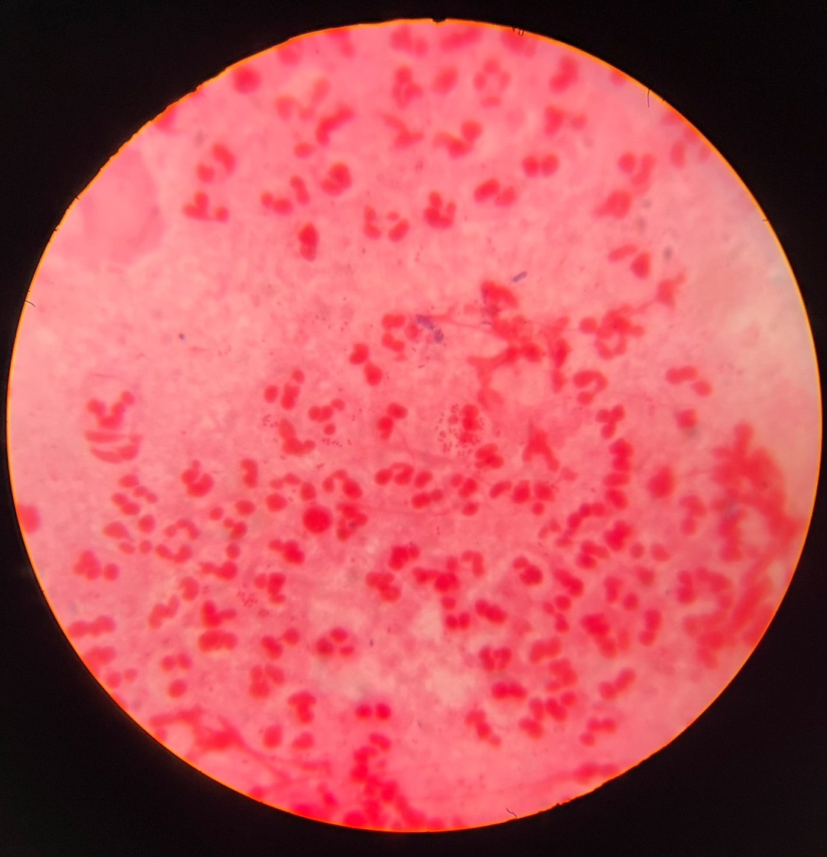
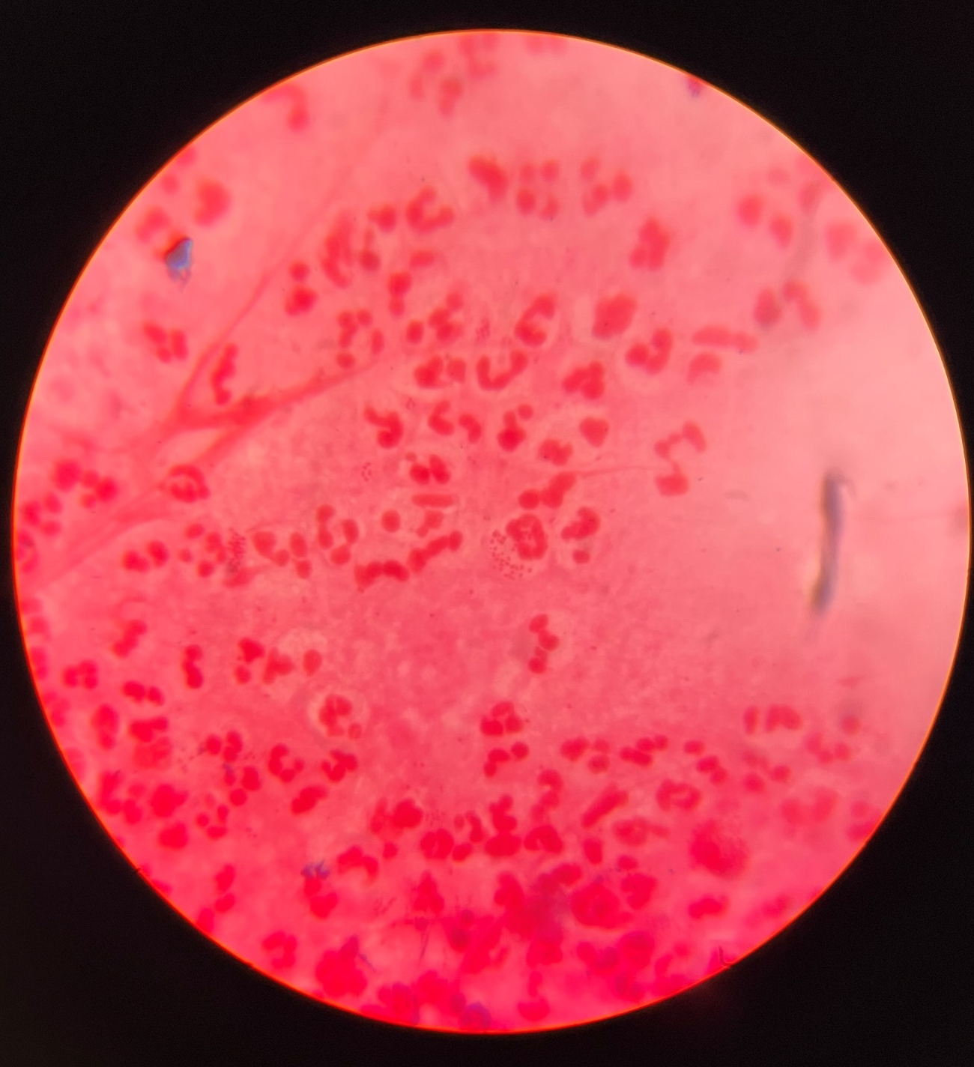

Slide 41
Culture: Endocervical culture has a sensitivity of 80-90%. As cervical swabs contain normal flora, hence, selective media are preferred such as Thayer Martin medium(chocolate agar added with antibiotic)
Blood culture (using automated blood culture systems) and synovial fluid cultures should be done in suspected cases of DGI.
Identification: species identification is important to differentiate gonococci from other commensal Neisseria species.
Gonococci are catalase and oxidase positive.
They ferment only glucose but not maltose and sucrose
Automated systems such as MALDI-TOF can be used.

Slide 42
Molecular method: NAATs such as PCR are available for detection of Neisseria gonorrhoeae from the clinical specimens targeting 16s or 23s rRNA gene.
5. Why can’t we develop a vaccine?
They are associated with phase and antigenic variation.
Besides pili and Opa, gonococcal lipo-oligosaccharide also undergoes antigenic variation.
This complex, high frequency antigenic variation provides specific ligands for different cell receptors which allows the organism to escape from immune surveillance, and makes it very difficult to develop a vaccine.

Slide 43
6. Mention the drug resistance in gonococci.
The likely cause of treatment failure is penicillin resistance.
Penicillinase-producing Neisseria gonorrhea (PPNG) were first described in the Far East, and are now endemic in the U.S. These strains produce a plasmid encoded beta-lactamase.

Slide 44
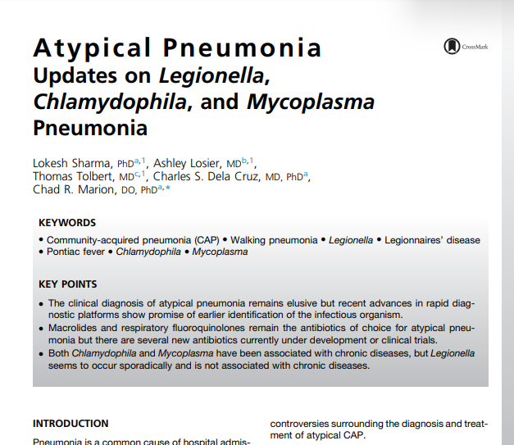

Slide 45
References
MLA. Tille, Patricia M., author. Bailey & Scott's Diagnostic Microbiology. St. Louis, Missouri :Elsevier, 2014.
Apurba S Sastry, Sandhya Bhat. Essential of Medical Microbiology. 4th Edition New Delhi, Jaypee brothers Medical Publishers; 2023.
Centers for Disease Control and Prevention.

Slide 46
MCQs
1. STIs are most common in which age group?
A. Teens and young adults up to age 24
B. People ages 30 to 45
C. People 60 and older
D. All of the above

Slide 47
2. Which is the most common STI caused by bacteria?
A. Gonorrhea
B. Syphilis
C. Chlamydia
D. Genital warts

Slide 48
3. One symptom of genital herpes is:
A. Tingling or burning in the genital area
B. Painful blisters in the genital area
C. A and B
D. None of the above

Slide 49
4. Which major organ can be affected by untreated syphilis?
A. Heart
B. Brain
C. Liver
D. A and B

Slide 50
5. Which of these are other types of STIs?
A. Chancroid
B. Scabies
C. Molluscum contagiosum
D. HTLV
E. All of the above

Slide 51
THANK YOU

