Slide 1
Sulfonamides
Dr. Shruti Brahmbhatt

Slide 2
Introduction to chemotherapy

Slide 3
Chemotherapy- treatment of systemic/topical infections with drugs that have selective toxicity for an invading organism without damaging the host tissues.
Antibiotic suppress the growth of organism or destroy it.
Paul Ehrlich “the father of modern chemotherapy” showed that certain dyes can destroy the organism
Many infections which were earlier incurable, now can be treated with just a few doses of antimicrobials

Slide 4
Mechanism of action
Inhibit the cell wall synthesis- penicillins, cephalosporins
Damages the cell membrane- causing leakage of cell contents- polymyxin
Binds to ribosomes and inhibit the protein synthesis- chloramphenicol, tetracycline
Inhibit DNA gyrase enzyme- fluoroquinolones
Inhibit DNA function- Rifampicin
Interferes with metabolic steps- sulfonamides

Slide 5
Bacteriostatic- inhibits growth of bacteria
  E.g sufonamides
Bactericidal- kill the bacteria
  E.g penicillin, cephalosporins

Slide 6
Antibacterial spectrum
Narrow spectrum- penicillin- gm positive
Broad spectrum- gram negative
  tetracycline & chloramphenicol
Factors influencing the successful chemotherapy – site, concentration, host defense, sensitivity

Slide 7
Resistance
Unresponsiveness of microorganism to the antimicrobial agent
Natural – mycobacterium tuberculosis resistant to other antibiotics
Acquired- previously sensitive microbes become resistant

Slide 8
Resistance is acquired by bacteria by change in DNA
DNA changes occur by mutation or transfer of genes
Transfer of genetic material occurs by transduction, transformation or conjugation
Cross resistance- seen among chemically related drug

Slide 9
Prevention of resistance
Antibiotic to be used only when necessary
Selection of appropriate antibiotic
Correct dose & duration
Combination in TB

Slide 10
Dose of antibiotics
MIC- minimum conc. to prevent growth of bacteria
Concentration dependant killing- aminoglycosides
Time dependant killing- beta lactam antibiotics
Post antibiotic effect- aminoglycosides

Slide 11
Combination of antibiotics
Synergism-
  (A+ B) > A + b
  Trimethoprim + Sulfamethoxazole
  INH + Rifampicin
To prevent resistance
  Tuberculosis

Slide 12
Disadvantages of combination
Risk of toxicity- hepatotoxicity
Increased cost of therapy
Resistance

Slide 13
SULFONAMIDES and COTRIMOXAZOLE

Slide 14
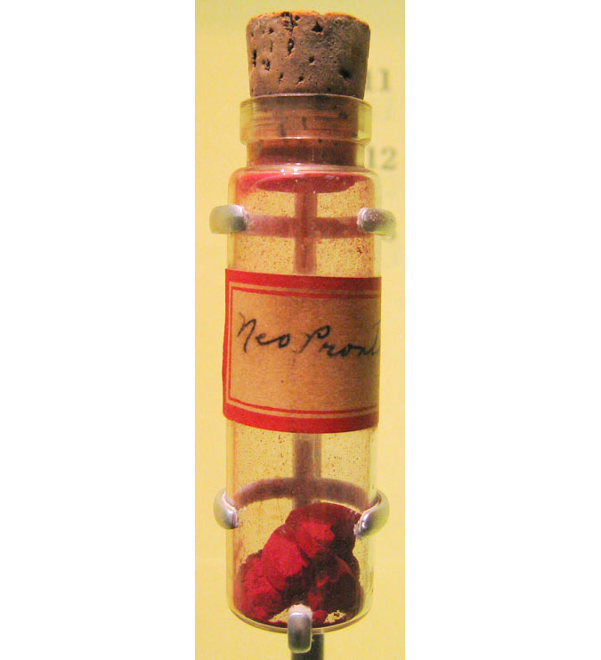
Introduction
first antimicrobial agents-effective against pyogenic bacterial infections
sulfonamido-chrysoidine-Domagk -action against streptococci
Treated his daughter
Sulfanilamide- active AMA

Slide 15
Classification
Short acting (4-8 hr): Sulfadiazine
Intermediate acting ( 8-12 hr ) : Sulfamethoxazole
Long acting(7 days):
    Sulfadoxine
    Sulfamethopyrazine
Special purpose sulfonamides:
  Sulfacetamide sod.
  Mafenide,
  Silver sulfadiazine,
  Sulfasalazine

Slide 16
ANTI BACTERIAL SPECTRUM
Primarily bacteriostatic
Maninly active against gram negative bacilli e.g E.coli, Shigella, Salmonella, H. Influenza, V. Cholera, Proteous mirabilis
Moderately active against N. Gonorrhoea, N. Meningitidis

Slide 17
Staph.aureus, gonococci, meningococci, pneumococci,E scherichiac oli, and Shigella respond, but majority are resistant
Chlamydiae
Actinomyces
Nocardia
Toxoplasma

Slide 18
Resistance to Sulfonamides
gonococci, pneumococci,Staph. aureus,meningococci, E. coli, Shigella and some Strep. pyogenes, Strep. viridans and anaerobes
  produce increased amounts of PABA
  folate sythetase enzyme has low affinity for sulfonamides- alteration
  adopt an alternative pathway in folate metabolism
  loss of permeability for drug

Slide 19
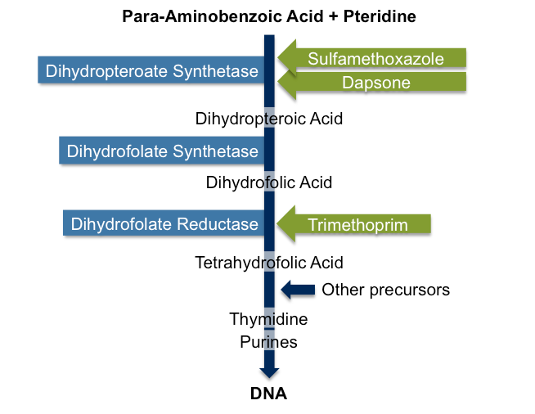
Notes:
Sulfonamide is structural analogue of PABA
Human cells are freely permeable to exogenous folic acid but bactria are not /synth own fa for its growth and multiiplication/active form is tetrahydrofolic acid or folinic acid/ responsible for synthesis of bacterial proteins, RNA & DNA/ folic acid cnsists of Pteridine+ PABA+ Glutamate/ Sulfonamide being structural analgue of PABA entrers in place of PABA and comptete for the enzyme/ non fnctional analogue is formed and its grrowth ceases/bacteriostatic
Trimenthoprim- analgue of pteridine/ inhibitbv DHFR/ it has much higher affinity for bacterial DHFR than protozoal or mamalain DHFR/

Slide 20
PHARMACOKINETICS
rapidly and nearly completely absorbed
Not to give via sc or IM – solutions are alkaline- painful
highly protein bound those are longer acting
widely distributed in the body—enter serous cavities easily- BBB and Placenta
Good accumulation in prostatic fluid
primary pathway of metabolism –acetylation
crystalluria
excreted mainly by the kidney ( acetylated metabolites are inactive and low solubility in acidic urine)

Slide 21
THERAPEUTIC USES

Slide 22
Rarely used as single agents
Largely replaced by FDC (cotrimoxazole)

Slide 23
Topical Use
Sulfacetamide
Silver Sulfadiazine
Mafenide

Slide 24
Sulfacetamide
highly soluble compound
only mildly irritating to the eye in concentrations up to 30%
‘OCULAR INFECTIONS’
(chlamydia, including ophthalmia neonatorum caused by Ch. Oculogenitalis)
The incidence of sensitivity reactions-LOW

Slide 25
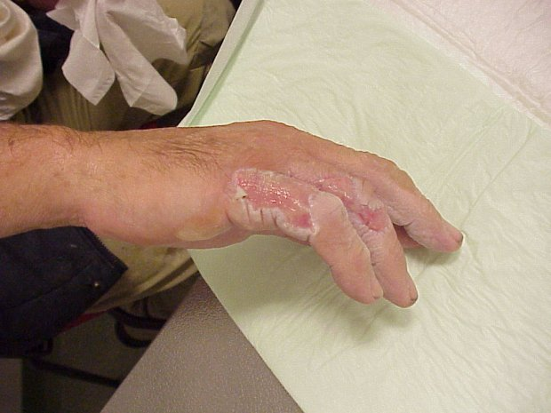
Silver Sulfadiazine
as 1% cream
active against a large number of bacteria and fungi
Slowly releases silver ions (additional antimicrobial effect)
Prevention of burnt surfaces and chronic ulcers
Local side effects are-burning sensation on application , itch

Slide 26
Mafenide
not a typical sulfonamide
inhibits a variety of gram positive and gram-negative bacteria
Pseudomonas, clostridia to prevent
Prevention of burnt surfaces
biggest limitation- burning sensation and severe pain when applied to raw surface

Slide 27
Systemic use
Alone is RARE- combination
Though.....
chronic urinary tract infection
streptococcal pharyngitis
gum infection
Cotrimoxazole
Sulfadoxine + pyrimethamine- malaria,
pneumocystis jiroaeci pneumonia in AIDS patients and in toxoplasmosis.

Slide 28
ADVERSE EFFECTS
Nausea, vomiting and epigastric pain
Crystalluria
Hypersensitivity reactions
Hepatitis
haemolysis in a dose dependent manner in individuals with G-6 PD deficiency
Agranulocytosis
Aplastic Anemia
Kernicterus
Notes:
Crystalluria – risk can be minimised by adequate intake of water/ make urine alkaline to excrete drug faster/
Kernicterus- to be avoided in neonates and women with last trimester

Slide 29
COTRIMOXAZOLE
fixed dose combination of Trimethoprim and sulfamethoxazole
Trimethoprim is a diaminopyrimidine-inhibit bacterial dihydrofolate reductase
Both individually- bacteriostatic
But in combination- bacteriocidal
sequential steps
synergistic

Slide 31
trimethoprim is a highly selective inhibitor of dihydrofolate reductase of lower organisms:
~100,000 times more drug is required to inhibit human reductase than the bacterial enzyme

Slide 32
WHY COMBINED?........
Same t1/2-(10hr)
Sequential blockade - Bactericidal
Optimal synergism of most organisms is exhibited at a plasma concentration ratio of sulfamethoxazole20: trimethoprim 1 (dosage 5:1)
the MIC of each component may be reduced by 3-6 times
Less adverse effects

Slide 33
Why trimethoprim’s conc. Is less?.....
Larger volume of distribution
crosses blood-brain barrier and placenta, while
sulfamethoxazole has a poorer entry
Rapidly absorbed
Trimethoprim is 40% plasma protein bound, while sulfamethoxazole is 65 % bound.
partly metabolized in liver and
excreted in urine.

Slide 34
Antibacterial Spectrum
The antibacterial spectrum of trimethoprim is similar to that of sulfamethoxazole
Most gram-negative and gram-positive microorganisms are sensitive to trimethoprim, but resistance can develop when the drug is used alone

Slide 35
Bacterial Resistance
acquisition of a plasmid that codes for an altered dihydrofolate reductase

Slide 36
Therapeutic Uses
Urinary Tract Infections
E. Coli, proteus mirabilis
Cotrimoxazole for 5 to 10 days BD
Prostatitis
Conc. In prostatic fluid
Cotrimoxazole BD for 3 weeks

Slide 37
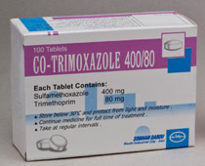
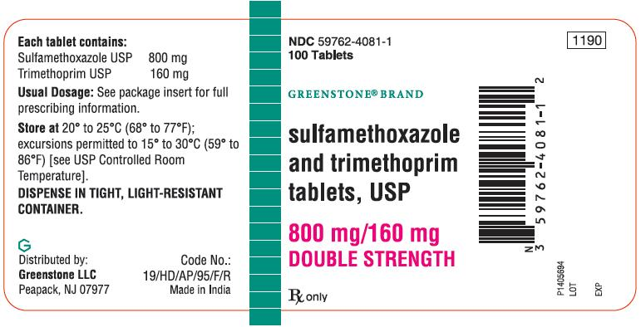

Slide 38
Bacterial Respiratory Tract Infections
acute exacerbations of chronic bronchitis
Otitis media
acute maxillary sinusitis - H. influenzae
  800-1200 mg sulfamethoxazole plus 160-240 mg trimethoprim twice a day

Slide 39
GI Infections
Typhoid- second line drug
Bacterial diarrhoeas and dysentery-Campylobacter, E. coli, Shigella
But quinolones preferred

Slide 40
Infection by Pneumocystis jiroveci in pts with AIDS
High-dose therapy
(trimethoprim 15-20 mg/kg per day plus sulfamethoxazole 75-100 mg/kg per day)
prophylactic as well as therapeutic value

Slide 41
Chancroid
Cotrimoxazole(800+160mg)BD for 7 days-3rd choice
Prophylaxis in Neutropenic Patients
agranulocytosis patients and treating respiratory

Slide 42
Adverse effects
Nausea, vomiting, stomatitis, headache and rashes
folate deficiency -precipitate megaloblastosis- long term use in succeptible malnourished or alcoholic)
Should not be given during pregnancy-Neonatal haemolysis
Exfoliative dermatitis, Stevens-Johnson syndrome, and toxic epidermal necrolysis

Slide 43
Permanent impairment of renal function-with renal disease
A high incidence of fever, rash and bone marrow hypoplasia -Infection by Pneumocystis jiroveci in pts with AIDS

Slide 44
Thank You

