Slide 1

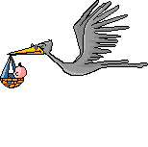

COMPETENCY BASED RESPIRATORY PHYSIOLOGY
EBES DOCUMENT
Dr J M Harsoda
PROF AND HEAD
DEPARTMEN OF PHYSIOLOGYSBKSMI AND RC SUMANDEEP VIDYAPEETH

Slide 2
COMETENCY CODE: PY6.3 (contd…)
DESCRIBE AND DISCUSS THE TRANSPORT OF CARBONDIOXIDE.
(NERVOUS AND CHEMICAL CONTROL OF RESPIRATION)

Slide 3
TRANSPORT OF CO2 BY BLOOD
INTRODUCTION
TRANSPORT OF CO2 :-
1 In the Dissolved State (7 % ).
2 In the Form of Bicarbonate Ion (70-80 %)
3 In Combination with Hb and Plasma Protein -
Carbaminohemoglobin (23-30 %).
CO2 DISSOCIATION CURVE
HALDANE EFFECT

Slide 4
TRANSPORT OF CO2 IN THE DISSOLVED STATE
A small portion of the CO2 is transported in the dissolved state to the lungs. Recall that the Pco2 of venous blood is 45 mmHg and that of arterial blood is 40 mmHg. The amount of CO2 dissolved in the fluid of the blood at 45 mmHg is about 2.7 ml/dl The amount dissolved at 40 mmHg is about 2.4 ml/dl or a difference of 0.3 ml. Therefore, only about 0.3 ml of CO2 is transported in the dissolved form by each dl of blood .This is about 7 % of all the CO2 normally transported.

Slide 5
TRANSPORT OF CO2 IN FORM OF BICARBONATE IONS AND CARBOAMAINOHAEMOGLBIN
INTERSTITIAL FLUID CAPILLARY
RBC
Hgb Hgb.CO2
+ CA
co2 co2 CO2 + H2o H2CO3
HCO3 + H + Hgb = HHgb
CELL CL
CO2
CL
HCO3
Chloride shift PLASMA

Slide 6
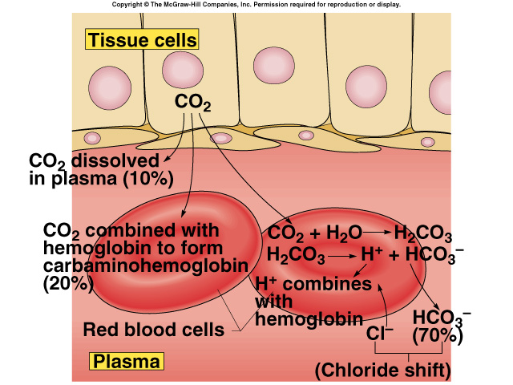
TRANSPORT OF CO2 AND CHLORIDE SHIFT

Slide 7
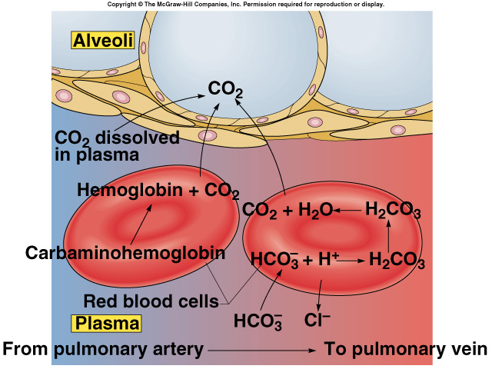
Reverse Chloride Shift in Lungs

Slide 8
CO2 DISSOCIATION CURVE
CO2 DISSOCIATION CURVE - indicates total amount of blood Co2 in all its forms depends on Pco2 .
Note that the normal blood Pco2 ranges between the limits of 40 mm Hg in arterial blood and 45 mm Hg in venous blood, which is a very narrow range.
That is, the concentration of co2 rises to about 52 ml /dl as the blood passes through the tissues and falls to about 48 ml/dl as it passes through the lungs.
Therefore,(52ml – 48ml) 4 ml CO2/dl is transported from tissues to lungs.

Slide 9
CO2 DISSOCIATION CURVE
60
52
48 Normal operating range
CO2
in ml
0
0 40 45 100
Pco2 = in mmHg
J M Harsoda (2012) EBES DOCUMENT, Respiratory Physiology;SV.

Slide 10
HALDANE EFFECT
Binding of O2 with hemoglobin tends to displace CO2 from the blood. Indeed, this effect, called the Haldane effect, is quantitatively far more important in falls 52ml to 48 ml/dl (point B). This represents an additional 2ml/dl loss of CO2. Thus, the Haldane effect approximately doubles the amount of CO2 released from the blood in the lungs and approximately doubles the pickup of CO2 in the tissues.

Slide 11
HALDANE EFFECT
54 A Po2=40 mmHg
52
Co2 Haldane effect
In ml
48 Po2=100 mmHg
B
0
0 40 45 60
PCo2 = in mmHg

Slide 12
RESPIRATORY EXCHANGE RATIO (R)
The ratio of carbon dioxide output to oxygen uptake is called the respiratory exchange ratio (R).
R = Rate of CO2 output / Rate of O2 uptake
Therefore, R = 4 ml/5 ml = 0.825
For a person on a normal diet consuming average amounts of carbohydrates, fats, and proteins, the average value for R is considered to be 0.825

Slide 13
CONTROL OF RESPIRATION
INTRODUCTION
NERVOUS CONTROL OF RESPIRATION BY
RESPIRATORY CENTERS
MEDULLARY CENTERS
PONTINE CENTERS
CHEMICAL CONTROL OF RESPIRATION
CENTRAL CHEMORECEPTOR MECHANISMS
PERIPHERAL CHEMORECEPTOR MECHANISMS
OTHER RECEPTORS
ABNORMAL PATTERNS OF RESPIRATION

Slide 14
RESPIRATORY CENTERS
DORSAL RESPIRATOY GROUP (DRG)
MEDULLRY CENTERS
VENTRAL RESPIRATORY GROUP (VRG)
APNEUSTIC CENTER
PONTINE CENTERS
PNEUMOTAXIC CENTER

Slide 15
PHYSIOLOGIC ANATOMY OF RESPIRATORY CENTER
4th VENTRICLE PNEUMOTAXIC CENTER
DORSAL RESPIRATORY GROUP
(DRG) INSPIRATION INHIBITION
VAGUS APNEUSTIC CENTER
GLOSSOPHARYNGEAL
VENTRAL RFSPIRATORY GROUP
(VRG)
(EXPIRATION AND INSPIRATION)
RESPIRATORY MOTOR PATHWAY

Slide 16
MEDULLARY RESPIRATORY CENTERS
DORSAL RESPIRATORY GROUP (DRG):-
Anatomy: The DRG is a bilateral group of neurones that lies within the nucleus of the tractus solitarius, dorsal surface of medulla.
Functions:
The DRG neurones are primarily inspiratory neurones (i.e., they discharge during inspiration)
The DRG may be the primary rhythm generator for respiration.

Slide 17
CONTD….. Functions of DRG
Inspiratory “Ramp” Signal:- The nervous signal that is transmitted to the inspiratory muscles, mainly the diaphragm. normal respiration, it begins weakly and increases steadily in a ramp manner for about 2 sec. Then it ceases abruptly for approximately the next 3 sec,which turns off the excitation of diaphragm and allows elastic recoil of the lungs and the chest wall to cause expiration.
The obvious advantage of the ramp is that it
causes a steady increase in the volume of the lungs
during inspiration, rather than inspiratory gasps

Slide 18
CONTD….. Functions of DRG
Afferent input to the DRG comes primarily from the vagus and glossopharyngeal nerves, which carry information from the peripheral chemoreceptors and mechanical receptors in the lungs.
Low O2 tensions, high CO2 tensions, and low pH level that stmulate DRG.
Increase electrical traffic within the RAS that stimulate DRG.
Inflation of lungs that inhibit DRG.
Efferent outflow from DRG goes to the centrolateral phrenic and intercostal motoneurons and to the VRG.

Slide 19
VENTRAL RESPIRATORY GROUP (VRG):-
Anatomy: Located in each side of the medulla, about 5 mm anterior and lateral to the DRG, The VRG is lies in the nucleus ambiguus rostrally and the nucleus retroambiguus caudally.
Functions:
The neurons of the VRG remain almost totally inactive during normal quiet breathing. When the respiratory drive for increased pulmonary ventilation becomes greater than normal, respiratory signals spill over into the VRG from the basic oscillating mechanism of the DRG. As a consequence, the VRG contributes extra respiratory drive as well.

Slide 20
PONTINE RESPIRATORY CENTERS
PONTINE CENTERS are area of the brain stem that modify the activity of the medullary respiratory centers.
APNEUSTIC CENTER:-
Anatomy: Apneustic center lies in the caudal area of the pons, but it has not been identified with any specific collection of neurones.
Functions:
Efferent outflow from apneustic center increase the duration of inspiration,slowing respiratory rate and resulting in a deeper and more prolonged inspiration.

Slide 21
CONTD…….. PONTINE CENTERS
Inhibition: The apneustic center is normally inhibited by impulses carried by the vagus nerve, also by the actvity of the Pneumotaxic center. Bilateral vagotomy and destruction of the Pneumotaxic center results in prolonged periods of inspiration (i.e., apneusis).
PNEUMOTAXIC CENTER:-
Anatomy: A pneumotaxic center, located dorsally in the nucleus parabrachialis of the upper pons.
Functions:
Control the Duration of Inspiration.
Regulation of the Respiratory Rate.

Slide 22
MCQ TEST AFTER END OF LECTURE
1 The amount of CO2 dissolved in the fluid of the
blood at 45 mmHg is about:
A 2.4 ml/dl
B 2.7 ml/dl
C 19.4 ml/dl
D 14.4 ml/dl
2 Transport of co2 In the Form of Bicarbonate Ion:
A 07 %
B 23-30 %
C 70-80 %
D 97%

Slide 23
MCQ TEST AFTER END OF LECTURE
3 Normal function of DRG neurones is causes:
A Expiration and inspiration
B Inspiration
C Force expiration
D Deep inspiration
4 Regulation of the Respiratory Rate by:-
A Dorsal respiratoy group
B Apneustic center
C Pneumotaxic center
D Ventral respiratory group

Slide 24
MCQ TEST AFTER END OF LECTURE
5 Low O2 tensions, high CO2 tensions, and low pH
level that stmulate:
A Apneustic center
B VRG
C DRG
D Pneumotaxic center

Slide 25
CENTRAL CHEMORECEPTOR MECHENISMS
C
INSPIRATORY CENTER
(DRG)
CHEMOSENSITIVE AREA
(CENTRAL CHEMORECEPTORS)
H + HCO3
CO2 + H2O H2CO3

Slide 26
CENTRAL CHEMORECEPTORS
Anatomy: Central chemoreceptors are located bilaterally, lying only 0.2 mm beneath the ventral surface of the medulla.
Functions:
Central chemoreceptors respond to the H+concetration in the CSF and the surrounding interstitial fluid. CO2 readily crosses the blood brain barrier, because it is a small, very soluble, uncharged molecule. The hydration and subsequent dissociation of CO2 into H+ and HCO3- alters the H+ concentration in the CSF and brain tissues. An increase in CSF CO2(H+) causes the central chemoreceptors to stimulate respiration. A decrease in CSF CO2(H+) causes the central chemoreceptors to inhibit respiration.

Slide 27
EFFECTS OF BLOOD BRAIN BARRIER CO2(H+) ON CENTRAL CHEMORECEPTERS
BRAIN BLOOD
H+
H+
H2CO3 H2O + CO2 CO2
HCO3 + H+
CNTRALCHEMORECEPTOR
BLOOD BRAIN BARRIER
J M Harsoda (2011) EBES DOCUMENT, Respiratory Physiology;SV.

Slide 28
PERIPHERAL CHEMORECEPTOR MECHANISMS
Anatomy: Peripheral chemoreceptors are located in the carotid and aortic bodies.
The carotid bodies are located bilaterally in the
bifurcations of the common carotid arteries. Their
afferent nerve fibers pass through Hering’s nerves to the glossopharyngeal nerves and then to the DRG of the medulla. The aortic bodies are located along the arch of the aorta; their afferent nerve fibers pass through the vagus also to the DRG of the medulla.

Slide 29
FUNCTION OF PERIPHERAL CHEMRECEPTORS
Peripheral chemoreceptors respond to lowered O2 tension, increase CO2 tension, and increased H+ concentration in the arterial blood.
The peripheral chemoreceptors rapidly increase their firing rate as the arterial O2 tension falls below 60 – 80 mmHg. Afferent impulses from these receptors are carried to the DRG of medulla from the aortic and carotid body receptors via vagal and glossopharyngeal nerves, respectively to increase the rate and depth of respiration.

Slide 30
DRG PERIPHERAL CHEMORECEPTORS
MEDULLA GLOSSOPHARYNGEAL NERVE
VAGUS NERVE
CORTID BODY
(PERIPHERAL CHEMORECEPTERS)
CARTID ARTERY
AORTIC BODY
(PERIPHERAL CHEMORECEPTORS)
ARCH OF AORTA
J M Harsoda (2011) EBES DOCUMENT, Respiratory Physiology;SV.

Slide 31
REGULATION OF RESPIRATION BY OTHER RECEPTORS
STRETCH RECEPTORS AND HERING BREUER REFLEX
IRRITANT RECEPTORS
J RECEPTORS
CHEST WALL RECEPTORS

Slide 32
STRETCH RECEPTORS
Stretch receptors located in small air ways are stimulated by inflation of the lungs. Stimulation of these receptors initiates the Hering-Breuer reflex, which terminates inspiration by sending impulses that inhibit the pontine and medullary centers via vagus nerves. This reflex is not very powerful in adult humans. But functions in newborns and in some animal species.

Slide 33
IRRITANT RECEPTORS
Irritant receptors are located in the large air ways and are stimulated by smoke, noxious gases, and particulates in the inspired air.
These receptors initiate reflexes that cause coughing , broncho constriction , mucus secretion and breath holding (i.e., apnea ).
Chronic exposure to inhaled irritants (e.g., from smog, industrial atmospheres, or cigarette smoke) can lead to bronchitis.

Slide 34
J RECEPTORS
J receptors are located in the pulmonary interstitium at the level of the pulmonary capillaries and are stimulated by distension of the pulmonary vessels (e.g.,as caused by left ventricular failure, pulmonary embolism, and certain chemicals or drugs). These receptors initiate reflexes causing rapid, shallow breathing (i.e., tachypnea).

Slide 35
CHEST WALL RECEPTORS
Chest wall receptors can detect the force generated by the respiratory muscles during breathing. If the force required to distend the lungs becomes excessive (either as a result high airway resistance or low compliance ). The information from these receptors gives rise to the sensation of dyspnea (difficulty in breathing).

Slide 36
MCQ TEST AFTER END OF LECTURE
1 Central chemoreceptors respond to:
A The increased H+concetration in the CSF.
B The increased O2 concetration in the CSF.
C lowered CO2 concetration in the CSF.
D The CO concetration in the CSF.
2 Peripheral chemoreceptors respond to:
A increased O2 concentration.
B lowered CO2 tension.
C A decrease in CSF CO2(H+).
D lowered O2 tension, increase CO2 tension, and
increased H+ concentration.

Slide 37
MCQ TEST AFTER END OF LECTURE
3 Stimulation of Stretch receptors initiates the:
A Baroreceptor Reflexes
B Hering-Breuer reflex
C Bainbridge Reflex.
D Abdominal compression reflex.
4 J receptors initiate reflexes causing:
A Bronchitis.
B Dyspnea
C Tachypnea)
D Apnea

Slide 38
MCQ TEST AFTER END OF LECTURE
5 Irritant receptors initiate reflexes that cause:
A Coughing
B Difficulty in breathing
C Rapid, shallow breathing
D Hyperapnea

Slide 39


