Slide 1
Composition & Functions of Blood & Plasma Proteins
DR SHALINI RANJAN

Slide 2
Hematology :- Study of Physiology of Blood & Blood Disorders
Study of Blood Physiology = Study of different components of Blood, their formation,their role in different body functions & dysfunctions
Study of Blood Disorders = Study of pathophysiology of diseases of blood & their management,and pathological alterations in Blood in other (Non-Hematological) Diseases

Slide 3
Blood :-
Defined as Liquid Connective tissue that fills the Heart & Blood Vessels
Normal Blood Volume = 5-6 litres (8% of Body Weight)

Slide 4
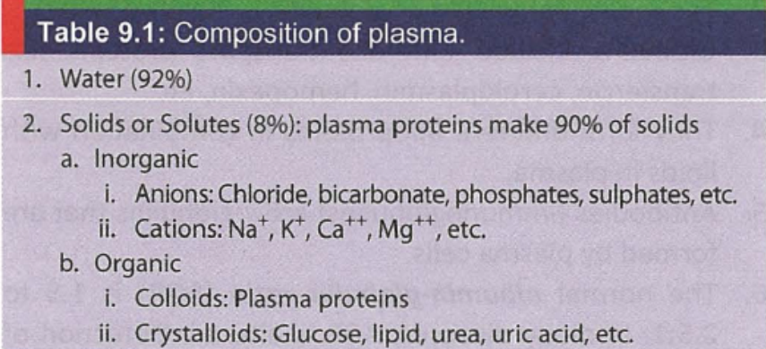
Composition of Blood :-
Cellular Component = Formed elements-Red Blood Cells (Erythrocytes)
-White Blood Cells (Leucocytes)
-Platelets (Thrombocytes)
Fluid Component = Plasma----Constitutes 55% of Total Blood Volume
----Water + Solid particles

Slide 5
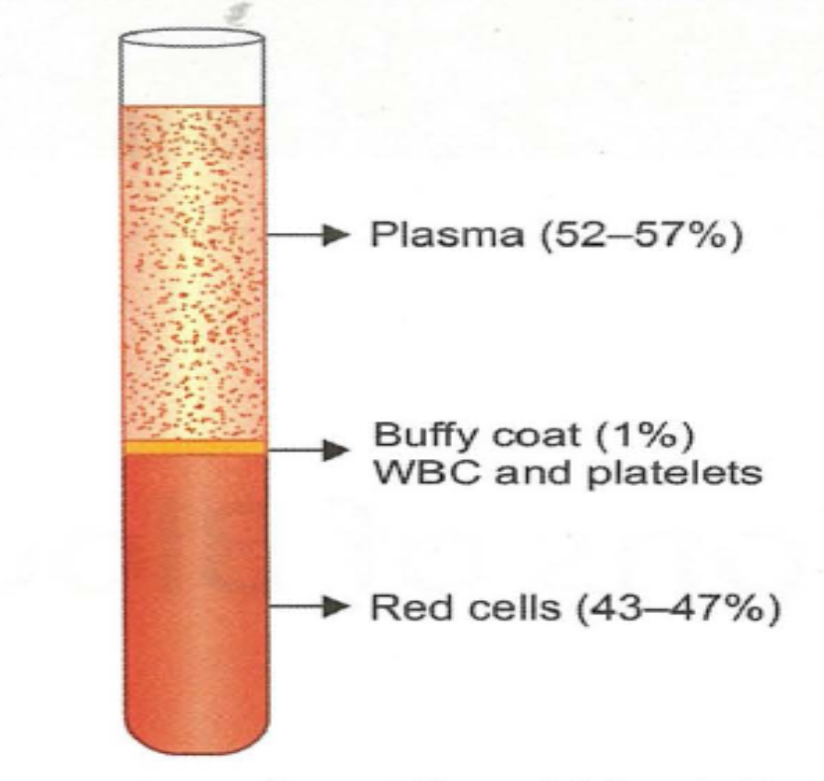
When Blood is collected in an Anticoagulated tube & allowed to settle by Centrifugation, 3 Layers are visible :-
1.The Uppermost Layer=Plasma Layer
= 55%
2.Bottom Layer=RBC mass
=45%
3.Middle thin Layer=Buffy Coat
=WBCs + Platelets
= 1%

Slide 6
Buffy Coat :-
It is the thin middle layer that separates the upper plasma & lower red cell mass after centrifugation of Blood
Contains WBCs & Platelets
In Diseases,Abnormal cells are also found in the Buffy Coat.
Ex :- •LE cells in Systemic Lupus Erythematosus
•Atypical/Primitive Blood Cells in Malignant/Premalignant
Conditions
Blood film prepared from Buffy Coat is useful for detection of Bacteria,Fungi,Parasites residing within WBCs

Slide 7
Functions of Blood :-
1.Respiratory functions---
Blood delivers Oxygen from Lungs to tissues & Carbon dioxide from tissues to the Lungs
2.Transport Medium ---
Blood acts as a Transport Medium for Hormones,Chemical Substances,Nutrients,Vitamins,etc.These all circulate in Blood and get distributed to all tissues of the Body. Thus,Blood regulates Growth & Metabolism of the tissues

Slide 8
3.Temperature Regulation :-
Blood conducts heat from the Interior of Body to the Surface through Blood Vessels. Heat is continuously produced in the Body due to Metabolism.
Blood absorbs this Heat & transfers to the Body Surface.
Hence,Vasoconstriction----Preserves Body’s heat
Vasodilation -----Facilitates Heat Dissipation from Body
4.Excretory Function :-
Blood helps in Excretion of Waste materials by transporting them from different body parts to the Kidney

Slide 9
5.Water Homeostasis :-
Its Known that 55% of Blood= Plasma & 92 % of Plasma =Water
Loss of Water as in Diarrhea,Vomiting,Excessive Sweating
Decreased Blood Volume (Hypovolemia)
Cellular Dehydration
Mechanisms are activated to increase water content of Blood
By maintaining Blood Volume, Water Homeostasis is achieved

Slide 10
6.Acid-Base Balance :-
Blood contains Plasma proteins,Hemoglobin & Bicarbonates. All of these play an important role in maintaining Acid Base Balance of Body
7.Immunity :-
Blood contains cells that play primary role in Cellular Immunity
It contains Antibodies that play major role in Humoral Immunity
Blood also contains cells & chemicals that take part in Nonspecific Defense of the Body
8.Storage :-
Blood is the Storage site of Nutrients,Chemicals,Hormones & Electrolytes

Slide 11
9.Body Color :-
Blood provides natural color to the Body.
In Anemia & Hypovolemia,Body becomes pale
10.Nutritive Functions :-
Blood delivers all nutrients,such as Glucose,Lipids,Proteins,Vitamins, Minerals,etc to all tissues of the body for their utilization & Storage
11.Oncotic Pressure :-
The Albumin present in Blood exerts Osmotic pressure,which is referred to as “Oncotic Pressure” that controls Capillary filtration & prevents Edema formation

Slide 12
Blood Volume

Slide 13
Blood Volume :-
Total Blood Volume = 70-80 ml/kg of Body Weight
  Adult Males = 5-6 litres of Blood
  Adult Females =4.5-5.5 litres of Blood
  Children = Absolute Volume is Les
  =Vol/Kg Body Weight is more (80-90 ml/kg-BW)
Blood Volume also expressed as per Square meter of Body Surface Area
Normal= 2.8 lit/m²

Slide 14
Effective Blood Volume:-
Total Blood Volume – Volume that is sequestrated
It means the Volume which is present actually in the Circulation that helps in tissue perfusion
But, it is difficult to estimate the sequestered volume of Blood in the Visceral Organs

Slide 15
Specific Gravity & Viscosity

Slide 16
Specific Gravity of Whole Blood
1.050
Depends on the number of cells & composition of Plasma
Loss of Water from Blood as occurs in Dehydration increases Specific gravity

Slide 17
Viscosity :-
It is the measure of resistance of Blood to flow
It is 4-5 times that of Water
Its due to the number of cells & macromolecules like proteins present in the Blood

Slide 18
Plasma & Serum

Slide 19
Plasma :-
Fluid component of Blood
Constitutes 55% of the Total Blood Volume
If the Whole Plasma is to be used for Investigations,Blood is collected with Anticoagulants (Anticoagulated Blood) & Centrifuged.
The Supernatant portion of the tube is the Plasma

Slide 20
Fresh Frozen Plasma :-
In cases where plasma needs to be stored for years for future analysis , Plasma is stored frozen below -20°C.In this form its referred to as “Fresh Frozen Plasma (FFP)”
FFP can be stored upto 7 yrs in a Blood Bank
But to preserve Clotting factors Plasma must be frozen within 6 hrs after collection
FFP is used for Plasmapheresis (Therapeutic Plasma Exchange)

Slide 21
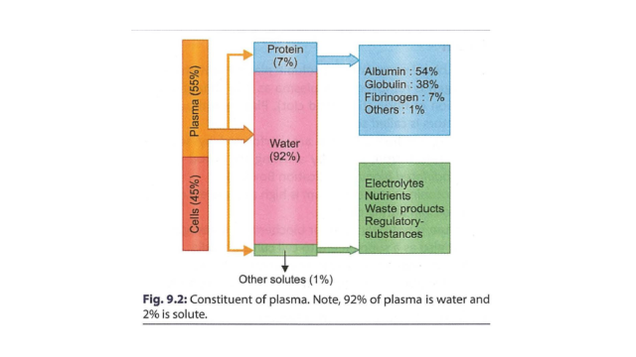
Composition of Plasma :-
Plasma = Water + Solids
= 92% Water +7% Plasma Proteins + 1% other solutes

Slide 22
Serum :-
Plasma without Clotting factors is called as “Serum”
Serum includes antibodies, antigens, electrolytes, hormones and any exogenous substances such as drugs and microorganisms and all proteins except Clotting factors.
Thus it has applications not only in the field of clinical diagnostics, but also in research.

Slide 23
How to Collect Serum :-
After collection of the whole blood, allow the blood to clot by leaving it undisturbed at room temperature.
This usually takes 15-30 minutes.
Remove the clot by centrifuging at 1,000-2,000 rpm for 10 minutes in a refrigerated centrifuge.
The resulting supernatant is designated as “Serum”

Slide 24
Importance of Serum :-
Many biochemical tests are performed by separating serum from Plasma
Serum is used as a supplement to cell culture media.Serum ensures a better environment for growth of cells in vitro as it contains all nutrients,sugar,proteins,hormones & other factors
Serotonin content of Serum is High as Platelets release Serotonin during Clotting

Slide 25
Plasma Proteins

Slide 26
Plasma Proteins :-
Are the major solute constituents of Plasma
Normal Plasma Protein Concentration= 6-8 g/dl
Types of Plasma Proteins---
Albumin = 4-5.5 g%
Globulin =1.5-3 g%
Fibrinogen =0.3 g%
Plasma proteins are formed mainly in Liver

Slide 27
Albumin
Major Constituent of Plasma proteins
Formed in Liver
T_{1/2} = 20 Days
MW = 66000
Smallest in Diameter
Kidney Diseases---Glomerular Injury---Albuminuria-- Plasma Proteins
(Hypoalbuminemia)
Liver Diseases--- Formation of Albumin (Hypoalbuminemia)
Hypoalbuminemia--- Colloidal Osmotic Pressure---Edema formation

Slide 28
Globulin :-
Formed in Liver,Cells of Reticuloendothelial System & Plasma cells
3 Categories---α (α₁,α₂)
---β (β₁,β₂)
---γ
MW=90,000-1,56,000
Ex:- Transport Proteins-Transferrin,Ceruloplasmin,Hemopexin
Lipoproteins
Antibodies/Immunoglobulins (γ-globulins)

Slide 29
Albumin-Globulin Ratio (AGR):-
Normal Albumin-Globulin Ratio (AGR) =1.5 to 2 : 1
AGR is altered in many Immunological/Inflammatory Diseases
AGR helps in Diagnosis & Assessment of Prognosis of some diseases

Slide 30
Fibrinogen :-
MW=3,40,000
Produced in Liver
Significance :---- • Helps in Coagulation
• Contributes to the Viscosity of Plasma
• Determines ESR

Slide 31
Functions of Plasma Proteins :-
Osmotic Pressure –
Plasma proteins are Osmotically active molecules
They exert Osmotic pressure called as “Oncotic Pressure”
Normal Oncotic Pressure=25 mm Hg
Oncotic Pressure helps in maintaining volume of Vascular Comptt
They prevent loss of fluid from capillaries into interstitial tissue space

Slide 32
Liver + Kidney Diseases
Hypoalbuminemia/Hypoproteinemia
Oncotic Pressure < Hydrostatic Pressure
Escape of Water into Interstitial tissue space
Oedema

Slide 33
2. Viscosity :-
Viscosity of Blood---50% due to Plasma Protein & 50% due to RBCs
Viscosity depends on the Molecular Shape of Plasma Protein
Fibrinogen ---Elongated + Fibrillar in Shape,Contributes more to Blood
Viscosity
Albumin---Ellipsoid in Shape,Less Contribution to Blood Viscosity

Slide 34
3.Immunity :-
Antibodies are Plasma proteins (Gamma globulins)
They mediate Humoral Immunity that protects the body from infections & from the effect of toxic substances
4.Coagulation :-
Blood clotting depends upon Fibrinogen & Other Clotting factors which are Plasma proteins
5. Transport :-
Plasma proteins serve as Carrier molecule for transport of various substances like hormones,drugs,metals,etc

Slide 35
6.Buffering :-
Plasma proteins are important protein buffers of the body that maintain Acid-Base balance
7.Protein Store :-
Plasma proteins serve as Mobile Protein Reserve of the Body,which can be utilized for tissue growth,esp in conditions of protein depletion
8.Synthetic Function :-
Plasma proteins provide substrate for the synthesis of protein hormones like Erythropoietin & various enzymes

Slide 36
9.Determination of ESR :-
ESR depends mostly on the concentration of Fibrinogen in the Plasma as Fibrinogen facilitates “Rouleaux formation” which in turn increases ESR (Erythrocyte Sedimentation Rate).
In conditions of Acute Inflammation,Fibrinogen concentration increases,thus ESR becomes more.
Hence,ESR is a non specific marker of Inflammation

