Slide 1
Diabetes Mellitus
Dr. Jayant Patharkar
Associate Professor,
Dept. of Pharmacology

Slide 2
Diabetes mellitus (DM) : It is a metabolic disorder characterized by
hyperglycaemia,
glycosuria,
hyperlipidaemia,
negative nitrogen balance and
sometimes ketonaemia.

Slide 3
Incidence of type 2 diabetes mellitus(DM):
382 million worldwide
65 million in India
It is expected to increase to 109 million by 2035

Slide 4
Diabetes Mellitus: Two major types
Type I Diabetes Mellitus:
Insulin Dependent diabetes mellitus (IDDM)
Juvenile onset diabetes mellitus
β cell destruction in pancreatic islet cells
Type IA : Autoimmune antibodies against pancreatic β cell detected in blood
Type IB : Idiopathic , no β cell antibodies found
In Type I DM , insulin levels are low or very low
Ketosis is common
Less common
Low degree of genetic predisposition

Slide 5
Type II Diabetes Mellitus:
Noninsulin dependent diabetes mellitus (NIDDM)
Maturity onset Diabetes mellitus
No or less destruction of β cells of pancreatic islets
No circulating antibodies found against pancreatic β cells
Very common > 90% cases are Type II DM
High rate of genetic predisposition

Slide 6
Causes of Type II DM :
Abnormal gluco-receptors of β cells – respond at higher glucose concentration
Relative β cell deficiency
↓ sensitivity of peripheral tissues to insulin
Reduction in no. of insulin receptors
Excess of hyperglycemic hormones (i.e. glucagon) / obesity leads to relative insulin deficiency

Slide 7
Insulin:
Insulin – Two chain polypeptide
51 amino acids with molecular weight 6000
A-chain has 21 while B-chain has 30 amino acids
Pork insulin is more homologous than beef insulin
Insulin synthesized in β cells of pancreatic islets

Slide 8
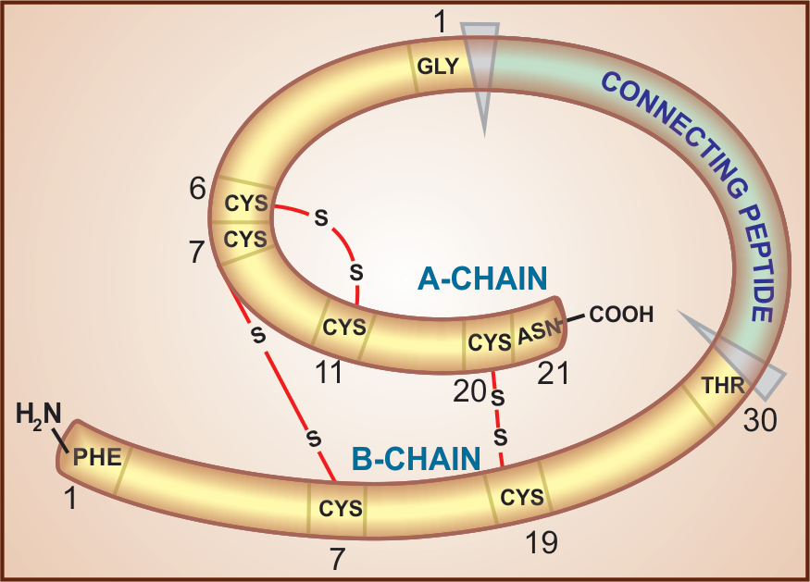
Human proinsulin; connecting peptide, having 35 amino acids, is split off leaving insulin molecule with two chains joined by two disulfide bridges

Slide 9
Regulation of insulin secretion:
Insulin secretion from β cells - regulated by chemical, hormonal & neural mechanism
Chemical : β cells have glucose sensing mechanism
Entry of glucose into β cells
↓
Inhibition of ATP sensitive K+ channels
↓
Partial depolarization of β cells
↓
Increase in intracellular Ca2+ availability
↓
Exocytotic release of insulin storing granules

Slide 10
Hormonal control: Different cells of pancreatic islets secretes different hormones
The α cells secrete glucagon
The δ cells elaborating somatostatin
• Somatostatin inhibits release of both insulin and glucagon.
Glucagon evokes release of insulin as well as somatostatin.
Insulin inhibits glucagon secretion.
Amylin, another β cell polypeptide released with insulin, inhibits glucagon secretion through a central site of action in the brain.
The three hormones released from closely situated cells influence each other’s secretion

Slide 11
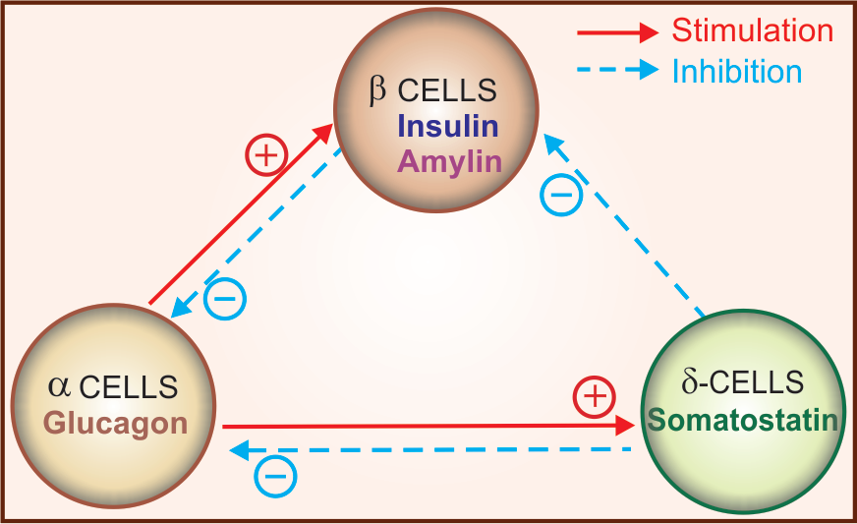

Slide 12
Neural : The islets are richly supplied by sympathetic and vagal nerves.
Adrenergic α2 receptor activation decreases insulin release (predominant) by inhibiting β cell adenylyl cyclase.
Adrenergic β2 stimulation increases insulin release (less prominent) by stimulating β cell adenylyl cyclase.
Cholinergic—muscarinic activation by ACh or vagal stimulation causes insulin secretion through IP3/DAG-increased intracellular Ca2+ in the β cells

Slide 13
The primary central site of regulation of insulin secretion is in the hypothalamus:
stimulation of ventrolateral nuclei evokes insulin release,
Whereas, stimulation of ventromedial nuclei has the opposite effect

Slide 14
Actions of Insulin:
Meal derived glucose, amino acids, fatty acids & fuel storage
Major anabolic hormone- Synthesis of glycogen, lipids & proteins
Facilitates glucose transport across cell membrane- Skeletal muscle & fats. Liver, brain, RBC, WBC and renal medullary cells are independent
Intracellular utilization of glucose - phosphorylation to form Glucose-6-PO4- increased production of glucokinase, also glycogen synthase
Inhibits gluconeogenesis from protein, free fatty acids & glycerol by decreasing synthesis of ( gene mediated) phosphophenol pyruvate carboxykinase

Slide 15
4. Inhibits lipolysis in adipose tissues- favour triglyceride synthesis
In diabetes, increased free fatty acids & glycerol- ketone bodies
5. Facilitates amino acid entry & their synthesis to protein- also inhibits protein breakdown in muscles & other cells.
In absence of insulin excess pyruvate, glucose & urea ( Negative nitrogen balance)

Slide 16
Fate of Insulin:
Distributed only extracellularly - Given orally gets degraded in GIT
Secreted & Injected insulin metabolized in liver, kidneys & muscles
First pass metabolism- 50% of insulin passing through portal vein.
Degraded after receptor mediated internalization
Biotransformation – Sulfide bonds are reduced- Chain A & B are separated- Broken down to amino acids

Slide 17
Preparation of Insulin:
Classically – produced from beef & pork pancrease
Contains 1% (10000 ppm) other proteins - Potentially antigenic
Replaced with highly purified pork/beef insulin / recombinant human insulin/ Insulin analogues
Single peak & monocomponent insulin (MC) – proinsulin < 10 ppm - Stable, less resistance & lipodystrophy.
Notes:
Parts per million

Slide 18
Types of Insulin Preparations:
Regular ( Soluble) Insulin:
Buffered neutral pH solution unmodified insulin stabilized by small amount of zinc
Forms hexamers around zinc ions- released slowly & gradually by dilution on SC administration
Peak onset 2-3 hours & lasts for 6-8 hours
Drawbacks:
Before meals - early postprandial hyperglycemia & late postprandial hypoglycemia – injected ½ to 1 hour before
Do not provide basal level of action – interdigestive period
Slow onset of action & is not applicable for IV injection

Slide 19
Long acting – Modified or retard preparations:
Rendered insoluble - Complexed with protamine or excess zinc
Lente (Insulin-zinc suspension) 2 types
Ultralente: Large particle size, crystalline & insoluble in water- long acting
Semilente: Small particle size, amorphous- short acting
Lente: 7:3 ratio mixture
Notes:
Amorphous: having no definite shape, form or structure

Slide 20
Isophane Insulin ( Neutral Protamine Hagedorn or NPH)
Protamine added just sufficient to complex all insulin molecules
Neither are in free form - Neutral pH
On injection : Dissociate slowly- Intermediate action
Used in combination with regular insulin in 70:30 ratio or 50:50
Injected twice daily before breakfast & dinner ( Split regimen)
Available preparations:
Highly purified MC pork regular insulin
Highly purified MC pork Lente
Highly purified MC NPH
Highly purified regular insulin & isophane (30:70 ratio)

Slide 21
Human Insulin:
Same amino acid sequence as human insulin - produced by recombinant DNA technology
Prepared from Escherichia coli
Human actrapid ( Regular insulin) - 40 U/ml
Human monotard (Lente), Human insulatard (NPH)
Human mixtard (30:50), Insuman (50:50)
Advantages: More water soluble & more rapid absorption than porcine or bovine, more defined peak, Shorter duration of action

Slide 22
Insulin analogues :
Recombinant DNA technology, modified pharmacokinetic – greater stability & consistency
Insulin Lispro: Reversing Proline & lysine at B28 & B29 position- quick acting – just before meal
Insulin Aspart : B28 is replaced by aspartic acid- Mimics physiological insulin
Insulin glulisine: Replacing aspartic acid at B23 by lysine & glutamic acid replacing lysine at B 29- Continuous SC insulin infusion
Insulin glargine: Long acting- precipitates at neutral pH on SC injection- Depot created- slow dissociation- 24 hours slow blood level- Usually bed time

Slide 23
Summary of Insulin Preparations:
Short acting: Regular soluble insulin – clear appearance; 6-8 hours- can be mixed with others except glargine
Intermediate acting: Lente, NPH or Isophane- Cloudy; 20-24 hours- Regular
Long acting: Glargine & Detemir- clear; 24 hours-can not be mixed with others ( can be combined)
Rapid acting: Lispro, Aspart, Glulisine- clear; 3-5 hours- can be mixed with Regular & NPH

Slide 24
ADRs & Drug interactions:
Hypoglycemia:
Injection of large doses, missing a meal after injection, vigorous exercise
Symptoms : Sweating, anxiety, palpitation, tremor- Counter regulatory: dizziness, headache, behavioral changes, visual disturbances, hunger, fatigue, weakness, muscular incoordination etc- due to deprivation. below 40 mg/dL- seizures & coma
Treatment Glucose orally & IV- Glucagon 0.5 to1mg

Slide 25
Interactions:
Beta blockers ( beta-2 prolong hypoglycemia), Thiazide, diuretics, steroids, OC pills, Acute alcohol ingestion ( Hypoglycemia- glycogen depletion)
Lithium & aspirin ( Hypoglycemia – Enhance insulin secretion)

Slide 26
Uses of Insulin:
Purpose : Restore metabolism to normal, avoid symptoms due to hyperglycemia & glycosuria & prevent complications
Indications: Type 1 DM
Post pancreatectomy diabetes
Gestational diabetes
Type 2 DM : Not controlled by diet & exercise, failure of oral hypoglycemics, underweight, tide over crisis & complications ( Ketoacidosis)

Slide 27
Treatment :
According to requirement & convenience of each patient- by testing urine & blood glucose levels
Type1 DM: Usually 0.4 to 0.8 U/Kg/day
Target : To obtain basal control- No single daily dose of long/intermediate/short acting ones can fulfill
Multiple (2-4) injections daily of long & short acting or long acting with Oral hypoglycemics ( Meal time)
Conventionally, split mixed regimen: Mixture of regular with Lente/isophane ( 30:70 or 50:50) – before breakfast & before diner

Slide 28
Basal bolus regimen: 3-4 daily injections- a long acting (glargine) insulin before breakfast or before bedtime with 2-3 meal time injections of short rapidly acting insulin ( Lispro or Aspart)
Other uses: Diabetic ketoacidosis ( Coma), Hyperosmolar ( non-ketotic hyperglycemia) coma
Insulin resistance: Type 2 DM, Age, large body fats, pregnancy
Acute insulin resistance: Infection, trauma, surgery, stress etc
Insulin devices: Insulin Pen devices, Inhaled insulin, Insulin pumps etc

Slide 29
Diabetes Mellitus-II
Dr.Jayant Patharkar

Slide 30
Oral Hypoglycemic agents:
These drugs are effective orally
Classification:
A) Enhance insulin secretion:
1. Sulfonylureas ( KATP channel blockers)
First generation: Tolbutamide
Second generation: Glibenclamide (Glyburide)
Glipizide, Gliclazide, Glimepiride

Slide 31
2. Meglitinide analogues
Repaglinide, Nateglinide
3. Glucagon-like peptide-1 (GLP-1) receptor agonists
Exenatide, Liraglutide
4. Dipeptidyl peptidase-4 (DPP-4) inhibitors
Sitagliptin, Vildagliptin, Saxagliptin, Alogliptin, Linagliptin

Slide 32
B. Overcome insulin resistance
Biguanide (AMPK activator)
Metformin
2. Thiazolidinediones ( PPAR √ activator)
Pioglitazone
C. Miscellaneous antidiabetic drugs
α-glucosidase inhibitors
Acarbose, Miglitol, Voglibose
Notes:
peroxisome proliferator-activated receptor γ (PPAR γ)

Slide 33
2. Amylin analogue
Pramlintide
3. Dopamine –D2 receptor agonist
Bromocriptin
4. Sodium-glucose cotransport-2(SGLT-2) inhibitor
Dapagliflozin

Slide 34
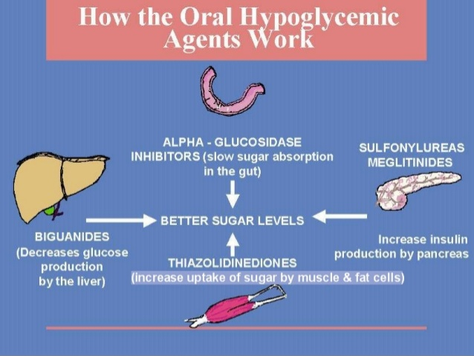

Slide 35
Sulfonylureas (K_{ATP} channel)
↓ blood glucose level
Second generation sulfonylureas used
Mechanism of action:
Stimulate release of insulin from pancreas
Rate of insulin release at any concentration of glucose increased
Thus risk of hypoglycemia at low glucose concentration also

Slide 36
The sulfonylureas (SU) block the sulfonylurea receptor (SUR1)
sulfonylurea receptor (SUR1) - ATP-sensitive K+ channel (KATP) in the membrane of pancreatic β cells blocked
outward flow of K+ ions is thereby restricted
↓
intracellular K+ concentration rises and the membrane is partially depolarized
↓
augmenting Ca2+ channel opening as well as release of Ca2+ from intracellular stores.
↓
The Ca2+ ions promote fusion of insulin containing intracellular granules with the plasma membrane
↓
exocytotic release of insulin

Slide 37
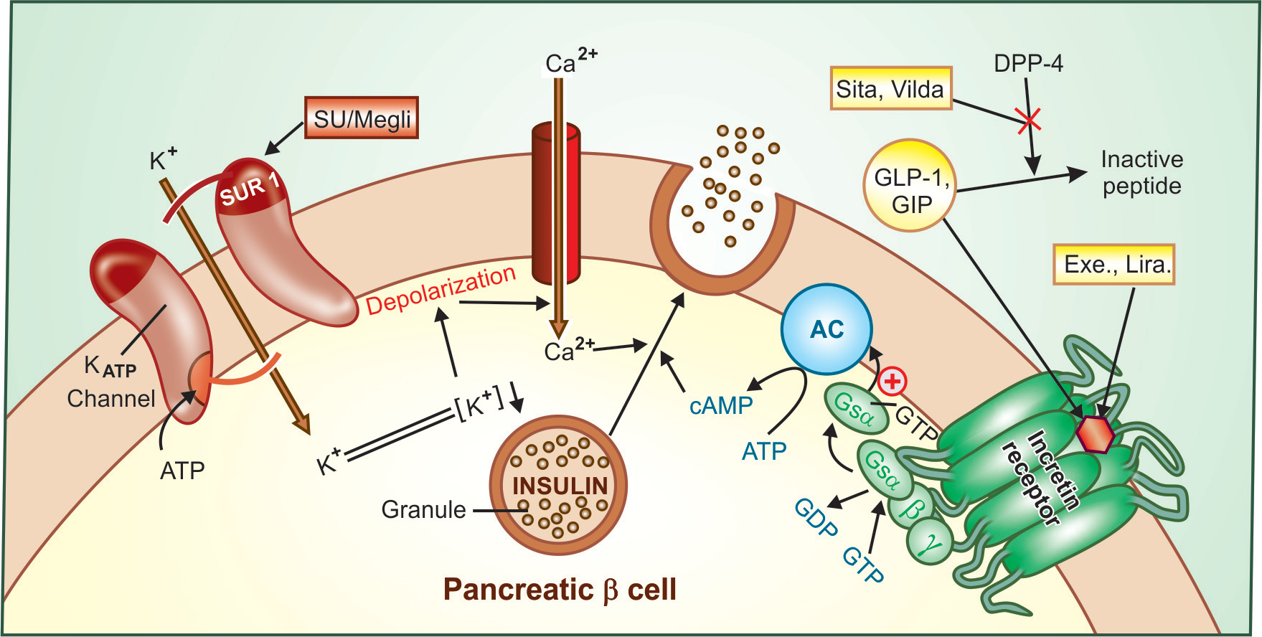

Slide 38
Extra hepatic action: Insulin releasing action of SUs decreases
This is due to down regulation of sulfonylurea receptors (SUR1) on β cells
ln this phase, they sensitize the target tissues
(especially liver) to the action of insulin
Pharmacokinetics:
Orally absorbed
90% or more plasma protein bound
Metabolites are excreted in urine

Slide 39
Drug interactions of SUs:
Drugs enhancing the SU action-
A) Displace from protein binding site- Phenylbutazone, sulfinpyrazone, salicylates, sulfonamides
B) Inhibit metabolism/ excretion- Cimetidine, ketoconazole, sulfonamides, warfarin, chloramphenicol, acute alcohol intake
C) Synergistic action- salicylates, propranolol, sympatholytic antihypertensives, lithium, theophylline, alcohol

Slide 40
Drugs that decrease SU action-
Induce metabolism- Phenobarbitone, phenytoin, rifampicin, chronic alcoholism
B) Opposite action/suppresses insulin release-corticosteroids, thiazides, furosemide, oral contraceptives

Slide 41
Adverse effects:
Hypoglycemia
Weight gain
Hypersensitivity-
rashes, photosensitivity, purpura, transient leucopenia, agranulocytosis

Slide 42
Meglitinide (K_{ATP} channel blockers) :
These have same mechanism of action as that of SUs
K_{ATP} channel blockers
Short & quick release of insulin
i.e. Repaglinide, Nateglinide
Reduce meal time hyperglycemia

Slide 43
Glucagon-like peptide-1(GLP-1) receptor agonists:
GLP-1: It is an important incretin
It is released from the gut in response to ingested glucose
It induces insulin release from pancreatic β cells
Inhibit glucagon release from α cells
Slows gastric emptying & suppresses appetite
GLP-1 induces insulin release only at high glucose concentration
Importantly they preserve β cell function in type II DM
As they are peptide inactive orally & are given by s.c. injection
i.e. Exenatide, Liraglutide

Slide 44
Dipeptidyl peptidase-4(DPP-4) resistant analogues:
GLP-1 itself is not suitable for clinical use
As it is rapidly degraded by the enzyme Dipeptidyl peptidase-4(DPP-4)
Hence, Dipeptidyl peptidase-4(DPP-4) resistant analogues have been developed
i.e. Sitagliptin, Vildagliptin, Saxagliptin
Notes:
They will reduce postprandial as well as fasting glucose

Slide 45
Dipeptidyl Peptidase-4 (DPP-4) inhibitors:
Orally acting drugs which inhibit enzyme DPP-4
Indirectly acting insulin secretagogues
They acts by preventing degradation of GLP-1 & GIP (Gastric Inhibitory Polypeptide) incretins
DPP-4 inhibitors markedly increase insulin secretion in response to ingested glucose/meal
Thus decrease postprandial hyperglycemia
i.e. Sitagliptin, vildagliptin

Slide 46
Biguanide (AMPK activator):
Metformin:
It does not cause hypoglycemia in nondiabetic subjects
It does not stimulate pancreatic β cells
It does not cause insulin release
Mechanism of action:
It causes activation of AMP-dependent protein kinase(AMPK)
Suppresses hepatic gluconeogenesis & glucose output from liver
2. Enhances insulin mediated glucose uptake in skeletal & fat cells

Slide 47
Overcomes Insulin resistance in type II DM patients
Glycogen storage in skeletal muscles
Reduced lipogenesis in adipose tissue
3) Interferes with mitochondrial respiratory chain and promotes peripheral glucose utilization through anaerobic glycolysis.

Slide 48
Adverse drug reactions:
Abdominal pain, anorexia, bloating, nausea, metallic taste, diarrhoea
Lactic acidosis: rare but serious ADR
Hence it is contraindicated in hypotensive states, heart failure, severe respiratory, hepatic & renal disease
Vit B₁₂ deficiency
Uses: First drug of choice in all type II DM patients

Slide 49
Thiazolidinedione (PPARγ agonist):
These drugs are selective agonists for nuclear peroxisome proliferator-activated receptor γ (PPAR γ)
It is expressed in fat cells
It enhances GLUT4 expression & translocation
Thus entry of glucose in fat & muscle cells improved
It has ability to reverse insulin resistance
i.e. Pioglitazone

Slide 50
Adverse drug reactions:
Plasma volume expansion, edema, weight gain, headache, myalgia
CHF is precipitated
It is contraindicated in liver disease & CHF
Drug interactions: Failure of oral contraceptives during Pioglitazone therapy
Ketoconazole inhibit & rifampin induces metabolism of Pioglitazone

Slide 51
α Glucosidase inhibitors:
Acarbose: It reversibly inhibits α-glucosidase
α-glucosidase is an enzyme required for digestion of carbohydrate in the brush border of small intestine mucosa
It also slows down digestion & absorption of polysaccharides & sucrose
GLP-1 release is promoted
It reduces postprandial glycaemia
Other drugs miglitol, Voglibose

Slide 52
Sodium-glucose co-transport-2(SGLT2)inhibitor:
SGLT-2 transport: As glucose filtered at glomerulus is reabsorbed in the proximal tubule
Inhibition of this transport causes glycosuria & lowers blood glucose in type II DM
It also induces weight loss
i.e. Dapagliflozin

Slide 53
Role of oral hypoglycemic only in type II DM:
1.Age above 40 years at the onset of disease
2.Obesity at the time of presentation
3.Duration of disease < 5 years when starting treatment
4. Fasting blood sugar < 200 mg/dL
5. Insulin requirement < 40 U/day
6. No ketoacidosis or history of it or any other complication

Slide 54
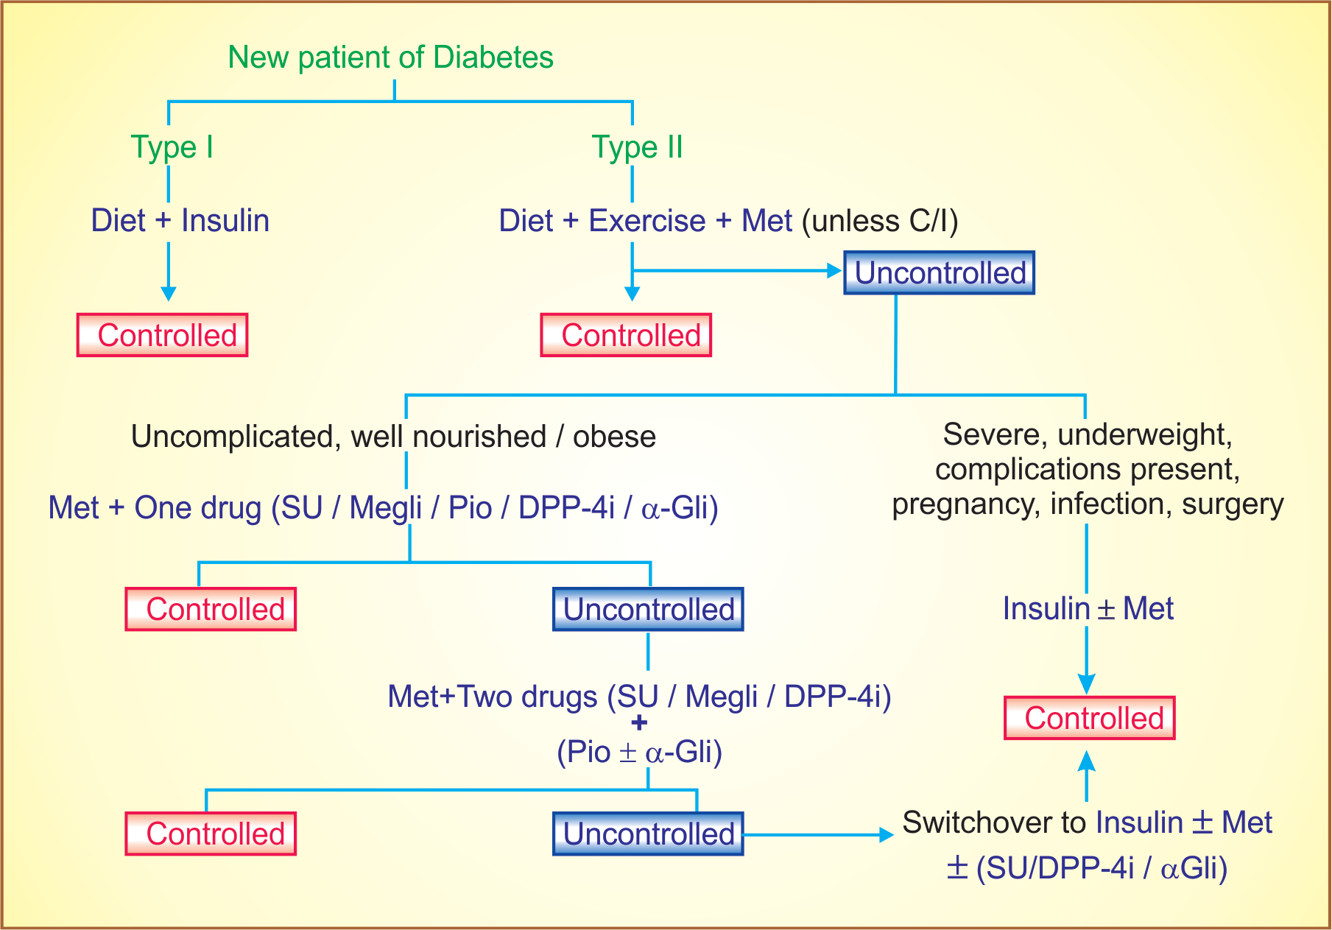

Slide 55
MCQs

Slide 56
Q 1. This is true about diabetes mellitus
A) hyperglycaemia
B) glycosuria
C) negative nitrogen balance
D) All of the above

Slide 57
Q 2. This not true about Type II diabetes mellitus
Insulin dependent diabetes mellitus
B) No or less destruction of β cells of pancreatic islets
C) No circulating antibodies found against pancreatic β cells
D)Very common > 90% cases are Type II DM

Slide 58
Q 3. These are actions of Insulin
Glucose transport across the cell
Glucose utilization intracellularly
Anabolic hormone- synthesis of glycogen, lipids & proteins
All of the above

Slide 59
Q 4. This is long acting insulin
Insulin glargine
Insulin lispro
Human insulin
Insulin aspart

Slide 60
Q 5. These are adverse effects of insulin
Hypoglycemia
Lipodystrophy
Allergic reactions
All of the above

Slide 61
Q 1. This is true about Sulfonylureas
Stimulate release of insulin from pancreas
B) Rate of insulin release at any concentration of glucose increased
C) Both A & B are correct
D) None of the above

Slide 62
Q 2. This not ADR of Sulfonylureas
Weight gain
Hypoglycemia
Lactic acidosis
All of the above

Slide 63
Q 3. This is DPP-4 inhibitor
A) Exenatide
B) Liraglutide
C) Saxagliptin
D) None of the above

Slide 64
Q 4. Metformin acts by following mechanisms
Suppresses hepatic gluconeogenesis & glucose output from liver
B) Enhances insulin mediated glucose uptake in skeletal & fat cells
C) Reduced lipogenesis in adipose tissue
D) All of the above

Slide 65
Q 5. These are adverse effect of Metformin except
Weight gain
Lactic acidosis
Vit B₁₂ deficiency
Abdominal pain

