Slide 1
BONE MARROW & HEMOPOIESIS
DR SHALINI RANJAN

Slide 2
BONE MARROW
It is the site of Normal Hemopoiesis after Birth
Hemopoiesis/Hematopoiesis = Active Process of Formation of Blood Cells that maintains the Normal number of Blood Cells in Peripheral blood & also responds to the Increased demands in situations like Hemorrhage or Infections
Bone Marrow contains a range of Hemopoietic Precursor cells & a Storage pool of Mature Cells for their release into peripheral circulation

Slide 3
All Blood Cells are derived from the Pluripotent Stem Cells,referred to as “Hematopoietic Stem Cells (HSCs)”
HSCs sustain life long production of all Blood Lineages
HSCs maintain Homeostasis of Blood Cells by generating numerous RBCs,WBCs & Platelets needed everyday

Slide 4
Types of Bone Marrow :-
3 types :-
Red Marrow
Yellow Marrow
White Marrow

Slide 5
Red Marrow :-
Active Marrow
Red in Color
Consists of many Blood Vessels containing---
    Sinusoidal Capillaries (Vascular Sinuses)
    Marrow Stroma

Slide 6
Marrow Stroma:-
Consists of a Network of Sinuses
Sinuses originate at Endosteum,from Cortical capillaries & terminate into Systemic Circulation via Collecting vessels
Hematopoiesis occurs in Intersinus Spaces

Slide 7
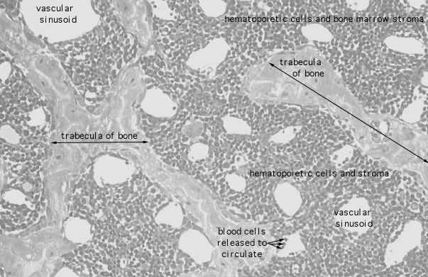

Slide 8
Red Bone Marrow is present in almost all bones of the body at birth
But with advancing age,Red Marrow is replaced by fatty tissues & becomes inactive
At 20-30 yrs of age, Red marrow of Long bones cease to produce Blood Cells
After the age of 30 yrs ,Active Red Marrow is restricted to Membranous bones like Skull,Vertebrae,Ribs,Sternum & Pelvic & Pectoral Girdles

Slide 9
Yellow Marrow :-
It contains Less Blood Vessels & More fat cells & fibro-fatty tissues
Yellow bone marrow is located in the cavities of long/limb bones.
It doesnot participate in Hemopoiesis
Ex:- Marrow of Bones of Hand,Feet,Legs & Arms at 20 yrs of Age
Yellow marrow can revert back to hemopoietically active Red Marrow when prolonged demand exists as in Chronic Hemolytic Anemia

Slide 10
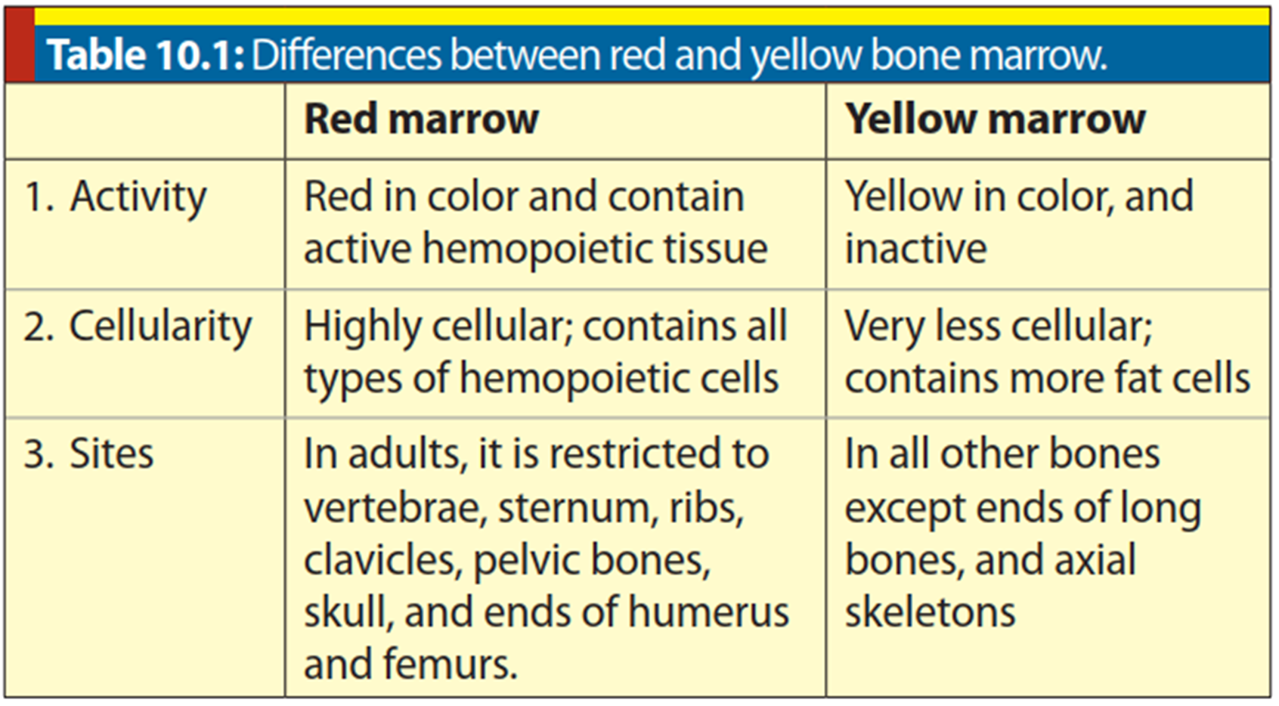

Slide 11
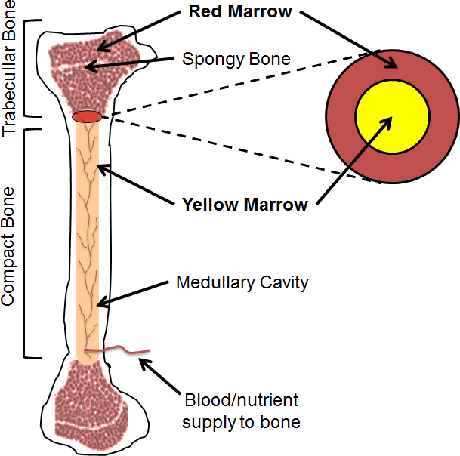

Slide 12
White Marrow
In very old persons,there is a Gelatinous transformation of Fat to Mucoid material in Bone Marrow,which is referred to as “White Marrow”

Slide 13
BONE MARROW EXAMINATION

Slide 14
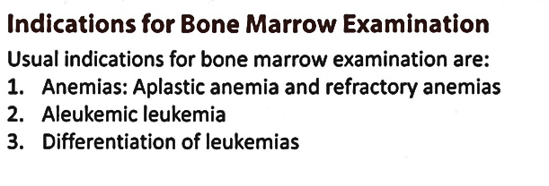
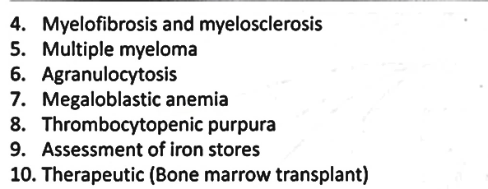
Bone Marrow Examination is indicated in Complex Hematological Disorders & Malignant Hematological Conditions
These Clinical Conditions require Detailed Analysis of Cellularity & Activity of Marrow

Slide 15
Bone Marrow Examination gives the following assessments---
1.Cellularity of Marrow
2.Myeloid-Erythroid Ratio
3.State of Erythropoiesis,Myelopoiesis & Megakaryopoiesis
4.Number of Lymphocytes
5.Plasma Cells
6.Other Cells-Metastatic Tumor Cells,Parasites,Fungus etc
7.Evaluation of Iron Stores

Slide 16
Bone Marrow Transplantation (BMT) :-
Process of Collection & Infusion of Hematopoietic Stem Cells obtained from the Bone Marrow into the Bone Marrow/Peripheral Blood,of either of the other Individuals or of the own Hematopoietic Stem Cells (HSCs)

Slide 17
ERYTHROPOIESIS
The process of Development, Maturation & Release of Red blood cells into the Circulation is called Erythropoiesis.
RBCs have a finite life span of about 120 days.
Bone marrow precisely replaces the red cells lost by senescence, hemorrhage or destruction.

Slide 18
SITES & STAGES OF ERYTHROPOIESIS
There are three stages of erythropoiesis
  Mesoblastic,
  Hepatic and
  Medullary

Slide 19
Mesoblastic Stage
During Early Embryonic life, erythropoiesis takes place in the mesoderm of yolk sac .This is called mesoblastic stage.
Hepatic Stage
From the 5th week to 5th month of gestation, erythropoiesis takes place in the liver and spleen (hepatic stage).

Slide 20
Medullary Stage
From the 5th month of intrauterine life till whole life, the bone marrow starts forming red cells (medullary stage).
However, erythropoiesis in bone marrow is very slow in second trimester.
Medullary erythropoiesis becomes more effective towards end of third trimester. After birth, bone marrow becomes the sole site of erythropoiesis.
Extramedullary erythropoiesis in postnatal life is always considered abnormal

Slide 21
From Birth Till adolescent period, marrow cavity of all bones are involved in Erythropoiesis,
After Adolescence Erythropoiesis regresses in the limb bones. (Long Bones)
After the age of 20–30 years, erythropoiesis is mostly limited to Membranous Bones--Sternum, ribs, vertebrae, skull, pelvic and pectoral girdles

Slide 22
STEPS OF ERYTHROPOIESIS
There are four major steps of erythropoiesis:
  Stem cells,
  Progenitor cells,
  Precursor cells and
  Mature cells

Slide 23
In general, during erythropoiesis, following cellular changes take place:
Cell size progressively reduces.
Size of nucleus and number of nucleoli decreases, chromatin material condenses and finally nucleus disappears.
Staining reaction of cytoplasm changes from deep basophilic to polychromatophilic (acidophilic plus basophilic) and finally to acidophilic type.This occurs mainly due to gradual reduction in quantity of RNA material.

Slide 24
I.STEM CELLS
A) Pluripotent Stem Cells
Pluripotent stem cells are the mother stem cells that form stem cells for different cell lines.
Stem cells have two unique properties:
1. Self renewal
  They have the capacity to renew themselves. Therefore, at no time bone marrow is depleted of the stem cells.
2. Differentiation.
  They have the capacity to develop (differentiate) into the subsequent progenitor cells.

Slide 25
B) Committed Stem Cell
These cells develop from pluripotent stem cells.
There are specific two categories of stem cells: Stem cells for Myeloid series and Stem Cells for Lymphoid series.
Myeloid stem cells form erythroid series, megakaryoid series, monocytic series and granulocytic series .
Stem cells for Erythroid Series give rise to progenitor cells for Erythroid cell lines.
There are two progenitor cells:
  BFU-E and
  CFU-E

Slide 26
2.PROGENITOR CELLS
There are two types of progenitor cells:
1) BFU-E and
2) CFU-E.
The BFU-E and CFU-E develop from a common progenitor CFU-Mg/E

Slide 27
BFUs-E are burst forming units-erythroid progenitor cells that give rise to large number of CFU-erythroid cells.
CFUs-E are colony forming units-erythroid progenitor cells that give rise to moderate number of blast cells of erythrocytic series.
Thus, BFU-E forms CFU-E, which in turn forms blast cells (erythroblasts).

Slide 28
3.PRECURSOR CELLS
The precursors for erythrocytes are called Erythroblasts/ Normoblasts.
Normoblasts develop from Pronormoblasts.
There are three successive forms of
Normoblasts: Early, Intermediate and Late

Slide 29
PRONORMOBLAST
Pronormoblasts (proerythroblast) are the first blast cells to appear in bone marrow and the first identifiable cells of erythrocyte series.
CHARACTERISTICS:-
SIZE= 15–20 μm in Dia. SHAPE= Irregularly rounded or slightly oval.
CYTOPLASM
The cytoplasm is less in amount, occupies about 20% of the cell. Presence of high concentration of polyribosomes makes the cytoplasm intensely basophilic.
Cytoplasm has high content of RNA, which indicates vigorous protein synthesis in the cell.

Slide 30
NUCLEUS
The nucleus is large and occupies 80% of the cell. It contains multiple nucleoli.
Mitosis is present.
HEMOGLOBIN
Hemoglobin is not yet formed in the cell.

Slide 31
EARLY NORMOBLAST (BASOPHILIC ERYTHROBLAST)
CHARACTERISTICS:-
SIZE= 12-18 μm in Dia; ACTIVE MITOSIS
CYTOPLASM
Cytoplasm is scanty, deep blue and basophilic. The basophilic cytoplasm is due to continuation of many polyribosomes in it.

Slide 32
NUCLEUS
  Nucleus is large and occupies three-fourth of the cell area.
  Nucleus is composed of dark violet heterochromatin clumps
  interspersed with pink clumps of euchromatin.
  The chromatins are connected by linear strands. This often
  gives nucleus the appearance of wheel spokes.
HEMOGLOBIN
Hemoglobin appears for the first time in Early Normoblasts in erythropoiesis.

Slide 33
INTERMEDIATE NORMOBLAST (POLYCHROMATIC ERYTHROBLAST)
CHARACTERISTICS:-
SIZE=10–15 µm in Dia
CYTOPLASM
The cytoplasm changes from blue to pink as hemoglobin dilutes the polyribosome content.
NUCLEUS
Nucleus is small and occupies about half of the cell area. The distribution of heterochromatin clumps in nucleus gives the appearance of checkerboard pattern. There are no nucleoli.

Slide 34
HEMOGLOBIN
Hemoglobin synthesis increases, which makes the cell acidophilic. The presence of RNA material makes the cytoplasm basophilic.
Thus, mixture of acidophilic hemoglobin and basophilic RNA in cytoplasm makes it polychromatic.

Slide 35
LATE NORMOBLAST (ORTHOCHROMATIC ERYTHROBLAST)
CHARACTERISTICS:-
SIZE= 7-12 μm in Dia; NO MITOSIS
CYTOPLASM
Cytoplasm is deeply eosinophilic giving the appearance of an orthochromatic cell.

Slide 36
NUCLEUS
Nucleus is small and pyknotic at the beginning.
Sometimes, dark nuclear chromatin materials are arranged in a typical pattern to give the appearance of a cart-wheel.
Finally, the pyknotic nucleus disintegrates.
HEMOGLOBIN
Hemoglobin synthesis increases and almost completes in this stage.

Slide 37
4.MATURE CELLS
Reticulocytes
Reticulocytes are the immediate precursors of red cells. Therefore, they are also called as Juvenile red cells.
They are mature cells with full complement of hemoglobin.
They are slightly larger than red cells.
They have a network of reticular nuclear material. The reticular network is nothing but the remnants of disintegrated organelles, and especially of the nuclear fragments.
Due to the presence of reticular network, the cells are called reticulocytes.
The reticulum is stained by Supravital stains.
The Normal Reticulocyte count is 0–1 per cent of red cells in adults

Slide 38
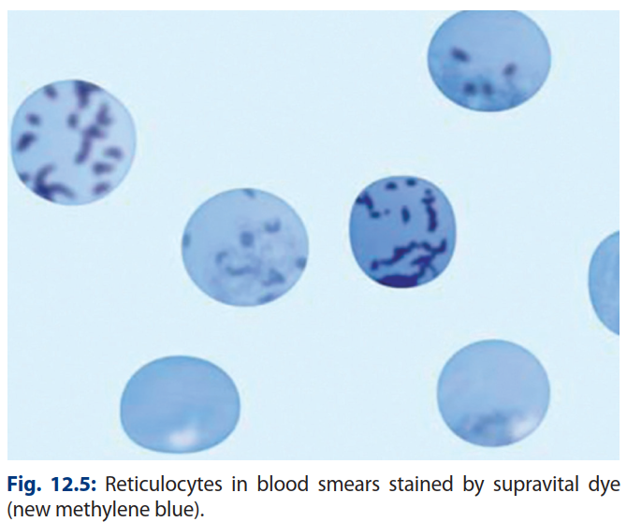

Slide 39
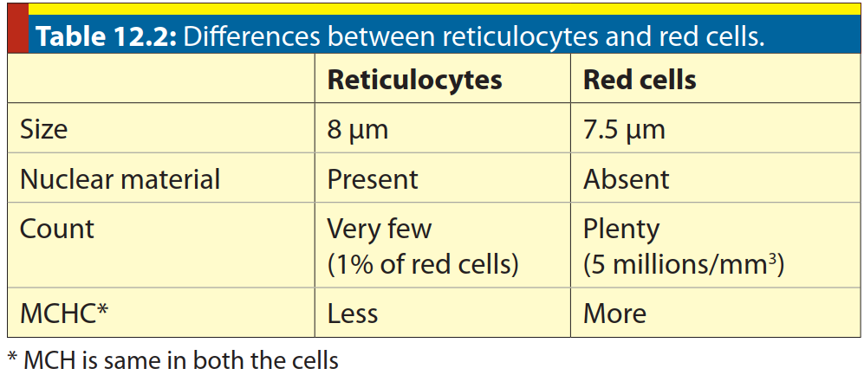

Slide 40
Reticulocyte Response
The reticulocyte count is performed to assess the therapeutic response of anemias to treatment in which the patient is deficient in one of the substrates essential for the synthesis of red cells.
Therapy begins, new red cells are formed and released rapidly into the circulation before cells are fully matured. Therefore, many reticulocytes are also released with the release of young red cells.
This results in increase in Reticulocyte Count, which is called Reticulocyte response.
Reticulocyte response indicates a favorable response to treatment.
This is typically observed at the beginning of treatment for Megaloblastic anemia and Iron deficiency anemia.

Slide 41
Erythrocytes
    Erythrocytes are the final cells in erythropoiesis.
    They are biconcave discs.
    They have the diameter of about 7.5 µm

Slide 42
Pluripotent Stem Cells
Myeloid Stem Cell
CFU-GEMM
CFU-Mg/E
BFU-E
Progenitor Cells
Stem Cells
CFU-E
Pronormoblasts
Early Normoblasts
Precursor Cells
Intermediate Normoblasts
Late Normoblasts
Reticulocytes
Mature Cells
Erythrocytes

Slide 43
DURATION OF ERYTHROPOIESIS
The total period for erythropoiesis occurs in 7 to 9 days.

Slide 44
REGULATION OF ERYTHROPOIESIS

Slide 45
A.HORMONAL FACTORS
1.ERYTHROPOIETIN
Source
Erythropoietin is produced mainly by the interstitial cells in peritubular capillary bed of kidney.
To some extent, it is also produced by juxtaglomerular cells and extraglomerular mesangial cells of kidney.
Kidney secretes about 85% of erythropoietin.
The rest 15% comes from liver.

Slide 46
Functions
Erythropoietin stimulates erythropoiesis in several ways.

Slide 47
Regulation of Erythropoietin (Ep) Production
Factors that increase Ep production:
Hypoxia, low blood volume, anemia, lung diseases and hormones like epinephrine, nor-epinephrine, androgen, thyroxine, prolactin, ACTH etc.
Factors that decrease Ep production:
Estrogen inhibits erythropoiesis.

Slide 48
2.ANDROGENS
Androgens stimulate erythropoiesis.
This is the major cause of higher red cell count & Hb in males than in females.

Slide 49
3.ESTROGENS
Estrogens inhibit erythropoiesis.
This is the reason why females have low RBC Count & low Hb as compared to males apart from menstrual blood loss every month

Slide 50
4.THYROXINE, CORTISOL AND GROWTH HORMONE
Thyroxine stimulates erythropoiesis.
Growth hormone increases the mitosis and maturation of erythroid precursors.
Cortisol produces mild erythrocytosis.

Slide 51
5.INTERLEUKINS AND GM-CSF
Interleukin 1, 3 and 5
GM-CSF (granulocyte-macrophage colony stimulating factor)

Slide 52
B.DIETARY FACTORS
1.Iron
Iron is the raw material for synthesis of heme component of hemoglobin.
Therefore, iron deficiency results in hypochromic microcytic anemia.

Slide 53
2.VITAMIN B₁₂ AND FOLIC ACID
These two vitamins are necessary for maturation of red cell precursors as they promote DNA synthesis.
For synthesis of DNA, thymine is required and tetrahydrofolate is necessary for thymine synthesis, which is formed from folic acid.
Therefore, folate deficiency leads to arrest of mitosis and chromosome division in the absence of DNA synthesis.

Slide 54
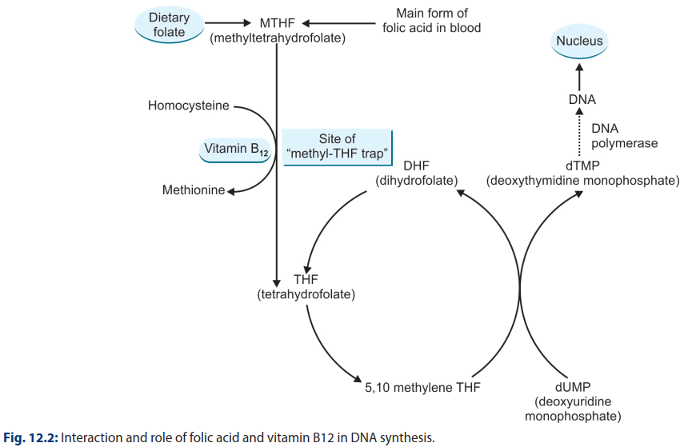

Slide 55
Vitamin B₁₂promotes conversion of methyl-tetrahydrofolate to its active tetrahydrofolate (THF) form. Methyl-THF accumulates in the cell, which is known as methyl-THF trap.
Therefore, vitamin B₁₂deficiency also causes arrest of chromosomal division.
In fact, folic acid and vitamin B₁₂interact with each other for synthesis of DNA.
Thus, in deficiencies of these two vitamins, megaloblasts are produced in the bone marrow instead of normoblasts.Therefore, the resulting anemia is called megaloblastic anemia.
Megaloblasts produce macrocytes that manifest as macrocytic anemia.

Slide 56
3.Protein
Protein is essential for synthesis of globin component of hemoglobin. Therefore, protein deficiency is invariably associated with hypochromic anemia.
4.Other Nutritional Factors
Vitamin C helps in absorption of iron. Therefore, vitamin C deficiency causes anemia.
Minerals like copper and cobalt influence hemoglobin formation. Thus, deficiency of these minerals leads to anemia.

Slide 57
C.OTHER FACTORS
1.Intrinsic factor
Intrinsic factor is secreted from Oxyntic cells of stomach along with hydrochloric acid.
It helps in absorption of Vitamin B12 (Extrinsic factor of Castle) from terminal part of ileum.
Intrinsic factor deficiency produces megaloblastic anemia (Pernicious anemia).

Slide 58
2.Environmental Factors
Hypoxia due to any cause increases erythropoiesis by increasing erythropoietin production.
Common physiological cause of hypoxia is high altitude.
Hypoxia occurs at high altitude due to decreased oxygen content in the Atmospheric Air that decreases oxygen availability to tissues.
Pathological causes of hypoxia are, anemia, low blood volume, cardiac diseases that decrease tissue blood flow as occurs in heart failure, and respiratory diseases

Slide 59
3.Drugs and Chemicals
Vasoconstrictor agents like catecholamines,
Nucleotides like cAMP, NAD, NADP,
Products of red cell destruction (hemolysates) Stimulate erythropoiesis.
Cobalt salts and
Thyroxine

