Slide 1
Red Blood Cells
DR SHALINI RANJAN

Slide 2
Red Blood Cells are named as “Erythrocytes” as “Erythros” means Red
RBCs appear red in a stained smear of peripheral blood
The Red Color of RBCs is due to the presence of Hemoglobin that accounts for 90% of weight of Red Cells
In a stained smear,the Central part of Red Cells is pale like a Halo & Peripheral part is more red as Red Cells are thick peripherally & thin at the center
Red Cells are the Major Cellular Elements of Blood & transport O2 from Lungs to tissues & CO2 from tissues to Lung

Slide 3
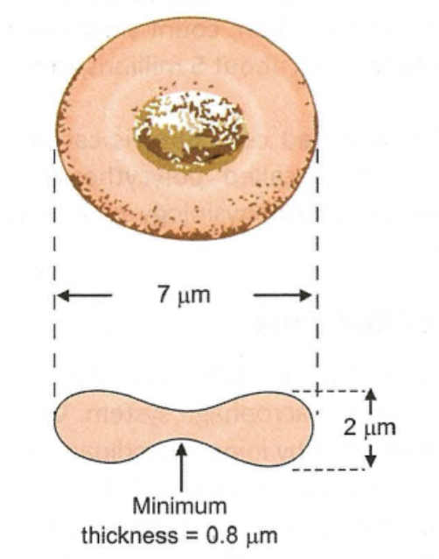
Structure :-
Non-nucleated
Biconcave Disc (Exchange of O2 & CO2 is maximal with Biconcave
Configuration)
Diameter =7.5 μm (7 to 8 μm)
Thickness=2 μm at the Periphery
=1 μm at the Center
Surface Area = 140 μm²
Volume = 87μm³ (78 to 94 μm³)

Slide 4
Composition :-
Water 62.5%
Hemoglobin=35%
Other=2.5% ---Glucose
  ---Lipids-Cephalin,Cholesterol & Lecithin
  ---Proteins-Glutathiones,Albumin
  ---Enzymes-Glycolytic Enzymes,Carbonic anhydrase &
  Catalase

Slide 5
Red Cell Count :-
Adult males -----4.5-6 millions/cu mm of Blood
Adult females---4-5.5 millions/cu mm of Blood
Newborns ---6-8 millions/cu mm of Blood (d/t Hemoconcentration)
Children ---3-5 millions/cu mm of Blood
Decrease in RBC Count ----Anemia
Increase in RBC Count ----Polycythemia/Erythrocytosis

Slide 6
Life Span of Red Cells :-
Usual Life =120 Days
Aged red cells are destroyed by tissue macrophage system

Slide 7
Abnormal Red Cells :-
Based on Size---
Normocyte– If Red cells volume=Normal=87μm³ (78 to 94 μm³)
Discocyte– Normal Red Cell which is a smooth,biconcave disc
Microcyte---If Red Cell Volume=Less than Normal
---Ex-Iron deficiency Anemia
Macrocyte--If Red Cell Volume=More than Normal
--Ex-Megaloblastic Anemia
Anisocytes—Red cells are of different sizes

Slide 8
Based on Colour :-
Normochromic Cells—Red Cells with Normal Red Colour appearance
Hypochromic Cells---
Red Cells with pale appearance due to decreased Hemoglobin Concentration or Abnormal thinning of red cells
Ex-Iron Deficiency Anemia

Slide 9
Based on Shape ---
Poikilocytes- Red Cells are of different shapes
- Usually seen when older cells are circulating in Blood
Spherocytes-
Red Cells assuming a Spherical shape instead of Biconcave Shape
Ex-Hereditary Spherocytosis
Elliptocyte-
Red Cells assuming a Oval Shape
Ex-Hereditary Elliptocytosis,Thalassemia,IDA

Slide 10
Red Cell Membrane :-
Red Cell Membrane is the most thoroughly studied biological membrane due to its easy accessibility
Made up of 3 Major structural elements :-
  Lipid Bilayer
  Integral Proteins
  Membrane Skeleton

Slide 11
Lipid Bilayer :-
Composed of Phospholipid & Cholesterol
Impermeable Barrier between Cytoplasm & External Environment
Helps to maintain a slippery exterior, so that RBCs don’t stick to the Vascular endothelium

Slide 12
Integral Proteins-
Embedded in Lipid Bilayer
Imp Membrane Proteins---Band-3 protein (Anion Exchanger-1)
---Glycophorins
---Rh D protein
---Various Ion Channels
Functions :-
Allow Red cells to participate in wide range of functions like-
  Antigenic Determination
  Cellular Metabolism

Slide 13
Membrane Skeleton
It is present on the Internal side of the Red Cell Membrane
2 Important proteins present in it ---Ankyrin
---Spectrin
Ankyrin---
An Asymmetric Polar Protein
Provides Primary Linkage between Membrane Skeleton & Lipid Bilayer
Disruption of this linkage decreases Membrane Stability
Abnormalities of Ankyrin is the most common cause of Hereditary Spherocytosis

Slide 14
Spectrin :-
Most Abundant Membrane Skeletal Protein
Constitutes 75% of the Mass of Membrane Skeleton
Composed of 2 subunits: α and β
The αβ heterodimers align & intertwine with each other in antiparallel fashion to form flexible rod like structure
These dimers further self-associate to form tetramers

Slide 15
Tetramers are composed of Multiple repeats
They provide a strong elastic filament to overlying cell membrane via formation of lattice-like meshwork linked to Integral Membrane Proteins
Functions of Spectrin :-
Maintain Cellular Shape
Provide Structural Support to Membrane lipid Bilayer
Regulate Lateral mobility of Integral Membrane proteins
Defect in Association of αβ heterodimers leads to---
  Hereditary Elliptocytosis
  Poikilocytosis

Slide 16
Common Membrane Defects :-
Ankyrin & Spectrin provide ---
    Biconcave Shape to RBCs
    Deformability to RBCs
    Membrane Stability to RBCs
    Durability to RBCs
Deficiency of Ankyrin & Spectrin results in Membrane Defects like---
Spherocytosis
Elliptocytosis These defects make the cells so rigid that they
Poikilocytosis are destroyed prematurely

Slide 17
Metabolism of Red Cells :-
Lack Nuclei,Mitochondria & Ribosomes.So, not adequate synthesis of Proteins & Lipids
Glucose=Primary fuel,Main Source for Energy Supply
Glycolytic Enzymes are present but TCA Cycle Enzymes are Absent
So, Glycolysis is used to oxidize Glucose anaerobically to gain ATP
90% Glucose oxidized by Glycolysis
HMP Shunt provides NADPH. 10% Glucose oxidized by HMP Shunt
Glucose entry into RBC is independent of Insulin.Glucose enters via Facilitated Diffusion

Slide 18
NADPH (Nicotinamide Adenine Dinucleotide Phosphate Hydrogen)is a good reducing agent. The H atom can be easily given out, so that it reduces other compounds like Glutathione in RBCs
Glutathione (GSH) is a ubiquitous, redox active, small molecule that is critical to cellular and organism health.
Reduced glutathione (GSH) is considered to be one of the most important scavengers of reactive oxygen species (ROS)

Slide 19
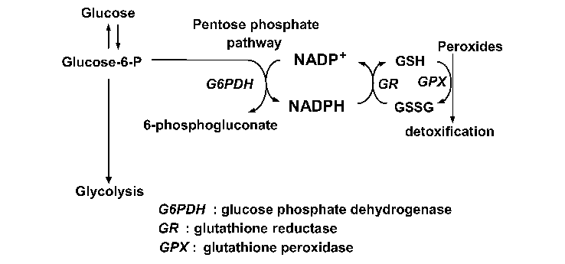
Continuous Exposure of RBC to ROS in Blood
HMP SHUNT

Slide 20
G-6-PD is the sole contributor of NADPH as there is no mitochondria in RBCs
In the absence of G-6-PD,which is an Inborn Error of Metabolism , red cells are more susceptible to Oxidative Damage
Hence , Hemolytic Anemia is Common in G-6-PD deficiency.
Especially ,Hemolysis is facilitated on Exposure to Anti-Malarial Drugs & Certain Sulpha Drugs having high Redox Potential
As G6PD deficiency leads to increased oxidative stress in red blood cells, this may in turn have a negative influence on the parasite. As such, individuals who possess this mutation have Natural Resistance against Malaria

Slide 21
Functions of Red Cells :-
Transport of O2 from Lungs to the tissue via Hemoglobin
Transport of Co2 from tissues to Lungs via Hemoglobin
Maintenance of Acid Base Balance as Hemoglobin is an important buffer of Blood
Red Cells contribute to 50% of Viscosity of Blood
Antigen on RBC Membrane helps in Blood Group Classification

Slide 22
Applied Aspects

Slide 23
Red Cell Fragility :-
Tendency of the cells to hemolyze =Fragility
2 Types :-
Mechanical Fragility
Osmotic Fragility
Mechanical Fragility :-
Lysis of Red Cells due to Mechanical Stress & Strain
Red Cell Diameter is slightly more than the Diameter of Avg Capillaries
When Red Cells pass through capillaries & splenic pulp,the membrane undergoes Mechanical Stress

Slide 24
On an Avg,a Red Cell passes about 3 lakh times through capillaries during its life span,which makes the cell more fragile
When Red cells become older,their membrane becomes rigid which make cell vulnerable to rupture
Red cell Memb. Defects increase Mechanical Fragility

Slide 25
Osmotic Fragility :-
Lysis of Red Cells on Exposure to different Osmotic Solutions
Assesses the Integrity of RBC Memb.
It helps in Diagnosis of Anemia in which physical properties of RBCs are altered.
It detects whether or not the Red Cells can be easily hemolyzed

Slide 26
In an Isotonic Solution,the Solution of Equal Concentration as that of Red Cell Content------
The Red Cells remain Intact
Such a solution has the same tonicity as that of Plasma
Ex-0.9% Nacl,5% Glucose,10% Mannitol & 20% Urea
In a Hypertonic Solution,a Solution with Tonicity >0.9% Nacl-----
RBCs Shrink due to loss of Water from them by Exosmosis
In Hypotonic Solutions (Tonicity < 0.9% Nacl)---
Red Cells absorb Water by Endosmosis which results in Swelling & Rupture of RBCs

Slide 27
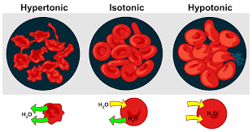

Slide 28
Conditions of Decreased Fragility :-
Iron Deficiency Anemia
Thalassemia
Sickle Cell Anemia
Obstructive Jaundice
Post-Splenectomy

Slide 29
Conditions of Increased Fragility :-
Hereditary Spherocytosis
Congenital Hemolytic Anemia
Other Conditions where Spherocytes are found in Blood

Slide 30
Packed Cell Volume

Slide 31
PACKED CELL VOLUME (PCV)/ HEMATOCRIT (Hct)
It is the fractional volume of blood that erythrocytes occupy
In other words,it is the amount of packed red cells following Centrifugation
When blood is centrifuged in a tube,the red cells are packed together at the bottom of the tube by centrifugal force,as red cells are heavier than the plasma
The percentage volume of the Packed Red Blood Cells gives the PCV or Hct

Slide 32
Clinical Significance of PCV :-
PCV is a reliable index of the Red Cell population. PCV provides useful info about the Red Cell mass which can be correlated with Red Cell Count & their Hemoglobin Content
PCV,RBC Count & Hb Content are essential for determination of Red Cell Indices that help in detecting & classifying the various types of anemias

Slide 33
Normal Value of PCV :-
Adult Male = 46% (40-50%)
Adult Female = 42% (37-47%)
Variations in PCV :-
PCV decreases in Conditions of Decreased Red Cell Count
PCV increases in Conditions of Increased Red Cell Count
When cells are deformed as in Spherocytosis or Sickle cell Disease,more plasma is trapped between the packed RBCs,which gives a “False High Result”

Slide 34
Erythrocyte Sedimentation Rate

Slide 35
ERYTHROCYTE SEDIMENTATION RATE (ESR)
When Blood is taken outside Body,RBCs have the property of Rouleaux formation (Piling on top of one other)
Rouleaux are heavier than the Individual RBC.
Hence,when whole blood is allowed to settle in a tube,sedimentation of RBCs is facilitated due to Rouleaux formation
The rate at which the red cells fall or sediment under the effect of gravitational force acting over rouleaux is known as “Erythrocyte Sedimentation Rate (ESR)”

Slide 36
Difference between ESR & PCV :-
In PCV,packing of red cells at the bottom of the tube is accomplished by Centrifugal Force
In ESR,columns of red cells settle by Gravitational Force

Slide 37
Factors Affecting ESR :-
Shape & Number of Red Cells
a) Shape of Red Cells—
Biconcave shape favours Rouleaux formation
Alteration of Shape of RBCs decreases Rouleaux formation
Hence,ESR is less in ●Hereditary Spherocytosis (Spherical RBCs)
●Sickle cell Anemia (Sickle shaped RBCs)

Slide 38
b) Number of Red Cells/Red Cell Mass :-
Red Cell Mass contributes to Blood Viscosity
Increase in Red Cell Mass--- Increases Viscosity---Medium becomes thick-----Slower Velocity of Fall of RBCs---Decreases ESR
Thus,ESR decreases in Polycythemia & increases in Anemia (except Sickle cell Anemia)

Slide 39
ii) Size of Rouleaux
ESR depends on the mass of the falling particles i.e the Size of Rouleaux
Larger the Size of Rouleaux,faster is the fall
Factors that increase the Size of Rouleaux facilitate ESR
Increase in Red Cell Size without change in their Shape increases the Size of Rouleaux

Slide 40
iii) Plasma Factors :-
Size & Number of Rouleaux mainly depends on the Fibrinogen Concentration of Plasma
Globulin Content of Plasma also contributes
Red Cells carry Negative Charge on their Surface.Hence,Normally they repel each other
But when Fibrinogen Conc. Increases,it neutralizes this negative charge & facilitate Rouleaux Formation

Slide 41
In some Pathological Conditions,apart from Fibrinogen, few other Plasma Factors also increase in Blood.
These are named as “Acute Phase Reactants”
They also neutralize Negative Charges on RBCs & facilitate Rouleaux formation
Hence,ESR increases in Acute Infections & Non-infective Inflammations
Ex of APRs= C reactive Protein (CRP)-Increases in Acute Rheumatic Fever
= Globulin (Abs)-Increases in malignancies & Collagen Diseases

Slide 42
iv) Other Factors :-
1.Body Temp. –Increased Temp.—Decreased Blood Viscosity-- ESR
2.Conditions where Thicker Plasma--- Rate of Sedimentation--- ESR

Slide 43
Normal Values :-
ESR is usually measured by Wintrobe & Westergren Methods
ESR is higher in females due to less RBC Count & less Hb than males
In Wintrobe Method--
Males: 0-9 mm/hr
Females : 0-20 mm/hr
In Westergren Method—
Males : 3-5 mm/hr
Females : 5-12 mm/hr

