Slide 1
Intellectual Property Rights
Trade Secrets
Commercialization of IPR
- Dr Kalpesh Zanzrukiya

Slide 2
PATENTS
  A patent is a form of intellectual property. It consists of a set of exclusive rights granted by a sovereign state to an inventor or their assignee for a limited period of time, in exchange for the public disclosure of the invention. An invention is a solution to a specific technological problem, and may be a product or a process.
COPYRIGHTS
  Copyright is a legal concept, enacted by most governments, giving the creator of an original work exclusive right to it, usually for a limited time. Generally, it is "the right to copy", but also gives the copyright holder the right to be credited for the work, to determine who may adapt the work to other forms, who may perform the work, who may financially benefit from it, and other related rights. It is a form of intellectual property (like the patent, the trademark, and the trade secret) applicable to any expressible form of an idea or information that is substantive and discrete.

Slide 3
TRADE MARKS
  A trademark, trade mark, or trade-mark is a recognizable sign, design or expression which identifies products or services of a particular source from those of others. The trademark owner can be an individual, business organization, or any legal entity. A trademark may be located on a package, a label, a voucher or on the product itself.
INDUSTRIAL DESIGNS
  An industrial design right is an intellectual property right that protects the visual design of objects that are not purely utilitarian. An industrial design consists of the creation of a shape, configuration or composition of pattern or color, or combination of pattern and color in three dimensional form containing aesthetic value. An industrial design can be a two- or three-dimensional pattern used to produce a product, industrial commodity or handicraft.

Slide 4
TRADE SECRETS
  any information having commercial value, which is not in the public domain, and for which reasonable steps have been taken to maintain its secrecy
  creative as well as innovative ideas that are unknown to other competitors to gain an edge over and maintain the uniqueness of their product/service.
  Information that isn’t known to competitors and is protected by confidentiality agreements

Slide 5
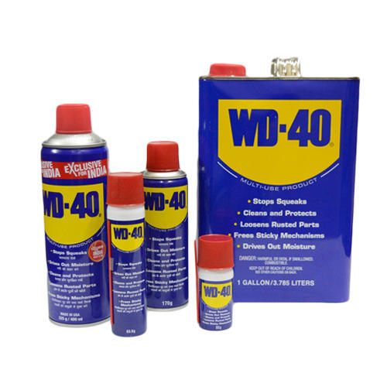
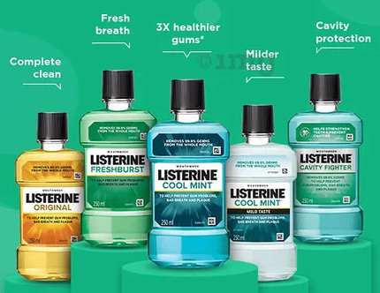
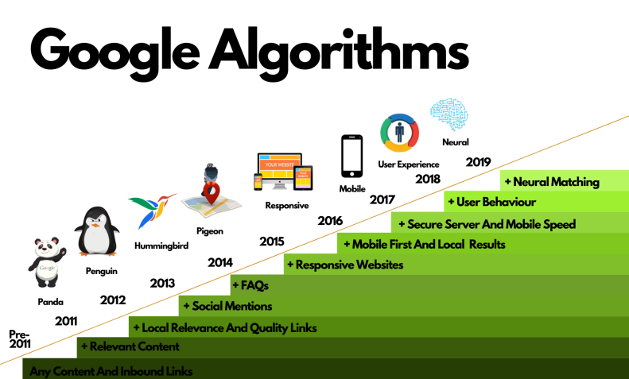


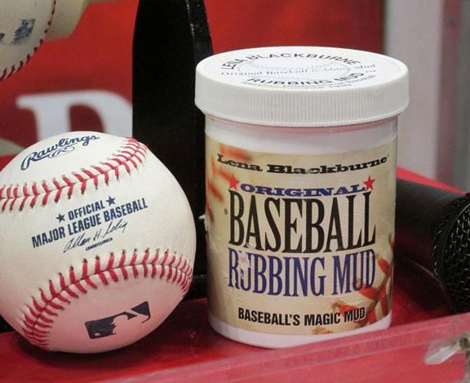
Examples

Slide 6
Laws related to IPR in India
Trade Marks Act, 1999
The Patents Act, 1970 (amended in 2005)
The Copyright Act, 1957
The Designs Act, 2000
The Geographical Indication of Goods (Registration and Protection) Act, 1999
The Protection of Plant Varieties and Farmers Rights Act, 2001
The Information Technology Act, 2000
Tort Law/ Contracts Act
IPC, CrPC

Slide 7
Laws for Trade Secret
  No specific law in India till date
  Tort or Contracts law
  National Innovation Act 2008 (Draft) by the Department of Science and Technology, GOI was the first real effort in protecting Confidential Information, trade secrets and innovation.

Slide 8
“Confidential information” is defined under Section 2 (3) of the Act as
  information, including a formula, pattern, compilation, program device, method, technique, or process, that:
  (a)is secret, is not generally known among or readily accessible to persons within the circles that normally deal with the kind of information in question;
  (b)has commercial value because it is secret; and
  (c)Has been subject to reasonable steps under the circumstances by the person lawfully in control of the information, to keep it secret.

Slide 9
Criteria for being a Trade Secret
- TRIPS agreement Article 39.2
(a)The information is not, as a body or in the precise configuration and assembly of its components, generally known among or readily accessible to persons that normally deal with the kind of information in question
(b)The information has actual or potential commercial value because it is secret
(c)The person lawfully in control of the information has taken reasonable steps under the circumstances to keep it a secret.

Slide 10
Trade Secret Infringement
(a)When any employee comes into possession of a secret or any confidential information in normal course of his work, and either carelessly or deliberately transfers that information to any unauthorized person;
(b)When any unauthorized person (may be a new employer) incites such an employee to provide him with such information as has been mentioned above; and
(c)When, under a license for the use of know-how, a licensee is in breach of a condition, either expressed in any agreement or implied from conduct, to maintain secrecy in respect of such know-how and fails to do so.

Slide 11
Patent vs. Trade Secret
 | Patent | Trade Secret
Right to Exclude | Yes | No
Require disclosure | Yes | No
Limited Protection in Time | 20 year | No
Cost to obtain, maintain, and enforce | High | Lower (varies)
Protect Against Reverse Engineering, Independent Invention | Yes | No
Protections against design around | No | No

Slide 12
Ways to Protect Trade Secrets
Comprehensive Trade Secret Policy
Employer-Employee agreement conditions
Promote Employee Loyalty
Monitoring Employee Activities – online, offline
Trade Secret Audits

Slide 13
COMMERCIALIZATION OF IPR
Traditional IP & Evolving IP
Assignment
Licensing
Cross License
Patent Pool
Negotiations
Defensive Publications
Technical Disclosures
Patent Trolling
Brand Management
Brand and Pricing Strategies
Patent Mining
Patent Landscaping
Patent Mapping

Slide 14
References
Niharika Sanadhya. Protecting Trade Secrets In India In The Absence Of A Regime 9th June, 2020 Available online at https://www.khuranaandkhurana.com/2020/06/09/protecting-trade-secrets-in-india-in-the-absence-of-a-regime/
Draft National Innovation Act of 2008 by Department of Science and Technology, Govt of India
Anirudh Hariani The Draft National Innovation Act, 2008: Breaking the Shackles of Indian Innovation Indian Law Journal Available online at https://www.indialawjournal.org/archives/volume3/issue_1/article_by_anirudh.html

