Slide 1
Diuretics
Dr. Jhanvi Vaghela

Slide 2
Introduction
The kidneys play an important role in regulating the volume and the composition of the body fluids.
They also secrete erythropoietin and thus serve as an endocrine organ.
They have a rich blood supply; almost 25% of cardiac output is received by the kidneys.
Hence, several drugs and their metabolites during their passage through the kidneys can cause either beneficial or adverse effects.

Slide 3
The functional unit of the kidney is termed as the nephron.
Drugs can modify the renal functions:
  Indirectly by modifying its circulation.
  Directly by affecting the nephron function.
Most of the therapeutically useful agents act mainly by modifying various functions of the nephron.

Slide 4
Diuretics
Diuretics are the drugs which increase excretion of sodium and water in urine.
These may be classified according to their efficacy as high ceiling (loop), medium ceiling (thiazides) and low ceiling (carbonic anhydrase inhibitors, potassium sparing and osmotic diuretics) diuretics.

Slide 5
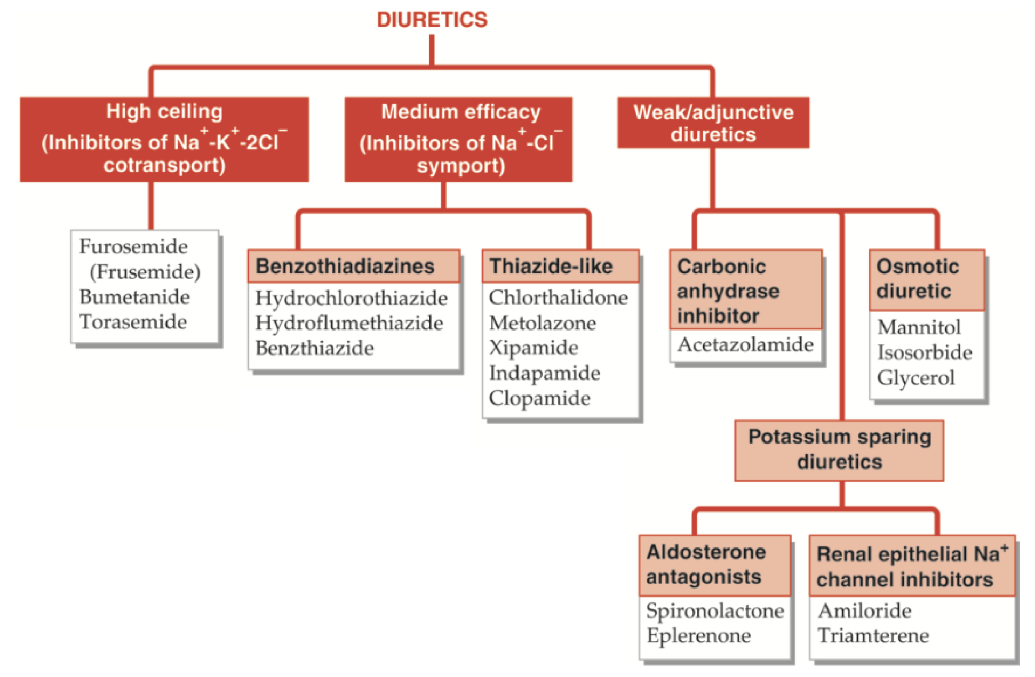

Slide 6
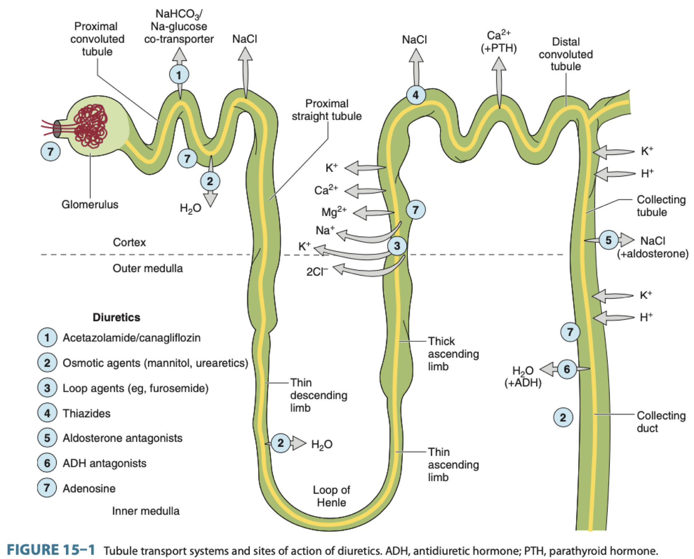

Slide 7
We can also classify diuretics based on their site of action.
  Diuretics Acting on the Proximal tubule (PT)
      Carbonic anhydrase inhibitors
  Diuretics Acting on the Loop of henle
      Loop diuretics
      Osmotic diuretics
  Diuretics Acting on the Distal tubules and collecting Ducts
      Thiazides
      K⁺ sparing diuretics

Slide 8
High ceiling diuretics

Slide 9
Loop diuretics
  Furosemide (Frusemide),
  Bumetanide,
  Torasemide (Torsemide)
These are inhibitors of Na⁺ K⁺ 2Cl– symporter present at the luminal membrane of the ascending limb of the loop of Henle.

Slide 10
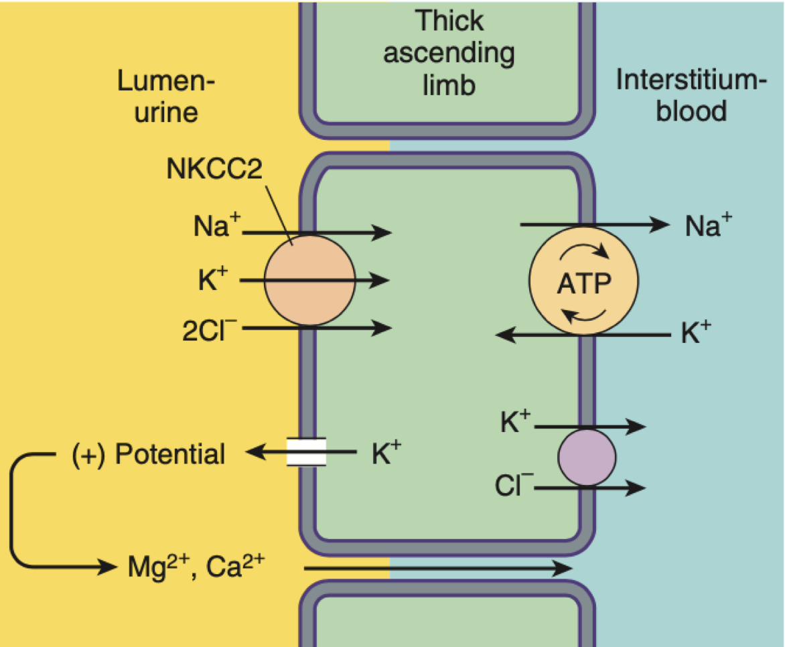

Slide 11
FUROSEMIDE (Frusemide)
It is a potent, oral, diuretic agent.
Mechanism of action: It blocks the Na+–K+–2Cl− symport.
also inhibits the reabsorption of Ca++ and Mg++
Given i.v. bolus, it is a venodilator and increases the renal blood flow
It increases PGE2 synthesis in the kidneys, which has a locally protective, vasodilator effects.

Slide 12
Pharmacological actions:
Kidneys:
  Intense diuretic action starts within an hour of oral administration and is completed in 4–6 h.
  It has a steep dose–response curve without a ceiling effect.
  Because of its short duration of action, furosemide is administered twice a day when sustained diuresis is desired.
  It causes marked sodium, potassium, chloride and phosphate loss.
  Loop diuretics are potent renin releasers.
  GFR is not affected.

Slide 13
Blood vessels and blood pressure:
  Intravenous furosemide dilates the peripheral vasculature, lowers the arterial BP, and causes rapid venous pooling of blood, thus reducing the cardiac preload and afterload.
Metabolic actions:
  Like thiazides, furosemide can cause hyperglycemia, hyperuricemia and rise in blood urea.
  Calcium and magnesium excretion is increased.

Slide 14
Adverse reactions
It causes excessive loss of sodium, potassium and chloride and can precipitate serious hypovolaemia.
A patient may complain of weakness, fatigue, dizziness and cramps;
orthostatic hypotension can occur.
Excessively rapid diuresis in elderly may precipitate acute urinary retention.
Rapid diuresis with excessive K+ loss can precipitate hepatic coma in the presence of liver disease.
Less common reactions include skin rashes, nausea, diarrhoea and rarely acute pancreatitis, thrombocytopenia and neutropenia.

Slide 15
Adverse reactions
It increases plasma triglycerides, total and LDL cholesterol.
Hearing loss, usually transient, with or without tinnitus, has been reported following very large doses in patients with renal failure.
Furosemide can enhance the toxicity of lithium, aminoglycosides and cephalosporins.
Its action is inhibited by NSAID such as indomethacin.
It should be avoided in pregnancy.

Slide 16
Preparations and dosage:
Tablet 40 mg.
Furosemide injection, 20 mg in 2 mL.
Dose: 40–100 mg daily.

Slide 17
Therapeutic uses:
As a diuretic:
  Furosemide is a very effective, potent and usually safe diuretic.
  However, it has no distinct advantage over thiazides, in the treatment of moderate oedema. It is more useful in severe oedema.

Slide 18
Therapeutic uses:
Pulmonary oedema:
  Given intravenously, it can be life-saving in patients with pulmonary oedema.
  Acute renal failure
  Chronic renal failure

Slide 19
Therapeutic uses:
Barbiturate poisoning:
  It is used to induce forced diuresis.
Hypercalcaemia:
  Intravenous furosemide, together with normal saline infusion, is valuable in the emergency management of hypercalcaemia.

Slide 20
Therapeutic uses:
As an antihypertensive:
  Furosemide cannot be recommended for long-term antihypertensive therapy because of high dose requirements, short duration of action and its high diuretic potential.
  High ceiling diuretics are indicated in hypertension only in the presence of renal insufficiency, heart failure, or in resistant cases and in hypertensive emergencies; otherwise thiazides are preferred.

Slide 21
TORSEMIDE
BUMETANIDE
This congener is as active as furosemide in similar doses.
However, it is absorbed completely, and 80% of the drug is metabolised in the liver.
Its diuretic action is similar to those of furosemide. One milligram of bumetanide equals 40 mg of furosemide in its diuretic potency.
Its absorption is nearly 80% and is metabolised in the liver.
Its half-life is not prolonged in renal insufficiency.
Axosemide, tripamide and piretanide are the other diuretics belonging to the furosemide group.

Slide 22
ETHACRYNIC ACID:
Ethacrynic acid, an unsaturated ketone derivative of phenoxy-acetic acid, is a potent oral diuretic like furosemide.
Chemically, it is unrelated to other diuretics.
The diuretic and metabolic effects of ethacrynic acid are similar to those of furosemide.
Like furosemide, it can be used in oedematous states, especially in patients allergic to sulphonamides.
However, it is more prone to cause adverse effects particularly, nausea and deafness.

Slide 23
Moderate ceiling diuretics

Slide 24
Benzothiadiazines (thiazides) diuretics
  Hydrochlorothiazide
  Hydroflumethiazide,
  Benzthiazide,
  Chlorthalidone,
  Metolazone,
  Xipamide,
  Indapamide,
  Clopamide
These are Inhibitors of Na⁺-Cl ̄ symport.

Slide 25
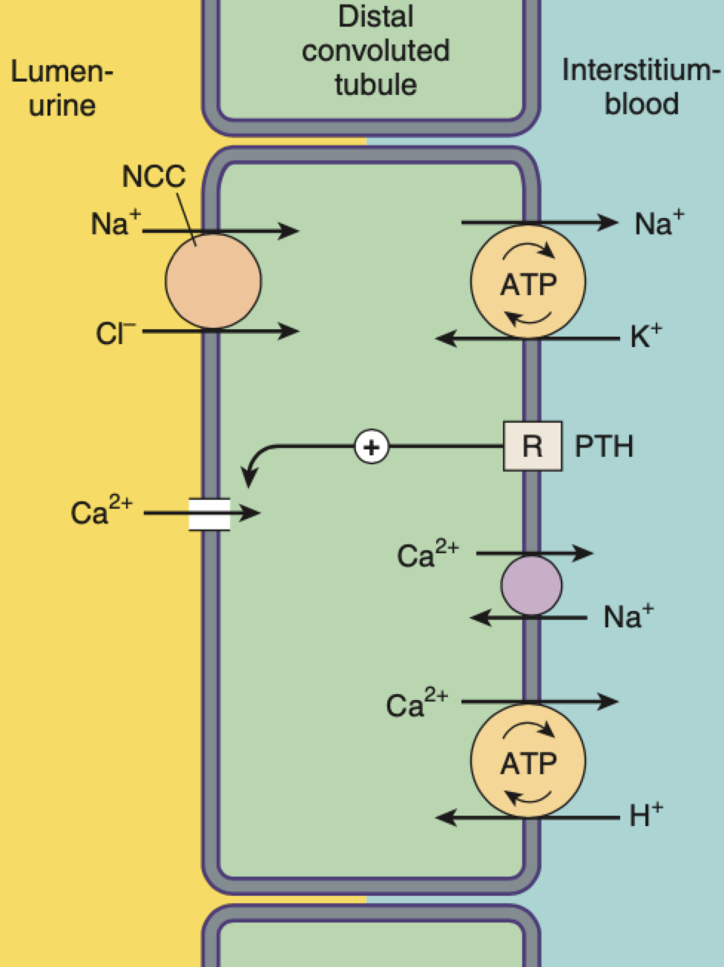
These drugs act by inhibiting Na⁺-Cl– symporter at the luminal membrane of early DT.

Slide 26
Pharmacological actions:
Kidneys
Moderate diuretic effect.
Chlorothiazide has a weak carbonic anhydrase inhibitory activity and it causes some loss of bicarbonate.
Because of the marked inhibitory action on sodium reabsorption, a large amount of sodium is made available to the distal segment where exchange of K+ with Na+ takes place.
This may cause increased potassium loss.

Slide 27
Pharmacological actions:
Kidneys
Excessive renal loss of sodium and chloride may cause hyponatraemia and hypochloraemia; excessive potassium loss can cause hypokalemia, thus leading to hypokalaemic hypochloraemic alkalosis.
Long-term use causes hypomagnesaemia
Thiazides are less effective when GFR falls below 30–40 mL/min.

Slide 28
Blood vessels: Thiazides produce a mild antihypertensive effect partly due to their action on sodium metabolism and partly due to their direct action on blood vessels.
Metabolic actions: Thiazide may causes
▪ Hyperglycaemia
▪ Hyperuricaemia
▪ Hypercalcaemia
▪ Hyperlipidaemia

Slide 29
The mechanism by which thiazides cause hyperglycaemia is not known.
These drugs can unmask or aggravate the pre-existing diabetes mellitus.
Diazoxide, a thiazide derivative with potent hyperglycaemic action, has been used in the treatment of hypoglycaemia.
However, during long-term therapy of hypertension, thiazides do not significantly increase the incidence of diabetes mellitus.

Slide 30
Thiazides also decrease the reabsorption of uric acid from proximal tubule, thus raising plasma uric acid level.
In addition, they compete with uric acid for urate transporter causing uric acid retention.
occasionally, it can precipitate gout.
Unlike loop diuretics , thiazides reduce urinary calcium loss by acting on distal convoluted tubules and promote calcium retention; they are useful in treating idiopathic hypercalciuria.

Slide 31
Serum cholesterol and triglycerides may increase slightly
Other action: In patients with nephrogenic type diabetes insipidus, thiazides decrease urinary volume.

Slide 32
Adverse reactions:
Apart from electrolyte disturbances such as hypokalaemic and hypochloraemic alkalosis, these drugs have few serious toxic effects.
Hypokalemia increases the risk of fatal toxicity of certain arrhythmias and drugs like digoxin.
They may cause dilutional hyponatraemia.
Because of structural similarity to sulphonamide, allergic reactions such as dermatitis and thrombocytopenia may occur.
In the presence of renal and hepatic insufficiency, these drugs may precipitate renal failure or hepatic coma.

Slide 33
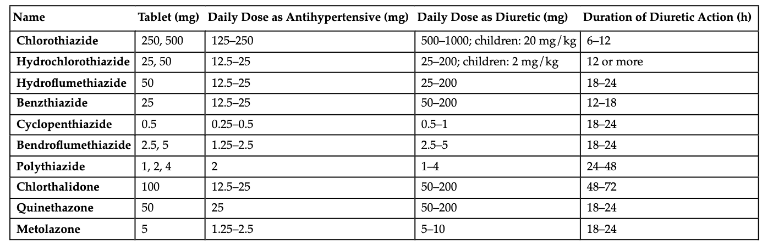
Preparations and dosage

Slide 34
Therapeutic uses:
1. Edema
Thiazides may be used for mild- to-moderate cases.
For mobilization of edema fluid more efficacious diuretics are preferred, but thiazides may be considered for maintenance therapy.
They act best in cardiac edema; are less effective in hepatic or renal edema.
Thiazides are powerless in the presence of renal failure, but metolazone may still act.

Slide 35
2. Hypertension
Thiazides and related diuretics, especially chlorthalidone and indapamide are one of the first line drugs.
3. Diabetes insipidus
Thiazides decrease positive free water clearance and are the only drugs effective in nephrogenic diabetes insipidus.
4. Hypercalciuria with recurrent calcium stones in the kidney.
Thiazides act by reducing Ca2⁺ excretion.

Slide 36
Thank you

Slide 37
Mechanism of action of Thiazide diuretics:
a) Inhibit K+-Cl− symport in collecting duct.
b) Inhibit Na+-Cl− cotransport in early part of distal tubule.
c) Inhibit Na+- Cl− co-symporter in late part of distal tubule.
d) Inhibit Na+-K+ symporter in proximal tubule

Slide 38
2. Following are high ceiling diuretics EXCEPT:
a) Furosemide c) Bumatenide
b) Spironolactone d) Torasemide
3.Furosemide can cause all except:
a) Hypokalaemia c) Hyponatremia
b) Hypocalcaemia d) Hypoglycaemia

Slide 39
4. Drug acts on proximal convoluted tubule:
a) Acetazolamide c) Thiazide
b) Furosemide d) Spironolactone
5. Which drug is combined with thiazide to reduced chance of hypokalemia?
a) Acetazolamide c) metolazone
b) Spironolactone d) glycerol

