Slide 1
Neuro muscular junction
Dr.Dipika Baria(MD)

Slide 2
Neuromuscular junction
(example of chemical synapse)
Neuromuscular junction : The synapse between motor neuron and muscle fiber is called the neuromuscular junction
Motor unit : single motor neuron and the muscle fibers it innervate

Slide 3
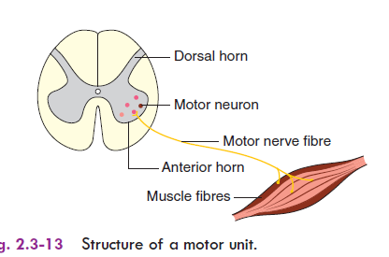
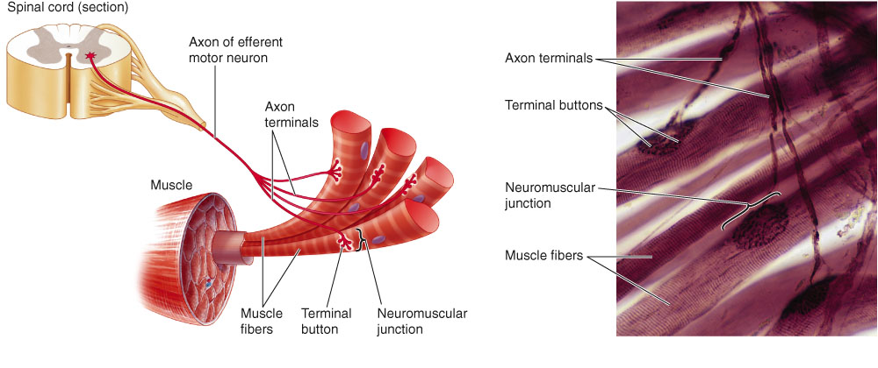
Motor unit
The motor neuron, including its axon and axon terminals and the muscle fibers supplied by it are called a MOTOR UNIT.

Slide 4
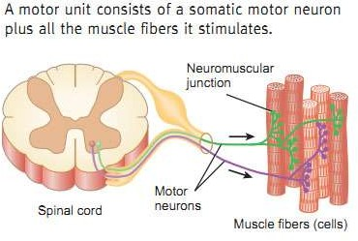
Motor unit
Motor neuron, axon terminal and muscle fibers together called as motor unit

Slide 5
Neuromuscular junction
Structure of NMJ -divided into three parts:
  Presynaptic
  Synaptic
  Post synaptic portions

Slide 6
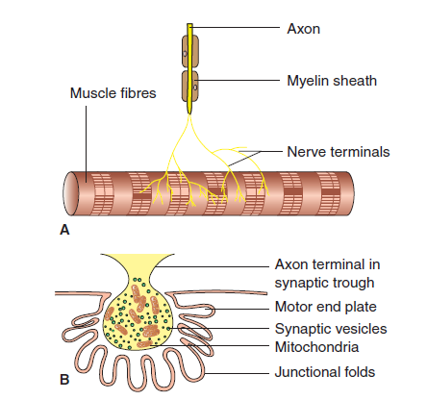

Slide 7
Presynaptic Portion ( Axon Terminal)
The neurons innervating skeletal muscle fibers are known as motor neurons that have their cell bodies in anterior horn of the spinal cord or in the brainstem.
Their axons are myelinated and are the largest- diameter axons in the body.

Slide 8
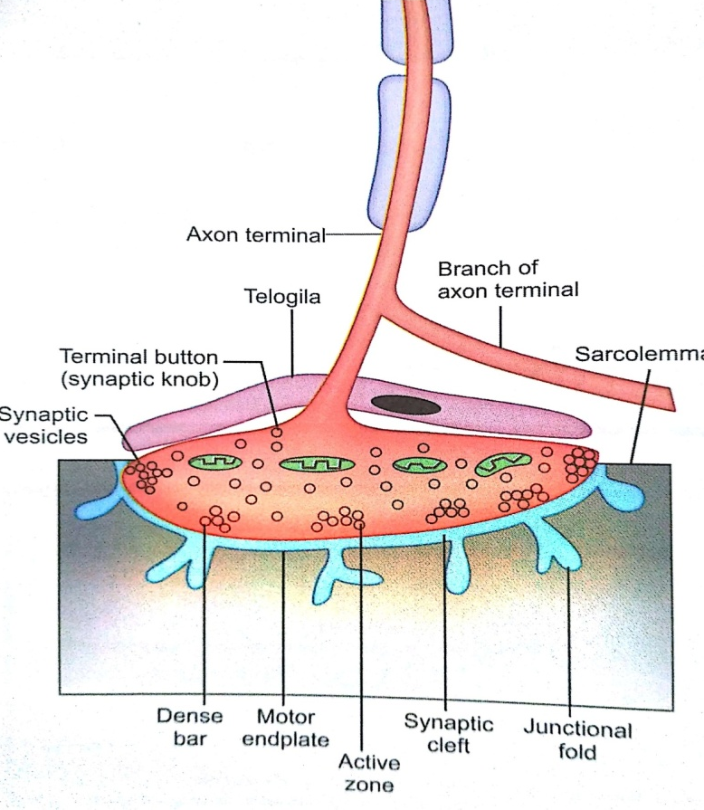
Features of presynaptic portion of NMJ
Axon :-of motor neuron approaches the muscle fiber, it loses its myelin sheath, and divides extensively into several fine branches of about 2 µm in diameter called axon terminals.
The axon terminals : covered by Schwann cells known as Teloglia

Slide 9
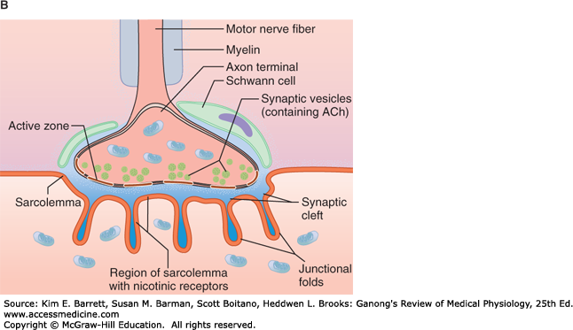
Teloglia

Slide 10
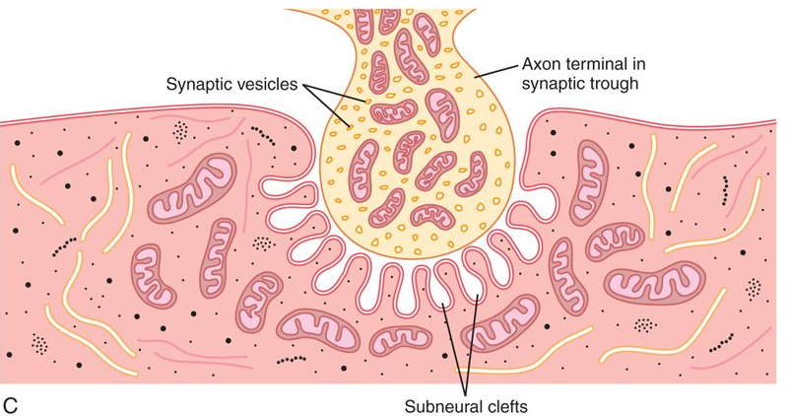
Neuromuscular junction

Slide 11
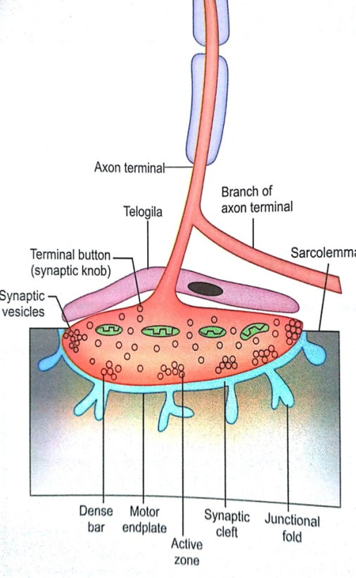
SYNAPTIC KNOB
Each terminal is expanded at its end to form a knobby structure called synaptic knob or terminal button.
It lies in the groove (synaptic trough) in the surface of the muscle fiber.
It contains plenty of mitochondria and neurotransmitter vesicles containing ACh.
Higher metabolic activity seen due to plenty of mitochondria.
Ach synthesized within the mitochondria

Slide 12
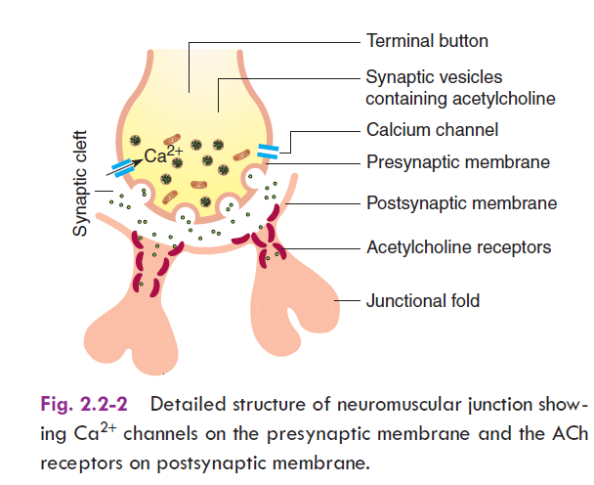
Pre synaptic membrane:
It refers to the axonal membrane lining the terminal buttons of nerve ending

Slide 13
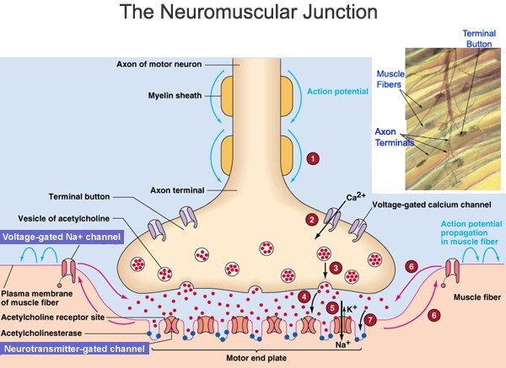

Slide 14
Neurotransmitter vesicles
They are clustered around specific points called ACTIVE ZONES.
The membrane at the active zones is modified to form DENSE BAR that contains numerous voltage gated Ca++ channels.

Slide 15
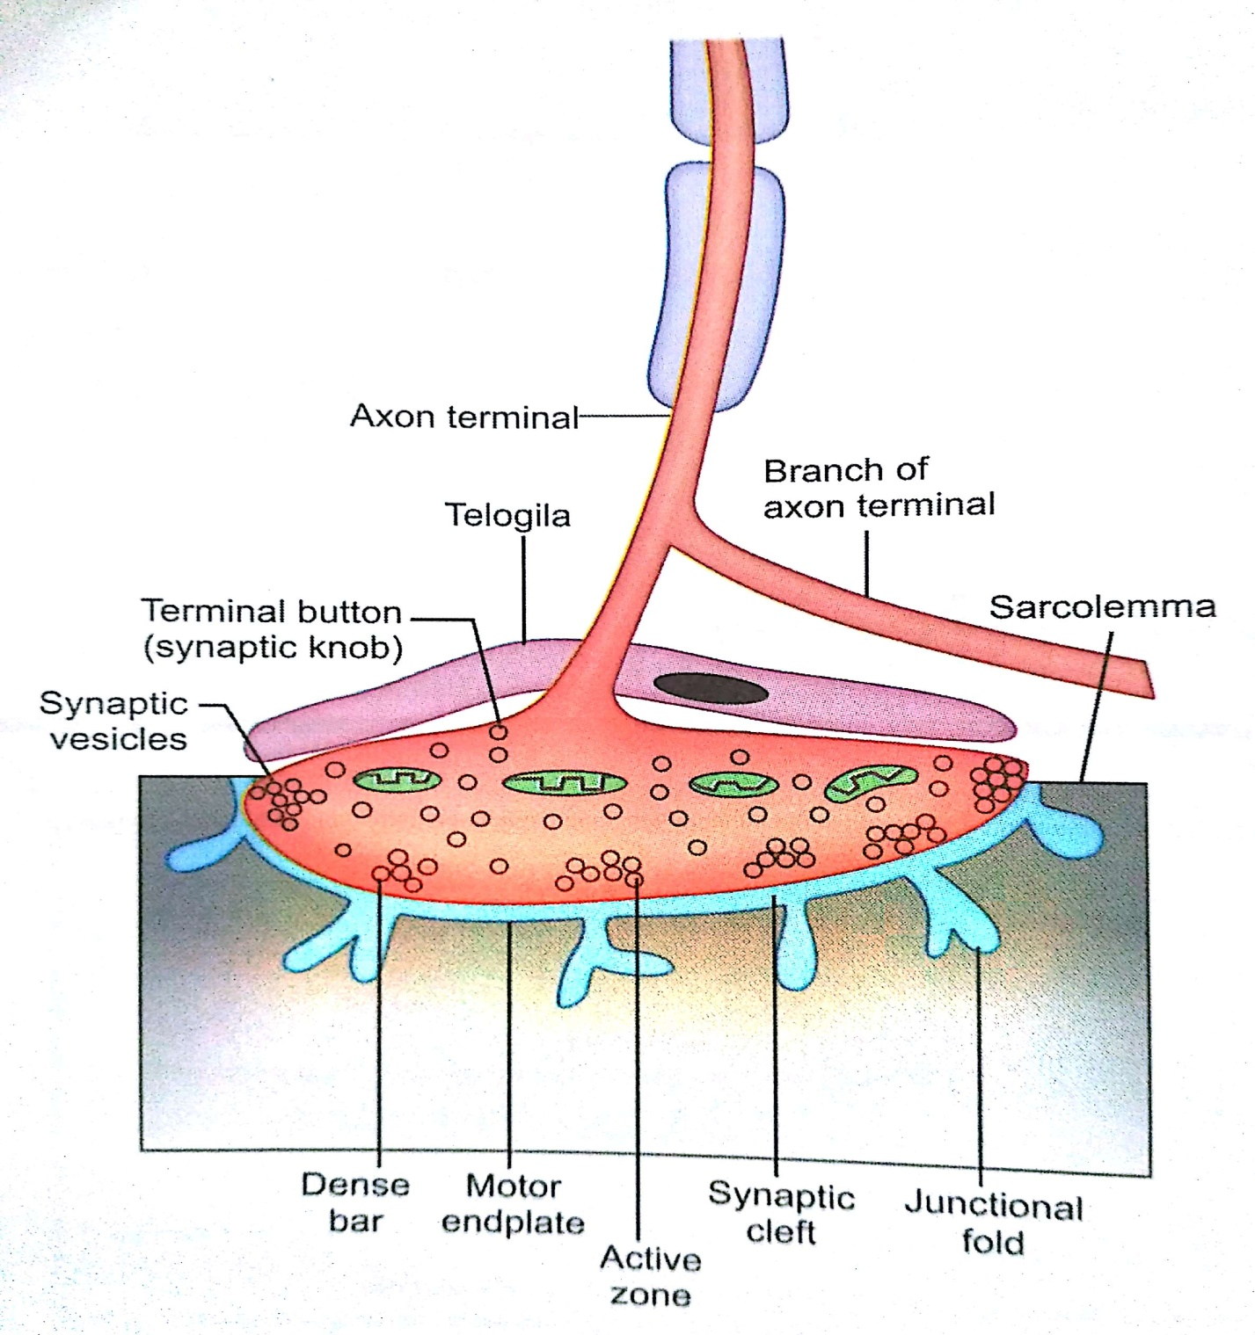

Slide 16
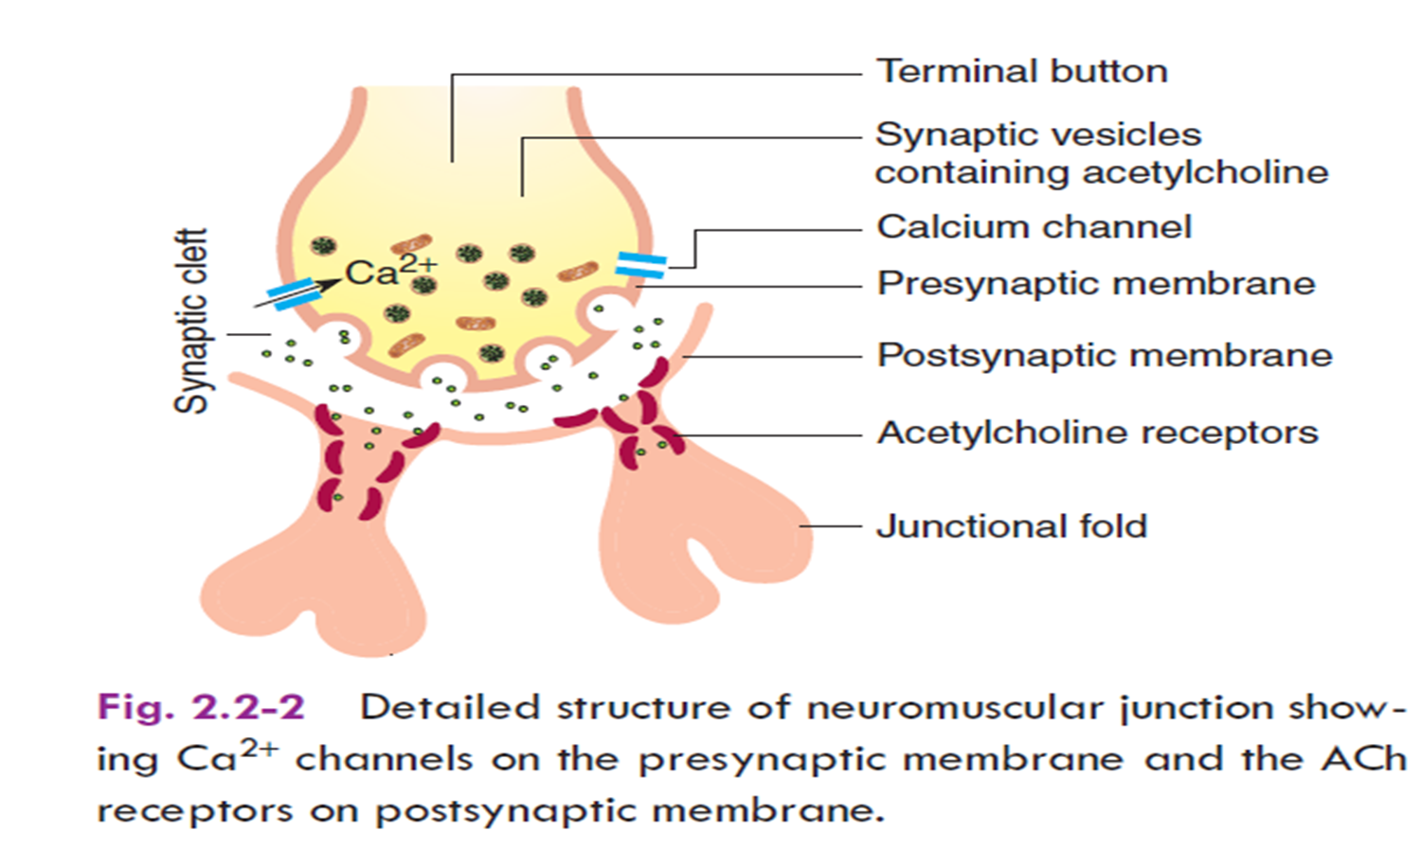
Synaptic cleft
This is the gap between the terminal button and the muscle fiber, which is about 40-100 nm wide.
The cleft contains the enzyme acetylcholine-esterase (AChE)
AChE rapidly hydrolyzes ACh into acetate and choline.

Slide 17

Postsynaptic portion (end plate membrane)
It is a muscle fiber membrane (sarcolemma) in the NMJ.
The postsynaptic portion is known as the END PLATE MEMBRANE (motor end plate).
The area increases many times as it is thrown into several folds called JUNCTIONAL FOLDS.
The end plate membrane contains numerous nicotinic Ach receptors , which are concentrated at the crests of the junctional folds.
It also contains voltage gated Na+ channels.
Notes:
AchR is permeable to both Na+ and K+.
But the electrochemical gradient is favorable for Na+ entry.

Slide 18
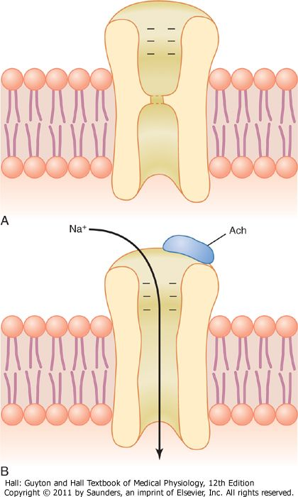
Ach receptors at NMJ
AChR at NMJ are nicotinic type
An average end plate contains about 15-40 million AChR
The AChR protein is a chemically gated ion channel that opens when two molecules of Ach bind to it.

Slide 19
Mechanism
Of
neuromuscular transmission

Slide 20
Neuromuscular transmission
NMT is the transmission of impulse from the motor neuron to the skeletal muscle fibers supplied by the neuron.
Mechanisms divided into three parts:
  Presynaptic events
  Synaptic events
  Post synaptic events

Slide 21
Presynaptic events
:
  Arrival of AP
  Depolarizes the membrane of terminals
  Activation and opening of Ca++ channels
  Calcium influx
  Increase movement of microtubules and microfilaments
  Migration of neurotransmitter vesicles to the inner surface of the presynaptic membrane.
The vesicles fuse with the membrane
Discharge their content into the synaptic cleft by exocytosis process.

Slide 22
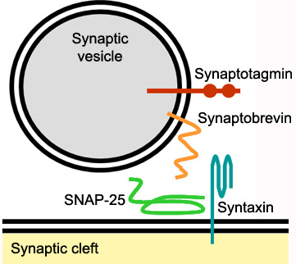
Role of syntaxin and synaptobrevin
Help in docking and fusion
Synaptobrevin in the vesicle membrane links with syntaxin and SNAPs(soluble NSF attachment protein(N-ethylmaleimide-sensitive fusion protein)in the cell membrane

Slide 23
Release of acetylcholine by the nerve terminals
Effect of acetylcholine on the postsynaptic membrane
Development of end plate potential
Miniature end plate potential
Removal of acetylcholine by cholinesterase
Initiation of the action potential in the muscle fibre.

Slide 24
Quantal release
Depolarization of the terminal button causes synchronous release of about 60-200 vesicles from different parts of the presynaptic membrane.
Each vesicle contains around 4000- 10,000 Ach molecules.
The vesicle or the multimolecular packet of Ach is known as quanta, and the process of release is known as quantal release of neurotransmitter.

Slide 25
Events at the synaptic cleft
The released Ach molecules diffuse across the synaptic cleft and bind to the receptors present at the post synaptic membrane.
Some molecules of Ach hydrolyzed by AChE, and some diffuse out of the cleft
Ach
acetate
AChE
choline
Ach

Slide 26
Events at the end plate
The major purpose of postsynaptic mechanism is to generate action potential in sarcolemma adjacent to end plate.
Binding of Ach to AchR
Na+ influx
Rapid local depolarization of motor end plate
Known as EPP – end plate potential
EPP –decreases the membrane potential to the firing level
Opens the voltage gated Na+ channels
AP at the membrane adjacent to the end plate region

Slide 27
The AP propagates along the sarcolemma and T-tubule network.
The binding of Ach to AchR is loose and reversible
So Ach diffuses away and gets rapidly hydrolyzed by AChE to acetate and choline.
The action of Ach is terminated
Closure of ion channels, cessation of end plate potential and then AP.

Slide 29
EPP- end plate potential
It is like graded potential.
EPP decays slowly with time and distance from the end plate region---DECREMENTAL CONDUCTION.

Slide 30
EPSP
EXCITATORY POSTSYNAPTIC POTENTIAL
It is < 1 mV.
So that several EPSPs are required to attain the threshold and generate ACTION POTENTIAL in the postsynaptic neuron.
Stimulation of a single motor neuron produces an EPP of about 70 mV.
EPP of this magnitude is much bigger than that required to bring the membrane potential to firing level.

Slide 31
Therefore , stimulation of motor nerve always produces action potential in each muscle fiber supplied by it;
i.e. all the muscle fiber in a motor unit contract in response to discharge of its motor neuron.
In skeletal muscle the EPP is always a depolarizing potential.

Slide 32
Miniature End Plate Potential
When the motor nerve is at rest, spontaneously occurring potentials of minute amplitude (0.1 to 4 mV) are recorded from the postsynaptic membrane.
These potentials are known as miniature end plate potential (MEPP)
It occurs due to release of the contents of a single Ach vesicle by exocytosis that opens around 2000 Ach channels in a very small area of the end plate membrane.

Slide 33
DRUGS AFFECTING NEUROMUSCULAR JUNCTION
AND DISORDERS Of NMJ

Slide 34
Neuromuscular blocker
1.Curare or the active principle of D-tubocurarine
It is a toxic alkaloids
Historically it was use for arrow poison
prevents the neuromuscular transmission by combining with acetylcholine receptors.
The acetylcholine released thus cannot combine with the receptors and so end plate potential does not develop.
The curare form drugs are called receptor blockers since they block the neuromuscular transmission by acting on the acetylcholine receptors.
It was use in conjunction with an anaesthetics for relaxing during surgery

Slide 35
2.Bungarotoxin
found in the venom of deadly snakes
Also blocks neuromuscular transmission by binding with the acetylcholine receptors.

Slide 36
3.Succinylcholine and Carbamylcholine act like acetylcholine
cause depolarization of the postsynaptic membrane.
But, these are not destroyed by cholinesterase
so the muscle remains in a depolarized state for a long time.
Thus, these drugs block the myoneural junction by keeping the muscle in a depolarized state.
Use as a depolarising neuromuscular blocker in general anaesthesia

Slide 37
4.Botulinum toxin
is derived from the bacteria Clostridium botulinum.
It blocks the transmission across the myoneural junction by preventing the release of acetylcholine from the terminal buttons of the nerve endings.
Causes flaccid paralysis.

Slide 38
Botulinum toxin: Clinical use
Therapeutic and cosmetic purpose:
    Local injection of highly diluted toxin (botox treatment) produce muscle relaxation at the desired site for reduce facial wrinkles.
Medical uses:
It is used to treat numbers of disorder characterized by overactive muscle movement
1.Achalasia cardia:
    It is injected into the lower esophageal sphincter to treat Achalasia cardia.
2.Strabismus (crossed eyes) and blepharospasm(forcible closure of the eyelids):
    It is injected into extraocular muscles to decrease their over activity
    Others are:
    Spasm of head and neck,limbs,jaw,vocal cord
    Side effect: paralysis of uninteded muscle

Slide 39
Neuromuscular stimulators
Drugs having acetylcholine like action.
The drugs methacholine,carbachol and nicotine act like acetylcholine and
produce end plate potential exciting the muscle fibre.
However, these drugs are either not destroyed or are destroyed very slowly by the enzyme acetylcholinesterase.
So they cause repeated stimulation and continuous action of muscle, thereby causing a state of muscle spasm.

Slide 40
Drugs that inactivate the enzyme cholinesterase(anticholinesterase).
The drugs like Neostigmine, Physostigmine
stimulate the neuromuscular junction by inactivating the enzyme acetylcholinesterase.
Once this enzyme is inactivated, the acetylcholine released at the nerve terminal cannot be hydrolysed,
this leads to repeated stimulation and continuous action of muscle.
The effect of neostigmine and physostigmine lasts for several hours
Use: Mysthenia gravis (improve muscle strength)

Slide 41
Neuromuscular dysfunctions

Slide 42
Myasthenia gravis
Autoimmune disorder
Antibodies that attack the acetylcholine receptors
Antibodies that block or destroy their own acetylcholine receptors at the postsynaptic neuromuscular junction.
Causes muscle paralysis because of inability of the neuromuscular junctions to transmit enough signals from the nerve fibres to the muscle fibres.

Slide 43
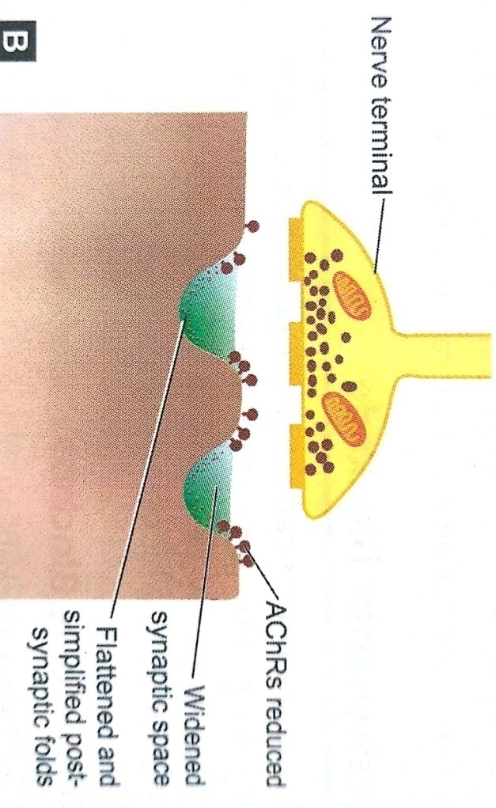
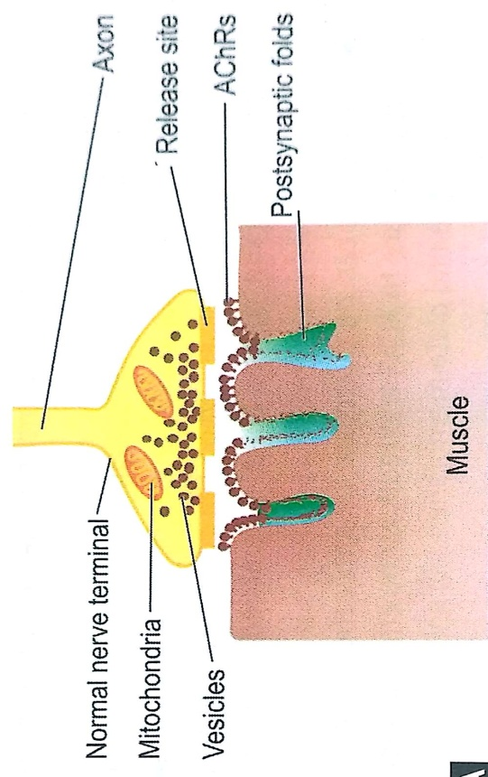
Etiology
It results from a decrease in the no. of AChR present on the motor end plate due to production of circulating auto antibodies against these receptors.

Slide 44
The anti- AchR antibodies have following three major functions
They compete with Ach to bind to AChR, producing receptor blockade.
They induce endocytosis of AChR.
They damage the postsynaptic membrane.

Slide 45
Clinical features:
Fatigue :
    Normally, On repeated stimulation of the motor nerve, the amount of Ach released per action potential gradually decreases.
    But the amount is enough to generate an EPP well above the threshold level .
    In myasthenic patients due to the postsynaptic changes along with the presynaptic rundown, after a few motor nerve impulses, the successive contractile responses become feebler, causing FATIGUE.

Slide 46
Clinical features:
Relatively rare : 14-20:1,00000
WOMEN are affected more than men in a ratio of 3:2
THE MUSCLE WEAKNESS(voluntary muscle):
  Increases during prolonged use of the muscle and improves after rest or sleep.
  Thus , the patient feels better in the morning , but symptoms aggravate toward evening or after exertion.

Slide 47

Symptoms:
Facial paralysis
Trouble in talking
Difficulty in breathing, swallowing,
Double vision
Dropping of eyelids
Problems in walking
Complication:
Mysthenia crises ,in which paralysis of respiratory muscles can lead to death

Slide 48
Diagnosis
Blood test for antibodies
Examination of reflex
Sensory examination
Tensilon test: drug prevent breakdown of Ach
Positive in MG patient if their muscle get stronger after injection with tensilon
Motor function
CT SCAN ,MRI To rule out tumor

Slide 49
Physiological basis of treatment
No cure for MG
But goal is manage symptoms and control the activity of immune system
Administration of AChE inhibitors:
  Like pyridostigmine and neostigmine
  They increase the concentration of Ach at the NMJ.
THYMECTOMY:
  Immune response mediated by T cells .
  Thymectomy blunts down the immune response and improves the condition.
  -Life style changes
  Rest
  Avoid stress and heat exposure

Slide 50
Immunosuppression:
  Drugs like glucocorticoids and azathioprine are given
  They inhibit the immunological mechanisms.
Plasmapheresis:
  It removes AchR antibodies from plasma.

Slide 51
Lambert- Eaton Myasthenic Syndrome
It is presynaptic disorder of the neuromuscular junction due to production of auto antibodies against voltage-gated Ca++ channels.
The decreased Ca++ influx in the presynaptic axon terminals results in impaired Ach release from the nerve endings.
The muscular weakness is primarily seen in the limb muscles.

Slide 52
Nerve and muscle
Structure and classification of nerve fiber
Action potential of nerve fiber
Degeneration and Regeneration of nerve fiber
Properties of nerve fiber
Structure of Neuro muscular junction
Neuro muscular transmission
Disorders of neuromuscular junction
Structure of skeletal muscle fiber
Action potential skeletal muscle
Molecular basis of muscle contraction/ cross bridge cycle
or Walk along theory or the modern theory of muscle contraction/
Excitation contraction coupling of skeletal muscle
Properties skeletal muscle
Difference between skeletal muscle and smooth muscle
Difference between isotonic and isometric contraction
Rigor mortis
Mysthenia gravis

Slide 53
CCES
1. Ach receptor present at NM junction are
A. Nicotinic
B. Muscarinic
C. alpha
D. beta

Slide 54
2.Potential develop at motor end plate during nerve muscle transmission is k/as
A. EPP
B. MEPP
C. AP
D NONE

Slide 55
3.Single motor neuron and the muscle fibers it innervate, k/as
A. Motor nerve
B. Motor
C. Sensory unit
D.Motor unit

Slide 56
4.Disease where antibodies formed against Ach receptors is
A Lamberteaton syndrome
B. Dystrophy
C. Hypotonia
D.Myasthenia gravis

Slide 57
5.Disease where antibodies formed against Ca++ receptors is
A. Myesthenia gravis
B. Lambert eaton syndrome
C. Dystrophy
D. Hypotonia

Slide 58
1. Junction between neuron and muscle is k/as
a. NM junction b. MN junction
c. MM junction d. NN junction
2. Ach receptor present at NM junction are
a. Nicotinic b. Muscarinic c. α d. β
3. Neurotransmitter released at NM junction is
a. Ach b. Epinephrine c. serotonin d. histamin
4. Potential develop at motor end plate during nerve muscle transmission is k/as
a. EPP b. MEPP c. AP d None
5. Single motor neuron and the muscle fibers it innervate, k/as
a. motor unit b. motor nerve c. motor d. sensory unit

Slide 59
6 . Anticholinesterase inhibiter neostigmine is
a. NM junction stimulator b. NM junction inhibiter
c. Both d. none
7.Disease where antibodies formed against Ach receptors is
a. myasthenia gravis b. Lambert Eaton syndrome
c. dystrophy d. hypotonia
8. Disease where antibodies formed against Ca++ receptors is
a. Myesthenia gravis b. lambert eaton syndrome
c. dystrophy d. hypotonia
9. Small quanta (packets) of Ach are released randomly from nerve cell at rest generates
a. EPP b. MEPP c. AP d None
10. Curare is
a. Competitive inhibitor of Ach receptor b. blocker of Ach receptor
c. Stimulator of Ach receptor d. modulator of Ach receptor

