Slide 1
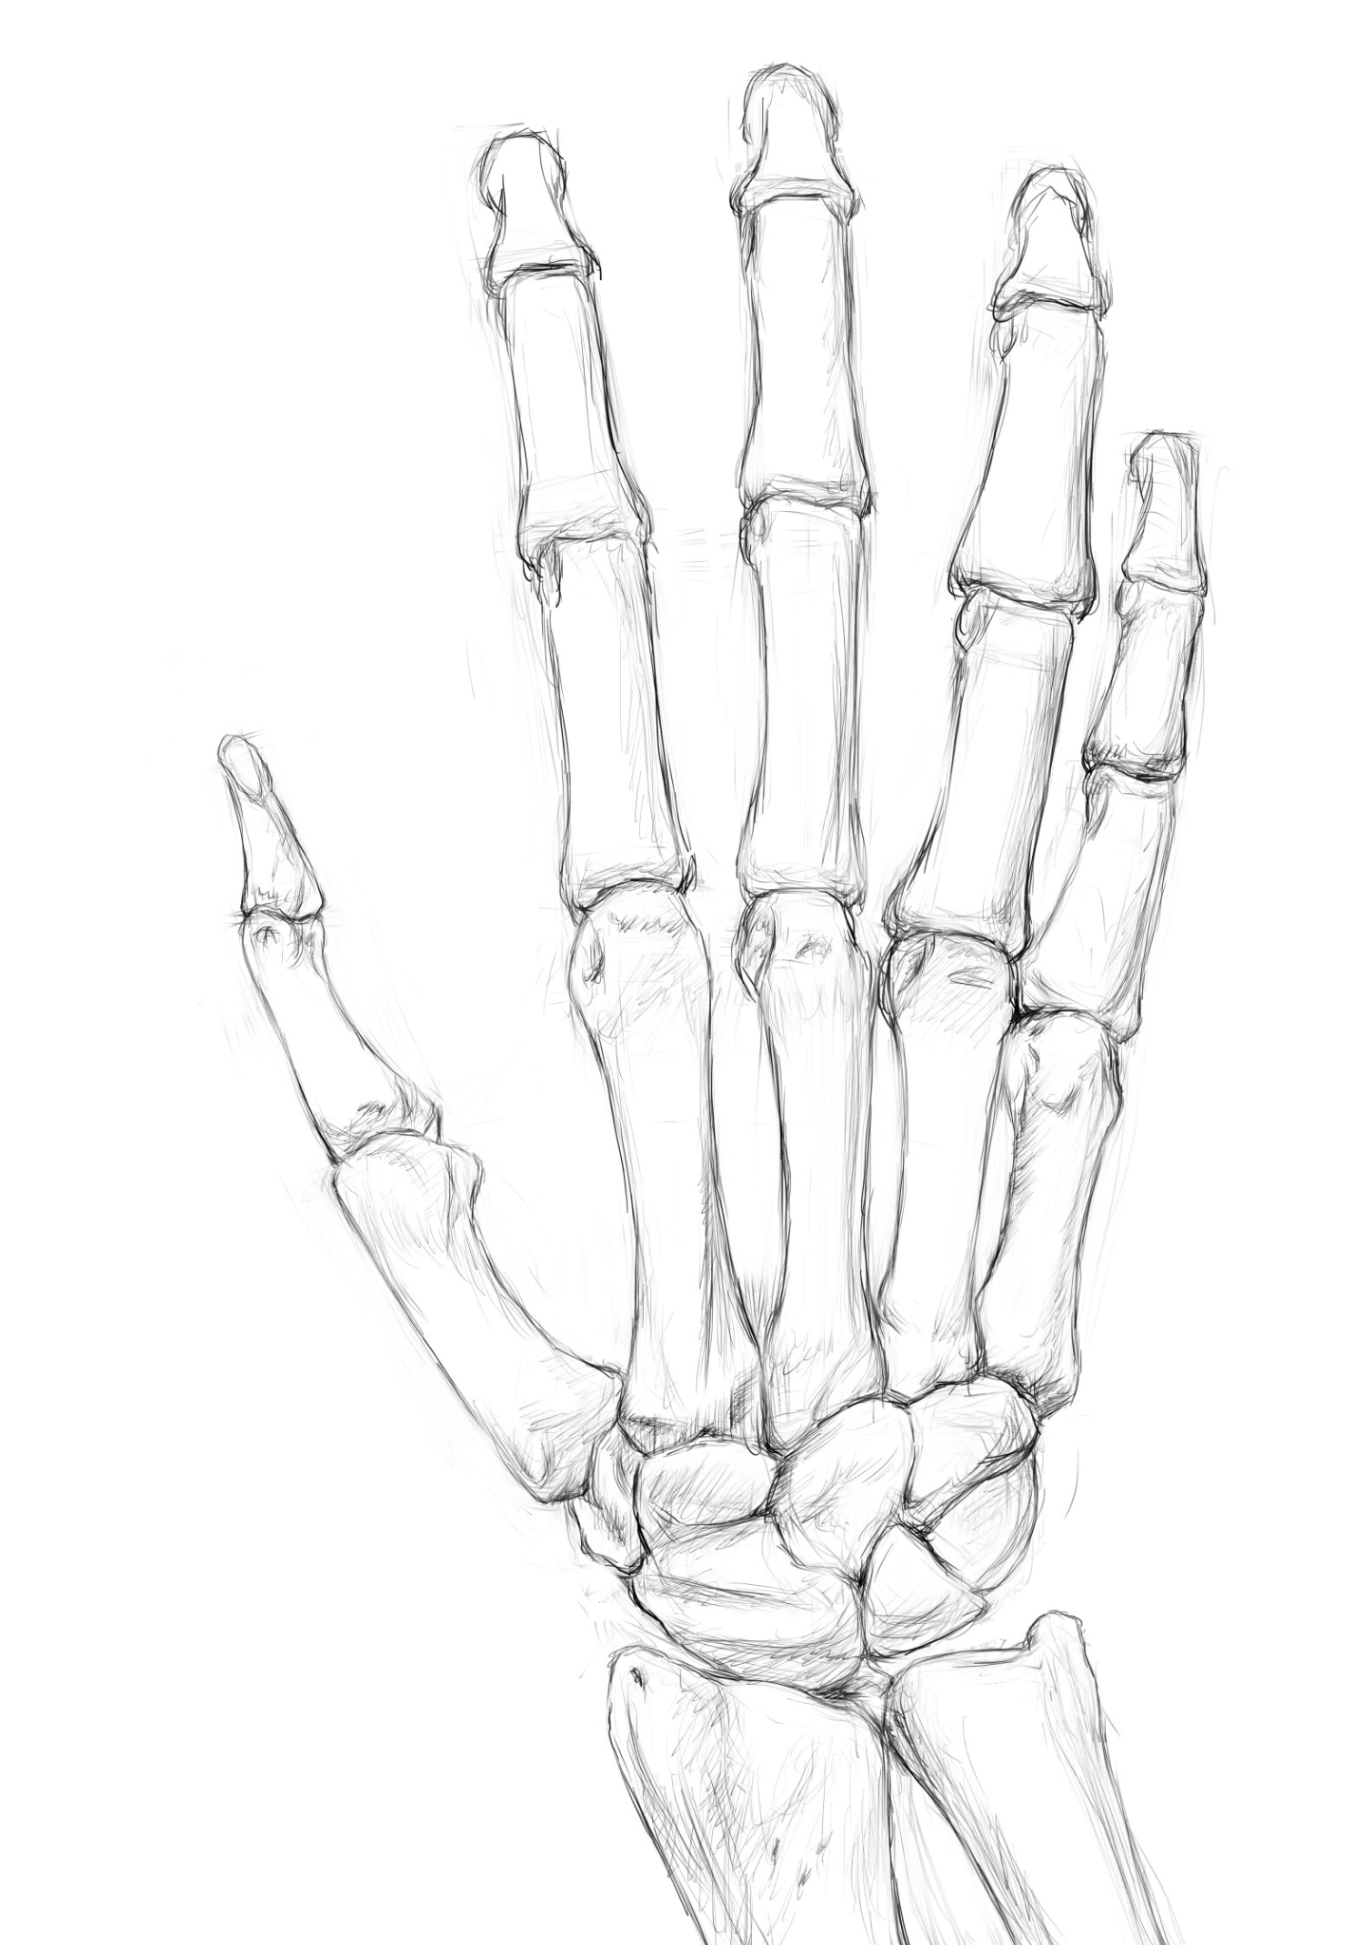
Pharmacotherapy of rheumatoid arthritis
Dr Jhanvi Vaghela

Slide 2
Introduction
Rheumatoid arthritis (RA) is a chronic, systemic, inflammatory disease predominantly affecting joints, and periarticular (synovial) tissues.
A formidable disease, being capable of producing severe crippling deformities and functional disabilities.
Common clinical signs and symptoms are pain and/or joint swelling, morning stiffness at least for one hour, fatigue, fever and weight loss.

Slide 3
Common in women and elderly persons.
Its aetiology is unknown, although the main risk factors include genetic factors and smoking.
Infection as the initial trigger has been suspected.
Current evidence indicates that RA is an autoimmune disease.
Autoantibodies to the Fc portion of IgG antibody are produced by B lymphocytes in the blood and synovial tissues in 80% of RA patients.

Slide 4
High titres of serum RA factor (RF), typically of the IgM isotype, are associated with more severe joint disease with extra-articular manifestations.
Other important antibodies are those directed against citrullinated peptide (ACPA) which seems to be more specific and sensitive marker.
About 50%–80% of RA patients have RF or ACPA or both.
Clinical diagnosis is confirmed by estimating ESR, autoantibody and radiographs.
Antibodies are detected years before onset of disease.

Slide 5
Pathophysiology
RA comprises three basic interrelated pathological processes:
  Inflammation
  Synovial proliferation
  Joint tissue destruction
RA factor-containing immune complexes found in the joints activate the pathological process.
The earliest lesion is vasculitis, an inflammation of small blood vessels.
The inflammation causes oedema of the synovium and infiltration with mononuclear cells, macrophages, lymphocytes and plasma cells.

Slide 6
There is intense local production of IgG by the plasma cells.
The activated macrophages, lymphocytes and fibroblasts produce a variety of cytokines that promote further synovial proliferation and inflammation.
Tumour necrosis factor (TNF-alpha), produced by activated macrophage, exerts powerful effects on the immune system, induction of proinflammatory mediators.
Synovial fluid in RA contains PGs (mainly PGE2), leukotriene B4, TNF-alpha, interleukins and other cytokines.
It is now believed that the monokines IL-1 and IL-6, and TNF-alpha are the central mediators of active rheumatoid process.

Slide 7
Classification of drugs used in RA
Anti-inflammatory analgesic drugs: Aspirin and other NSAID.
Anti-inflammatory drugs with indirect analgesic action: Glucocorticoids. They also have immunomodulatory activity.
These two groups act rapidly, relieve pain and control inflammation; they thus help to improve and maintain joint function.
However, they do not halt the underlying destructive process.

Slide 8
3. Disease-modifying antirheumatic drugs (DMARD), e.g. methotrexate, sulphasalazine, chloroquine, gold salts, and leflunomide.
They have no analgesic or immediate anti-inflammatory effect and begin to act after 6–12 weeks.
They remain in the body for a long time and probably modulate immune function.
They arrest the basic destructive process in the joints and modify the course of the disease.
They may induce remission.

Slide 9
4. Biological agents:
This heterogenous group includes complex protein molecules which are developed using molecular biological techniques.
Their action is predictable and results from interaction with cytokines or cell surface molecules. These are as follows:
a. TNF-alpha blockers: infliximab, adalimumab and etanercept
b. IL-1 receptor antagonist : anakinra
c. IL-6 receptor antagonist : tocilizumab
d. T cell activation inhibitors : abatacept
e. Anti–B-lymphocyte antibody : rituximab
f. Tyrosine kinase inhibitor : tofacitinib
5. Immunosuppressants: Azathioprine and Cyclosporine-A.
They can be life saving when severe vasculitis complicates the clinical picture.

Slide 10
Anti-inflammatory analgesics:
These drugs act symptomatically, and relieve pain, decrease the swelling and help to improve the joint movements.
Aspirin is required to be given in the dose of 3–5 g daily to maintain therapeutic blood levels of 20–30 mg.
Although useful, such high doses cause GI adverse reactions.
Enteric coated aspirin may cause less gastric irritation. It should be avoided in the elderly.
Aspirin and indomethacin can be given as rectal suppositories so as to avoid gastric irritation.

Slide 11
Other NSAIDs used are
  ibuprofen (200–400 mg thrice daily),
  diclofenac (75–100 mg twice daily),
  naproxen (250 mg twice daily) and
  ketoprofen (50 mg thrice daily), given with food.
A single dose of naproxen 500 mg taken at bedtime may also be effective.
Ibuprofen is perhaps the best tolerated among the NSAIDs.
Since piroxicam and diclofenac have prolonged action, a single dose at bedtime often may be effective for relieving the night pain and the early morning stiffness.
The risk of GI bleeding in patients taking NSAIDs is very high in RA.
This can be prevented to some extent by prophylactic use of PPI

Slide 12
Glucocorticoids
These drugs have potent anti-inflammatory action.
Given orally, they produce dramatic symptomatic relief which lasts as long as they are used.
They act by inhibiting the synthesis and/or by suppressing the actions of inflammatory mediators.
Prednisolone is started in the dose of 1 mg/kg/day, and then tapered gradually to a maintenance dose of 7.5 mg/day. The small maintenance dose may be continued as needed.
Glucocorticoids are not used as monotherapy.

Slide 13
Glucocorticoids
Low doses of prednisolone (5 mg/day) that do not affect clinical inflammation may have a joint protective effect and can be combined with DMARD.
Larger doses are required to control severe systemic manifestations of RA such as pericarditis and vasculitis.
Their major drawback is their toxicity.
Furthermore, relapse rate after stoppage is high.
The newer synthetic ‘super steroids’ do not offer any advantages over prednisolone.

Slide 14
DMARDs
GOLD SALTS:
  Water-soluble gold preparations
  MOA: sodium aurothiomalate, aurothiosulphate and aurothioglucose get deposited in synovial macrophages in inflamed joints and inhibit their function.
  They produce definite but slow and unpredictable improvement.
  Sodium aurothiomalate (Myocrisin) is usually employed in the dose of 10–25 mg i.m. weekly for prolonged periods or 50 mg weekly for 20 injections.

Slide 15
Absorption, fate and excretion:
  Sodium aurothiomalate is rapidly absorbed and is distributed in the kidney, liver, spleen and other tissues.
  It is excreted in urine. Gold salts accumulate in the kidney and remains in the body for many years.
Adverse reactions: Gold salts can cause dermatitis, nephropathy, oral ulceration, bone marrow depression, peripheral neuropathy and liver damage.
The incidence of toxicity is fairly high and regular clinical and haematological supervision is mandatory.
Gold toxicity is treated with prednisolone (10–20 mg daily) and dimercaprol.
They are now rarely used.
Auranofin, an oral gold compound, is better tolerated and less toxic than the injectable gold salts but is much less effective.

Slide 16
CHLOROQUINE & HYDROXYCHLOROQUINE:
Antimalarials
MOA: These are taken up by macrophages and lymphocytes.
  They inhibit phagocytosis, decrease T-cell activation and reduce inflammatory cytokines, i.e. TNF-alpha.
  They produce moderate benefit in active RA and systemic rheumatoid diseases.
  They have mild anti-inflammatory action and probably act as immunomodulators.

Slide 17
Chloroquine phosphate is given in the dose of 250 mg (maximum 4 mg/kg) daily.
The improvement is slow, and prolonged treatment (6-12 months) is necessary for full benefit.
After getting good relief, the frequency of the daily dose is progressively reduced to once a week; the drug may have to be continued in that dose perhaps indefinitely, as the disease may recur on stopping the drug.
The dose of hydroxychloroquine sulphate is 400 mg/day; the maintenance dose is 200–400 mg (maximum of 6.5 mg/kg/day). After good relief, its dose is reduced in the same manner as with chloroquine.
They are perhaps the best tolerated and relatively safe DMARD.
Long-term therapy may rarely cause retinopathy and irreversible visual impairment.
Hence, periodic ophthalmic examination during therapy is mandatory.

Slide 18
METHOTREXATE (MTX)
This folic acid antagonist, given intermittently, appears to be highly effective, has acceptable long-term toxicity and is cost-effective.
The initial dose is usually 5–7.5 mg orally, taken as a single dose once a week.
In these small doses, methotrexate has anti-inflammatory action but no immunosuppressive or cytotoxic action.
Its action is probably related to inhibition of aminoimidazole carboxamide (AICAR) transformylase and thymidylate synthetase, thereby preventing neutrophil chemotaxis.
Clinical response is usually seen in 4–8 weeks.
If no response is seen even after 8 weeks of therapy, the dose may be increased by 2.5 mg every other week to a maximum of 15 mg once weekly and maintained until improvement occurs. Relapse occurs following its discontinuation.

Slide 19
SULFASALAZINE
This drug, used in the treatment of ulcerative colitis.
The mesalamine component of sulfasalazine inhibits pro-inflammatory cytokines, immunoglobulin, COX and lipo-oxygenase and thus exerts anti-inflammatory action.
Sulphapyridine, which is absorbed more, reduces IL-8 synthesis and probably inhibits angiogenesis.
The dose required (1–2 g/per day) is larger than that required to treat ulcerative colitis.
With this dosage, adverse reactions are common and include allergy, nausea, vomiting and headache. Rarely, neutropenia, haemolytic anaemia and thrombocytopenia may occur.

Slide 20
LEFLUNOMIDE
Pyrimidine synthesis inhibitor
After absorption, it is converted to active metabolite which inhibits RNA synthesis and cell growth; it also prevents T cell proliferation.
The dose is 100 mg daily for three days, followed by maintenance dose of 10–20 mg per day.
The adverse effects are diarrhoea, reversible alopecia, skin rash, hypertension and hepatic damage.
Anaphylaxis and Stevens–Johnson syndrome have been reported.
The drug is carcinogenic and teratogenic.

Slide 21
Biological agents
Very expensive and need to be given parenterally.
Most of them can precipitate opportunistic infections.

Slide 22
TNF-alpha blockers:
INFLIXIMAB:
  This is a chimeric, monoclonal anti-TNF antibody that is 75% human protein and 25% mouse protein.
  The cytokine TNF-alpha is actively produced at the synovial sites in RA.
  Infliximab binds to the TNF-alpha with high affinity and inhibits its binding with its receptors and thus prevents its biological activity.
  Given by i.v. infusion once in 2 months, it causes dose-dependent neutralisation of human TNF-alpha.
  It is distributed mostly in the vascular compartment with a terminal t½ of 8–12 days.

Slide 23
It is well tolerated in the doses used.
The most common ADR are headache, nausea, rash and cough.
It may precipitate respiratory tract infections including TB.
The recipient can develop antibodies to infliximab.
Infliximab has also been used in the treatment of Crohn disease, psoriasis and ankylosing spondylitis.

Slide 24
ADALIMUMAB:
  This is a recombinant, human anti-TNF monoclonal antibody.
  It is given subcutaneously every second week and has t½ of 9–14 days.
  It has similar actions as infliximab.
Certolizumab pegol and golimumab are the newer anti-TNF agents.
ETANERCEPT:
  This fusion protein is a dimer consisting of TNF receptor joined to Fc domain of human IgG molecule.
  It binds to TNF-alpha & TNF-beta.
  It is given subcutaneously 25 mg twice a week.

Slide 25
IL-1 receptor antagonist:
ANAKINRA
  recombinant human IL-1 receptor antagonist and is given subcutaneously.
  It is used in combination with MTX.
  It is also used in inborn syndromes associated with high IL-1 production and also for systemic forms of juvenile inflammatory arthritis.

Slide 26
IL-6 receptor antagonist:
TOCILIZUMAB
  an IL-6 receptor blocker,
  is effective in patients not responding to DMARD or anti-TNF agents, or both.
  It is administered intravenously.
  Its ADR are similar to anti-TNF agents.
  In addition, it may increase total and LDL-cholesterol and cause neutropenia.

Slide 27
T-cell activation inhibitors:
ABATACEPT: This is a fusion protein of cytotoxic T-lymphocyte antigen-4 linked to IgG-1.
  It prevents T-cell activation and lowers the serum concentration of inflammatory cytokines in RA.
  It is given intravenously, slowly, on day one and repeated at 2 and 4 weeks thereafter.
  It has been used to treat RA not responding to other agents.
  The patient should be tested for tuberculosis before starting the treatment, and should be watched for any infection.

Slide 28
Anti–B-lymphocytic antibody:
RITUXIMAB
  is a monoclonal antibody which selectively depletes the CD20 B-lymphocytes which play a role in the autoimmune response and in the chronic synovitis associated with RA.
  It is claimed to be useful in RA which has proved resistant to TNF-alpha blockers.
  The major concern about TNF-alpha inhibitors and other biological agents is increased risk of infection.
  Live virus vaccines are contraindicated in patients receiving biological agents.

Slide 29
Tyrosine kinase inhibitor
TOFACITINIB
is the first oral Tyrosine kinase inhibitor approved for RA patients, who had inadequate response or are intolerant to methotrexate.
Tyrosine kinase is a signalling mediator in various immune pathways.
it prevents the phosphorylation and activation of intracellular mediators involved in immune response and inflammation that lead to joint destruction.
Adverse effects include diarrhoea, nasopharynigitis, headache, hypertension, hypercholesterolaemia, opportunistic infections, neutropenia, lymphopenia, anaemia and increased liver enzymes.
It is metabolised by CYP3A4. It should not be used with biological agents.

Slide 30
Immunosuppressive agents
Various alkylating agents like azathioprine, cyclosporine-A, cyclophosphamide have been used to induce remission in RA.
These drugs act as suppressors of B and T lymphocytes.
However, they are less effective and more toxic.

Slide 31
The current goals of therapy of RA are as follows:
Suppression of disease activity as soon as possible and reduction of symptoms
Arrest of the erosive and functional joint damage
Improvement in laboratory indices
Induction and maintenance of a long-term clinical and radiological remission after cessation of drug therapy.
There is now convincing evidence that early treatment (preferably within 12 weeks) with DMARD has the potential to improve the quality of life and long-term outcome in patients with RA.

Slide 32
Choice of drug therapy
Patients with confirmed diagnosis of RA have a lifelong disease which persists, spreads and causes damage throughout its course.
Choice of drug therapy would be guided by drug efficacy, safety and affordability.
Although associated inflammation may be reversible, the cytokine-induced damage is not.
Bone loss has been shown to occur rapidly at the onset of the clinical disease.

Slide 33
The recommendations for optimum treatment are as follows:
Early use of DMARD (methotrexate, chloroquine or sulphasalazine) in combination. Such combination treatment has been shown to reduce joint swelling and delay bone damage.
NSAID in adequate doses are added as bridge drugs for quick symptomatic relief of pain and fever. They are administered along with PPI for gastroprotection.
Judicious use of low-dose prednisolone (5–10 mg/day) along with DMARD.
In severe cases, short-term glucocorticoid in high doses at the onset, which is to be tapered to a maintenance dose later.
Use of biological agents is reserved for patient resistant to DMARD combination.
Depending upon the response, quick changes in drug combination may be needed.
Frequent follow-up and monitoring of the progress is mandatory.

Slide 34
The treatment should be started immediately without waiting for results of lab tests if the clinical diagnosis and ESR indicate RA.
Weekly methotrexate is currently favoured because of its relatively rapid onset of action, long-term benefit, acceptable toxicity, good compliance and low cost.
The maximum improvement usually occurs after 6 months of therapy.
However, its efficacy in most patients is partial and disease remission occurs in minority.
The drug may be supplemented by folic acid which may counter some of its toxicity without compromising its efficacy.
Methotrexate is usually combined with sulphasalazine and low-dose prednisolone.
Some experts advise more aggressive initial treatment with methotrexate, sulphasalazine, glucocorticoid and chloroquine.

Slide 35
Local intra-articular injection of a glucocorticoid is useful in controlling inflammation.
Its indications are as follows:
  One or two joints that are ‘resistant’ in the patient, otherwise well controlled on medical therapy.
  Patients with one active joint in whom oral NSAID are contraindicated.
Usually, hydrocortisone acetate suspension is given in the dose of 25–50 mg for big joints and 5–10 mg for small joints.
The number of injections depends upon the response, but it is advisable to avoid them more often than once in 3 months.
The drug may also be injected extra-articularly into painful ligaments, tendons and inflamed bursae with beneficial results.

Slide 36
Supportive therapy:
RA being a chronic disease, general supportive therapy including good nutrition and attention to psychological aspect is as important as drug therapy.
Both physical and mental rest is essential.
During the acute stage the rest must be complete, along with proper splinting of affected joints.
A firm mattress with only one firm, low pillow should be allowed at bedtime.
Anti-anxiety and antidepressant drugs may be helpful along with analgesics to control anxiety and insomnia.
In most patients with active disease, bed rest for 4 weeks followed by 2–6 weeks of planned rehabilitation is advisable.

Slide 37
Immobilisation of inflamed joints is carried out for 4 weeks followed by active exercises.
Light exercises should also be prescribed during complete rest, to be carried out in the recumbent position for improving circulation and correcting faulty posture.
Proper exercises and physiotherapy during and after the recovery stage are essential for achieving maximum benefit.
Use of warm baths and hot packs helps to loosen joints and relieve the stiffness.
Exercise following heat helps to maintain the mobility of joints.
Other comorbid states such as osteoporosis, CV disorders and depression need to be treated.
Patients may also need help to combat the serious social and economic problems that are usually associated with such a chronic and disabling ailment.

Slide 38
In spite of recent advances, ‘cure’ in RA is still elusive.
Majority of patients recover partially and only a few lucky may get long remission.

Slide 39
Gout

Slide 40
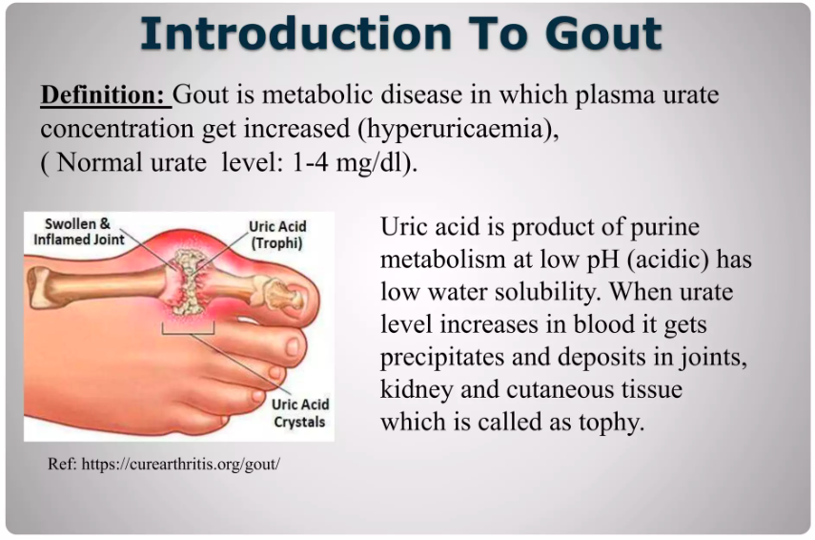

Slide 41
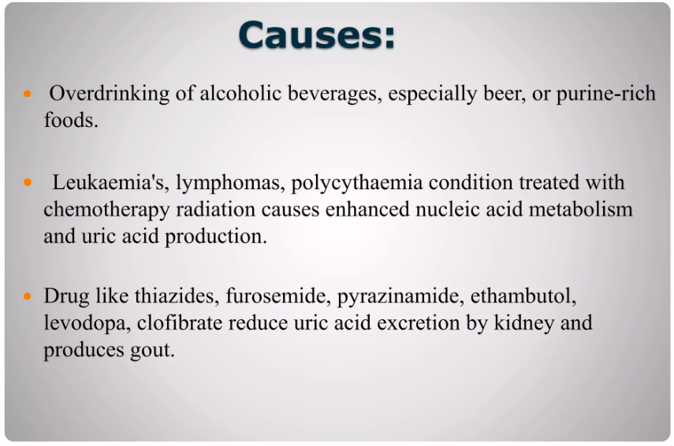

Slide 42
Uric acid synthesis
Hypoxanthine==> Xanthine ==> Uric acid
Enzyme- Xanthine Oxidase

Slide 43
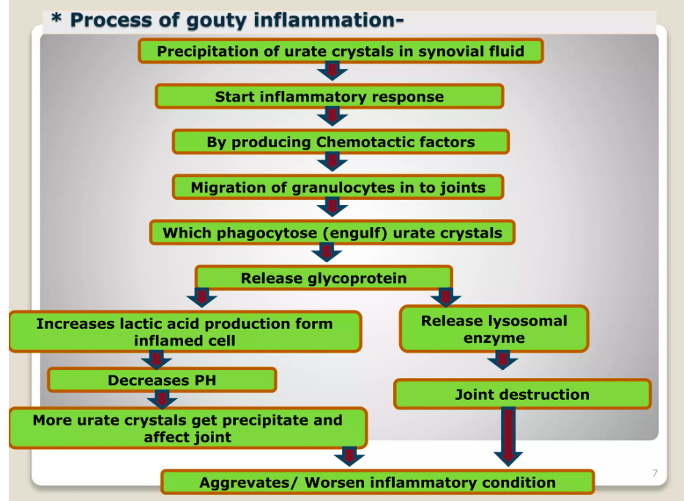

Slide 44
An acute attack of gout occurs as an inflammatory reaction to crystal of sodium urate deposited in the joint tissue
There is infiltration of granulocytes which phagocytize the urate crystals and release glycoprotein that causes joint destruction

Slide 45
Joint becomes red, swollen, tender and extremely painful
Secondary hyperuricemia may be drug induced/lymphoma/leukemia
Gout may also be due to decreased excretion of uric acid.

Slide 46
Strategies in the treatment of gout is either to decrease the synthesis of uric acid or to enhance the excretion of uric acid.

Slide 47
Drugs used in gout
  Acute gout
    Colchicine, NSAIDs
  Chronic gout
    Uric acid synthesis inhibitor: Allopurinol
    Uricosuric drug: Probenecid, Sulphipyrazone, Benzbromarone

Slide 48
Colchicine
  Alkaloid of Colchicum autumnale
  anti inflammatory agent effective only against gouty arthritis
  It is not an analgesic

Slide 49
Actions
  Highly effective in acute gout attacks
  Dramatically relieves pain in few hours
  Increases gut motility by neurogenic stimulation

Slide 50
M/A
  Inhibits migration of granulocytes into inflamed area & inhibit release of glycoprotein
Pharmacokinetics
  Rapidly absorbed orally
  Metabolised in liver

Slide 51
ADR
  Dose related
  Nausea, vomiting, diarrhoea, abdominal pain earliest side effects
  Anemia, leukopenia, alopecia
  Hemorrhagic gastroenteritis, nephrotoxicity, CNS depression, muscular paralysis, respiratory failure

Slide 52
Uses
  Acute gout
    Colchicine 1mg orally initially f/b o.5 mg every 2-3 hours relieves pain & swelling with in 12 hours
    But diarrhoea limits its use
  Prophylaxis
    Colchicine may also be used for the prophylaxis of recurrent episodes of gouty arthritis.

Slide 53
NSAIDs
  Symptomatic relief in the treatment of gout
  Indomethacin is a most commonly used agent in acute gout
  Piroxicam, Naproxen & other newer NSAIDs are also used
  Relieve acute attack in 12-24 hours
  Better tolerated than Colchicine
  But they are not recommended for long term use

Slide 54
Allopurinol
  Analogue of hypoxanthine
  Inhibits the uric acid sythesis

Slide 55
M/A
  Purine nucleotides are degraded to hypoxanthine
  Allopurinol & its metabolite Alloxathine both inhibit xanthine oxidase enzyme
  Thus, prevent the uric acid synthesis

Slide 56
Pharmacokinetics
  80% absorbed orally
  t1/2- 2 to 3 hours & of Alloxanthine 24 hrs

Slide 57
ADR
  Mild
  Hypersensitivity reactions include fever & rashes
  Gastrointestinal irritation, headache, nausea, dizzines
Attacks of acute gouty arthritis may be seen frequently during the initial months of treatment with Allopurinol.

Slide 58
Drug interactions
  The anticancer drugs- 6 mercaptopurine & Azathioprine are metabolised by Xanthine oxidase
  Hence when Allopurinol is used concurrently, the dose of these anticancer drugs should be reduced

Slide 59
Uses
  Allopurinol is used in chronic gout & secondary hyperuricemia
  Initial dose 100 mg/day and gradually up to 300 mg/day depending on the response
  Colchicine should be given concurrently for first few weeks to prevent acute attack

Slide 60
Uricosuric drugs
Probenecid
  Organic acid
  Developed to inhibit the renal tubular secretion of penicillin in order to prolong its action
  It blocks tubular reabsorption of Uric Acid
  Promotes its excretion
  Well absorbed & well tolerated

Slide 61
ADR
  Gastrointestinal irritation
  Skin rashes
  Large amount of water should be given to prevent formation of renal stones

Slide 62
Uses
  Chronic gout & secondary hyperuricemia
  May precipitate acute attack of gout due to fluctuating urate levels

Slide 63
Sulfinpyrazone
  Pyrazolone derivative is another uricosuric drug
  Similar to probenecid
  Used in chronic gout

Slide 64
Benzbromarone
  Potent Uricosuric drug
  Inhibit renal tubular reabsorption of uric acid
  Used as an alternative in patients allergic to other drugs
  Can be used in combination with Allopurinol

Slide 65
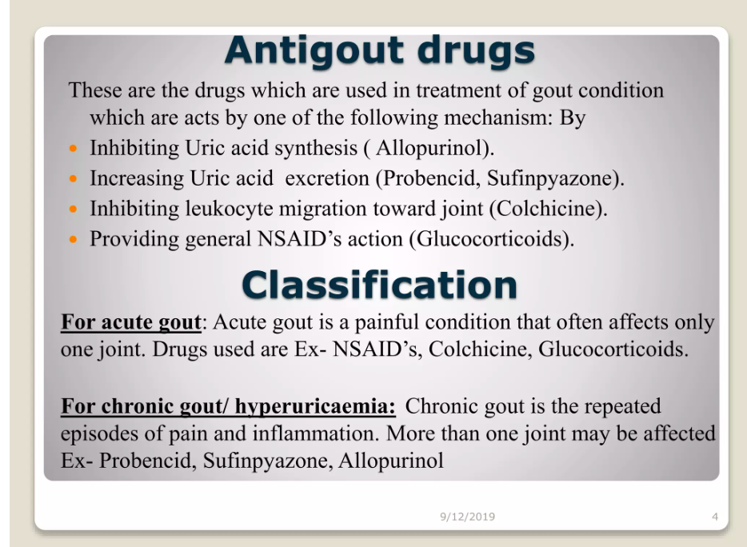

Slide 66
Which of the following drug is used in acute gout?
Colchicine
Benzbromarone
Probenecid
Sulfinpyrazone

Slide 67
2. Which of the following drug should be given along with Allopurinol to prevent acute attack?
Colchicine
Probenecid
Sulfinpyrazone
Benzbromarone

Slide 68
3. Which of the following drug can precipitate acute attack?
NSAIDs
Probenecid
Allopurinol
Colchicine

Slide 69
4. All are the used in chronic gout except?
Colchicine
Benzbromarone
Probenecid
Sulfinpyrazone

Slide 70
5. Which of the following is uric acid synthesis inhibitor?
Allopurinol
Probenecid
Benzbromarone
Sulfinpyrazone

Slide 71

