Slide 1
Medical Certification of Cause of Death
- Dr. Kalpesh Zanzrukiya
MD Forensic Medicine

Slide 2
In this session
No. | COMPETENCY | Domain (K/S/A/C) | Level (K/KH/S/SH/P) | Core (Y/N)
FM1.9 | Describe the importance of documentation in medical practice - patient case records, discharge summary, medical certificates, medico-legal reports, Registers, MCCD, Birth & Death certificates | K | KH | Y
FM1.10 | Select appropriate cause of death in a particular scenario by referring ICD 11 code | K | KH | Y
FM1.11 | Write a correct cause of death certificate as per ICD 11 document | S | SH | Y

Slide 3
SPECIFIC LEARNING OBJECTIVES At the end of this session, the 2nd MBBS student.... | Integration
 | N
 | N
 | N
 | N

Slide 4
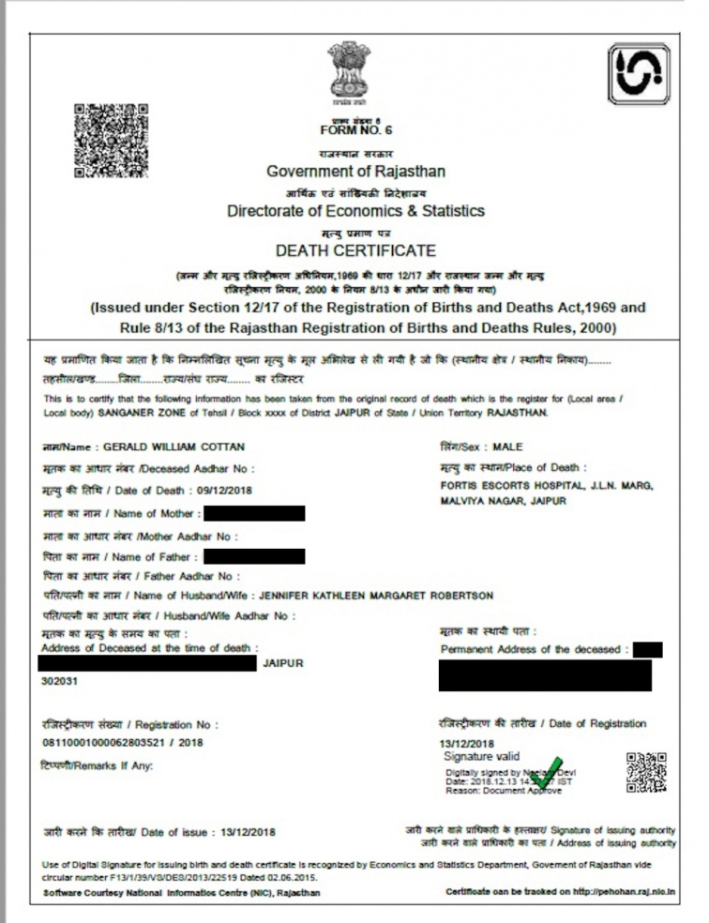
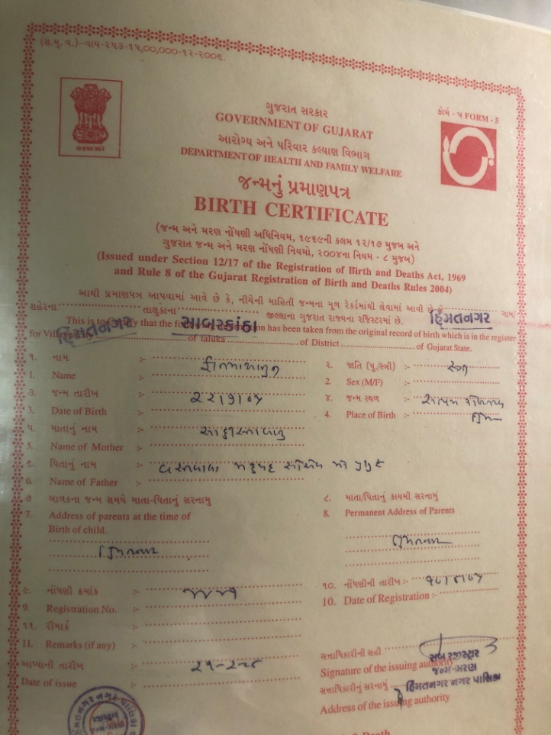
INTRODUCTION
Birth & Death Registration Act 1969

Slide 5
MCCD – Medical Certification of Cause of Death
Certification of ‘Death’ & ‘Cause of death’ by a medical practitioner who has attended the deceased during last illness or ailment.
To be issued free of charges/fees.
If not given, can be punished.
It’s a moral & ethical obligation as last attending doctor.

Slide 6
The data on causes of death is coded as per ICD-11 coding.
Public health planners, administrators, medical professionals, research workers.
Purpose -
  Assessing the effectiveness of current public health programs
  A feed-back for planning future health policy
  Deciding priorities of health and medical research programs.

Slide 7
Standard form of MCCD(as per WHO guidelines)
Form no. 4 – for institutional death
Form no. 4A – for non-institutional deaths

Slide 8
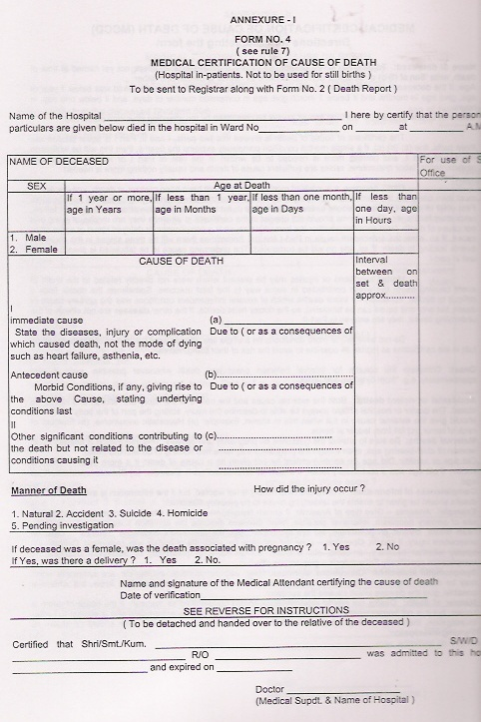

Slide 9
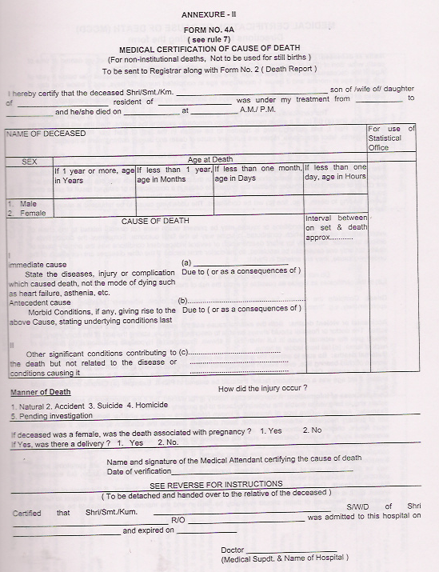
Form 4 A

Slide 10
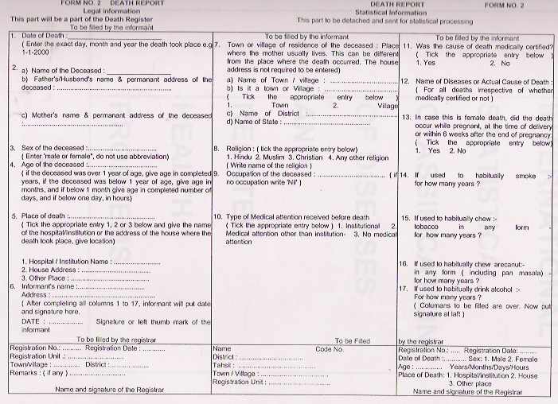
Death report

Slide 11
Rules to follow
Every column should be filled.(if any ‘not applicable’, mention).
Legible writing. No short forms/initials.
Be assure for each detail(Name, age, sex,…, date & time of death,…)
Name: full name(if unnamed newborn, S/o D/o _______)(if unknown male c/o _____ PS)
Age : >1 yr – in yrs, 1mth to 1yr – in mths, 1d to 1mth – in days
Sex : M/F

Slide 12
CAUSE OF DEATH
Two parts
Part I
Immediate Cause (a)
Antecedent Cause (b)
Underlying cause (c)
Part II
Other significant conditions

Slide 13
Part I(a) - Immediate Cause
The disease, injury or complication that directly lead to death.
There must always be an entry on line (a)
Not mode of dying (Heart failure, respiratory failure, cardio-respiratory arrest, coma etc.)
In case of a violent death - result of external cause (e.g. Fracture of skull base, crushed chest, cut injury of neck vessels..)
Senility/old age should not be written if specific cause is known, write in part II

Slide 14

Part I(b) - Antecedent Cause
Condition antecedent to the immediate cause of death both with respect to time and etiological/ pathological relationship.
E.g. - Case of duodenal ulcer…

Slide 15
Part I(c) - Underlying Cause
The condition which gave rise to the antecedent condition on line (b).
If the sequence of events comprise more than 3 stages extra line or entries may be made in part I as (d).
Very important b’cos….. condition on the lowest line of part I will be taken as a underlying cause and used for statistical classification of cause of death by ICD.

Slide 16
Part II (Other significant conditions)
Enter all other diseases or conditions contributed to death but not directly causing the death.
Alcohol, smoking, environmental factors, remote injury/diseases, pregnancy, surgery etc.

Slide 17
Time interval
Between onset of condition & death
If not known exact – write in approx. (several months, since birth)
If not known at all – write ‘unknown’
[Where an important detail is unknown, the fact should be stated.]

Slide 18
Manner of death
Natural
Accidental
Suicide
Homicidal
Pending investigation/Undetermined

Slide 19
If the deceased a female,…
If death associated to pregnancy – Yes/No
If yes, was there a delivery? – Yes/No
  Simply tick
  Important for maternity related indices & health policies(MMR etc.)

Slide 20
Sign, Name, Degree & MCI Reg. No. of certifying doctor with Date
Detachable part – to be handover to relative
  ‘Death slip/ Death declaration report’
  Sign, Name of doctor/superintendent of hospital
  Necessary to produce at cremation/funeral site.

Slide 21
Not to mention COD in MCCD in –
  MLC cases where PM is to be done/needed
  Brought dead/dead on arrival cases – MLC case
  Suspicion/ doubt of any crime – MLC case
  Still birth cases – form no.3
  mention only ‘as per PM Report’ in COD , issue ‘Death declaration report’
In case of medico-legal cases(MLC), the MCCD has to be issued by the police authorities/PM conducting Dr. However, the Registrar should be informed of such cases, by the hospital.

Slide 22
Death Declaration Report
This is to notify that patient named ___________________________ which was under treatment at ______________________ Hospital, Vadodara has been declared dead after due medical examination by me on Dt___________ time_________. He/she was under treatment for _____________________ until death.
Sign :
Name :
Stamp:

Slide 23
Practical Points
No hurry but no delay.
No charge any fees.
Never in advance.
Never without personally examination of deceased person & assured about COD.
Not to mention COD in MCCD in – (‘death declaratn report’)
  MLC cases where PM is to be done/needed
  Brought dead/dead on arrival cases
  Suspicion/ doubt of any crime
  Still birth cases
In cases where PME is done - MCCD to be filled by PM conducting doctor (last attending Dr. !)

Slide 24
MCCD is not a ‘Death certi’/ ‘Cause of Death certi’ – not for relatives nor for legal purpose/police.
MCCD is a medical certificate. Maintain confidentiality.
All certificates sent to the local registrar along with death reports on 5th of every month
- 21* days timelimit, than late charges

Slide 25
Sample exercise 1
A lady aged 23 years was admitted to a hospital. She had alleged H/o suicidal burns before1 hour- by pouring of kerosene and fired up herself. O/E patient had 78% burns(superficial & deep). She developed septicemia and died after 3 days of admission.

Slide 26
Answer
A lady aged 23 years was admitted to a hospital. She had alleged H/o suicidal burns before1 hour- by pouring of kerosene and fired up herself. O/E patient had 78% burns(superficial & deep). She developed septicemia and died after 3 days of admission.
Part-I | Septicemia Burns 78% (superficial & deep) Kerosene flame burns | 1 days 3 days 3 days
Part-II | NIL

Slide 27
Sample exercise 2
57yrs old male admitted in the hospital in the state of shock with h/o severe haemetemesis since 2 hours. On investigation he was found to have oesophageal varices due to portal hypertension. He was known hypertensive since last 10 years. There was h/o jaundice 1 year back which was diagnosed as hepatitis B. He died within 12 hours of admission in spite of all the treatment efforts. Issue MCCD.

Slide 28
Answer
57yrs old male admitted in the hospital in the state of shock with h/o severe haemetemesis since 2 hours. On investigation he was found to have oesophageal varices due to portal hypertension. He was known hypertensive since last 10 years. There was h/o jaundice 1 year back which was diagnosed as hepatitis B. He died within 12 hours of admission in spite of all the treatment efforts. Issue MCCD.
Part-I | Haemetemesis Oesophageal varices Portal Hypertension Hepatitis B | 14 hrs Unknown Unknown 1 yr
Part-II | Hypertension | 10 yrs

Slide 29
Sample exercise 3
59 years old male was admitted to the hospital with shock & signs of septicemia along with gangrene of left foot. Patient had fever since 7 days. He had H/O chronic bronchitis and diabetes since 5 years. Patients had also diagnosed as C/O carcinoma of pancreas and operated for the same 5 years back. Patient died 2 days after admission due to septicaemic shock. Issue MCCD.

Slide 30
Sample exercise 4
26 years old woman delivered a male child on 15-12-2017 at 7:30 pm. The baby was premature (30 weeks of gestation) & birth weight 1350 grams. After birth baby had respiratory distress. On examination baby was hypothermic and had blood stained froth at nostrils and mouth. The diagnosis was suggestive of pulmonary hemorrhage. In spite of treatment, baby’s condition deteriorated and he died on 16-12-2017 at 5:30 am. Issue MCCD.

Slide 31
Sample exercise 5
On 18/08/16, 01:15am; emergency service 108 got a call from waghodia highway for a car accident. There was a 21yr old male driver with bleeding from head & face with crush injury over chest. In spite of all efforts by 108 ambulance doctor, the boy died on way to hospital. Boy declared brought dead at 01:45am at Dhiraj Hospital. You are doctor in-charge of the 108 ambulance. What to do for MCCD?

Slide 32
Sample exercise 6
A family physician got a call for home visit for his 74yrs old female pt, at 6:00am on 22/08/16. On reaching he found no signs of life. The pt was having H/o ischemic heart disease since 15yrs and diabetes since 20yrs. Pt was diagnosed as ‘acute angina’ by the physician previous day 7pm, but pt refused any treatment for it & got DAMA after primary treatment. Issue MCCD.

Slide 33
THANKS

Slide 34
MCQ 1
In case of death of a patient admitted to hospital, which form would you fill for MCCD?
  Form no. 4
  Form no. 4A
  Form no. 3
  Form no. 2

Slide 35
MCQ 2
As per regulations for MCCD, who is supposed to certify the MCCD form the deceased?
  Physician under which the patient is admitted
  Last attending doctor or doctor having personal knowledge of the case
  Any doctor on duty at time of death of the patient
  Any registered doctor, irrelevant to doctor-patient relationship

Slide 36
MCQ 3
What are the rules to mention the ‘chronological order’ for causes of death of a patient in MCCD form?
  Grave and most serious medical condition to be mentioned in first line(Ia) and milder ones at lower lines.
  Medical condition directly leading to death, to be mentioned in first line(Ia) and conditions antecedent to that in lower lines chronologically
  The chief mode of death(cardiac/respiratory/CNS failure) to be mentioned in first line(Ia) and conditions leading to that in lower lines chronologically
  There is no particular order. All conditions patient suffering from, can be mentioned in single line.

Slide 37
MCQ 4

Slide 38
MCQ 5
What to do with a filled MCCD form?
  To be given to near relative of deceased.
  MCCD form to be made in duplicate, One copy to be given to near relative and other copy to retain as hospital record.
  Lower detachable part of MCCD certificate to be handed over to near relative as a death slip and remaining certificate to be sent to the registrar office.
  Whole MCCD certificate is to be kept as hospital record.

