Slide 1
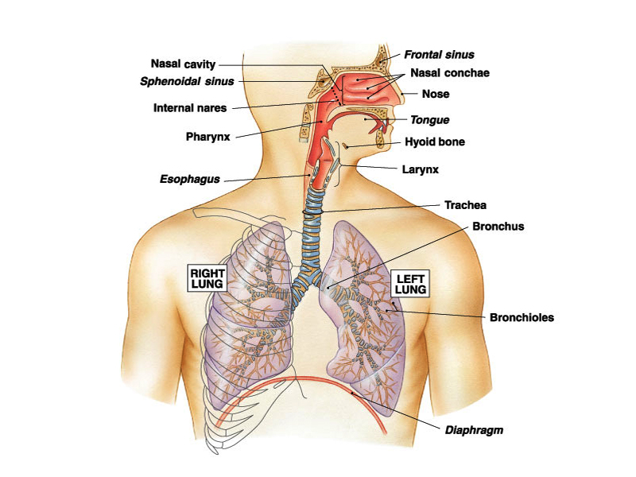
Mechanism of Respiration- 1(PY-6.2)
DR. DIKSHA YADAV
Associate Prof.

Slide 2
OVERVIEW
Respiratory movements
Introduction
Difference b/w inspiration & expiration
Muscle of Respiration
Mechanism of respiration
Respiratory pressure - Intrapleural pressure
- Intra-alveolar pressure
Lung Elastance & Compliance
Work of breathing

Slide 3
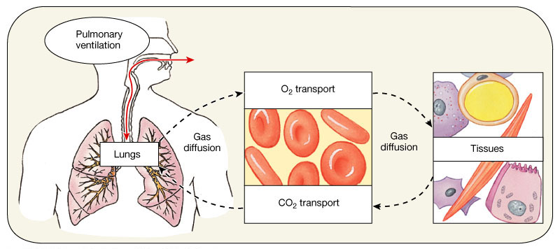
Three process
Environmental Air
        Pulmonary Ventilation
Lung alveoli
        Pulmonary Diffusion
Capillary Blood
        Transport of Gases
Tissue

Slide 4
RESPIRATION
Eupnea means rhythmic breathing at rest
It consists of Inspiration and Expiration.
Normal rate: 12-16 / min.
Ratio of respiration : Arterial Pulse → 1: 5

Slide 5
Inspiration
Active process – 2 sec
↓ Intra pleural &
Intra-alveolar pressure
Air rushes in
Enlarged thorax
Enlarged lung volume
Contraction of diaphragm pulls lower surfaces of lungs downwards.
Expiration
Passive process: 2-3 sec
↑ Intrapleural &
intra alveolar pressure
Air rushes out
Smaller thoracic cage
Less lung volume
Relaxation of diaphragm & elastic recoil of lung and chest wall

Slide 6
Muscle of respiration
Inspiratory muscles
Primary muscle
Diaphragm (C3 - C5)
External intercostal muscle ( T1-T11)
Accessory muscle
Sternocleidomastoid
Serratus anterior
Elevator of Scapulae & Pectorals
Expiratory muscles
Primary muscle
Internal intercostal muscle
( Intercostal nerve)
Accessory muscle
Abdominal muscle
- Rectus abdominis
- Transvers abdominis
- Internal oblique
- External oblique

Slide 7
MECHANICS OF BREATHINGS/ PV
Lungs can be expanded & contracted in two ways:
1. Downward and Upward movement - Diaphragm
lengthen /shorten chest cavity ( / Vertical Diameter)
2. Elevation and Depression of the Ribs
( / anteroposterior diameter of chest cavity.

Slide 8
Movement of thoracic cage
Inspiration → enlargement of thoracic cage
↑ Anteroposterior-
Transverse diameter elevation of ribs
&
Vertical diameter → descent of diaphragm
Change in thoracic cavity – movement of four units
Thoracic lid
Upper costal series
lower costal series
Diaphragm

Slide 9
Mechanism of Tidal Respiration
1. INSPIRATION
Normal Respiration (quiet breathing)
→ Diaphragm & External intercostal muscle
Diaphragm
Dome shape – musculocutaneous partition b/w thorax & abdomen.
Convexity directed towards thorax.
Contraction of diaphragm →70-75% expansion of chest

Slide 10
Contraction of diaphragm following changes
Dome flattened → vertical diameter
→ Normal breathing : 1-1.5 cm
→ forced inspiration : 7 – 7.5 cm
Descent of Diaphragm → intra-abdominal pressure
Lifts the lower ribs → Thoracic expansion laterally & Anteriorly ( Bucket handle & pump Handle Movement )

Slide 11
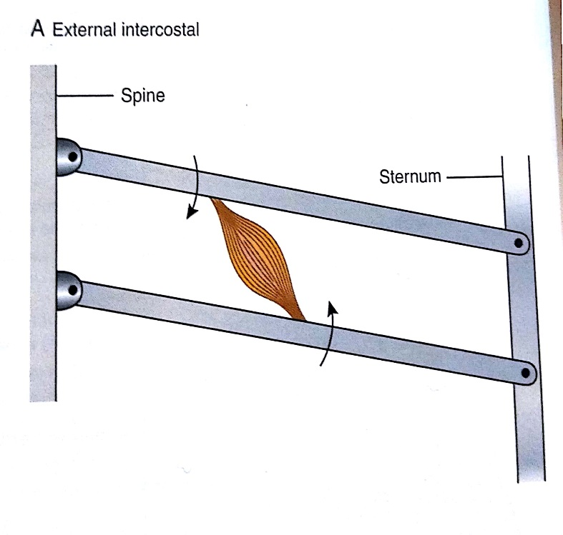
External Intercostal Muscles
Located in between the ribs
Fibers slop – downward & forward
→ Supplied by intercostal nerves.
When they contract
Ribs → Elevated : lateral & AP diameter
→ Enlargement of Thoracic cavity
Two types of movement
1. Bucket Handle movement (7-10th rib)
2. Pump Handle movement (2-6th rib )

Slide 12
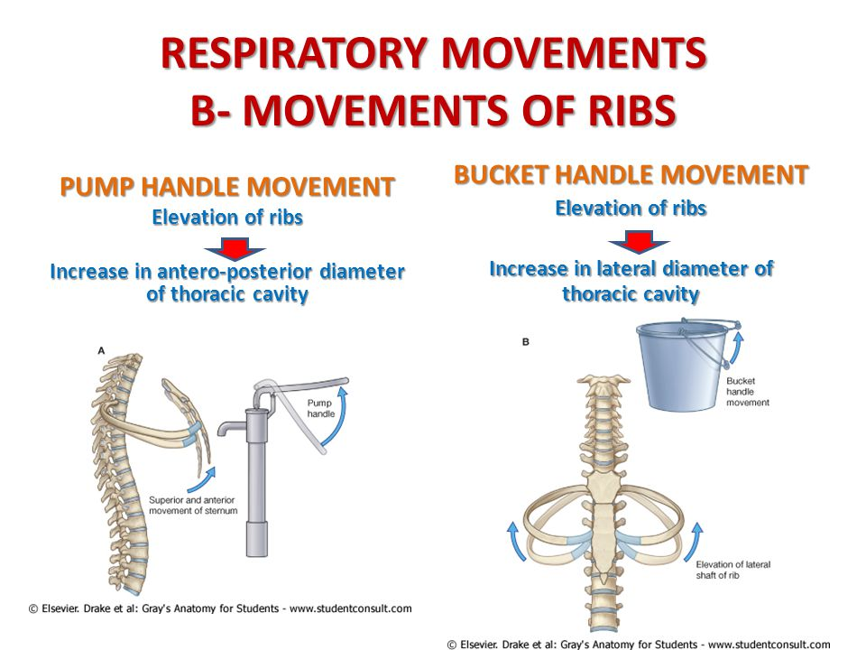

Slide 14
2. EXPIRATION
Passive phenomenon, brought by elastic recoil of lungs
Thoracic cavity due to relaxation of diaphragm & External intercostal muscle.
Tone of muscle of anterior abdominal wall which forces relaxing diaphragm upward
Serratus posterior inferior muscles → Pull down ribs.

Slide 15

Video

Slide 16


Slide 17
Mechanism of Forced Respiration
Forced inspiration
1. Forced contraction of diaphragm
→ descent – 7-10 cm ( N – 1-1.5 cm)
2. Forceful contraction of external intercostal muscle
→ more elevation of ribs – Transverse & AP Diameter
3. Contraction of accessory muscle

Slide 18
Forced Expiration
Exercise / severe respiratory disease
Active Process
1. Contraction of abdominal muscle
→ es Abdominal pressure
→ force diaphragm upward → reducing vertical diameter
2. Contraction of internal intercostal muscle

Slide 19
RESPIRATORY PRESSURES
1) Intra pleural / intrathoracic pressure
2) Intra alveolar / Intra pulmonary pressure
3) Trans pulmonary pressure
4) Mediastinal pressure
parallels the intra pleural pressure

Slide 20
Intra Pleural Pressure
Pressure inside Pleural Cavity
Normal value : Always Negative
( expressed in relation to atmospheric pressure )
Expiration : – 5 cm H2O &
Inspiration : – 7 cm H2O
Cause → Elastic recoil of lung
→ Pumping of Pleural fluid → lymphatics

Slide 21
Significance –
Prevent lung collapse
Due to –ve pressure Large veins & vena cava enlarged
- ve pressure act like pump & pull venous blood toward heart against gravity
thus Intrapleural responsible for venous return ,
so its called respiratory pump for venous return.

Slide 22
Factor Affecting IPP
Physiological
1. Deep inspiration
2. Valsalva maneuver
3. Gravity
Pathological
1.Emphysema
2. Injury to chest wall

Slide 23
Factors affecting IPP
PHYSIOLOGICAL
Deep inspiration
Deep expiration
Valsalva Maneuver is forceful expiration against closed glottis which can cause blackout or unconsciousness - coughing, defecation, sneezing, parturition, micturition, blowing a balloon.
Gravity effect in standing more –ve IPP at apex than base
PATHOLOGICAL
Emphysema as loss of lung elasticity so more IPP and chest expands and becomes barrel chest
Injury to thoracic wall causing air to enter pleural space till IPP becomes equal to atmospheric pressure and thus lungs collapse.

Slide 24
Severe attack of cough can lead to unconsciousness - as Valsalva maneuver occurs
- more positive IPP
- which reduces cardiac input or venous return
- so less cardiac output
- cerebral ischemia
- unconsciousness.

Slide 25
Intra alveolar Pressure
Pressure inside alveoli
Normal values : – 760 mmHg (= atmospheric pressure)
Inspiration: – 1 mmHg Expiration : + 1 mmHg
End of inspiration & expiration = A. pressure
Forced inspiration closed glottis
(muller’s maneuver ): – 80 mmHg
Forced expiration closed glottis
( Valsalva maneuver ) : 100 mmHg

Slide 26
Significance
1) Allows air to flow in and out.
2) Helps in exchange of gases between alveolar air and blood.

Slide 27
Transpulmonary pressure
Pressure difference b/w
Intra-alveolar & Intrapleural pressure
measure elastic force in lung
Responsible for collapsing tendency of lung
(Recoil pressure )

Slide 28
b

Slide 29
THANK YOU
          Conti…….
Lung Elastance & Compliance
Work of Breathing

Slide 30
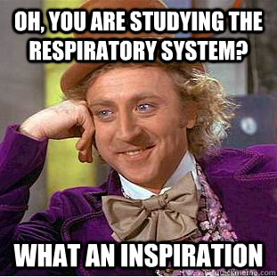
Thank You…

