Slide 1
METALLIC POISONS
- Dr Kalpesh Zanzrukiya

Slide 2
In this session..
Introduction - metallic poisons
  Arsenic
  Mercury
  Iron
  Lead
  Copper
  Potassium
  Others
Antidote of metallic poisons – Chelating Agents

Slide 3
In this session
No. | COMPETENCY | Domain (K/S/A/C) | Level (K/KH/S/SH/P) | Core (Y/N)
FM9.3 | Describe General Principles and basic methodologies in treatment of poisoning: decontamination, supportive therapy, antidote therapy, procedures of enhanced elimination with regard to Arsenic, lead, mercury, copper, iron, cadmium and thallium | K | KH | Y

Slide 4
SPECIFIC LEARNING OBJECTIVES At the end of this session, the 2nd MBBS student.... | Integration
Should able to describe General Principles and basic methodologies in treatment of poisoning: decontamination, supportive therapy, antidote therapy, procedures of enhanced elimination with regard to Arsenic, lead, mercury, copper, iron, cadmium and thallium | N

Slide 5
Antidote
Substances that counteract or neutralize the illeffect of poison
Types
  Mechanical/physical – mechanically neutralize OR prevent absorption
  Chemical – combine to poison -> harmless compounds -> excretion in feces, urine
  Physiological/ Pharmaco – acts at body tissues, produce opposite effects to poison’s effect
  Bypass - O2 in CN poisoning

Slide 6
Mechanical/Physical Antidote
Activated charcoal
  Fine, black powder
  Destructive distillation of wood pulp -> activating agents(steam, CO2) [double/super activated]
  M/A - Adsorb remaining poison from cavity
      Absorb poison from circulating blood into GI lumen
  Not effective – corrosive acids, heavy metals, Cyanide, HC, Ethanol
Demulcents
  Forms protective coating
  Milk, Starch, egg white, mineral oil, milk of Mg, AlOH
  Used in corrosive poisons
Bulky food – for powder glass, pins, coins

Slide 7
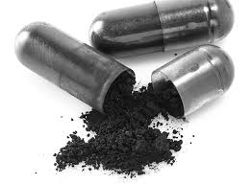
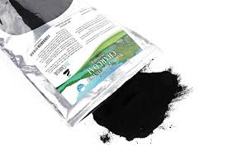
Activated Charcoal

Slide 8
Chemical Antidote
ANTIDOTE | POISONS
NaCl | Silver nitrate
Albumin | Mercuric chloride
CuSO4 (mild) | Phosphorus
KmNO4(1:5000) | Opium, heroin, phosphorus, strychnine, HCN, barbiturates
Tincture/Lugol’s Iodine | Most alkaloids, Pb, Hg, Ag, strychnine
Tannic acid 4% | Metallic poisons, nicotin, cocaine
Alkali | Acids
Universal antidote [burned toast2 + MgO + tea1] | Household poisons [not recommended now]

Slide 9
Physiological/Pharmaco Antidote
ANTIDOTE | POISONS
Atropine | Physostigmine, OP, OCl
Cyanide | Amyl Nitrate
Barbiturates | Amphatamines, Strychnine
Opioid drugs | Naloxone, Neltrexone, Nalorphine
Coma cocktail [100ml 50D + 100mg Thiamine + 2mg naloxone] | Coma due to unknown poisoning
BAL | Hg, As, Pb, Cu, Au, Bi, Thallium, Sb
EDTA | Hg, As, Pb, Cu, Co, Fe, Ni, Cd
Panicillamine | Hg, Pb, Cu
DMSA | Hg, As, Pb
Desferrioxamine, Deferiprone | Fe

Slide 10
Chelating Agents
BAL(British anti-lewisite) (Dimercaprol)
  Have 2 unsaturated SH groups -> binds to metals
  -> Stable compounds -> excreted in urine
  Dose : 12-24mg/kg/day in 3 to 6 divided doses
  Deep i.m. injection
  C/I – liver failure, G-6 PD deficiency
EDTA (CaNa2 versanate) - 50 to 75mg/kg/day
  i.v. infusion in 5D/NS
Penicillamine – orally or i.v.
  Dose : 30mg/kg/day in 4 divided doses
DMSA(DiMercapto Succinic Acid), DMPS(DiMercapto 1-Propane Sulfonic acid) – orally or i.v. – 10/5mg/kg/dose TDS or BD
Desferrioxamine – 1gm i.m. F/b 500mg 4hrly(max 6gm/d)

Slide 11
ARSENIC
Arsenious oxide, Arsenic Trioxide
‘Sankhya’, ‘Somalkhar’
Physical characteristics:
  White, crystalline powder
  Tasteless, odorless, floats on water, sublimes on heating
Used in:
  Weedkillers, insecticides, rat poisons, taxidermy
  Cu arsenite & Cu acetoarsenite(Paris Green)

Slide 12
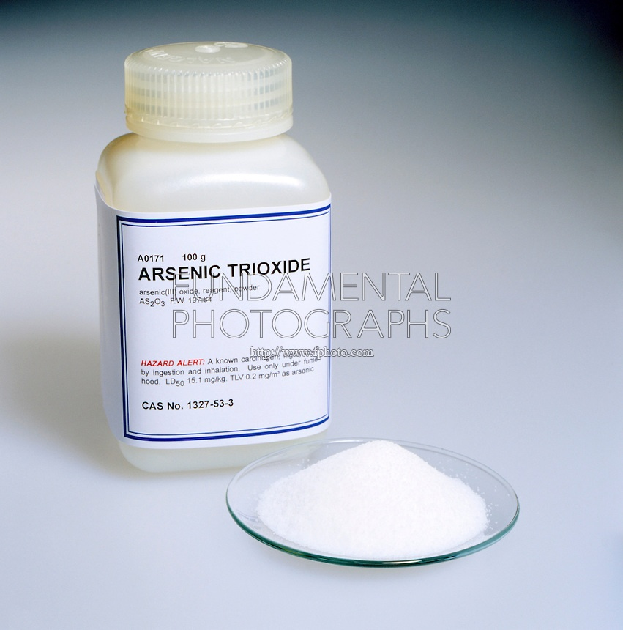
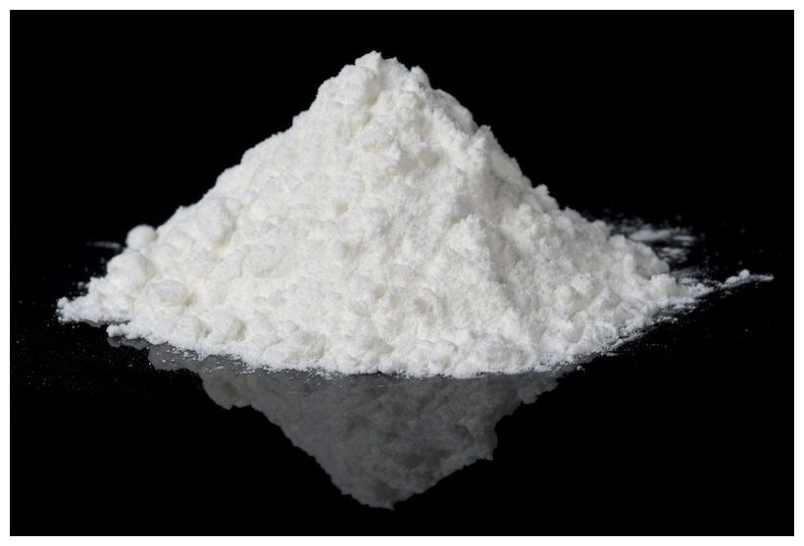

Slide 13
Mech of action – combines to –SH groups of mitochondrial enzymes and interfere the cellular respiration
Signs & Symptoms
  Fulminant poisoning (3 to 5gm) – circulatory shock
  GI poisoning – NVD, rice-water diarrhoea with tenesmus (mimics cholera), Renal failure

Slide 14
Fatal Dose – 0.1 to 0.2gm
Fatal period – 1 to 2 days
Treatment :
  ABCD
  Gastric lavage with warm water/milk
  Antidote
    BAL(British Anti Lewisite) deep i.m.
    Penicillamine orally/iv
    DMSA(DiMercapto Succinic Acid), DMPS(Di Mercapto 1-Propane Sulfonic acid) orally/iv
  Supportive – glucose saline, NS, Bicarbonate, ORS

Slide 15
PM findings
  Signs of dehydration
  Garlic like smell
  Mucosa of GIT – congestion, edematous, submucosal hemorrhage
  Stomach mucosa – red velvety
  Viscera preserved for Chemical analysis – routine, Bone, Hair, Nails
  Chemical tests – Marsh Test, Reinsch Test

Slide 16
Chronic poisoning
  CNS – polyneuritis, parasthesia
  Skin – raindrop pigmentations
  Nails – Aldrich mees lines
  GIT, CVS, Kidneys, Liver
  Bone marrow – anemia
  Carcinogenic - lung cancer, skin cancer, leukaemia

Slide 17
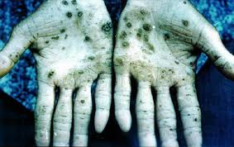
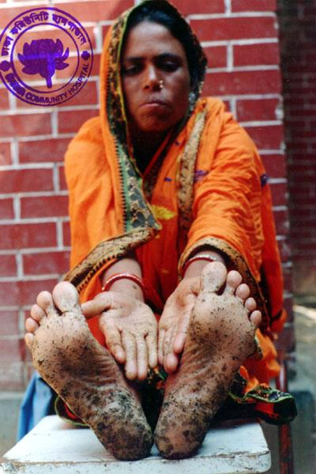
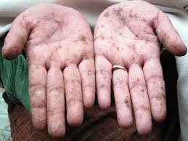
Raindrop pigmentations

Slide 18
Medicolegal Importance
  Homicide - Ideal homicidal poison
  Accidental, occupational poisoning
  Abortificient
  Cattle poison
  Aphrodisiac
  Arsenophagists
  Difference B/w Arsenic poisoning & Cholera

Slide 19
MERCURY
‘Quick silver’
Physical characteristics:
  Liquid metal, bright silver color
  Volatile at room temp.
  Two types of compounds – mercuric, mercurous
Toxic compounds:
  Mercuric chloride
  Mercuric oxide
  Mercuric iodide
  Mercuric cyanide
  Mercuric sulphide (Vermilion, sindoor, cinnabar)

Slide 20
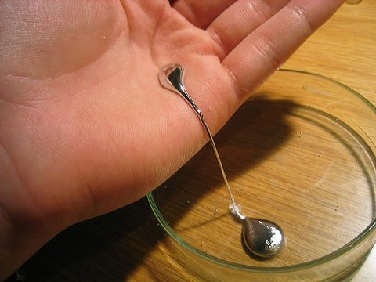
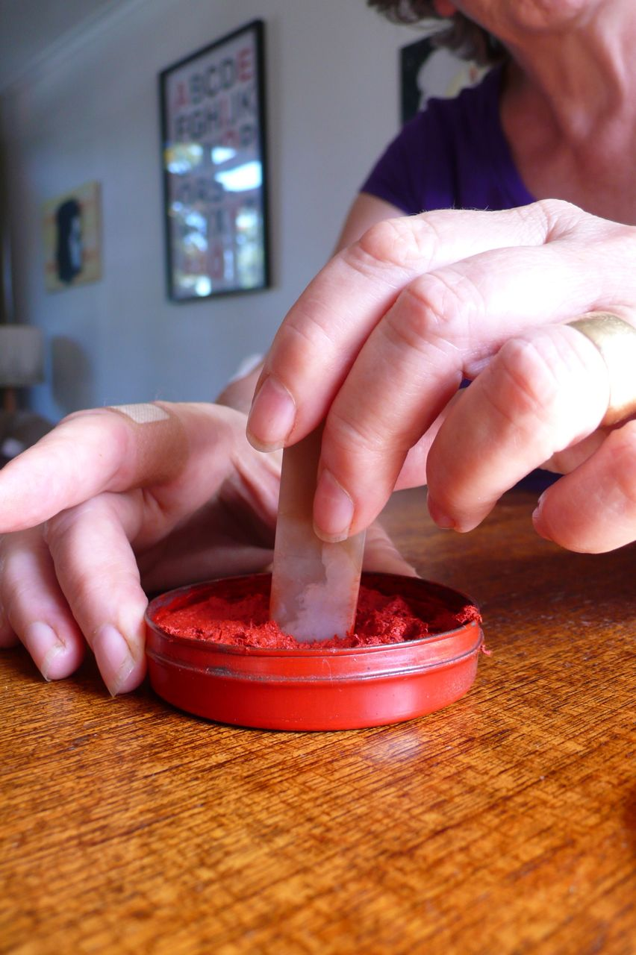
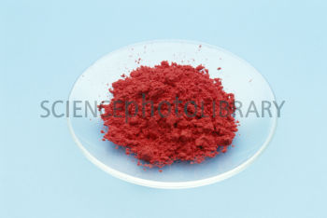

Slide 21
Symptoms
  Acrid metallic taste, NVD -Bloody vomit
  Corrosion of mouth mucosa, Glossitis, ulcerative gingivitis
  Membranous colitis, hematochesia
  Renal tubular acidosis, necrosis, uremia, failure
  CNS – ataxia, parasthesia, neuropathies
  Circulatory shock
  If vapor inhaled directly – respi irritation, pul. Edema, pneumonitis

Slide 22
Fatal Dose – 1 to 2gm Mercuric Chloride,
Fatal period – 3 to 5 days
Treatment :
  If emergency, ABCD
  Gastric lavage with milk/egg white/ albumin/ 5% Na Formaldehyde sulfoxylate
  Whole bowel irrigation
  Antidote
    D- penicillamine
    BAL
  Supportive – glucose saline, NS, Bicarbonate, ORS, O2
  Urine must be kept alkaline
  Hemodialysis if renal failure

Slide 23
PM findings
  Signs of dehydration
  Mucosa of GIT – inflammation, congestion, corrosion, hemorrhage & coagulation
  Kidneys – ATN, hemorrhagic GN
  Viscera preserved for Chemical analysis – routine, Bone, Hair, Nails
  Chemical tests – Cu wire + HCl => silvery coating on wire

Slide 24
Chronic poisoning [Hydragyrism]
  Classic triad – gingivitis, tremors, neuropsychiatric changes
  Gingivitis, hypersalivation, blue line, sore throat
  Danbury tremors, hatter’s shake, glass blower’s shakes
  Concussio mercurialis
  Mercurial erethism – glass industries, anxiety, depression, shyness, irritation, loss of confidence, emotional lability, delusions, hallucinations, memory loss & insomnia
  Mercurialentis – brown deposition on ant. lens capsule
  Acrodynia/ Pink disease – idiosyncratic hypersensitivity Sn in children, gen rash over palms & whole body, anorexia, pain, parasthesia, irritability, photophobia.
  Treatment – Chelation therapy(BAL, d-P, DMPS/DMSA) and supportive Rx

Slide 25
Medicolegal Importance
  Accidental, occupational poisoning
  Homicide, suicidal - rare
  Abortificient
  Minamata disease

Slide 26
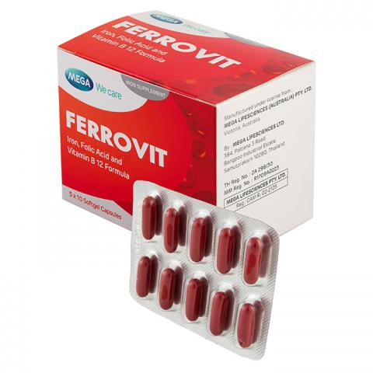
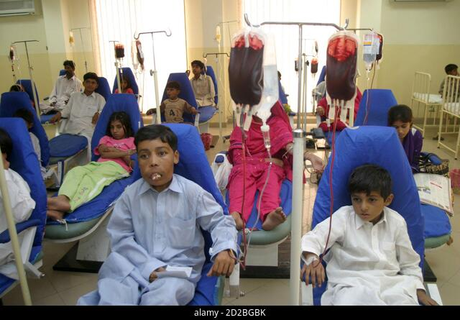
IRON
Mech of action : inhibition of mitochondrial functions & corrosive
Iron poisoning (overload) occurs in patients of hemoglobinopathies who requires recurrent Blood Transfusions. E.g. Thalassemia, Sickle cell anaemia etc.

Slide 27
Acute poisoning
Symptoms
  1st stage – NVD, abd pain, GI haemorrhage, shock, acidosis
  2nd stage – symptom free
  3rd stage – metabolic acidosis, jaundice, hypoglycemia, shock, hepatic & renal failure, coma
  4th stage(delayed Cx) – gastric strincture, pyloric stenosis

Slide 28
Fatal Dose – 20 to 30 gm
Fatal period – 24 to 30 hrs
Treatment :
  If emergency, ABCD
  Gastric lavage with 5% Na Bicarbonate
  Demulsants – egg white, milk
  Antidote – Desferrioxamine(iv), Deferiprone(iv/oral)
  Supportive - fluids, glucose, multivitamins

Slide 29
PM findings
  Mucosa of GIT – congestion, corrosion, hemorrhages, perforation
  Liver & kidneys – necrotic changes
  Viscera preserved for Chemical analysis – routine
Medicolegal Imp
  Suicidal poisoning – Fe tablets
  Accidental poisoning

Slide 30
Reference books
The Essentials of FMT by Dr KSN Reddy
Modern Medical Toxicology by Dr VV Pillay
Essentials of FMT by Dr A Aggrawal
Textbook of MJFMT by Dr CK Parikh
MCQs

Slide 31
MCQ 1
A factory worker visits a doctor with c/o tingling & numbness in both feets since 2 wks. On examination, his conjunctiva was pale, palms & soles had raindrop pigmentation and horizontal lines over fingernails. Most probable diagnosis would be
Copper poisoning
Iron poisoning
Arsenic poisoning
Mercury poisoning

Slide 32
MCQ 2
A factory worker visits a doctor with c/o tingling & numbness in both feets since 2 wks. On examination, his conjunctiva was pale, palms & soles had raindrop pigmentation and horizontal lines over fingernails. All following antidotes may be used except
BAL
Desferrioxamine
D-penicillamine
DMSA

Slide 33
MCQ 3
‘Erathism’ and ‘Pink disease’ are characteristically seen in poisoning of
Lead
Iron
Arsenic
Mercury

Slide 34
MCQ 4
In case of suspected death due to Arsenic trioxide poisoning, which of following chemical test may be used for confirmation
Marsh test
Silver nitrate test
Barium chloride test
Stool microscopy

Slide 35
MCQ 5
Which of following chelating agent would be treatment of choice in case of iron overload
British anti lewisite
Dimercapto succinic acid
Dimercapto 1-propane sulfonate
Desferrioxamine

Slide 36
In this session..
Introduction - metallic poisons
  Arsenic
  Mercury
  Iron
  Lead
  Copper
  Potassium
  Others

Slide 37
LEAD
Toxic compounds & Physical characteristics :
  Lead tetroxide(vermilion, sindur, red lead) – orange/scarlet red crystalline powder
  Lead acetate (sugar of lead) – white crystals
  Lead carbonate (safeda) – white powder
  Lead monoxide – pale orange
  Lead sulphate
  Lead Chromate – Bright Yellow powder

Slide 38
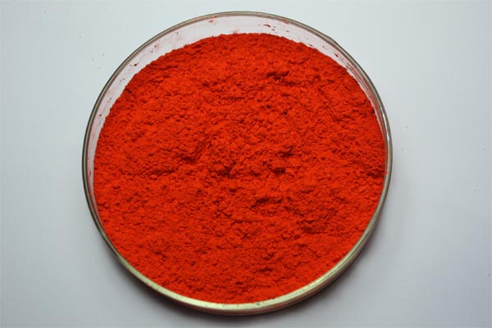
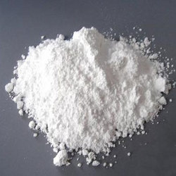
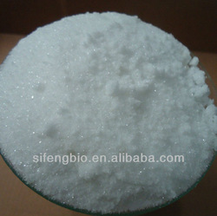
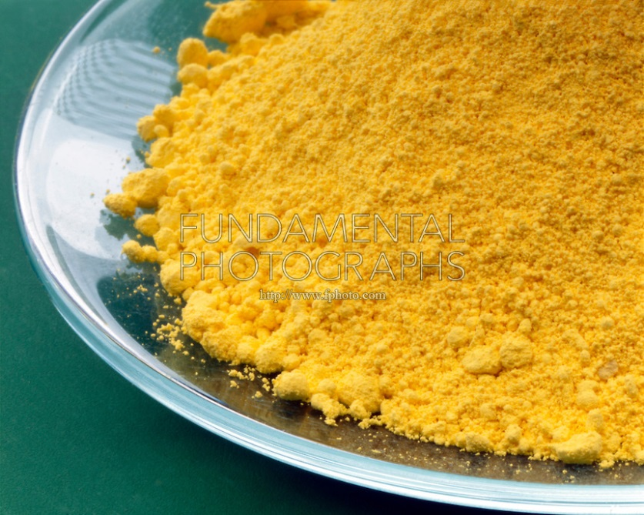

Slide 39
Acute poisoning
Symptoms
  Metallic taste, dry throat, NV
  Burning abdominal pain
  Circulatory shock
  Headache, insomnia, depression
  coma

Slide 40
Fatal Dose – 20gm Lead acetate, 40gm Lead carbonate
Fatal period – 1 to 2 days
Lab Ix – Bl porphyrine level > 0.07mg%, Urine porphyrine > 0.15-0.3mg%

Slide 41
Treatment :
  If emergency, ABCD
  Gastric lavage with milk/egg white/ albumin, 1% Na or Mg sulphate
  Antidote
    DMSA, DMPS
    EDTA
    BAL
    D-penicillamine
  Supportive
    Thiamine, B12 – for neurological symptoms
    Ca gluconate – for colic
    Mg & Na Sulphate – hastens excretion in stool
  Peritoneal/Hemo-dialysis if renal failure

Slide 42
PM findings
  Burtonian line on gums
  Mucosa of GIT – congestion, ulceration, hemorrhages
  Kidneys & Liver – contracted
  Bone marrow – hyperplasia
  Peripheral nerves – segmental demylinations
  Viscera preserved for Chemical analysis – routine, Bone
  Chemical tests – HCl => white precipitates

Slide 43
Chronic poisoning [Plumbism/ Saturnism]
Paints, toys, printers, glass industry, lead pipes
Anaemia – sideroblasts, polychromasia, punctate basophilia/ basophilic stippling, reticulocytosis, eosinophilia, monocytosis
Lead line (Bertonian line) – Pb, Cu, Hg, Fe, Bi, Ag
Abdominal colic & constipation
Lead palsy – tremors, numbness, cramps, hyperesthesia, radial nerve palsy(wrist drop), foot drop, peripheral neuritis
Lead Encephalopathy – headache, insomnia, anxiety, irritability, delirium, convulsions, coma; permanent brain damage(irreversible)
CVS – HT
Kidneys – interstitial nephritis
Reproductive system – menstrual abnormalities, abortion(2nd T), sterility, gynecomastia
General – anorexia, dyspepsia, hair loss

Slide 44
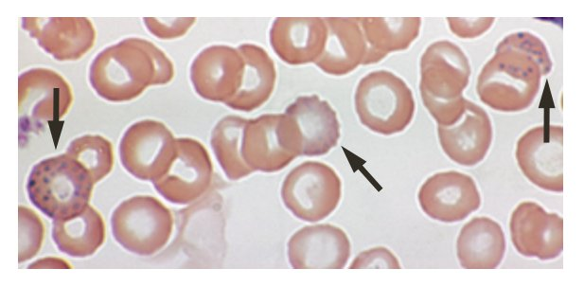
Blood Smear in Plumbism

Slide 45
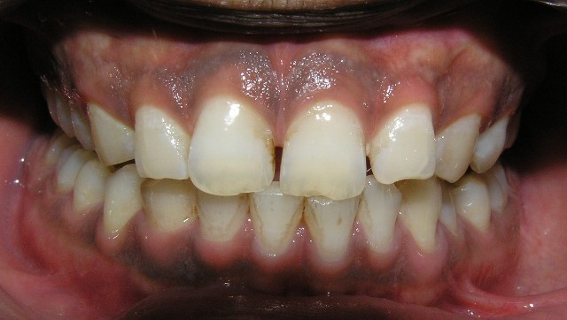
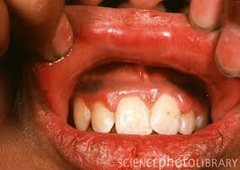
Burtonian lines on gums

Slide 46
Medicolegal Importance
  Accidental poisoning
  occupational poisoning
  Homicide, suicidal - rare
  Abortificient (lead oleate)
  Cattle poison (red lead)
  Poisoning from gunshot wound retained bullet fragments (in 12 to 48 days)

Slide 47
COPPER
Toxic compounds & Physical characteristics :
  Copper Sulphate (Blue vitriol) – blue crystals
  Copper subacetate (verdigris) – bluish green mass/powder
Mech of action - Powerful inhibitors of enzymes

Slide 48
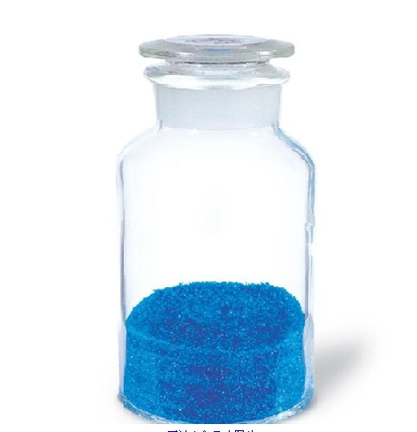
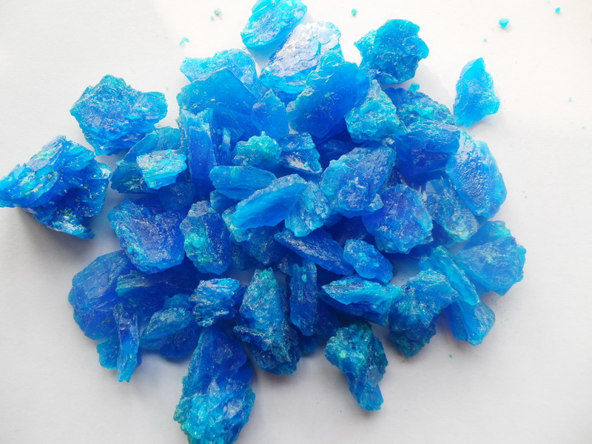
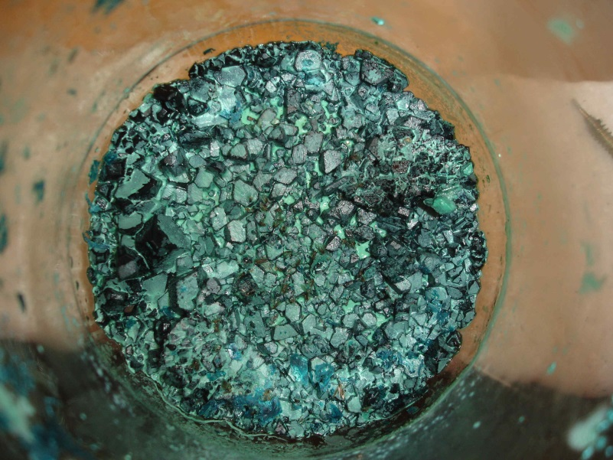
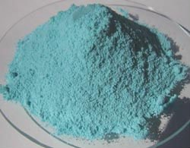

Slide 49
Acute poisoning
Symptoms
  Metallic taste, burning pain, NV – blue-green
  Abdominal colic, diarrhoea
  Haemolysis, Hb uria, meth Hb, jaundice, pancreatitis
  Leg cramps, spasms, convulsions
  Circulatory shock, liver failure, kidney failure
  Headache, drowsiness, coma
  Inhalation of Cu fumes – URT irritation
  Skin contact – chemical dermatitis, discoloration

Slide 50
Fatal Dose – 30gm CuSO4, 15gm Cu subacetate
Fatal period – 1 to 3 days
Treatment :
  If emergency, ABCD
  Gastric lavage with 1% Potassium ferrocyanide => insoluble cupric ferrocyanide
  demulsants
  Antidote
    D-penicillamine
    EDTA
    BAL
  Supportive
    Ca gluconate – for colic
    Liver protactive diet, glucose, multivitamins
  Hemo-dialysis if renal failure, Liver failure

Slide 51
PM findings
  Greenish blue froth
  Mucosa of GIT – congestion, ulceration, hemorrhages
    Greenish blue discoloration with contents
  Liver – congested, fatty
  Kidneys – tubular necrosis
  Viscera preserved for Chemical analysis – routine, Hair
  Chemical test – Ammonium hydroxide => greenish blue precipitates

Slide 52
Chronic poisoning [Wilson’s Disease]
Industrial workers, fume inhalation, food contamination with virdigris
Vineyard sprayer’s lung Dz – histiocytic granulomas
Hemolytic anaemia
Blue line on gums – Pb, Cu, Hg, Fe, Bi, Ag
Abdominal colic, NVD,
Liver – cirrhosis, jaundice, liver failure
Peripheral neuritis, wasting of muscles, psychosis
Chalcosis – Cu deposition in tissues
Keyser Flersher’s ring in cornea (slit lamp examination)
General – anorexia, greenish hair discoloration

Slide 53
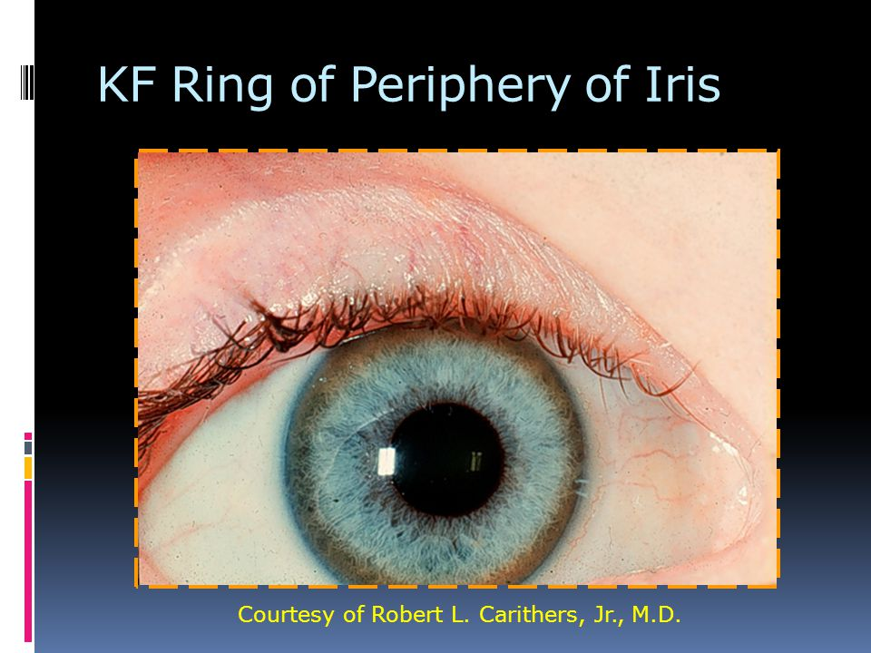

Slide 54
Medicolegal Importance
  Accidental poisoning
  occupational poisoning
  Homicide, suicidal - rare
  Abortificient
  Cattle poison

Slide 55
POTASSIUM PERMANGANATE
Physical characteristics :
  Dark purple crystals
Mech of action : a strong irritant, corrosive & coagulative necrosis

Slide 56
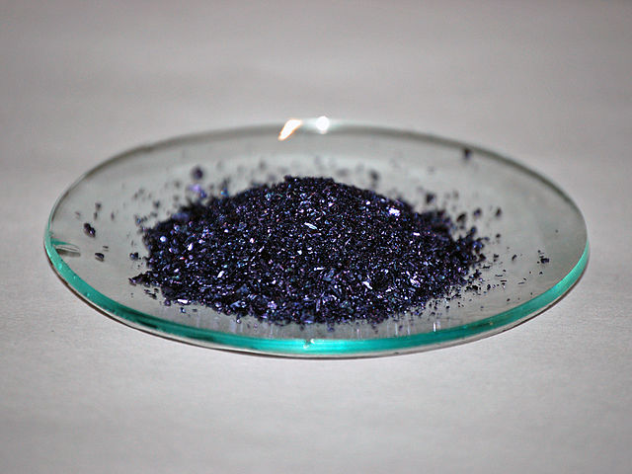
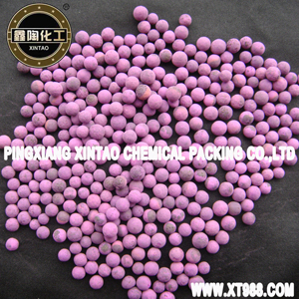
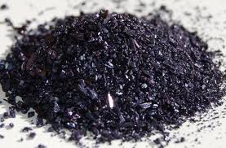

Slide 57
Acute poisoning
Symptoms
  Sweet astringent taste, burning pain, NV
  Lips, teeth, gums, tongue discoloration(dark brown), corrosion
  Dysphagia, dyspnoea, persistant spasmodic cough
  Abdominal pain
  Circulatory shock
  Skin contact – chemical dermatitis, discoloration

Slide 58
Fatal Dose – 5 to 10gm
Fatal period – few hrs
Treatment :
  If emergency, ABCD
  Gastric lavage with 20% Na Thiosulphate, demulsants + Activated charcoal
  Supportive - fluids, glucose, multivitamins

Slide 59
PM findings
  Dark brown to black discoloration of oral mucosa
  Mucosa of GIT – congestion, corrosion, hemorrhages
    Dark brown to black discoloration with contents
  Liver & kidneys – necrotic changes
  Viscera preserved for Chemical analysis – routine

Slide 60
Medicolegal Importance
  Accidental poisoning
  Suicidal poisoning
  Homicide - rare
  Abortificient – KMnO4 tablets
  Feigned injuries

Slide 61
Other metallic toxins
Thalium – alopecia, skin rashes, painful peripheral neuropathy & mental confusion
Barium
Manganese – Parkinsonism
Nickle –Lung cancer
Cadmium
Antimony
Zinc – metal fume fever

Slide 62
Reference books
The Essentials of FMT by Dr KSN Reddy
Essentials of FMT by Dr A Aggrawal
Modern Medical Toxicology by Dr VV Pillay
Textbook of MJFMT by Dr CK Parikh
MCQs

Slide 63
MCQ 1
Blood smear of a patient from medicine ward shows following picture. It is characteristic of which chronic poisoning?
Copper poisoning
Lead poisoning
Arsenic poisoning
Mercury poisoning

Slide 64
MCQ 2
Antidote of choice in case of Lead poisoning is
DMSA
BAL
d-penicillamine
Activated charcoal

Slide 65
MCQ 3
Which of following does not indicate signs & symptoms of chronic copper poisoning?
Dark blue line over gums
Mandibular osteonecrosis
KF ring over cornea
Cirrhosis of liver

Slide 66
MCQ 4
Antidote of choice in case of Wilson’s disease is
DMSA
BAL
d-penicillamine
Desferrioxamine

Slide 67
MCQ 5
Which of following chelating agent would be treatment of choice in case of iron overload
British anti lewisite
Dimercapto succinic acid
Dimercapto 1-propane sulfonate
Desferrioxamine

