Slide 1
MEDICO-LEGAL CASES & ISSUES IN CLINICAL PRACTICE
Dr Lavlesh Kumar
Dept. of Forensic Medicine & Toxicology
SBKS MI&RC, Sumandeep Vidyapeeth

Slide 2
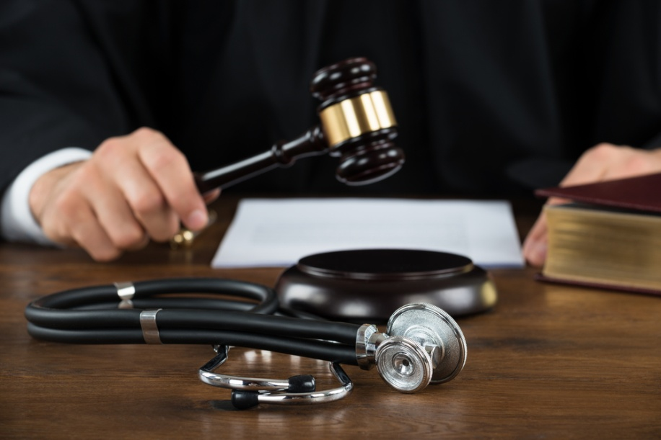
Medico-legal Cases in clinical practice
Medico-legal Issues in clinical practice

Slide 3

MLC Cases
MLC case – any case where attending doctor, after eliciting history & examining patient, thinks that some legal investigation is essential to establish and fix responsibility for the unlawful act as per existing laws of the land.

Slide 4
To be Considered as MLC Cases
Assault injuries – physical assault
Domestic violence and Child abuse
Accident injury cases – RTA, Industrial, Animal attack, Fall from height, Asphyxia, Drowning
Burns – flame, electric, chemical
Poisoning cases, poisonous animal bites
Alcoholism, addictive drugs toxicity
Brought dead cases, undiagnosed sudden death
Unidentified coma patient, mentally ill patient
Sexual assault, Rape, Sodomy, molestation, child sexual abuse
Criminal abortion, disputed paternity-maternity
Suicidal injuries*

Slide 5
Why it is important to register MLC cases & inform to police ?
S.39,154 CrPC – Doctors are bound to give information of any offence (unnatural cases) to police
S.177,201-204 IPC - No inform/ Wrong/ Incomplete/ Fabricated information
S.197 IPC – issue False certificate
Mediclaim, Life insurance claims, Govt schemes (Ayushyamaan Bharat, MAA Yojana), Motor vehicle accident claims

Slide 6
What to Do in MLC cases?
Emergency primary treatment
Follow “MLC protocols”
Proper documentation – History & Examination findings, “MLC Case” registration, Sample preservation, investigations reports, Daily notes, Discharge summery, Certificates
Inform to police – admission, referral, discharge, DAMA, LAMA, death, OPD
If impending death – Dying Declaration (IEA S.32)
If death occur – inform police & advise for MedicoLegal PM
COD in MCCD certi – ‘as per PM Report’
[If admitted for more than 24hrs and diagnosis & cause of death is confirm than Dr can issue MCCD]
CONSULT to seniors, Incharge consultant & RMO for guidance/ advise

Slide 7
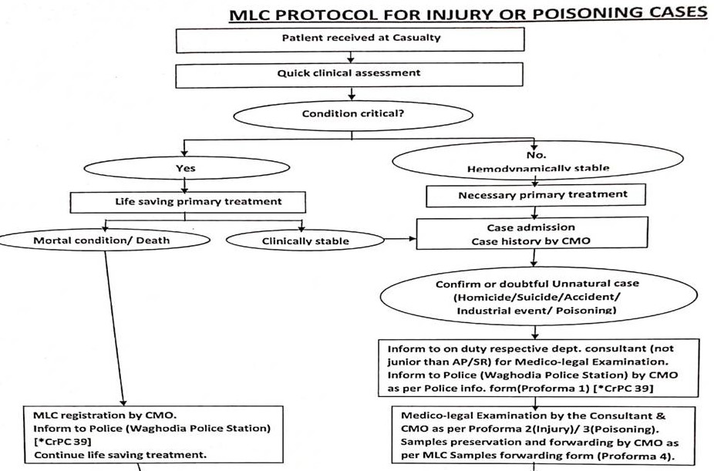

Slide 8
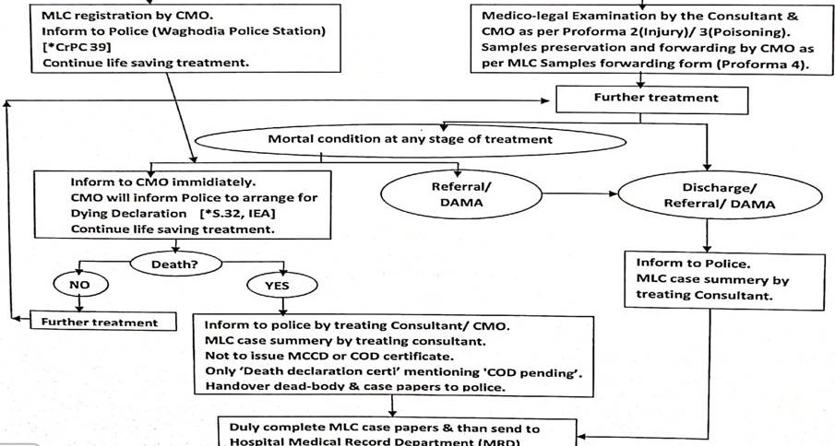

Slide 9
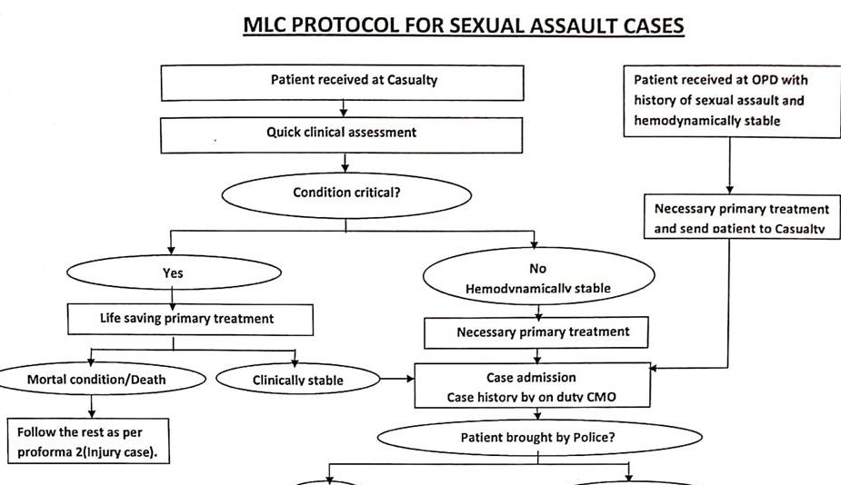

Slide 10
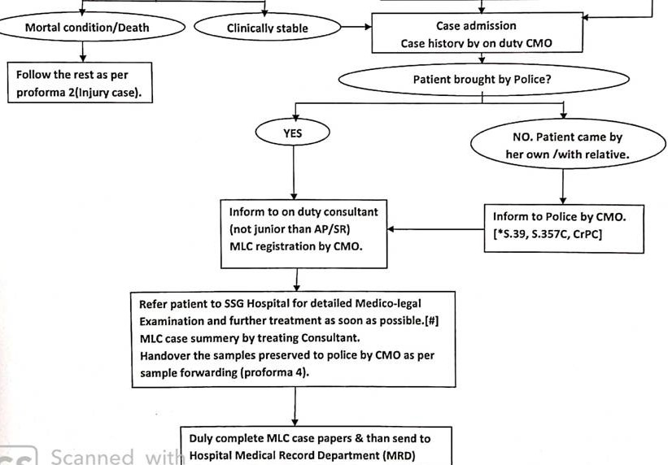

Slide 11
What NOT to do
Refuse/ Refer to Govt hospital without primary evaluation & life saving treatment
Work/ Take decisions in hurry
Incomplete history
Incomplete examination
Incomplete documentation
Get influenced by patient/ relative’s wishes & emotions
Not consulting seniors

Slide 12
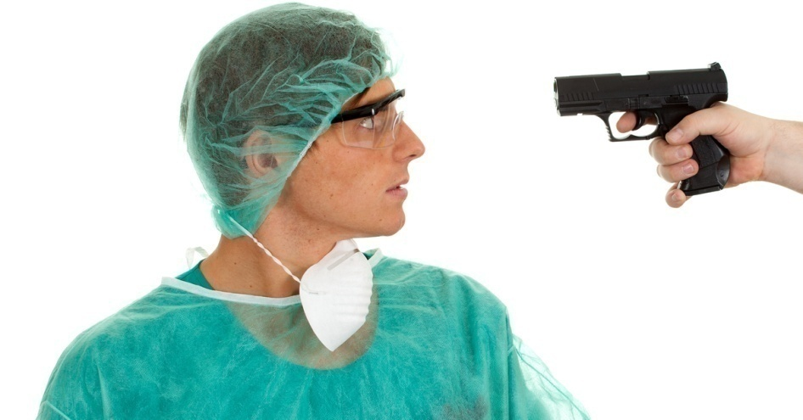
Medico-legal Issues
Medical Accidents
Medical mishap, ADR of drugs
Assault on doctor/ staff
Vandalism
On duty hustle between staff
Negligence – Medical, Non-medical

Slide 13
Medical Negligence – Failure to take due care and caution. Breach of duty caused by the omission to do something which a reasonable person should have done OR doing something which a prudent & reasonable person would not.[SC Jacob Mathew Case]
Doctor, Nurse, paramedical staff, product failure, Patient, Contributory, Composite

Slide 14
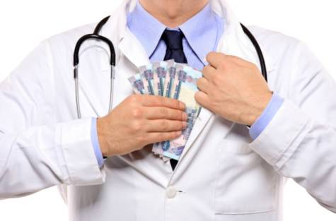
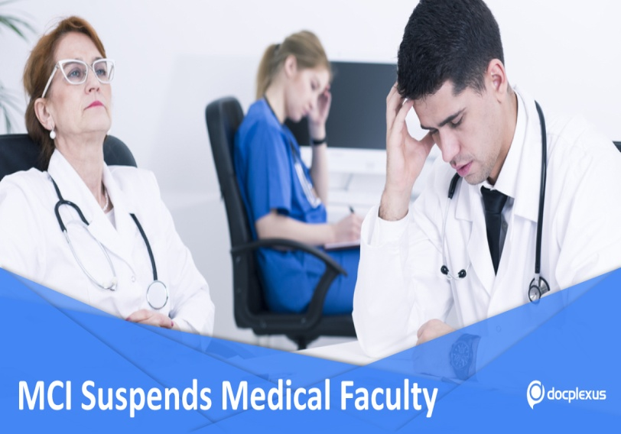
Professional Misconduct
On duty – liquor/ drugs
Unethical relations with patient/ attendants
Refuse to treat on absurd grounds
Dichotomy, Touts
Association/ assistance with unqualified person
Self publicity in media
‘Social media posts’- photo-video posts of cases.

Slide 15
Penalising authorities
State Med Council, NMC Ethics Board
Consumer Forum/ Commission
Courts – Civil, Criminal
Institute – SBKS MI&RC, Sumandeep Vidyapeeth

Slide 16
What to do
Follow Medical Ethics as per MCI Professional Conduct, Etiquette and Ethics Regulations. Stay away from unethical medical practice.
Readiness, Responsibility, Respect
Consent, Documents
Learn & practice AETCOM – with patients, relatives, colleague medicos & paramedical staff, police & govt officials, media persons...
Be Cautious – when using social media
No alcohol/ drugs while onduty.
Consult seniors/ RMO to clear doubts

Slide 17
PRACTICAL EXAMPLES
What to do when a case is within purview of MLC but patient/ relatives not willing to involve police?
  Informed refusal/ Negative consent for MLC

Slide 18
Can a case be labelled MLC any time later ?
Can an MLC case be reverted to non-MLC case ?

Slide 19
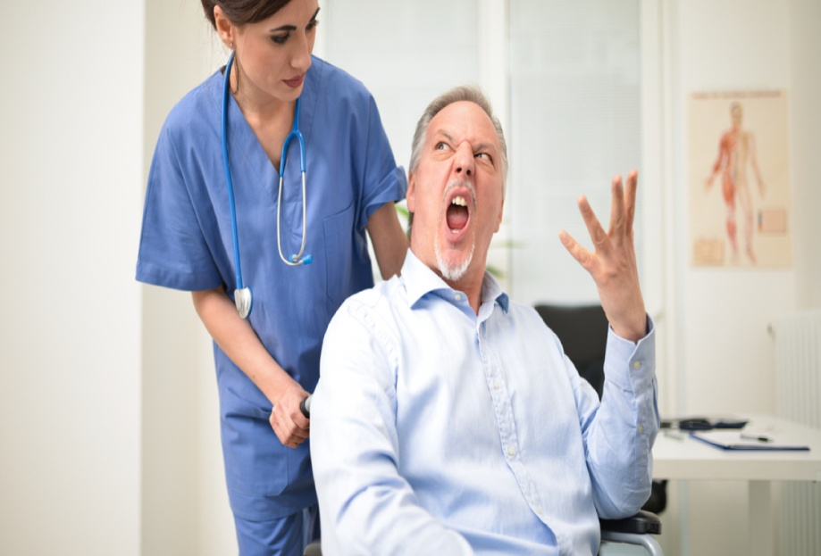
What to do if you notice Unethical conduct by colleague/ junior/ senior/ other staff ?

Slide 20
What if patient not leaving the hospital, though cured?
What if the relatives do not take away the dead body ?

Slide 21
Does refusing a patient to attend constitute negligence ?
Does a doctor have a right to decide which patient he would examine first?
  Rights & Duties of a RMP
  Rights & Responsibilities of Patient
  Sexual assault victim cases, Acid attack victims

Slide 22
What is the liability of a junior doctor in a team approach to a patient?
Is a senior doctor liable for negligence of his junior doctor/ nursing staff?
  ‘Vicarious liability’ – Respondent superior

Slide 23
Medical records - Whose property?
Sometimes patients demand possession of all original hospital records. When refused, they get violent. What to do?
How long should the medical records be preserved ?

Slide 24
KEEP CALM & ACT WISE
Consult & Discuss complex issues with your Senior Consultants/ PG Guide/ HOU/ HOD regularly.
RMO, Dhiraj Hospital – Dr B. R. Solanki
Additional Medical Superintendent
– Dr Lakhan Kataria, Dr Jasmin Jasani
Medical Superintendent – Dr Vijoy Singh
Dept of FMT

Slide 25
Code of Conduct
Code of Conduct – PG booklet
Indian Medical Council Professional Conduct, Etiquette and Ethics Regulation, 2002
https://www.mciindia.org/CMS/wp-content/uploads/2017/10/Ethics-Regulations-2002.pdf
WMA Modern Physician’s Pledge
https://jamanetwork.com/journals/jama/fullarticle/2658261
UGC affidavit

