Slide 1
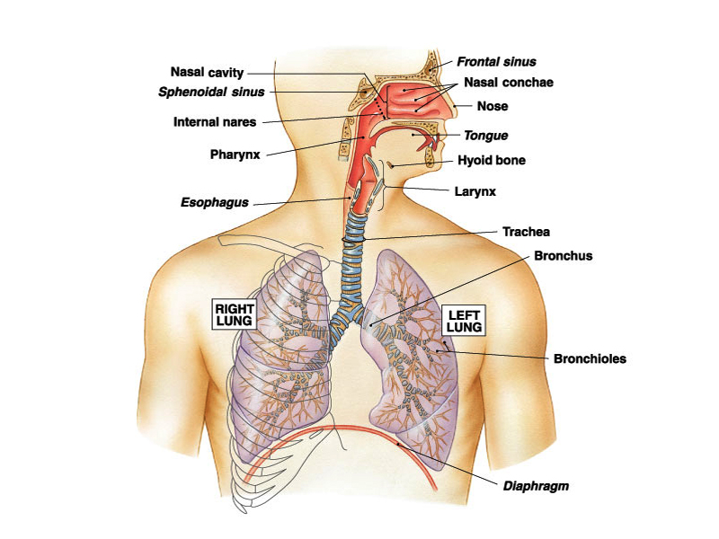
PULMONARY VENTILATION (PY-6.4)
DR. DIKSHA YADAV
Associate Prof.

Slide 2
OVERVIEW
Respiratory movements
Introduction
Difference b/w inspiration & expiration
Muscle of Respiration
Mechanism of respiration
Respiratory pressure - Intrapleural pressure
- Intraalveolar pressure
Lung Elastance & Compliance
Work of breathing

Slide 3
PULMONARY ELASTANCE
Elastance of Thoracic Cage & Lung
Alveolar Surface tension
Surfactant

Slide 4
Movements of Lungs
Lung – elastic structure but tendency to collapse
During inspiration During expiration
Negative Pressure Pressure come back to Pre inspiratory stage
Expansion of lung Thoracic cavity
Compress lung tissue
Air come out

Slide 5
Elastance of Thoracic cage
Constant tendency of thoracic cage to expand.
Elastic property of thoracic cage is due to elastic nature of
    Ribs
    Muscles
    Tendons

Slide 6
ELASTANCE OF LUNG
lungs are under constant threat to collapse even in resting condition because of certain factors.
Factor causing collapsing tendency of lung
1. Elastic property – collagen & elastic fibers
2. Surface tension –
  Tension exerted by fluid secreted from alveolar epithelium on surface of alveolar membrane.
  Alveoli tend to become progressively smaller & tend to collapse .

Slide 7
Surface Tension
Force that tends to minimize surface area at the interface (fluid – air interface)
Caused due to unbalanced attraction of liquid molecules below the surface of alveolar membrane.
Tendency to reduce size of alveolus
result
Recoil tendency of lung
i.e. ↑ tendency of lung to deflate.

Slide 8
Blockage of air passage
Surface tension in alveoli tend to collapse alveoli
Create positive pressure in alveoli
Push the air out
Pressure generated calculated by Laplace law.

Slide 9
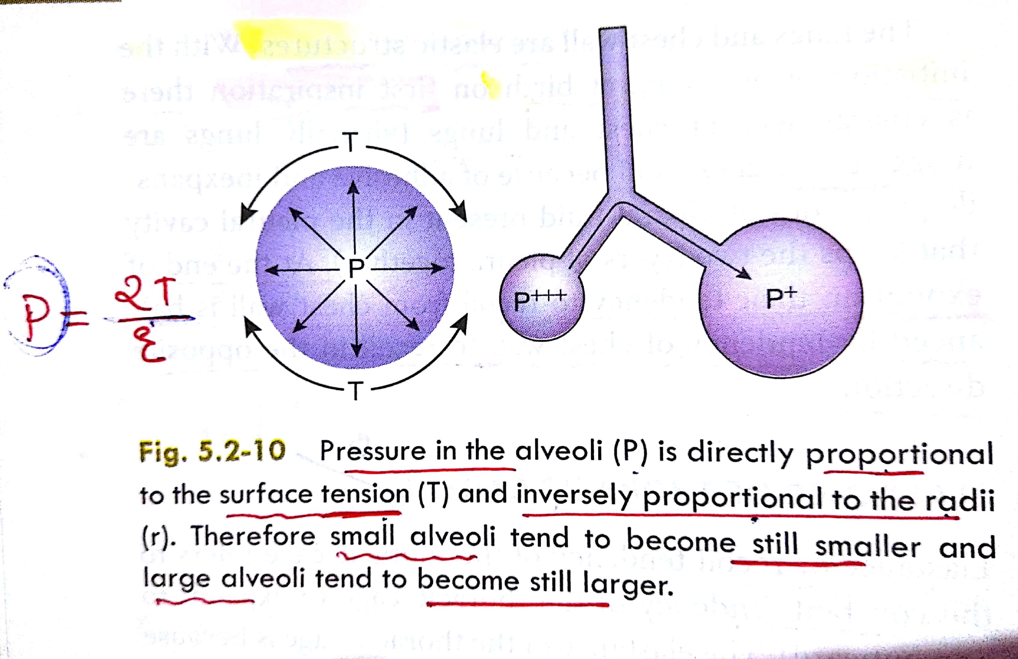
Law of Laplace –
Pressure = 2 X T (Surface tension )
R(Radius of alveolus )

Slide 10
Factors preventing collapsing tendency of lungs
Intrapleural pressure
Always negative → keep lung expanded & prevent from collapse
Surfactant
Substance secreted in alveolar epithelium
Reduce surface tension & prevent collapsing.

Slide 11
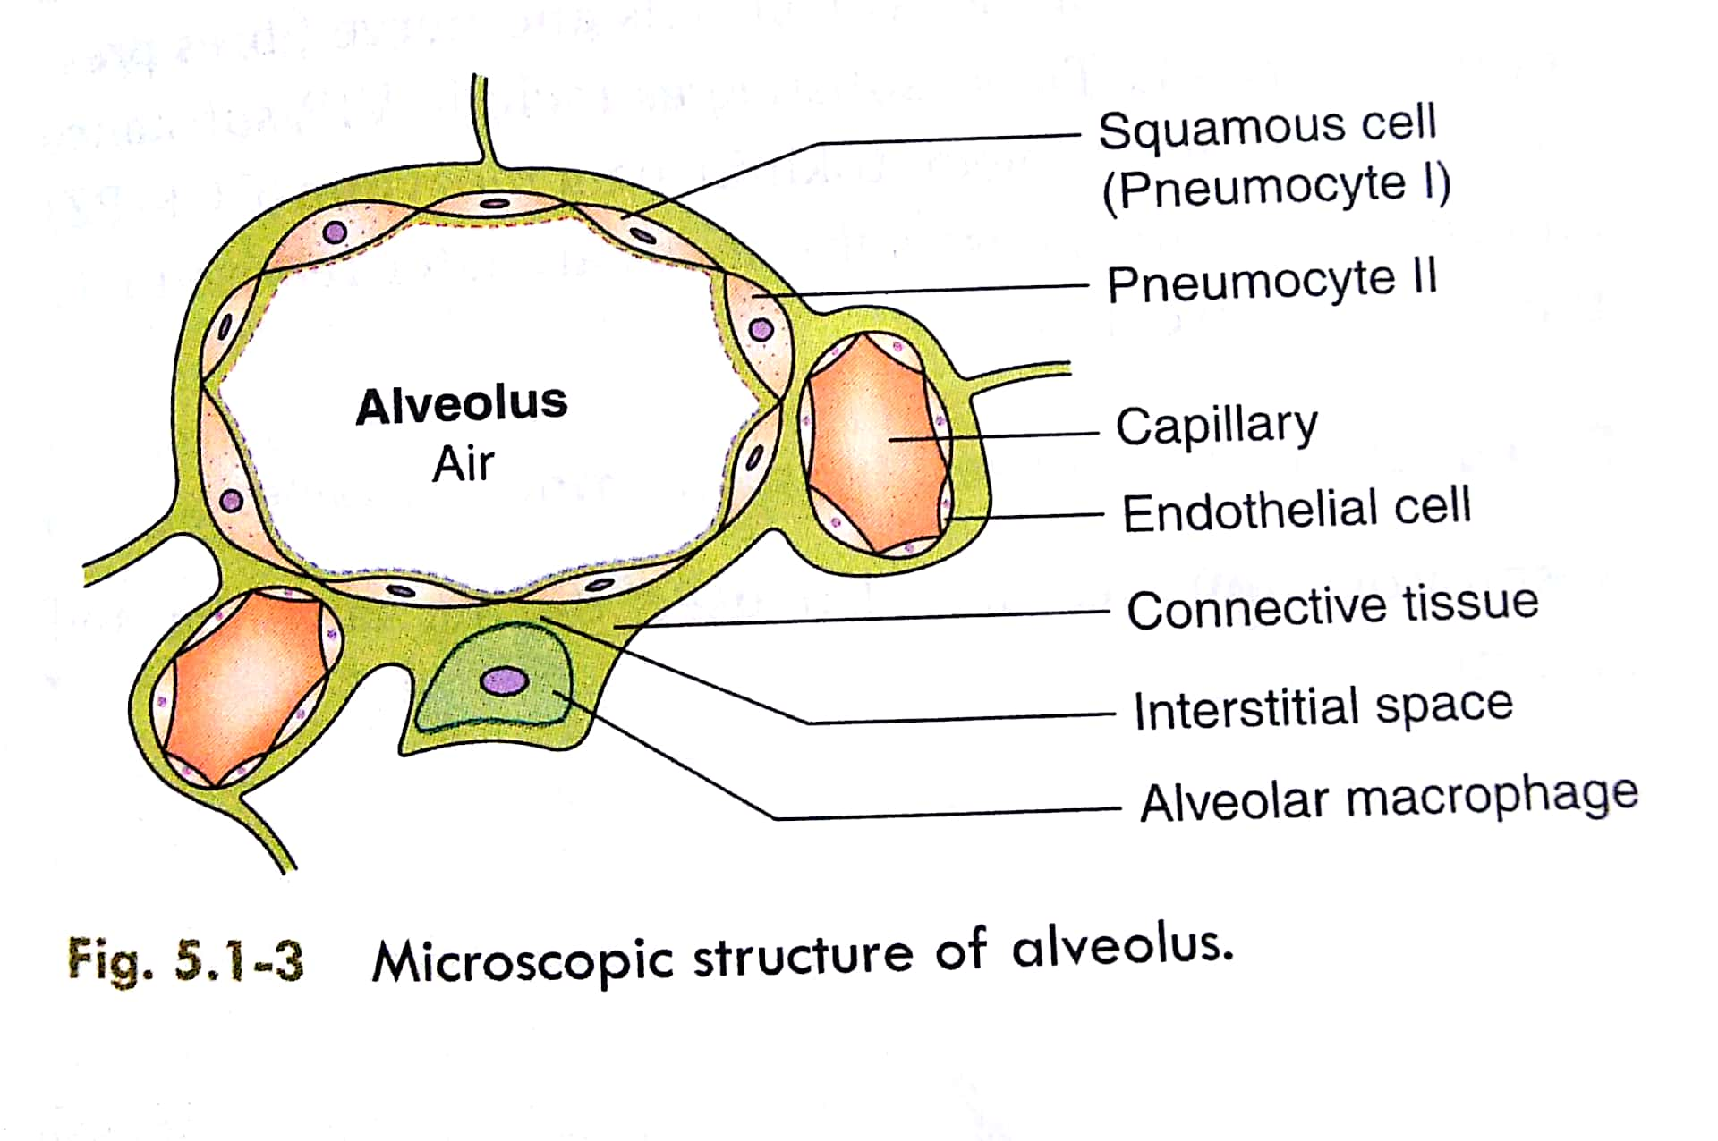

Slide 12
SURFACE TENSION
The force that tends to minimize the surface area at the interface is known as Surface Tension.
Caused due to unbalanced attraction of surface molecules by molecules below the surface.
In the lungs. Surface tension at the fluid-air interface of alveolus has a tendency to reduce the size of each alveolus, thus resulting in recoil tendency of the lung.
SURFACTANT:
Surfactant is a substance which reduce the surface tension at the interface because of absorption of surface active molecules at the interface.

Slide 13
SURFACTANT
Surface active agent in water
reduces the surface tension of water.
Secreted - type II alveolar epithelial cells, which constitute 10 % surface area of the alveoli.
Granular cell, containing lipid attachments secreted
surfactant into the alveoli.
( Pulmonary surfactant )

Slide 14
Surfactant –
lipoprotein complex formed by lipids Phospholipids , Proteins & Ions
Phospholipids : DPPC ( dipalmitoylphosphatidylcholine)
Other lipids - Triglycerides & Phosphatidylglycerol
Proteins : Apo-protein , SPA, SPB,SPC & SPD
Ions : Ca ions.

Slide 15
Factors affecting Surfactant
Decreases
Long term inhalation of 100% O2
Occlusion of main bronchus & pulmonary artery
Cigarette smokers
Cutting of both vagi
Insulin
Increases
Thyroid ↑ size and no of inclusion bodies in type II cells
Glucocorticoids fasten maturation of surfactant
Vagal stimulation –
Ach - acts on type II cells
- increases

Slide 16
Effect of deficiency of surfactant
Infant – Collapse of lung → RDS /hyaline membrane diseases
Adult – ARDS
Deficiency – susceptibility of bacterial & viral infection
In diabetic mothers there is fetal hyperinsulinemia - this insulin inhibits surfactant – so high chance of RDS.
In infants with low thyroid hormone levels in plasma are more prone to RDS.

Slide 17
Respiratory Distress Syndrome
Surfactant deficiency is an important cause of infant respiratory distress syndrome (IRDS; hyaline membrane disease),
Serious pulmonary disease develops in infants born before their surfactant system is functional.
More so in premature infants who have small size of alveoli and less surfactant
Surface tension in the lungs of these infants is high, and there are many areas in which the alveoli are collapsed-(atelectasis). .

Slide 18
ARDS
Adult respiratory distress syndrome.
Caused by surfactant deficiency as a result of extremely difficult to expand the lungs.
Respiratory work is greatly increased.
Inadequate exchange of gases due to alveolar instability and pulmonary oedema.
Results in severe respiratory insufficiency.
Causes:
Cigarette smoking,
long term inhalation of 100% oxygen,
Occlusion of bronchus or pulmonary artery.

Slide 19
Treatment
Administration of phospholipid alone by inhalation has little value in the treatment of IRDS.
synthetic surfactant and a surfactant preparation derived from bovine lungs are available for use by inhalation.
Used prophylactically at birth and as replacement therapy,
they decrease the severity of IRDS but not the incidence of chronic lung disease in survivors.

Slide 20
Actions of surfactant
1) Reduces the ST → prevents the collapse.
2) Stabilizes the alveoli and helps to maintain uniform size of alveoli.
3) lung Compliance & work of breathing.
4) By reducing ST it keeps the alveoli dry & prevents pulmonary oedema.

Slide 21
5) Role in defense within lung against infection & inflammation.
- hydrophilic proteins destroy the bacteria and viruses and also control the formation the mediators of inflammation.
6) Helps in the first breath of infants where strong respiratory movements are made and prevents the collapse of lungs by reducing ST.

Slide 22
LUNGS COMPLIANCE
Introduction
Graph
Factor affecting compliance
Type
Change in compliance

Slide 23

LUNGS COMPLIANCE
Compliance :
Dispensability/ Stretch ability of lung & thorax
Change in volume of lung per unit change in transpleural pressure.
Compliance = ___ V
P
Where,V=volume of the lung,P=airway pressure and differ.
It is expressed as litre/cm H2O
Normal - Lungs & thorax together – 0.13 L / cm H2O
Normal - Lungs alone – 0.22 L / cm of H20

Slide 26
Factors affecting compliance of both lung and thorax
1) Deformities of thorax like kyphosis & scoliosis - reduce compliance.
2) Pulmonary congestion –
excess blood in pulmonary capillaries (as seen in LVF) mechanically opposes lung expansion and reduces compliance.
3) Paralysis of respiratory muscles.
4) Fibrotic pleurisy –
inflammation of pleura resulting in fibrosis.

Slide 27
5) Pulmonary fibrosis as seen in pulmonary TB – Increase number of collagen fibers which opposes expansion.
6) Pleural effusion, and abnormal thorax like pneumothorax, hydrothorax, pyothorax, hemothorax.
7) Emphysema - more compliance which is a paradox. Here elastic recoil is less as elastic fibers of lungs are degenerated and thus loss of elasticity
8) Old age - high compliance again paradox because here there is some change in arrangement of elastic fibers so elasticity is lost and lungs remain expanded

Slide 28
Types of Lung Compliance
1) Static Compliance - volume / pressure change
2) Specific Compliance – Static compliance / FRC
use - to compare compliance of lungs of different sizes.
3) Dynamic Compliance –
It is time taken to cause volume change by unit pressure change.
important when airways are narrow as in asthma where static may be normal but dynamic may decrease.
it is an index of Bronchospasm.

Slide 29
Change in Compliance
Decreased
tuberculosis , silicosis
scarring / fibrosis
destruction of lung / tissue
RLD – restrictive lung diseases
( greater force to expand )
Increased
Emphysema & aging
Alveolar septa
(provide restrictive force in lung )
destroyed in both conditions

Slide 30
WORK OF BREATHING
Energy generated by respiratory muscles to overcome the resistance in thorax & respiratory tract.
Resistance to breathing
Tissue resistance – tissue expand & contract.
It is comprises: Elastic and Viscous resistance
Elastic resistance- It is sum of forces of elastic recoil of lung and chest wall. Elastic recoil of the lungs is due to +nce of elastic fibres & alveolar surface tension.
Viscous resistance- is the resistance offered by the non-elastic tissues in the lungs.

Slide 31

Airway resistance – caused by friction of gas molecules b/w themselves & walls of airways.
Factors affecting airway resistance determined by
  1. Rate of gas flow
  2. Airway diameter
  3. Length of airway
  4. Type of airflow .

Slide 32
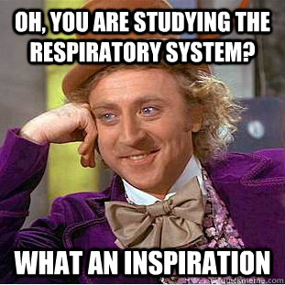
Thank You…

