Slide 1
Practical – PM Report
Skeletonised deadbody/ Bunch of bones
- Dr R G Datta

Slide 2
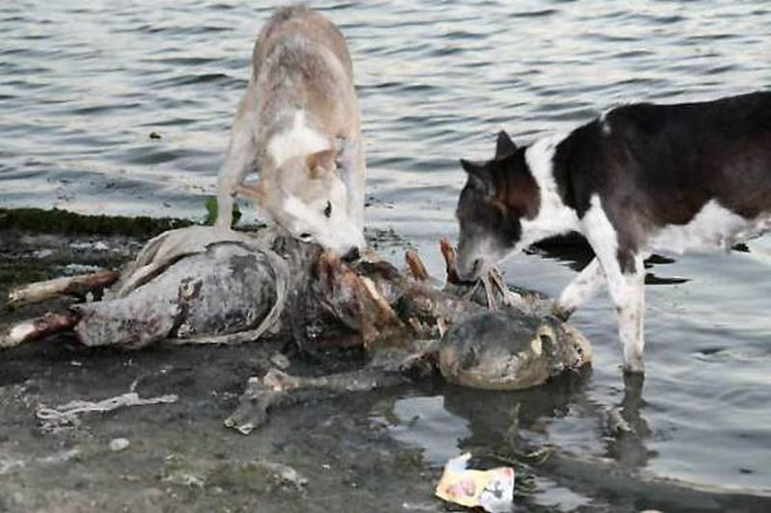
CASE

Slide 3
A 16yrs old girl is reported missing since 3 months by her parents. Today early morning a skeletonized deadbody found near riverbank in same locality. The cloths and other personal belongings were identical to the missing girl’s description. Write a hypothetical PM note for this deadbody.

Slide 4
PM no. _______ Date: ________
Name of diseased : Unknown female C/o Waghodia PS
Address : Unknown
Autopsy by Dr. XYZ
a) Deadbody sent by - PI, Piparia PS
b) Name & place - as per
inquest (magistrate)
c) Distance of place - as per inquest
Deadbody brought by - HC Mrs. DEF sign___
Deadbody identified by- Mr. MNO sign___
relationship – husband of deceased

Slide 5
4. Date & Time of
receipt of deadbody - ______ on ______
begin of autopsy - ______ on ______ end of autopsy - ______ on ______
5. Substance of acc…….
………supposed COD - as per inquest
6. If autopsy not conducted at hospital
    - Not Applicable

Slide 6
External examination
7. Cloths & ornaments:
  A yellow colored flower print design kurti – ‘M’ sized
  A yellow coloured laggings.
  A whitish gray bra.
  A brown colour underwear
  A silver metallic chain with oval pendant around neck.
8. Condition of cloths
  All cloths stained with dust, dirt, weeds & foul smelling decomposed body fluids at places.
  Multiple tear marks (animal neebling marks) noted over kurti.

Slide 7
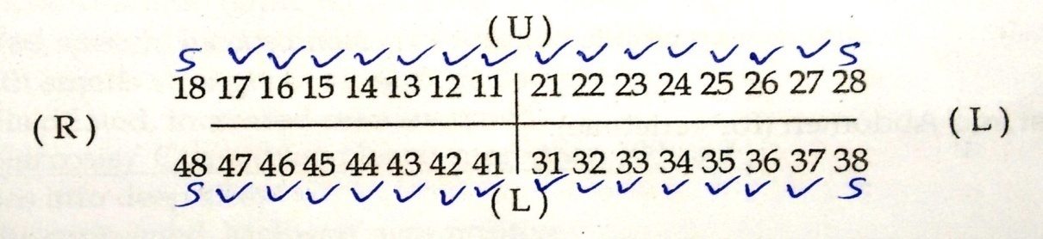
9. If deadbody unidentified :
Full length of body (Vertex to heel) – 150cms
Scalp hairs – fallen off, black coloured, 20-30cms long, tucked in ‘pony tail’ fashion.
Pubic hairs – fallen off in under wear, 5-8 cms long , black
Dental status – total 28 teeth present, all permanent, 3rd molor teeth not erupted but space present in both jaws, no artificial denture.
If deadbody of newborn : NA

Slide 8
10. Condition of body : built & nourishment cannot be commented due to advanced decomposition & skeletonization.
11. Rigor mortis : cannot be commented due to skeletonization and decomposition – no skeletal muscle tissue is seen.
12. PM lividity, decomposition : cannot be commented due to skeletonization and decomposition – no body area with intact skin is present.

Slide 9
13. External features of body:
  Whole body in advanced decomposition stage – skeletonization.
  foul smell of decomposition over whole body
  All body parts in skeletonised. Skin & other soft tissues missing over whole body. Tags of soft tissues noted attached to all bones at places. All bones seems attached loosely by tags of ligaments & fibrous tissues.
14. Condition of skin : as mentioned above
15. Injuries over external genitalia : NA
16. Hands & fingers (in case of drowning) : NA

Slide 10
17. External injuries : Gnowing and neebling marks by carnivorous animals noted over skull, long bones of forearms, arms and legs. Margins of wounds pale.
18. Palpable fracture? : No fracture noted.
18(a) injuries in 17 & 18 antemortem? : No. Injuries mentioned in column 17 above are postmortem.

Slide 11
Internal examination
19. Head :
  Skull – no injury present except gnawing marks
  Orbits rounder, All muscle attachment sites smoother – supraorbital ridges, zygoma, mastoid process, external occipital protuberance not prominent
  Frontal slop - rounded
  Meninges & Brain – decomposed to shriveled dry mass.

Slide 12
20. Thorax :
  ribs : no injury present.
  Pleura : decomposed to shriveled dry mass.
  Trachea & bronchi : decomposed to shriveled dry mass. Hyoid bone noted missing.
  Right lung : decomposed to shriveled dry mass.
  Left lung : decomposed to shriveled dry mass.
  Pericardium : decomposed to shriveled dry mass.
  Heart : decomposed to shriveled dry mass.
  Major vessels : decomposed to shriveled dry mass.
  Sternum – lower two segments of body part are fused. Rest parts not fused.

Slide 13
21. Abdomen :
  Wall : missing
  Peritoneum : missing
  Cavity : Open. No S/o hemorrhage seen
  Esophagus : decomposed to shriveled dry mass.
  Stomach : decomposed to shriveled dry mass.
  Small Intestine : decomposed to shriveled dry mass.
  Large intestine : decomposed to shriveled dry mass.
  Parts of GIT noted disintegrated at places due to decomposition

Slide 14
  Liver : decomposed to shriveled dry mass
  Gall Bladder : decomposed to shriveled dry mass
  Spleen : decomposed to shriveled dry mass
  Pancreas, adrenals : decomposed to shriveled dry mass
  Kidneys : decomposed to shriveled dry mass
  Gonads & pelvic organs : decomposed to shriveled dry mass
  Urinary bladder : decomposed to shriveled dry mass
  Bony pelvis – gynaecoid shape, greater sciatic notch wider than 85 degree, sub pubic angle 90 degree
  All long bones - smoother, lighter, muscle markings not prominent

Slide 15
Additional remarks & Viscera samples :
  Samples preserved for Blood grouping & DNA analysis
  1) Bunch of scalp hairs
  2) Molar teeth
  3) Left Humerus bone
  Samples preserved for chemical analysis
    Mass from abdomen organs region
    Right Humerus bone – whole
    Bunch of scalp hairs
    Nails of both hands
    Molar teeth
  Samples preserved for diatom tests
  1) Sternum bone
  2) left Femur bone
22. Vertebra & Spine : No fracture/ any injuries noted. No s/o antemortem hemorrhages over cervical spine.

Slide 16
X-ray examination for age estimation
  Upper ends of Humerus, Both ends of Femur & Tibia-Fibula not fused.
  Lower end of humerus & upper ends of radius ulna fused
  Iliac crests & Ischial tuberosities appeared but not fused.

Slide 17
Opinion
Whole skeleton is of one single human
Sex of deceased : Female
Age of deceased : 17+/-1 year (i.e. between 16 to 18 years)
Stature of deceased : 155+/- 3cms
Time of death : 1 month to 3 months before PM examination
All external injuries : Postmortem gnawing-neebling marks
Pending reports : report for chemical analysis and diatom tests of samples
Cause of Death : “Antemortem Drowning”
Date _________ Sign of Doctor

Slide 18
Sharma R, Garg RK, Gaur JR. Various methods for the estimation of the post mortem interval from Calliphoridae: A review. Egyptian Journal of Forensic Sciences March 2015; Vol 5 (1), Pg 1-12. https://doi.org/10.1016/j.ejfs.2013.04.002
Sharma R, Garg RK, Gaur JR | Various methods for the estimation of the post mortem interval from Calliphoridae: A review | The primary objective of this study is to gather baseline data and to stimulate further study of the forensically important flies in India, especially those species that have established themselves as the primary indicators of time since death.This is a review research paper. | The new approaches for estimating time since death discussed above seem more reliable and can be used with confidence in medico-legal cases given the inherent difficulties in generating a precise post mortem interval estimate are considered.

Slide 19
