Slide 1
Practical – Injury certificate
Medical examination & certificate for Injury
- Dr Pruthvi Patel

Slide 2
In this session
No. | COMPETENCY | Domain (K/S/A/C) | Level (K/KH/S/SH/P) | Core (Y/N)
FM14.1 | Examine and prepare Medico-legal report of an injured person with different etiologies in a simulated/ supervised environment | S | SH/P | Y
FM14.10 | Demonstrate ability to identify & prepare medicolegal inference from specimens obtained from various types of injuries e.g. Contusion, abrasion, laceration, firearm wounds, burns, head injury and fracture of bone | S | KH | Y

Slide 3
Specific Learning Objectives At the end of this session, the 2nd MBBS student.... | Integration
1. should able to examine an injured person with different etiologies in a simulated/ supervised environment 2. should able to prepare Medico-legal report of an injured person with different etiologies in a simulated/ supervised environment | Y General Surgery Orthopedics
1. should able to identify the specimens/ models/ photographs of various types of mechanical injuries e.g. Contusion, abrasion, laceration, incised wound, stab wound, chop wound, fractures, firearm wounds. 2. should able to prepare medicolegal inference from specimens/ models/ photographs of various types of mechanical injuries e.g. Contusion, abrasion, laceration, incised wound, stab wound, chop wound, fractures, firearm wounds. | Y General Surgery Orthopedics

Slide 4
CASE
Write a hypothetical Injury certi for a 22 yrs old man, having alleged H/o injuries due to assault by 2 unknown persons with a lathi and a knife 30mins ago. Mention simple & grievous injuries.

Slide 5
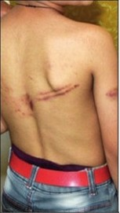
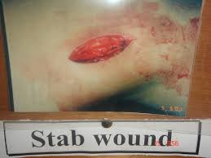
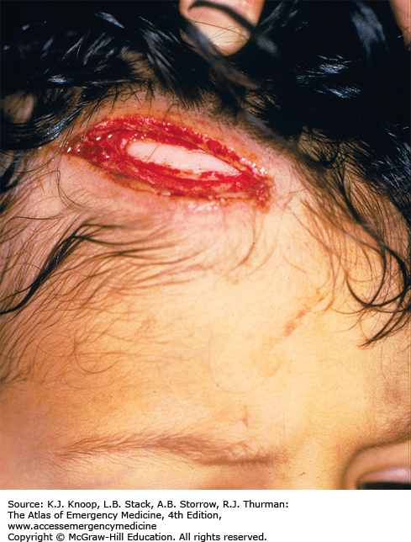
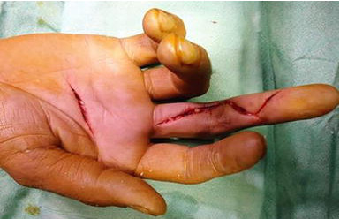
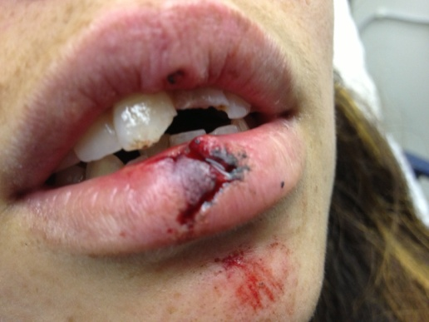

Slide 6
MLC No- 123/16
Name- Mr. ABC
Age- 22 yrs Sex – Male
Address- 22, Mustaq-ali road, vadodara
Occupation- student
Requested by- PSI, waghodia PS
Brought by- PC Mr. DEF, B No. 123, Wag. PS

Slide 7
Dt, Place & Time of Examination:
Time_____,Dt_____, Emergency, Dhiraj hospital
Exam in presence of : ---
Consent- मुजे मेरी भाषामे डॉक्टर साहबने मेरी शारीरिक जांच और उसके मेडिकोलीगल अभिप्रायों के बारे मे सब समजाया हे ये सब समजकर मे इस के लिए अपनी मरजी से अनुमति देता हु।
ABC -----
Sign examinee in presence of
Identification marks
  A black mole of size 1mm x 1mm over right angle of mandible
  A tattoo of ‘786’ in size of 2cm x 2cm over back of right hand.

Slide 8
Brief History : alleged H/o assault by 2 unknown persons with a lathi & a knife 30 mins ago.
General Examination:
Ht- 165cms
Wt- 62kgs
Build- avg
Mental status- conscious, oriented
Temp- 98.8°F
P – 84/min
BP- 130/80mmHg

Slide 9
Sr. No | Type of Injury | Site | Size | Nature of injury | Type of weapon | Remark /investigation
1 | Stab wound | Obliquely over right-front part of abdomen, upper outer angle 5cm below & 10cms right to xiphisternum | 3.5cm x 0.5cm x cavity deep, Upper-outer angle acute & lower-inner angle relatively blunt | Grievous | Sharp edged & pointed | USG, CT scan abdomen – stab wound over right lobe of liver, hemo-pneumoperitoneum. Fresh injury. Surgery.
2 | Incised wound | Obliquely over right palm, lower outer end at base of Rt thumb | 5.5cm x 0.5cm x muscle deep, tailing over outer end | simple | Sharp edged | Fresh injury. Surgical stitching & dressing

Slide 10
3 | Laceration | Obliquely over right side of forehead, upper-outer end 8cms right to midline & 5cms above right supraorbital ridge | 4cms x 0.5cms x bone deep | simple | Hard & blunt | Fresh injury. Surgical stitching & dressing, CT scan head
4 | Rail road pattern contusion | Left side of back, upper outer end 25cms left to midline & 20cms below top of left shoulder | 5cms x 4cms with interweaning normal skin area of 2cms | simple | Hard, blunt, rod shaped | Fresh injury Dressing Xray left shoulder
5 | Tooth fractures | upper both central inciser teeth | -- | Grievous | Hard & blunt | Fresh injury Xray ortho-pentomogram
Sign of examinee Sign of RMP
                With Name & Designation

Slide 11
Exercise 1
Prepare a hypothetical Injury certificate for a 16yrs boy who brought to casualty by his friend. There is alleged H/o the boy had been assaulted by his schoolmates by a ‘wooden block’ and ‘a bicycle chain’ 20 mins ago. Mention two simple & two grievous injuries.

Slide 12
Exercise 2
Prepare a hypothetical Injury certificate for a 30yrs man, brought to casualty by 108 ambulance. There is alleged H/o injuries dut to assault by two ‘money landers’ for some loan dispute with a ‘lathi’ and ‘sword’ 15mins ago. Mention two simple & two grievous injuries.

Slide 13
Exercise 3
Prepare a hypothetical Injury certificate for a 21yrs lady who brought to casualty by her husband. There is alleged H/o that the lady had been assaulted by some unknown road side robbers with a ‘knife’ and a ‘iron chain’. Mention two simple & two grievous injuries.

Slide 14
Ambade VN, Godbole HV. Comparison of wound patterns in homicide by sharp and blunt force. Forensic science international. 2006 Jan 27;156(2):166-70.
Ambade VN, Godbole HV. | Comparison of wound patterns in homicide by sharp and blunt force. | A comparison of patterns of injuries between sharp force and blunt force homicide was performed. | Thorax was the commonest site in sharp force in contrast to head in blunt force. Hand and forearm were the commonest sites of defence injuries. The majority of the blunt force victims had lesions in only one region in contrast to involvement of 2–4 regions in sharp force. Knife and wooden/iron rods were the weapons of choice.

Slide 15
Any questions ?
Complete injury certificates in practical journal and make entry in index page.
Observe injury patients in Casualty/ Emergency, Surgery, Orthopedic wards and observe MLC/injury certificate in their casefiles.

