Slide 1
TISSUE REPAIR :WOUND HEALING
Dr Smita Patel
Pathology

Slide 2
The Extracellular Matrix
A dynamic, constantly, remodeling, macromolecular complex
  Interstitial matrix
  Basement membrane (BM)
Major components
  Collagens
  Elastic fibers
  Fibronectin
  Laminin
  Proteoglycans

Slide 3
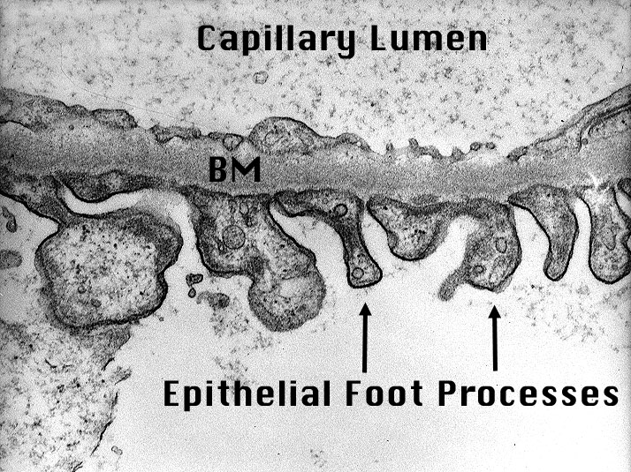
Basement membrane

Slide 4
The Extracellular Matrix
Roles of ECM
  mechanical support for cell anchorage
  determination of cell orientation (polarity)
  control cell growth
  maintenance of cell differentiation
  scaffolding for tissue renewal
  establishment of tissue microenvironments, storage and presentation of regulatory molecules

Slide 5
Repair by Connective Tissue (Fibrosis)
Severe or persistent tissue injury destroy
  parenchymal cells
  stromal framework
incomplete repair by unregenerated parenchymal cells with fibrosis
Fibrosis consists of four components
  formation of new blood vessels (angiogenesis)
  migration and proliferation of fibroblasts
  deposition of ECM
  maturation and reorganization of the fibrous tissue (remodeling)

Slide 6
Angiogenesis
The procondition of fibrous repair
Four steps
  proteolytic degradation of the parent vessel BM, allowing formation of a capillary sprout
  migration of endothelial cells from the original capillary toward an angiogenetic stimulus
  proliferation of the endothelial cells behind the leading edge of migrating cells
  maturation of endothelial cells with inhibition of growth and organization into capillary tubes

Slide 7
Angiogenesis
The procondition of fibrous repair
Four steps
  proteolytic degradation of the parent vessel BM, allowing formation of a capillary sprout
  migration of endothelial cells from the original capillary toward an angiogenetic stimulus
  proliferation of the endothelial cells behind the leading edge of migrating cells
  maturation of endothelial cells with inhibition of growth and organization into capillary tubes

Slide 8
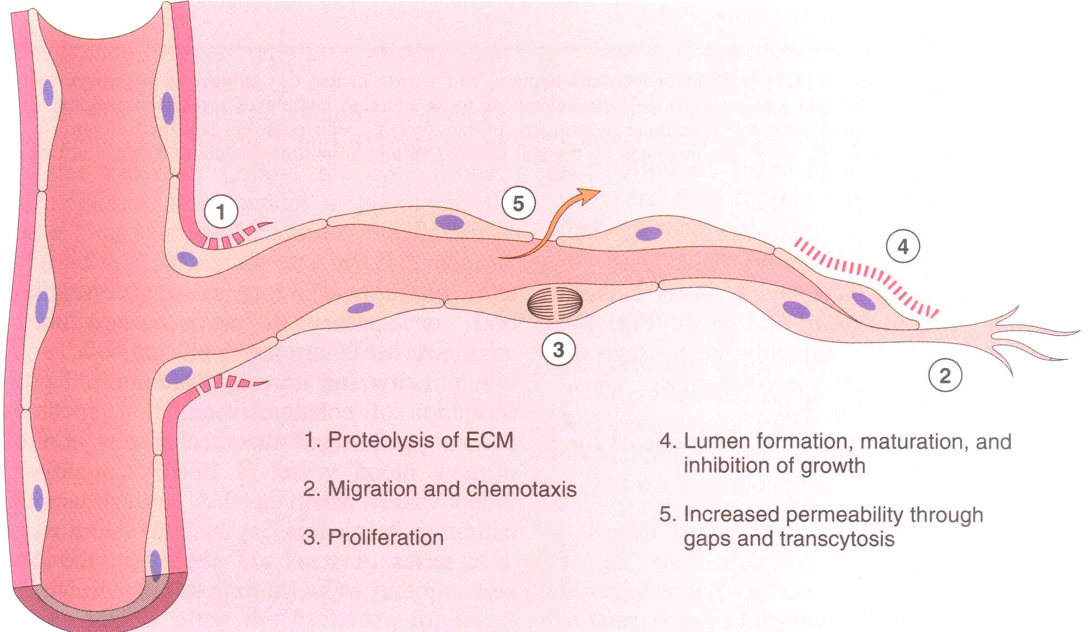
Steps in the process of angiogenesis

Slide 9
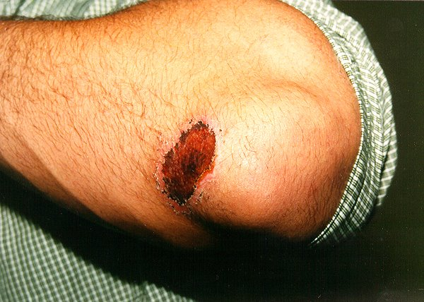
Fibrosis (scar formation)
Granulation tissue is the initial event in the repair of an injury, and consists of richly vascular connective tissue which contains capillaries, young fibroblasts, and a variable infiltrate of inflammatory cells
Do not confuse with GRANULOMA
Student’s soccer injury. An abrasion in the elbow.
Notes:
Granulation tissue: Small, fleshy, bead like protuberances, consisting of outgrowths of
new capillaries, on the surface of a wound that is healing.

Slide 10
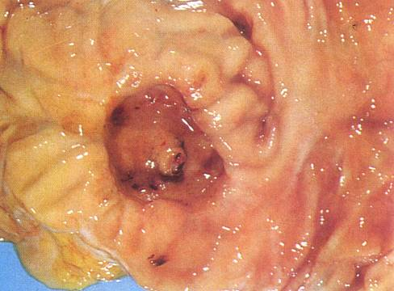
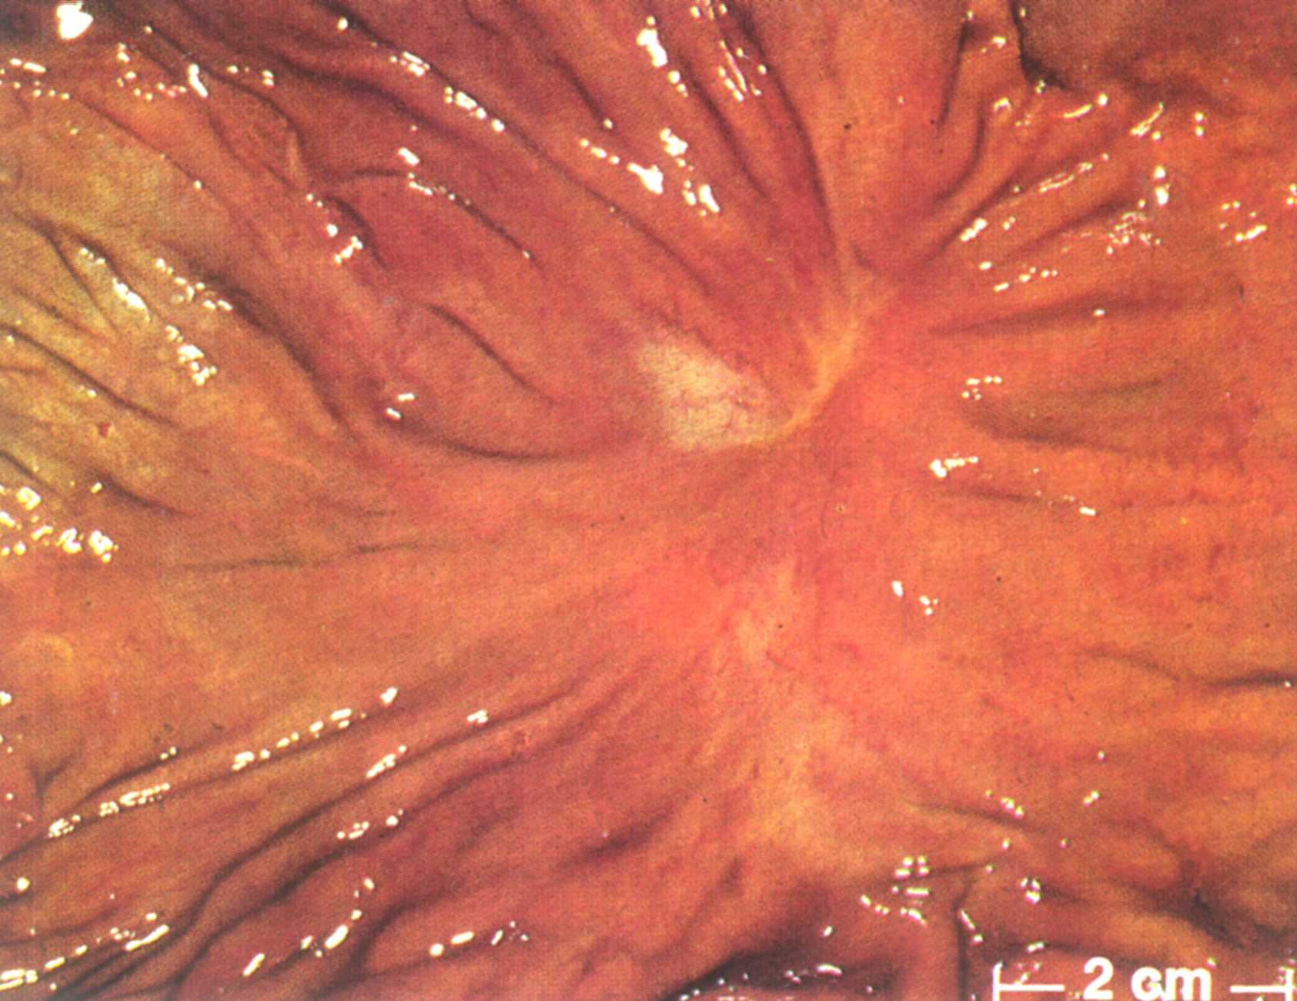
Bleeding of a deodenal ulcer. Note a ruptured artery in the base of
Ulcer.
A healed gastric ulcer. Note the radiation of folds from the ulcer.

Slide 11
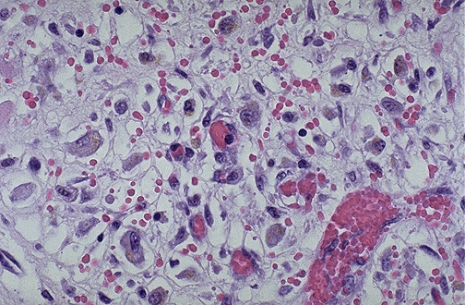
A fresh granulation tissue: Note the fibroblasts, new capillaries
and a few inflammatory cells.

Slide 12
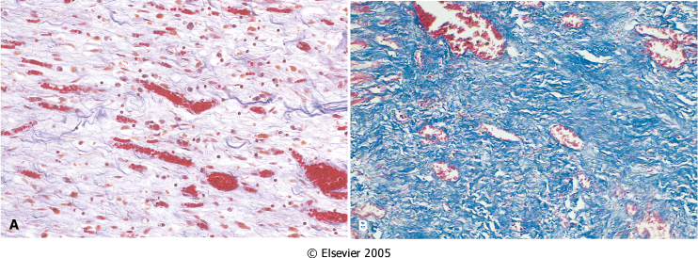
Granulation tissue
Notes:
A, Granulation tissue showing numerous blood vessels, edema, and a loose ECM containing occasional inflammatory cells. This is a trichrome stain that stains collagen blue; minimal mature collagen can be seen at this point. B, Trichrome stain of mature scar, showing dense collagen, with only scattered vascular channels.

Slide 13
Roles of Granulation Tissue in Fibrous Repair
Growth into the necrotic tissue, hemorrhage, thrombi, inflammatory exudate and replace them(organization)
Connect the separated tissue, restore the lost tissue and support them to keep the integrity of body
Protect the wound and anti-infection

Slide 14
Scar Remodeling
A scar after surgical operation or trauma will become softer, smaller because of degradation of collagens and other elements of ECM by metalloproteinases (collagenases)
Over growth of scar is called keloid

Slide 15
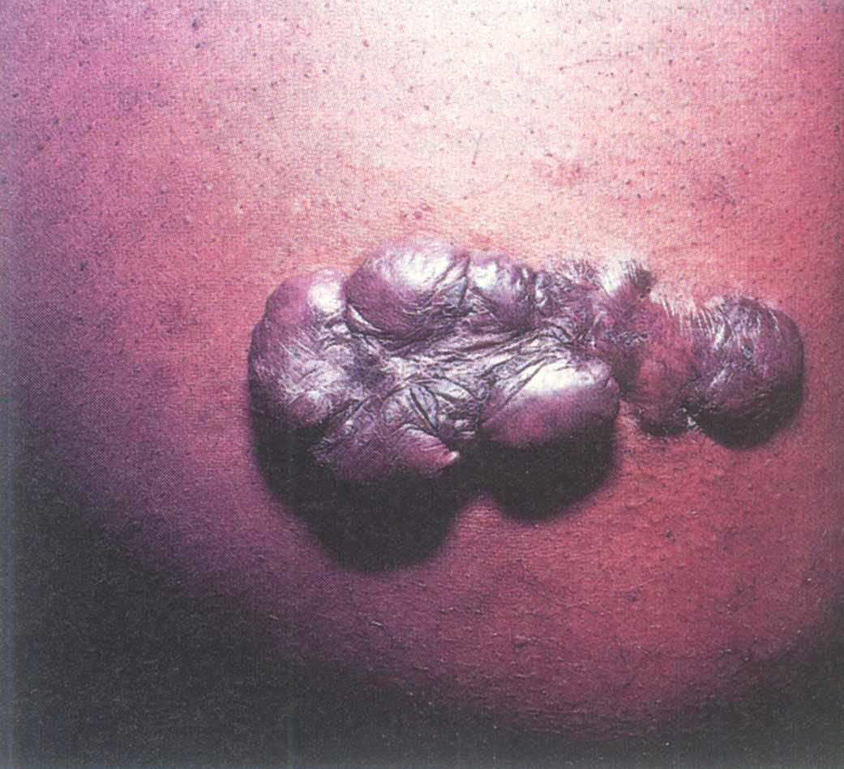
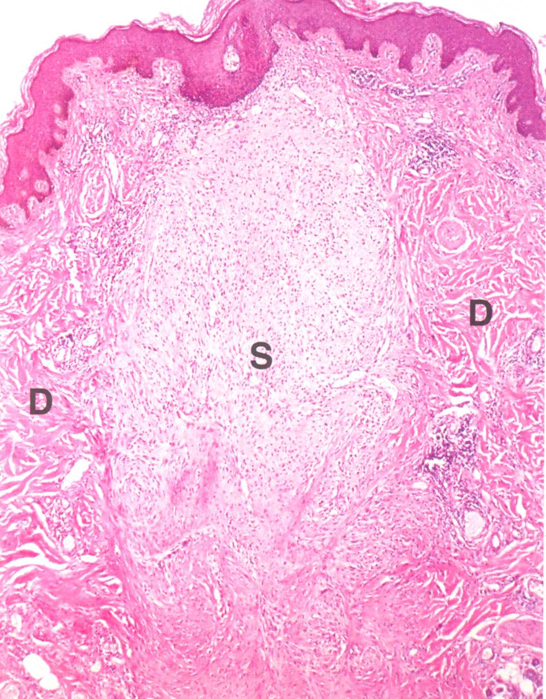
Keloid

Slide 16
Healing of Skin Wound
Primary intention: the usual case with a surgical wound, in which there is a clean wound with well-apposed edges, and minimal clot formation
Secondary intention: when wound edges cannot be apposed, (e.g., following wound infection), then the wound slowly fills with granulation tissue from the bottom up. A large scar usually results.

Slide 17
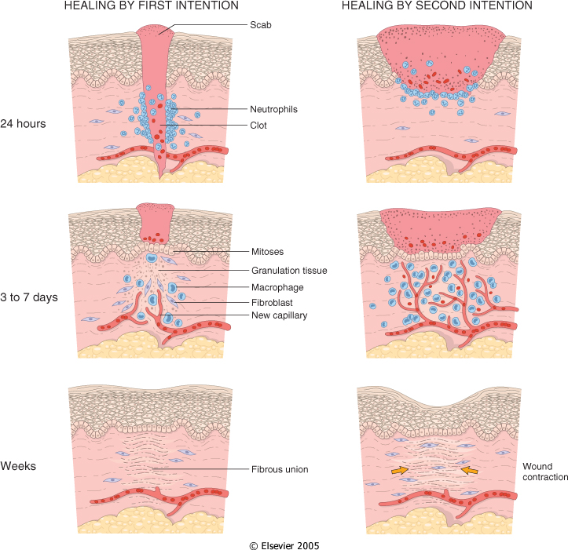
Notes:
Steps in wound healing by first intention (left) and second intention (right). Note large amounts of granulation tissue and wound contraction in healing by second intention.

Slide 18
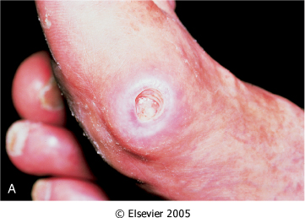
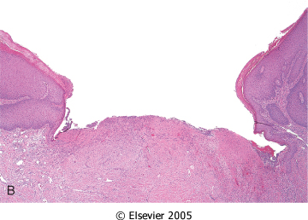
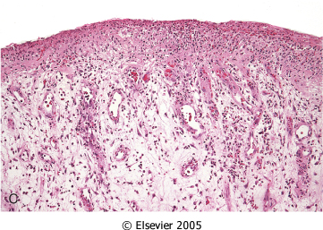
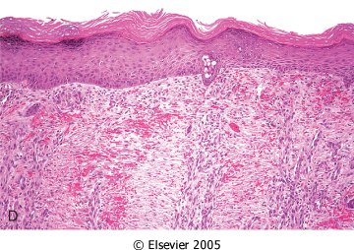
The Healing in secondary intension Skin Ulcer
Notes:
Healing of skin ulcers. A, Pressure ulcer of the skin, commonly found in diabetic patients. The histology slides show B, a skin ulcer with a large gap between the edges of the lesion; C, a thin layer of epidermal reepithelialization and extensive granulation tissue formation in the dermis; and D, continuing reepithelialization of the epidermis and wound contraction.

Slide 19
Factors that Influence Wound Healing
Type, size, and location of the wound
Vascular supply (diabetics heal poorly)
Infection - delays wound healing and leads to more granulation tissue and scarring
Movement - wounds over joints do not heal well due to traction
Radiation - ionizing radiation is bad, UV is good
Overall nutrition: vitamin and protein deficiencies lead to poor wound healing, especially vitamin C, which is involved in collagen synthesis
Age: younger is definitely better!
Hormones - corticosteroids drastically impair wound healing, because of their profound effect on inflammatory cells

Slide 20
MCQ-1
Effects of corticosteroids on wound
  Improves healing
  Impair healing
  Stops healing
  Lead to infection of healing

Slide 21
MCQ-1
Effects of corticosteroids on wound
  Improves healing
  Impair healing
  Stops healing
  Lead to infection of healing

Slide 22
MCQ-2
Scar formation occur in which type of wound
  Clean wound
  Irregular marginated wound
  Smooth marginated wound
  Non infective wound

Slide 23
MCQ-2
Scar formation occur in which type of wound
  Clean wound
  Irregular marginated wound
  Smooth marginated wound
  Non infective wound

Slide 24
MCQ-3
Precondition for fibrous repair
  Angiogensis
  Metastasis
  Dysplasia
  None

Slide 25
MCQ-3
Precondition for fibrous repair
  Angiogensis
  Metastasis
  Dysplasia
  None

Slide 26
MCQ-4
Reason for delayed wound healing
  Poor blood supply
  Delayed cleaning of wound
  Rapid movements of joints around wound
  All

Slide 27
MCQ-4
Reason for delayed wound healing
  Poor blood supply
  Delayed cleaning of wound
  Rapid movements of joints around wound
  All

Slide 28
McQ-5
Wound contraction occurs in which wound
  Surgical healed wound
  Traumatic wound
  No such relation
  Primary wound

Slide 29
McQ-5
Wound contraction occurs in which wound
  Surgical healed wound
  Traumatic wound
  No such relation
  Primary wound

Slide 30
Factors Affecting Wound Healing
S. Guo and L.A. DiPietro
J Dent Res 89(3):219-229, 2010
NAME OF AUTHOR | TITLE OF STUDY & DESIGN | AIM | RESULT | CONCLUSION
S. Guo and L.A. DiPietro | Factors Affecting Wound Healing | This article reviews the recent literature on the most significant factors that affect cutaneous wound healing and the potential cellular and/or molecular mechanisms involved. A better understanding of the influence of these factors on repair may lead to therapeutics that improve wound healing and resolve impaired wounds. | . | Wound healing is a complex biological process that consists of hemostasis, inflammation, proliferation, and remodeling. Large numbers of cell types—including neutrophils, macrophages, lymphocytes, keratinocytes, fibroblasts, and endothelial cells— are involved in this process. Multiple factors can cause impaired wound healing by affecting one or more phases of the process and are categorized into local and systemic factors. The influences of these factors are not mutually exclusive. Single or multiple factors may play a role in any one or more individual phases, contributing to the overall outcome of the healing process.

Slide 31
THANK YOU

