Slide 1
Epidemiology prevention and control of hypertension
Dr Tushar Patel
Associate Professor
Dept. of Community Medicine
SBKS MI RC Sumandeep Vidyapeeth

Slide 2
Magnitude of problem
What is hypertension? What is blood pressure?
Etiology/Epidemiological factors
symptoms, complications
Prevention and control
Magnitude of problem

Slide 3
Hypertension
Hypertension is defined as a systolic blood pressure equal to or above 140 mm/Hg or diastolic blood pressure equal to or above 90 mm/Hg or any level of blood pressure in patients taking antihypertensive medication.
Confirmation of diagnosis: number of repeat measurements and interval between measurements depends on severity of BP
Grade 3 – single visit; Grade 2: days/weeks interval, at least two readings; Grade 1 – months interval (E.S.H.), more readings

Slide 4
Blood Pressure
Blood pressure (BP) is the pressure exerted by circulating blood upon the walls of blood vessels
Pressure = force/area
Force = mass* acceleration
Low density = more acceleration
Low protein = low density
Vasoconstriction = less area

Slide 5
Etiology
Primary (90%):
  Causes unknown
Secondary:
  Pregnancy (pre-eclampsia)
  Renal Diseases
  Endocrine diseases .. Hyperaldosteronism, Pheochromocytoma
  Drug induced – o. c. pills, corticosteroids
  Co-arctation of aorta

Slide 6
Modifiable Risk Factors
Obesity
  More blood volume
  Diet (total calorie intake) and physical activity (expenditure)
Diet – Na, K, Protein
Smoking - vasoconstriction
Alcohol
Physical activity - may
Stress
  Increased catecholamine - may

Slide 7
Non-modifiable factors
Age
  higher
Sex
  Male
Ethnicity
  Black
Genetic factors
  First degree relatives

Slide 8
Magnitude of problem
What is blood pressure? What is hypertension?
Etiology/Epidemiological factors
Prevention and control
Magnitude of problem

Slide 9
Primary prevention

Slide 10
Amount:
40 kcal/kg/day – total calorie requirement
A deficit of 1000 kcal/d (500 kcal/d) should cause a loss of 1 kg (0.5 kg) per week
Standard reference male – 60 kg wt, sedentary lifestyle – 2400 kcal (1 CU)
    Cereals (raw) – 450 gm
    Pulses (raw) – 75 gm
    Oil – 33 gm
  Composition:
  Diet rich in low glyceamic index food such as fruits, vegetables, whole grain etc. substituted for simple carbohydrate, high fat avoided.

Slide 11
Fats intake can be reduced by:
changing how you cook –
  prefer other food
  boil, steam or bake rather than fry
  Use little oil

Slide 12
Na/K imbalance
What is daily requirement of sodium and potassium?
Sodium
  Physiological need – 2 g/day
  Salt not more than 5 g/ day
Potassium
  Adult should consume at least 3.5 g/day

Slide 13
What advise you will give a person to reduce salt intake?
not adding salt, soy sauce during the preparation of food;
not having salt on the table;
limiting the consumption of salty food

Slide 14
Which food items are rich in sodium?
Baking soda/powder used, soy sauce
French fries, cheese puff, popcorn etc.
Cheese, Butter, Margarine
Preserved foods, like pickles

Slide 15
Which food items are rich in potassium?
beans and peas (1,300 mg of potassium per 100 g),
nuts (approximately 600 mg/100 g),
vegetables such as spinach, cabbage etc (550 mg/100 g) and
Fruit such as bananas, papayas and dates (300 mg/100 g).

Slide 16
Food to avoid for high cholesterol
    Food with saturated fats
    Coconut oil and palm oil
    Cheese, ice-cream
    Butter, Vanaspathi ghee
    Food with trans fat
    Baked foods – Cookies,
    Fast food - pizza, pasteries, Salty snacks, etc.
    Butter, Margarine, Cake etc

Slide 17
DASH diet
Whole grains
More fruit and vegetables
Beans, Peas and nuts
Low fat
Dietary Approach to Stop Hypertension

Slide 18
Physical Activity
At least 5 times a week
Moderate intensity such as cycling, walking, swimming
Should last at least 30 min, (go up to 1 hr/day)
1 hr moderate intensity activity burns 200-300 kcal

Slide 19
Avoid Smoking
Yoga and meditation

Slide 20
Secondary Prevention

Slide 21
Symptoms
Most hypertensive people have no symptoms at all. – Silent killer
Sometimes
  headache,
  dizziness,
  chest pain,
  Palpitations of the heart and
  nose bleeds.

Slide 22
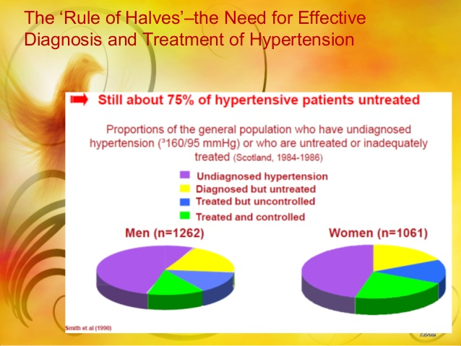

Slide 23
Complications
Stroke
Ischemic Heart Disease
CCF
Renal Failure
Retinopathy
Notes:
Due to arterial damage

Slide 24
Complications
Associated Factor which increases risk of complications
tobacco use,
obesity,
Physical inactivity
high cholesterol
diabetes mellitus

Slide 25
Secondary prevention
Early Diagnosis
Control of BP

Slide 26
Screening and Diagnosis
How is BP measured?
After 5 minute rest in sitting position
Support the arm (put on table)
Cuff should cover > two-third of arm
Lower pressure slowly (2mm/second)
Read the BP to the nearest 2 mm/hg
White coat blood pressure?
Take two measurements 2 minute apart at each visit – take average

Slide 27
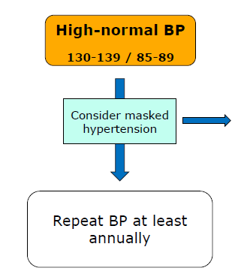
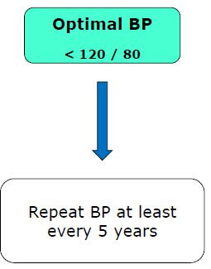
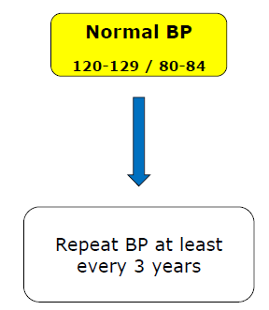
Screening and Diagnosis

Slide 28
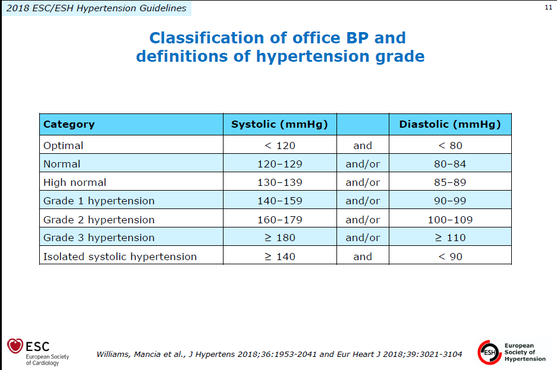
Notes:
Office BP – measured at hospital
Home based blood pressure -

Slide 29
NPCDCS
Above 30 years of age
Annually
If BP above 140/90 mm/Hg – referred to higher centre
Confirmation of diagnosis: number of repeat measurements and interval between measurements depends on severity of BP
Grade 3 – single visit; Grade 2: days/weeks interval, at least two readings; Grade 1 – months interval (E.S.H.)

Slide 30
Investigations for Hypertensive Pt.
Blood Potassium and sodium
Urinary protein
Blood creatinine and eGFR
Blood Lipids
Blood triglycerides
HbA_{1C}
12 lead ECG
2 D Echo

Slide 31
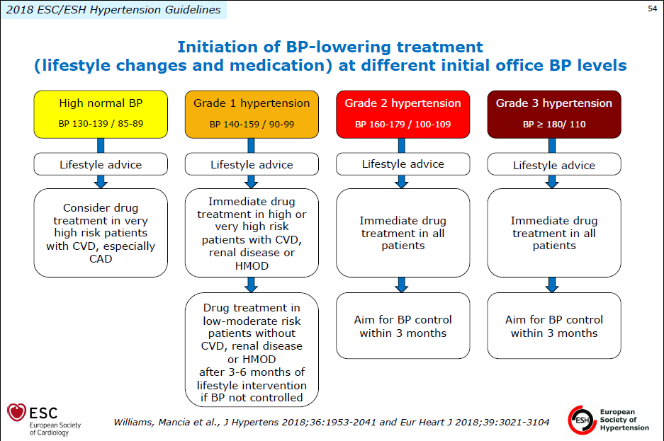
Notes:
Hypertension Mediated Organ Damage

Slide 32
Logically –
  Obese person – more blood volume – diuretics
  Hypo-protienaemia – ACE inhibitor / ARB

Slide 33
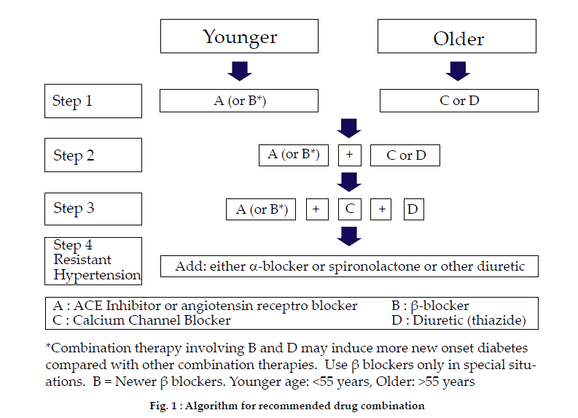
Low-risk grade 1 hypertension

Slide 34
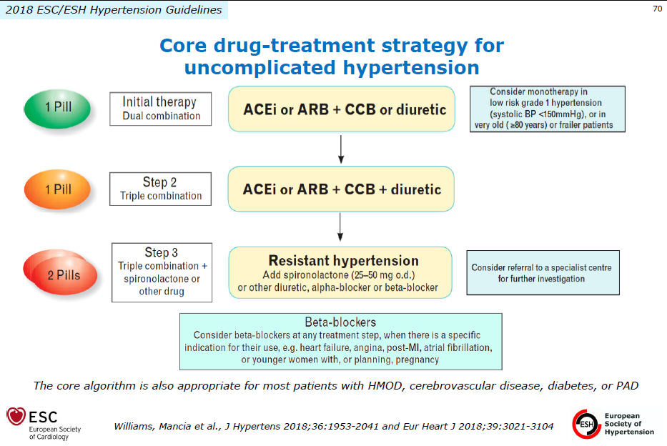
Notes:
Low dose two drug combination is more effective than monotherapy

Slide 35
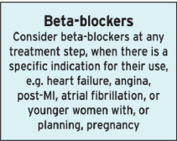

Slide 36
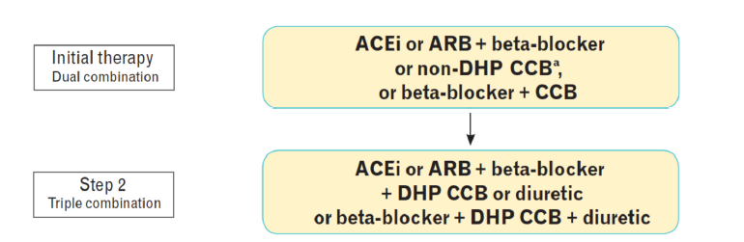

Slide 37
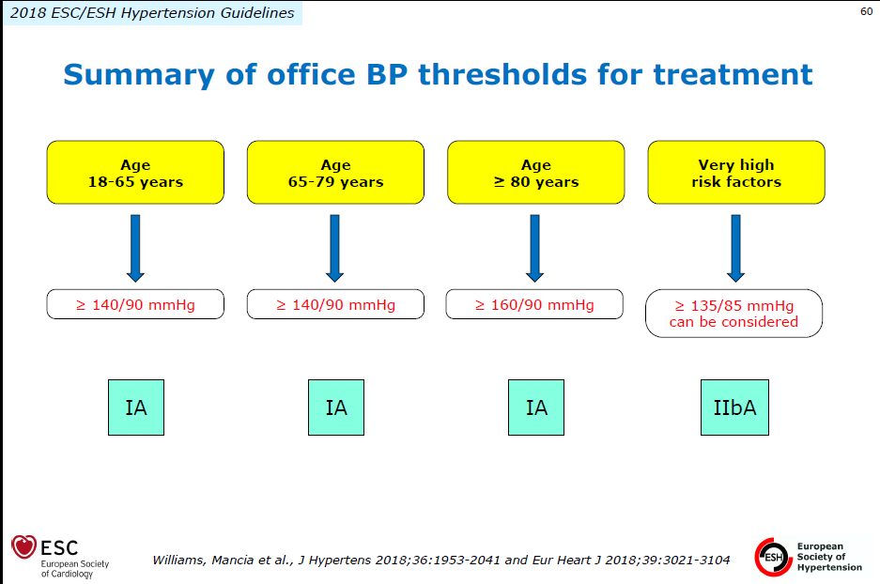

Slide 38
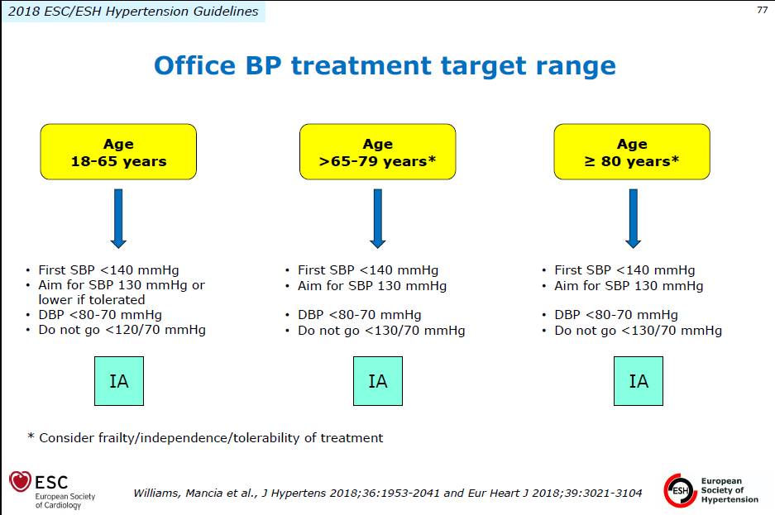

Slide 39
Self Care
monitoring blood pressure 6 monthly (3 monthly if at high risk)
checking blood sugar, blood cholesterol and urine albumin
adopting the healthy behavior – diet, tobacco
regularly taking any prescribed medications for lowering blood pressure

Slide 40
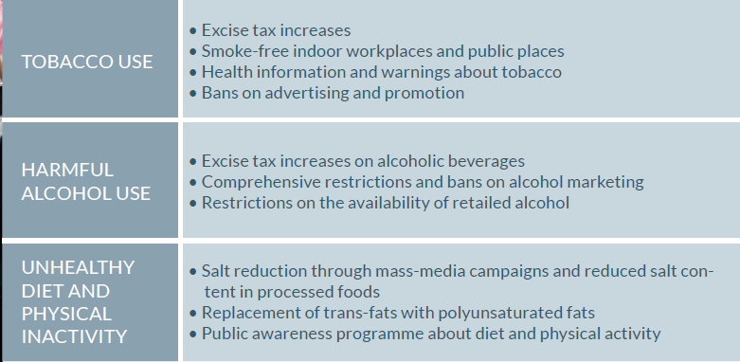
Population based cost effective interventions

Slide 41
National Programme for prevention and control of
Cancer, Diabetes, CVD and Stroke
NPCDCS

Slide 42
The target population for screening is as follows:
All men and women over 30 years for Oral Cancer, Hypertension and Diabetes Mellitus;
All women over 30 years for Cervical and Breast Cancer
Screening for cancers will take place once in five years, and for hypertension and diabetes it should be done annually.

Slide 43
On a fixed day in a week- the ANM, assisted by the ASHA would screen for HTN, DM, and Oral Cancers, Cervical cancer (sub-centre and above) and Breast cancer.
Those with a systolic BP of over 140 and a diastolic BP of over 90 mm of Hg, or Random Blood Sugar of 140 mg/dl and above would be referred to a Medical officer (MBBS), at the nearest facility.

Slide 44
Once the diagnosis of HT/Diabetes is established, the patient must receive at least a month’s supply of drugs from the PHC.
Once the condition is stable, the state could also decide to provide the patient with a three- month supply, with the ANM/ASHA visiting the patient each month for ensuring compliance or keeping stock and distributing drugs every month.

Slide 45
For those individuals who are already on treatment under the care of a private practitioner, they could be offered the choice of taking drugs from the public health system, after appropriate confirmation.
Community Follow up of these individuals would be by the ASHA making visits to enable
  behaviour modifications,
  treatment compliance, and
  encouraging patients to go the sub centre for regular check-up of BP/blood glucose.

Slide 46
What is blood pressure? What is hypertension?
Magnitude of problem
Etiology/Epidemiological factors
Prevention and control

Slide 47
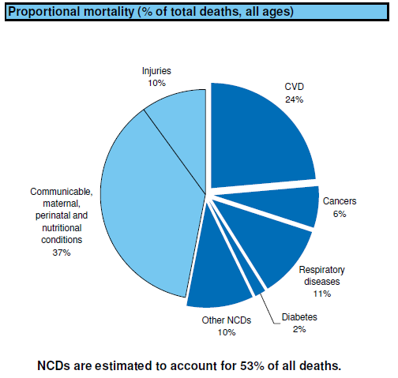
CAUSES OF DEATHS IN INDIA
More than 50% of deaths are premature (Before 70 years)
Notes:
47

Slide 48
Magnitude of Problem
Hypertension is responsible for at least 45% of deaths due to ischemic heart disease, and 51% of deaths due to stroke
Geographical distribution -
Prevalence in India –
Trend -

Slide 49
Magnitude of Problem
Geographical distribution – more in developing countries
Prevalence in India – 25% in adults
Trend - increasing

Slide 50
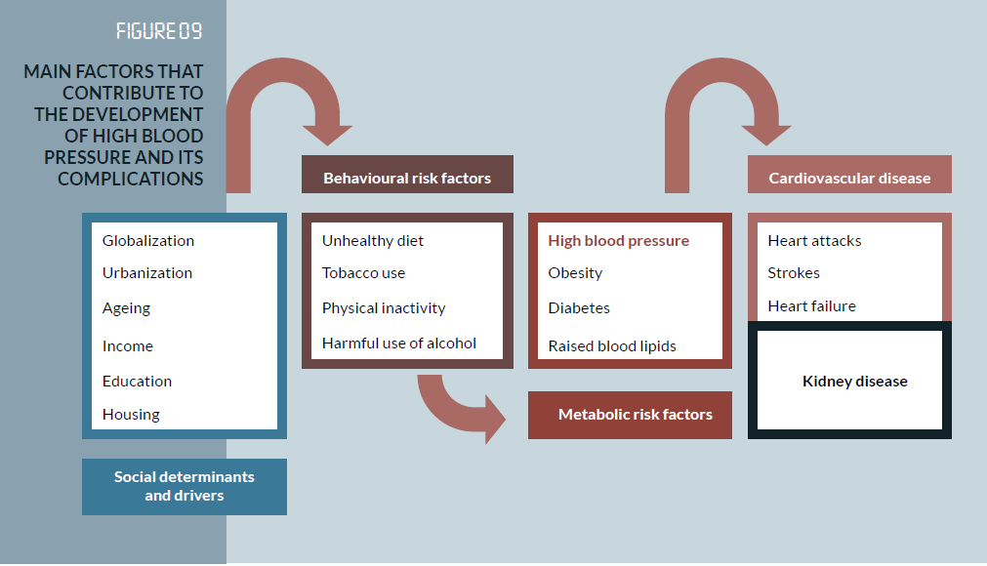
Risk Factors
Notes:
Urbanization-lifestyle changes: uneployment – stress: Ageing – advancing age prevalence Increases: housing: access to health care servicves

Slide 51
High risk Strategy
High Risk persons
  Family History of HT
  “Tracking” of BP
Only when risk factors have low prevalence
  Population strategy has more potential

Slide 52
The principles of screening at the community level are: that no individual should need to travel more than half an hour to be screened
Hypertension, Diabetes, oral and breast cancer screening can be offered in the outreach services at the village level
cervical cancer screening requires a space where speculum examinations and VIA can be done, including facilities for sterilization of equipment.

Slide 53
The patient will need to go the PHC for the first follow up at the end of the first three months after diagnosis, and sooner if required.
An annual specialist consultation at the nearest nodal CHC with an NCD clinic, is also recommended.

Slide 54
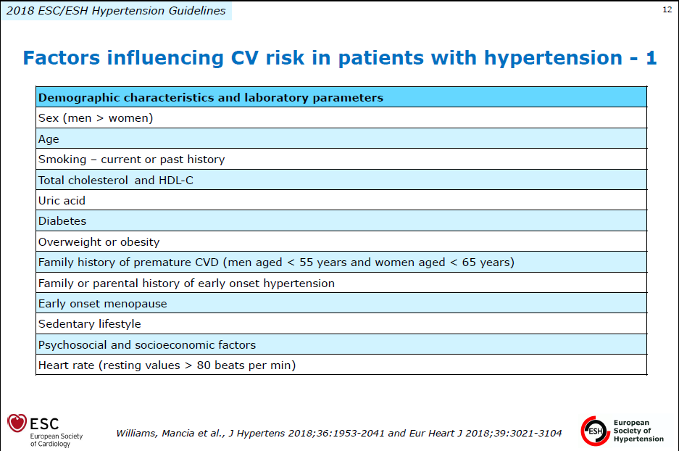

Slide 55
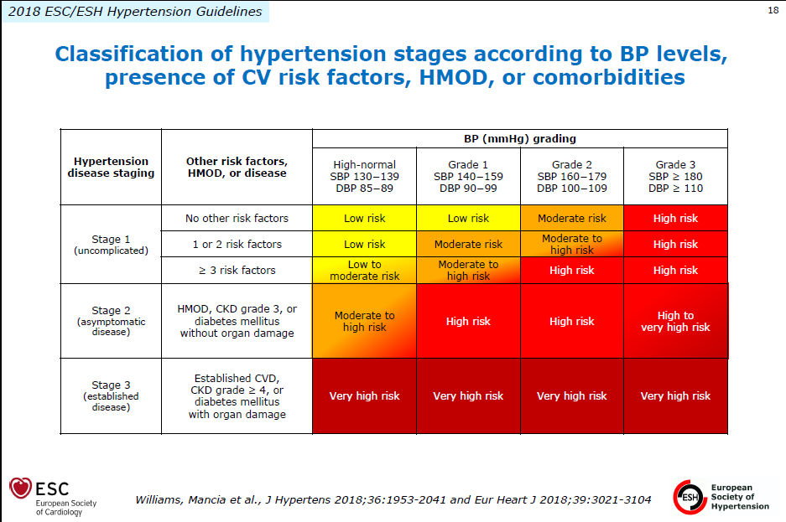
Notes:
Hypertension Mediated Organ Damage

Slide 56
JNC 8
In patients >60 years of age, start medications at blood pressure of >150/90 mm Hg and treat to goal of <150/90mm Hg (SP 10 higher than JNC 7)
In patients age < 60 years of age and any age but with diabetes or chronic kidney disease, start medications at blood pressure of >140/90mm Hg and treat to goal of <140/90mm Hg (10 higher than JNC 7)

Slide 57
Title | Method | Result | Conclusion
Janelle Ann Bartsch, et al. Secondary prevention of stroke in Saskatchewan, Canada: hypertension control Int J Stroke 2013 Oct;8 Suppl A100:32-8. | Multi-year cross-sectional study. The target population was all Saskatchewan residents who were hospitalized in Saskatchewan for a stroke or TIA between April 1, 2001 and March 31, 2008. A select indicator that measures adherence to use of antihypertensive medications for secondary stroke prevention was calculated. | The management of hypertension for secondary stroke prevention is sub-optimal in S Saskatchewan. Approximately 40% of patients were not taking antihypertensives at 90 days after discharge from acute care. | There is a need for province-wide improvement to secondary stroke prevention in Saskatchewan, Canada.

