Slide 1
CM 8.2: Aids
Dr Piyush Parmar
Associate Professor
Dept. of Community Medicine
SBKS MI RC SUMANDEEP VIDYAPEETH

Slide 2
SLO
Introduction
Epidemiology
Transmission
Prevention

Slide 3
introduction
AIDS, the acquired immuno-deficiency syndrome
sometimes called "slim disease“
fatal illness caused by a retrovirus known as the human immuno-deficiency virus
Once infected, it is probable that a person will be infected for life.
The term AIDS refers only to the last stage of the HIV infection

Slide 4
Types of hiv epidemics
Low-level HIV epidemics
  HIV prevalence has not consistently exceeded 5% in any defined subpopulation.
Concentrated HIV epidemics
  HIV prevalence is consistently over 5% in at least one defined sub-population but is below 1% in pregnant women in urban areas.
Generalized HIV epidemics
  HIV prevalence consistently over 1% in pregnant women

Slide 5
Classification of states in india
Group I High Prevalence States :HRG >5%, >1% in ANC
  Maharashtra, Tamil Nadu, Karnataka, Andhra Pradesh, Manipur and Nagaland
Group lI Moderate Prevalence States :>5% in HRG, <1% in ANC
  Gujarat, Goa and Pondicherry
Group III Low Prevalence States : <5% in HRG, <1% in ANC

Slide 6
epidemiology
AGENT FACTORS:
Agent:
When the virus was first identified it was called "lymphadenopathy-associated virus (LAV)" by the French scientists
USA: "human T-cell lymphotropic virus III (HTLV-lll)
May 1986, the international Committee on the Taxonomy gave it a new name : human immuno-deficiency virus (HIV)
The virus is 1/10,000th of a millimetre in diameter.
It is a protein capsule containing two short strands of genetic material(RNA) and enzymes.

Slide 7
agent factors contd
The virus replicates in actively dividing T4 lymphocytes
Can remain in lymphoid cells in a latent state that can be activated
The virus has the unique ability to destroy human T4 helper cells.
The virus is able to spread throughout the body: can pass through the blood- brain barrier and can then destroy some brain cells.
There are two types of HIV - the most common HIV 1 and a more recently -recognized virus (in West Africa) called HIV 2.

Slide 8
agent factors contd..
Virus is easily killed by heat.
It is readily inactivated by ether, acetone, ethanol (20 per cent) and beta-propiolactone(1:400 dilution)
Relatively resistant to ionizing radiation and ultraviolet light

Slide 9
agent factors contd..
2. RESERVOIR OF INFECTION : These are cases and carriers.
Once a person is infected, the virus remains in the body life-long.
The risk of developing AIDS increases with time.
Since HIV infection can take years to manifest itself, the symptomless carrier can infect other people for years.

Slide 10
agent factors contd..
SOURCE OF INFECTION:
Largest concentration in blood, semen and CSF.
Lower concentrations have been detected in tears, saliva, breast milk, urine and cervical and vaqinal secretions.
HIV has also been isolated in brain tissue, lymph nodes, bone marrow cells and skin.

Slide 11
Epidemiology contd..
HOST FACTORS
AGE :
Among sexually active persons; aged 20-49 years: represent the most productive members of the society, and those responsible for child-bearing and child-rearing.
Children under 15 make up less than 3 per cent of the cases.

Slide 12
2. SEX :
In North America, Europe and Australia about 51 per cent of cases are homosexual or bisexual men.
In Africa, the sex ratio is equal
Certain sexual practices increase the risk of infection more than others, e.g., multiple sexual partners, anal intercourse, and male homosexuality.
Higher rate of HIV infection is seen in Commercial Sex Workers.

Slide 13
3. HIGH RISK GROUPS :
Male homosexuals and bisexuals,
heterosexual partners (including prostitutes)
intravenous drug abusers,
transfusion recipients of blood and blood products, haemophiliacs and clients of STD.

Slide 14
immunology
The immune system disorder is due to gradual depletion of t-helper or T-4 cells or CD-4 + T lymphocyte or CD-4+ cells
When the virus reproduces, the infected T-helper cells are destroyed: people with AIDS tend to have low overall white blood cell count
T- helper: T-suppressor cell: 2:1 in normal individuals is reversed in people with AIDS
Lymphopenia: with a total lymphocyte count of below 500 c.mm

Slide 15
Mode of transmission
Sexual transmission
Every single act of unprotected intercourse with an HlV-infected person exposes the uninfected partner to the risk of infection.
Factors affecting risk:
  the presence of STD:8-10 times increased risk
  the sex and age of the uninfected partner: Chances of transfer from male to female twice more likely: higher concentration in semen and larger surface exposed
    Risk is higher if woman is menstruating
    Adolescent girls and women above 45 yrs
  the type of sexual act: anal intercourse carries a higher risk of transmission
  the stage of illness of the infected partner: window period, well advanced disease
  the virulence of the HIV strain involved.

Slide 16
2. Blood contact
transmitted by contaminated blood transfusion of whole blood cells, platelets and factors VIII and IX derived from human plasma
Highly infective when introduced in large quantities directly into the blood stream
The risk of contracting HIV infection from transfusion of a unit of infected blood is estimated to be over 95%
Risk depends on the “dose” of virus: transfusion > needle prick, other skin piercing instruments
Contaminated syringes and needles: important route in injectable drug users because of repeated exposure

Slide 17
3. Maternal- foetal transmission : mother-to-child transmission
through the placenta, during delivery or by breast-feeding.
In the absence of any intervention, rates of this form of transmission can vary from 20-25 per cent.
Transmission during the peripartum period accounts for one third to two-thirds of overall numbers infected, depending on whether breast-feeding transmission occurs or not
The risk of infection is higher if the mother is newly infected, or if she has already developed AIDS.

Slide 18
Incubation period
From a few months to 10 years or even more
It is estimated that 75 per cent of those infected with HIV will develop AIDS by the end of ten years
CLINICAL FEATURES:
Initial infection with the virus and development of antibodies
Asymptomatic carrier state
AlDS-related complex (ARC)
AIDS.

Slide 19
INITIAL INFECTION
First few weeks: general mild illness (fever, sore throat and rash)- a few weeks after initial infection with the virus.
Most HIV – infected people have no symptoms for the first five years or so.
They look healthy and feel well although right from the start they can transmit the virus to others.
Once infected, people are infected for life
HIV antibodies usually take between 2 to 12 weeks to appear in the blood-stream

Slide 20
Window period
The period before antibodies are produced
The person is particularly infectious because of the high concentration of virus in the blood
He will test negative on the standard antibody blood test.

Slide 21
Asymptomatic carrier state
Infected person has anti bodies
No overt signs of disease
Persistent generalised lymphadenopathy
Not certain how long this stage lasts

Slide 22
Aids related complex
Has illness caused by the damage to the immune system but no signs of neoplasms or opportunistic infections
Unexplained diarrhoea, lasting longer than a month,
Fatigue
Malaise
Loss of more than 10 per cent body weight
Fever, night sweats
Milder opportunistic infections: oral thrush, generalised lymphadenopathy or enlarged spleen

Slide 23
aids
End stage disease
A number of oppurtunistic infections commonly occur at this stage and/or cancers that occur in people with otherwise unexplained defects in immunitv.
Death is due to uncontrolled or untreatable infection.
Tuberculosis and Kaposi sarcoma are seen relatively early.
when T-helper cell count has dropped to around 100.
  Serious fungal infections such as Candida oesophagitis
  Cryptococcus meningitis and penicillosis
  Pneumocystis jiroveci pneumonia
  Toxoplasma gondii encephalitis
People whose counts are below 50 have the late opportunistic infections such as cytomegaloviral retinitis.

Slide 24
In Africa: Wasting syndrome called Slim Disease
  chronic diarrhoea and severe weight loss
AIDS encephalopathy or AIDS dementia:
  When HIV crosses blood-brain barrier
  Not due to any opportunistic infection
  Due to the action of the virus itself

Slide 25
Control of aids
Prevention
  Education
  Prevention of blood borne infection
Antiretroviral treatment
Specific prophylaxis
Primary health care

Slide 26
Prevention-education
Health education to enable people to make life-saving choices- avoiding indiscriminate sex, using condoms etc
Avoid the use of shared razors and toothbrushes.
Intravenous drug users should be informed that the sharing of needles and syringes involves special risk.
Women suffering from AIDS or who are at high risk of infection should avoid becoming pregnant, since infection can be transmitted to the unborn or new born.
Educational material and guidelines for prevention should be made widely available.
All mass media channels should be involved in educating the people on AIDS

Slide 27
Prevention of blood borne transmission
People in high-risk groups should be urged to refrain from donating blood, body organs, sperm or other tissues.
A blood should be screened for HIV 1 & HIV 2 before transfusion.
Transmission of infection to haemophiliacs can be reduced by introducing heat treatment of factors VIII and IX
Strict sterilization practices should be ensured in hospitals and clinics.
Pre-sterilized disposable syringes and needles should be used as far as possible.

Slide 28
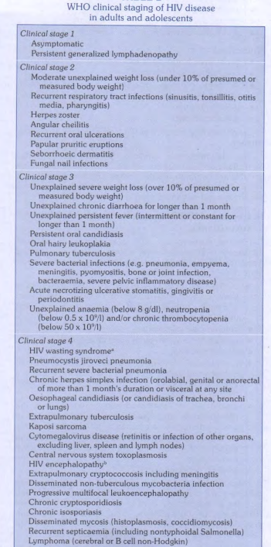

Slide 29
Initiation of ART based on CD4 count and WHO clinical staging
WHO Clinical Stage | Recommendations
HIV infected Adults & Adolescents (Including pregnant women)
Clinical Stage I and II | Start ART if CD4 < 350 cells/mm3
Clinical Stage III and IV | Start ART irrespective of CD4 count
For HIV and TB co-infected patients
Patients with HIV and TB co-infection (Pulmonary/ Extra-Pulmonary) | Start ART irrespective of CD4 count and type of tuberculosis (Start ATT first, initiate ART as early as possible between 2 weeks to 2 months when TB treatment is tolerated)
For HIV and Hepatitis B and C co-infected patients
without any evidence of chronic active Hepatitis | Start ART if CD4 < 350 cells/mm3
With documented evidence of chronic active Hepatitis | Start ART irrespective of CD4 count

Slide 30
treatment
In pregnant women: AZT + 3TC + NVP twice daily
(Zidovudine, Lamivudine,Nevirapine)
Post-exposure prophylaxis (PEP) is a necessary secondary prevention measure in health care settings,
healthcare workers or patients may be accidentally or through unsafe procedures be exposed to the risk of HIV transmission.
First aid care
counselling and risk assessment
HIV testing and counselling
Depending on the risk assessment, the short term(28 days) provision of antiretroviral drugs, with support and follow up.

Slide 31
pep
ARVs for PEP should be initiated as soon as possible after exposure within the first few hours and no later than 72 hours.
Not to be prescribed to people already known to have been infected with HIV prior to the exposure incident.
The administration of ARV drugs for PEP should never be delayed because of testing procedures
If the first test is negative it should be repeated after three and six months
WHO recommends that the PEP ARV regimen contain two NRTI drugs.
If drug resistance is suspected the addition of a protease inhibitor (PI) may be considered
Notes:
TDF + 3TC (tenofovir + lamivudine)

Slide 32
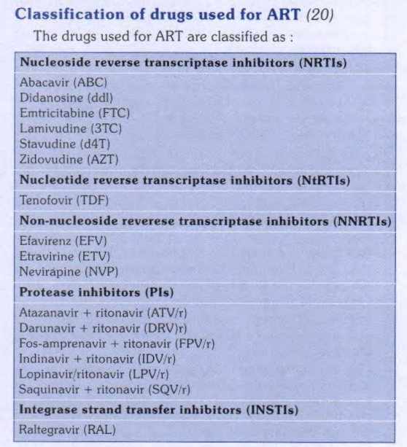

Slide 33
monitoring the efficacy of ART
Clinical improvement
  gain in body weight,
  decrease in occurrence and severity of HlV-related diseases (infections and malignancies),
Increase in total lymphocyte count,
Improvement in biological markers of HIV (when available)
  CD4 + T-lymphocyte counts,
  Plasma HIV RNA levels.

Slide 34
Specific prophylaxis
Cotrimoxazole prophylaxis
Any WHO clinical stage and CD4 <250 cells/mm3 or
Any WHO clinical stage, CD4 <350 cells/mm3 and if patient is symptomatic or
WHO stage 3 or 4 irrespective of CD4 count
If CD4 is awaited: WHO clinical stage 3 or 4 (This includes all patients with TB)

Slide 35
JE Werle, E F Teston- HIV/AIDS and the social determinants of health: a time series study; Revista brasilera de enfermageon 2022 Apr 15;75(4):e20210499. doi: 10.1590/0034-7167-2021-0499 | Objective: To analyze the time trend, spatial distribution, and the cases of human immunodeficiency virus/acquired immunodeficiency syndrome cases with social determinants of health. | Ecological and analytical study, carried out based on the cases of human immunodeficiency virus/acquired immunodeficiency syndrome notified in a state in the Brazilian Midwest, from 2009 to 2018. The study used descriptive analysis, polynomial regression, and geospatial analysis. | In 10 years, there were 9,157 notifications, growing each year. There was a growing trend for both sexes (p<0.001, r2=0.94). The City Human Development Index was related to the higher number of cases (city of notification, p=0.01; and city where the person lives, p=0.02). The highest concentration was in cities that house health macro-regions. | Social determinants have a relationship with the time trend and the spatial distribution of cases and can direct strategies for prevention and care.

Slide 36
Thank you
https://forms.gle/GuvDYEzrQHgNHQa29

