Slide 1
OEDEMA
Dr Shashikant Mavadiya
Pathology

Slide 2
Definition :
Oedema is clinically apparent increase in the interstitial fluid volume.

Slide 3
Oedema in the different body cavities are given specific names
Depending on the location-
– Hydrothorax - Pleural cavity
– Hydropericardium - Pericardial cavity
– Hydroperitoneum (ascites) – Peritoneal
cavity
- Anasarca - Severe and generalized edema
with profound subcutaneous tissue swelling

Slide 4
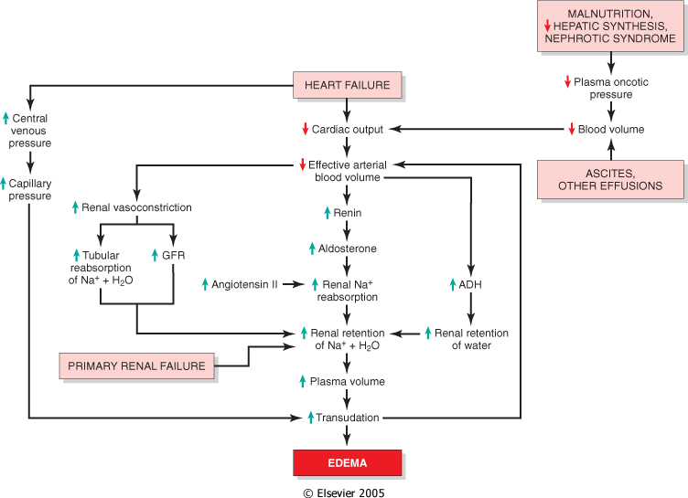
Edema - Pathogenesis

Slide 5
  1.INCREASED HYDROSTATIC PRESSURE
    A)DUE TO IMPAIRED VENOUS RETURN
    CONGESTIVE HEART FAILURE
    COSTRICTIVE PERICARDITIS
    CIRRHOSIS OF LIVER
    OBSTRUCTION OR NARROWING OF VEINS
    B)DUE TO ARTERIOLAR DILATATION
    HEAT
    NEROHUMORAL EXCESS OR DEFICIT

Slide 6
  2. DECREASED ONCOTIC OR OSMOTIC PRESSURE
    NEPHROTIC SYNDROME
    CIRRHOSIS
    MALNUTRITION
    PROTIEN LOSING GASTROENTEROPATHY

Slide 7
3.SODIUM RETENTION
    EXCESSIVE SALT INTAKE WITH REDUCED RENAL FUNCTION
    INCREASED TUBULAR RESORPTION OF SODIUM
    1.REDUCED RENAL PERFUSION
    2.INCREASED RENIN- ANGIOTENSIN – ALDOSTERONE SECRETION

Slide 8
4.LYMPHATIC OBSTRUCTION
INFLAMATORY
NEOPLASTIC
POSTSURGICAL
POST RADIATION

Slide 9
Oedema can be
1.Depending on the distribution
Localized ,Generalized → Anasarca
2. Clinically Pitting/Nonpitting
Soft (Pitting), Hard (Non-Pitting)
3. Depending on the cause - Cardiac , renal, Hepatic, nutritional, lymphatic obstruction
4. Depending on the tissue involved
Lung, subcutis, brain
5. Depending on the composition of oedema fluid
Transudative, exudative

Slide 10
 | TRANSUDATE | EXUDATE
1 | THEY ACCUMULATE IN SEROUS CAVITY DUE TO NON INFLAMATORY PROCESS | DUE TO INFLAMATORY PROCESS
2 | DUE TO DISTURBANCE IN THE CIRCULATION WITH PASSIVE CONGESTION AND EDEMA | DUE TO BACTERIAL INNFECTION
3 | SP GRAVITY <1.018 | >1.018
4 | PROTIEN <3 Gm/DL | >3 Gm/DL
5 | FEW CELLS ARE PRESENT | MANY CELLS Eg NEUTROPHILS ,LYMPHOCYTES .
6 | BACTERIA ABSENT | BACTERIA PRESENT
7 | LDH- LOW | HIGH
8 | Eg CCF | PURULENT EFFUSION
9 | FLUID LDH/SERUM LDH<0.6 | >0.6

Slide 11
TYPES OF OEDEMA:
1.CARDIAC OEDEMA
2. RENAL OEDEMA
3. PULMONARY OEDEMA

Slide 12
1.CARDIAC OEDEMA
Cardiac diseases → Oedema (Generalized)
Cardiac pump failure due to MI, Valvular Ds, tamponade, L–R Shunt, Corpulmonale →
- Severe, generalized oedema
- Usually in the dependant parts of the body eg., ankles (in erect posture), sacral region (while lying down).
- It pits on pressure.
- Usually prominent in the evenings.

Slide 13
Pathogenesis of Cardiac oedema
CCF → CO & Venous Return Increased central Venous pressure → Increased capillary hydrostatic pressure → fluid escapes into interstitial tissue space through out the body → Oedema

Slide 14
Compensatory mechanisms kick in
Reduced CO →chemo/Baro receptors in the arterial/atrial walls , reduced Renal Perfusion → Symp stimulation → Vaso constriction.
Activation of Renin Angiotensin System, Increased Aldosterone & ADH secretion →
Decreased GFR & increase Sodium & Water retention →
Increased Circulating Blood Volume → if heart failure is not treated a vicious cycle is set up → more fluid escapes into the interstitial tissue space → More oedema

Slide 15
2.RENAL OEDEMA
Renal Ds
→ Nephrotic Syndrome – extensive oedema
→ Nephritic Syndrome – moderate oedema
- The oedema is generalized but is more pronounced in the periorbital region and
is usually more pronounced in the morning.
- Later Anasarca

Slide 16
Nephrotic Syndrome –
Primary Renal ds / Secondary to Systemic ds
- Heavy proteinuria → Hypoalbuminaemia →
Decrease in plasma oncotic pressure →
Fluid escapes into the interstitial tissue
space at arterial end of capillary & is unable to
return to blood vessel at the venous end
lumen → Oedema
Glomerular destruction → reduced water
excretion → contributes to oedema
Reduced circulating plasma volume →
Hypovolemia → reduced Cardiac output

Slide 17
Compensatory mechanisms kick in
Chemo/baro receptors → Vaso constriction,
Renal Ishchemia → activation of rennin Angiotensin system & Increased secretion of aldosterone & AntiDiuretic Hormone → Increase in Plasma Volume
hydrostatic pressure improves & Plasma oncotic pressure persists → Large amount of fluid persists in the interstitial tissue space → more Oedema

Slide 18
3.PULMONARY OEDEMA
Pulmonary oedema can occur as isolated localized oedema
Or
lungs may be involved in an example of generalized oedema

Slide 19
A.Haemodynamic oedema
LV failure, Mitral Stenosis & Mitral Insufficiency →Increased Hydrostatic pressure
Backing up of blood in Pulmonary vasculature → 1. increase in the hydrostatic pressure in the pulmonary vasculature → fluid escapes in to pulmonary interstitial space in the alveolar septa , 2. Stasis of blood in the pulmonary vasculature → increased capillary endothelial permeability

Slide 20
→ fluid escapes into the pulmonary interstitial tissue space. With accumulation of more fluid in the pulmonary interstitial tissue space the lymphatics are overwhelmed/ compressed → more fluid in the pulmonary interstial tissue space. Pulmonary Interstitial Oedema
When the pulmonary interstitial tissue fluid collection increases 10 fold more than normal, fluid escapes into alveolar airspace → Alveolar Oedema

Slide 21
B. Irritant Oedema
Fulminant pulmonary & extra pulmonary infections, inhaled toxic agents aspiration, shock radiation injury, hypersensitivity uraemia & ARDS
The pulmonary capillary endothelium & alveolar membrane are damaged by direct toxic effect
→ Xs fluid → pulmonary interstitial space → alveoli → Pulmonary Oedema

Slide 22
C. Acute High Altitude oedema
Rapid High altitude climbing with out allowing time to acclimatize → anoxic damage to pulmonary capillary wall → point haemorrhages & alveolar haemorrhages & oedema.

Slide 23
LUNG PATHOLOGY :
Gross: Heavy, cut surface oozes/drips pink frothy fluid - the product of churning up of Fluid & air during the process of breathing
Micro.: Alveolar spaces are filled with pale pink homogenous proteinaceous fluid. The pulmonary septal capillaries & larger pulmonary vessels are distended & engorged with blood. Occasional red cells & brown pigment containing alveolar macrophages (Heart Failure cells) may be present

Slide 24
MCQ1
Hydrothorax is seen in
  Lung
  Pleural cavity
  Heart
  kidney

Slide 25
MCQ1
Hydrothorax is seen in
  Lung
  Pleural cavity
  Heart
  kidney

Slide 26
MCQ-2
Oedema due to decrease in oncotic pressure is due to
    NEPHROTIC SYNDROME
    CIRRHOSIS
    MALNUTRITION
    All

Slide 27
MCQ-2
Oedema due to decrease in oncotic pressure is due to
    NEPHROTIC SYNDROME
    CIRRHOSIS
    MALNUTRITION
    All

Slide 28
MCQ3
Heart failure cell is seen in which pathology
  Lungs
  Heart
  Spleen
  stomach

Slide 29
MCQ3
Heart failure cell is seen in which pathology
  Lungs
  Heart
  Spleen
  stomach

Slide 30
MCQ_4
Complete body edema is known as
  Anasarca
  PYOARCA
  NEOSARCA
  NO TERMINOLOGY

Slide 31
MCQ_4
Complete body edema is known as
  Anasarca
  PYOARCA
  NEOSARCA
  NO TERMINOLOGY

Slide 32
MCQ5
Nature of exudates
  Inflammatory
  Non inflammatory
  Neoplastic
  none

Slide 33
MCQ5
Nature of exudates
  Inflammatory
  Non inflammatory
  Neoplastic
  none

Slide 34
The impact and role of hepatic hydrothorax in the prognosis of patients with decompensated cirrhosis: A retrospective propensity score-matched study
Bo Ma Tianling Shang Jianjie Huang Zhixin Tu Yan Wang Yujin Han Xiaoyu Wen Qinglong Jin
NAME OF AUTHOR | TITLE OF STUDY & DESIGN | AIM | RESULT | CONCLUSION
Bo Ma Tianling Shang Jianjie Huang Zhixin Tu Yan Wang Yujin Han Xiaoyu Wen Qinglong Jin | The impact and role of hepatic hydrothorax in the prognosis of patients with decompensated cirrhosis: A retrospective propensity score-matched study | Hepatic Hydrothorax (HH) is one of the complications in patients with decompensated cirrhosis and its impact and role in the prognosis of patients with decompensated cirrhosis are not yet clear. Thus, this study aimed to determine the role of HH in patients with decompensated cirrhosis and the long-term impact on their mortality. | Results: A total of 737 patients were included. Out of 113 HH patients, 106 could be matched to 106 non-HH patients. After matching, baseline characteristics were well-balanced. The multifactorial Cox proportional hazards model indicated that hepatic encephalopathy and HH were independent risk factors affecting prognostic survival in patients with decompensated cirrhosis (P < 0.01), with risk ratios and 95% confidence intervals (CI) of 2.073 (95% CI: 1.229–3.494, P < 0.01) and 4.724 (95% CI: 3.287–6.789, P < 0.01), respectively. Prognostic survival was significantly worse in the HH group compared to patients in the non-HH group, with mortality rates of 17.9, 30.1, and 59.4% at 6 months, 1 year, and 2 years in the HH group, compared to 0.9, 3.8, and 5.6% in the non-HH group, respectively. The estimated median survival time was 21 (95% CI: 18–25) months in the HH group and 49 (95% CI: 46–52) months in the non-HH group (P < 0.001). | Hepatic hydrothorax is significantly associated with higher mortality in patients with decompensated cirrhosis and is a highly negligible independent decompensated event affecting their prognosis.

