Slide 1
Hypertensive Retinopathy

Slide 2
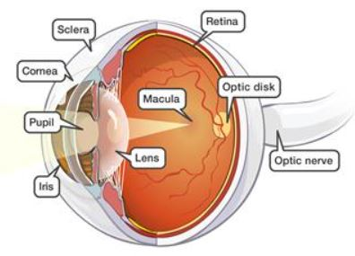
Introduction
Why does one want to see the fundus when one can just measure B.P.
Eye is the only organ of the body where one can observe the blood vessels directly
Finding Ophthalmoscopic signs of HT can suggest
  Chronicity & Severity of HT
  Chances of having other systemic disease

Slide 3
Associations of HT signs
Focal arteriolar narrowing | Current blood pressure | +++
 | Incident hypertension Metabolic syndrome | +
Generalized arteriolar narrowing | Current blood pressure | +++
 | Past blood pressure | +++
 | Incident hypertension | ++
 | Incident clinical stroke | +
 | Carotid atherosclerosis | ++
 | Incident heart disease | ++
 | Cardiovascular mortality | +
 | Metabolic syndrome | +
Larger retinal venular caliber | Incident clinical stroke Cardiovascular mortality | ++
Severity of HT retinopathy | Associations | Strength of association*
Grade I/II hypertensive retinopathy | Stroke | +/++
 | Ischemic heart disease | +/++
Grade III hypertensive retinopathy | Stroke | +++
 | Cognitive impairment | +++
 | Cardiovascular mortality | +++
 | Renal dysfunction | +++
Grade IV hypertensive retinopathy | Mortality | +++
Retinal micro vascular changes | Associations | Strength of association*
Retinal hemorrhages | Current blood pressure | +++
Microaneurysms | Carotid artery disease | +++
Cotton wool spots | Incident clinical stroke | +++
 | Subclinical cerebral disease (MRI) | +++
 | Cognitive impairment | +++
 | Cardiovascular mortality | +++
 | Renal dysfunction | +++
Arterio-venous nicking | Current blood pressure | +++
 | Past blood pressure | +++
 | Incident clinical stroke | ++
 | Subclinical cerebral disease (MRI) | ++
 | Renal dysfunction | +
 | Metabolic syndrome | +

Slide 4
Hypertension and eye
HT Retinopathy
HT Choridopathy
Optic neuropathy
Increases Risk of Arterial and Venous occlusion
Pathogenesis of Glaucomatous Optic Damage and Diabetic Retinopathy

Slide 5
Retinal circulation physiology
Sympathetic and parasympathetic innervation of retina is negligible
No innervation beyond the lamina cribrosa.
Autoregulation of retinal vessels is important for maintaining constant flow and despite changes in perfusion pressure and metabolic needs

Slide 6
Pathophysiology -Phases
1 Vasoconstrictive Phase: Acute
In the vasoconstrictive phase, due to the elevated luminal pressures, local autoregulatory mechanisms cause retinal arteriole narrowing and vasospasm to reduce flow.
2 Sclerotic Phase: Chronic
In the sclerotic phase, the layers of the endothelial wall undergo changes such as intimal thickening, medial hyperplasia, and hyaline degradation in the arteriolar[11] worsening arteriolar narrowing, AV crossing changes, copper and silver wiring causing retinal ischemia (cotton wool spots)
Cotton wool spots are caused by ischemia to the nerve fiber layer secondary to fibrinous necrosis and luminal narrowing. Ischemia to the nerve fibers leads to decreased axoplasmic flow, nerve swelling, and ultimately fluffy opacification.
3 Exudative Phase: Acute or Chronic
In the exudative phase, there is a disruption of the blood-retinal barrier and leakage of plasma & proteins lipids & blood causing retinal edema (+/- SRF) , Hard Exudates & Retinal hemorrhages, respectively

Slide 7
Pathophysiology -Phases
3 Exudative Phase: Acute or Chronic
In the exudative phase, there is a disruption of the blood-retinal barrier and
Leakage of plasma causing retinal edema (+/- SRF)
Leakage of proteins lipids causing Hard Exudates
Leakage of blood causing Retinal hemorrhages,
Retinal hemorrhages develop when necrotic vessels bleed into either the superficial retina (nerve fiber layer) (flame shaped hemorrhage) or the inner retina (dot blot hemorrhage).
Exudates occur later in the course of disease, surrounding areas of hemorrhage, as a result of lipid accumulation.

Slide 8
SYMPTOMS are RARE
SIGNS
Arteriosclerotic changes
  Bilat Arteriolar narrowing ( Attenuation)
  Arterio-venous crossing changes (AV Nicking) with venous constriction and banking
  Arteriolar color changes
    Copper wire arterioles are those arterioles in which the central light reflex occupies most of the width.
    Silver wire arterioles are those in which the central light reflex occupies all of the width of the arteriole.
    Vessel Sclerosis
Ischemic changes (e.g. cotton wool spots)
Exudative
  Hemorrhages , (flame shaped > Dot blot)
  Retinal Edema + Sub Retinal Fluid + Hard Exudate
  Ring of exudates around macula aka “Macular star "
Papilledema or optic disc edema seen in pt with malignant HT
VASCULAR
EXTR-VASC

Slide 9
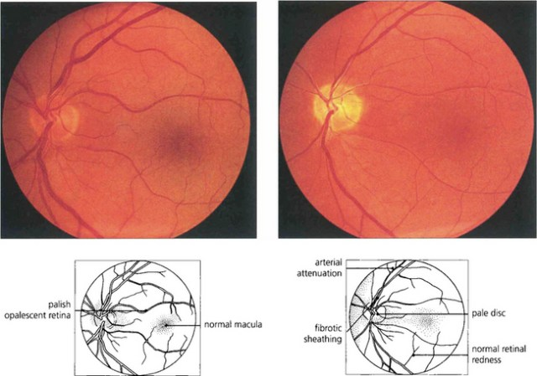
Arterial Attenuation (generalized)

Slide 10
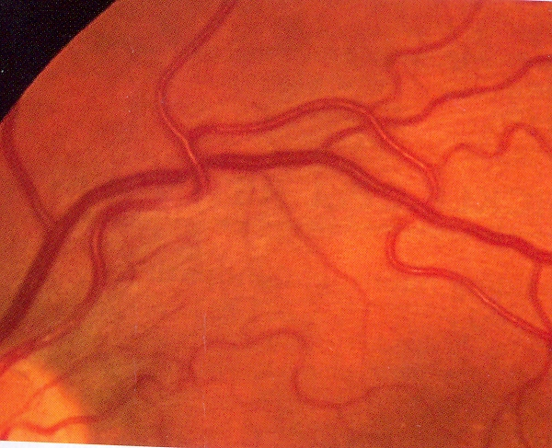
AV nicking:
The most commonly accepted belief is that the crossing phenomenon was due to venous compression by a thickened arteriole within the shared sheath
Impeded circulation results in a dilated or swollen vein peripheral to the crossing, causing hourglass constrictions on both sides of the crossing and aneurysmal-like swellings.

Slide 11
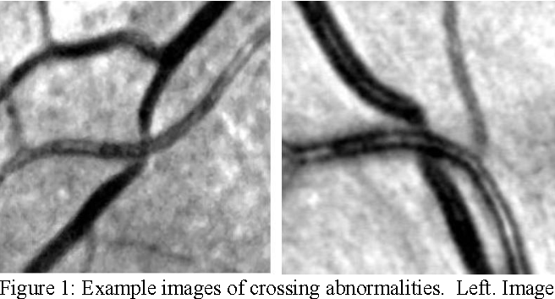
Example images of crossing abnormalities.
Left. Image shows both
Gunn’s Sign - tapering at AV crossing
Salus Sign - the S shaped curving
Right. Image shows
Salus Sign - the S shaped curving with little to no tapering at the crossing.

Slide 12
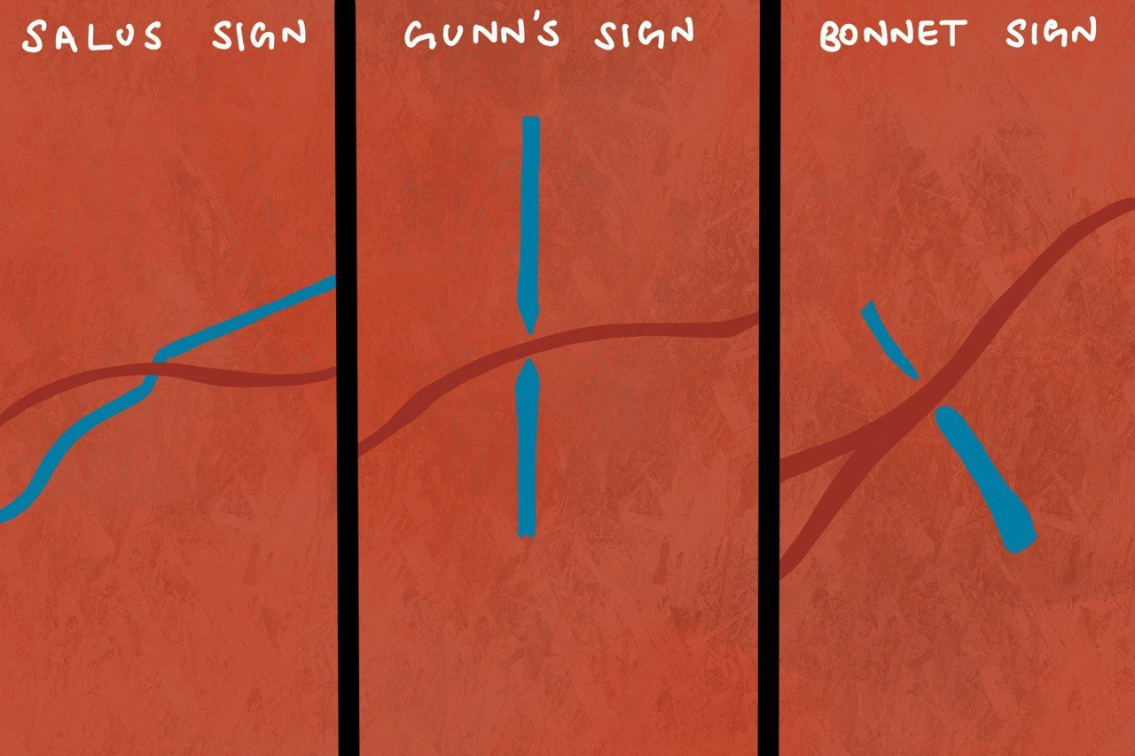
Salus‘ phenomenon – I stage….
Severe cases of arteriolosclerosis where the venule is shifted from its site, as if it was getting out of the way, and we see it as an arch or a saddle-shaped (S-Shape) curve of venules beneath arterioles .
Salus‘ phenomenon – II stage
The venule “completely disappears“ within the retinal tissue
Gunn’s Sign
At AV crossing site the venule is widened before the crossing as it is —pushed down“ and narrower, thereafter its normal width is regained.
In the beginning, the Gunn‘s signs can be noticed sporadically, later their number increases

Slide 13
Bonnet sign
Banking of veins distal to AV crossing
Omega Sign
The angle of arteriolar branching increases, becoming obtuse, rectangular even acquiring the shape of the Greek letter omega
Pine’s Sign
In the sites of arteriolo-venular crossing (A-V crossing) the transparency of the vascular wall of arterioles retreats,
thus causing that the portion of venule beneath the arteriole insites of A-V crossing stops being noticeable

Slide 14
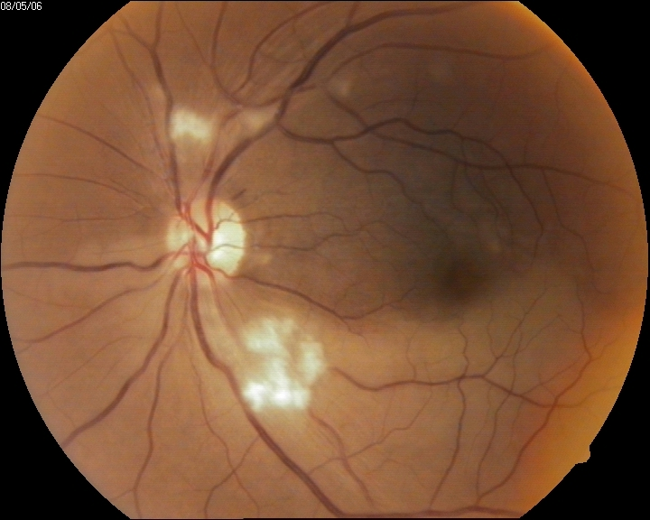
Cotton wool spot
They appear as puffy white patches caused by damage to nerve fibers by swelling in the surface layer of the retina.
The cause of this swelling is due to the reduced axonal transport (and hence backlog of intracellular products) within the nerves because of the ischaemia.
Area of cystoid bodies - axoplasmic debris within adjacent bundles of unmyelinated ganglion cell axons. Their formation is widely held to reflect focal ischaemia from terminal arteriolar occlusion, but credible evidence supporting this view is lacking.

Slide 15
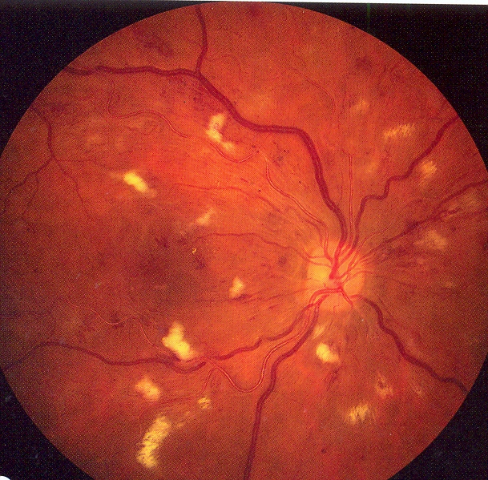

Slide 16
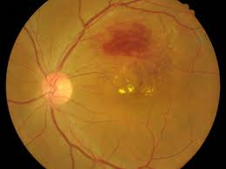
Microaneurysms & Hemorrhages
Microaneurysms: Postulated to occur at localized areas of capillary wall weakness, microaneurysms are most visible by angiography. Stasis engorgement of the capillaries may lead to anoxia and poor nutrition, which contributes to microaneurysm formation.
Retinal hemorrhages: In addition to microaneurysms, loss of endothelial integrity leads to extravasation of plasma, which leads to retinal hemorrhages. Streak hemorrhages located in the nerve fiber layer predominate over the blot hemorrhages located deeper in the outer plexiform layer.

Slide 17
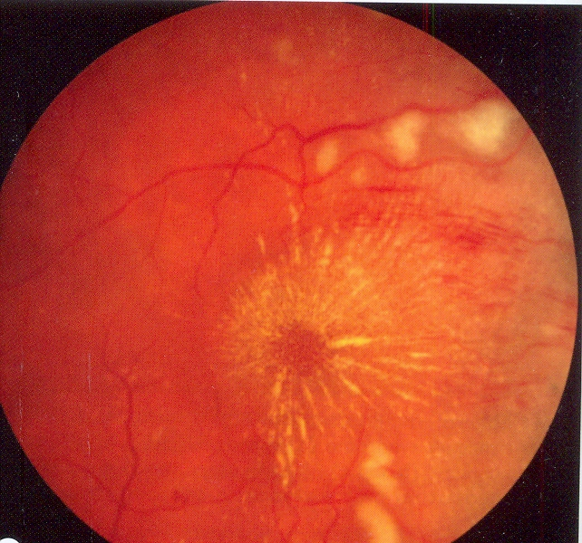
Hard Exudates
Histologically, High BP & Leaky aneurysm cause extravasation of Plasma & proteins & lipids containing macrophages.
Although the deposits assume many shapes and appear in many parts of the retina, the macular star is the most predominant appearance, (and this appearance is due to the radially oriented nerve fiber layer of Henle.)

Slide 18
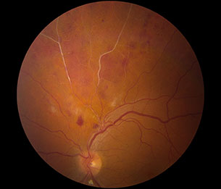
Sclerosis of Vessels

Slide 19
Macular edema and SRF
Two different mechanisms have been proposed.
Hayreh believes that the retinal edema occurs from transudation of choroidal fluids that enter the retina after breakdown of the Outer Blood-Retinal (RPE) (after Hypertensi Choroidopathy). Along also comes Protein rich exudates
Others traditionally have believed that the edematous fluid arises from autoregulatory failure, leading to increased transmural pressure in the distal arterioles and proximal capillaries with subsequent transudation of fluids into the retinal tissue.

Slide 20
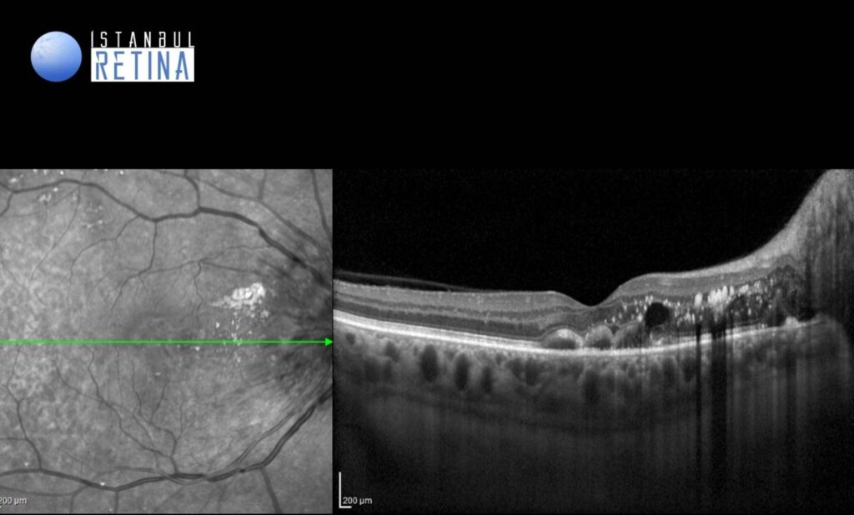
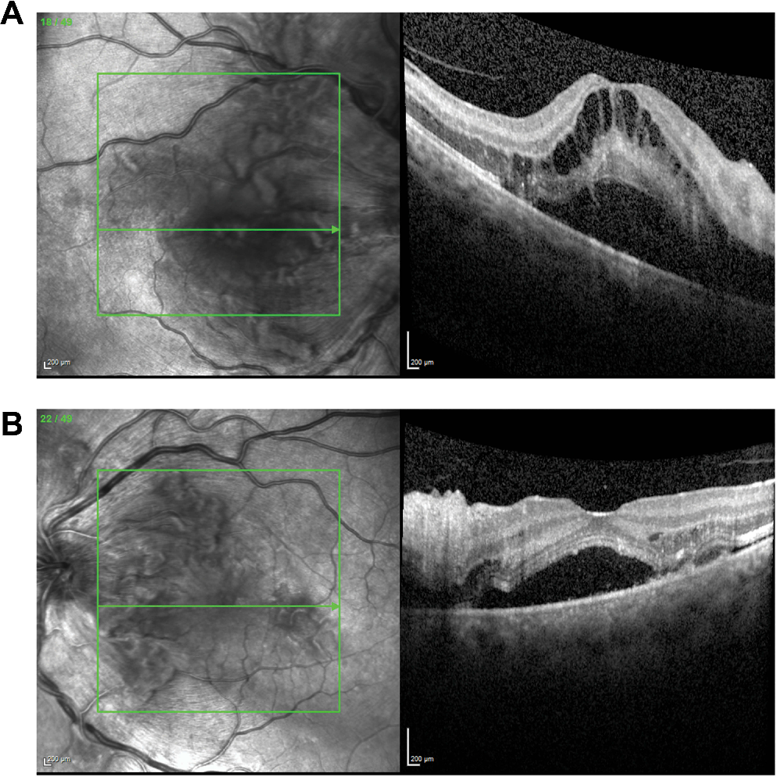
Signs of Acute HT Retinopathy
include
  constricted and tortuous arterioles,
  retinal hemorrhage
  hard exudates
  cotton wool spots
  retinal edema, and
  papilledema

Slide 21
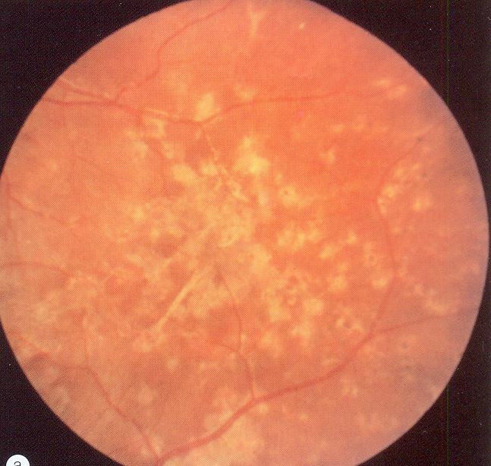
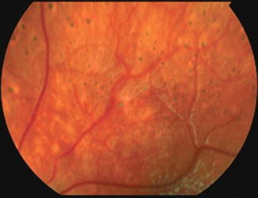
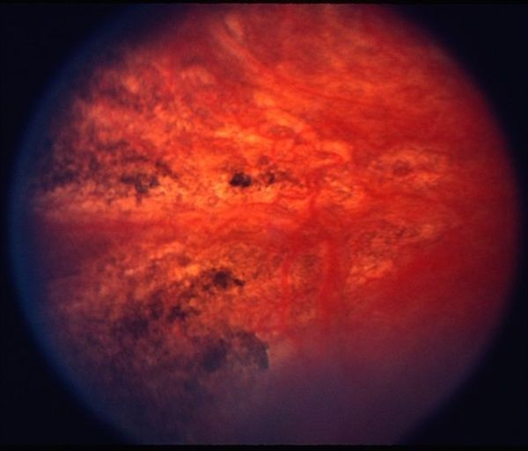
Siegrist streak & Elschnig spots
Elschnig spots in the mid-periphery, seen at 4 months after presentation of malignant hypertension in a child (Courtesy of D.A.Morisson et al.)

Slide 22
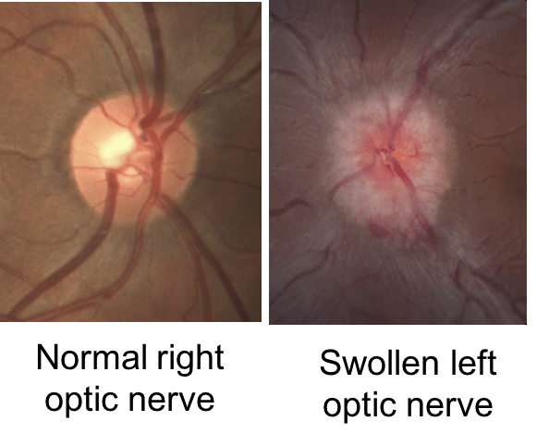
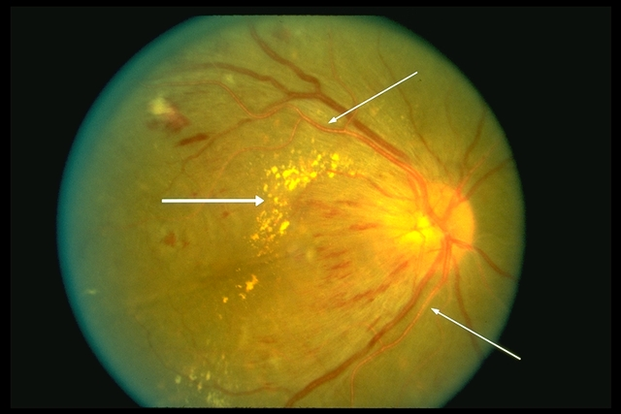
Signs of HT Optic Neuropathy
The signs include
flame shaped hemorrhages at the disc margin,
blurred disc margins,
congested retinal veins,
Florid disc edema or papilledema, and
Hard exudates can deposit in the macula causing a macular star.
Optic nerve pallor is also present in patients with chronic hypertension.
The differential diagnosis includes diabetic papillopathy, radiation retinopathy, incomplete central retinal vein occlusion (CRVO), anterior ischemic optic neuropathy, and acute macular neuroretinitis.

Slide 23
Scheie classification & Modified Scheie classification.
FOR HT RETINOPATHY
Stage 0 - Diagnosis of hypertension but no visible retinal abnormalities
Stage 1 - Diffuse arteriolar narrowing; no focal constriction
Stage 2 - More pronounced arteriolar narrowing with focal constriction
Stage 3 - Focal and diffuse narrowing with retinal hemorrhage
Stage 4 – Stage 3 + Retinal edema, hard exudates, optic disc edema
Grade 0 - No changes
Grade 1 - Barely detectable arterial narrowing
Grade 2 - Obvious arterial narrowing with focal irregularities
Grade 3 - Grade 2 plus retinal hemorrhages and/or exudates
Grade 4 - Grade 3 + disc swelling
FOR ARTERIOSCLEROSIS
Stage 0: Normal
Stage 1: Broadening of arteriolar light reflex
Stage 2: Stage 1 + AV crossing changes
Stage 3: Copper wiring of arterioles
Stage 4: Silver wiring of arterioles

Slide 24
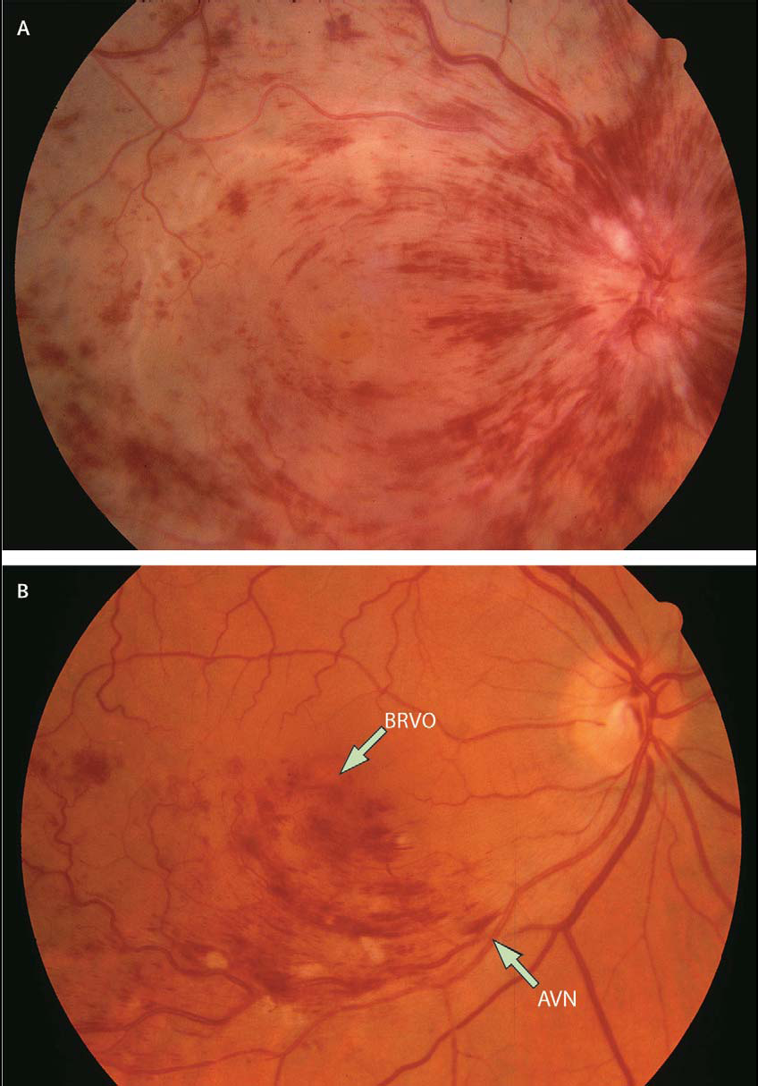
Hypertension and vascular oclusions
The 10-year cumulative incidence was reported to be 0·4% for central retinal vein occlusions and 1·2% for branch retinal vein occlusions.*
*Cugati S, Wang JJ, Rochtchina E, Mitchell P. Ten year incidence of retinal vein occlusion in an older population: The Blue Mountains Eye Study. Arch Ophthalmol 2006; 124: 726–32.

Slide 25
Hypertension and glaucoma
INCREASE risk of damage to ONH d/t raised IOP
Systemic hypertension is suspected to increase the risk of the development and progression of glaucoma.
Direct microvascular damage from systemic hypertension could impair blood flow to the anterior optic nerve due to narrowing of the retinal vasculature.
Second, hypertension could interfere with autoregulation of the posterior ciliary circulation, which is already impaired in glaucoma.
could induce hypotensive episodes, especially at night.
Finally, systemic blood pressure is closely related to intraocular pressure the main risk factor for glaucomatous optic-nerve damage.

Slide 26
Hypertension and diabetic retinopathy
Diabetic patients with hypertension seem to have less ability to regulate retinal blood flow than non-diabetic patients,
so, hypertension can lead to endothelial damage in the retinal vasculature and increased expression of (VEGF)vascular–endothelial growth factors.*
In type 2 diabetes, neither systolic nor diastolic blood pressure was related to the incidence and progression of retinopathy.**
*Hsueh WA, Anderson PW. Hypertension, the endothelial cell, and the vascular complications of diabetes mellitus. Hypertens 1992; 20:253–
** Suzuma I, Hata Y, Clermont A, et al. Cyclic stretch and hypertension induce retinal expression of vascular endothelial growth factor and vascular endothelial growth factor receptor-2: potential mechanisms for exacerbation of diabetic retinopathy by hypertension. Diabetes 2001; 50: 444–54.

