Slide 1
INTRACELLULAR ACCUMULATION
DR.KUNTAL PATEL
PATHOLOGY

Slide 2
AT THE END OF LECTURE STUDENT SHOULD BE ABLE TO ANSWER THE FOLLOWING ….
CLASSIFICATION
PATHOGENESIS
TYPES
MORPHOLOGY

Slide 3
THREE CATEGORIES:
(1) a normal cellular constituent accumulated in excess, such as water, lipids, proteins, and carbohydrates;
(2) an abnormal substance
exogenous, such as a mineral or products of infectious agents,
endogenous, such as a product of abnormal synthesis or metabolism; and
(3) a pigment.
may accumulate either transiently or permanently,
harmless to the cells, but on occasion they are severely toxic.
located in either the cytoplasm (frequently within phagolysosomes) or the nucleus.

Slide 4
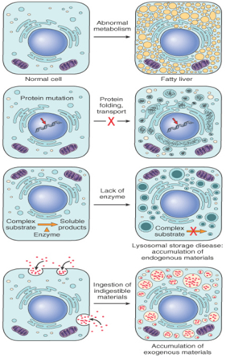
Mechanisms :
abnormal metabolism, as in fatty change in the liver;
mutations causing alterations in protein folding and transport, as in alpha₁-antitrypsin deficiency;
deficiency of critical enzymes that prevent breakdown of substrates that accumulate in lysosomes, as in lysosomal storage diseases;
inability to degrade phagocytosed particles, as in hemosiderosis and carbon pigment accumulation.

Slide 5
LIPIDS
triglycerides, cholesterol/cholesterol esters, and phospholipids.
Steatosis (Fatty Change)
- often seen in the liver
CAUSE In industrialized nations, by far the most common cause of significant fatty change in the liver (fatty liver) is alcohol abuse
MECHANISMS
Excess accumulation of triglycerides within the liver may result from defects in any one of the events in the sequence from fatty acid entry to lipoprotein exit .

Slide 6
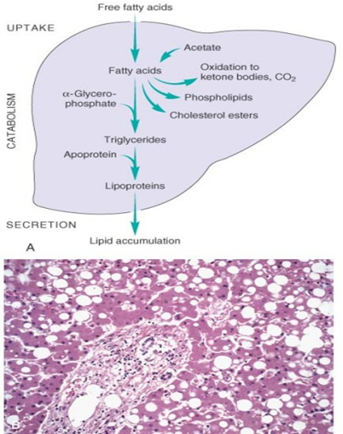

Slide 7
Morphology.
clear vacuoles within parenchymal cells. H & E Stain.
The sections may then be stained with Sudan IV or Oil Red-O, both of which impart an orange-red color to the contained lipids.
The periodic acid-Schiff (PAS) reaction is commonly employed to identify glycogen

Slide 8
Liver(morphology)
may not affect the gross appearance.
With progressive accumulation, the organ enlarges and becomes increasingly yellow until, in extreme instances, the liver may weigh 3 to 6 kg and be transformed into a bright yellow, soft, greasy organ.
-

Slide 9
Heart.
Lipid is found in cardiac muscle in two patterns:
In one, prolonged moderate hypoxia, causes intracellular deposits of fat, which create grossly apparent bands of yellowed myocardium alternating with bands of darker, red-brown, uninvolved myocardium (tigered effect).
The other pattern of hypoxia is produced by more profound hypoxia or by some forms of myocarditis (e.g., diphtheria) and shows more uniformly affected myocytes.

Slide 10
PROTEINS
Intracellular accumulations of proteins usually appear as rounded, eosinophilic droplets, vacuoles, or aggregates in the cytoplasm.
By electron microscopy, they can be amorphous, fibrillar, or crystalline in appearance.
In some disorders, such as certain forms of amyloidosis, abnormal proteins deposit primarily in the extracellular space

Slide 11
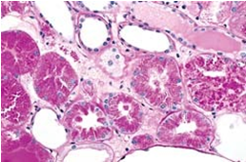
Protein reabsorption droplets in the renal tubular epithelium

Slide 12
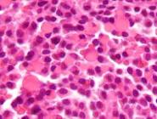
Russell bodies

Slide 13
HYALINE CHANGE
which gives a homogeneous, glassy, pink appearance in hematoxylin and eosin.
This does not represent a specific pattern of intracellular accumulation.

Slide 14
GLYCOGEN
-energy store that is present in the cytoplasm.
-seen in patients with an abnormality in either glucose or glycogen metabolism.
-glycogen masses appear as clear vacuoles within the cytoplasm.
Diabetes mellitus is the prime example of a disorder of glucose metabolism.
Glycogen also accumulates within the cells in a group of closely related disorders, all genetic, collectively referred to as the glycogen storage diseases, or glycogen.

Slide 15
PIGMENTS
Pigments are colored substances, some of which are normal constituents of cells (e.g., melanin), whereas others are abnormal and collect in cells only under special circumstances. Pigments can be exogenous, coming from outside the body, or endogenous, synthesized within the body itself.

Slide 16
Exogenous Pigments.
carbon or coal dust, air pollutant of urban life. When inhaled, picked up by macrophages within the alveoli and is then transported through lymphatic channels to the regional lymph nodes in the tracheobronchial region. Accumulations of this pigment blacken the tissues of the lungs (anthracosis) and the involved lymph nodes.
In coal miners, the aggregates of carbon dust may induce a fibroblastic reaction or even emphysema and thus cause a serious lung disease known as coal worker's pneumoconiosis
Tattooing is a form of localized, exogenous pigmentation of the skin. The pigments inoculated are phagocytosed by dermal macrophages.

Slide 17
Endogenous Pigments.
Lipofuscin is an insoluble pigment, also known as lipochrome and wear-and-tear or aging pigment.
The term is derived from the Latin (fuscus = brown), thus brown lipid.
In tissue sections, it appears as a yellow-brown, finely granular intracytoplasmic, often perinuclear pigment . On electron microscopy, the granules are highly electron dense, often have membranous structures in their midst, and are usually in a perinuclear location.

Slide 18
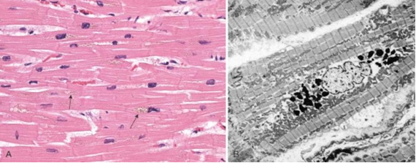
Lipofuscin granules in a cardiac myocyte as shown by A, light microscopy (deposits indicated by arrows), and B, electron microscopy (note the perinuclear, intralysosomal location).

Slide 19
Melanin, derived from the Greek (melas = black), is an endogenous, non-hemoglobin-derived, brown-black pigment formed when the enzyme tyrosinase catalyzes the oxidation of tyrosine to dihydroxyphenyalanine in melanocytes.
For all practical purposes, melanin is the only endogenous brown-black pigment.
The only other that could be considered in this category is homogentisic acid, a black pigment that occurs in patients with alkaptonuria, a rare metabolic disease. Here the pigment is deposited in the skin, connective tissue, and cartilage, and the pigmentation is known as ochronosis

Slide 20
Hemosiderin is a hemoglobin-derived, golden yellow-to-brown, granular or crystalline pigment in which form iron is stored in cells.
-represents aggregates of ferritin micelles. Under normal conditions, small amounts of hemosiderin can be seen in the mononuclear phagocytes of the bone marrow, spleen, and liver, all actively engaged in red cell breakdown.

Slide 21
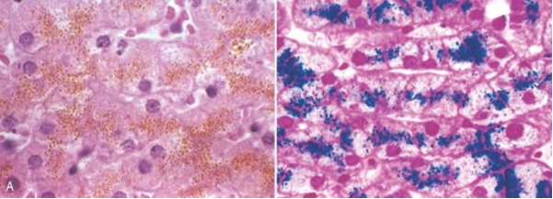
Hemosiderin granules in liver cells. A, H&E section showing golden-brown, finely granular pigment. B, Prussian blue reaction, specific for iron

Slide 22
Cellular Aging

Slide 23
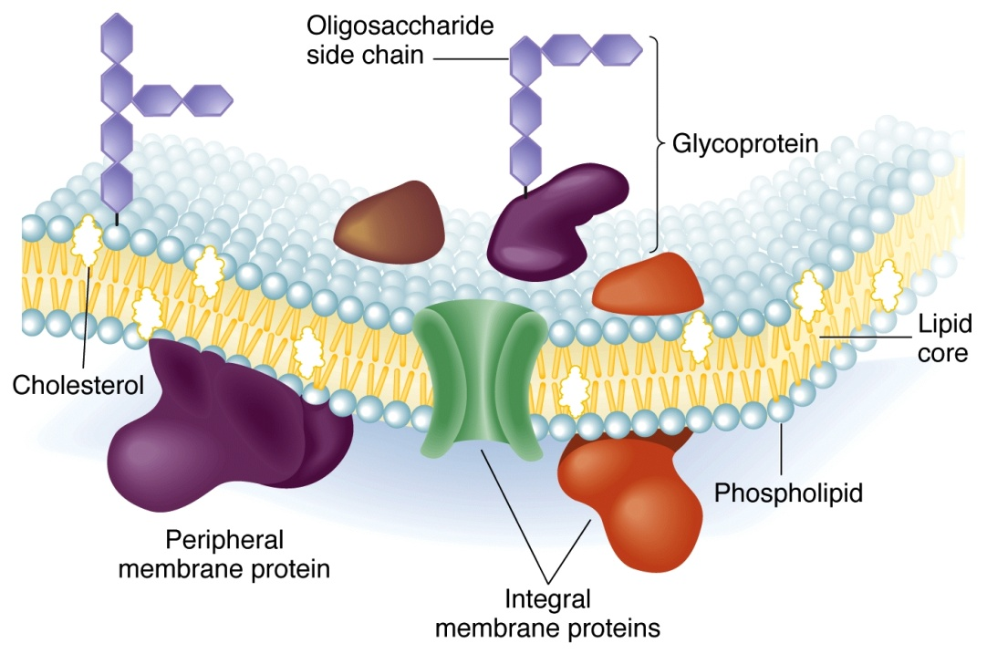
Plasma Membrane:
Structural Changes lead to
Changes in permeability
Less Fluid due to increase in saturated fatty acids

Slide 24
Nuclear Changes
Chromatin becomes more condensed
(increase cross-links)
(disulfide bonds between histones)
Implication: Damage to DNA less likely repaired
Lymphocytes in culture, add reducing agents to medium
(break disulfide bonds)
senescent cells divide again

Slide 25
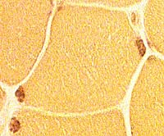
Cytoplasmaic Changes
Increase volume with age
Lipofuscin- (age pigment)
found in non-dividing cells
e.g. nerve and muscle
Yellow - brown lipofuscin
granules

Slide 26
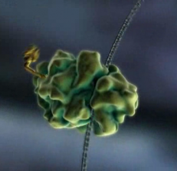
Ribosomal Changes
rRNA decreases with age
general decline in protein synthesis

Slide 27
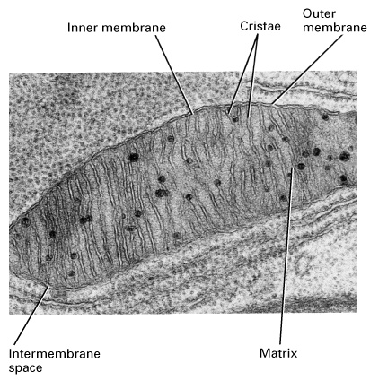
Mitochondrial Changes
Decrease number of folds (cristae)
Decrease in number of mitochondria

Slide 28
Lysosomal Changes
Decrease in activity leads to
accumulation of cellular garbage
e.g. lipofuscins
Release of enzymes leads to cell death

Slide 29
Pre-programmed Cell Death (apoptosis)
Apoptosis vs. Necrosis
Necrosis - external cause (trauma)
random breaks in DNA
Apoptosis- internal cause (cellular suicide)
non-random 180 base fragments
Apoptosis - natural developmental process
e.g. interdigital tissue (webbing)
neurons

Slide 30
PATHOLOGIC CALCIFICATION

Slide 31
MCQ

Slide 32
1.
Special stain for demonstration of fat
Oil red O
Sudan
Congo red
H and E

Slide 33
1.
Special stain for demonstration of fat
Oil red O
Sudan
Congo red
H and E

Slide 34
2
Accumulation of carbon pigment in tissue of lung is called as…
Anthrecosis
Silicosis
Asbestosis
byssinosis

Slide 35
2
Accumulation of carbon pigment in tissue of lung is called as…
Anthrecosis
Silicosis
Asbestosis
byssinosis

Slide 36
3
The color of melanin pigment is…
Black
Blue
Yellow brown
Brick red

Slide 37
3
The color of melanin pigment is…
Black
Blue
Yellow brown
Brick red

Slide 38
4.
Special stain for iron is..
Perl stain
PAS
Congo red
H and E

Slide 39
4.
Special stain for iron is..
Perl stain
PAS
Congo red
H and E

Slide 40
Vesterdal LK, Danielsen PH, Folkmann JK, Jespersen LF, Aguilar-Pelaez K, Roursgaard M, Loft S, Møller P.
Toxicology and Applied Pharmacology
Volume 274, Issue 2, 15 January 2014, Pages 350–360
NAME OF AUTHOR | TITLE OF STUDY & DESIGN | AIM | RESULT | CONCLUSION
Vesterdal LK, Danielsen PH, Folkmann JK, Jespersen LF, Aguilar-Pelaez K, Roursgaard M, Loft S, Møller P. | Accumulation of lipids and oxidatively damaged DNA in hepatocytes exposed to particles. LEVEL 4 | Exposure to particles has been suggested to generate hepatosteatosis by oxidative stress mechanisms. We investigated lipid accumulation in cultured human hepatocytes (HepG2) and rat liver after exposure to four different carbon-based particles. HepG2 cells were exposed to particles for 3h and subsequently incubated for another 18h to manifest lipid accumulation. In an animal model of metabolic syndrome we investigated the association between intake of carbon black (CB, 14nm) particles and hepatic lipid accumulation, inflammation and gene expression of Srebp-1, Fasn and Scd-1 involved in lipid synthesis. There was a concentration-dependent increase in intracellular lipid content after exposure to CB in HepG2 cells, which was only observed after co-exposure to oleic/palmitic acid. | All four types of particles also generated oxidatively damaged DNA, assessed as formamidopyrimidine DNA glycosylase (FPG) sensitive sites, in HepG2 cells after 3h exposure. The animal model of metabolic syndrome showed increased lipid load in the liver after one oral exposure to 6.4mg/kg of CB in lean Zucker rats. This was not associated with increased iNOS staining in the liver, indicating that the oral CB exposure was associated with hepatic steatosis rather than steatohepatitis | The lipid accumulation did not seem to be related to increased lipogenesis because there were unaltered gene expression levels in both the HepG2 cells and rat livers. Collectively, exposure to particles is associated with oxidative stress and steatosis in hepatocytes.

Slide 41
THANK YOU

