Slide 1
DIABETES MELLITUS
Dr.Maharshi Patel
Associate Professor
Department of Community Medicine
SBKS MI RC Sumnadeep Vidyapeeth

Slide 2
EPIDEMIOLOGY
100 million people worldwide
85-90% cases are Type II
17 million people in US (6.2% of population)
90-95% Type II
5.9 million people are undiagnosed
Approximately 1 million new cases/year

Slide 3
Prevalence in India
As opposed to western countries where the prevalence is about 2-5%, some developing countries have the prevalence of 10-12%.
In India, it ranges from 2.1% (New Delhi) to 12.4% (Kerala).
In Southern India, there was a 40% increase in the prevalence over 6 years duration (Ramachandran 1997).
A diabetic patient spent Rs. 4510 per year and for foot care the cost increased to Rs. 7200 per year (Sobhana 2000,2001).

Slide 4
CLASSIFICATION
TYPE I
  Deficiency of insulin secretion
  Possible autoimmune process with destruction of beta pancreatic cells
  Genetic predisposition and possible links to viral infections and environmental factors
  Require insulin supplementation, prone to develop DKA

Slide 5
CLASSIFICATION
TYPE II
  Resistance to action of insulin on target organs
  Decrease in insulin production
  Increased risk with obesity high fat, high caloric diets
  Stronger genetic predisposition
  Variety of initial presentations: HHNKS, nephropathy, retinopathy, neuropathies
  Disease can be delayed or prevented with lifestyle changes

Slide 6
RISK FACTORS
Age
Sex
Genetic factors
Immune mechanisms
Obesity
Maternal Diabetes
Sedentary Life Style
Diet
Dietary Fiber
Malnutrition
Alcohol
Viral Infections
Chemical Agents
Stress
Social Factors

Slide 7
CLASSIFICATION
SECONDARY CAUSES
  Exocrine pancreas disease: pancreatitis
  Genetic syndromes: Downs, Turners
  Infections: CMV, Congenital rubella
  Drugs: Glucocorticoids, Dilantin, beta agonists
  Endocrinopathies: Cushing's, Acromegaly

Slide 8
Classification
Gestational
  Presents only during pregnancy
  135,000 cases annually
  Increased risk of developing diabetes post partum
  Tight glycemic control required to prevent macrosomia, fetal cardiac and CNS abnormalities

Slide 9
PATHOPHYSIOLOGY
Increased accumulation of glucose in retina, kidneys,nerves,vasculature
Increased concentrations glucose metabolites (Sorbitol) affecting Na-K-ATPase activity
Resultant membrane damage leads to cellular damage and destruction
Glycosylation of cellular proteins causes chemical cross linking altering structure and function (HBA1C)
Artherogenesis multifactorial process: hyperglycemia, hyperlipidemia, modification/oxidation of lipoprotein

Slide 10
CLINICAL FEATURES
Polyuria
Polydipsia
Polyphagia
Weight loss
Blurred vision
Poor wound healing
Increase in infections
  Candidal vaginitis/balanitis
  UTI
  Malignant Otitis Externa

Slide 11
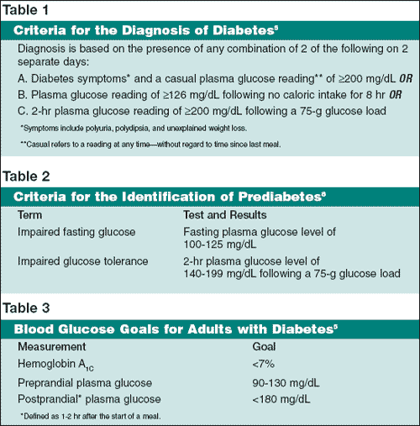

Slide 12
Acute Hyperglycemia
Defined as blood glucose >300mg/dL
H&P: Underlying Cause
  Medication History: (beta agonists, corticosteroids, diuretics)
  Infections: (pneumonia, urinary tract infections, foot and skin sources)
  Noncompliance or changes in drug regimens
  Coronary or CNS ischemia

Slide 13
Cardiovascular Complications
Leading cause of death in diabetic patients
2-4 times greater risk of ischemic heart disease or stroke
Prone to silent heart attacks or atypical presentation
Increased risk of cardiomegaly and CHF
High incidence of peripheral vascular disease

Slide 14
Ophthalmologic Complications
Diabetic Retinopathy is the leading cause of blindness in patients 25-74
Increased risk of glaucoma and cataracts
97% of DM I-II patients taking insulin have some form of retinopathy
Intensive glucose control lowers risk of proliferative retinopathy 75%
Red and/or painful eye or simple headache warrants intraocular pressure measurement
Fundal exam: cotton wool spots, microaneurysms, vascular proliferation

Slide 15
Diabetic Nephropathy or CKD
Leading cause of end stage renal disease
Accounts for 43% of all cases of new onset renal failure per year
Renal hypertension results in protein deposition and sclerosis of glomerulus
Microalbuminuria clinical marker for presence and degree nephropathy

Slide 16
Infections
Rhinocerebral mucormycosis
Malignant otitis externa
Foot and lower extremity ulcers
Staph. Infections
UTIs

Slide 17
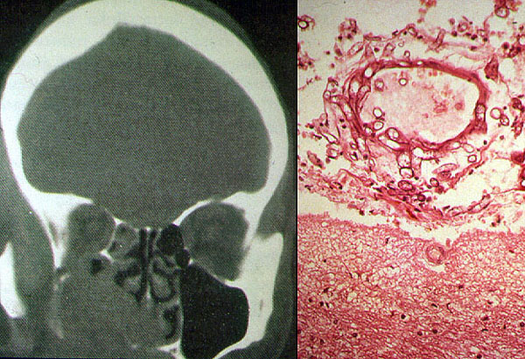
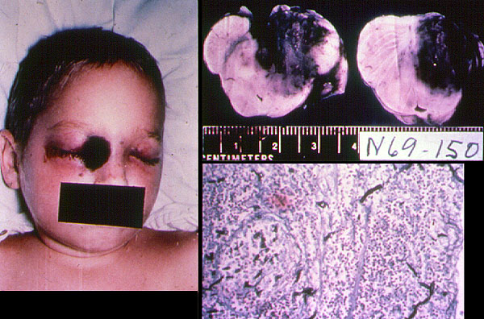
Rhinocerebral Mucormycosis

Slide 18
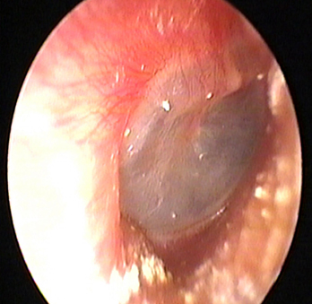
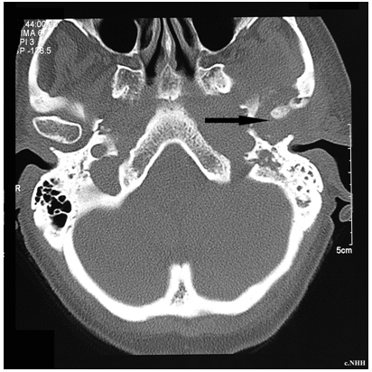
Malignant Otitis Externa

Slide 19
Foot and Lower Extremity Ulcers
Affects 15% of diabetic patients, 20% of diabetic admissions
Pathologic triad: neuropathy, atherosclerotic vascular disease, impaired immunity
Risk factors: High HBA1C, older age, duration of disease, tight fitting shoes, smoking
Classification:
  Non-limb-threatening: <2cm ulceration and no inflammation
  Limb-threatening: >2cm ulceration or inflammation, ascending lymphangitis, bone involvement, nonpalpable pulses
  Life-threatening: signs of sepsis, metabolic derangements (DKA, HHNKS)

Slide 20
Management Lower Extremity Ulcers
Superficial and uninfected ulcers: non-adherent dressing, avoidance of weight bearing, follow up with specialist in diabetic care
Limb and Life threatening: radiographs, tissue culture from base of ulcer, empiric antibiotic therapy, immediate surgical consult
CBC,BUN Cr, blood cultures, urinalysis

Slide 21
Long Term Goals
Glycemic control:
  Blood Glucose: preprandial 90-130 mg/dL, post prandial <180 mg/dL
  HBA1C <7% (quarterly)
Glycemic control in DM II patients staged
  Stage 1: Diet and exercise
  Stage 2: Oral hyperglycemic agents
  Stage 3: Combination insulin and oral medications
Blood pressure control: <130/80 mm Hg
Control serum cholesterol levels: <200 mg/dL

Slide 22
Long Term Care
Annual urinalysis (microalbuminuria)
ACEI-ARB, Statin, ASA (81-162 mg/qd)
Immunization: influenza yearly, pneumococcal
Smoking cessation
Annual ophthalmologic and comprehensive foot exam
Diet and Exercise
Attend Diabetic Education Class

Slide 23
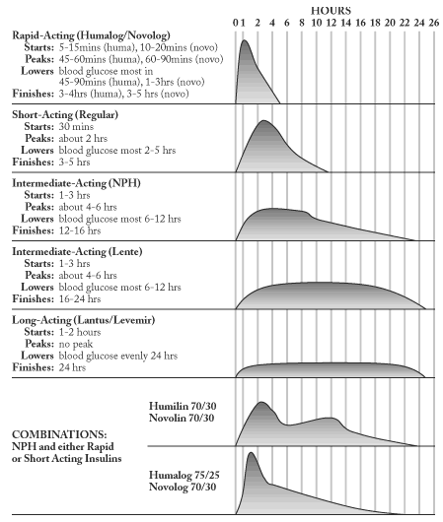

Slide 24
Metsärinne K, Bröijersen A, Kantola I, Niskanen L, Rissanen A, Appelroth T, Pöntynen N, Poussa T, Koivisto V, Virkamäki A. High prevalence of chronic kidney disease in Finnish patients with type 2 diabetes treated in primary care. 2014 | Cross sectional study | Data were collected and recorded from 42 primary care centres, which recruited 629 patients diagnosed with type 2 diabetes (T2D) to this non-interventional study. Data including patient characteristics, kidney function and albuminuria, blood pressure, HbA1c, lipid and lipoprotein levels, and diabetes duration as well as current medication was collected in each patient | History of dyslipidemia had in 73.3% of patients, 27.8% had cardiovascular disease and 82.7% had hypertension. The primary endpoint, prevalence of CKD of any grade (1-5) or albuminuria, was 68.6%. 16.2% of patients had an estimated glomerular filtration rate (eGFR) <60ml/min/1.72m², classifying as CKD 3-5. Only one patient was within CKD5. Combining the patients with CKD 3-5 and/or the presence of albuminuria, 34.7% seemed to suffer from significant CKD.

Slide 25
MCQs
1. Diabetes has genetic predisposition.
A). True
B). False

Slide 26

2. Type 1 diabetes mellitus is associated with destruction of which type of cells?
A). Alpha cells
B). Beta cells
C). Gamma cells
D). Lamda cells

Slide 27
3.Most common secondary causes of DM
  A)Exocrine pancreas disease: pancreatitis
  B)Genetic syndromes: Downs, Turners
  C)Infections: CMV, Congenital rubella
  D) All of the above

Slide 28

4. Which are the the cardinal signs of diabetes
Polyuria
Polydypsia
Polyphasia
All of the above.

Slide 29

5. Long term or inappropriate use of steroidal drugs can lead to diabetes
True
False

