Slide 1
VISUAL PATHWAY AND FIELD DEFECTS
Dr. Hetaj Sheth

Slide 2
MATHS of OPHTHALMOLOGY
Ophthalmology is similar to Mathematics Equation
Pt’s Vision = Best vision minus Any Vn loss d/t disorders of sub-structures of eye
Unaid Vn = 100 - (Ref+Tear+Cornea+Aq+Pupil+Lens+Vit+Retina+ ON +VnPath)
BCVA(Gl)= 100 - ( Tear+Cornea+Aq+Pupil+Lens+Vit+Retina+ ON +VnPath)
BCVA(Gl)= 100 - ( Examn on TL / SLE + Ophthalmoscopy + ON +VnPath)
Can be detected (not always) by Imaging study OR Electrophysiological Tests

Slide 3
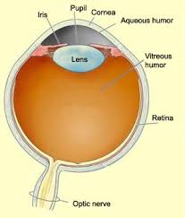
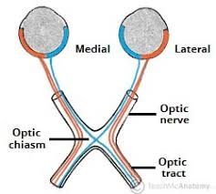
MATHS of OPHTHALMOLOGY
So if everything till retina is Normal
Then suspect disorders of
optic nerve or
visual pathway
Sometimes there can be a hinting SIGN in form of disc edema or disc pallor

Slide 4
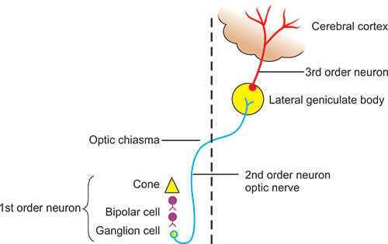
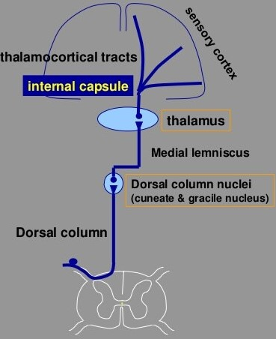
Neuronal order of Visual pathway
Feature | Somatic | Visual
Sensory end organ | Nerve endings in the skin | Rods and Cones
1st order neuron | Dorsal Root Ganglion | Bipolar cells of retina
2nd order neuron | Nuc.Gracilis Nuc. Cuneatus | Ganglion cells of retina
3rd order neuron | In Thalamus | In Lateral Geniculate body

Slide 5
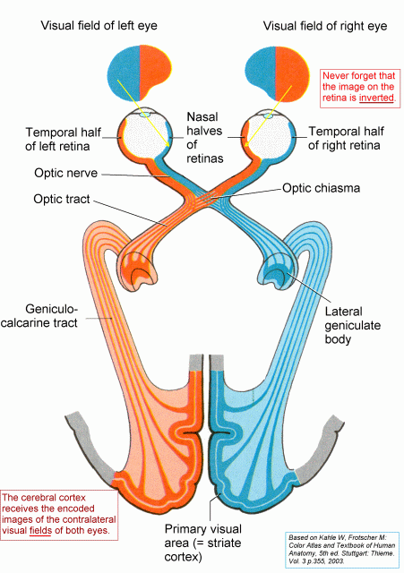
INTRODUCTION
Visual pathway- seven levels through which visual impulses pass through:
Retina
Optic Nerve
Optic Chiasma
Optic Tract
Lateral Geniculate Body
Optic Radiation
Cortical Areas

Slide 6
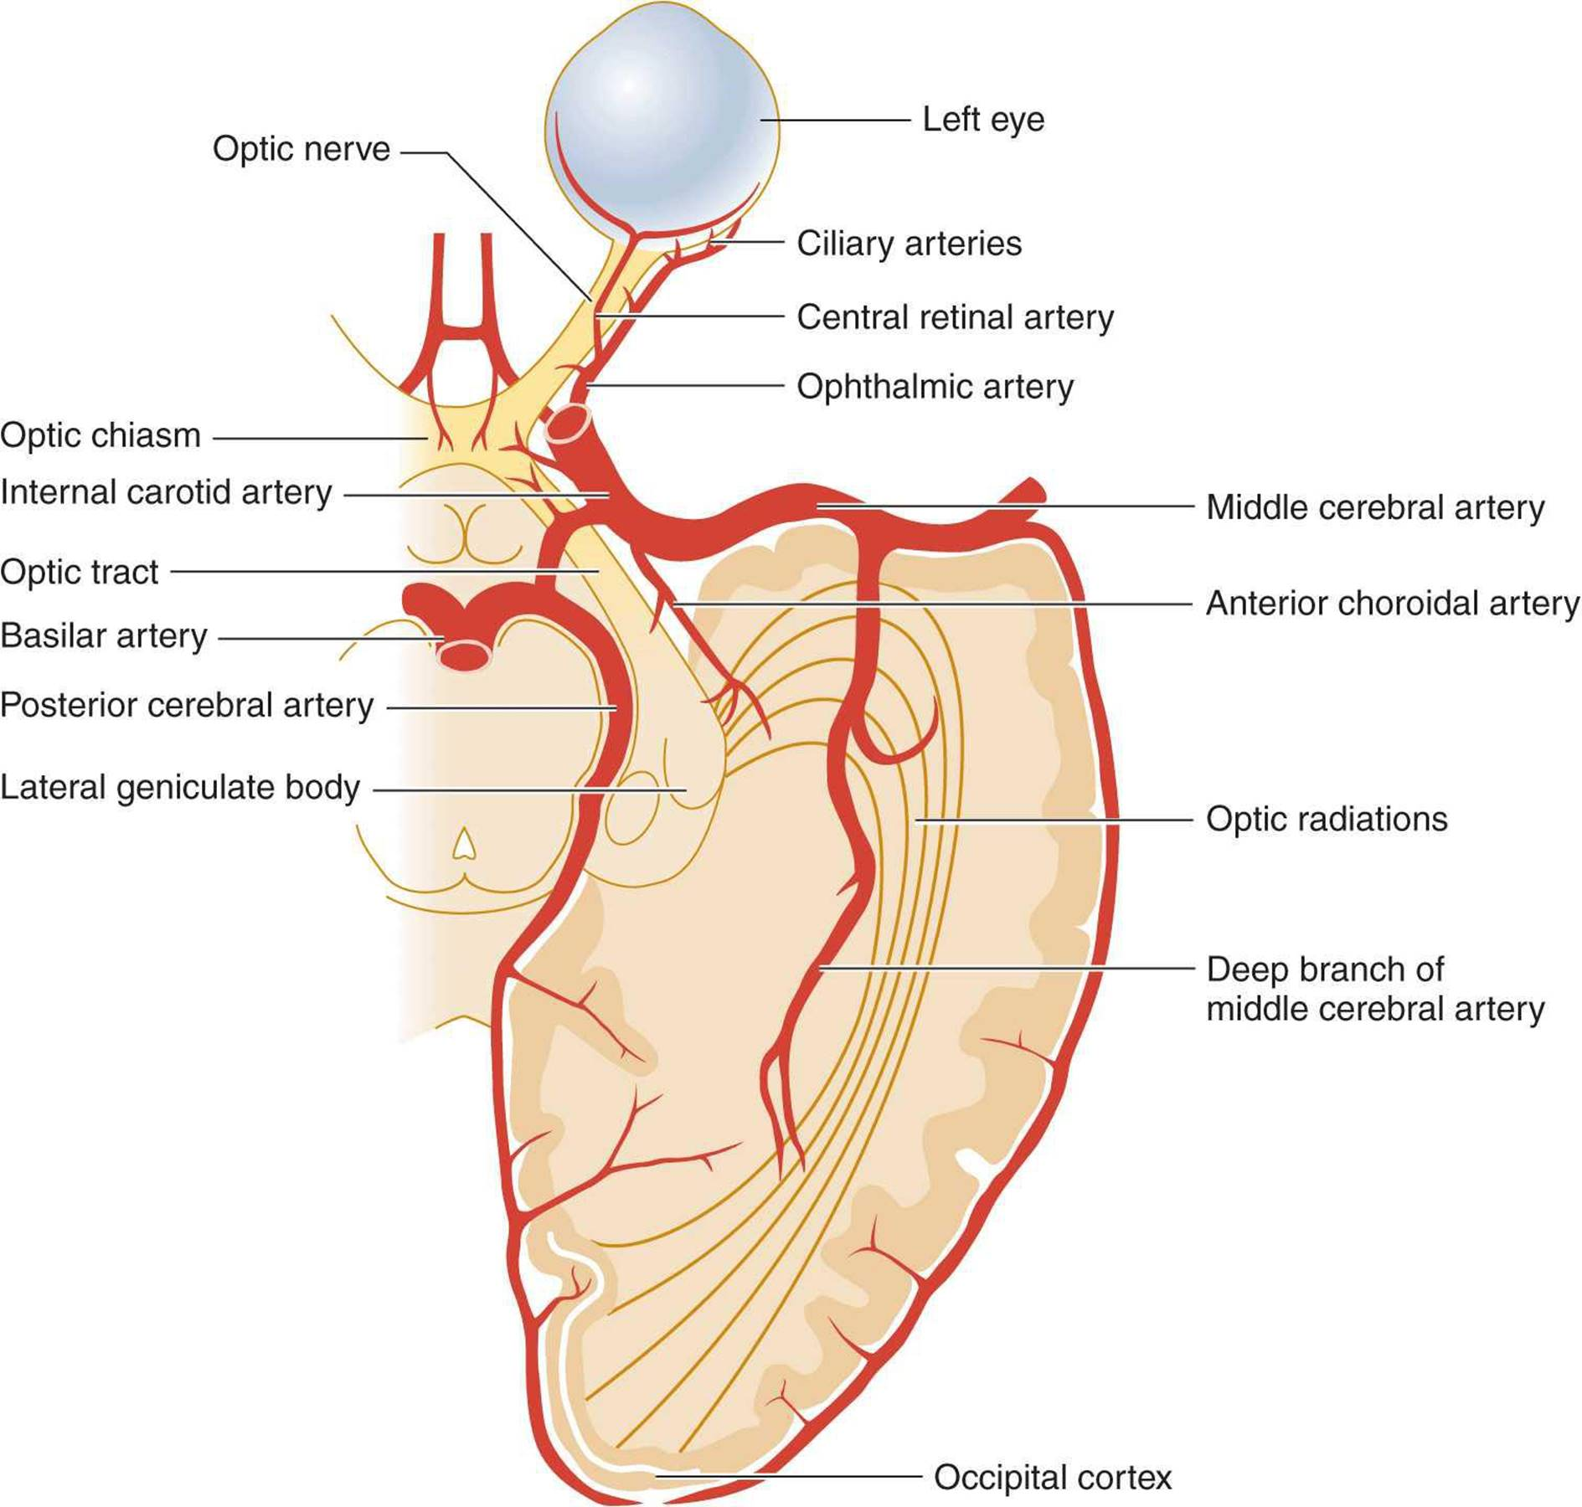
Arterial supply
ON-Head (intraocular part) by Arterial circle of Zinn, CRArt
Orbital part of ON – by axial sys from Central Retinal Art
Visual Pathway in general is supplied by Pial network of vessels which receives from
  Int. CA
  Mid. CA
  Ant Chr A
  Basilar A
  Post. CA
  Calcarine A

Slide 7
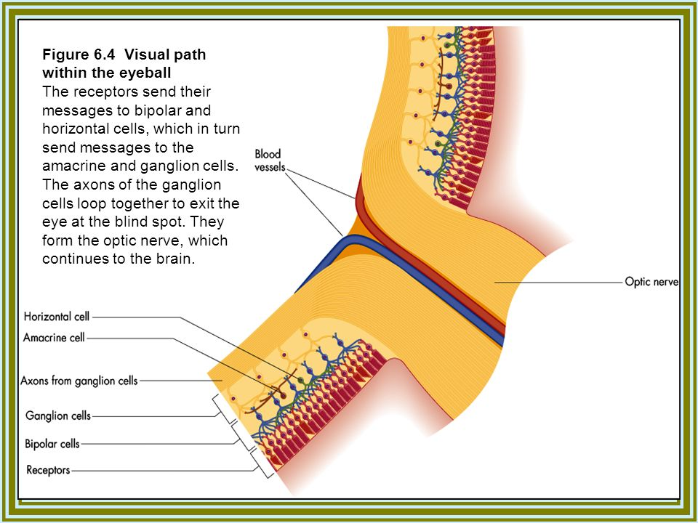
Start of visual pathway - RETINA
NO Photoreceptors in area of Optic disc
Cones (color vision, three types: R, G, B) (~7 million cones) are tightly packed in the macula (100,000),
Rods are absent from macula and optic disc (blind spot).
Flow of info is from photoreceptors to bipolar cells to ganglion cells.
Horizontal cells amacrine cells and Müller cells modulate the signal (e.g., surround inhibition)
Axons of retinal ganglion cells form the optic nerve at the optic disc
Optic nerve (Figs. 2.3, 2.4) contains 1 million fibers (comparison: cochlear nerve 50,000 fibers)

Slide 8
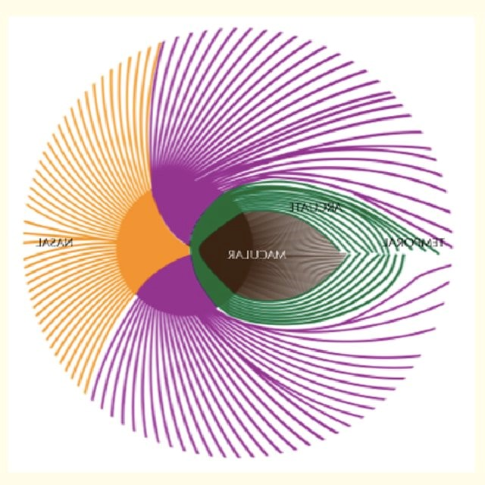
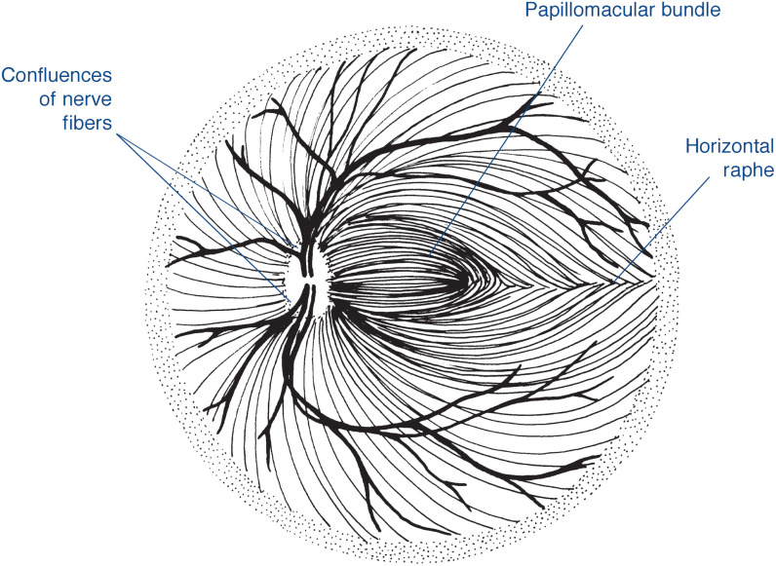
Arrangement of retinal fibers
ARRANGEMENT ON RETINA
Fibres from the Nasal half come directly to optic disc as Sup & Inf Radiating fibres
Those from the macular area come horizontally as papillomacular bundle
Fibres from the Temporal retina arch over papillomacular bundle as Sup & Inf Arcuate fibres with Horizontal raphe between them
Sup Arcuate fibres
Sup Radiating fibres
Nasal
Temporal
Inf Radiating fibres
Inf Arcuate fibres

Slide 9
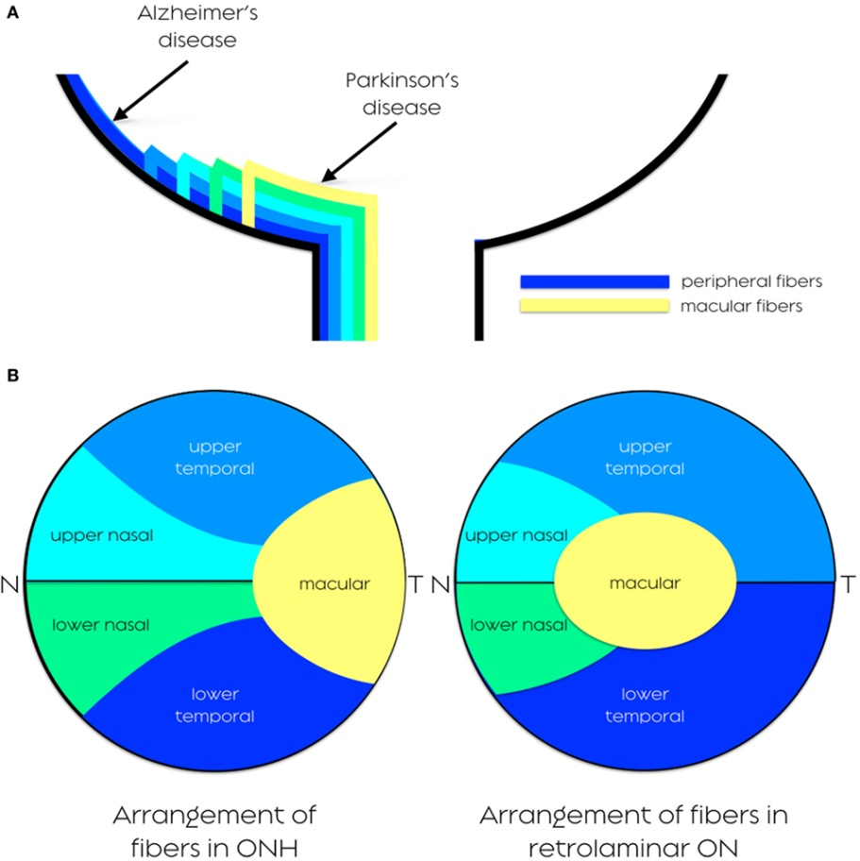
Arrangement of fibers in OPTIC NERVE
ARRANGEMENT IN OPTIC NERVE
Those from peripheral retina lie more deep in retina and occupy more periphery (superficial) in ON
The Arcuate fibres are more susceptible to glaucomatous damage
Macular fibres are more resistant to glaucoma
Sup Arcuate fibres
Sup Radiating fibres
Macular fibers are on the temporal side of the optic disc and the adjacent optic nerve and move to the central part of the nerve as the papillomacular bundle for most of the distal pathway. The larger nonmacular fibers are on the periphery.
Nasal
Temporal
Inf Radiating fibres
Inf Arcuate fibres

Slide 10
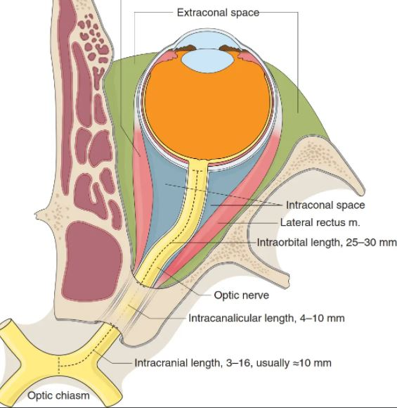
optic nerve – Basic ANATOMY
4 PARTS | Intra-Ocular | Intra-Orbital | Intra-Canalicular | Intra-Cranial
Length (45-50mm) | 1mm | 25-30mm | 4-9mm | ~10mm
From | Lamina cribrosa | Back of eyeball | Optic canal Opening | Optic foramina
Till | Emerge at back of eyeball | Optic foramina | Optic foramina | Optic chiasma
Applied Anatomy |  | Sinuous to allow eye movements | Ophthalmic A. crosses over & Sympathetic plexus | Cavernous Sinus
 |  | Some fibres of EOM attached to ONSheath (painful eye move) | Sphenoidal & Post Ethmoidal sinus (RBNeuritis) | Pituitary tumors Circle of Willis Aneurysms
Optic nerve tumors(gliomas)
Age <10yr
& Neurofibromatosis
Optic nerve sheath Meningioma
Adults ~40yr
In NF2

Slide 11
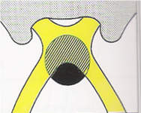
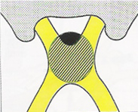
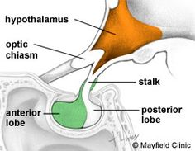
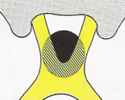
Optic chiasma-anatomy
Prefixed 10%
Chiasma Antr to Pituitary
Place of crossing of nasal retinal fibers to opposite side and temporal fibers to ipsilateral optic tract
Relation of Chiasma to Pituitary
  Can be central(directly above sella, pitutary tumors involves it first)
  prefixed(tumors involve optic tract first)
  postfixed(tumors involve optic nerve first)
Tuberculum sellae
Central 80%
Sella Turcica
Post fixed 10%
Chiasma Post to Pituitary
Dorsum sellae

Slide 12
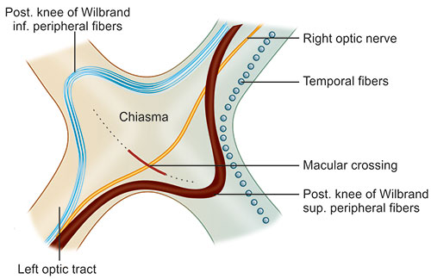
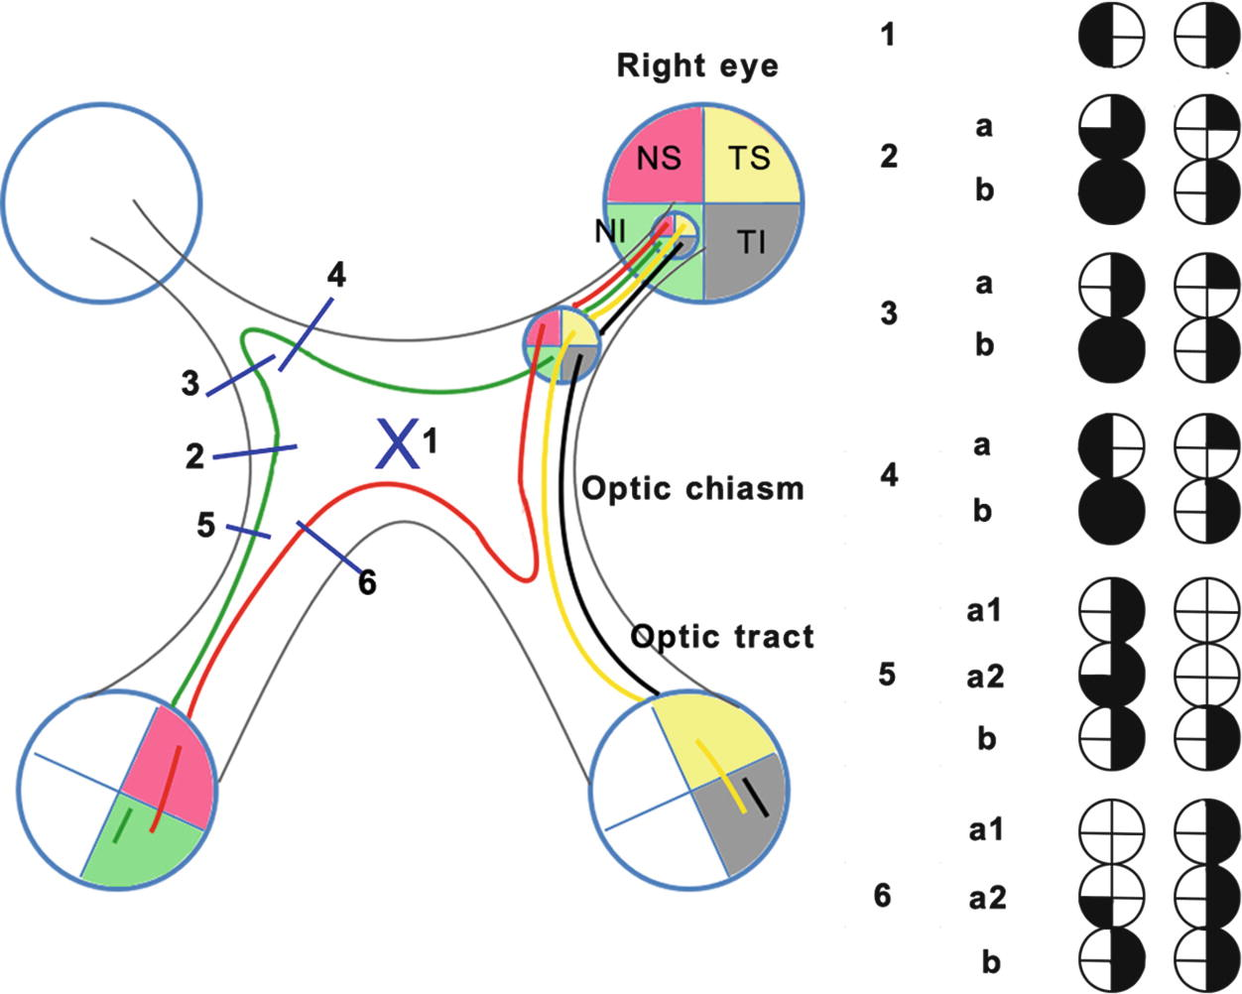
Optic chiasma arrangement of fibers
Lower nasal (sup hemifield) fibers traverse - low and anteriorly – forms a loops in terminal part of opposite Optic Nerve. Its called Anterior knee of Willebrandt
Upper nasal (inf hemifield) fibers traverse - high and posteriorly - forms a loops in initial part of opposite Optic Tract. Its called Posterior knee of Willebrandt
Temporal fibers - uncrossed - run backwards in lateral part
Crossing macular fibers decussate in central to posterior part of chiasma

Slide 13
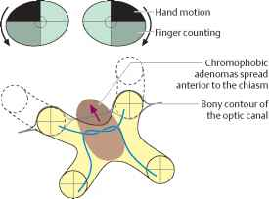
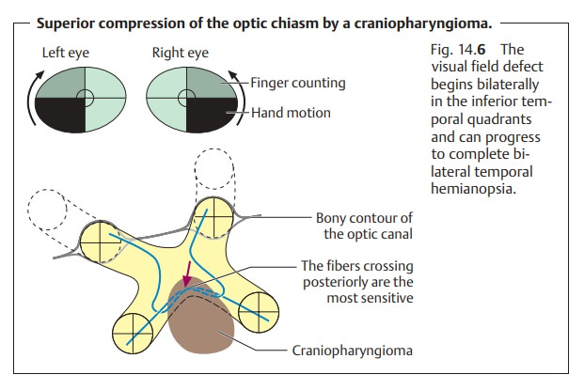
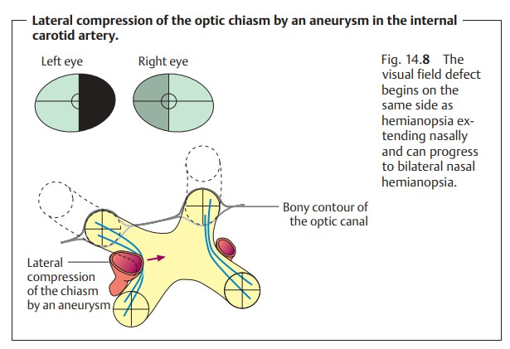
Lesions of visual pathway
Pituitary Tumor
Begins as Bitemporal Sup Quad
Copression starts from below
Craniopharyngioma
Begins as Bitemporal Inf Quad
Copression starts from above

Slide 14
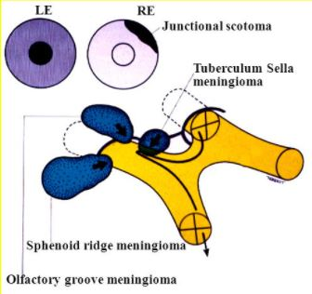
CHiasmal Junctional Syndrome
Anterior Junction or Chiasmal Syndrome - Lesion of optic nerve just anterior to the optic chiasma
Ipsilateral optic nerve involvement leads to Ipsi Anopsia
Anterior Wilbrand’s knee (Contralateral inferior nasal retinal fiber) leads to Contra SupTemp Quad
Posterior Junction or Chiasmal Syndrome-Lesions of optic tract just posterior to the optic chiasma
(Remember: Macular fibers that cross do so in the central and posterior portions of chiasma.)
Ipsilateral temporal retinal fibers involvement
Contralateral nasal retinal fibers involvement
Posterior Wilbrand’s knee (Ipsilateral superior nasal retinal fibers) involvement
They produce centrally placed bitemporal scotomas.

Slide 15
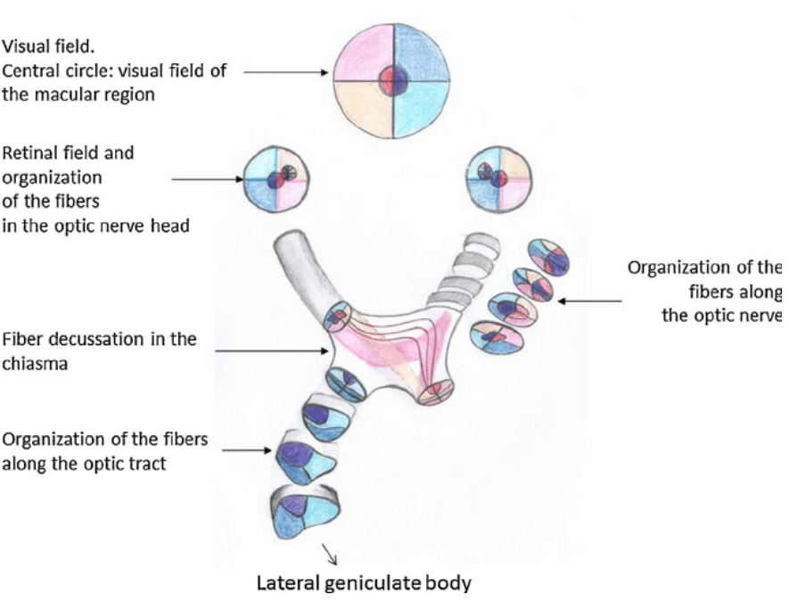
Optic tract
Extend from chiasm posterolaterally around hypothalamus, around cerebral peduncles to lateral geniculate nuclei
the fibers are rearranged to correspond with their position in the LGB
Macular fibers -dorso laterally.
Sup quad fibres – medial
Inf retinal fibres - lateral

Slide 16
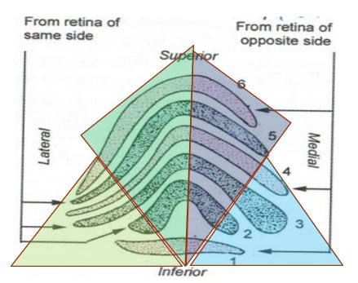
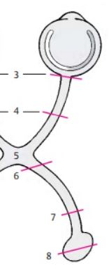
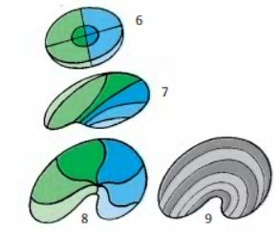
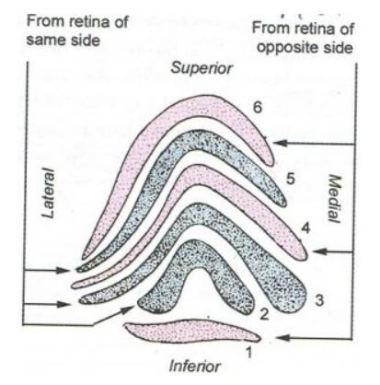
Lateral Geniculate Body
Grey matter is split into 6 parts or LAMINAE by the white matter.
Axons from the ipsilateral eye end in laminae 2, 3 and 5.(uncrossed)
Axons from the contralateral eye end in laminae 1, 4 and 6.(crossed)
They divide into parvocellular and magnocellular subtypes.
Parvocellular subtypes (Outer or Superior 4 LAMINAE)– projections from small ganglion cells sensitive to color and shape
Magnocellular subtypes (Inner or Inferior 2 LAMINAE )– projections from larger ganglion cells sensitive to motion
Fibers from
  Upper retina - medial part of LGB
  Lower retina- lateral part
  Macular fibers –central2/3

Slide 17
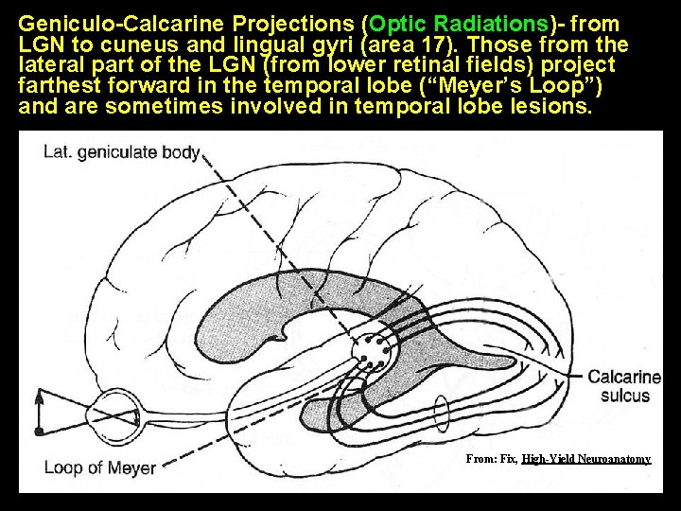
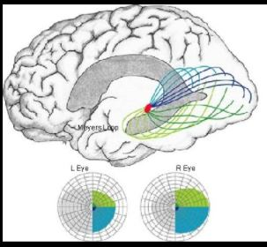
Optic radiations
Optic radiations extend from Lateral Geniculate Body (LGB) to Visual cortex.
SUPERIOR FIBRES - Parietal lobe optic radiations start in the medial LGN and taking a direct, nonlooping course (Baum’s loop) over the top of the inferior horn of the lateral ventricle and then travel posteriorly through the lower parietal white matter to the superior calcarine cortex (Cuneus Gyrus)
They subserve inferior visual fields and account for contralateral inferior quadrantanopsia
INFERIOR FIBRES - Temporal lobe optic radiations start in the lateral LGN, course anteriorly toward the temporal pole before turning posteriorly in a sharp loop (Meyer’s loop) to course around the lateral wall of the inferior horn of the lateral ventricle then posteriorly to the inferior calcarine cortex (lingual Gryrus. (traverse posterior limb / retrolenticular part of internal capsule)
They subserve superior visual fields and account for contralateral superior quadrantanopsia following temporal lobectomy.

Slide 18
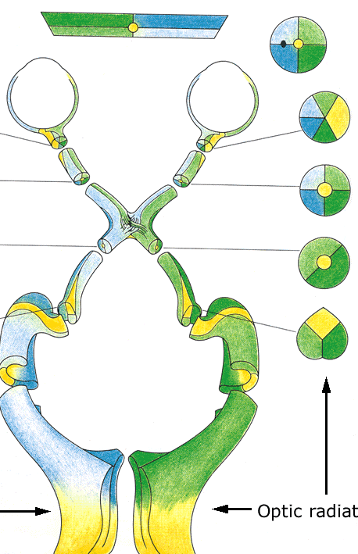
Arrangement
Temporal rotation of fibers
upper retinal fibers-- upper part of optic radiation
lower retinal fibers -- lower part. of optic radiation
Macular fibers -- central part

Slide 19
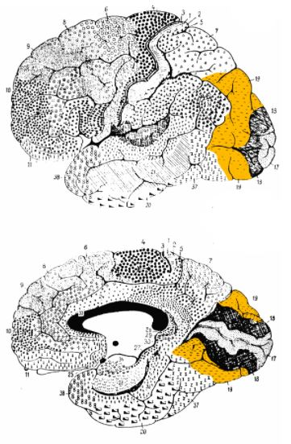
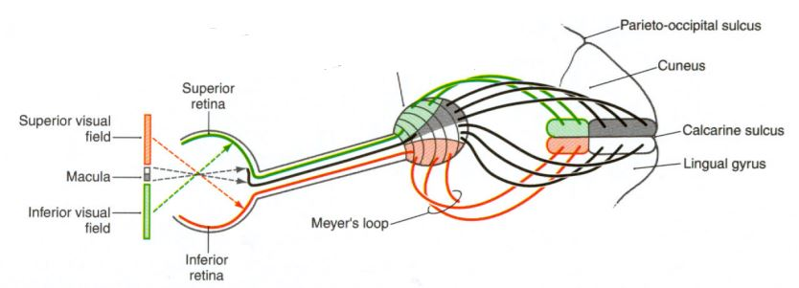
Primary visual cortex
The Optic Radiation end along the superior and inferior lip of calcarine sulcus
This area is also called striate cortex or area 17
There are 6 layers for primary visual cortex. Optic radiation terminate in the 4 rth layer
Macula projects to posterior one third of the calcarine cortex (occipital pole).
  Macula represented posteriorly,
  peripheral retina anteriorly (fovea at occipital pole),
  upper field inferior,
  right field on left.
Primary visual cortex projects to secondary visual areas (peristriate cortex) V2 (area 18) and V3 (area 19) in adjacent occipital lobe cortex.

Slide 20
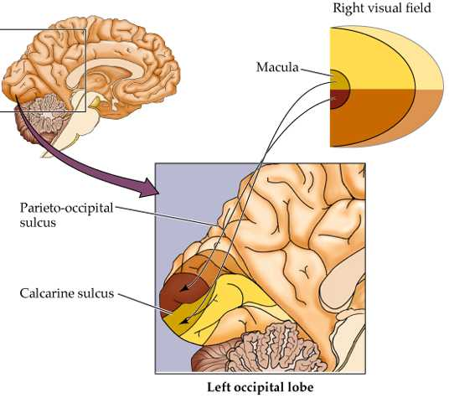
Occipital cortex - Arrangement
Fovea, Macula - tip of occipital cortex
Peripheral field -medial portion of occipital lobe
Most peripherel fibers of unilaterally represented temporal crescent --most anterior part of occipital cortex
Superior retinal quadrants –dorsally, inferior- ventrally

Slide 21
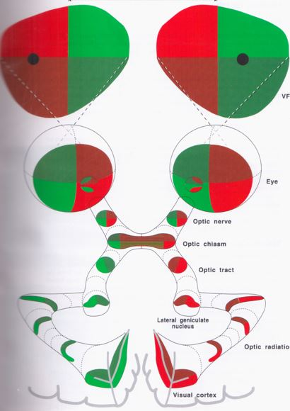
Visual Field
    Blind spot corresponding to disc
Retinal Field
Distal Optic Nerve
Proximal Optic Nerve
Optic Chiasma
Optic Tract
Lat Geniculate Nuc
Optic Radiations
Visual Cortex

Slide 22
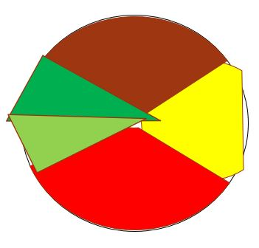
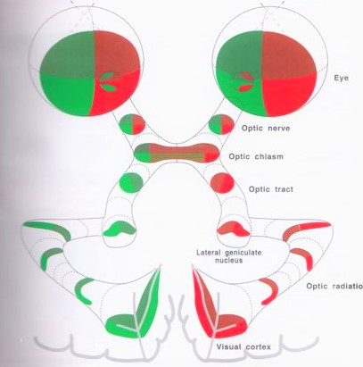
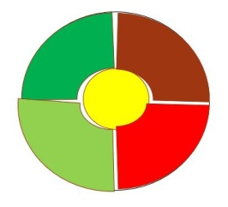
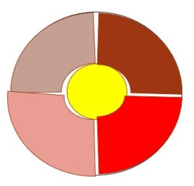
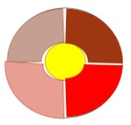
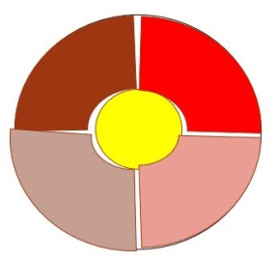
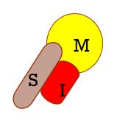
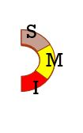
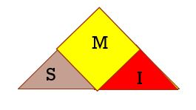
LE
RE
Contra - Sup
Ipsi - Sup
Sup → Medial
Sup fibres

Slide 23
M
S
I
M
S
M
S
I
a
I
a

Slide 24
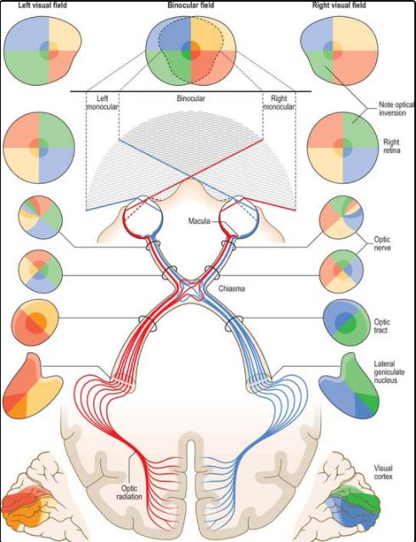

Slide 25
Optic nerve lesions
Pattern similar to nerve fibre bundle involvement as the pattern is maintained
Central scotomas----optic neuritis,extrinsic compression
Cecocentral scotomas---toxic amblyopia
Arcuate and paracentral scotomas---vascular origin,Glaucoma
Altitudinal and sector defects----vascular(ION)

Slide 26
Chiasmal lesions
Binasal hemianopia
Local ocular diseases:
glaucoma,ION,drusen,pit,hypoplasia
Ectatic parasellar arteries
Hydrocephalus
Basal tumors
Bitemporal hemianopia-
Decussating nasal fibers
Causes ----
Pitutaryadenomas
Craniopharyngioma
Meningioma
Optic glioma
Apoplexy
ICA Aneurysms

Slide 27
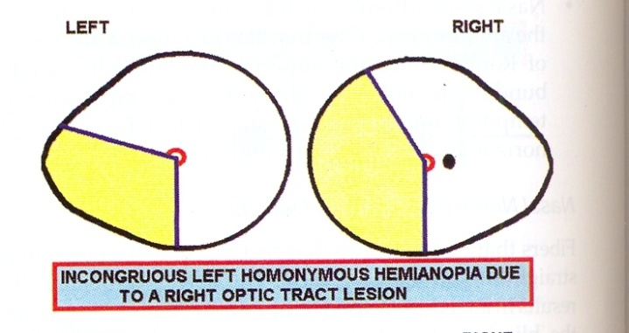
Optic tract lesions
Contralateral homonymous hemianopia wih incongruity
Bow tie pattern of optic atropy
RAPD+
Causes:
Compresssive lesions
Piutary adenomas
Gaint aneurysm of ICA
Meningioma
Craniopharyngioma
Vascular lesions
Trauma
Vasospsam of Anterior choroidal artery
Sarciodosis,MS
Associations:endocrine dysfunction,memory impairment,pyramidal tract signs

Slide 28

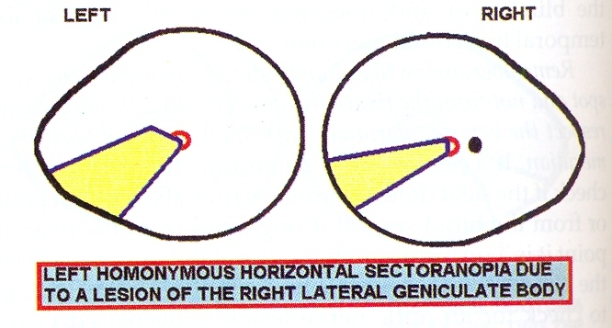
LGN Lesions
Incongrous contralareral homonymous hemianopia
Sectorial hemianopia
Optic atrophy
Causes :
Infarctions
CPM
Para infectious

Slide 29
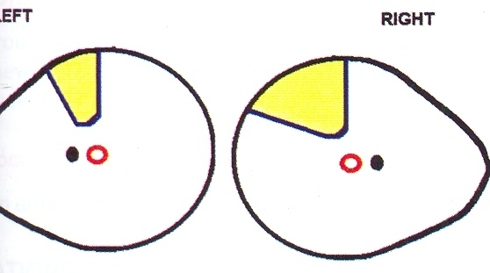
Optic radiation lesions
TEMPORAL LOBE LESIONS
Anterior lesions (Meyer’s loop)- contralateral homonymous superior quadrantanopia (pie in the sky defect)
Congrous lesions
No optic atrophy or pupillary defects
Associated features:
seizures,paragnosia,visual and auditory
hallucinations,aphasia(L sided lesion)
Causes:glioma,trauma,abscess,demylination
anterior choroidal artery infarction

Slide 30
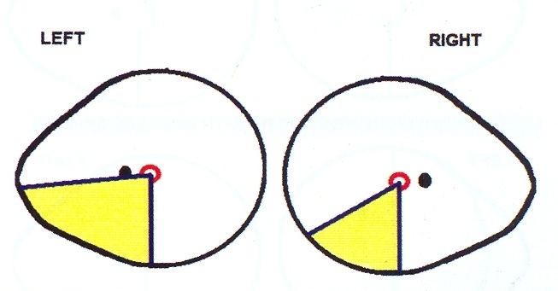
PARIETAL LOBE LESIONS
Contralateral inferior homonymous quadrantanopia
Causes:Infarction
Hemorrhage
AVM
Tumors
Associations:
Cortical sensory disturbances
®sided lesion –hemineglect
(L) –visual agnosia,word blindness,
Gerstmann’s syndrome

Slide 31
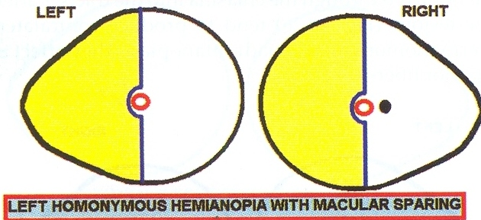
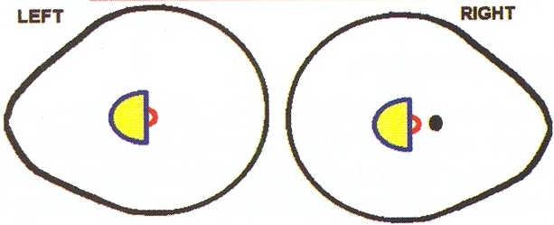
Striate cortex lesions
C/L congruent homonymous hemianopia
Macular splitting
Macular sparing
(atleast 5degrees of
macular field shd be spared)
C/L inferior quadranopia-upper part of calcarine fissure
C/L supr quadranopia-lower part
C/L central homonymous hemianopia-occ.pole lesion (systemic hypo perfusion)

Slide 32
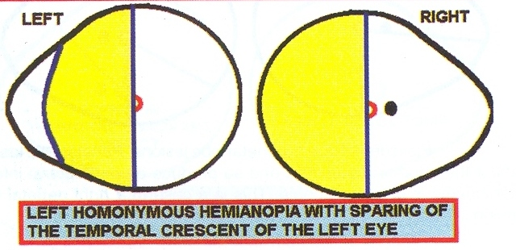
Striate cortex lesions
Peripheral scotoma-lesion anterior to pole
Hemianopia sparing temporal cresent-near complete lesion sparing anterior part
Monocular temporal crescent scotoma-retro splenial lesion

Slide 33
Causes of striate cortical lesions
PCA Infarctions
associated features: amnesia,prosapgnosia,colour perception defects
Brain stem features
Hemorrhage
Vascular malformations
Malignancy
Mid line lesions –b/l involvement

Slide 34

Visual field defect i

Slide 35


Visual field defect ii

Slide 36

Optic radiation and visual cortex lesions

Slide 37

There are at least 4 brain regions that directly receive visual information from retina
Retino-Geniculate pathway : Primary pathway for visual info to Lat Geniculate Nucleus(LGN) of thalamus for conscious vision
Retino-Pretectal tract : Retina to Pretectal area of Midbrain for pupillary light reflex
Retino-Collicular Path : To superior Colliculus for eye movement reflexes(eg conjugate eye movement in response to head movements)
Retino- Hypothalamic path : To Bilateral Suprachiasmatic nuclei(SCN) of Hypothamus for Circadian rhythm and neuro-endocrine function

Slide 38




Light reflex
Light reflex
LGN
MGN
Sup.Colliculus
3rd N Nucleus
SC

Slide 39


Light Reflex pathway
Sensory – Rods & Cones
Bipolar cells
Retinal Ganglion cells
Travel along OpNr → OpCh → OpTr
End in Pretectal Nucleus of Sup. Colliculus
Interneurons fibres go to Accessory motor nuc of Edinger-Westphal nucleus of BOTH sides
It then Supplies ipislateral Occulomotor Nuc
After emerging from midbrain run superficially in 3rd Nerve – (Inferior)
Inferior division of 3rd Nerve
Ciliary Ganglion
Short Ciliary Nerves
Sphincter pupillae muscle
Parasympathetic pathway First Order –Retina to Pretectal nucleus in the Brain Stem ( at the level of the superior colliculus)
Second order – Pretectal nucleus to EWN ( Bilateral innervation )
Third order – EWN to Ciliary ganglion.
Fourth order – Ciliary Ganglion to Sphincter pupillae ( via short ciliary nerves )

Slide 40




Swinging flashlight - RAPD
Swinging-flashlight test What it assesses –
Compares direct and consensual responses of each eye (as opposed to seeing whether they are there or not)
How to perform – In a dim room light, the examiner notes the size of the pupils. The patient is asked to gaze into the distance, and the examiner swings the beam of a penlight back and forth from one pupil to the other, and observes the size of pupils and reaction in the eye that is lit.
Normal Response – Normally, each illuminated pupil promptly becomes constricted.
The opposite pupil also constricts consensually.
Ambient-Bright
Ambient-Dim
Torch- (N) eye
Torch- Affect eye
Torch- Back to (N) eye

Slide 41
Thank you

