Slide 1
Benign and Malignant Tumors
Dr Devanshi Gosai
Pathology

Slide 2
Neoplasm
is an abnormal growth of tissue.
Also known as a tumor
(meaning "new formation")

Slide 3
Definition of Tumor
“A tumor is an abnormal mass of tissue, the growth of which exceeds and is uncoordinated with that of the normal tissues and persists in the same excessive manner after cessation of the stimuli which evoked the change”
Classification of a tumor:
Benign
Malignant

Slide 4
Benign tumors
are non-malignant/non-cancerous tumor.
A benign tumor is usually localized, and does not spread to other parts of the body.
Benign tumors are typically slow-growing.
Most benign tumors respond well to treatment and They often have well-defined borders, so
surgical removal can be an effective treatment.
However, if left untreated, some benign tumors can grow large and lead to serious disease because of their size.
Benign tumors can also mimic malignant tumors, and so for this reason are sometimes treated.
Benign tumors can be serious if they press on vital structures such as blood vessels or nerves. sometimes they require treatment and other times they do not.

Slide 5
Malignant tumors:
cancerous growths.
usually fast-growing,
They are often resistant to treatment, may spread to other parts of the body and they sometimes recur after they were removed.

Slide 6
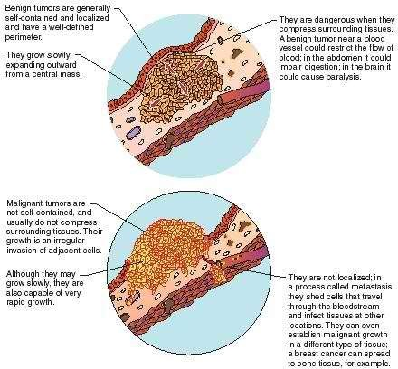

Slide 7
Cell Characteristics
Benign
Well-differentiated cells that resemble normal cells of the tissue from which the tumor originated
Malignant
Cells are undifferentiated and often bear little resemblance to the normal cells of the tissue from which they arose

Slide 8
Mode of growth
Benign
Tumor grows by expansion and does not infiltrate the surrounding tissues; usually encapsulated
Malignant
Grows at the periphery and sends out processes that infiltrate and destroy the surrounding tissues

Slide 9
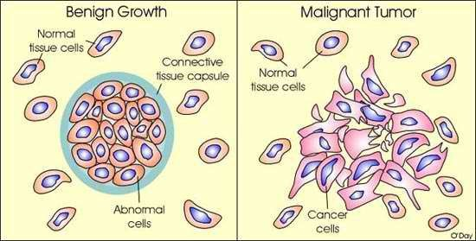

Slide 10
Rate of growth
Benign
Rate of growth is usually slow
Malignant
Rate of growth is variable and depends on level of differentiation; the more anaplastic the tumor, the faster its growth

Slide 11
Metastasis
Benign
Does not spread by metastasis
Malignant
Gains access to the blood and lymphatic channels and metastasizes to other areas of the body

Slide 12
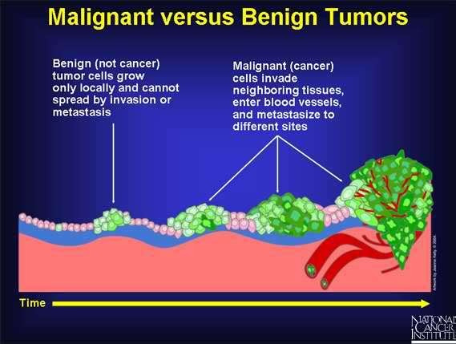

Slide 13
General effects
Benign
Is usually a localized phenomenon that does not cause generalized effects unless its location interferes with vital functions
Malignant
Often causes generalized effects, such as anemia, weakness, and weight loss

Slide 14
Tissue destruction
Benign
Does not usually cause tissue damage unless its location interferes with blood flow
Malignant
Often causes extensive tissue damage as the tumor outgrows its blood supply or encroaches on blood flow to the area; may also produce substances that cause cell damage

Slide 15
Ability to cause death
Benign
Does not usually cause death unless its location interferes with vital functions
Malignant
Usually causes death unless growth can be controlled

Slide 16
Nomenclature – Benign Tumors
-oma = benign neoplasm
Mesenchymal tumors
  chrondroma: cartilaginous tumor
  fibroma: fibrous tumor
  osteoma: bone tumor
Epithelial tumor
  adenoma: tumor forming glands
  papilloma: tumor with finger like projections
  papillary cystadenoma: papillary and cystic tumor forming glands
  polyp: a tumor that projects above a mucosal surface

Slide 17
Nomenclature – Malignant Tumors
Sarcomas: mesenchymal tumor
  chrondrosarcoma: cartilaginous tumor
  fibrosarcoma: fibrous tumor
  osteosarcoma: bone tumor
Carcinomas: epithelial tumors
  adenocarcinoma: gland forming tumor
  squamous cell carcinoma: squamous differentiation
  undifferentiated carcinoma: no differentiation
  note: carcinomas can arise from ectoderm, mesoderm, or endoderm

Slide 18
MCQ-1
Well differentiated cells are seen in
Bening
Metstatic
Anaplstic
malignant

Slide 19
MCQ-1
Well differentiated cells are seen in
Bening
Metstatic
Anaplstic
malignant

Slide 20
MCQ-2
Local compressing is most common seen in
Malignant
Benign
No such relation
metastatic

Slide 21
MCQ-2
Local compressing is most common seen in
Malignant
Benign
No such relation
metastatic

Slide 22
MCQ-3
Capsulated tumor
Malignant
Benign
No such relation
metastatic

Slide 23
MCQ-3
Capsulated tumor
Malignant
Benign
No such relation
metastatic

Slide 24
MCQ-4
Abnormal amount of centromere is seen in which type of cell division
Malignant
Benign
No such relation
metastatic

Slide 25
MCQ-4
Abnormal amount of centromere is seen in which type of cell division
Malignant
Benign
No such relation
metastatic

Slide 26
MCQ-5
Local morphology is preserved in
Bening
Maligant
Both
No such concept

Slide 27
MCQ-5
Local morphology is preserved in
Bening
Maligant
Both
No such concept

Slide 28
Distinction between benign and malignant soft tissue tumors based on an ultrasonographic evaluation of vascularity and elasticity
Shusa Ohshika, Tatsuro Saruga, Tetsuya Ogawa, Hiroya Ono, and Yasuyuki Ishibashi
NAME OF AUTHOR | TITLE OF STUDY & DESIGN | AIM | RESULT | CONCLUSION
Shusa Ohshika, Tatsuro Saruga, Tetsuya Ogawa, Hiroya Ono, and Yasuyuki Ishibashi | Distinction between benign and malignant soft tissue tumors based on an ultrasonographic evaluation of vascularity and elasticity | This study targeted consecutive cases that were examined by US prior to biopsy, surgery, and pathological tissue diagnosis at our hospital from April 2016 to September 2018. Medical records, US data, and MRI data were investigated in April 2019, and the cases without sufficient data were excluded. A total of 167 lesions in 164 cases (86 male, 78 female) was enrolled in the present study. The mean age was 56 years (range: 5 to 92). Pediatric cases were only eight (5 to 16 years). | Evaluation of image findings on US and MRI Values of VI and MSV were significantly higher in the malignant group than in the benign and intermediate group (P<0.001, respectively) (Table II). There were no significant differences in the values of VI between the benign and intermediate groups (P=0.592). While the tumor size in the intermediate and malignant groups was significantly larger than that of the benign group (P<0.001), there was no significant difference in tumor size between the intermediate and malignant groups (P=0.109). Ratio of deep lesion was higher in the intermediate and malignant groups (P=0.005). | In conclusion, evaluating vascularity by SMI and elasticity by SWE is a useful technique to distinguish between benign or intermediate and malignant tumors, even if the evaluations are performed separately. Furthermore, our SS established based on these evaluations including tumor size via MRI showed high diagnostic accuracy for malignant soft tissue tumors. Therefore, an SS based on the US evaluation of vascularity and elasticity is a useful initial diagnostic tool for soft tissue tumors.

Slide 29
THANK YOU !!

