Slide 1
Paraneoplastic syndromes
Dr Jigar Shahl
Pathology

Slide 2
Definition
Paraneoplastic syndrome is a disease or a symptom that is a consequence of cancer, but not due to the presence of local cancer cells.
Paraneoplastic syndrome is mediated through:
  Cross reacting antibodies
  Production of physiologically active factors
  Interference with normal metabolic pathways
  idiopathic

Slide 3
Paraneoplastic syndrome
Classification
  Endocrine: hormone secreting tumours
  Neurological: immune mediated
  Mucocutaneous
  Haematological
  others
Overview of:
  Syndromes
  Causes
  Therapy

Slide 4
Endocrine
Cushing’s syndrome
SIADH
Hypoglycemia
Hypercalcemia
Carcinoid syndrome
hyperaldesteronism

Slide 5
Neurological
Lambert-Eaton Myasthenic Syndrome
Paraneoplastic cerebellar degeneration
Encephalomyelitis
Brain stem encephalitis
Anti-NMDA encephalitis
Polymyositis
Paraneoplastic opsoclonus myoclonus

Slide 6
Dermatological
Acanthosis Migrans
Dermatomyositis
Leser-Trelat sign
Necrolytic migratory erythema
Sweet’s Syndrome
Florid cutaneous Papillomatosis
Pyoderma gangrenosum
Acquired generalised hypertrichosis

Slide 7
Haematological
Granulocytosis
Polycythemia
Trausseau’s sign
Nonbacterial thrombotic endocarditis
Anemia
DIC

Slide 8
Other
Membranous glomerulonephrits
Tumor-induced osteomalacie
Stauffer Syndrome
Neoplastic fever

Slide 9
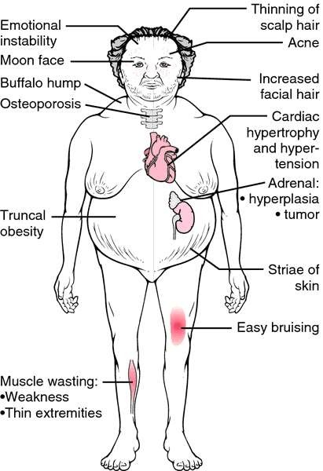
Endocrine: Cushing’s syndrome
Cushing’s syndrome
ACTH dependent (85%)
  ACTH secreting pituitary adenoma
  Ectopic ACTH secreting tumour (SCLC, pancreatic, adrenal, thyroid tumours, thymoma)
ACTH independent (15%)
  Primary adrenocortical
tumours (uncommon)
24 hrs urinary free cortisol
Treatment the cause

Slide 10
Endocrine: SIADH
Syndrome of inappropriate ADH (secretion)
1. insertion of aquaporin-2 in apical membrane in distal tubule: increased water absorption
2. Increases urea reabsorption in collecting ducts.
Associated with:
  SCLC
  Pancreas carcinoma
  Lymphoma (non-hodgkins)
  SCC of head and neck
Clinical:
  Euvolemic hyponatremia
  plasma hypo-osmolality (plasma Osm< Urine Osm)
  urine Na concentration > 20 mmol/l
Treatment
  Treat underlying cause
  Fluid restriction
  Carefull administration of hypertonic Saline
  Demeclocyclin (tetracyclin which induces DI)

Slide 11
Endocrine: hypoglycemia
1. Islet cell malignancies: usually after hepatic metastases have developed
2. Insufficient gluconeogenesis due to near complete
replacement of hepatic parenchyma by tumor
3. Secretion of Insulin-like Growth Factor II (IGF-II). Seen in febrosarcoma, haemangiofibropericytoma, hepatoma)
Diagnosis: fasting hypoglycemia
  Plasma insulin/pro-insulin/peptide C during hypoglycemia
Treatment:
  Anticancer treatment
  Glucose/glucagon
  Nocturnal meals

Slide 12
Endocrine: hypercalcemia
Most common metabolic emergency in cancer.
10-20 % of cancer patients.
1. parathyroid hormone related protein (PTHrP)
  SCC, breast, renal, melanoma, prostate cancer.
  Binds and activates PTH receptor causing
    Osteoclast differentation: bone resorption
    Hypophosphatemia
    hypercalciuria
  Symptoms of hyperparathyroidism, but low PTH, low calcitriol
Calcitriol
  Increases Ca absorption in GIT
  Lymphoma: hypercalciuria, low PTH, high Calcitriol.
Bone metastasis: uncoupling of bone resorption and formation, no direct effect of metastasis. MM: IL-6, RANKL, osteoprotegerin, IL-3

Slide 13
Clinical features of hypercalcemia
Cardiovascular
  Hypertension, short QT, arrhythmia
GIT
  Constipation, vomiting, anorexia, PUD, pancreatitis
Renal
  Polyuria, polydipsia, nephrogenic DI, nephrolithiasis, renal failure
(irreversible)
Rheumatological
  Gout, pseudogout, chondrocalcinosis
Musculoskeletal
  Weakness, bone pain,
Psychiatric
  Anxiety, depression, cognitive dysfunction, organic brain syndromes, psychosis
Neurologic
  Hypotonia, hyporeflexia, myopathy, paresis, coma

Slide 14
Endocrine: Carcinoid syndrome
Humoral factors producing neuro-endocrine tumours 80 % from small bowel. But gastric, bronchial also possible.
> 40 secretory products identified, most important:
  Serotonin, histamine, tachykinin, kallikrein, prostaglandins
Liver metabolises most, so carcinoid syndrome seen most often when liver metastases have developed.
Symptoms:
  Episodes of flushing: hypotension and tachycardia (histamine and bradykinin)
  Cutaneous venous teleangiectasia
  Secretory diarrhoea (serotonin)
  Cardiac valvular lesions (serotonin)
  bronchospams

Slide 15
Carcinoid syndrome
Diagnosis:
  HIAA in 24 hr urine.
  MRI for tumour localisation
  Somatostatin receptor scintigraphy (ostreoscan)
Treatment:
  Removal of tumour (difficult as most have extensive disease)
  Symptomatic treatment:
    Diarrhoea: octreotide, cypraheptadine, cholestyramine
    Flushing: antihistamine, octreotide,
    Interferon alfa (IFNa)

Slide 16
Neurological
(from up to date overview summary)
Antibodies against antigens on cancer cells cross reacts to antigens on cells of nervous system
Paraneoplastic syndrome can proceed cancer diagnosis
Almost all cancers can cause neurological paraneoplastic syndrome (except for brain cancer)
Patients suspected of having paraneoplastic neurological syndrome should have serum tested for antibodies, however
Neuroimaging studies, LP’s, Electrophysiological studies can be useful
Two general approaches for treatment:
□ Remove the antigen and treat the cancer
Suppression of immune response.

Slide 17
Lambert Eaton Myasthenic Syndrome
Antibodies against voltage gated Calcium channels: causing interference with normal Calcium flux required for release of Acteylcholine at neuromuscular endplate
SCLC, Hodgkin lymphoma, Thymoma
Clinically
  Slowly progressive symmetrical proximal muscle weakness of lower limb
  Autonomic dysfunction (dry mouth)
  No extra ocular muscle weakness, or upper limb weakness
  Reduced deep tendon reflexes
  Recovery of strength or reflexes after short vigorous exercise

Slide 18
Anti NMDA receptor encephalitis
> 30 % children, associated with teratoma
80 % good outcome (better if associated with cancer)
Clinical
Prodromal stage:
  Headache, flulike symptoms, URTI
Initial symptoms
  Behavioral changes, seizure, rhythmic movement,s decreased cognition, memory difficulties,
speech problems
Secondary symptoms
  Autonomic dysfunction, hypventilation, cerebellar ataxia, hemiparses, catatonia

Slide 19
Limbic encephalitis
Several antibodies
  Anti Hu: SCLC
  Anti Mg2: germ cell testis
  Anti NMDA: teratoma
  Anti VGKC: thymus
Indistinguishable from HSS encephalitis
  Subacute onset of seizures, short term memory loss, confusion and psychiatric symptoms.
CSF: lymphocytosis, raised protein, normal glucose, increased igG (auto antibodies)

Slide 20
Subacute cerebellar degeneration
Multiple different auto-antibodies identified that cross react to Cerebellar Purkinje cells
T-cell immune response
Associated with SCLC, breast cancer, ovarian/uterus/ cancer, Hodgkins lymphoma
Rarely no cancer involved
Clinical
  signs similar to peripheral vestibular problem
  Severe cerebellar symptoms

Slide 21
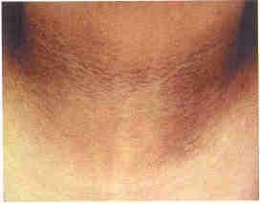
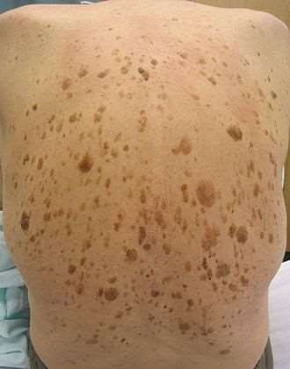
Dermatological:
Acanthosis nigricans
Leser Trelat sign
Thickened darker skin in neck, armpits, skin folds o mucous membranes
Gastrointestinal tumours, prostate, breast or ovarian cancer
TGF
Fades when cancer treated
Explosive onset of multiple sebarrhoic keratosis on erythematous skin
Gastro-intestinal adenocarcinoma
breast/ lung/urinary tract cancer
Often associated with
acanthosis nigricans

Slide 22
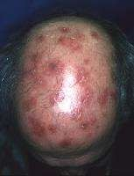
Sweet’s Syndrome
□ Acute febrile neutrophilic dermatosis
□ Associated with leukemia
Acute tender red nodules or
plaques
Fever, arthralgia, oral lesions, eye involvement
Almost all organs can be involved
Neutrophil mediated, with role
for TNF, G-CSF
Prednison extremely effective, most immunosuppressive drugs are.

Slide 23
Hematological: DVT/PE
Hypercoagulability
  ?abnormalities blood composition
    Increased clotting factors
    Cancer procoagulent A
    Tissue factor
    cytokines
  ?Increased release of plasminogen activator
Surgical intervention
Chemotherapy: endothelial damage
Indwelling CVC’s
Prolonged immobilisation

Slide 24
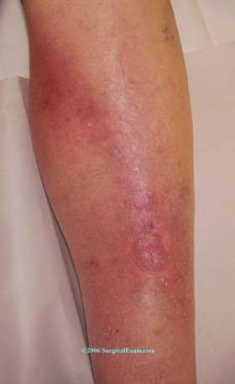
Trousseau’s sign
Migratory thrombophlebitis
Glioma’s, pancreatic or pulmonary adenocarcinoma
hypercoagulobility

Slide 25
Para neoplastic syndrome due to
  Cross reacting antibodies
  Production of physiologically active factors
  Interference with normal metabolic pathways
  All

Slide 26
Para neoplastic syndrome due to
  Cross reacting antibodies
  Production of physiologically active factors
  Interference with normal metabolic pathways
  All

Slide 27
Endocrine paraneoplastic not seen
Cushing’s syndrome
SIADH
Hypoglycemia
hyponatremia

Slide 28
Endocrine paraneoplastic not seen
Cushing’s syndrome
SIADH
Hypoglycemia
hyponatremia

Slide 29
Types of Paraneoplastic syndrome
  Endocrine: hormone secreting tumours
  Neurological: immune mediated
  Both
  None

Slide 30
Types of Paraneoplastic syndrome
  Endocrine: hormone secreting tumours
  Neurological: immune mediated
  Both
  None

Slide 31
Trousseau’s sign seen in
Glioma’s
pancreatic
pulmonary adenocarcinoma
All

Slide 32
Trousseau’s sign seen in
Glioma’s
pancreatic
pulmonary adenocarcinoma
All

Slide 33
Lambert Eaton Myasthenic Syndrome sewen in
Non hodgkin lymphoma
Hodgkin lymphoma
Pancreatic cancer
none

Slide 34
Lambert Eaton Myasthenic Syndrome sewen in
Non hodgkin lymphoma
Hodgkin lymphoma
Pancreatic cancer
none

Slide 35
Paraneoplastic Neurologic Syndrome in the PNS Euronetwork Database
Bruno Giometto, MD; Wolfgang Grisold, MD; Roberta Vitaliani, MD, PhD; et al
NAME OF AUTHOR | TITLE OF STUDY & DESIGN | AIM | RESULT | CONCLUSION
Bruno Giometto, MD; Wolfgang Grisold, MD; Roberta Vitaliani, MD, PhD; et al | Paraneoplastic Neurologic Syndrome in the PNS Euronetwork Database | To analyze various types of PNS, frequent tumor and antibody associations, clinical characteristics of individual syndromes, and possible therapeutic and prognostic strategies. | Data from 979 patients were analyzed, representing the largest PNS investigation to date. The findings elucidate the clinical evolution of paraneoplastic cerebellar syndrome according to the onconeural antibodies present, the heterogeneity and prognosis of dysautonomic disorders, and the clinical variability of paraneoplastic limbic encephalitis. | The study results confirm that PNS influences oncologic patient survival. Tumors are the main cause of death, but some types of PNS (such as dysautonomia) have a poorer prognosis than malignant neoplasms.

