Slide 1
Epidemiology of Japanese Encephalitis
Dr Abhishek Somani
Assistant Professor
Dept. of Community Medicine
SBKS MI RC Sumandeep Vidyapeeth

Slide 2
Introduction
Japanese encephalitis is a viral disease that infects animals and humans.
It is transmitted by mosquitoes
In humans causes inflammation of the membranes around the brain
The first time severe epidemics occurred in Japan
Since then it occurred annually and gradually spread towards S E Asia
Notes:
How JE was knw to the world
Origin of terms
History- global scenario

Slide 3
Global Picture

Slide 4
History of JE
1870’s: “Summer encephalitis” epidemics
1924: Great epidemic outbreak in Japan
1935: Virus first isolated from a fatal human encephalitis case
1938: Virus isolated from Culex tritaeniorhynchus
Notes:
The first historic mention of Japanese encephalitis occurred during the “summer encephalitis” outbreaks in the late 1870’s. The next documented epidemic in Japan occurred in 1924 with 6,125 human cases resulting in 3,797 human deaths (62% case-fatality rate). The virus was first isolated in Japan in 1935 from a fatal human case of encephalitis. In 1938, the virus was first isolated from its primary vector species, Culex tritaeniorhynchus

Slide 5
1940-1978: Disease spread with epidemics in China, Korea and India
1955: Disease was first time recognised in India
1972: Outbreaks reported in UP, Assam, West Bengal
1983-1987: Vaccine available in U.S. on investigational basis
Notes:
In 1940, JE was first identified in China and in 1949 it was identified in Korea during a major epidemic that resulted in 5,548 human cases. In 1954 the virus was recognized in India and a major epidemic occurred in 1978 with over 6,000 human cases occurring. In 1983, in South Korea, JE immunizations started in children as young as age 3 except in endemic areas where the vaccine was recommended in children even younger. From 1983 to 1987 the JE vaccine was available in the U.S. on an investigational basis.

Slide 6
2005: Outbreak in Ghorakpur , UP
2006: Government of India introduced vaccine in UIP schedule in highly endemic states.
2009: National Program for prevention and control of JE
Notes:
Outbreak in ghorakpur claimed many lives upto 1000 children, worst outbreak ever

Slide 7
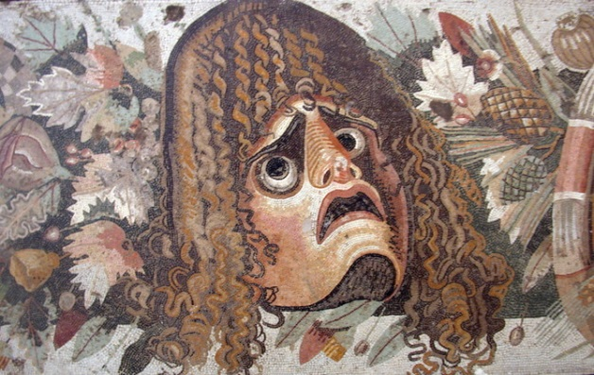
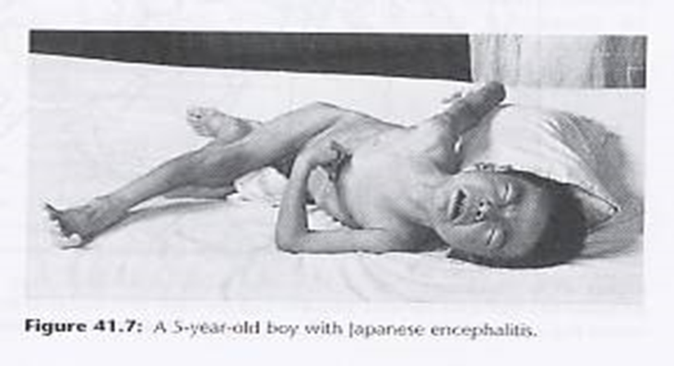
Type A / Type B JE
Type A Japanese Encephalitis
Type B Japanese Encephalitis
Encephalitis lethargica
Von Economos disease
Unknown etiology
Vector borne disease
Viral infection of CNS
Notes:
Symptoms of type a :high fever, sore throat, headache, lethargy, double vision, delayed physical and mental response, sleep inversion and catatonia.[3] In severe cases, patients may enter a coma-like state (akinetic mutism). Patients may also experience abnormal eye movements ("oculogyric crises"),[7] parkinsonism, upper body weakness, muscular pains, tremors, neck rigidity, and behavioral changes including psychosis. Klazomania (a vocal tic) is sometimes present

Slide 8
Why JE is important for Public Health Experts?
JE virus causes at least 50 000 cases of clinical disease each year(children < 10 years)
Results in 10 000 deaths ,15 000 neuro-psychiatric sequelae
Outbreaks of JE have occurred in several previously non-endemic areas
It is a preventable disease and no specific antiviral treatment
WHO biologicals, http://www.who.int/biologicals/areas/vaccines/jap_encephalitis/en/

Slide 9
Extent of problem in India
First case was reported in 1955
Outbreaks have been reported from different parts of the country.
15 states have reported JE incidence
Annual incidence ranged between 1714 and 6594 and deaths between 367 and 1665

Slide 10
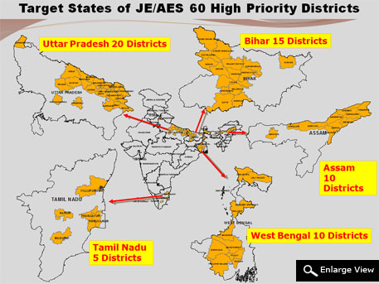
Endemic areas in India
Notes:
There are 15 states that show cases of JE every yr, but these 5 states are considered under highly endemic area coz they account for total 80% cases all over India

Slide 11
Epidemiological Triad
Time
Agent
Host
Environment

Slide 12
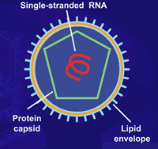
Agent: ARBOVIRUSES
Viruses of vertebrates transmitted by hematophagus insect vectors
Special characteristic: Ability to multiply in arthropods
More numerous in tropical than in temperate zones
Flavivirus
Notes:
Group B arbo virus, Flavi virus, the glycoprotein envelope of the virus contains specific as well as cross reactive neutralizing epitopes

Slide 13
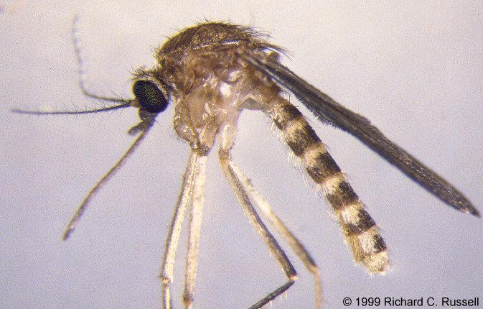
Vector Transmission
Most common type of Mosquito:Culex vishnui group
Culex tritaeniorhynchus
Culex vishnui
Culex pseudovishnui
Culex

Slide 14
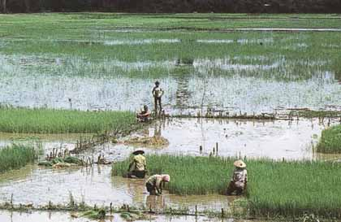
Breeding places
Irrigated rice fields
Shallow ditches
Pools of water
Primarily outdoor resting in vegetation
Flight range : 1-3 kms
Notes:
Culex vishnui subgroup is very common, widespread and breed in water with luxuriant vegetation mainly in paddy fields and the abundance is related to rice cultivation, shallow ditches and pools.
These vectors are primarily outdoor resting in vegetation and other shaded places but in summer may also rest in indoors.
They are in principally cattle feeders, though human and pig feeding are also recorded in some areas

Slide 15
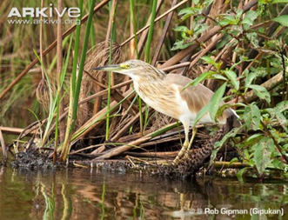
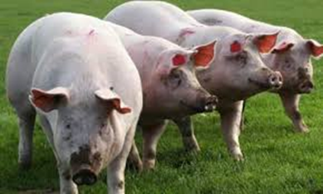

Hosts
Natural reservoir of infection
Amplifier Hosts
Accidental Host
Dead end Host
Pond heron
Notes:
Birds : Pond herons, cattle egrets, poultry birds, appear to be involved in natural transmission of JE virus.
The vector mosquito species prefer cattle blood as compared to that of human beings.
The pigs are “amplifier hosts” for the virus.
Migratory birds may be involved in the transfer of virus one region to another
Cattle :It is believed that prevalence of an enormously large population of cattle in India may act as deterrent to the spread of JE infection.
Pigs : Infected pigs do not manifest many overt symptoms of the disease but allow multiplication and circulation of the virus in their blood. They are capable of infecting a large number of vector mosquito species, which in turn may transmit the virus to man after the completion of extrinsic incubation period of 9-12 days.

Slide 16
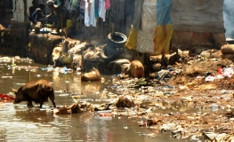
Environment
Specific vectors for different geographical and ecological areas
Immune status of various population groups
Increased Rainfall
Piggeries within 4-5 kms from human dwellings

Slide 17
Factors favouring outbreak
Increase in susceptible population
High density of Culex mosquitoes
Presence of amplifying hosts such as pigs, water birds etc.
Paddy cultivation

Slide 18
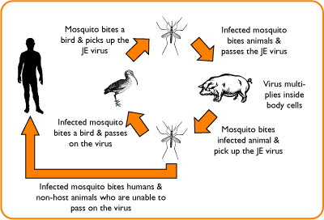
Pathogenesis

Slide 19
Clinical Features
Incubation Period - 5 to 15 days
Only 1 in 300 infections develop into encephalitis.
Prodromal stage: Fever, headache and malaise.
Acute encephalitic stage: Fever, focal CNS signs, convulsion altered sensorium progressing to coma.
Late stage and sequelae: Temperature & ESR
normal level, neurological signs become stationary
Notes:
Prodromal stage: Fever, headache and malaise. Duration- 1 to 6 days.
b} Acute encephalitic stage: Fever, 38 to 40.7°C,
nuchal rigidity, focal CNS signs, convulsion altered
sensorium progressing in many cases to coma.
c} Late stage and sequelae: Temperature & ESR
touch normal level, neurological signs become
stationary

Slide 20
Case Classification
Suspected case:
Probable Cases:
Laboratory-Confirmed case:
Notes:
Case Definition of Suspected case:
- Acute onset of fever, not more than 5-7 days duration.
- Change in mental status with/ without
• New onset of seizures (excluding febrile seizures)
• (Other early clinical findings – may include irritability, somnolence
or abnormal behavior greater than that seen with usual febrile
illness)
Laboratory-Confirmed case : A suspected case with any one of the following markers:
• Presence of lgM antibody in serum and/ or CSF to a specific virus including
JE/Entero Virus or others
• Four fold difference in lgG antibody titre in paired sera
• Virus isolation from brain tissue
• Antigen detection by immunofluroscence
• Nucleic acid detection by PCR
Probable Cases
Suspected case in close geographic and temporal relationship to a laboratoryconfirmed
case of AES/JE in an outbreak

Slide 21
Lab investigations
Presence of lgM antibody in serum and/ CSF
Four fold difference in lgG antibody titre in paired sera
Antigen detection by immunofluroscence
Nucleic acid detection by PCR
Virus isolation from brain tissue

Slide 22
Differential Diagnosis
Meningitis
Febrile Convulsions
Rey’s Syndrome
Rabies
Cerebral Malaria
Toxic Encephalopathy

Slide 23
Treatment
There is no specific anti-viral medicine available against JE virus.
Managed symptomatically.
In the acute phase maintaining fluid and electrolyte balance and control of convulsions, if present.
Maintenance of airway is crucial

Slide 25
Prevention and Control:
Vaccination:
Three types of Vaccines are available:
1.The mouse-brain derived, purified and Inactivated vaccine.(Nakayama or Beijing strains)-91% efficacy.
2.The cell culture derived-inactivated.(Beijing P-3 strain)-85%
3.The cell culture derived, live attenuated vaccine(SA 14-14-2 strain)->95% efficacy.

Slide 26
Mouse-brain derived inactivated vaccines: only vaccine against JE approved by the WHO.
The primary vaccination is done between the ages of 1 and 3 at doses of 0.5mL to 1mL (0.25 to 0.5 with children under age 3) subcutaneously.
On days zero, seven, and 30 with a booster after one year and thereafter every three years until age 10-15 years.

Slide 27
Advantages:
Protective immunity after 1 month of second dose.
Best used inter-epidemic period-efficacy of 90%.
Disadvantages:
high production cost.
lack of long-term immunity, and adverse allergic reactions.

Slide 28
2. Inactivated hamster kidney cell-culture-derived
JE vaccine:
Vaccine is based on the Beijing-3 strain of JEV.
Used since 1967.
Protective efficacy of 76-90%.
It has relatively fewer side effects and is easy to manufacture.

Slide 29
3. Vaccine based on the SA14-14-2 strain:
This is an attenuated and genetically stable strain.
Protective efficacy-95%-98%.
manufactured in China.
Single dose followed by single booster after 1 year.
In India, JE vaccination was started in 2006,
154 out of 181 JE endemic districts as identified by (NVBDCP), have been covered under JE campaign with a single dose of vaccine.

Slide 30
JE Vaccine has been introduced in the Routine Immunization with two doses of JE vaccine,
first at 9-12 months of age.
Second at 16-24 months of age of children.

Slide 31
Strategies for control of JE:
National programme for prevention and control of JE+AES under NVBDCP was approved by Gov. of India in 2011.
Phase–I of the programme - 60 districts in 5 States-Assam, Bihar, Tamil Nadu, Uttar Pradesh & West Bengal .
The goal:
to reduce morbidity, mortality and disability in children due to JE/AES.

Slide 32
to strengthen and expand JE vaccination in affected districts.
By vaccination of children of 1-15 years of age.
2. to strengthen surveillance activities through sentinel sites in Tertiary health care institutions.
3.Early diagnosis and Proper case management at PHCs,CHCs,higher centres.

Slide 33
4.Integrated vector control measures-
ULV fogging-Malathion –late evening
During outbreak situations, fogging applications have to be carried out at 7-10 days interval .
Cover the vegetation around the houses, breeding sites, animal shelves.
Personal protection-
Protective clothing
Use of mats,coils and aerosols
Repellants-Neem oil, DEET, Permethrin

Slide 34
5. To estimate disability burden due to JE,
and to provide for adequate facilities for physical, medical, neurological and social rehabilitation.
Establishment of PMR units in endemic areas.
Provision of Orthopedic prosthesis.

Slide 35
6.To carry out intensified IEC/BCC activities regarding JE.
Media, Interpersonal communication .
7.Capacity building-training of Medical officers, ANMs

Slide 36
Challenges faced in Prevention and control JE
Outdoor habit of the vector
Scattered distribution of cases spread over relatively large areas
Role of different reservoir hosts
Specific vectors for different geographical and ecological areas
Immune status of various population groups is not known making it difficult to delineate vulnerable population groups

Slide 37
Roop Kumari & Pyare L Joshi. (‎2012)‎. A review of Japanese encephalitis in Uttar Pradesh, India. WHO South-East Asia Journal of Public Health, 1 (‎4)‎, 374 - 395. World Health Organization. Regional Office for South-East Asia. | Meta-analysis (Highest level of evidence) | An epidemiological profile of JE (1978–2009) has been compiled and analysed to understand the trend and status of the disease. | As compared with the total number of JE cases reported in the country, UP contributed a fifth of the disease burden (20.4% of cases and 18.7% of deaths) during 1978–1987 (Figures 1A and1B). Its contribution increased between 1988 and 1997 to 24.3% cases and 20.9% deaths, and represented well over half of the total cases and deaths reported in the country between 1998 and 2009. While the proportion of JE cases reported from Uttar Pradesh in 1997 was only 14%, it started increasing dramatically from 1998 and in 2005, a major outbreak in UP contributed over 90% of all suspected JE cases (6061) – and over 89% deaths (1501) – in the country. During the four following years, 2006–2009, 80.8%, 73.6%, 78.5% and 77.0% of cases, respectively, were contributed by the State of Uttar Pradesh | Japanese encephalitis is still a major health problem in eastern Uttar Pradesh, north India. No antiviral drug against JEV is available.32 Chemical control of vector populations with insecticides plays a marginal role in control of the disease due to their exophilic behaviour. The use of larvicides is limited as vector mosquitoes prefer to breed in large water bodies. In some situations, e.g. during outbreaks of JE, space-spraying may interrupt the transmission cycle for a short time.

Slide 38
THANK YOU

