Slide 1
Nasal tuberculosis and leprosy

Slide 2
Levels of Evidence
Grade A – Systemic reviews, Meta analyses, RCT
Grade B – Non-randomised studies
Grade C – Observational studies
Grade D – Case Series, Expert opinion

Slide 3
Levels of Evidence
**** ~ Systematic reviews, meta analysis of randomized control studies
*** ~ Non randomised studies
** ~ Observational or non experimental studies
* ~ Expert opinion

Slide 4
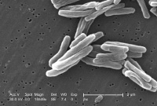
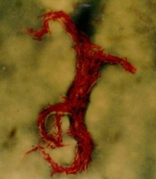
TUBERCULOSIS

Slide 5
PATHOPHYSIOLOGY
Pulmonary
Extra-pulmonary:
                Lymphnodes
                Vertebral bodies
                Adrenals
                Meninges
                GI tract

Slide 6
CLINICAL FEATURES
FORMS
Nodular
Sinus Granuloma
Ulcerative

Slide 7
LUPUS VULGARIS
Apple jelly nodules
Ulcers:
        Pale Granular base
        Undermined edges
Slowly progressive
Malignant transformation [**]

Slide 8
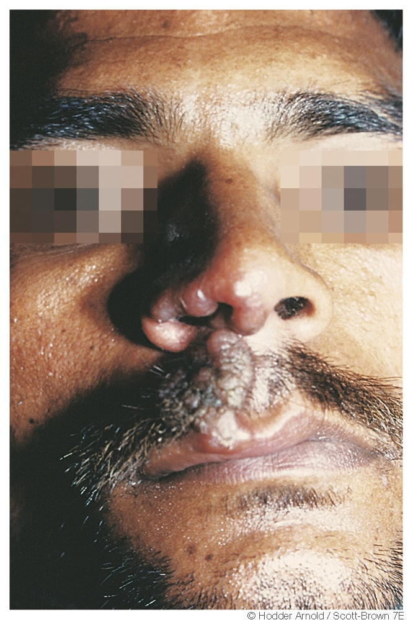
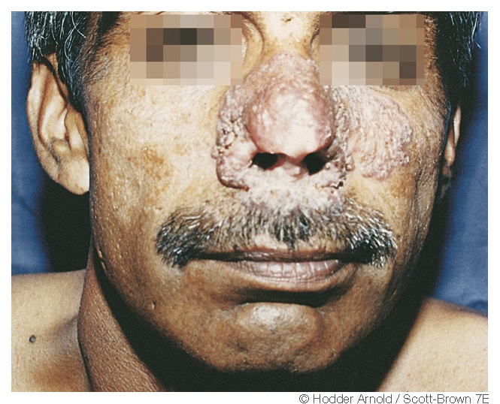
LUPUS VULGARIS

Slide 9
ULCERATIVE FORM
Symptoms:
            Nasal obstruction
            Crusting
            Discharge
            Epistaxis
DDx:
            Wegner’s Granulomatosis
            Malignancy [**]

Slide 10
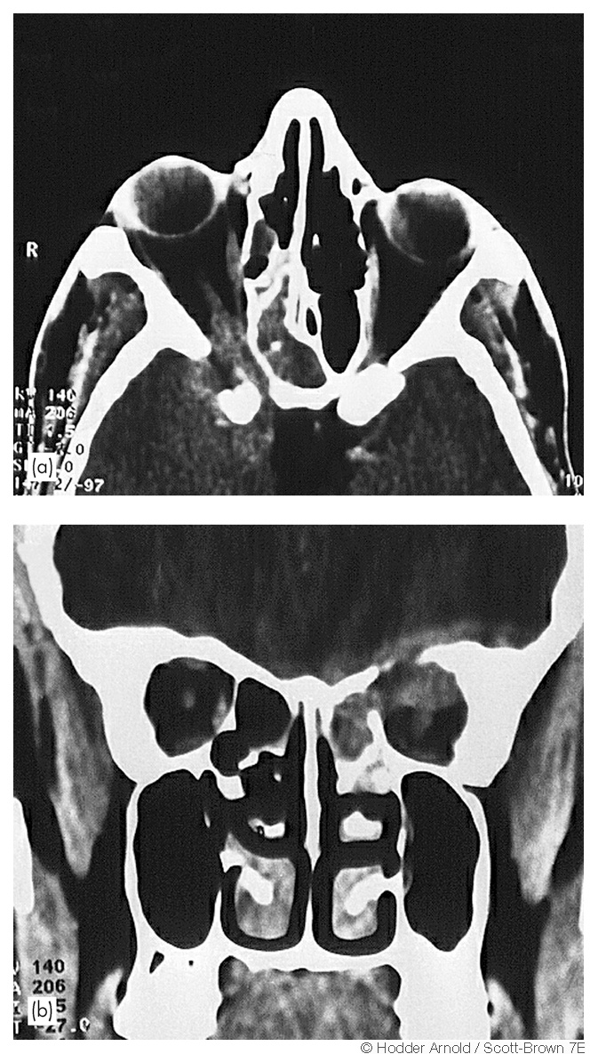
SINUS GRANULOMA

Slide 11
DIAGNOSIS
Tissue biopsy
Microbiological diagnosis
BACTEC ^{(1) [***/**]}
Manteaux Test
Chest x-ray [***]

Slide 12
TREATMENT
Two months:
              Isoniazide
              Rifampicin
              Ethambutol
              pyrazinamide
Four months:
              Isoniazide
              Rifampicin

Slide 13
LEPROSY
Hansen disease
Goal of WHO: to reduce rate of new cases with grade 2 disability by 35%.

Slide 14
pathophysiology
Tuberculoid
Lapromatous

Slide 15
morbidity
Ulnar & Median: Claw hand
Posterior Tibial: Planter insensitivity & Clawed toes
Common Paroneal: Foot drop
Facial & Greater Auricular

Slide 16
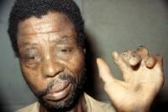

Slide 17
Clinical Feauters
Symptoms:
            Nasal obstruction
            Crust formation
            Blood stained discharge
            Hyposmia ⁽²⁾
Atrophic Rhinitis
Septal perforation
Saddle nose

Slide 18
diagnosis
Clinical findings⁽³⁾:
                Hypo-pigmented lesion with loss of sensation
                Nerve thickening
Bacteriological Examination

Slide 19
Treatment
Type | Daily, Self administered | Monthly Supervised | Months
Paucibacillary | Dapsone 100mg | Rifampicin 600mg | 6-12
Multibacillary | Dapsone 100mg, Clofazimine 50mg | Rifampicin 600mg, Clofazimine 300mg | 24

Slide 20
references
Williams RG, Jones TD. Mycobacterium marches back. Journal of laryngology and Otology.1995;109:5-13.
Barton RPE. Ear nose and Throat involvement in leprosy. In: Hastings RC. Leprosy. Edinburgh: Churchill Livingstone,1985:243-52.
WHO expert committee on leprosy. Seventh Report, WHO, Technical report series no.874,1998;24.

Slide 21
NAME OF STUDY | NAME OF AUTHOR | REFERENCE DETAILS | SAMPLE SIZE | RESULT | P VALUE | CONCLUSION
Nasal mucosa study of leprosy contacts with positive serology for the phenolic glycolipid 1 antigen | Martins AC¹, Miranda A, Oliveira ML, Bührer-Sékula S, Martinez A. | Braz J Otorhinolaryngol. 2010 Sep-Oct;76(5):579-87.. | 31 | Between seropositive contacts, real-time PCR was positive for M. leprae DNA in 06 (19.35%) of them and the higher number of genome copies were found in contacts who became sick. | <0.05 | Through the combination of various methods, tests on the contacts can help identify subclinical infection and monitor the contacts that could be responsible for spreading the disease

Slide 22
Q-1Drugs used to treat Leprosy are all except
Dapsone
Isoniazide
Rifampicin
Clofazimine

Slide 23
Q-2 Leprosy affects all system except
Peripheral nervous system
Central nervous system
Skin
Nasal mucosa

Slide 24
Q-3 Which of the following is used for screening of tuberculosis?
Paul-bunnel test
Montoux test
SSS(slit skin smear)
KOH

Slide 25
Q-4 Culture media for M.TB
Muller Hinton
New York Agar
L-J medium
Blood Agar

Slide 26
Q-5 Cardinal Sign(s) of Hensan’s disease
a. hypopigmented,hypoanesthetic patch
b. thickened peripheral nerve
c. SSS positive for acid fast bacilli
d.all of the above.

