Slide 1
MICROBIOLOGY OF PNEUMOCOCCUS

Slide 2
Levels of Evidence
Grade A – Systemic reviews, Meta analyses, RCT
Grade B – Non-randomised studies
Grade C – Observational studies
Grade D – Case Series, Expert opinion

Slide 3
Levels of Evidence
**** ~ Systematic reviews, meta analysis of randomized control studies
*** ~ Non randomised studies
** ~ Observational or non experimental studies
* ~ Expert opinion

Slide 4
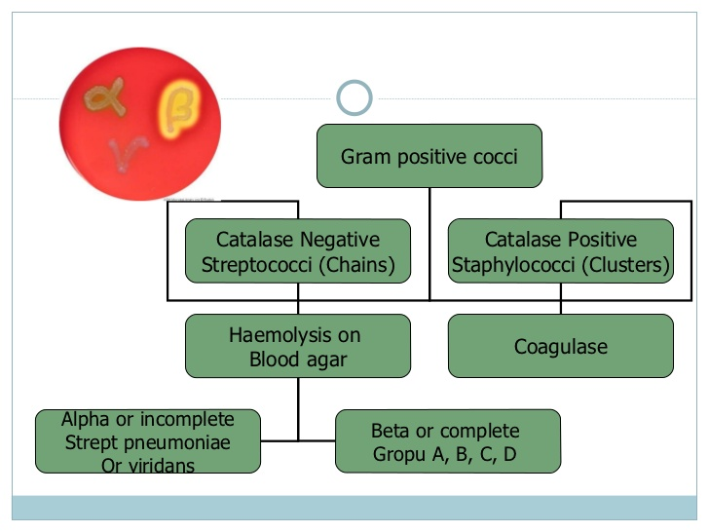

Slide 5
PNEUMOCOCCUS
Gram-positive diplococci (in pairs)
Encapsulated ovoid coccus
Non-motile
Fastidious (enriched media)
Blood or chocolate agar
Alpha haemolysis + draughtsman appearance
Soluble in bile
Optochin sensitive

Slide 6
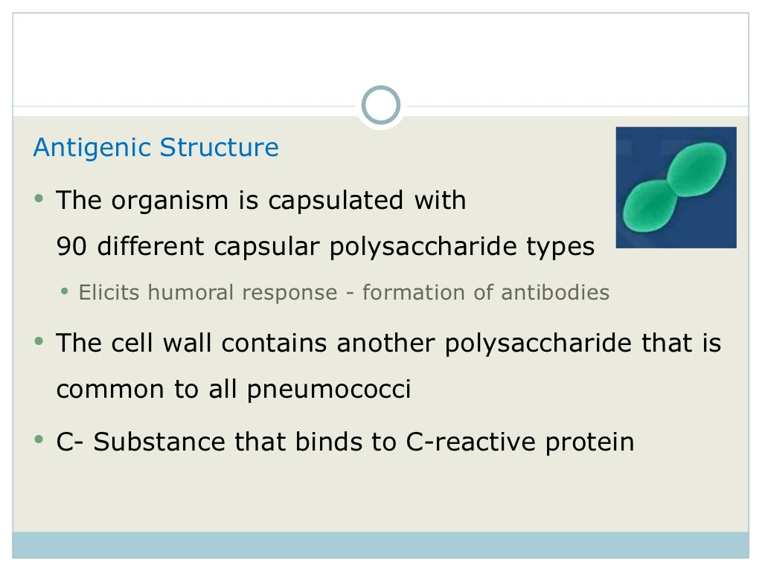

Slide 7
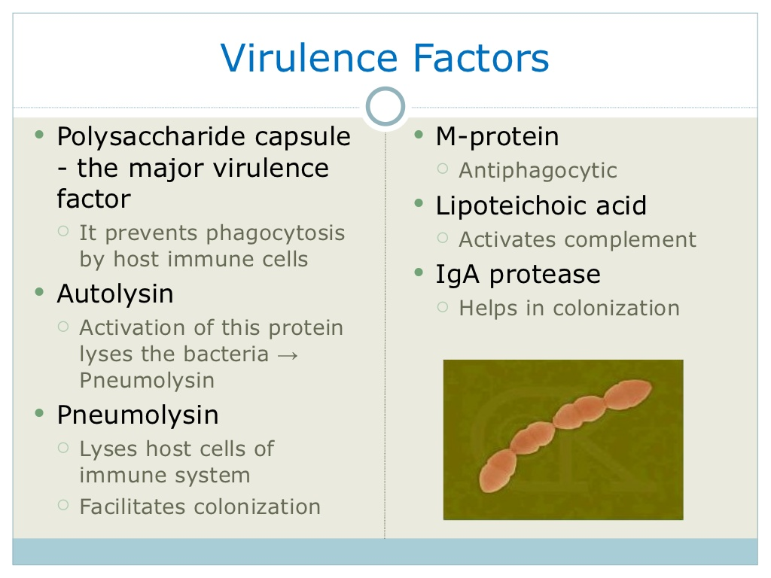

Slide 8
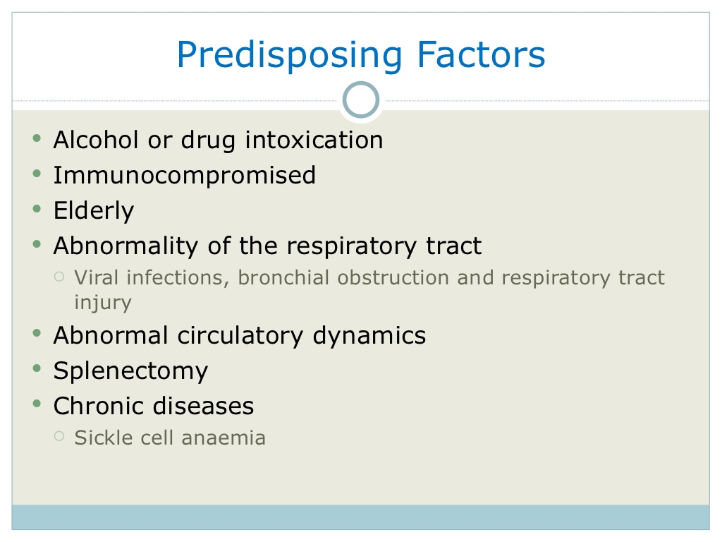

Slide 9
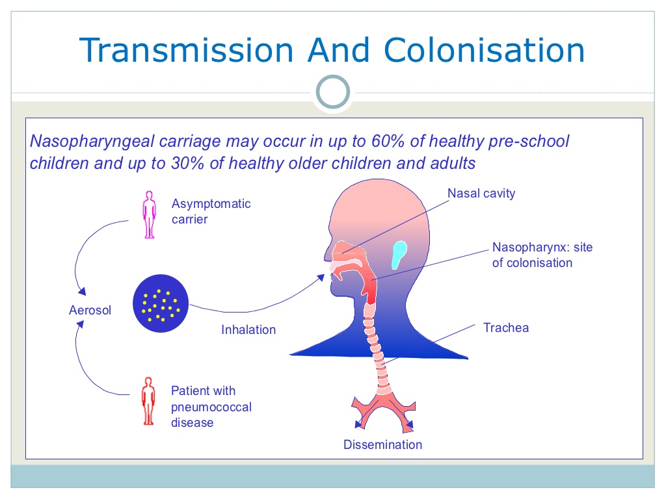

Slide 10
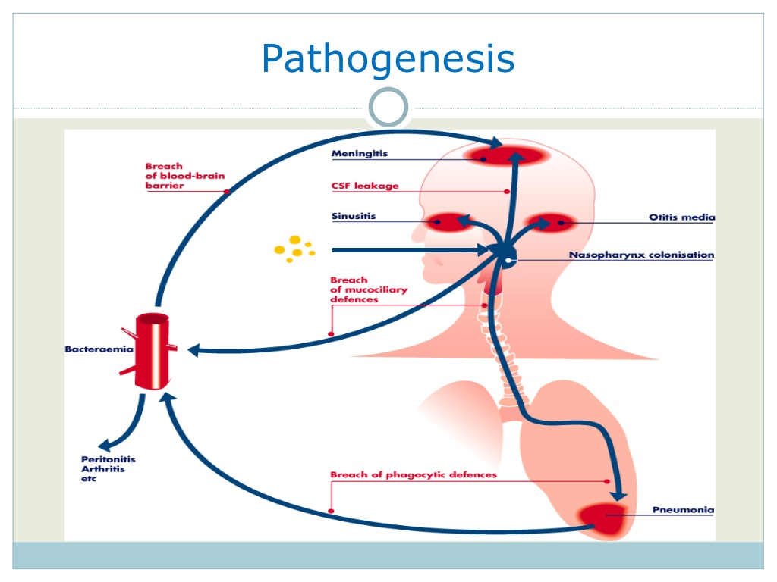

Slide 11
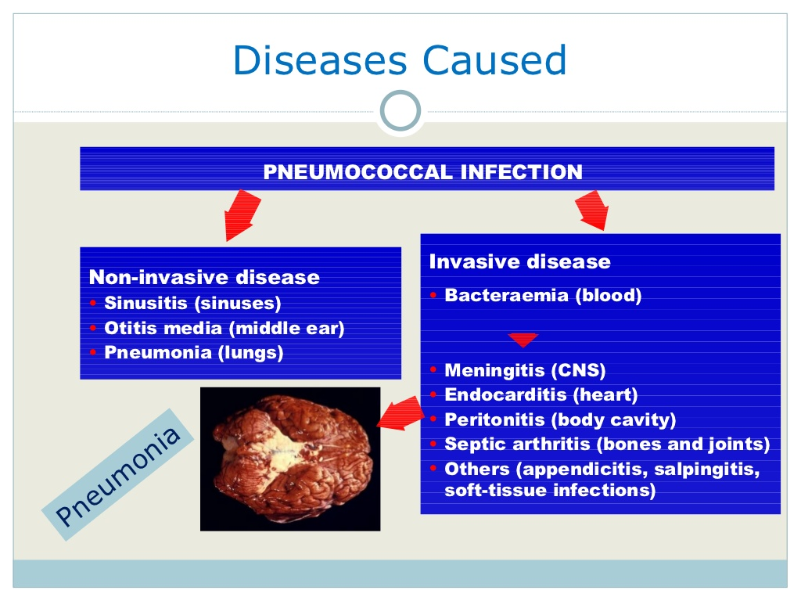

Slide 12
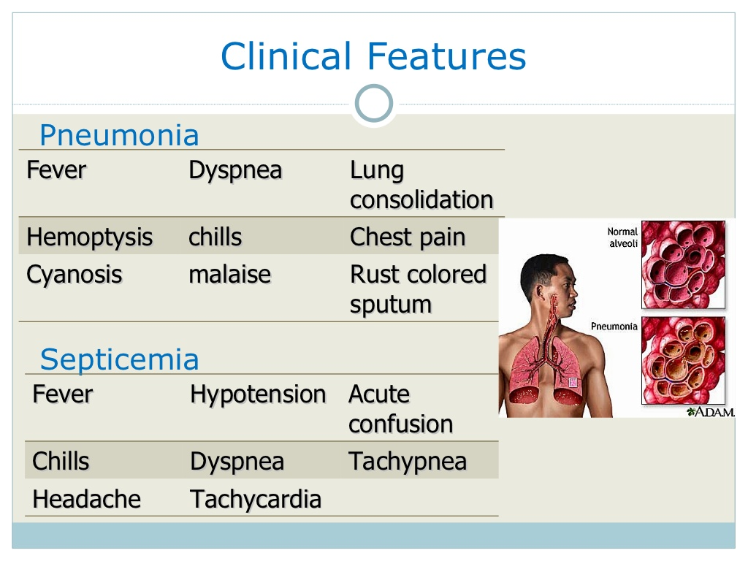

Slide 13
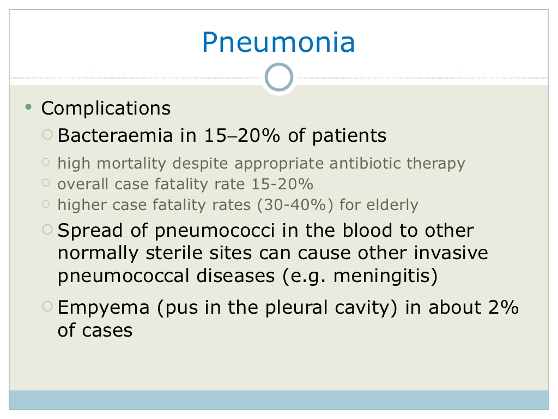

Slide 14
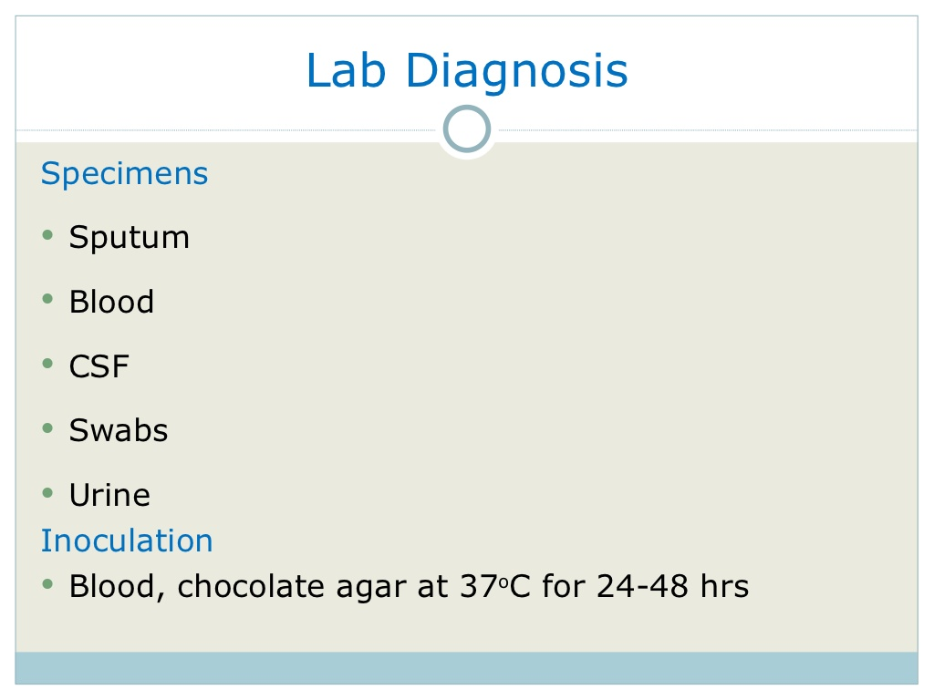

Slide 15
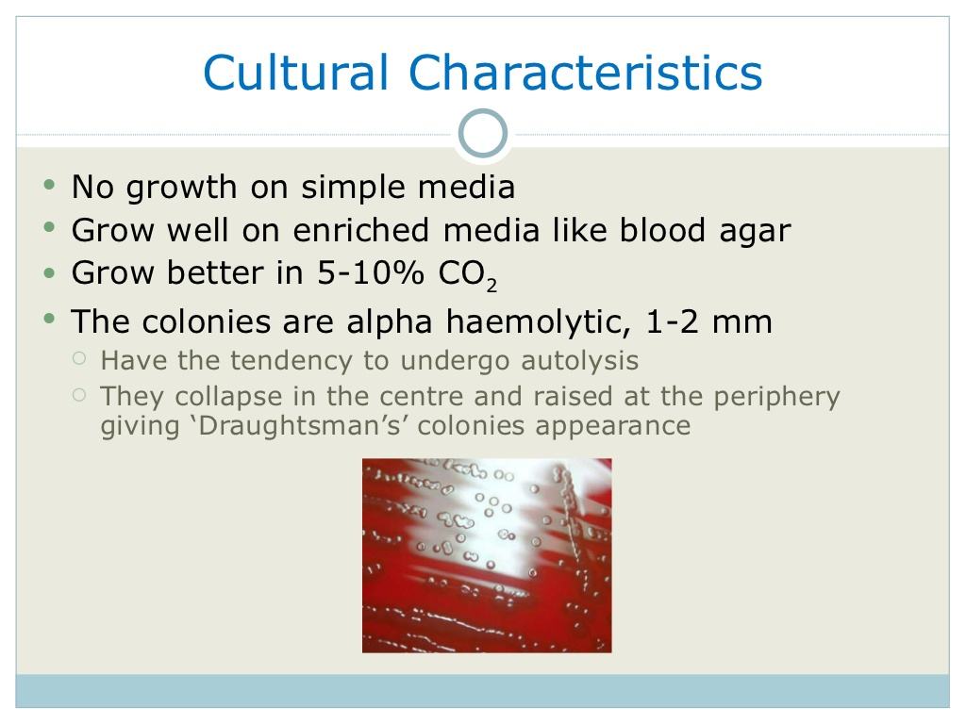

Slide 16
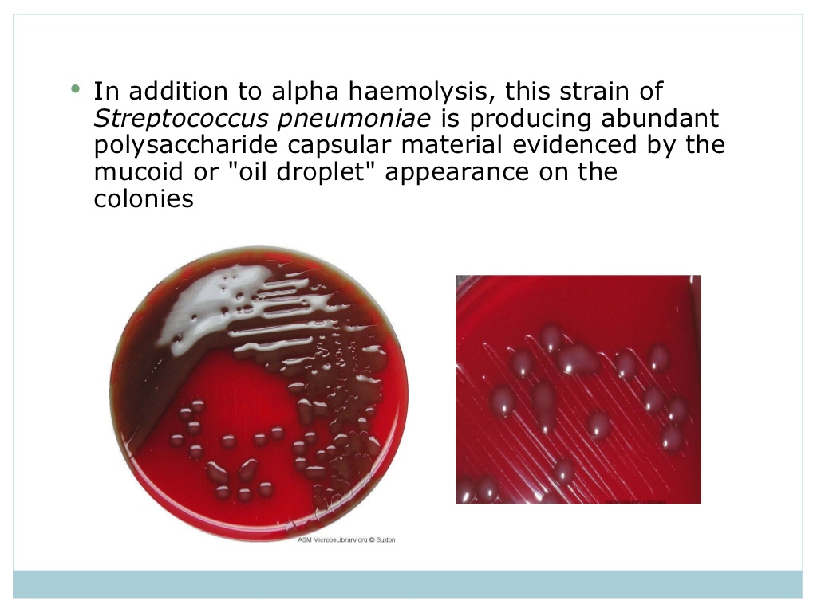

Slide 17
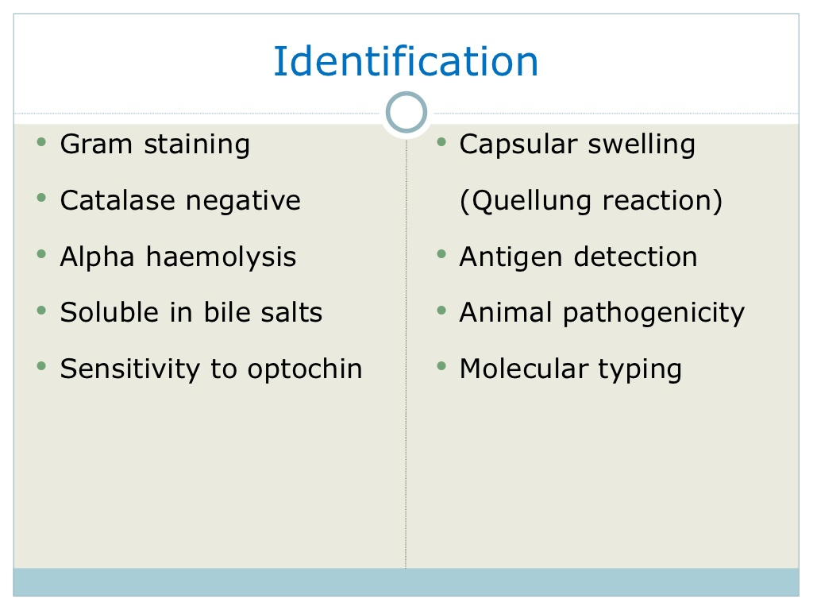

Slide 18
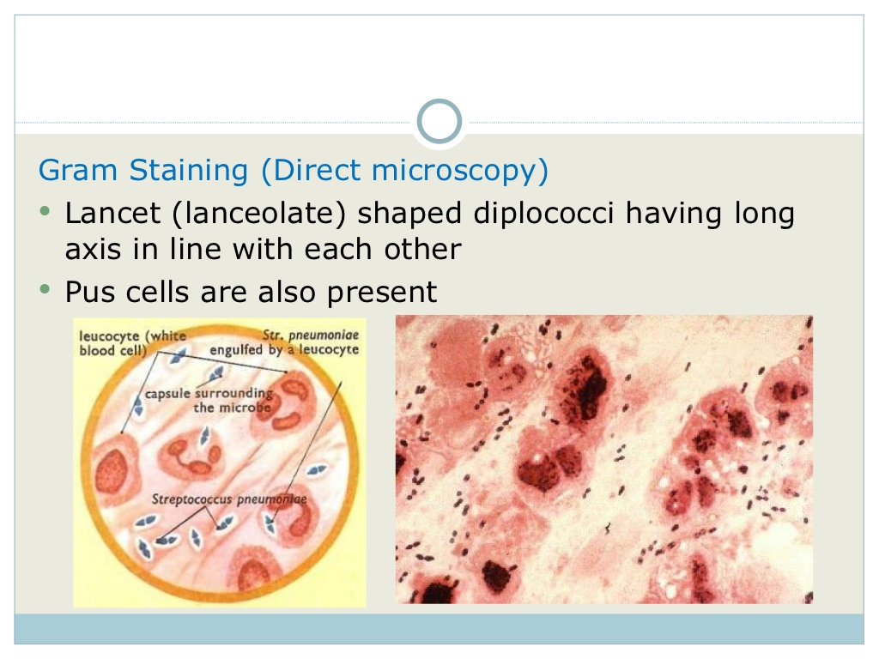

Slide 19
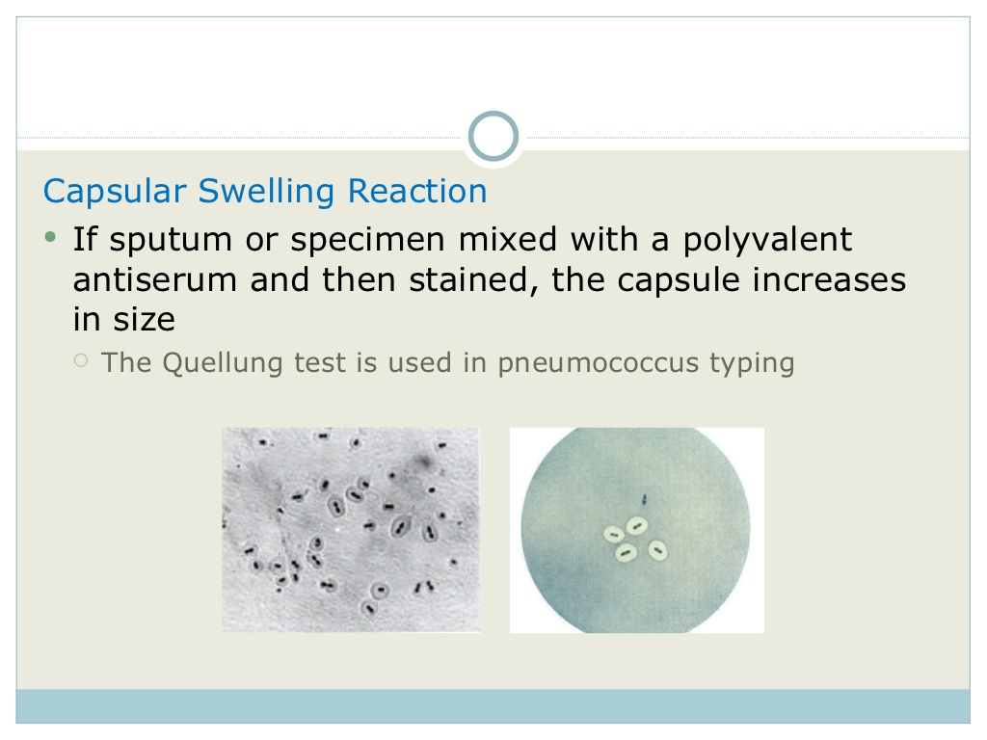

Slide 20
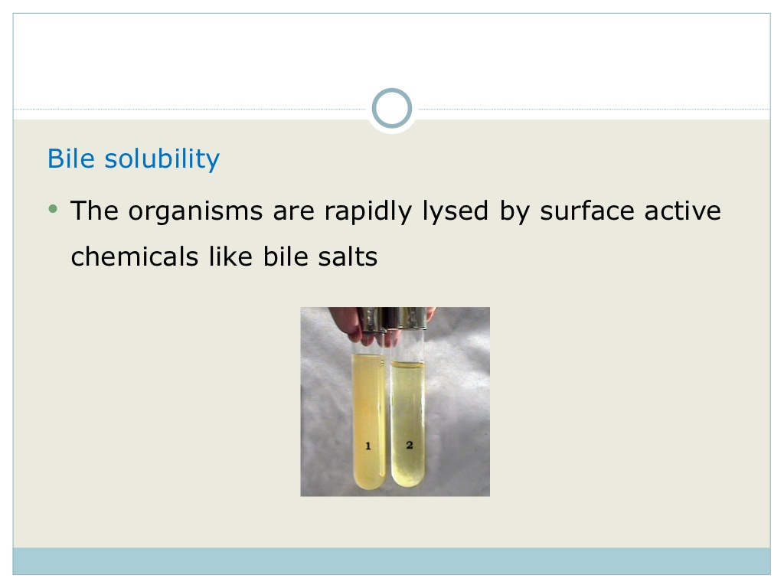

Slide 21
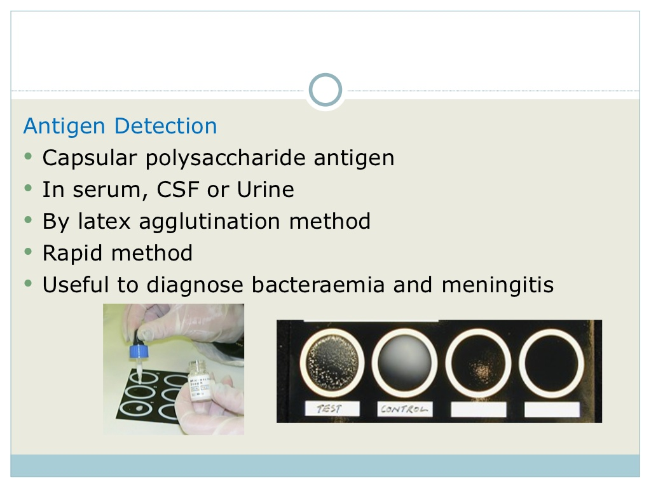

Slide 22
REFERENCES
Carlyle horstmeier and John a. washington.Microbiological study of streptococcal bacteremia applied microbiology, oct. 1973, p. 589-591

Slide 23
NAME OF STUDY | NAME OF AUTHOR | REFERENCE DETAILS | SAMPLE SIZE | RESULT | P VALUE | CONCLUSION
Microbiological Study of Streptococcal Bacteremi | CARLYLE HORSTMEIER AND JOHN A. WASHINGTON II | APPUED MICROBIOLOGY, Oct. 1973, p. 589-591 | 280 | streptococci were isolated from 280 patients (19% of those with bacteremia). Of this number, 54 had group D streptococci (45 were enterococci), 218 had α- or γ-hemolytic nongroup D streptococci, and 49 had β-hemolytic streptococci. |  | With the increased frequency in recent years of gram negative bactremia,there has been less attention devoted to streptococcal bactremia.

Slide 24
QUESTIONS
1.PNEUMOCOCCUS IS GRAM POSITIVE OR NEGATIVE?
Gram positive
Gram negative
All of the above
None of the above

Slide 25
IS IT BILE SOLUBLE OR NOT?
Bile soluble
Not soluble
All of the above
None of the above

Slide 26
IS IT OPTOCHIN SENSITIVE OR NOT?
Sensitive
Not sensitive
All of the above
None of the above

Slide 27
What is pneumococcus?
A bacteria
A virus
A fungus
None of the above

Slide 28
WHAT IS THE APPEARNCE OF THE COLONIES OF PNEUMOCOCCUS?
Tear drop
Draughtmen’s
All of the above
None of the above

Slide 29
THANK YOU

