Slide 1
Fungal rhinosinusitis:-

Slide 2
Levels of Evidence
Grade A – Systemic reviews, Meta analyses, RCT
Grade B – Non-randomized studies
Grade C – Observational studies
Grade D – Case Series, Expert opinion

Slide 3
Levels of Evidence
**** ~ Systematic reviews, meta analysis of randomized control studies
*** ~ Non randomized studies
** ~ Observational or non experimental studies
* ~ Expert opinion

Slide 4
The role of fungi in the nose and PNS is unclear, even if in some healthy individuals fungi can be cultured from nasal secretions.
May be part of normal flora
Patient’s state of immunocompetence is of importance in predicting aggressiveness of fungal organism. [**]

Slide 5
Fungal rhinosinusitis divide in 2 types:-
1) Invasive:-
Acute invasive
Chronic invasive
Chronic Granulomatous invasive
2) Noninvasive:-[****]
Allergic
Fungus ball (mycetoma)

Slide 6
Noninvasive fungal sinusitis:-
Fungus ball

Slide 7
Previously its incorrectly referred as mycetoma
Presence of tangled mats of hyphae in one or more sinus cavities.
More common in maxillary sinus followed by sphenoid sinus or any sinus
Aspergillous is most common organism [***]
In humid climate

Slide 8
Present in immunocompetent patients without invasion of mucus membrane on HPE & must be distinguished from saprophytic fungi which corresponds to fungal spores on crusts & mucus in nose. [***]

Slide 9
Clinical features :
Unilateral PND[***]
Cacosmia
Asymptomatic
In acute cases;
Fever, proptosis, blurring of vision are uncommon

Slide 10
Diagnosis:-
Radiographic findings:-
CT scan PNS:-[***]
Heterogeneous opacification is the most common findings associated with
Bony thickening and Sclerosis of the sinus wall
Calcification may frequently seen (non specific).
Bone erosion may seen when significant inflammatory reaction of the mucous membrane.

Slide 11
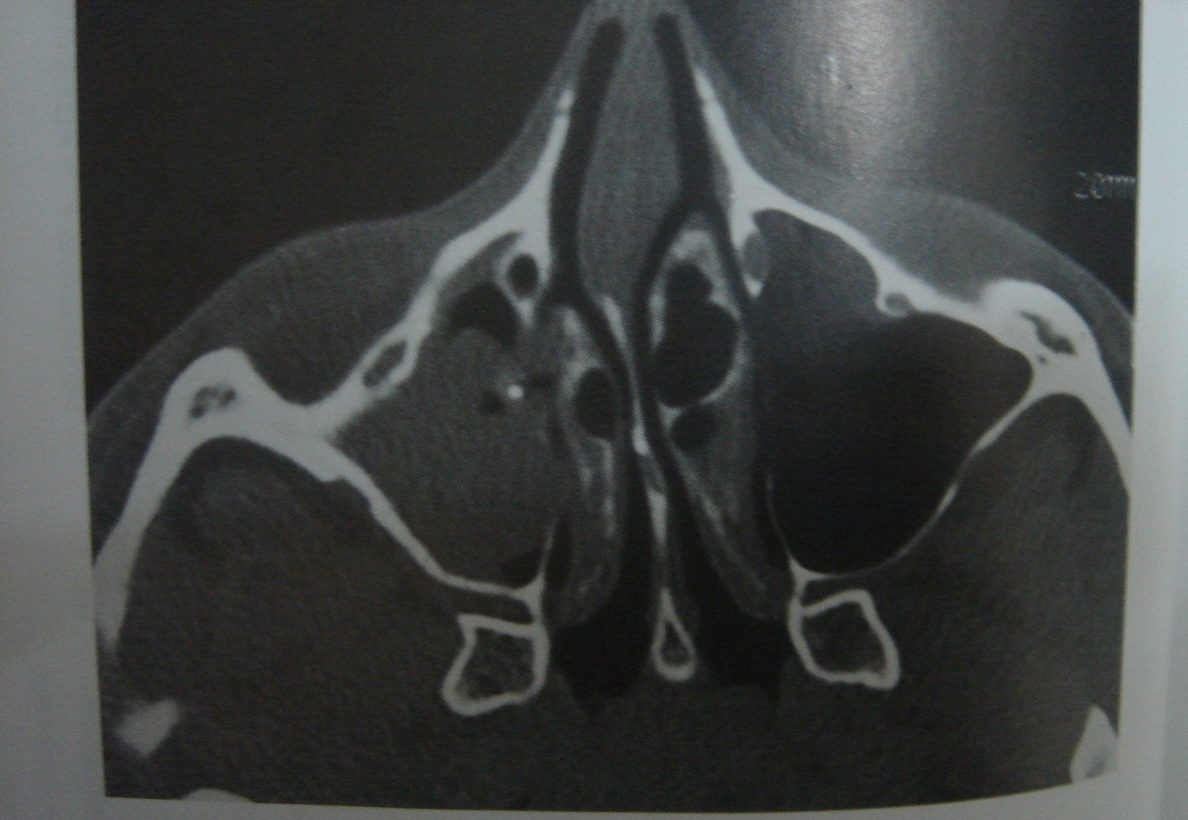

Slide 12
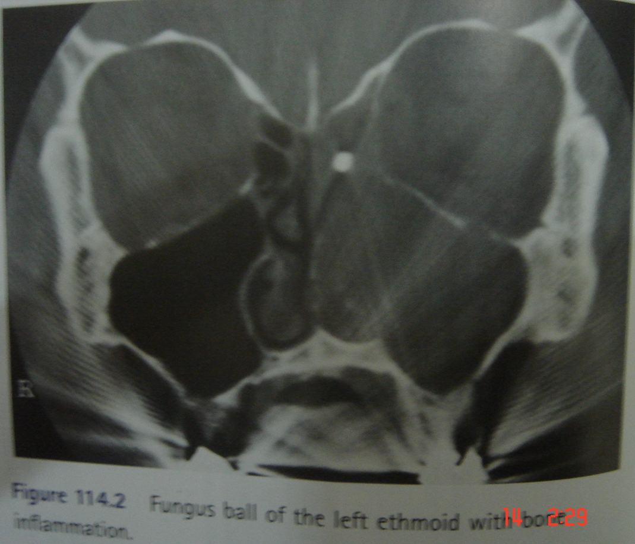

Slide 13
Histopathological :-
To confirm the diagnosis
No mucosal invasion
H&E stain:-
Gommori methenamine silver stain:-
Culture may lead to identification of fungi agent :-
But according to the publications it was only seen in 20 -50% of cases.

Slide 14
Treatment:-
Surgical removal of fungus ball [grade A]
FESS
Appearance:-
Thick, friable cheese like, gritty, rubbery or greasy mass that can easily separate from mucosa.
No antifungal or medical treatment [grade A]

Slide 15
Allergic fungal rhinosinusitis:

Slide 16
It is found in immunocompetent patients with an allergy to fungus. [**/*]
Fungi causes hypersensitivity reside in the mucin & provide continuous stimulation.
Similar etiology to allergic bronchopulmonary aspergillosis
Common fungi :- bipolaris species
curvularia lunata,
alternaria
aspergillus(rare)

Slide 17
Dematiaceous species are the fungal agents most responsible [***]
Common in warm & humid climate may be in warm & dry climate
Common in younger age group
Both male & female
Bilateral nasal polyp may be unilateral

Slide 18
Pathophysiology:-
Inhalation of fungi(atopic patient)
antigenic stimulus
inflammatory response of the mucous membrane
oedema associated with production of “allergin mucin”

Slide 19
Allergic mucin :
Thick green to gray laminate of dense inflammatory cells, mostly eosinophills, in various stages of degranulation, Charcot- Leyden crystals & fungal hyphae.
  Charcot-Leyden crystals
    Breakdown of cells by enzymes produced by eosinophils
    Slender and pointed at each end
    Pair of hexagonal pyramids joined at bases

Slide 20
Diagnosis:-
KUHN s classification:-
stage | Endoscopic findings
Stage 0 | No mucosal oedema or allergic mucin
Stage 1 | Mucosal oedema with or without allergic mucin
Stage 2 | Polypoidal oedema with or without alergic mucin
Stage 3 | Sinus polyp with fungal debris or allergic mucin

Slide 21
Radiological findings:-
CT findings:-
Multiple sinuses involved
near complete sinus opacification and bone expansion .
Hyperattenuating allergic mucin in lumen of sinuses, can show smooth erosion of bone. No direct invasion of dura and periorbita is seen.

Slide 22
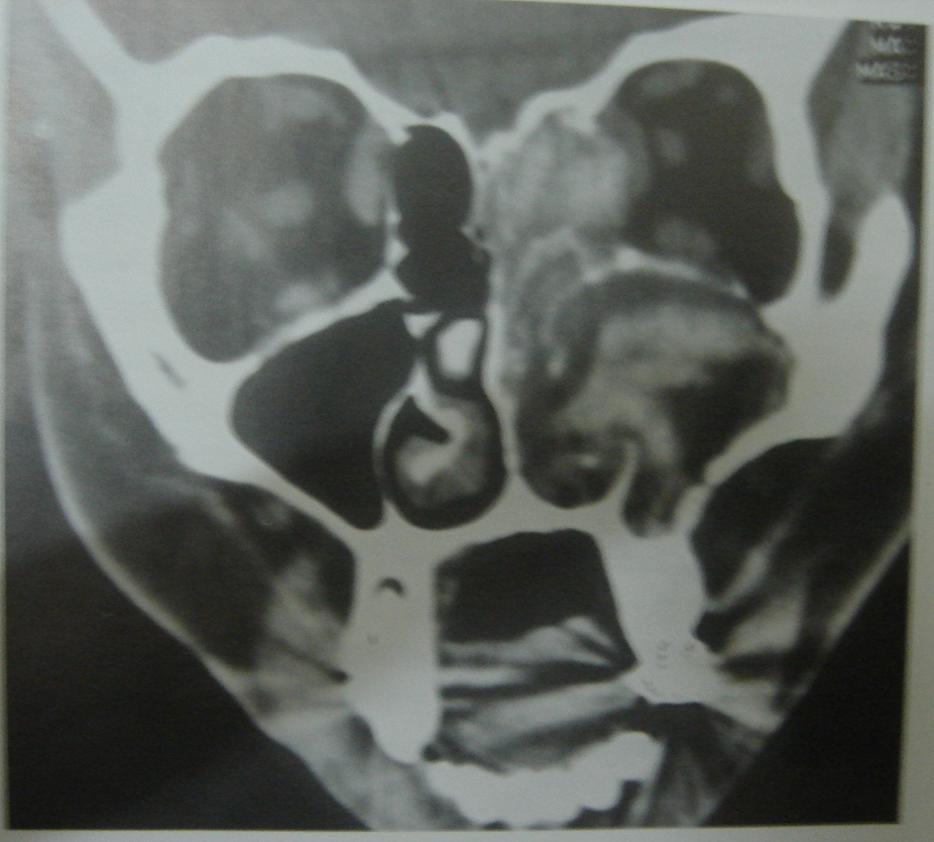

Slide 23
MRI findings:-
  Can have multiple T1 appearances
  Characteristic low T2 signal due to high concentration of various metals such as iron, magnesium and manganese concentrated by fungal organisms as well as high protein and low free water content in allegric mucin.
  Inflamed mucosal lining is relatively hypointense on T1-weighted images and hyperintense on T2-weighted images and demonstrates enhancement after intravenous administration of gadolinium contrast material

Slide 24
Other tests:-
Skin allergy test
RAST
Total eosinophil count
Absolute eosinophil count
Total serum IgE
Antigen specific IgE and IgG
Positive fungal stain or culture
Peripheral eosinophilia
Nasal polyposis
Culture

Slide 25
Clinical & biological criteria for diagnosis is still under debate, including nasal polyps, thick mucin, hypersensitivity type I for fungus, eosinophillic mucin. [**]
The presence of hyphae in mucin associated with eosinophils is one of the main criteria for diagnosis.

Slide 26
Treatment:-
Surgical removal of allergic mucin and restoration of normal sinus drainage . [grade B]
Long term use of topical nasal steroids for suppression of immune response to prevent postsurgical recurrence. [grade B]
Topical/systemic antifungal medication not needed .
May also helped by allergen immunotherapy:-
Antihistamines, oral antileukotrienes, oral steriods and nasal irrigation are useful.

Slide 27
Invasive fungal rhinosinusitis
Acute Invasive/fulminant Fungal Sinusitis

Slide 28
Characterized by a mycotic infiltration of the mucous membrane of the nasal cavity and/or PNS.[**/*]
In Immunocopromised patients
Common cause:- Diabetes:
-Rhizopus, Rizomucor, Absidia and Mucor
Immunecompromised:- Aspergillus 80%
Angioinvasive organism -> thrombosis

Slide 29
Clinical features:-
Fever
Rhinorrhoea
Proptosis, ophthlmoplegia, focal neurological signs
Early diagnosis & control of primary immunological disorder are essential for prognosis.[***]
Prognosis depend on early diagnosis

Slide 30
Diagnosis :
Nasal endoscopy & biopsy: [***]
discoloration (black, necrotic turbinates), granulations, ulceration & crusts in nose.
Oral cavity & oropharynx examination
All cranial nerves examination
Histological examination: H & E stain
Gommori methenamine silver
periodic acid schiff & Gridley

Slide 31
CT Findings:- [***]
Hypoattenuating mucosal thickening or soft tissue attenuation within the lumen of paranasal sinus and nasal cavity
Rapid, aggressive bone destruction with intracranial/intraorbital extension- may occur with intact bony wall with fungi extending along vessels, etc.
Look for cavernous sinus thrombosis and carotid invasion, occlusion or pseudoaneurysm

Slide 32
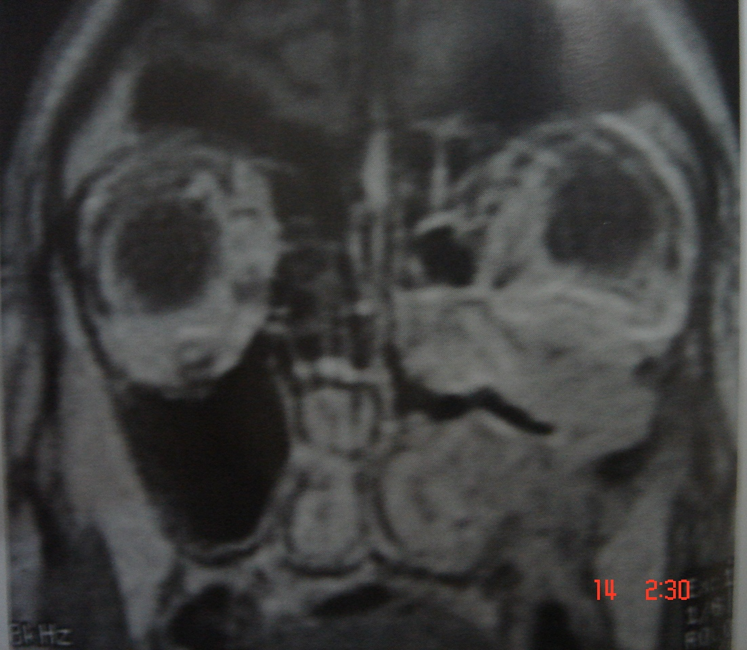
MRI [***]

Slide 33
Treatment:-
Prompt aggressive surgical debridement of affected tissues and systemic antifungal therapy. [grade B]
Reversal of underlying causes of immunosuppression -diabetic ketoacidosis is necessary.
Administration of amphotericin B and newer antifungal agents:-

Slide 34
Medical treatment
  Systemic antifungals
    Amphotericin B infusion
      1mg/kg/day
      Serious side effects
        ototoxicity, nephrotoxicity (occurs in 80% of cases)
    Lipid-based form of Amphotericin B
      More expensive
      Less toxic
      Can achieve higher concentrations of drug
      5mg/kg/day
    Posaconazole →effect on mucor and aspergillus, may become antifungal of choice for mucormycosis in future.
    step-down therapy from iv amphotericin B.

Slide 35
    voriconazole
      Used most often when Aspergillus involved
      Much less toxic than Amphotericin B
      Mucormycosis are resistant to these.
Topical Amphotericin B rinses
  Have shown some success, but mixed results
Surgical treatment
  Goals
    Decrease pathogen load
    Remove devitalized tissue
    Establish pathways for sinus drainage
    Debride until clear, bleeding margins

Slide 36
Chronic Invasive Fungal Sinusitis

Slide 37
Chronic non-granulomatous Fungal Sinusitis
Inhaled fungal organisms deposited on nasal passageways/sinuses.
Insidious progression over months to years .
Most common in northen Africa & Asia [**/*]
Healthy individual

Slide 38
Slower disease process than acute
Rare
Biggest difference:
  Most patients are immunocompetent
Common fungi
  Aspergillus (most common - >80% of cases)
  Bipolaris
  Candida
  Mucormycosis

Slide 39
Signs/Symptoms
  Similar to symptoms of chronic rhinosinusitis
    Nasal congestion, rhinorrhea, facial pressure, headaches, polyposis
  Proptosis, visual changes, anesthesia of skin, epistaxis
    More concerning
  Does not respond to antibiotics
  Worsens with steroids

Slide 40
Diagnosis
  Full H&N examination with nasal endoscopy
    Nasal polyps, thick mucus
    Rarely find ulcerations
    Biopsy if suspect fungal disease or note any changes
  CT & MRI
    Similar findings to AFIFS – bony destruction, extrasinus extension, unilateral

Slide 41
Diagnosis
  Pathology
    Invasion of blood vessels, neural structures, and surrounding mucosa
    Few inflammatory cells
      Major difference between acute and chronic invasive disease
    No Granuloma formation
      Main difference between chronic invasive fungal disease and granulomatous invasive fungal disease

Slide 42
Treatment:-
Surgical removal of affected tissues and systemic antifungal medication. [grade B]
Need aggressive therapy needed due to high mortality and morbidity.

Slide 43
  Similar to AFIFS – surgical + medical
  Surgery
    resect all involved tissue to expose bleeding margins
  Systemic antifungals
    Start with Amphotericin B until can rule out Mucormycosis
    Best length of treatment not well studied
      Most recommend 3-6 months of therapy
  Topical Amphotericin B sinus rinses
  Close F/U and debridement required
    Biopsy anything that is suspicious as asymptomatic recurrence is not uncommon

Slide 44
Granulomatous Invasive Fungal Sinusitis
Appears exactly like CIFS
Very rare
Presence of multinucleated giant cell granulomas
  Most important difference between Chronic and Granulomatous disease
Aspergillus flavus
Most often seen in North Africa and Southeast Asia

Slide 45
Presentation and work-up are exactly the same as CIFS
Treatment
  Surgical resection to bleeding margins
  Topical antifungal rinses
  Systemic antifungals
    Oral voriconazole or itraconazole
    Minority of authors believe systemic antifungals not required
  Close F/U and debridement required
    Biopsy anything that is suspicious as asymptomatic recurrence is not uncommon

Slide 46
Thank you

Slide 47
MCQ

Slide 48
1. Which is the following is incorrectly referred as Fungus ball previously ?
Acute invasive fungal sinusitis
Chronic invasive fungal sinusitis
Chronic Granulomatous invasive fungal sinusitis
Allergic fungal sinusitis
Mycetoma

Slide 49
2. Which are the following are types of non invasive fungal sinusitis?
Acute invasive fungal sinusitis
Chronic invasive fungal sinusitis
Chronic Granulomatous invasive fungal sinusitis
Allergic fungal sinusitis
Fungus ball

Slide 50
3. Which is the following sinus in which Fungal ball is most commonly seen?
Maxillary sinus
Ethmoid sinus
Frontal sinus
Sphenoid sinus

Slide 51
4. Which is the following sinusitis in which allergic mucin is present?
Acute invasive fungal sinusitis
Chronic invasive fungal sinusitis
Chronic Granulomatous invasive fungal sinusitis
Allergic fungal sinusitis
Fungus ball

Slide 52
5. Which is the following in which KUHN’s classification is applied?
Endoscopic ally
Radiologically
Clinically
None of the above

Slide 53
Thank you

Slide 54
E
D,e
A
D
A

