Slide 1
SURGICAL MANAGEMENT OF OBSTRUCTIVE SLEEP APNEA
PROF. TAPAN NAGPAL
ENT & HEAD & NECK & SKULL BASE
SURGEON

Slide 2
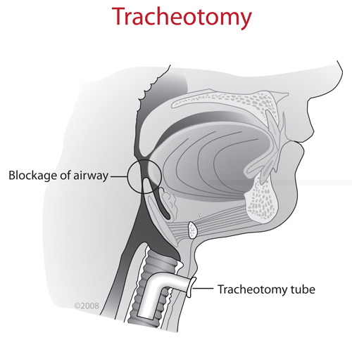
A

Slide 3
Incidence of nasal causes
Ongoing study of 54 cases of ENT co-morbid conditions in OSAS under Dr. Ajay George, Prof. & HoD, ENT & I/C Sleep clinic in collaboration with dept. of Pulmonology.
Group I: Patients with primary snoring or mild OSAS
(AHI < 15 events/hour)
Group II: With moderate to severe OSAS patients
(AHI > 15 events/hour).

Slide 4
VARIABLES ASSOCIATED WITH AHI (>15 events/hour) – Group II
VARIABLE | ODDS RATIO | p VALUE
NASAL PATHOLOGY (n=39) (DNS, BITH, POLYPI) | 4.429 | 0.04
MALLAMPATI SCORE | 0.294 | 0.03
ESS | 1.440 | 0.05
BERLIN’S QUESTIONNAIRE | 4.304 | 0.06
NECK CIRCUMFERENCE | 0.545 | 0.28

Slide 5
Why not conservative Mx.?
Patient compliance with regard to weight issues OR Bariatic surgery.
Severe OSA (medical contraindication).
Conclusively identifiable cause.
Compliance issues with CPAP.
(Mucosal irritation, Machine noise, Mask discomfort, Air leak causing sore eyes, Abdominal bloating, Claustrophobia.)

Slide 6
Perioperative issues
Medically Compromised patients
Post operative pulmonary edema
Complications of surgery per se.
Sub optimal surgical results.
PROPER PREOPERATIVE COUNSELLING.

Slide 7
SURGERIES
Tracheostomy
Nose
Palate & Pharynx
Tongue
Bone procedures
Maxillary advancement
Turbinoplasty
RFBOT
Lingual tonsillectomy
Lingual suspension
Lingualaplasty
Septoplasty
Mandibular advancement
Midline glossectomy
Adenoidectomy
Genioglossus advncement
Other procedures
UPPP
LAUP
Tonsillectomy
Hyoid suspension
Lat. pharyngoplasty
Implants
CAPSO

Slide 8
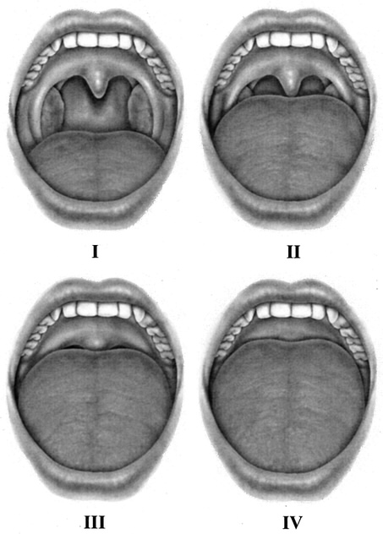
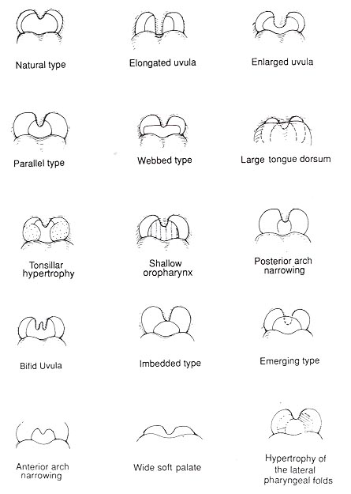

Slide 9
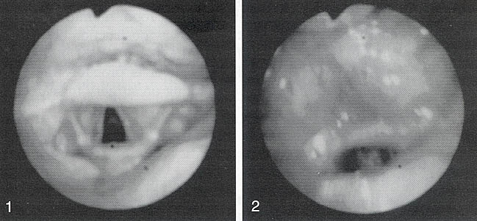
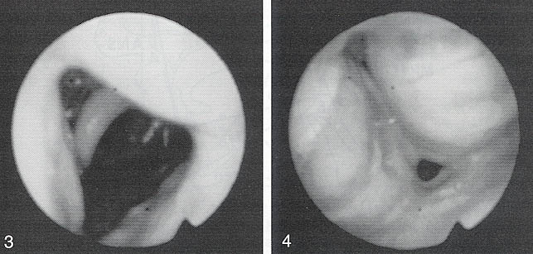
Muller Maneuver
BOT collapse
Hypo-pharynx collapse

Slide 10
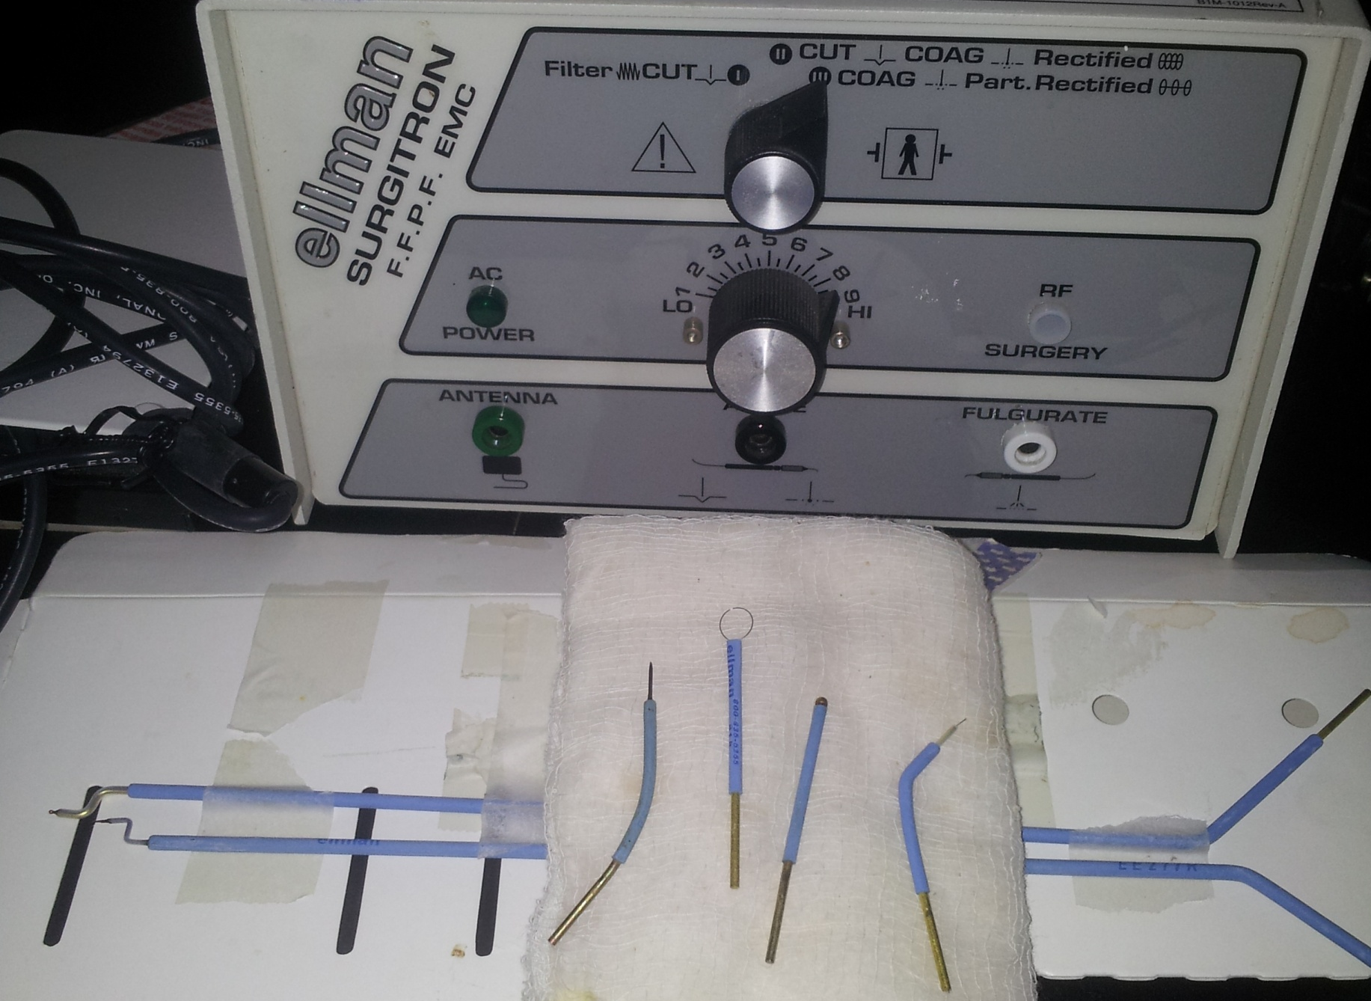
RADIO-FREQUENCY ABLATION

Slide 11
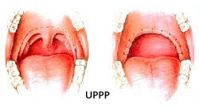
Palatal Reduction
Uvulopharyngopalatoplasty (UPPP)
Corrects oropharynx obstruction
Most common procedure
Trim excess palatal length and uvula
Often combined with tonsillectomy and/or lateral pharyngoplasty.
Success rate 40-50% (only 6% if macroglossia present)
Complication rate of 1.5% nonfatal, 0.2% fatal
* Success = RDI reduction of ≥50% or absolute drop of ≥20

Slide 12
Complications of Pharyngeal Procedures
Hemorrhage
Pain
Velopharyngeal insufficiency
Nasopharyngeal stenosis
Chronic pharyngitis

Slide 13
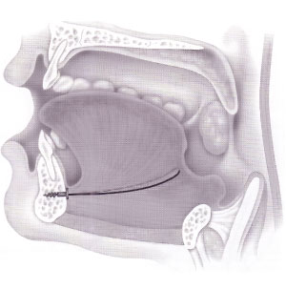
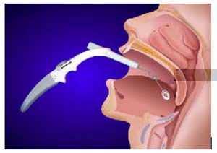
Tongue Base Suspension/Reduction
Suspension
Sutures attach to screw at inner mandible
Reduces tongue collapse
Variable success 20-82%
Reduction
Tissue reduction from heat generated by radiofrequency
Multiple office based treatments
Promising success rate 60-85%

Slide 14
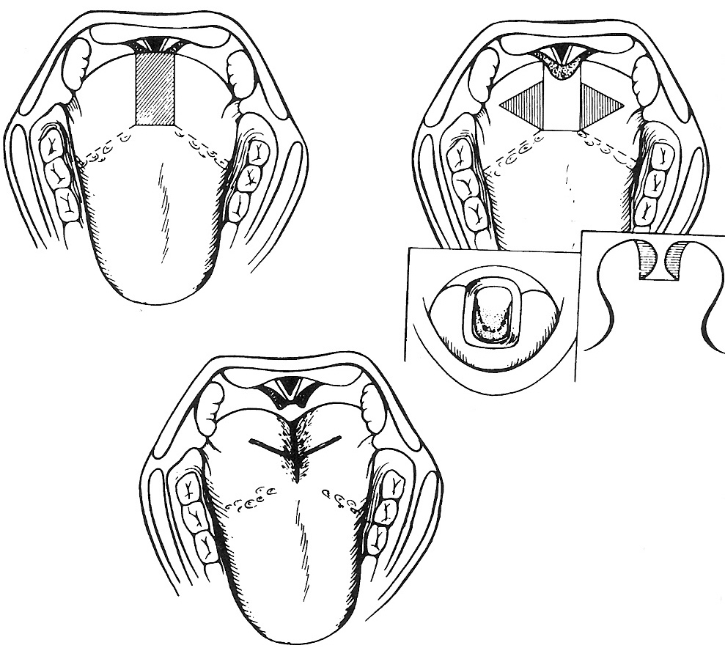
Surgical Management
  Lingualoplasty

Slide 15
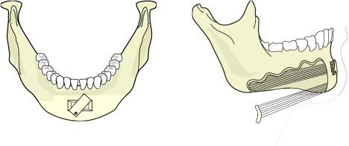
Genioglossus Advancement

Slide 16
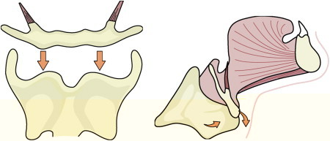
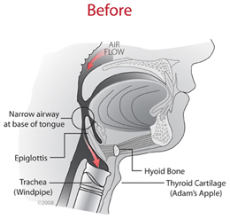
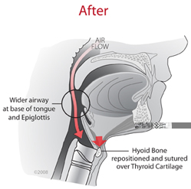
Hyoid Suspension

Slide 17
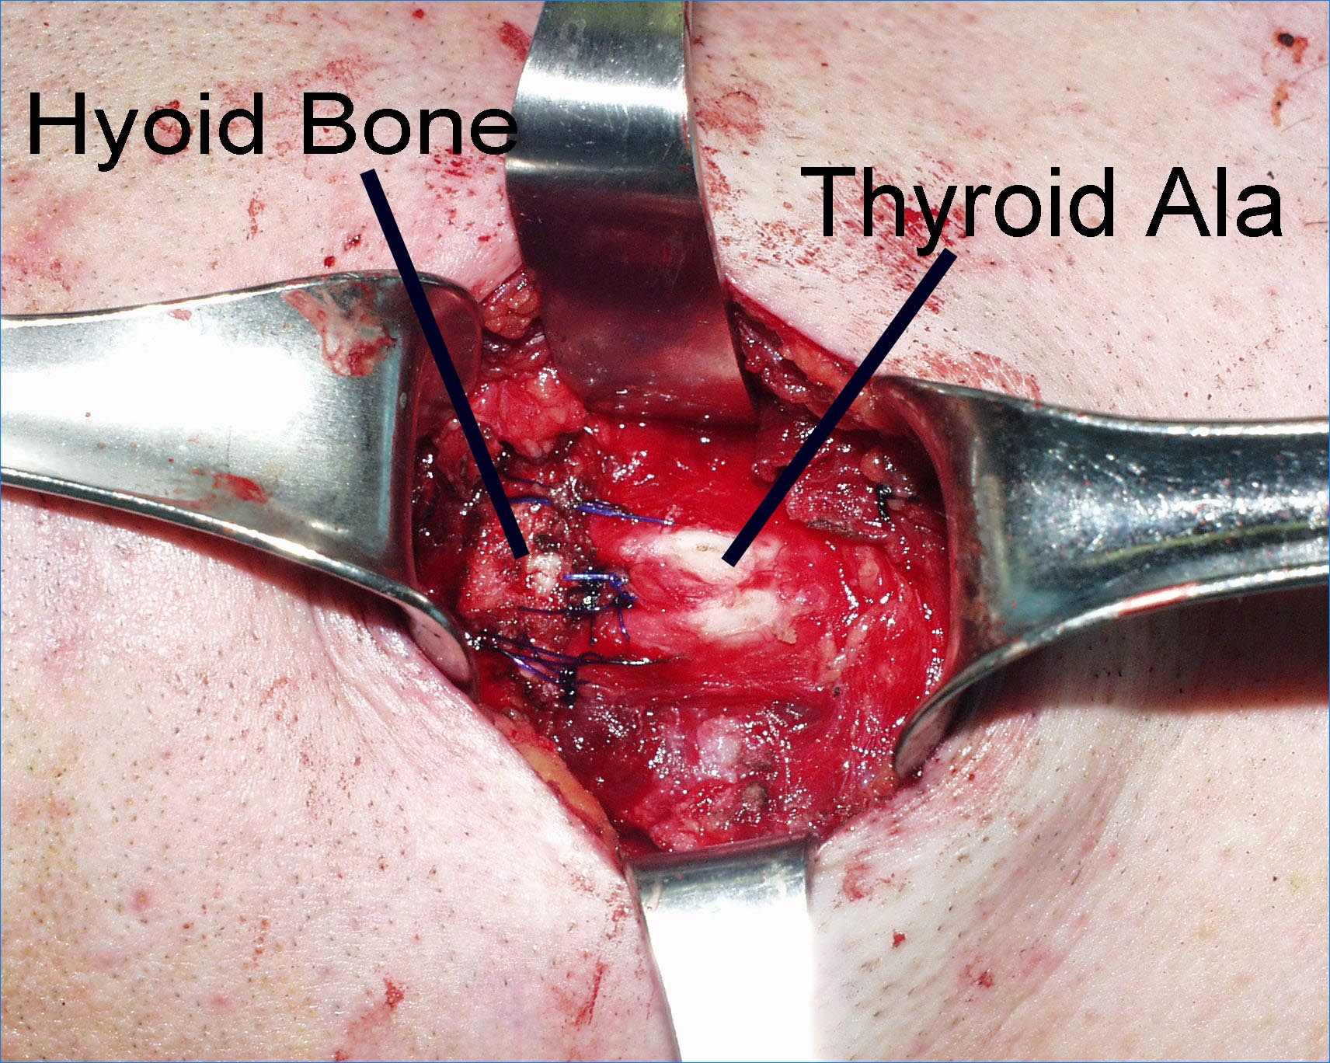
Hyoid Suspension

Slide 18
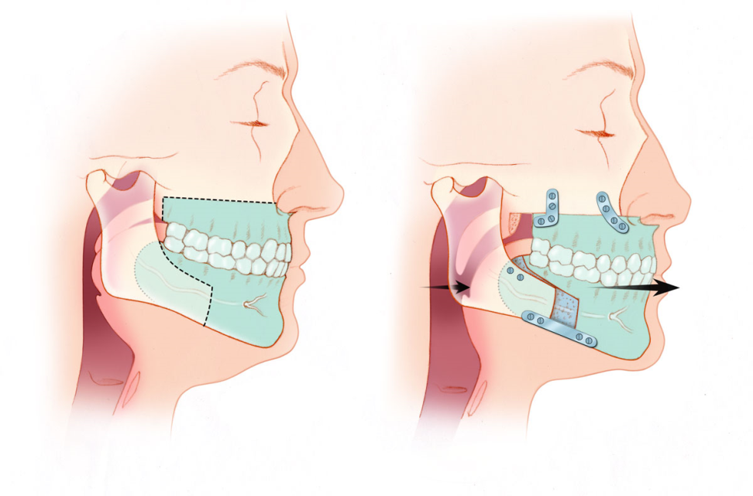
Mandibulomaxillary Advancement
Lefort I osteotomy
Bilateral ramus osteotomies
Anterior inferior mandibular osteotomy

Slide 19
Cephalometric analysis
(Lateral cephalogram)
Posterior airway space (< 5 mm)
Mandibular-hyoid distance (>24 mm)

Slide 20
MMA Complications
Malocclusion
Parasthesia (inferior alveolar, lingual or infraorbital)
Nonunion or malunion
Relapse of advancement
Significant bleeding
TMJ complaints
Sequalae – Alters facial appearance.

Slide 21
Stanford Protocol
To achieve goal of minimal surgical intervention while achieving cure:
Presurgical evaluation – PE with flexible scope, cephalometric analysis, sleep study
↓
Phase I surgery based on site of obstruction and severity of disease
↓
6 month postoperative sleep study
↓
Lack of success
↓
Phase II surgery - MMA

Slide 22
Recent advances
Pillar implant
Dental implant

Slide 23
There are many surgeries available that address obstruction at various sites within the upper airway.
Using a stepwise approach, multiple levels of the airway can be addressed
In appropriately selected patients, these procedures can cure OSA
These surgeries can reduce the severity of OSA, and make CPAP use more tolerable

