Slide 1
Chronic granulomatous conditions of nose

Slide 2
Levels of Evidence
Grade A – Systemic reviews, Meta analyses, RCT
Grade B – Non-randomised studies
Grade C – Observational studies
Grade D – Case Series, Expert opinion

Slide 3
Levels of Evidence
**** ~ Systematic reviews, meta analysis of randomized control studies
*** ~ Non randomised studies
** ~ Observational or non experimental studies
* ~ Expert opinion

Slide 4
Rhinoscleroma

Slide 5
Rhinoscleroma is a chronic granulomatous condition of the nose and other structures of the upper respiratory tract.
It is a result of infection by the bacterium Klebsiella rhinoscleromatis also known as Frisch bacillus.

Slide 6
Rhinoscleroma is contracted by means of the direct inhalation of droplets or contaminated material.
The disease probably begins in areas of epithelial transition such as the vestibule of the nose, the subglottic area of the larynx, or the area between the nasopharynx and oropharynx.

Slide 7
Rhinoscleroma usually affects the nasal cavity, but lesions may also affect the larynx; nasopharynx; oral cavity; paranasal sinuses; or soft tissues of the lips, nose, trachea, and bronchi.

Slide 8
Epidemiology
It is endemic to regions of Africa (Egypt, tropical areas), Southeast Asia, Mexico, Central and South America, and Central and Eastern Europe [**].
Rhinoscleroma tends to affect females somewhat more often than it does males.
Typically, rhinoscleroma appears in patients aged 10-30 years.

Slide 9
Clinical features
Atrophic stage:
Crusting & foul smelling
Granulomatous/proliferativr/nodular:
Disease may start as a single nodule or in groups in nasal cavity & do not suppurate or ulcerate
Cicatrization:
adhesions & stenosis distort normal anatomy
almost cartilage like hardness
malignant changes has been reported.[**]

Slide 10
Possible history findings
Nasal obstruction (most common complaint)
Rhinorrhea
Epistaxis
Dysphagia
Nasal deformity
Anaesthesia of the soft palate
Difficulty breathing that progresses to stridor
Dysphonia
Anosmia

Slide 11
Pathology
Mikulicz cell :
its transformed macrophage which is a large foam cell has central nucleus & a vacuolated cytoplasm containing bacilli.
Russel bodies:
its plasma cell with an eccentric nucleus & deep eosin staining cytoplasm

Slide 12
DD
Atrophic rhinitis
Tertiary syphilis
Lupus
Leprosy
Cancer

Slide 13
Treatment
Streptomycin
Tetracyclines
Chlorophenicol
2% acriflavin – 8 weeks
Steroids
  Locally
  Systemically
  Irradiation – 3000-3500Gy – 3weeks

Slide 14
Wegner’s Granulomatosis

Slide 15
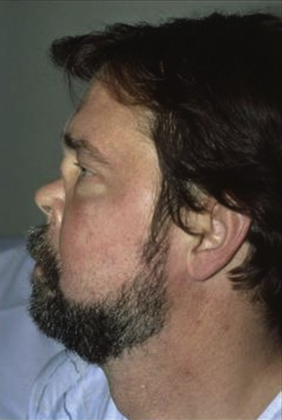
A condition characterized by granulomatous inflammation involving the respiratory tract; necrotizing vasculitis affecting small to medium sized vessels.
The pathological hallmark is the co-existence of vasculitis and granulomas and classically involves a triad of airway, lungs and renal disease.

Slide 16
Age and Sex
Significant number of patients below 25 years of age.
Younger patients present with a generalized form.

Slide 17
Aetiology
Aetiology remains unknown.
Its inflammatory nature and resemblance to polyarteritis nodosa suggests that it represents some form of hypersensitivity reaction.
It might be related to inhaled bacteria.

Slide 18
Clinical Features
Most patients start with minor ENT symptoms
  Variable degree of epistaxis
  Nasal Obstruction
  Bloody crusts
Destruction of intranasal structures including septum may follow leading eventually to nasal collapse.
Patients may complain of significant facial pain.

Slide 19
Clinical Features
Patients frequently complain of progressive malaise, pyrexia, weight loss and feel very unwell.
Nose and paranasal sinuses are involved in 80% patients.
Intranasal destruction of cartilage and bone leads to septal perforation.

Slide 20
Pulmonary symptoms
Cough
Haemoptysis
Pleuritic pain
Cavitation
Encapsulated lung abscess

Slide 21
Renal Symptoms
Between 30% to 90% patients develop renal symptoms.
Microscopic haematuria
Segmental or diffuse glomerulonephritis.

Slide 22
Ocular manifestations
Conjuctiviitis
Dacrocystitis
Corneal ulceration
Optic neuritis and retinal artery occlusion.
Blindness unilateral or bilateral

Slide 23
Otologic sympoms
Acute otitis media
Otitis media with effusion
Deafness
Otalgia
Both conductive and sensorineural hearing loss

Slide 24
Diagnosis
cANCA test is positive in 95% of patients.
A full blood count
ESR
Renal Profile
Urine analysis

Slide 25
Biopsy from septum or turbinates
Vasculitis
Granulomas of epithelial cell type
Multinucleated giant cells

Slide 26
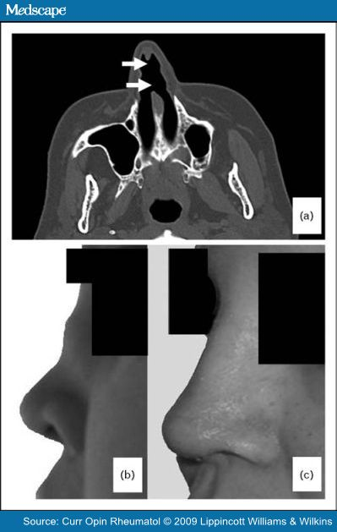
Mucosal thickening
Bone destruction
New bone formation

Slide 27
Treatment
Steroids and a variety of cytotoxic drugs improve short term prognosis by 90%.
Nasal symptoms managed by topical preparations.
Augmentation rhinoplasty

Slide 28
Tuberculosis

Slide 29
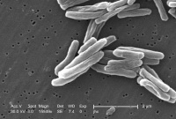
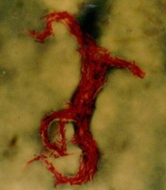

Slide 30
Mycobacterium tuberculosis
Atypical mycobacteria
Air borne or hematogenous spread or direct inoculation
Primary or secondary to pulmonary or milliary TB

Slide 31
CLINICAL FEATURES
FORMS
Nodular
Sinus Granuloma
Ulcerative

Slide 32
LUPUS VULGARIS (nodular form)
 Most common
 It is a post primary form of tuberculosis
 Arises in individuals with moderate type of immunity
 Infection arises from direct inoculation into dermis
It begins in vestibule
 Extends to adjoining skin and mucosa
 Presents as solitary, soft ,tiny, reddish brown gelatinous plaque known as apple jelly nodules.

Slide 33
  Blanching maneuvers make them more prominent.
 Usually painless
Nodules may coalesce and breakdown to form characteristic ulcers.
 It follows a chronic course and can lead to scarring, contractures and tissues destruction

Slide 34
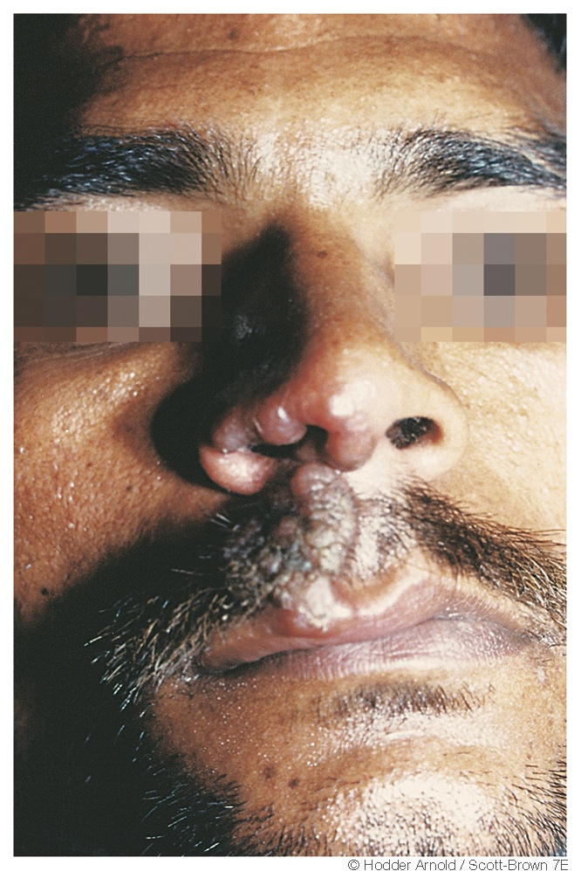
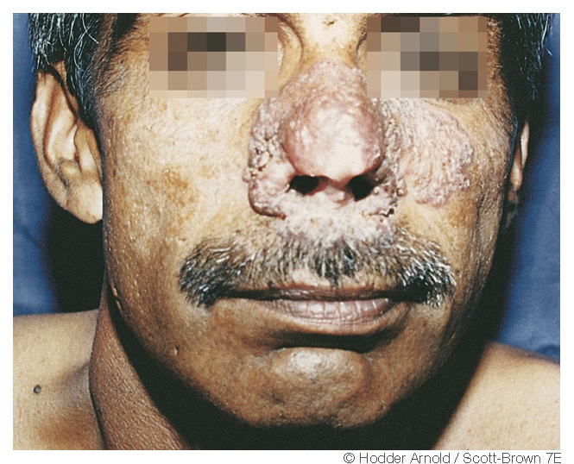
LUPUS VULGARIS

Slide 35
ULCERATIVE FORM
 It involves cartilagenous part of nasal septum or inferior turbinate.
 Unilateral or bilateral
 Presents with nasal obstruction, crusting, discharge and epistaxis.
 Progress to septal perforation(cartilegenous part).
Bony septum is not involved.
Clinically, confused with malignancy & wegener granulomatosis. [**]

Slide 36
SINUS GRANULOMA
 Involves paranasal sinuses
 Presents with diffuse soft tissue swelling
and multiple discharging sinuses
 CT and MRI show soft tissue mass.
 Diagnosis - external or endoscopic biopsy. [**]
 Treatment is anti tubercular therapy.

Slide 37
INVESTIGATIONS
 Biopsy of edge/ nodules around non healing ulcer.
Microbiological diagnosis
BACTEC ^{(1) [***/**]}
Manteaux Test
Chest x-ray [***]
TREATMENT
 ATT
 Surgical : silastic buttons
skin grafting

Slide 38
LEPROSY
Hansen disease
Goal of WHO: to reduce rate of new cases with grade 2 disability by 35%.

Slide 39
pathophysiology
Tuberculoid
Lapromatous

Slide 40
Clinical Feauters
Tuberculoid:
solitary lesions causing anesthetic cutaneous patches with nerve involvement with muscle paralysis
isolated CN (V & VII) paralysis
no mucosal involvement
may involve skin of vestibule
Lepromatous:
diffuse infiltration of skin, nerve & mucosal surfaces
Nasal obstruction, Crust formation,Blood stained discharge, Hyposmia ⁽²⁾
      Atrophic Rhinitis
      Septal perforation
      Saddle nose

Slide 41
Diagnosis
On clinical finding of anaesthesia of skin, thickened peripheral nerves & skin lesion (hypopigmented or reddish)
Bacteriological examination
Nasal smear
Biopsy (nasal mucosa/skin)

Slide 42
Treatment
Type | Daily, Self administered | Monthly Supervised | Months
Paucibacillary | Dapsone 100mg | Rifampicin 600mg | 6-12
Multibacillary | Dapsone 100mg, Clofazimine 50mg | Rifampicin 600mg, Clofazimine 300mg | 24

Slide 43
NAME OF STUDY | NAME OF AUTHOR | REFERENCE DETAILS | SAMPLE SIZE | RESULT | P VALUE | CONCLUSION
Nasal mucosa study of leprosy contacts with positive serology for the phenolic glycolipid 1 antigen | Martins AC¹, Miranda A, Oliveira ML, Bührer-Sékula S, Martinez A. | Braz J Otorhinolaryngol. 2010 Sep-Oct;76(5):579-87.. | 31 | Between seropositive contacts, real-time PCR was positive for M. leprae DNA in 06 (19.35%) of them and the higher number of genome copies were found in contacts who became sick. | <0.05 | Through the combination of various methods, tests on the contacts can help identify subclinical infection and monitor the contacts that could be responsible for spreading the disease

Slide 44
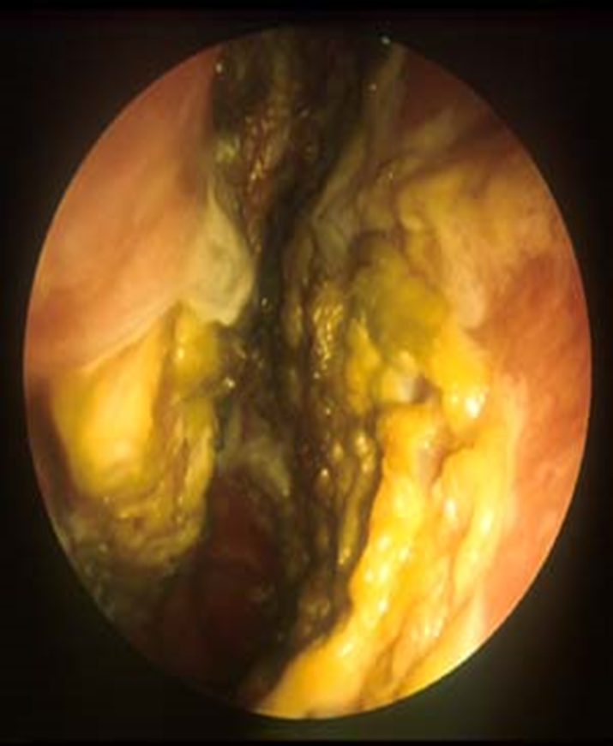
ATROPHIC RHINITIS
It is a chronic inflammation of nose characterized by atrophy of nasal mucosa and turbinate bones
The nasal cavities are roomy and full of foul smelling crusts

Slide 45
Microbiology
Klebsiella ozenae
  May be found in almost 100% of primary AR
  No predominance in secondary AR
Staphylococcus aureus
Proteus mirabilis
Escherichia coli
Corynebacterium diphtheriae

Slide 46
Atrophic rhinitis
primary
secondary

Slide 47
PRIMARY
Aetiology:
Hereditary factors
Endocrinal disturbance
Racial factors
Nutritional deficiencies
Infective

Slide 48
Secondary AR:
  Complication of sinus surgery
  Complication of radiation
  Following nasal trauma
  Sequela of granulomatous diseases and other infections : TB, Sarcoidosis, Leprosy, Rhinoscleroma, Syphilis

Slide 49
PATHOLOGY
Ciliated columnar epithelium is lost and is replaced by stratified squamous type
There is atrophy of seromucinous glands, venous blood sinusoids and nerve elements
Arteries in the mucosa, periostium and bones show obliterative endarteritis
The bone of turbinates under goes resorption causing widening of nasal chamber

Slide 50
CLINICAL FEATURES
  Anosmia
  Ozena, i.e. foul odor
  Extensive nasal crusting
  Subjective nasal congestion
  Enlargement of the nasal cavity
  Resorption or absence of turbinates
  Squamous metaplasia of nasal mucosa
  Depression

Slide 51
Current Therapies
Goals of therapy
  Restore nasal hydration
  Minimize crusting and debris
Therapy options
  Topical therapy (glucose in glycirine, alkaline douching, lid. paraffin)
  Saline irrigations
  Antibiotic irrigations
  Systemic antibiotics
  Implants to fill nasal volume
  Closure of the nostrils(young /modified young)

Slide 52
NAME OF STUDY | NAME OF AUTHOR | REFERENCE DETAILS | SAMPLE SIZE | RESULT | CONCLUSION
Modification of modified young's operation in the management of primary atrophic rhinitis | Sangeet. JagaKumar Poddar, M.V jagade | Indian Journal qf' Otolarygology and Head and Neck Surgery Vol. 53 No. 3, July - September 2001 | 30 | a.complete recovery 50% b.Partial recovery 40% c.No recovery 10% | procedure is advantageous over the pre-existing surgical procedures as - a. Breathing difficulty to the patient is minimized. b. Regular examination and cleaning of the nasal cavity can be done even postoperatively. c. This procedure can be done on both nostrils simultaneously. d. It is a technically easier procedure compared to the pre-existing techniques

Slide 53
Rhinitis sicca
Mild form of atrophic rhinitis.
Seen in hot, dry, dusty places (bakers, goldsmiths)
Crusting present only anteriorly
Bone atrophy and foetor are absent.
t/t : nasal douching and changing surrounding

Slide 54
Syphilis

Slide 55
Any age, neonate to old age
Caused by spirochetes, Treponema pallidum
STD & moderate risk of transmission with infected partner. [****/***]
Organism resides in perivascular lymphatics of the blood vessels wall & leads to endarteritis.

Slide 56
Clinical features
Primary syphilis:
Sore/chancre (10-19 days) & LNpathy
Lesion may spontaneously disappear in 6 wks
Secondary syphilis:
Most infectious stage, 6-10 wks after inoculation
Catarrhal rhinitis, crusting & fissuring of the vestibule [**]
Tertiary syphilis:
2 years after inoculation, commonly involve bony portion of septum
Pathological lesion is GUMMA, which begin with subcuteneous nodule, involve overlying skin & break down to punched out destructive ulcer

Slide 57
Invetsigations
VDRL
TPHA
FTA-ABS
Treatment:
Parenteral penicillin

Slide 58
references
Williams RG, Jones TD. Mycobacterium marches back. Journal of laryngology and Otology.1995;109:5-13.
Barton RPE. Ear nose and Throat involvement in leprosy. In: Hastings RC. Leprosy. Edinburgh: Churchill Livingstone,1985:243-52.
WHO expert committee on leprosy. Seventh Report, WHO, Technical report series no.874,1998;24.
Sangeet Kumar Poddar ~, M.V. Jagade.modification of modified young's operation in the management of primary atrophic rhinitis , Indian Journal q[' Otolarygology and Head and Neck Surgery Vol. 53 No. 3, July - September 2001

Slide 59
MCQ

Slide 60
Q-1Drugs used to treat Leprosy are all except
Dapsone
Isoniazide
Rifampicin
Clofazimine

Slide 61
2. Apple jelly nodule is seen in ________.
Tuberculosis
Leprosy
Rhinoscleroma
Syphilis

Slide 62
3. Miculicz cell is seen in ________.
Tuberculosis
Leprosy
Rhinoscleroma
Syphilis

Slide 63
Klebsiella ozenae
Staphylococcus aureus
C. Escherichia coli
D. Klebsiella rhinosceromatis
4. Frisch bacilli is __________.

Slide 64
5. Bony cartilage is most commonly involved in ________.
Tuberculosis
Leprosy
Rhinoscleroma
Syphilis

Slide 65
B
A
C
D
D

