Slide 1
EMOTION
Dr. Lakhan Kataria
Professor and Head
Department of Psychiatry

Slide 2
Emotion is a complex feeling state with psychic, somatic, and behavioural components. It is a stirred-up state caused by physiological changes occurring as a response to some event and which tends to maintain or abolish the causative event.
Feeling can be defined as a positive or negative reaction to some experience or event and is the subjective or experiential aspect of emotion.
Mood is a pervasive and sustained feeling tone that is experienced internally and that, in the extreme, can markedly influence virtually all aspects of a person's behaviour and perception of the world. Descriptions of mood should include intensity, duration and fluctuations, as well as adjectival descriptions of the type.
Affect is the subjective and immediate experience of emotion attached to ideas or mental representations of objects. Affect has outward manifestations that may be classified as restricted, blunted, flattened, broad, labile, appropriate, or inappropriate. It is what the doctor infers from the patient’s body language including facial expression and it may or may not be congruent with mood.

Slide 3
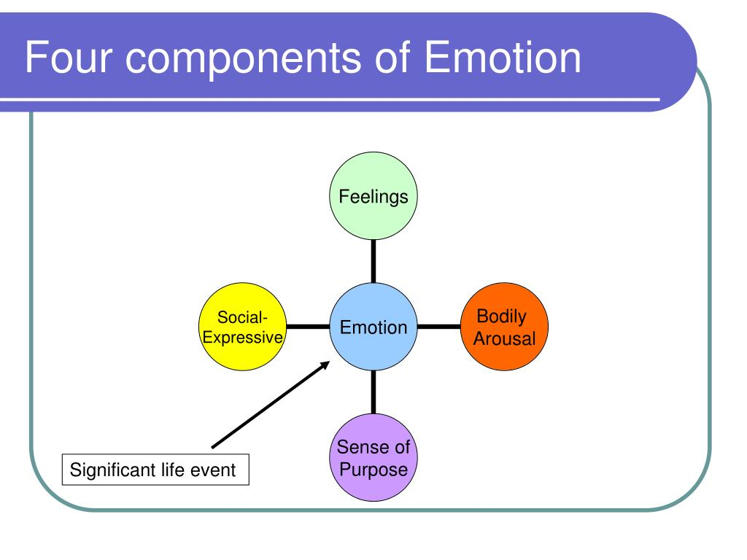
Components of Emotion

Slide 4
Feeling Component
Emotions are a subjective feeling.
Makes us feel in a particular way.
Meaning and personal significance.
Varies in intensity and quality.
Rooted in mental processing (Labeling).

Slide 5
Bodily Arousal
Biological activation.
Autonomic and hormonal systems.
Prepare and activate adaptive coping behaviour during emotion.
Body prepared for action.
Alert posture, clenched fists.

Slide 6
Purposive Component
Give emotion its goal-directed force.
Motivation to take action.
Cope with emotion-causing circumstances.
Why people benefit from emotions.
Social and evolutionary advantage.

Slide 7
Social - Expressive Component
Emotion’s communicative aspect.
Postures, gestures, vocalizations, facial expressions make our emotions public.
Verbal and nonverbal communication.
Helps us interpret the situation.
How person reacts to event.

Slide 8
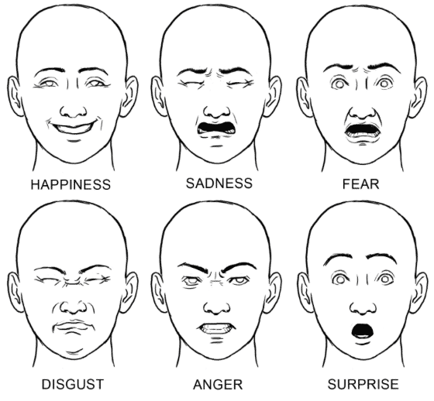
Basic Emotions
Ekman and colleagues (Ekman and Friesen, 1971) have shown that there are six basic emotions that are expressed:
anger
disgust
fear
happiness
sadness
surprise

Slide 9
Variety of Emotions
Positive Emotions - The emotions that lead one to feel good about one’s self which will lead to an emotionally happy individual.
Joy/Euphoria/Happiness
Confidence
Peace
Desire
Pride
Hope
Empathy
Gratitude
Negative Emotions – They decrease your energy and undermine your effectiveness. In negative emotional state, you find the lack of desire to do anything.
Sadness/Depression
Doubt
Jealousy
Frustration
Shame
Fear
Grief
Guilt

Slide 10
Factors Affecting Emotions
Personality- Personality features are associated with individual differences in daily emotional life, such as negative and positive affect, affect variability and affect reactivity.
Culture – Culture provides structure, guidelines, expectations and rules to help people understand and interpret behaviours.
Weather – Higher temperatures raise a person with low mood up, while wind or not enough sun made a low person feel even lower. Eg Seasonal affective disorder.
Stress – It can negatively affect patients with BMD-1. It involves dramatic shifts in mood and energy level.

Slide 11
Age - Older adults have more emotional stability than the younger ones and focus more on the good than the bad. When they experience a negative emotion, they recover more quickly.
Gender – Women are more emotional than men, although it depends on the emotional development at childhood as how to express emotions.
Environment – Our environment has an affect on how we feel. Living in a tidy and clean room, wearing a clean dress, enjoying natural beauty, makes emotional changes in human.

Slide 12
Marital Status – It explains life style challenges, accepting different preferences, sexual life etc
Organizational – Work load, Colleagues, Job satisfaction also play an important role.
Social – Traditions, Religion, Culture and Norms play a vital role.

Slide 13
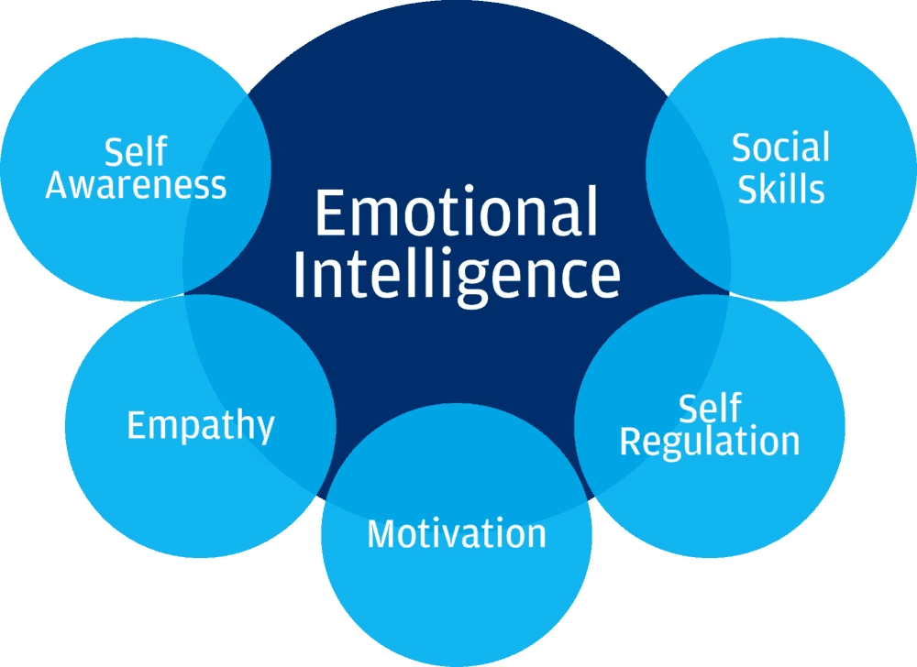
Emotional Intelligence
Emotional intelligence (otherwise known as emotional quotient or EQ) is the ability to understand, use, and manage your own emotions in positive ways to relieve stress, communicate effectively, empathize with others, overcome challenges and defuse conflict.

Slide 14
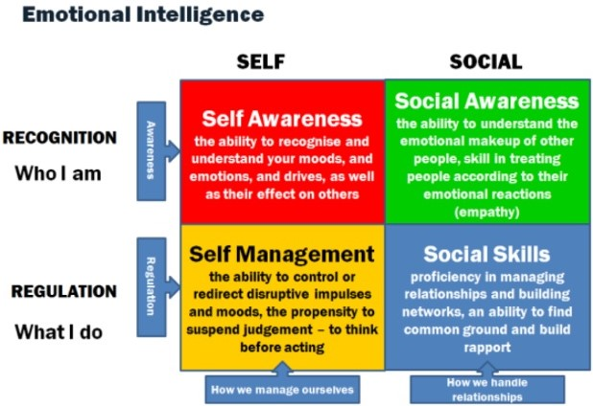

Slide 15
Expression and Perception of Emotion
When we perceive the emotional responses of other people, we respond in appropriate ways, with an emotional expression of our own. We also form our ideas of their personality based on their emotional expression.
The voice is one channel of emotional expression and so what is said and the way in which it is said are major factors in perception of emotion, non verbal bodily cues (also known as body language)are also used to interpret emotions. It consists of gestures, eye movements, head movements, shifts in posture, and movements of the arms, hands and legs.

Slide 16
Amongst these, one of the most important cue is facial expressions.
Charles Darwin said that there is an innate or inborn basis for the facial expression of certain emotions.
Although face is the most expressive part of our body, it is also the most easily controlled when trying to deceive someone. Not so easy to control are gestures of the hands, feet and legs.
Context- the situation in which an emotion occurs - gives us information for judging what emotion is being expressed. Of course, people are most accurate in their judgements when the facial expression and the context are both present and convey complementary information.
Learning plays a large role in expression of more subtle emotions like awe or jealousy. A factor complicating the perception of emotion is that a person often expresses several emotions at one time and this blend is hard to judge.

Slide 17
Physiology of Emotion
The bodily changes in emotion are produced by the activity of the Autonomic Nervous System which consists of 2 parts –
Sympathetic - releases E and NE and increases HR, BP, Blood Sugar and is active during the aroused states and during strong emotions like fear and anger. (Flight or fight response/Emergency Reaction)
Parasympathetic – decreases HR, BP and diverts blood to GIT and is active when we are calm and relaxed. (Relaxation response)
The bodily activity in emotion is a blend of both sympathetic and parasympathetic systems along with the somatic parts of the peripheral nervous system and hormonal system. Eg. In anger, HR and GI activity both increases.

Slide 18
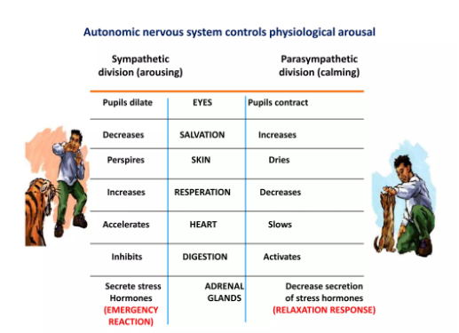
Autonomic Nervous System

Slide 19
Patterns of Bodily Response in Emotion
It seems that different bodily response patterns may be present in a number of emotions and that these patterns are related to the facial expressions of emotions.
A study was done in which actors were asked to mimic the innate facial expressions characteristic of basic emotions and hold for 10sec during which HR, skin temp of hands, skin resistance and forearm muscle tension was measured. High - Anger
High Skin Temp
Heart Rate Low- Fear, Sadness
Low – Happiness, Disgust
Surprise

Slide 20
The experiments indicated that –
Specific emotions can result in specific bodily changes.
Facial Muscle movements are closely related to the body’s internal adaptive response in emotion.
Thus, the outward and the inward manifestations of emotional states go hand in hand.

Slide 21
Arousal
The degree of arousal is an important part of emotionality.
The EEG is a record of changing electrical activity of millions of nerve cells, all functioning at the same time. The waves of EEG are very small voltage changes. The number of alternations of voltage aka frequency of electrical changes varies from 1-2 alternations/sec in deep sleep to > 50 in highly aroused states.
When a person is aroused or excited, the EEG consists of high frequency low voltage waves and as person becomes more relaxed, the frequency of the EEG decreases while the amplitude increases.
Another indicator of arousal in both humans and lower animals is the Orienting Reaction – an organism’s orientation to a new stimulus or to a stimulus change. It consists of tensing muscles and changing the position of the body and the head. The exact nature depends on the stimulus, the species, its age, its present state of arousal and other factors.

Slide 22
To make finer distinctions among degrees of arousal, HR, BP, breathing rate and depth, pupil size and skin conductance are also used.
If a small amount of electricity (so small that it cannot be felt) is passed across an area of skin, the resistance to the flow decreases (conductance increases) as a person becomes more aroused and alert. This is called the Galvanic Skin Response (GSR).
HR, BP, Breathing patterns and GSR are used in lie detector tests (polygraphs). Control Question Technique is often used in which neutral and general questions designed to evoke an emotional response from almost everyone and specific questions designed to evoke responses only from those with guilty knowledge are used. The false positive problem and the questionable validity of polygraphs has been recognised by courts.
In addition to their use in trying to discover guilt, polygraphs can also be used by the police in an attempt to force confessions from suspects. Business and government agencies use lie-detector tests to screen applicants for employment.
Notes:
An innocent person who knows nothing of the details of the crime should give larger response to control questions where as the suspect with the guilty knowledge will also give a larger response to specific questions id addition to the general questions.
For employment, the poly graph is not used to assess the truthfulness of responses as to provide an occasion to trap applicants into making admissions of past activities which might cast doubt on their suitabilty for employment.

Slide 23
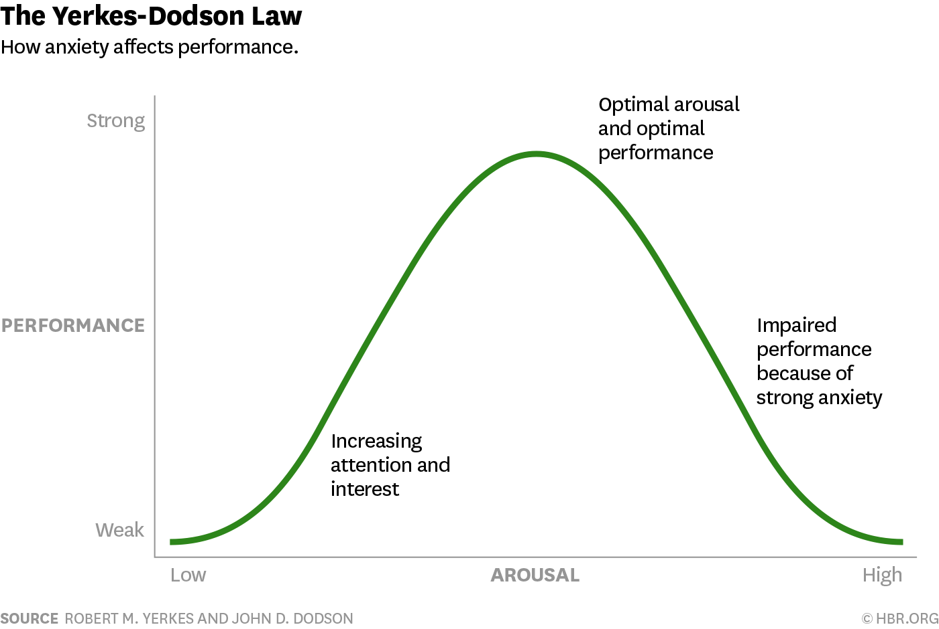
Arousal and Performance
Since arousal energizes behaviour, we think that more aroused a person, the better will be their performance for all tasks. However in complicated tasks, very intense arousal may impair performance.
Performance is an inverted U shaped function of level of arousal when cues must be discriminated.
Highly aroused or anxious people are not so likely to perform well on complex tasks as are people with lower level of arousal that is more nearly optimum.
Yerkes – Dodson Curve

Slide 24
Stress
Stress is an internal state which can be caused by physical demands of the body or by environmental and social situations which are evaluated as potentially harmful, uncontrollable or exceeding our resources for coping.
The physical, environmental and social causes of the stress state are termed stressors.
On one hand, stress can result in a number of physical, bodily responses while on the other it can cause psychological responses such as anxiety, hopelessness, depression, irritability and a general feeling of not being able to cope with the world.
Stress is often a factor in heart disease and cancer – 2 of the leading causes of death. Stress is also involved in much of our unhappiness, irritability and dissatisfaction.

Slide 25
Stressors
Any change in the environment, even a pleasant one demands some coping and a little stress is useful in helping us adapt. But beyond a point, stress becomes distress and some distressful events are injuries or infections of the body, annoying or dangerous events in our environment, major changes or transitions in life and anticipated or actual threats to our self-esteem.
Changes in one’s life are important stressors and can be measured in Life Change Units with the help of The Holmes- Rahe Life Stress Inventory (The Social Readjustment Rating Scale). By adding the life change units in a year, a life crisis score can be obtained.
Mild – 150-199 life change units
Moderate – 200-299 life change units
Severe - ≥ 300 life change units

Slide 26
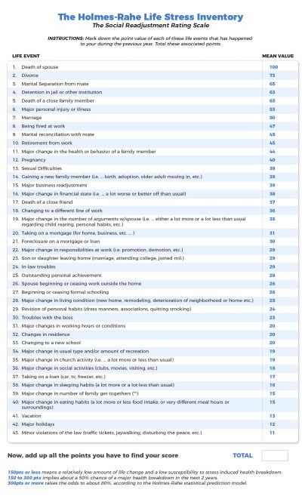

Slide 27
Stress Cycles
Stress has a number of immediate effects and, if the stressors are maintained, long-term behavioural, physiological, emotional, and cognitive (thinking) effects occur. If these effects hinder adaptation to the environment or create discomfort and distress, they themselves become stressors. (Distress Cycle)
Many people have developed ways of coping with stressors so that they are able to respond adaptively. (Wellness Cycle)
Teaching people adaptive ways of handling stress so as to promote the wellness cycle is an important part of the newly emerging field of behavioural sciences.

Slide 28
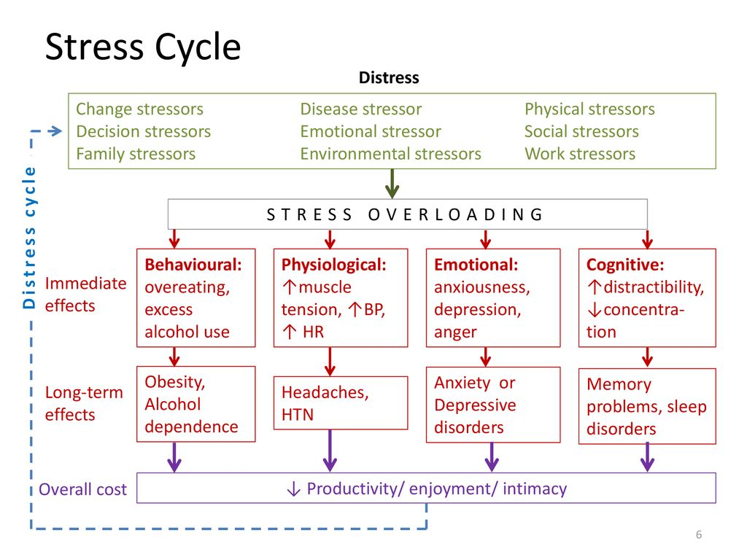
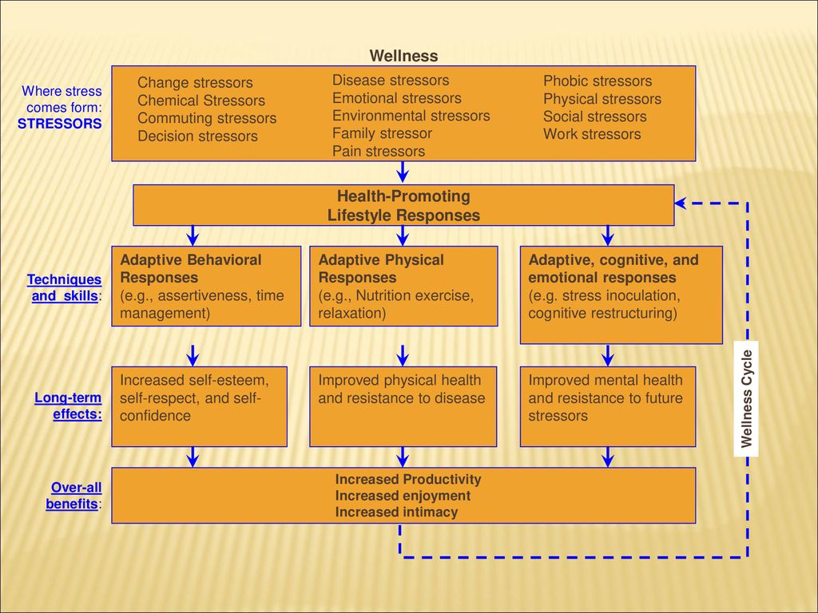
Distress Cycle Wellness Cycle

Slide 29
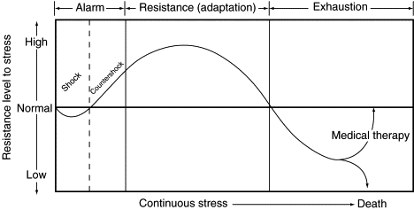
Effect of Stressors on the body
Hans Selye (1956,1976) termed the body’s response to stressors as the General Adaptation Syndrome which comprises of 3 stages –
Alarm Reaction
Stage of Resistance
Stage of Exhaustion

Slide 30
ALARM REACTION – It is essentially the emergency response of the body mediated by the sympathetic nervous system which will prepare us to cope with the stressor here and now.
STAGE OF RESISTANCE – If stressor continues to be present, this stage begins wherein the body resists the effects of the continuous stressor. However, resistance to new stressor is impaired. During this stage , certain hormonal responses of the body are an important line of defence in resisting the effect of the stressor – ACTH axis.
Perception of stressor
Corticotrophin releasing factor flows from hypothalamus to pituitary
Anterior Pituitary Gland from where ACTH is released
Signals sent from various parts of the brain to activate hypothalamus
ACTH reaches Adrenal Cortex and Cortisol and other hormones are released
Hormones allow the body to deal adaptively with stressors
Notes:
Adrenal medulla is stimulated during Alarm reaction to stimulate E and NE release.
Maintained high levels of cortisol and other hormones can be harmful – eg cortisol leads to formation of glucose by breaking down fats and proteins. In short run, it is adaptive but in the long run it can become serious as proteins are needed in the manufacturing of new cells (WBC’s) and it inhibits the formation of antibodies. Prolonged cortisol elevation can also lead to increased BP.

Slide 31
STAGE OF EXHAUSTION – In this stage, the body’s capacity to respond to both continuous and new stressor has been seriously compromised. For eg, due to actions of cortisol, a person can longer ward off infections and may also become sick and perhaps die.
Or due to other stressor-induced hormonal effects, stomach ulcers, diabetes, skin disorders, asthma, high BP, increased susceptibility to cancer may occur later in this stage,
The term Psychosomatic (mind-body) disorders is used when perceived stressors/mental events increase the susceptibility of the body to disease.

Slide 32
Coping with Stressors
The methods to cope with stress are –
Relaxation techniques
Hypnosis
Biofeedback
Systematic desensitization
The impact of a stressor can sometimes be reduced if a person has control over the stressor.
Notes:
Rat experiment with electric shocks and stomach ulcers

Slide 33
More successful copers have the following characteristics –
A) They seek information about how to deal with the problem and what their alternatives are.
B) They are prone to take direct action in trying to reduce stressor impact.
C) They are flexible in trying to cope, first trying one thing and then another.
D) They try not to deal with stressor through impulsive actions.
E) They use cognitive, or thinking, mechanisms such as reappraisal of the situation to deal with the stressor.

Slide 34
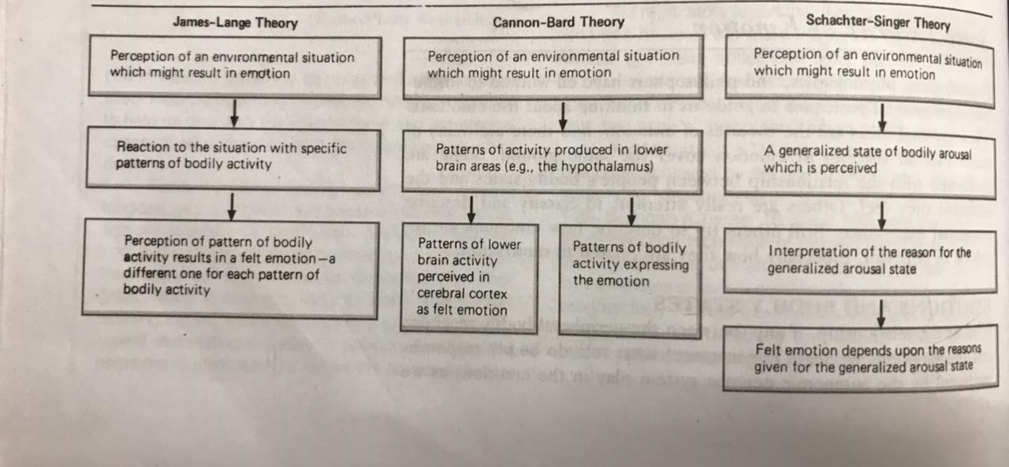
Theories of Emotion

Slide 35
James – Lange Theory : Felt Emotion is the Perception of Bodily Changes
For this theory to work, there must be a different set of internal and external bodily changes for each emotion, and the individual must be able to perceive them.
Cannon – Bard Theory : Felt Emotion and Bodily responses are independent events and both are triggered simultaneously.
in the sense that bodily reactions are not the basis of the felt emotion.
Schachter – Singer Theory : The Interpretation of Bodily Arousal
This states that the emotion we feel is due to our interpretation of an aroused or stirred up bodily state. They stated that the bodily state of emotional arousal is much the same for most of the emotions we feel and that even if there are physiological differences in the body’s patterns of responses, people cannot perceive them. Given a state of arousal, we experience the emotion that seems appropriate to the situation in which we find ourselves.

Slide 36
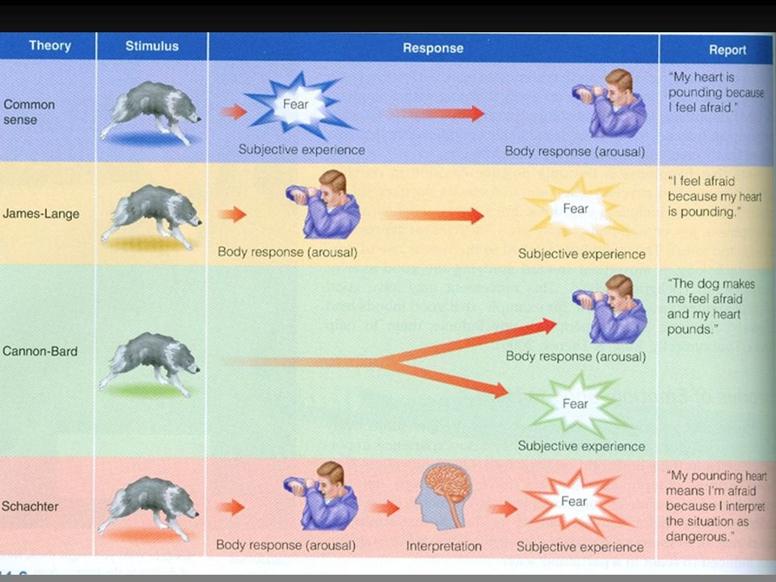
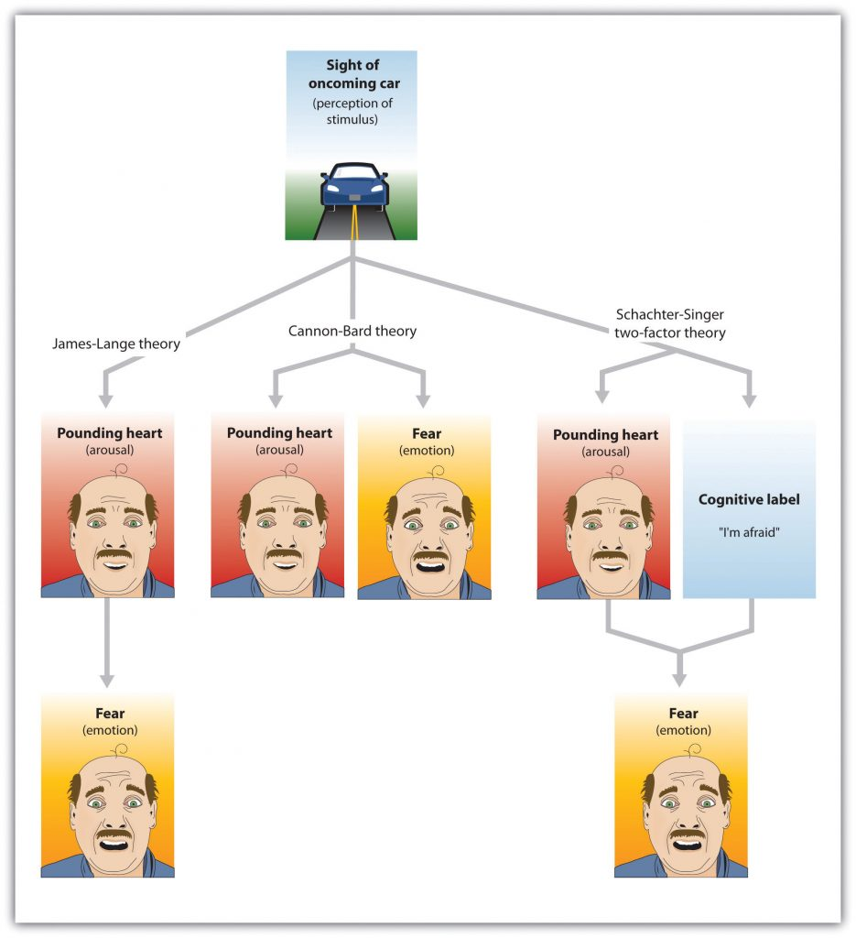

Slide 37
Subjects were given an injection of epinephrine (adrenalin), but told that it contained "Suproxin" --a fictitious vitamin which produced an aroused physiological state. Subjects in some groups were accurately informed that the injection would, result in a state of physiological arousal who attributed their feelings of arousal to the injection itself. When put in a situation designed to be a happy one, ignorant subjects indicated more happiness (euphoria) than did informed subjects. And ignorant subjects tended to feel angrier in an anger-arousing situation than did informed subjects. Thus, consistent with the theory, different emotions-euphoria or anger-were experienced with the same state of physiological arousal.
In experiments in which bodily arousal has been induced in other ways – for eg by physical exercise, results consistent with the Schachter-Singer theory have been obtained (Cantor et al., 1975 ). For example, one recent experiment found that aroused subjects who were ignorant, or uninformed, about the cause of their arousal- reported the aroused state as unpleasant even when they were in a "happiness-producing" situation (Maslach, 1979). In another experiment, subjects who were aroused with epinephrine but misinformed about the effects of the drug did not differ in their emotions from control subjects when placed in a "happy" situation.
Notes:
Subjects were given an injection of epinephrine (adrenalin), but told that the injection contained "Suproxin" --a fictitious vitamin which produced an aroused physiological state. Subjects in some groups were accurately informed that the injection would ,result in a state of physiological arousal who were expected to attribute their feelings of arousal to the injection itself. To a degree, the results were consistent with the experimenters' expectations. When put in a situation designed to be a happy one, ignorant subjects indicated more happiness (euphoria) than did informed subjects. And ignorant subjects tended to feel angrier in an anger-arousing situation than did informed subjects. Thus, consistent with the theory, different emotions-euphoria or anger-were experienced with the same state of physiological arousal.

Slide 38
A Cognitive Appraisal Theory of Emotion
The Schachter-Singer theory is often called a cognitive theory because it involves thoughts about the cause of the perceived state of arousal.
Another theory was given by Richard Lazarus and colleagues and this theory emphasizes the appraisal of information from several sources.
Since appraisal involves cognition, or the processing of information from the environment, the body, and memory, this theory is a cognitive one. The theory says that the emotions we feel result from appraisals, or evaluations, of information coming from the environmental situation and from within the body. In addition, memories of past encounters with similar situations, dispositions to respond in certain ways, and consideration of the consequences of actions that might result from the emotional state enter into the appraisal. The outcome of the complex appraisal of all this information is the emotion as it is felt.
Notes:
Relationship between felt emotion and appraisal of environmental situation. Emotion producing movie showing circumcision rites of Australian aborigines. One group was given a trauma track, another a denial track, another intellectual sound track and last grouphad no sound track. It was found that stress reactions (HR and GSR) was max in trauma f/b silent and lowest in denial and intellectual tracks.

Slide 39
Reappraisal of potentially emotion-producing situations is an important part of this cognitive theory. Reappraisal is also a way of coping with stressful situations.
People who reappraise emotion producing situations with denial, intellectualization, reaction formation or other normal defence mechanisms may find that they are able to reduce the intensity of the disturbing emotional feelings which accompany stressful situations.

Slide 40
Modal Model of Emotion
This model is a modification of the Lazarus theory which has 3 elements –
emotions arise when an individual attends to a situation and sees it relevant to their goals
emotions result in changes in subjective experience, behaviour and central and peripheral physiology
a response that may be modulated.

Slide 41
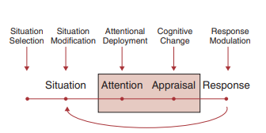
Five families of processes regulate emotions.

Slide 42
Bioinformational Approach
Given by Lang.
Emotion involves processing and accessing information stored in memory. Information on both the stimulus and the response is stored in memory.
This information is then interpreted on the basis of the significance of the event, allowing expression of the appropriate emotion in intensity consistent with the stimulus.

Slide 43
Dimensional Models
Dimensional models describe emotions in only two or three bidirectional dimensions, such as Eysenck’s (1967) two-factor model. One axis is called introversion–extroversion, and the other neuroticism–stability.
In Eysenck’s biological theory, emotions are associated with an individual’s level of arousal that is set either too high or too low by the RAS. Extroverts seek out greater stimulation because of low levels of arousal, whereas introverts, who have high levels of arousal, need less stimulation.
Neurotic individuals have increased reactivity in the autonomic nervous system. Emotion results from the interaction of these two axes and the limbic system.

Slide 44
Circumplex Model
This is an alternative to the dimensional model given by Tellegen.
In this emotions are placed in a circular order reflecting their relationship to other emotions. The opposite emotion is on the other side of the circle.
The model is divided into eight sections - strong engagement, high negative affect, unpleasantness, low positive affect, disengagement, low negative affect, pleasantness, and high positive affect.
Eg - An anxious mood is considered to be a high negative affect, with descriptors such as distressed, fearful, hostile, jittery, nervous, and scornful.
A depressed mood in the would be a low positive affect, including descriptors such as being drowsy, dull, sleepy, and sluggish.
A manic affect would be captured by terms in the high positive affect dimension: active, elated, enthusiastic, excited, peppy, and strong.

Slide 45
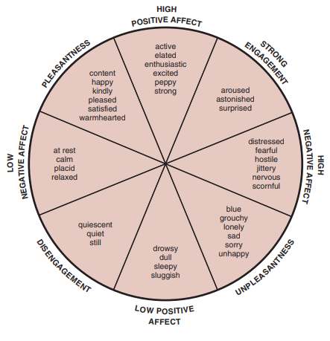

Slide 46
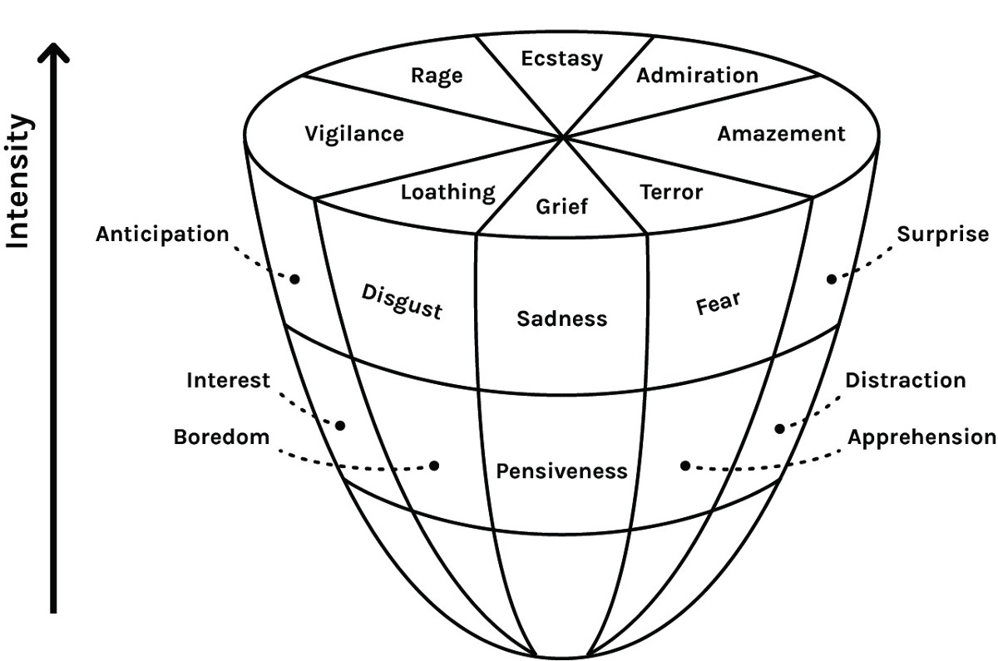
Theory of Relationships Among Emotions
Robert Plutchik has proposed a descriptive theory that is concerned with what are called primary or basic emotions and the ways that they can be mixed together.
He assumes that emotions differ in 3 ways – intensity, similarity to one another and polarity or oppositeness. He used these to draw a spatial model representing the relationships among the emotions.

Slide 47
Theories about Emotion and Motivation
Leeper (1970) says that almost all our sustained and goal-directed behaviour is emotionally toned and that it is the emotional tone which provides the motivation for long sequences of behaviour.
Another theory by Tomkins (1970,1981) states that emotions provide the energy for motives. He said that motives or drives give information about some need or condition of the body. Accompanying them are emotions or affects which provide the energy for the drives; they amplify the drives to give them strong motivational power.

Slide 48
Incentive Theory of Motivation - Thus the stimulus characteristics of the goal can sometimes start a train of motivated behaviour. This is the basic idea behind theories of incentive motivation. Thus in contrast with the push of drive theories, incentive theories are “pull theories" of motivation; because of certain characteristics they have the goal objects pull behaviour toward them. The goal objects which motivate behaviour are known as incentives. Individuals expect pleasure from the attainment of what are called positive incentives and from the avoidance of what are known as negative incentives.
Opponent Process Theory – It takes a hedonistic view of motivation. Basic to this theory is the observation that many emotional-motivating states are followed by opposing, or opposite states. Thus, as in feelings of pleasure and happiness follow feelings of fear and dread.
Notes:
Eg woman with lump in office
Eg person using heroin for the first time

Slide 49
Emotional Reaction
Normal Emotional Reaction - Some emotional reactions are normal responses to events or to primary morbid psychological experiences. An example of this is the grief reaction that follows the death of a loved one or the response of a previously healthy person to a life-threatening diagnosis.
Abnormal emotional reaction - These are states that are understandable in the context of stressful events but are associated with more prolonged impairment in functioning.

Slide 50
Abnormal Emotional Reaction
The Yerkes–Dodson curve which distinguishes between normal and abnormal emotional states shows that up to a certain level of stress there is no impairment but beyond a certain point functioning deteriorates. The point at which this happens is determined by individual attributes such as genetic and personality predisposition, and by external factors including social support and the duration and severity of the stressors.
Diagnostically, both the ICD-10 Classification of Mental and Behavioural Disorders and the Diagnostic and Statistical Manual of Mental Disorders define these abnormal emotional reactions as adjustment disorders with disturbance of mood.

Slide 51
Anxiety is an unpleasant affective state and a simple definition is ‘fear for no adequate reason’. It is accompanied by physical symptoms such as palpitations, sweating, difficulty breathing, dizziness, etc.
If the physical symptoms occur suddenly, and in combination, the result is overwhelming fear, and the term panic attack is used.
Overwhelming panic may lead to inactivity (being ‘paralysed with fear’) or ill-directed, chaotic overactivity.
Anxiety may be associated with anxious foreboding, i.e., a sense that something terrible will happen but without the knowledge of what this will be. Anxious foreboding is present in several disorders, such as generalised anxiety, depressive illness and panic disorder.

Slide 52
When the fear is restricted to one object, situation or idea, the term phobia is used. Phobias are associated with physical symptoms of anxiety and with avoidance. Most fears are learned responses. Some phobias are secondary to morbid states, most commonly depressive illness, and others, such as fear of contamination, are regarded as obsessional symptoms.
Depressed mood is one of the commonly experienced abnormal reactions. Depression can be a symptom secondary to another morbid process, an understandable reaction or an illness in itself.

Slide 53
Demoralization - It is characterised by feelings of isolation, despair, discouragement and helplessness. The individual feels trapped and unable to plan or initiate action towards a specific goal. It has been shown that such an extreme state can impact negatively on their wellbeing and functioning.
It is common in those with cancer and other serious physical or psychiatric illnesses.
The feeling differs from the low mood of the depressed person since its source is seen to be external and anhedonia is absent, but uncertainty about one’s future direction is prominent and motivation remains intact. Guilt is absent.

Slide 54
Abnormal Expressions of Emotion
These refer to emotional expressions that are very different from the average normal reaction. Those with abnormal expressions of emotion are generally aware of the abnormality and it may actually be the result of learning and of different cultural norms.
Lack of emotional response - Some depressed people fail to exhibit any emotion where some would be expected, this is termed ‘dissociation of affect’ and is said to be an unconscious defence against the impact of overwhelming stress which is described as a feeling of numbness. Derealisation and depersonalisation, although not primarily disorders of emotion but disorders of the experience of self, are associated with a feeling of being cut off. In both of these conditions the accompanying feeling of being unresponsive is the most common example of dissociation of affect.

Slide 55
Another variant of dissociation of affect is the belle indifférence that is seen in conversion disorder.
A defence that may manifest as lack of emotion is denial.
An unusual but significant abnormality in the expression of emotion is that seen in the ‘smiling depressive’ who retains the communicatory smile but loses the emotional element. So although able to visibly smile, their eyes remain unchanged and display a tension in the surrounding muscles. This is a feature of severe depression and can underestimate the depth of the depression.
Apathy may be erroneously confused with dissociation of affect. It means emotional indifference, often with a sense of futility. It may manifest itself as a lack of motivation and is found in those in prisons, in socially deprived areas and in disorders such as schizophrenia and the amotivational syndrome associated with cannabis misuse.
Perplexity is a tentative or bewildered, slightly puzzled state that occurs in anxiety, mild clouding of consciousness and emerging schizophrenia, as new psychotic experiences are occurring.

Slide 56
Morbid Expressions of Emotion
This is different from abnormal expression of emotion in that the patient is unaware of the morbidity in emotional expression even though it is apparent to observers.
In some patients with schizophrenia, there seems to be a complete loss of all emotional life such that the patient is indifferent to their own and others’ wellbeing. It shows itself as insensitivity to the subtleties of social intercourse and is known as inadequacy or blunting of affect. It was called as Parathymia by Bleuler and it manifests itself as social awkwardness and inappropriateness.

Slide 57
In others there seems to be a misdirection of emotions, known as incongruity, so that an indifferent event may produce a severe emotional outburst, while an event that objectively seems to be emotionally charged has no effect on the patient’s emotional response. Some argue that this may not necessarily be a primary disorder of affect but a congruous response to the distorted environment associated with delusions and other psychotic phenomena.
Finally, emotional constriction and its more severe form, flattening, are evident by a limitation in the usual range of emotional responses, so that that the patient displays little emotional response in any direction. Stiffening of affect may also be seen in some patients with schizophrenia when their emotional response is at first congruent but does not alter as the situation changes.

Slide 58
Lability of affect is defined as rapid and abrupt changes in emotion largely unrelated to external stimuli. These shifts occur without warning. Those with borderline personality disorder may also exhibit lability of affect. However, lability is most common in mixed affective states (dysphoric mania) and in mania, where short bursts of weeping are present. It may also be a feature in organic brain disease following damage to the frontal lobe, or after cerebrovascular accidents.
In affective incontinence there is total loss of control; this is particularly common in cerebral atherosclerosis and in multiple sclerosis, where spontaneous outbursts of laughter or crying occurs.

Slide 59
Morbid Disorders of Emotion
These are regarded as pathological states that, although sometimes triggered by stressful events, do not spontaneously resolve with removal of the stressor and therefore have their own independent momentum. These also include those states that arise without any precipitant.

Slide 60
Depressive illness is the most common and patients use terms such as ‘a weight’ or ‘a darkness’ to attempt to capture the exact emotional feeling. The morbid sadness in this illness may be associated with morbid thinking that may reach delusional intensity.
Often there is inhibition of thinking, loss of drive, decreased voluntary activity and psychomotor retardation. There may be difficulty making decisions due either to poor concentration or to obsessional doubting. Inner unrest, loss of energy, libido and confidence, anxiety, anorexia, anhedonia and early morning awakening are prominent.
If depression is severe and psychomotor retardation is marked, depressive stupor may occur. The apparent indifference of the person with severe depression must be differentiated from the apathy and lack of concern of the person with schizophrenia.
Morbid depression is found in depressive illness, bipolar disorder, schizophrenia and in acute and chronic organic states.

Slide 61
Morbid anxiety frequently occurs in association with morbid depression. In severe form it can present a picture of agitation. It is also found in organic states and may sometimes be secondary to terrifying visual hallucinations.
Irritability may be seen in depressive illness, schizophrenia, dysphoric mania and in patients having a temporal lobe foci.
Extreme apathy may be a feature of severe depression, schizophrenia or damage to the frontal lobe. This may result in self-neglect, inability to engage on day-to-day activities and social disengagement.

Slide 62
Morbid euphoria and elation classically occur in mania and hypomania but can also be seen in organic states and in hebephrenic schizophrenia. In mania and hypomania, there is an increased pressure of speech with prolixity, and flight of ideas or a subjective awareness of racing thoughts. Superficial bustling activity, disinhibition, distractibility, sometimes hypersexuality are also present.
Lesions of the hypothalamus may produce a clinical picture resembling mania with flight of ideas. Euphoria also occurs in multiple sclerosis, amnestic syndrome and in lesions of the frontal lobe. Frontal lobe damage with euphoria, often presenting as silliness, lack of foresight and indifference, is known as moria or Witzelsucht.
Ecstatic states may occur in schizophrenia, in those who misuse lysergic acid diethylamide, in epilepsy and in mass hysteria associated with religious services.

Slide 63
The Brain and Emotion
The brain is involved in the perception and evaluation of situations that give rise to emotion and it also controls the physiologic expression of emotion.
Hypothalamus and Limbic system are directly involved in regulating emotions. Damage to some structures in the limbic system produces great changes in the emotional behaviour of animals. Electrical stimulation to certain portions of limbic system and hypothalamus is rewarding to animals and pleasurable for humans.
The aroused state that is a part of many emotions is due to increased activation of brain cells in the cerebral cortex, limbic system and hypothalamus. Activity of cells in these brain areas is itself directly or indirectly influenced by Ascending Reticular Activating System(ARAS) which is fundamentally involved in keeping us awake, alert and conscious.

Slide 64
Neurobiology of Emotions
The brain is involved in perception and evaluation of situations that give rise to emotions.
The core parts involved are
1.Cerebral cortex
2.Limbic System – (Hypothalamus, septum, hippocampus, amygdala, cingulum)
3.Neurotransmitters

Slide 65
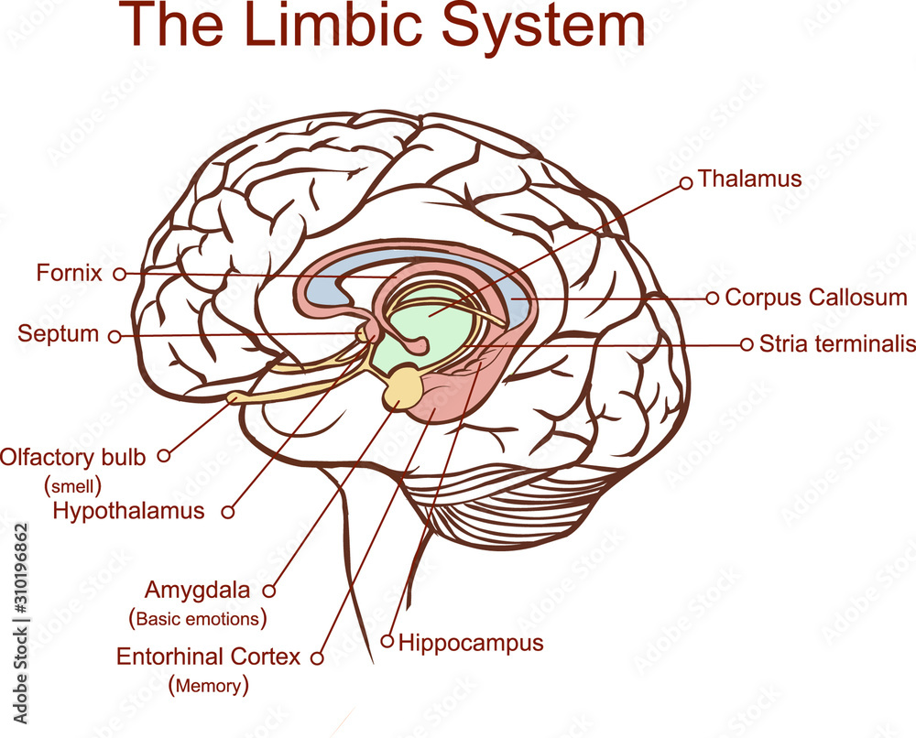

Slide 66
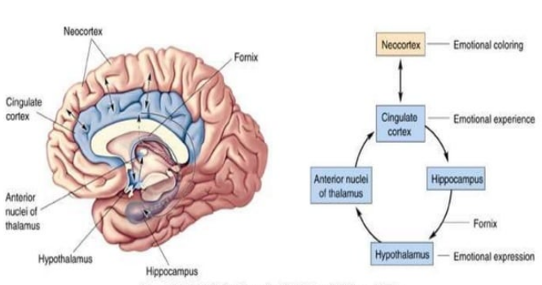
The Papez Circuit
The Papez circuit of the brain is one of the major pathways of limbic system and is involved in the cortical control of emotion.

Slide 67
Hippocampus-mediates the behavioral expression of emotion. Furious rabies results in signs of hyperactivity, excitable behavior, hydrophobia (fear of water) and sometimes aerophobia (fear of drafts or of fresh air) due to involvement of hippocampus.
If it is damaged, conscious memories cannot be formed. Learning not involving conscious memories remains intact.
Intense stress can alter its functioning in a normal person which due to which there is failure of formation of conscious memories of trauma but unconscious emotional memories will still be formed.
Anterior nucleus of Thalamus-plays a role in emotional control with its connection to the orbitofrontal cortex and the anterior cingulate cortex. Lesions lead to spontaneous laughing and crying.
Anterior Cingulate Gyrus- helps regulate emotions and pain. It is also involved in predicting and avoiding negative consequences. It is also the target for deep brain stimulation.
Notes:
Anterior Cingulate Gyrus – monitors errors, detects responses/completeness and reappraisal of negative emotional stimuli.

Slide 68
Hypothalamus-The hypothalamus also plays an important role in expression of emotion. Lateral parts of the hypothalamus are involved in emotions such as pleasure and rage, while the median part is associated with aversion, displeasure, and a tendency of uncontrollable and loud laughing.
Sham rage is behavior such as biting, clawing, hissing, arching the back and "violent alternating limb movements" produced in animal experiments by removing the cerebral cortex, but not hypothalamus. These behavioral changes are reversed with small lesions in hypothalamus.

Slide 69
Amygdala
The Amygdala is one of two almond-shaped clusters of nuclei located deep and medially within the temporal lobes of the brain’s cerebrum.
Primary role in the processing of memory, decision making, and emotional responses (including fear, anxiety, and aggression), the amygdalae are considered part of the limbic system.

Slide 70
The amygdalae perform primary roles in the formation and storage of memories associated with emotional events.
The left amygdala is involved in Reward System while the right amygdala is involved in Fear Conditioning.
Both right and left have independent memory systems but work together to store, encode and interpret memories and emotions.
Unconscious emotional memories are formed here.
The central nuclei is also involved in the genesis of fear response such as Defensive behavior (freezing or escape response)

Slide 71
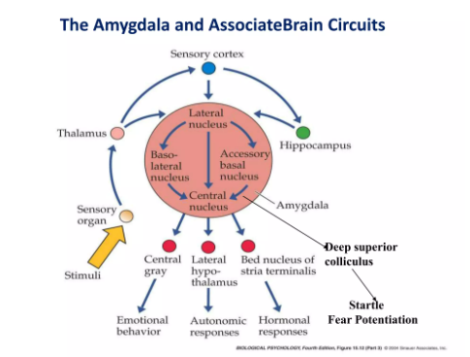

Slide 72
REWARD-
Glutaminergic neurons(in basolateral amygdala)
Nucleus Accumbens
Activation of these projections drives motivational salience through dopamine D1 receptor.
AGGRESSION -
Stimulating the amygdala - increases both sexual and aggressive behavior. It also increases vigilance/attention. Brain lesions that harm to the amygdala reduces fear and aggression. Thus, it appears that this part of the brain may play a role in the display and modulation of aggression.

Slide 73
ALCOHOLISM -
Protein kinase C-epsilon in the amygdala is important for regulating behavioral responses to morphine, ethanol, and controlling anxiety-like behavior.
When excessive drinking occurs, the amygdala is affected through behavioral changes and reduces the brain's plasticity, it makes it difficult for neurons to make connections to other neurons.
Often when binge drinking, or alcoholism occurs, our amygdala is affected and leads to behavior damage. These behavioral damages can be lack of control, inability to conduct oneself in a mature manner, aggressive behavior, loss of conduct, etc.

Slide 74
ANXIETY
There is also be a link between the amygdala and anxiety.
In particular, there is a higher prevalence of females that are affected by anxiety disorders as males have larger gray matter areas in amygdala and more serotonin receptors.
The amygdala is the primary structure of the brain responsible for fight or flight response.
The amygdala is directly associated with expression of conditioned fear. Studies suggest that animals lacking an amygdala have less fear expression and indulge in non-species like behavior.

Slide 75
Cerebral Cortex
The right side of the cortex is more involved in unpleasant emotions and the left in pleasurable emotions. Perception and expression of emotion and emotion related cues like facial expression, body posture and prosody may be a right hemisphere function.
Frontal Lobe – Interprets others emotion especially from facial expressions
Temporal Lobe – involved in recall of past experiences
Dysfunction of the cerebral cortex may be associated with disorders of emotional communication.

Slide 76
Whereas deficits of the left hemisphere appear to impair the comprehension and expression of language.
Deficits of the right hemisphere may be associated with an impaired ability to comprehend and express emotional gestures such as facial expression and emotional prosody. Some patients have either prosodic or facial emotional deficits.
The posterior portions of the neocortex appear to be important for comprehension and the anterior for expression of both emotional prosody and faces.

Slide 77
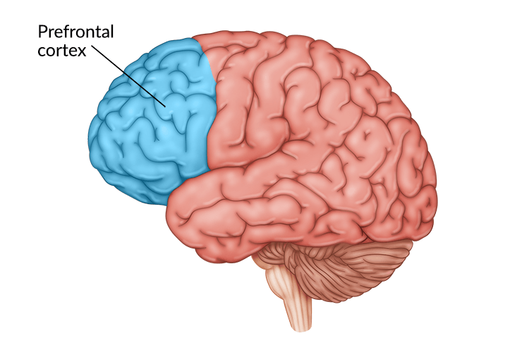
Prefrontal Cortex
The PFC comprises of 6 parts –
Dorsolateral
Venterolateral
Orbitofrontal cortex
Anterior Prefrontal
Venteromedial
Dorsomedial

Slide 78
Emotions are also regulated by prefrontal cortex.
Venterolateral PFC and orbitofrontal cortex activation is associated with suppressing and re-appraising negative emotional stimuli.
Venteromedial PFC integrates cognitive affective information and regulates the HPA axis in response to emotional stress.
PFC, Amygdala and hippocampus are involved in regulation of fear.
LPFC appears to lift the mood while activation of RPFC causes depression.
Lesions to the RPFC produces laughter, euphoria and Moria or Witzelsucht, a tendency to make jokes and puns.
Increased PFC activity leads to a decrease in amygdala activity.
Repetitive transcranial magnetic stimulation (rTMS) targets the left DLPFC. It is readily assessable to magnetic field and is interconnected with limbic system, which plays a dominant role in modulation of emotions.

Slide 79
Neurotransmitters and Emotions
Neurotransmitters and their presynaptic and postsynaptic receptors mediate emotion within the central nervous system.
The role of norepinephrine in depression has been suggested by the catecholamine deficiency hypothesis. Many antidepressant drugs increase synaptic concentrations of norepinephrine, whereas reserpine, a catecholamine-depleting drug, causes depressive symptoms.
Monoamines have been hypothesized to be associated with both basic emotions and facial expression of emotions.

Slide 80
Norepinephrine(NE) released from Locus Coerulus (LC) which is located in the pons.
Exposure to acute stress/fear results in increase in NE in LC, hypothalamus, hippocampus, amygdala, cerebral cortex.
Repeated exposure to stress decreases in release of NE in LC.
Patients with PTSD and panic disorder show evidence of increased NE activity.
Mice lacking Alpha 2 adrenergic receptors have heightened autonomic activation and concomitant anxiety behaviour.

Slide 81
5HT 1A receptor knock out mice show a marked elevation of anxiety and fear.
Under chronic stress there occurs a downregulation of 5HT 1A and upregulation of 5HT 2A.
Administration of 5HT 1A receptor partial agonist (buspirone, gepirone) and 5HT2A receptor antagonist exert anxiolytic effect.
Depressed patients have reduced concentration of 5 HIAA in CSF.

Slide 82
Corticotropin releasing Hormone(CRH) –
Central nucleus of amygdala contains CRH.
Axons of central nucleus cells target locus coerulus neurons which have CRH receptors and contain NE.
In administration of CRH in cerebral ventricles induces anxiety responses, including hypervigilance, enhancement of the freezing posture and decreased exploration in unfamiliar situations.

Slide 83
Gamma amino butyric acid and BZD receptors role in anxiety is well documented.
In Panic disorder, patients have reduced GABA-A and BZD binding in areas such as cortex, hippocampus and insula.
Glutamate System-NMDA receptors are involved in the conditioning of fear and learning. Blockade of NMDA receptor with antagonists such as AVP can block fear acquisitions and may even block expression.
Dopaminergic System – Inhibition of DA in Nucleus Accumbens leads to abnormalities in motivation and reward mechanisms.
Neuropeptide Y- It has anxiolytic effects.
It is involved in fear consolidation ,with studies showing administration of NYP impairs retention of traumatic memories and reduces anxiety during stressful tasks.
Recently cholecystokinin’s role in panic disorders has been established. Antagonists of CCK B receptor have anxiolytic effects.

Slide 84
Emotional Memory
Emotion has a powerful influence on learning and memory.
Amygdala along with prefrontal cortex and medial temporal lobe is involved in consolidation and retrieval of emotional memories.
Amygdala, hippocampus and prefrontal cortex are also involved in acquisition, extinction and recovery of fears to cues and contexts.
Hippocampus is critical for long term, declarative memory storage.
Propranolol impairs memory for emotionally provocative story but not for emotionally neutral story.

Slide 85
THANK YOU

