Slide 1
Neuropsychiatric aspects of Headache
By
Dr.Lakhan Kataria
Professor and Head
Department of Psychiatry

Slide 2
Introduction
It is said that about 70 percentage of population had experienced headache once in their life time
Overall prevalence of migraine is around 12%
There is associated psychiatric and physical co morbidities.
WHO has launched a global campaign called “Lifting the Burden” to reduce the burden of headache.

Slide 3
CLASSIFICATION
The International Classification of Headache Disorders - ICHD-3 classes
  Primary headache syndromes
1. Migraine
2. Tension-type headache
3. Trigeminal autonomic cephalalgias
4. Other primary headache disorders

Slide 4
2. Secondary headache syndrome
  Due to underlying pathology of the brain and adjacent structures
  More severe and more serious
  Needs detailed evaluation
Temporal arteritis, intracranial mass lesions.
Idiopathique intra cranial hypertension (pseudotumor cerebri),
Meningitis , subarachnoid haemorrhage
Post concussion headaches
3. Cranial neuralgias and other causes of facial pain

Slide 5
Migraine
Most disabling of the primary headache syndromes
Migraine without aura
Migraine with aura
Migraine with typical aura
Typical aura with headache
Typical aura without headache
Migraine with brainstem aura
Hemiplegic migraine
Familial hemiplegic migraine (FHM)
FHM1
FHM2
FHM3
Sporadic hemiplegic migraine (SHM)
Retinal migraine

Slide 6
ICHD-3 Criteria for Migraine without Aura
Previously k/a Common Migraine; Hemicrania Simplex
Diagnostic criteria:
A. At least five attacks fulfilling criteria B–D
B. Headache attacks lasting 4–72 hours (when untreated or unsuccessfully treated)
C. Headache has at least two of the following four characteristics:
1. Unilateral location
2. Pulsating quality
3. Moderate or severe pain intensity
4. Aggravation by or causing avoidance of routine physical activity (e.g. walking or climbing stairs)
D. During headache at least one of the following:
1. Nausea and/or Vomiting
2. Photophobia and Phonophobia
E. Not better accounted for by another ICHD-3 diagnosis.

Slide 7
ICHD-3 Criteria for Migraine with Aura
Previously k/a Classic or classical migraine
Diagnostic criteria:
A. At least two attacks fulfilling criteria B and C
B. One or more of the following fully reversible aura symptoms:
1. visual
2. sensory
3. motor
4. speech and/or language
5. brainstem
6. retinal
C. At least three of the following six characteristics:
1. at least one aura symptom spreads gradually over 5 minutes
2. two or more aura symptoms occur in succession
3. each individual aura symptom lasts 5–60 minutes
4. at least one aura symptom is unilateral
5. at least one aura symptom is positive
6. the aura is accompanied, or followed within 60 minutes, by headache
D. Not better accounted for by another ICHD-3 diagnosis.

Slide 8
Aura of migraine
1. Visual: m/c type; occurring in over 90% of patients fortification spectrum: zigzag lines moving across the visual field, leaving absolute or variable degrees of relative scotoma in its wake, consisting of visual disturbances with flashing lights.
2. Sensory: in the form of pins and needles moving slowly from the point of origin and affecting a greater or smaller part of one side of the body, face and/or tongue, Numbness
3. Speech and/or language: usually aphasic
4. Motor: motor weakness

Slide 9
5. Brainstem: dysarthria, vertigo, tinnitus, hyperacusis, diplopia, ataxia not attributable to sensory deficit, decreased level of consciousness (GCS <=13)
6. Retinal: scintillations, scotomata or blindness

Slide 10
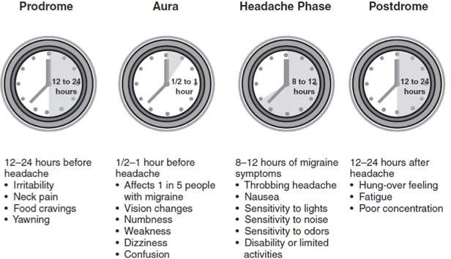
Evolution of migraine

Slide 11
Epidemiology and course
Migraine with aura usually present for the first time in males during teens.
In females the peak incidence is around early twenties.
About half of those with migraine remit, about 35 percent continue to have intermittent headache, and only 20 percent continue to develop chronic migraine over time.

Slide 12
Migraine in childhood - associated with gastrointestinal complaints,
:episodic bouts of stomach pain, vomiting, or diarrhoea.
The duration is shorter than that commonly observed in adults.
In women, migraine is strongly associated with reproductive system function
Increased incidence during puberty and the first trimester of pregnancy, and is associated with exogenous hormone use.
After menopause, the frequency of migraine attacks generally decreases dramatically.

Slide 13
Family history of migraine is one of the most potent and consistent risk factors for migraine.
Genetic factors are involved in 1/3rd of the migraine cases.
The mode of inheritance and the genes involved are still unknown

Slide 14
Pathophysiology of migraine
Believed to be due to the neuronal hyper excitability.
Sensory sensitivity that is characteristic of migraine is probably due to dysfunction of mono-aminergic sensory control systems located in the brainstem and hypothalamus.
Activation of the trigemino-vascular system; in the trigeminal nucleus results in release of vasoactive neuropeptides, particularly calcitonin gene-related peptide (CGRP), at vascular terminations of the trigeminal nerve and within the trigeminal nucleus.
Central projections to the periaqueductal gray and hypothalamus, from which reciprocal descending systems have establised anti-nociceptive effects.

Slide 15
Diffusion tensor imaging studies demonstrate abnormalities in primary and modulatory components of the central nociceptive pathways such as periaqueductal gray, somatosensory cortex, and in the occipital lobe in subjects with migraine with aura.
Other brainstem regions likely to be involved in descending modulation of trigeminal pain include the nucleus locus ceruleus in the pons and the rostroventromedial medulla.

Slide 16
Pharmacologic and other data point to the involvement of the neurotransmitter 5-hydroxytryptamine(5HT) & Dopamine(DA) in migraine.
Triptans are potent agonists of 5HT1B and 5HT1D receptors, some are active at 5HT1F receptors.
M/A of Triptans: Arrest nerve signaling in the nociceptive pathways of the trigemino-vascular system.
Most migraine symptoms can be induced by dopaminergic stimulation, dopamine receptor hypersensitivity in migraineurs, as demonstrated by the induction of yawning, nausea, vomiting, hypotension, and other symptoms of a migraine attack by dopaminergic agonists.
Dopamine receptor antagonists are effective therapeutic agents in migraine, especially when given parenterally or concurrently with other antimigraine agents

Slide 17
Migraine genes identified by studying families with familial hemiplegic migraine(FHM) reveal involvement of ion channels, suggesting that alterations in membrane excitability can predispose to migraine.
  FHM-1: Mutations in P/Q type voltage-gated calcium channel;
  CACNA1A gene (50% of FHMs).
  FHM-2: Mutations in Na-K ATPase;
  ATP1A2 gene (20% of FHMs).
  FHM-3: Mutations in neuronal voltage-gated sodium channel;
  SCN1A gene.

Slide 18
Precipitating factors of migraine
Hormonal changes - catamenial migraine
Stress or its cessation.
Fasting , fatigue, over-sleeping.
Particular foods and beverages.
Drug intake, chemical additives such as nitrates.
Bright light, stormy weather or barometric pressure changes
Exercise, alcohol
But these agents/situations vary dramatically within and between individuals.

Slide 19
Basilar -type migraine or basilar artery migraine
Seen in about 10% of cases, episodes are usually interspersed among classic attacks. Symptoms are often bilateral.
The attacks begin with a visual aura, sometimes extending to both half- fields and obscuring vision.
Then progress to symptoms of brainstem dysfunction such as vertigo, dysarthria, ataxia, tinnitus.
Sensory symptoms distally in the limbs and around the lips and tongue.
There may be LOC in between the onset of headache ,and it is believed to be due to ischemia of RAS

Slide 20
Retinal migraine – very rare
At least two attacks of fully reversible monocular visual symptoms followed by migraine headache.(IHS CRITERIA)

Slide 21
Familial hemiplegic migraine
Characterised by attacks of transient hemiplegia that are followed by headache
The hemiparesis is always associated with sensory, language or visual disturbances and in some cases confusion/drowsiness
Genetic predisposition

Slide 22
Tension-Type Headache(TTH)
Most common among primary headache syndromes
Tension -type headache is characterized by episodes of stable bilateral pain lasting several days at a time.
It causes band like, squeezing, symmetric pressure on
forehead, temples and neck.
Migraine and TTH can co-exist , or alternate

Slide 23
It is no longer believed to be due to muscle tension
Fatigue, cervical spondylosis, bright light, loud noise, and, at some level, emotional factors allegedly produce or precipitate TTH
Patients with TTH tolerate their pain and usually go about
their business, unlike people with migraine.

Slide 24
Epidemiology and course
More common in women , but not as prominent as that of migraine.
More common in young adults
The incidence comes down with age but not that much as of migraine.

Slide 25
ICHD-3 Criteria for Tension-Type Headache
Diagnostic criteria:
A. At least 10 episodes of headache occurring on 1–14 days/month on average for >3 months
(>=12 and <180 days/year) and fulfilling criteria B–D
B. Lasting from 30 minutes to seven days
C. At least two of the following four characteristics:
1. Bilateral location
2. Pressing or tightening (non-pulsating) quality
3. Mild or moderate intensity
4. not aggravated by routine physical activity such as walking or climbing stairs
D. Both of the following:
1. no nausea or vomiting
2. no more than one of photophobia or phonophobia
E. Not better accounted for by another ICHD-3 diagnosis

Slide 26
Chronic tension-type headache
A. Headache occurring on greater than or equal to 15 days per month on average for more than 3 months (greater than or equal to 180 days per year) and fulfilling criteria B–D.

Slide 27
Trigeminal autonomic cephalalgias
TACs are chacterized by relatively short-lasting attacks of head pain a/w cranial autonomic symptoms, such as lacrimation, conjunctival congestion or nasal congestion.
Pain is usually severe; because of the associated nasal congestion or rhinorrhea, patients are often misdiagnosed with “sinus headache”.
Patients wit TACs should undergo Pituitary imaging and Pituitary function tests because there is an excess of TACs presentations in patients with pituitary tumor -related headache.

Slide 28
Classification
Cluster headache
Episodic cluster headache
Chronic cluster headache
Paroxysmal hemicrania
Episodic paroxysmal hemicrania
Chronic paroxysmal hemicrania
Short-lasting unilateral neuralgiform headache attacks
Short-lasting unilateral neuralgiform headache attacks with conjunctival injection and tearing (SUNCT)
Short-lasting unilateral neuralgiform headache attacks with cranial autonomic symptoms (SUNA)
Hemicrania continua

Slide 29
Cluster headache(1 – 8 epi/day, each lasting for 15 - 180 min, M>F)
Cluster headache is a relatively rare form of primary headache with a population frequency of approximately 0.1%.
The pain is deep, usually retro-orbital, often excruciating in intensity, non-fluctuating, and explosive in quality.
A core feature of cluster headache is periodicity; at least one of the daily attacks of pain recurs at about the same hour each day for the duration of a cluster bout.

Slide 30
Pain for 8 to 10 weeks a year; this is usually followed by a pain free interval that averages a little less than 1year.
Patients are generally perfectly well b/w episodes.
Onset is nocturnal in about 50% of patients, and men are affected three times more often than women.

Slide 31
Patients with cluster headache tend to move about during attacks, pacing, rocking, or rubbing their head for relief; some may even become aggressive during attacks;
A/w ipsilateral symptoms of cranial parasympathetic autonomic activation; conjunctival congestion or lacrimation, rhinorrhea or nasal congestion, or cranial sympathetic dysfunction such as ptosis.
When photophobia and phonophobia are present far more likely to be U/L and on the same side of the pain;[B/L, as is seen in migraine]

Slide 32
Pathogenesis
Current theories of the etiology : Hypothalamic and central pain control regions and trigger a cascade of events in the brain stem comprising afferent pain and efferent parasympathetic pathways.
PET has shown vasodilatation of the major basal arteries during the acute pain attack in cluster headache.

Slide 33
Paroxysmal hemicrania(1 – 20 epi/day, each lasting for 2 – 30 min, M=F)
It is characterzed by frequent U/L, severe, several short-lasting episodes of headache.
Like cluster headache, the pain tends to be retroorbital and is a/w autonomic phenomena such as lacrimation and nasal congestion.
Essential features of PH: U/L; very severe pain; short-lasting attacks (2-45 min); very frequent attacks (usually more than 5 a day); marked autonomic features ipsilateral to the pain.

Slide 34
Male to female ratio in PH is close to 1:1.
TOC: Indomethacin (25-75 mg tid), which can completely suppress attacks of PH
Piroxicam has been used, although it is not as effective as indomethacin.

Slide 35
SUNCT/SUNA(3-200epi/day, each lasting for 5 sec to 4min, M=F)
SUNCT (short lasting unilateral neuralgiform headache attacks with conjunctival congestion and tearing):
at least 42 attacks, lasting for 5-240 sec; ipsilateral conjuntival congestion and lacrimation should be present.
SUNA (short-lasting unilateral neuralgiform headache attacks with cranial autonomic symptoms):
at least 42 attacks, lasting for 5-240 sec; conjunctival congestion or lacrimation is missing.
It is Rare primary headache syndrome characterized by severe, unilateral, orbital or temporal pain that is stabbing or throbbing in quality.
Pain located anywhere in head.

Slide 36
Therapy of acute attacks is not a useful in SUNT/SUNA because the attacks are of such short duration.
IV Lidocaine, which arrests the symptoms, can be used in hospitalized patients.
Long term prevention to minimize disability and hospitalization is the goal of treatment.
Treatment for prevention is Lamotrigine(200-400 mg/d), Topiramate and Gabapentin may also be efective.

Slide 37
Hemicrania continua (Moderate and continuous unilateral pain, F>M)
Essential features are moderate and continuous U/L pain a/w fluctuations of severe pain; complete resolution of pain with indomethacin; and exacerbations that may be a/w autonomic features, including conjunctival congestion, lacrimation, and photophobia on the affected side.

Slide 38
The age of onset ranges from 11 to 52years.
Women are affected twice as often as men.
The cause is unknown.
Treatment consists of Indomethacin.
Occipital nerve stimulation probably has a role in patients with hemicrania continua who are unable to tolerate indomethacin

Slide 39
Psychiatric aspects
Increased psychiatric co morbidities in patients suffering from migraine.
There is increased occurrence of anxiety and depression in migraine sufferers.
There are different psychological factors that can precipitate an attack. There are some personality types who may be suffering of migraine
Psychiatric co morbidity can adversely affect the treatment response

Slide 40
Anxiety and depression
These are the commonest co morbidities in migraine
Some studies pointed out that there is more chance of developing migraine in those with anxiety and depression.
Vice versa, there is 2-3 fold increase in risk of developing anxiety and depression in migraine. There is a small increase in incidence for those with migraine with aura.
prevalence of major depression, bipolar spectrum disorder (i.e. cyclothymia and hypomania), generalised anxiety and social phobia is more in patients with migraine.
Anxiety disorder is more common than depression.

Slide 41
Many cases are found to have mixed anxiety and depression.
The risk of suicide attempt is also increased in migraine, and it is of interest that not all this excess risk is explained by the presence of depression

Slide 42
Personality and stress in migraine
The evidence that a particular personality type predisposes a person to suffering migraine is not very strong.
People with migraine do have higher scores on neuroticism traits, including harm avoidance and social introversion as evident from studies.
There is increased emotional reactivity ,which in turn cause reactivity of ANS which is responsible for precipitating attacks.
These factors are associated with poor treatment response and chance of progressing to chronic migraine.

Slide 43
Psychiatric features associated with attacks
Sometimes patient may experience unusual health and vigour, amounting to elation.
There is history of increased energy and feelings of buoyancy at the beginning of the attack in some
In contrast some remain listless and fatigued for several days before attack.
Anxiety and irritability are common early on, with drowsiness and lethargy as the headache continues.
Depression can be severe.

Slide 44
Work up
Due to the vast dd’s in headache , a detailed evaluation is mandatory
A detailed history must be taken with special emphases to following factors
  Type and location of pain,
  Timing
  Precipitants
  Prodromal events
  Associated symptoms

Slide 45
Past history – similar episodes, no of episodes
Past treatment history
Family history
Thorough neurological examination - To rule out any secondary causes of headache
Look for pathological signs that may indicate a brain disorder
Psychiatric history
MSE

Slide 46
Headache symptoms indicating further diagnostic workup :
First headache
Worst headache
Gradual worsening over days or weeks
Abnormal neurological examination
Onset after age of 50
Ongoing systemic illness
Accompanied by fever
Vomiting prior to headache onset

Slide 47
Investigation
Routine blood investigations: to rule out other causes and to get a baseline before treatment
Brain imaging is not routinely indicated
Usually done if
Any abnormal neurological findings
Poor treatment response
Diagnostic clarity
CT- to rule out haemorrhage
MRI- in case of tumours, av malformations,hydrocephalus,vasculitis

Slide 48
Management- MIGRAINE
Mainstay of management is pharmacological
acute treatment and preventive treatment.
Pharmacological :
  Acute treatment
    Main aim is to treat the pain ,associated nausea and vomiting and to maintain hydration.
    patients are advised to make a headache diary to note migraine days, meals, menses, school examinations, stressful episodes, and other potential precipitants.
    For some patients, relaxation techniques or other forms of CBT may be
  helpful.

Slide 49
TRIPTANS :
Ergot derivatives
ergotamine and dihydroergotamine
MOA: CEREBRAL VASO CONSTRICTION
Should be used along with anti emetics to reduce nausea and vomiting.
Excessive use may lead to persistent,excessive vasoconstriction (ergotism) in the coronary arteries, digits, and elsewhere.
Might precipitate a miscarriage or cause foetal malformations, so NEVER TO BE USED IN PREGNANCY.
5HT1B/1D receptor agonists with
vasoconstrictive effects on blood vessels.
Can be given as oral, intra nasal spray or injection
Suma, Riza, Ele, Almo, Frova, Nara, Zolmi
Efficacy data at 2 hours favour eletriptan and rizatriptan
Sumatriptan is available in India
Common A/E: injection site reaction,
paraesthesia, dizziness,
warm sensation.
Avoided in individuals with uncontrolled hypertension, cardiovascular, or cerebrovascular disease

Slide 50
Anti emetics:
To treat the nausea and vomiting associated
Vomiting can result in reduced drug absorption
Metoclopramide, ondansetron
(Chance of dystonia with metoclopramide)
NSAIDs (Acetaminophen, Ibuprofen, Naproxen, Diclofenac)
Aspirin(325mg)

Slide 51
Preventive treatment
Headache >3 days per month and acute medications are not effective
Headache >8 days per month( Risk of overuse)
Disability despite acute medication

Slide 52
1. β-blocker (Propranolol, Metoprolol, Timolol);
2. Antidepressants (Amitriptyline, Venlafaxine);
3. Anticonvulsants (Valproate, Topiramate, Gabapentin);
4. Calcium channel blockers(Flunarizine), and
5. Aspirin
6. Other (OnanbotulinumtoxinA, caffeine)

Slide 53
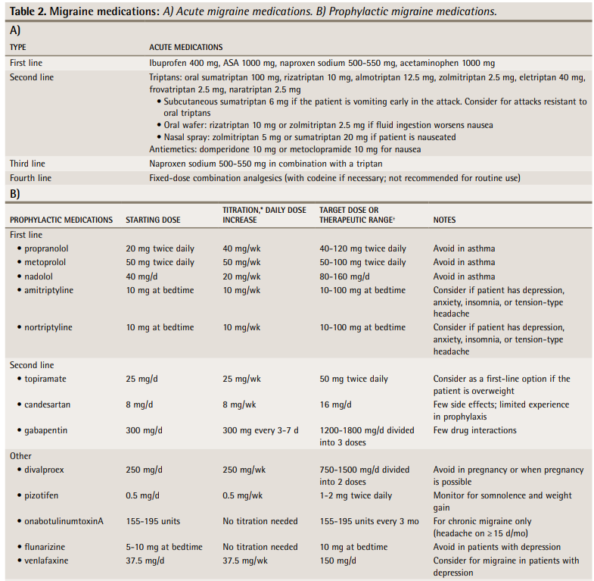

Slide 54
  Nonpharmacological Treatments
    Use of behavioural treatments including biofeedback, relaxation training, and cognitive behavioural therapy.
    Herbal treatments such as feverfew
    Dietary supplements such as magnesium
    and vitamin D
    Riboflavin(25mg)
    MgO and Riboflavin combination
Drug Treatment for Children and Adolescents.
  The only effective agents that have been effective in migraine prophylaxis for
children in multiple controlled trials are topiramate and flunarizine.
  cyproheptadine is commonly used as a preventative medication – no evidence

Slide 55
Treating migraine with psychiatric co morbidities
While treating special consideration has to be given
Aim is not just to reduce headache
Equal or more importance should be given in managing co morbid anxiety or depression
Drugs that can cause depressive symptoms should be avoided- beta blockers
Role of psycho therapy

Slide 56
Tension-Type Headache
Acute management : given when headache occurs less than twice a week
  Ibuprofen (800 mg) is the first DOC, followed by naproxen (825mg)
  Naproxen has less chance of GI disturbance
  Simple analgesics like paracetamol, aspirin can be used
  Adding caffeine (130 mg or 200 mg) significantly increases the efficacy of simple analgesics

Slide 57
Preventive treatment : indications
Headaches occur more frequently than two or three times per week
Acute therapy is ineffective
Analgesic consumption becomes excessive.
Drugs used
Amitriptyline or topiramate can be used
Amitriptyline should be started in low doses (10) and then tapered up
50 to 75 mg per day is needed to control symptoms
Should be discontinued after 6 months of use, have to taper and stop
MOA: not clearly understood
Possible – increase in levels of serotonin and endorphin , decreasing NMDA activity involved in pain pathway – so no role for SSRI

Slide 58
Non pharmacological treatment :
Behavioural treatments: relaxation and biofeedback alone or in combination
Cognitive behavioural treatments – stress management

Slide 59
Cluster Headache
Acute Treatment :
First-line abortive therapy: Sumatriptan (subcutaneous) with most people obtaining relief quickly; Home Oxygen can be very useful at high flow, 100% concentration via a non rebreathable mask at 12 to 15 L/min for up to 20 minutes.
Transitional treatments, such as Steroids (oral)-Prednisolone 60mg OD for 7 days F/B taper in 3 days, can help the patient through the acute phase while starting preventative strategies.

Slide 60
Prophylactic Treatment : Almost always indicated for treating cluster headache because of the extreme severity of pain induced by an acute attack, which often occurs at night.
  Lithium(400-800mg/day), valproic acid, Corticosteroids, the Calcium channel blockers (Verapamil – 40-60mg BD), β-blockers, topiramate.
  Neurostimulation therapy: Deep brain stimulation of the region of the posterior hypothalamic gray matter has proven successful.
  Favorable results have also been reported with the less invasive approach of occipital nerve stimulation and with a noninvasive vagal nerve stimulation.

Slide 61
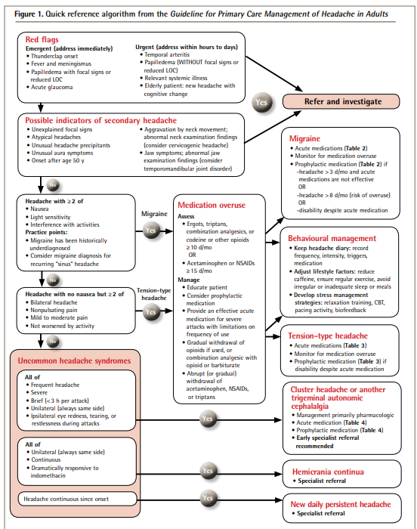

Slide 62
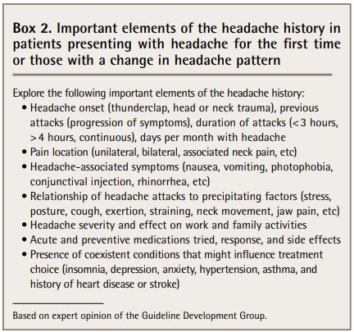

Slide 63
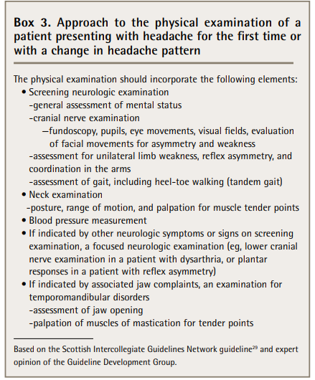

Slide 64
Thank You

