Slide 1
Management of
Alcohol use Disorder and
related conditions
By:
Dr.Lakhan Kataria
Professor and Head
Department of Psychiatry
SBKS MI & RC

Slide 2
GENERAL ISSUES FACED IN MANAGEMENT
chronic relapsing and recurring condition
continuous and prolonged care over long period of time.
An active collaboration with the family for treatment is required.
Management should be sensitive to the needs and modified to the patient's response and progress.

Slide 3
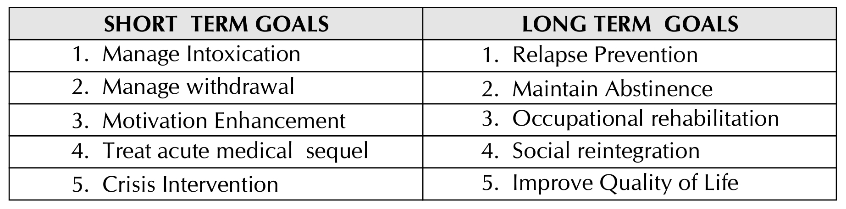
TREATMENT AIMS/GOALS
vary according to time frame.
Main goal
  maintain abstinence and if not possible decrease the frequency and severity of relapses and maximise functioning in between.

Slide 4
ASSESSMENT OF ALCOHOL USE DISORDERS
The goal of assessment also varies in different phases of the treatment.
  Establish: rapport, diagnosis and plan of management
  During intervention, monitoring the progress and assessing abstinence.

Slide 5
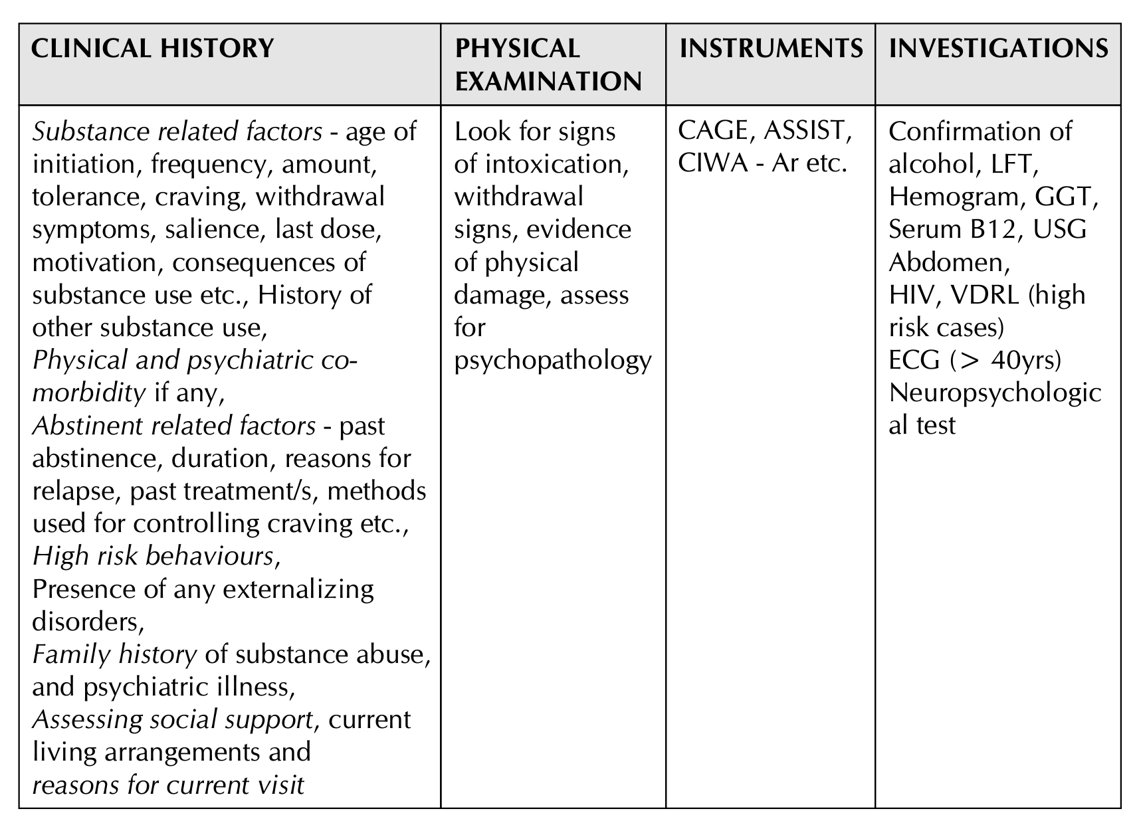
Identification in clinical setting and related laboratory tests
To establish an AUD diagnosis,
History of alcohol-related life problems. From patient and other reliable informant
screen for histories of alcohol-related accidents, interpersonal difficulties, problems at work, and encounters with the law.
If an AUD is probable, the diagnostic criteria and drinking history should be reviewed with the patient.

Slide 6
Screening Tools
CAGE used to screen Alcohol use problem
    ([need to] Cut down [on drinking], Annoyance when asked about drinking, Guilt [about drinking], [need for] Eye-openers the morning after heavy drinking), are also used.
The Alcohol Use Disorders Identification Test (AUDIT) uses ten items to review the pattern of life problems related to alcohol.
  it does not diagnose an AUD, but screens those who need a more detailed clinical interview.

Slide 7
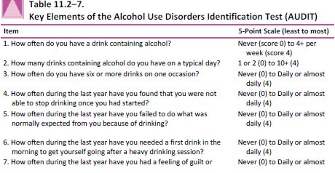
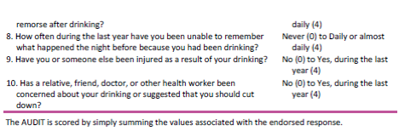

Slide 8
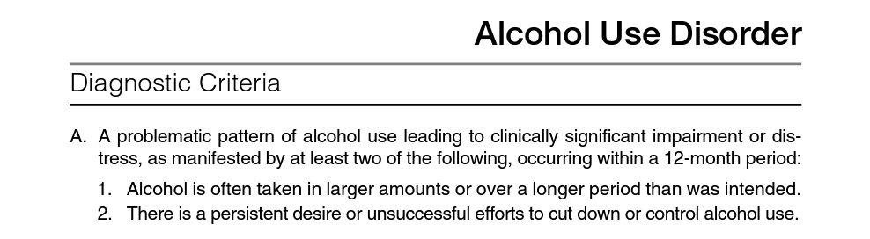
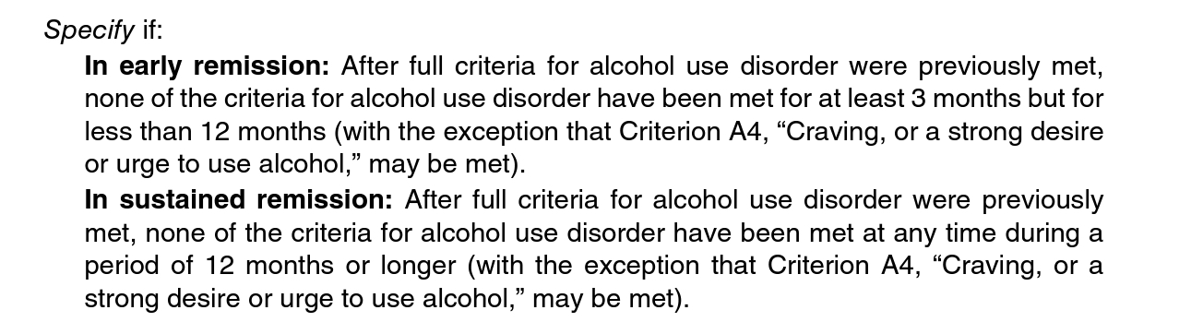
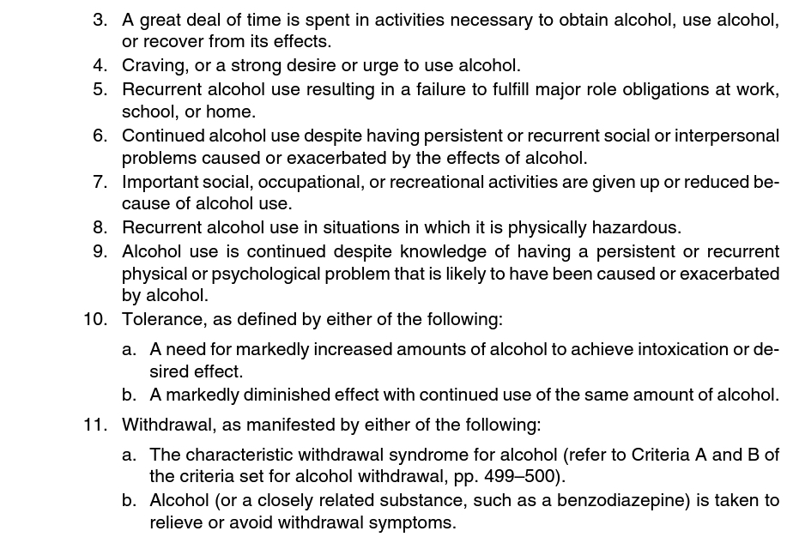
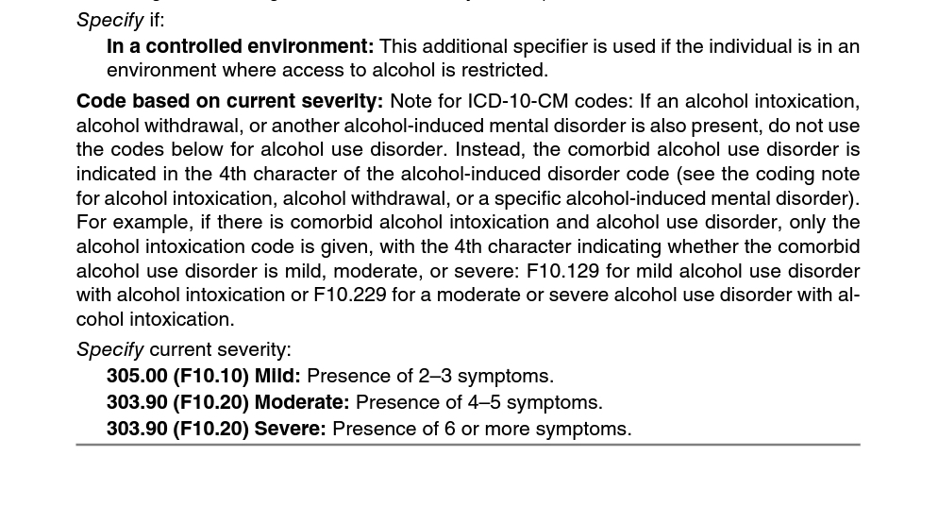

Slide 9
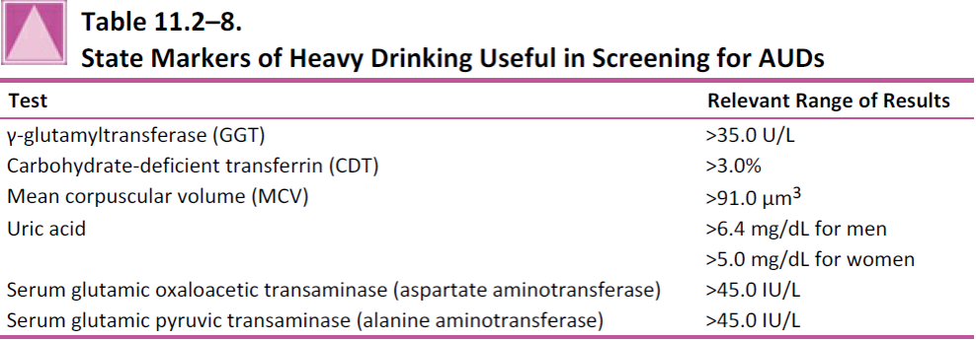
Identifying heavier drinkers vulnerable to AUDs is facilitated by several blood tests.
They reflect physiological alterations likely to be occur after ingesting about five or more drinks a day over several weeks.

Slide 10
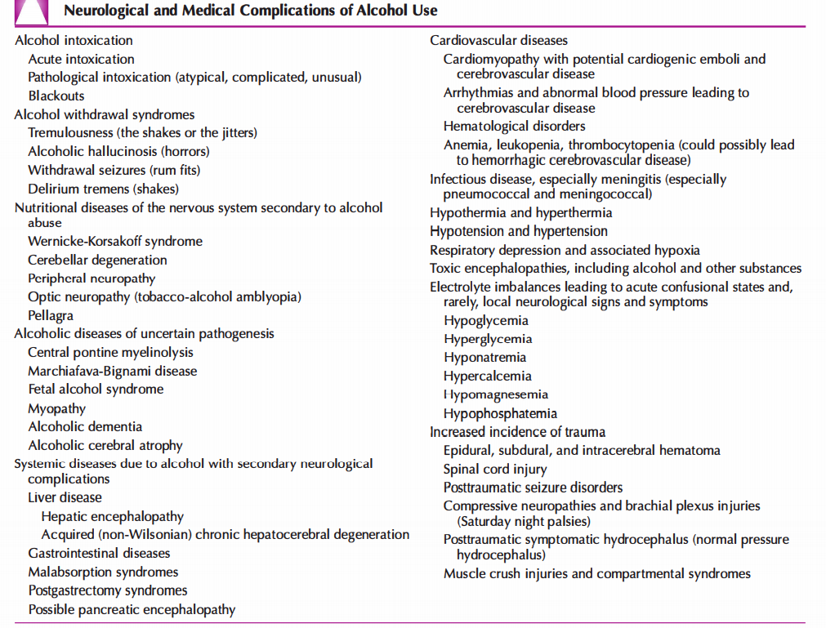

Slide 11
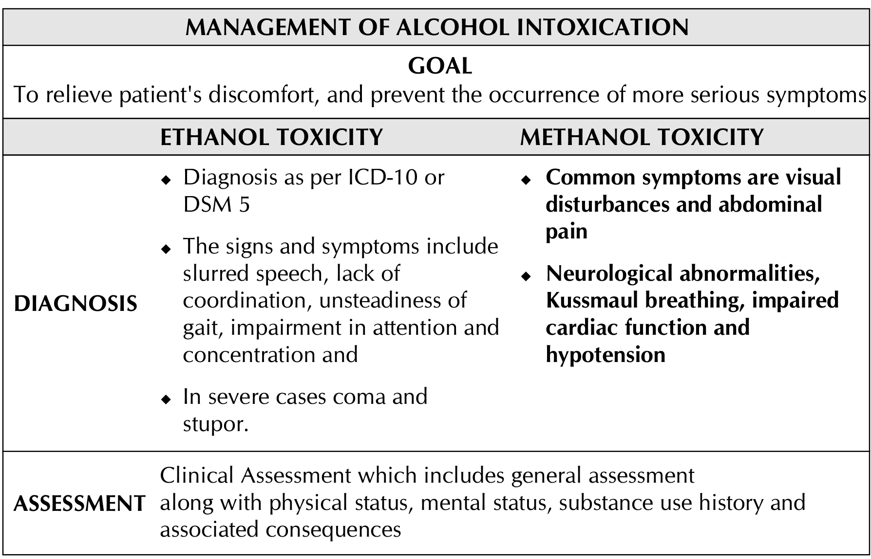
Signs of Alcohol intoxication: -
1. Slurred speech
2. Dizziness
3. Incoordination
4. Unsteady gait
5. Nystagmus
6. Impairment in attention or memory
7. Stupor or coma
8. Double vision
Sadock BJ, Sadock VA, Ruiz P, Kaplan & Sadock’s Synopsis of Psychiatry, Eleventh Edition, Chapter – 20.2, Pg. no. 624 – 638.

Slide 12
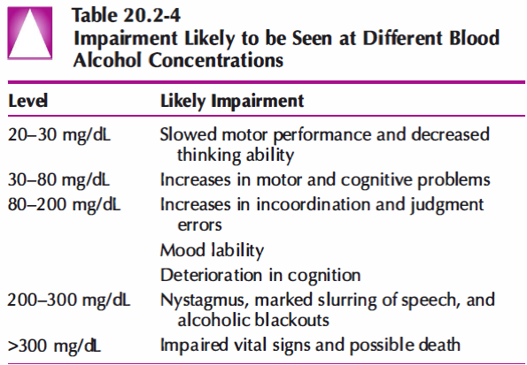

Slide 13
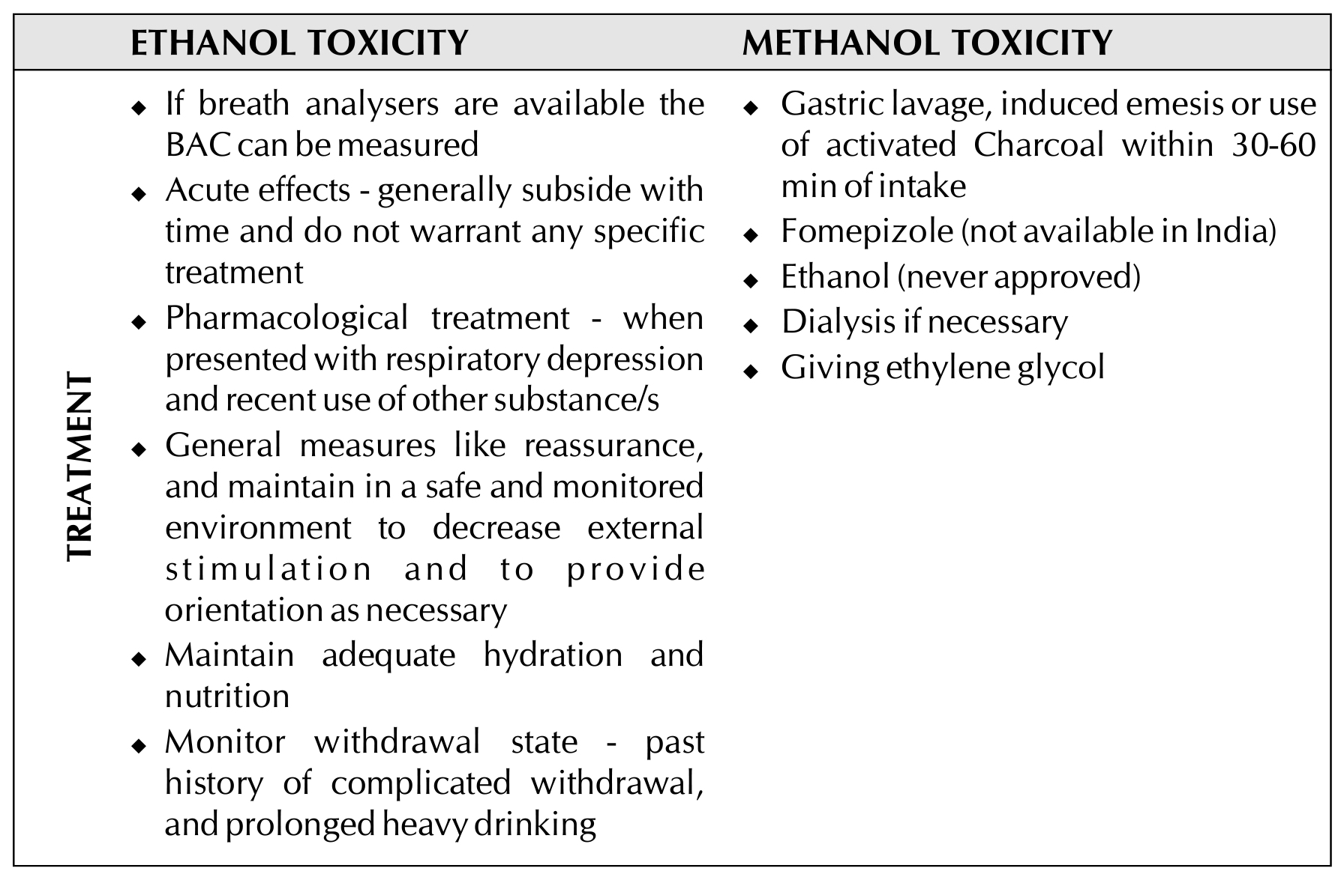

Slide 14
Signs of Alcohol withdrawal:
Tremulousness ("shakes","jitters") 6 to 8 hours after the cessation of drinking
Psychotic and perceptual symptoms begin in 8 to 12 hours
Seizures in 12 to 24 hours
Delirium tremens anytime in first 72 hours.
Other signs:
  general irritability,
  gastrointestinal symptoms (e.g., nausea and vomiting), and
  sympathetic autonomic hyperactivity:
    anxiety, arousal, sweating, facial flushing, mydriasis, tachycardia, and mild hypertension
Sadock BJ, Sadock VA, Ruiz P, Kaplan & Sadock’s Synopsis of Psychiatry, Eleventh Edition, Chapter – 20.2, Pg. no. 624 – 638.

Slide 15
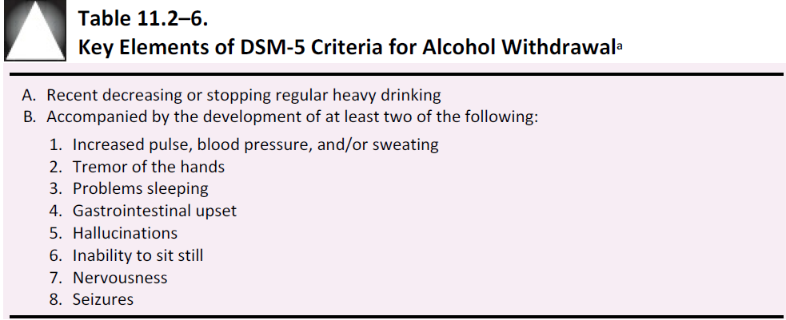

Slide 16
Simple withdrawal
Complicated withdrawal
Starts after 6-48 hrs after cessation or reduction in alcohol use
Symptoms suggestive of GI distress, anxiety, irritability, elevated blood pressure, tachycardia and autonomic hyperactivity
Symptoms intensify in initial period and diminish over 24-48 hrs
Symptoms would be normally abating over duration of 5-7 days.
WITHDRAWAL SEIZURES (RUM FITS)
Starts within 12-72 hrs of cessation of prolonged ingestion of alcohol
mostly generalized tonic clonic seizure
majority (60%) have multiple seizure but only 3% progress to status epilepticus
Around 30-40% progress to DELIRIUM TREMENS

Slide 17
Alcohol withdrawal seizures –
GTCS in character.
more than one seizure occurs 3 to 6 hours after the first seizure.
Status epilepticus is rare (< 3% pts.)
Seizure activity in Alcoholics includes other causative factors (head injuries, CNS infections & neoplasms, & cerebrovascular diseases)
Long-term severe alcohol abuse can result in :
  hypoglycaemia, hyponatremia, and hypomagnesemia,
  all of which can also be associated with seizures.

Slide 18
Alcohol withdrawal delirium –
It is a medical emergency
Begins after 2-5 days of sudden reduction or stoppage of alcohol
begin in a patient's 30s or 40s, after 5 to 15 years of heavy drinking, typically binge type.
Physical illness (e.g., hepatitis or pancreatitis) predisposes to the syndrome.
Features include: Usual withdrawal symptoms PLUS
  Coarse tremors of the limbs and whole body
  Reduced level of consciousness, disorientation, impaired recent memory, disruption in sleep wake cycle, transient hallucinations or delusions, with severe agitation
  Fluctuation and evening worsening of symptoms
  In addition: ataxia, mild pyrexia, autonomic disturbance
5 % of pts. with AUDs who are hospitalised have DTs.
Mortality: 20-50% without treatment and 5-10% with treatment
Complications include dehydration, arrhythmias, hypotension, renal failure and pneumonia

Slide 19
MANAGEMENT OF ALCOHOL WITHDRAWAL AND DETOXIFICATION WITHDRAWAL STATE
The factors which predict the severity of a withdrawal syndrome
ASSESSMENT: particular emphasis placed on
  Time elapsed since last use
  Concomitant use of other substance use
  Present concurrent history of general medical or psychiatric disorders
  Past complicated withdrawal syndromes

Slide 20
TREATMENT SETTINGS
Majority in outpatient settings
Inpatient care is needed in:
  1. Confusion or has hallucination
  2. Previous H/O complicated withdrawal
  3. Epilepsy/ H/o fits
  4. Malnourished
  5. Severe vomiting/ diarrhoea
  6. Suicidal risk
  7. Severe dependence coupled with unwillingness to be seen daily
  8. Previous failed home assisted withdrawal
  9. Has acute physical or psychiatric illness
  10. Has multiple substance misuse
  11. Unsupportive home environment

Slide 21
TREATMENT GOALS FOR WITHDRAWAL STATE
relieve discomfort,
prevent the occurrence of more serious symptoms
to engage patients in long-term management.
TREATMENT FOR ALCOHOL WITHDRAWAL
Pharmacological agents are treatment of choice
they reduce CNS hyper excitability and restore homeostasis
The ideal pharmacological agent:
  effective in relieving the symptoms of alcohol withdrawal and also should prevent alcohol withdrawal seizures and delirium
  It should be safe in overdose with benign side effect profile, less drug-drug interaction, tolerability and suppress drinking during and after alcohol withdrawal

Slide 22
Mx of Simple Withdrawal
BENZODIAZEPINES (BZD):
  Used due to cross tolerance with alcohol
  reduces the severity of withdrawal, prevents delirium and withdrawal seizures
  All BZD (short and long acting) are equally effective in management of the simple alcohol withdrawal state & in primary and secondary seizure prevention
  Long acting BZD are better in prevention of seizures and delirium tremens
  Short acting BZD (Oxazepam and Lorazepam) are preferred in liver damage, elderly and in cognitive impairment Dosing pattern
  Administration of 25 mg of chlordiazepoxide by mouth 3 – 4 times a day on the first day, (skip a dose if the patient is asleep or feeling sleepy).
  An additional one or two 25-mg doses can be given during the first 24 hours if the patient is jittery or shows signs of increasing tremor or autonomic dysfunction.
  The first day’s dose can be decreased by about 20 percent each subsequent day

Slide 23
ANTICONVULSANTS:
  they reduce glutamate overactivity and risk of brain toxicity
  Prophylactic use is not recommended except in cases of cooccurring seizure disorder and alcohol use
BACLOFEN:
  Selective GABA-B agonist
ACAMPROSATE:
  NMDA antagonist and GABA-A agonist
Beta-adrenergic receptor antagonists (e.g., propranolol) or alpha-adrenergic receptor agonists (e.g., clonidine ) are also recommended

Slide 24
Mx of Complicated Withdrawal
ALCOHOL WITHDRAWAL SEIZURES:
Those with alcoholic withdrawal delirium, or DTs, no optimal treatment has yet been developed.
Use of either benzodiazepines (high doses are sometimes required) or antipsychotic agents, such as haloperidol.
On the first or second day, doses are used to control behavior, and the patient can be weaned off the medication by about the fifth day
Benzodiazepines reduce withdrawal severity and the incidence of seizures and delirium
Both short acting (Lorazepam) and Long acting Benzodiazepines (Diazepam).
Long acting Benzodiazepines are effective
1 % of patients may have a single grand mal convulsion; with the peak incidence on the second day of withdrawal. but in the absence of evidence of a seizure disorder, they do not benefit from anticonvulsant drugs.
For Carbamazepine use evidence is insufficient

Slide 25
MANAGEMENT OF DELIRIUM TREMENS
GENERAL MEASURES:
  In patient care for all patients
  Maintain water and electrolyte balance
  Correct metabolic disturbance,
  nutritional supplement
  Close supervision
  Appropriate medications
  Safe and protective environment
SPECIFIC MEASURES:
  Benzodiazepines are more effective than neuroleptics in reducing mortality in alcohol withdrawal delirium
  Heavy doses of benzodiazepines are required
  Insufficient evidence - for use of Baclofen, Ethyl alcohol, Lamotrigine and magnesium

Slide 26
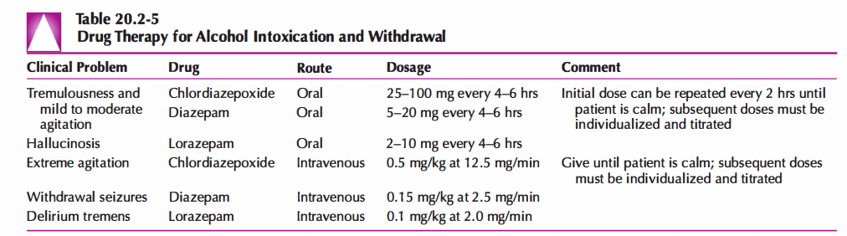

Slide 27
Protracted withdrawal –
Symptoms of anxiety, insomnia, and mild autonomic over activity are likely to continue for 2 to 6 months after the acute withdrawal has disappeared.
Acamprosate (2000 mg/day) may work by diminishing some of these symptoms.
It is important that the clinician warn the patient that some level of sleep problems or feelings of nervousness might remain after acute withdrawal and discuss cognitive and behavioral approaches that might be appropriate to helping the patient feel more comfortable.
Protracted withdrawal symptoms may enhance the probability of relapse.

Slide 28
ALCOHOL RELATED BRAIN DISORDERS
Alcohol induced persisting dementia –
  Global decreases in intellectual functioning, cognitive abilities & memory
  recent memory difficulties
  Brain functioning tends to improve with abstinence
  but perhaps 50% of all affected patients have long-term and even permanent disabilities in memory and thinking.
Alcohol induced persistent amnestic disorder –
  Disturbance in short-term memory caused by prolonged heavy use of alcohol.
  It is rare in persons younger than 35 years of age.

Slide 29
WERNICKE'S ENCEPHALOPATHY (WE)-
  Acute neuropsychiatric condition due to insufficient supply of Thiamine to the brain
  Diagnosis - dietary deficiency + 2 of the classic triad (Ophthalmoplegia, Ataxia, & Confusion)
  Presumptive diagnosis - if ophthalmoplegia, ataxia, acute confusion, memory disturbance, unexplained hypotension, hypothermia, coma, or unconsciousness in ADS
  High risk cases (suspicion needed) - using > 15 units /day for a month or more, evidence of recent weight loss/ vomiting / diarrhoea / malnutrition / peripheral neuropathy/chronic ill health
  MANAGEMENT:
    Medical emergency
    For all suspected and high risk individuals – parental thiamine 100 mg i.m or oral thiamine before glucose.
    In India –
      All suspected and high risk cases parental thiamine to be given for 2 weeks + oral thiamine of 100-200 mg /day for a minimum period of 3 months
      All cases of ADS it is recommended to start oral thiamine for minimum of three months.

Slide 30
KORSAKOFF'S SYNDROME -
  Undiagnosed or inadequately treated Wernicke's Encephalopathy proceed to Korsakoff's syndrome
  Diagnosis - Severe anterograde amnesia, retrograde amnesia and cognitive deficits
  The patient may or may not have the symptom of confabulation
  MANAGEMENT:
    Best treatment is timely recognition of WE & appropriate intervention and treatment
    200 mg thrice daily thiamine before carbohydrate in high risk cases
    Once cognitive impairment or Korsakoff's syndrome is evident (after thiamine replacement) - No additional pharmacotherapy to ameliorate cognitive impairment has been shown to be effective

Slide 31
Alcohol induced mood disorder –
  Results in major depressive disorder, but the intense sadness markedly improves within several days to 1 month of abstinence.
  80 % of people with alcoholism report histories of intense depression
  Mx: Psycho education and cognitive-behavioural treatment, wait & watch at least 2 to 4 weeks before starting antidepressant medications.
Alcohol induced anxiety disorder –
  80 % of alcoholic persons report panic attacks during at least one acute withdrawal episode.
  During the first 4 weeks of abstinence, people with severe alcohol problems are likely to avoid some social situations for fear of being overwhelmed by anxiety (i.e. symptoms resembling social phobia & agoraphobia)
  Mx: Reassurance, The symptoms are likely to diminish and subsequently disappear with time.

Slide 32
Other alcohol related neurological disorders –
  Fetal Alcohol Syndrome:
    It is the leading cause of intellectual disability occurring, when mothers who drink alcohol expose fetuses to alcohol in utero.
    Alcohol inhibits intrauterine growth and postnatal development
    leading to microcephaly, craniofacial malformations, limb and heart defects, short adult stature and development of a range of adult maladaptive behaviors.
    Women with alcohol-related disorders have a 35 % risk of having a child with defects.

Slide 33
MANAGEMENT OF ALCOHOL DEPENDENCE
PHARMACOLOGICAL MANAGEMENT
GOALS :
  Maintain & motivate for complete abstinence
  If not possible:
    Decrease the frequency and severity of relapses
    Maximise functioning in between
    Improve the quality of life

Slide 34
DISULFIRAM
  Aversive agent.
  Irreversible inhibitor of Aldehyde dehydogenase causes increase in the level of acetaldehyde
  if alcohol is consumed resulting in nausea, sensation of heat in head and neck, hypotension, flushing and palpitations.
  This deters people from drinking along with disulfiram Causes increase in the level of dopamine and decrease in the level of nor adrenaline in brain by blocking dopamine hydroxylase
  Dose: 250 mg/day for 1 year.
  Started when the body is alcohol free for at least 24 hrs
  Common side effects are drowsiness and gastric irritation
  Guiding principle to stop disulfiram is when patient and therapist mutually agree and patient is confident of remaining abstinence

Slide 35
NALTREXONE
  strong efficacy base
  Opiate receptor antagonist - decrease in euphoric and rewarding effects of alcohol,
  decrease in alcohol induced dopamine release which causes reduction in rewarding and decrease in craving
  Reduces return to heavy drinking by reducing lapse to relapse, but does not improve the abstinence rate.
  Long acting Injectable form of Naltrexone has been used to overcome poor adherence.
  Oral dose: 50 mg/day ( can be given also while using alcohol)
  Mild and transient side effects
    Most common adverse effect is nausea and sedation
    CNS: headache, dysphoria, fatigue
    GI: nausea, abdominal pain, vomiting, and liver toxicity
  Longer duration of use (6 months) had better outcomes compared to shorter duration (3 months) - benefits also observed to last for 3-12 months after stopping
Notes:
Injectable (not yet formally approved for use in India): 190 mg and 380 mg/month in people with poor adherence,(LA)

Slide 36
ACAMPROSATE (calcium acetyl homotaurinate)
  Synthetic molecule which is hypothesized as a functional glutaminergic NMDA antagonist and reduces hyperglutamatergic state and reestablishes the homeostasis.
  Acamprosate better than placebo in maintaining abstinence and in preventing relapse
  Dosage: (333 mg pill) 999 mg to 1998 mg/day based of weight of the patient
  Adverse effects: GI disturbance most common
  Not metabolised in the liver and excreted unchanged in kidney contraindicated in severe liver and renal impairment
  To be used for a year - benefits also observed to last for 3-12 months after stopping
Notes:
Injectable (not yet formally approved for use in India): 190 mg and 380 mg/month in people with poor adherence

Slide 37
BACLOFEN
  Stereo selective GABA B receptor agonist - inhibit the release of neurotransmitters such as Dopamine, 5HT, NA, Glutamate
  Baclofen has a higher rate of abstinence and decreases anxiety.
  Baclofen holds promise and should be first line of management in patients with moderate to severe cirrhotic liver disease.
  Dose: 30-60 mg/day
  First line of management in the presence of moderate to severe cirrhosis
TOPIRAMATE
  Reduces mesolimbic activity of dopamine by Facilitates GABA transmission, decrease in AMPA (Glutamate excitation)
  Reduces the percentage of heavy drinking days, maintain abstinence, harmful drinking consequences, physical health and quality of life.
  Dose: 150-300 mg/day
  Adverse effects: Paraesthesia, Anorexia, Insomnia, difficulty in concentration
Notes:
Injectable (not yet formally approved for use in India): 190 mg and 380 mg/month in people with poor adherence
Injectable (not yet formally approved for use in India): 190 mg and 380 mg/month in people with poor adherence

Slide 38
SELECTIVE SEROTONIN REUPTAKE INHIBITOR (SSRI)
  SSRIs are generally used for patients with comorbid depression, effectiveness is less consistent in non depressed patients
  SSRIs worsen outcome in early onset, family history of alcoholism
GAMMA HYDROXYBUTYRIC ACID (GHB)
  GABA-B agonist
  To prevent relapse and decrease in craving in patients during 3 months follow up
  Because of the risk of addiction drug should be used only under strict medical surveillance
ONDANSETRON
  5-HT3 antagonist
  May be effective in early onset users
ANTIPSYCHOTICS
  Aripiprazole, Quetiapine, Olananzapine, Amisulpride, Flupenthixol, Haloperidol and Clozapine – only case reports which state that they improve drinking outcome
  Not recommended for general use
Notes:
Injectable (not yet formally approved for use in India): 190 mg and 380 mg/month in people with poor adherence

Slide 39
Treatment of Independent Psychiatric Disorders
patient with bipolar I disorder who has an associated AUD with appropriate psychotherapy and lithium or valproic acid.
long-term antipsychotic medications to the patient with schizophrenia.
The goal is to minimize the symptoms of the independent psychiatric disorder in the hope that a greater level of life stability will be associated with a better prognosis for the patient’s alcohol problems.

Slide 40
MANAGEMENT OF ALCOHOL DEPENDENCE
PSYCHOSOCIAL INTERVENTIONS
  Psychosocial therapies differing widely in conceptual framework, intensity, duration, and location
  Structured specific therapies have better outcome compared to less structured supportive counselling
  No particular psychotherapy has been found consistently to be better than others
GOALS:
  Enhance efficacy of Pharmacotherapy
  Achieving sustained drug free status
  Change in life style and
  Improve quality of life

Slide 41
MOTIVATION ENHANCEMENT THERAPY
  Maximise patient's intrinsic desire to change substance use using motivational interviewing techniques
  Empathic, non-judgemental and supportive approach to examine patient's ambivalence about changing substance use behaviours
BRIEF INTERVENTIONS
  Also used for motivation enhancement
  Consists of FRAMES: Feedback, Personal Responsibility, Advice, Menu, Empathy and Self efficacy
  Lesser time and carried out in primary health care setting, cost effective
  Motivation Enhancement Therapy (MET) / Motivation Interviewing and Brief intervention (BI) have been found to be effective - They can be given in different setup by different professionals.
  A brief MET of 4 sessions has been found to be as effective
Notes:
The goal is to use the principles of motivational interviewing and brief interventions to help patients recognize the adverse consequences likely to occur if they do not stop drinking.
presenting complaint (e.g., insomnia or depression) is a useful way to both show empathy and enhance motivation for change.
alcohol either created or contributed to these problems and reassuring the patient that abstinence can be achieved.
If the person does not respond to the first brief intervention or motivational interview, the same nonjudgmental but persistent approach can be used each time an alcohol related problem is identified.
intervention often begins with a “brief intervention,” a cost-effective approach.

Slide 42
The goal is to establish an alliance with patients by demonstrating an understanding of their viewpoint while encouraging them to think through consequences associated with alcohol.
Between two visits separated by about 1 month, patients keep notes of their drinking patterns.
The second session reviews the same issues and is followed by several short telephone interviews.

Slide 43
COGNITIVE BEHAVIOUR THERAPY
  Based on social learning theories aimed at improving self control and social skills
  Along with medications they have found to be effective in relapse prevention & decrease in alcohol use
RELAPSE PREVENTION COUNSELLING
  Uses CBT techniques to develop greater self control over alcohol use behaviours to avoid relapse
  People who have better coping strategy for internal and external stressors, learn from previous lapses and have mastery over self control measures have better outcome
BEHAVIOURAL THERAPIES
  Based on learning theories and positive reinforcements for target behaviours
  Community reinforcement approach is effective

Slide 44
Counseling
Counseling in the first several weeks to months of recovery focuses on day-to-day life issues to help patients maintain a high level of motivation for abstinence and to enhance their functioning.
Psychotherapy techniques that provoke anxiety or that require deep insights may not be beneficial during the early phases of treatment.
treatment sessions explore the consequences of drinking, the likely future course of alcohol-related life problems, and the improvement that can be expected with abstinence.
Counseling also deals with how to build a lifestyle free of alcohol.
Whether in an inpatient or an outpatient setting, individual or group counseling is usually offered about three times a week for the first 2 to 4 weeks followed by less intense efforts, perhaps once a week, for the subsequent 3 to 6 months.

Slide 45
GROUP THERAPIES
  Helps in making efficient use of therapist time
  Encourage people to discuss problems and reduction in stigma
  Group therapies involving assertive techniques, social skill training, family focussed therapy and motivation enhancement has been shown to be effective
FAMILY THERAPY
  To address dysfunctional families and those with high expressed emotions that leads to substance abuse and plays an important role in Indian context
  Family therapies along with medication have found to be better in reduction of alcohol, relapses and this has also been found effective in Indian setup

Slide 46
Importance of the Family
AUDs affect many people in the patient’s life.
Counselling and support for spouses, offspring, and friends can help them work to rebuild key relationships.
learn how to avoid protecting the patient from the consequences of drinking.

Slide 47
SELF HELP GROUP APPROACH AND 12 STEP ORIENTED PROGRAMME
Alcoholics Anonymous (AA) –
  “12-step-based”
  Offers emotional support and a model of abstinence for people recovering from alcohol dependence
  Members of AA have help available 24 hours a day, associate with a sober peer group, learn that it is possible to participate in social functions without drinking, and are given a model of recovery by observing the accomplishments of sober members of the group.
  Learning about AA usually begins during inpatient or outpatient rehabilitation.
  The clinician can play a major role in helping patients understand the differences between specific groups.
  Some meetings are composed mostly of blue collar men and women, whereas others are mostly for professionals.
  Studies indicate that it is associated with improved outcomes, and incorporation into treatment programs saves money.

Slide 48
COMPARISON OF DIFFERENT THERAPIES
  Equivalent outcomes with both brief, non-intensive treatments and intensive treatments for moderately severe alcohol dependence
COMBINED PHARMACOLOGICAL AND NON PHARMACOLOGICAL APPROACH HAS BETTER EFFECTIVENESS

Slide 49
Rehabilitation
increasing and maintaining high levels of motivation for change
helping patients readjust to a lifestyle that maximizes functioning and decreases the risk for drinking
relapse prevention.
These steps often begin in the context of acute and protracted withdrawal syndromes and life crises.
The same general treatment approach is used in inpatient and outpatient settings.
The treatment process in either setting involves 2 to 4 weeks of care as an intensive period of help, followed by at least 3 to 6 months of less frequent outpatient care.
inpatient mode often depends on evidence of additional severe medical or psychiatric syndromes

Slide 50
Rehabilitation: - includes three major components:
A> Continued efforts to increase and maintain high levels of motivation for abstinence – through application of motivational interviewing. It includes 5 principles:
i> express empathy through reflective listening
ii> develop discrepancy between clients’ goals or values and their current behavior
iii> avoid argument and direct confrontation
iv> adjust to client resistance rather than opposing it directly
v> support self – efficacy and optimism

Slide 51
B> Work to help the patient readjust to a lifestyle free of alcohol: -
The need for a sober peer group.
A plan for social and recreational events without drinking.
Approaches for reestablishing communication with family members and friends.
C> Relapse prevention: -
First to identify situations in which the risk for relapse is high, and help patients develop modes of coping to be used when the craving for alcohol increases or when any event or emotional state makes a return to drinking likely.
Reminding the patient about the appropriate attitude toward slips. Slips help to identify high-risk situations and to develop more appropriate coping techniques.

Slide 52
MANAGEMENT OF ALCOHOL DEPENDENCE IN SPECIAL POPULATIONS
PREGNANCY AND LACTATION
  Adverse effect on mother, baby and course of pregnancy
  Fetal alcohol spectrum disorder
  Typical facies, growth and mental retardation
  MANAGEMENT
    Stop alcohol use
    Treat medical and psychological co-morbidities
    Monitor pregnancy closely
    Non-pharmacological treatments should be treatment of choice
    When needed drugs can be used after discussing about pros and cons and taking an informed decisions and close monitoring of the pregnancy

Slide 53
MANAGEMENT OF ALCOHOL DEPENDENCE IN SPECIAL POPULATIONS
YOUNG AGE GROUPS
  Associated disorder: Conduct disorder, ADHD, Major Depression, Anxiety/ Bipolar disorder
  MANAGEMENT
    Young people with problems of alcohol use have shown that school based interventions, family based interventions and multipronged interventions have found to effective in medium and long term
    Young children should also be assessed for psychiatric comorbidity and managed accordingly

Slide 54
MANAGEMENT OF ALCOHOL DEPENDENCE IN SPECIAL POPULATIONS
PROBLEMATIC ALCOHOL USER
  Refers to any user who has problem with alcohol use which may be physical, psychological, social consequences etc.
  Includes hazardous use of alcohol, harmful use of alcohol and alcohol dependence
  Hazardous use: term given by WHO to pattern of substance use which carries with it a risk of harmful consequences (physical/mental/social) to the substance users or others
  Harmful use of alcohol as per ICD-10 refers to use of alcohol leading to physical and psychological harm to the individual
  50% of Indian regular users contribute to the category of hazardous drinking
  MANAGEMENT
    Screening for alcohol use and Brief Intervention decrease considerable morbidity and mortality.
    Screening for alcohol use and Brief intervention (BI) has been found to decrease alcohol use in different settings and with different person providing intervention

Slide 55
Course and prognosis
Women have higher rates of independent depressive episodes and are less likely to be violent, have a full time job, or have less police records compared to men.
Older individuals are more likely to have medical problems, take multiple medications, and have fewer extensive social support systems compared to younger individuals.
Fewer than half of people with AUDs ever receive treatment for their disorder.
Once they complete a program, a majority do well and develop long-term, often permanent, abstinence.

