Slide 1
MEMORY
BY
Dr .himanshu Chauhan
Asssociate professor
DEPT OF PSYCHIATRY

Slide 2
Memory-The encoding, storage and retrieval of what was learned earlier.
Cognition-process through which information coming from the senses is transformed, reduced, elaborated, recovered and used.
Cognitive processes-Mental processes involved about knowing the world, they are important in perception ,attention, thinking, problem solving and memory.

Slide 3
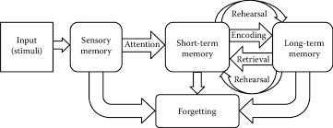
Atkinson Shiffrin Theory of Memory
Sensory Register-for few seconds
Unstable,labile
20-30 seconds
Holds tremendous amount of information in organized categories.
Permanent and hard to disrupt.
Consolidation-Temporal Lobe(Amygdala and Hippocampus)
Notes:
Long term

Slide 4
The Sensory Register
Information held for very brief time.
Most of the information is lost or simply decays.
If attention is paid-information is passed on to short term memory.
Experiments have shown that visual sensory register hold information for 1 second and can hold upto 11 to 16 items before it loses through decay.The vision is stored in the form of a faint image known as ICONIC IMAGE.
Auditory/hearing sensory register holds for longer-4 to 5 seconds.

Slide 5
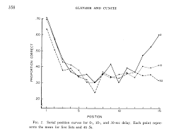
Short Term Memory
Memory that holds the information from sensory register for upto 30 seconds,depending upon a number of factors.
Experiment by Glanzer & Cunitz-for STM by technique known as FREE RECALL.
Words presented early(primacy effect) and late(Recency effect)are recalled well,and the words in the middle are recalled relatively poorly-SERIAL POSITION EFFECT.
Delay interval were filled with mental activity of counting.
After delay of 10 and 30 seconds,decrese recall in receny but not in primacy.

Slide 6
Reason for disappearance of recency effect with delay;-
1.Last items are still in STM, they have not been transferred to LTM, and this transfer is prevented by mental activity of counting.
2. STM is transient and has very limited storage capacity of about 5-9 items.
This capacity can be increased by a process k/a CHUNKING.
CHUNKING-. the process by which the mind divides large pieces of information into smaller units (chunks) that are easier to retain in short-term memory. As a result of this recoding, one item in memory (e.g., a keyword or key idea) can stand for multiple other items (e.g., a short list of associated points).

Slide 7
Fate of information in STM;-
1.Much information is LOST, displaced by incoming items.
2.RETRIEVAL-rapidly scanning through STM. Exhaustive process.
3.REHEARSAL-passed on through the next stage by LTM.

Slide 8
PROCESSING IN THE BRAIN
Visual information
Primary Visual Cortex(V1)
Ventral stream dorsal stream
Inferotemporal cortex parietal cortex
Identification of visual objects spatial location
They together register the immediate experience of perceptual processing and this is available as IMMEDIATE MEMORY.
It refers to the amount of information that can be held in mind (like a telephone number) so that it is available for immediate use. Immediate memory can be extended in time by rehearsing or otherwise manipulating the information, in which case what is stored is said to be in WORKING MEMORY.

Slide 9
REHEARSAL
For transfer of information from STM to LTM.
More the rehearsal, more likely to become part of LTM.
But recent studies show that sheer about of rehearsal may be less important than the way in which it is rehearsed.
Just going through information over and over again (MAINTAINANCE REHEARSAL),does not necessarily transfer it to LTM.
ELABORATIVE REHEARSAL involves material organization and giving meaning, It is an active rehearsal process and not just passive repetition.It is more likely to succeed to transform information to LTM.

Slide 10
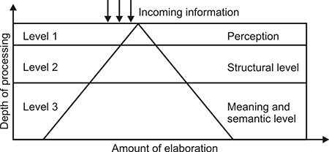
THE LEVELS-OF-PROCESSING THEORY
Given by Craik & Lockhart
According to it, Incoming information can be worked on at different levels of analysis. Deeper the analysis, better the memory
It has 3 levels;-
1.PERCEPTION-immediate awareness of the environment
2.STRUCTURE-what the input sounds or looks like, a deeper analysis
3.MEANING- meaning of the input is analyse, Deepest level.
Later added- ELABORATION: degree to which the information is processed, tied to, or integrated with existing memories.
Best memory-when processing is to the meaning level and elaboration is also most.
Notes:
2.eg-checking of spelling errors.
3.eg-ideas on the paper.

Slide 11
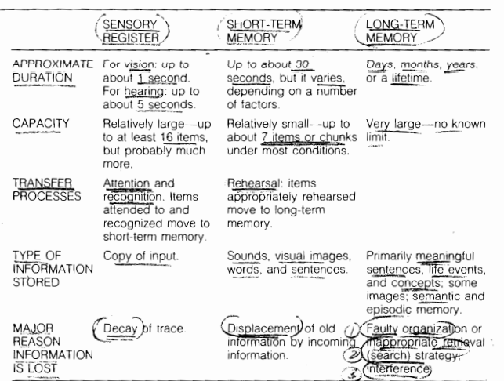
Summary of characteristics of stages of memory

Slide 12
Long term Memory
Can last for days, months, years or even a lifetime.
Infinite storage capacity.
No true forgetting from LTM. But we have difficulty remembering because of:-
It is not stored in an organized fashion.
Confusion or interference produced by new things.
Tip of the Tongue Phenomenon – Indicates that information is organized in LTM. When we try to retrieve words we tend to hit around the target wors by saying words that sound like the target word,starts with the same letter,contains the same number of syllables,has a meaning similar to the target word.

Slide 13
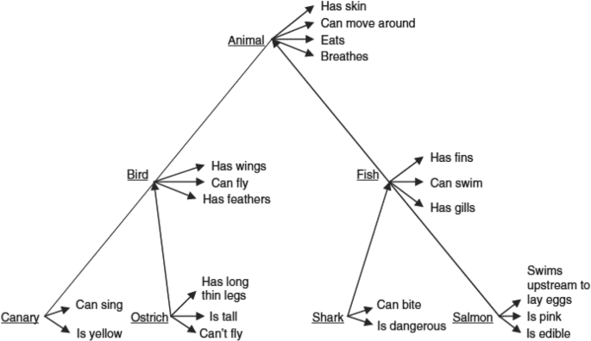
LTM-Semantic Memory
SEMANTIC MEMORY- the word ‘semantic’ means meaning.
It consists of knowledge of what words means, how the words are related to one another and the rules for using them in communication and thinking.
It is the kind of memory that makes our use of language possible.
It is very stable and there is little forgetting.
Information is stored in a highly organized way in logical hierarchies from general categories to specific ones.
Or as cluster of words with related meanings.

Slide 14
LTM-Episodic Memory
Consists of LTM for specific things that happened at particular time and place.
Memories of episodes on our own lives dated and have a biographical references.
Do not have logical organization and are more susceptible to forgetting.

Slide 15
LONG TERM POTENTIATION
The phenomenon of long-term potentiation (LTP) is a mechanism for LTM.
LTP is observed when a postsynaptic neuron is persistently depolarized after a high-frequency burst of presynaptic neural firing. LTP is a persistent strengthening of synapses based on recent patterns of activity that produce a long-lasting increase in signal transmission between two neurons
LTP has a number of properties that make it suitable as a physiological substrate of memory-
established quickly
lasts for a long time
associative i.e. it depends on the co-occurence of presynaptic and postsynaptic activity.
occurs only at potentiated synapses and not all.
prominently seen in Hippocampus.
Notes:
a change within a cell, during which the cell undergoes a shift in electric charge distribution, resulting in less negative charge inside the cell compared to the outside.

Slide 16
LTP is mediated postsynaptically by activation of NMDA receptors which permits influx of calcium and is maintained by increase in AMPA receptors.
In an experiment on mice, a selective deletion of NMDA receptors in the CAI field of the hippocampus, many aspects of CAI physiology remain intact, but the CAI neurons do not exhibit LTP, and memory impairment is observed in behavioral tasks.

Slide 17
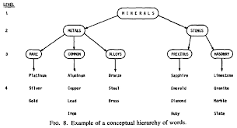
Organization of LTM
To remember things in LTM, organizing and arranging inputs or grouping them into some logical manner so that they make sense together.
This organizing may be inherent in the input itself or may be supplied by individuals as they learn and remember new things.
Mostly information is not well organized and we must provide our own organizational encoding. This is known as SUBJECTIVE ORGANIZATION.

Slide 18
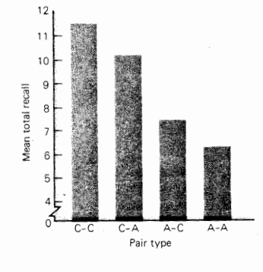
ROLE OF IMAGERY
LTM can either be encoded as verbal information or by forming imagery.
Images encoded are – not exact copy of the input
are not complete
partial with altered representation.
Experiment done on imagery and memory-PAIRED ASSOCIATE TECHNIQUE.
Equal number of pairs of concrete and abstract words were given.(C-C,
C-A, A-C, A-A)
1st word-stimulus , 2nd word-response.
Concrete words in the stimulus position evoked better imagery and thus resulted in best recall.
Imagery evoked by the response terms also led to good recall.
Notes:
PAT-1st word-stimulus,2nd word-response.
concrete and abstract words were paired.

Slide 19
ROLE OF CONSTRUCTIVE PROCESSES
During encoding, the input especially a complex event is modified ,accentuated or simplified. So what is ultimately encoded is far from the literal copy of the input.
These modifications are known as CONSTRUCTIVE PROCESSES.
Eg. storing only the gist or meaning of complex information, inferences.

Slide 20
Retrieval from LTM
RETRIEVAL CUES/REMINDERS/TAGS-They direct the memory to search the appropriate part of LTM library when they are attached to along with the information.
For eg. hund = dog (German) & hound =breed of dog used for hunting(English)
STATE DEPENDANT MEMORY/LEARNING-Eg of retrieval cues.
It is the situational influence that affects the retrieval from LTM.
For eg.information encoded in a particular drugged state might not be remembered when sobered up ,but when put back in the original drugged state,it can be retrieved.

Slide 21
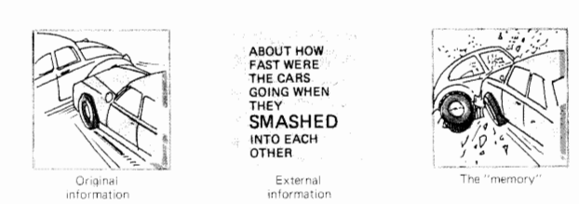
Reconstructive Processes in Retrieval
They are modifications of already stored input. Also sometimes k/a CONFABULATIONS.
They are seen as the answer to what biases the retrieval of what information was originally stored.
Experiment on this done by Loftus & Palmer
Subjects shown a short film on RTA .Immediately after that 2 groups with Qs on “How fast were the cars when they SMASHED/HIT each other?”.
One week later they were asked “Did you see any broken glass?”
Subjects who had been given ‘SMASHED’ Q were twice more likely to report broken glass when there was none.
Notes:
Constructive process-during encoding.
Reconstructive process-already stored input.

Slide 22
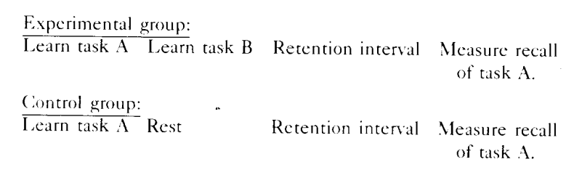
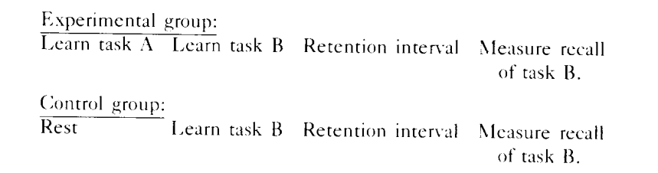
FORGETTING-Interferences & Motivated forgetting
INTERFERENCES-It is of two types.
1.Retroactive Interference-memory interference from activities that came after the event one is trying to remember
2.Proactive Interference-It is due to events that came before the to be remembered information.

Slide 23
Motivated Forgetting
Concept given by Sigmund Freud.He quotes “The forgetting in all cases is proved to be founded on a motive of displeasure”
Based on the concept of REPRESSION.It is the exclusion of distressing memories, thoughts or feelings from the conscious mind.
Some emotionally toned information is made unavailable for conscious thought.To dredge up the unconscious, repressed memories,psychoanalysts use _ FREE ASSOCIATION i.e. saying whatever comes to the mind as in this process,retrieval cues for the repressed memories are generated.
Hypnosis and truth serums are some other methods for the same.

Slide 24
AMNESIA
Profound loss of memory either due to loss of what has been stored or the ability to form new memories.
It can be –Biological or Psychological.
PSYCHOLOGICAL AMNESIA:
1.CHILDHOOD AMNESIA- 3 theories of why we do not remember early childhood memory(approx. 3 yrs of age)
i)Accoding to Freud-Due to repression.We are unable to retrieve our childhood memories because they are associated with forbidden, guilt arousing sexual and aggressive urges and might provoke guilt or anxiety.

Slide 25
ii) Schachtel –Due to differences in the ways younger and older people encode and store information.
Language development memory go hand in hand.Young children without language development encode memories in a nonverbal form, perphaps as images or feelings and are no longer available to verbal,language dominated adults.
iii)The brain is maturing and growing in the first few yrs of life and the memory machine is not able to store LTM.

Slide 26
2)DREAM AMNESIA-Three interpretations on why we forget most of our dreams.
i)Freud-Dreams are the expression of forbidden sexual or aggressive urges and can produce strong guilt or anxiety.
ii)Due to differences in the symbol systems used in dreaming and waking are different and therefore we have difficulty in retrieval.
iii)State Dependance-The dreaming brain is in a different state than the awake brain.

Slide 27
3)DEFENSIVE AMNESIA- Relatively rare,people may forget their names,where they are from and important details of their past lives.
Considered to be a way of protecting oneself from the guilt and anxiety from intense,intolerable situation or conflicts.
Extreme form of repression.
Suddenly amnesiac regains details of his earlier life maybe after weeks to years. But information during the episode itself is not retrievable. This is known as a MEMORY GAP.

Slide 28
BIOLOGICAL AMNESIA
1)TRANSIENT GLOBAL AMNESIA-Profound memory problem with no loss of consciousness
Cause not known but maybe due to changes in pattern of CBF.
Sudden without any obvious cause.
Typically lasts for few hours or days before memory becomes normal again.
GLOBAL because so much what has been stored is forgotten and no new memories are formed while the attack is in progress.
2 types- RETROGRADE(forgetting events one was exposed to in the past) & ANTEROGRADE (inablility to encode and store new information)
Retrograde deficits often have a temporal gradient, following a principle known as Ribot's law; deficits are most severe for information that was most recently learned.

Slide 29
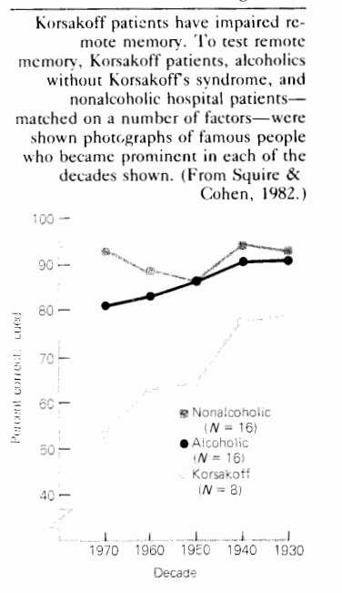
2)SUBSTANCE INDUCED AMNESIA
Marijuana has a limited impact on memory and hardly results in amnesia.
ALCOHOL-Can result in memory gaps after binge drinking.
It is an example of state dependent memory
Chronic drinking can results in KORSAKOFF SYNDROME in which anterograde amnesia is a prominent feature. But can also have loss of remote memories.

Slide 30
3)DISEASES OF THE BRAIN-Common diseases that can result in amnesia are syphilis, tumors, strokes, MS, senile dementia & primary degenerative dementia.
SENILE DEMETIA(senile meaning old age)-deficits in many intellectual abilities like memory, attention, judgement, abstract thought, personality changes like excessive dependence and irritablility are common.
Delusion and a general disorientation occur as the disease progresses.
Amnesia is largely ANTEROGRADE and therefore they have trouble learning new things.
Most commonly due to brain arteriosclerosis.
It is different from typical forgetfulness of old age which is also anterograde in nature, but normal old people are able to compensate by reminder cues, writing down what is to be written and organizing lives into routines.

Slide 31
PRIMARY DEGENERATIVE DEMENTIA
Begins in the middle age. Eg. Alzheimers disease.
Goes from relatively mild anterograde amnesia to a profound anterograde and retrograde amnesia-both recent and remote past are largely gone.

Slide 32
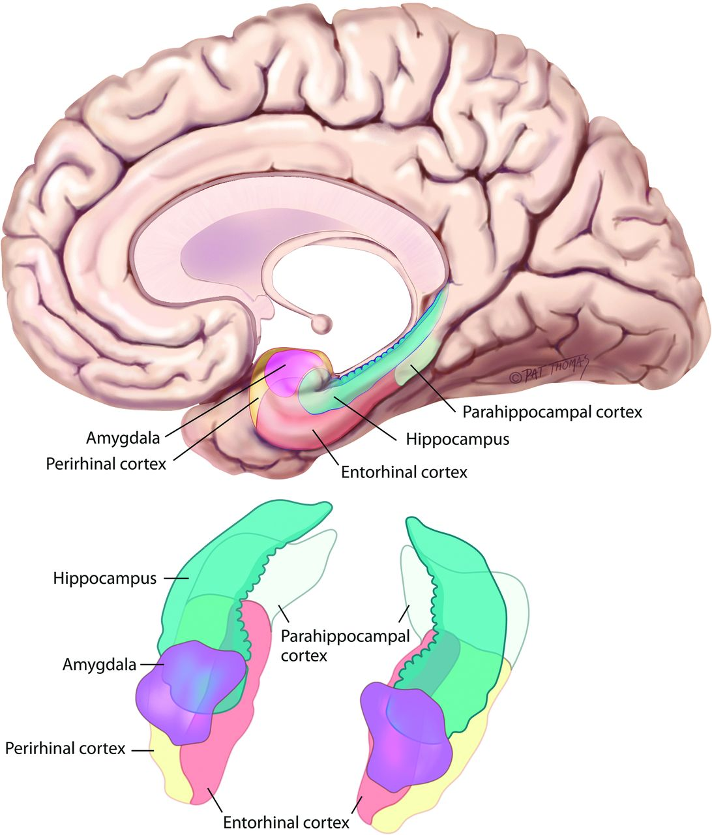
SPECIALIZED MEMORY FUNCTION
Amnesia can result from damage to the medial portion of the temporal lobe or from damage to regions of the midline diencephalon.
Medial temporal structures and connections that are crucial for memory. These include the hippocampus-which includes the dentate gyrus; hippocampal fields CA 1, CA2, and CA3; and the subiculum and the adjacent cortical regions, including the entorhinal, perirhinal, and parahippocampal cortices and Amygdala.
Modulatory effects of projections from the amygdala to the neocortex are responsible for producing enhanced memory for emotional or arousing events compared to neutral events

Slide 33
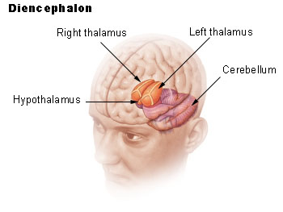
Damage to Medial Dienchephalon
The critical regions damaged in diencephalic amnesia include the mammillary nuclei in the thalamus, the dorsomedial nucleus of the thalamus, the anterior nucleus, the internal medullary lamina, and the mammillothalamic tract.
Alcoholic Korsakoff's syndrome is the most studied example of diencephalic amnesia, and in these cases damage is found in brain regions that may be especially sensitive to prolonged bouts of thiamine deficiency and alcohol abuse.
Patients with alcoholic Korsakoff's syndrome typically exhibit memory impairment due to a combination of diencephalic damage and frontal lobe pathology.

Slide 34
PATTERN COMPLETION
An event is experienced and encoded by virtue of a collection of cortical regions.
The hippocampus and adjacent cortex also receive high-level information from all sensory modalities.
Later, when the original event is recalled, the same set of cortical regions is activated
If a subset of the cortical regions is activated, the hippocampus and related structures can facilitate recall by facilitating the activation of the remaining cortical regions k/a PATTERN COMPLETION.
When the original event is retrieved and newly associated with other information, hippocampal-cortical networks can be modified

Slide 35
The neocortical components representing some events can become so effectively linked together that ultimately a memory can be retrieved without any contribution from the medial temporal lobe.
As a result, amnesic patients can exhibit normal retrieval of remote facts and events, as well as autobiographical memories.
In contrast to what is observed after damage restricted to the hippocampus, extensive retrograde impairments for facts and events from the distant past can also occur

Slide 36
MULTIPLE TYPES OF MEMORY
Amnesia affects only one kind of memory, declarative memory.
Declarative memory is what is ordinarily meant by the term memory in everyday language.
Declarative memory supports the conscious recollection of facts and events.
The classic impairment in amnesia thus concerns memory for routes, lists, faces, melodies, objects, and other verbal and nonverbal material, regardless of the sensory modality in which the material is presented.
Declarative memory depends on medial temporal and midline diencephalic structures along with large portions of the neocortex.
This system provides for the rapid learning of facts (semantic memory) and events (episodic memory).

Slide 37
The heterogeneous set of preserved abilities in amnesia is collectively termed nondeclarative memory.
Nondeclarative memory includes skill learning, habit learning, simple forms of conditioning, and a phenomenon called priming.
For these kinds of learning and memory, amnesic patients can perform normally.
Nondeclarative memory depends on several different brain systems. Habits depend on the neocortex
The neostriatum, and the cerebellum is important for the conditioning of skeletal musculature
The amygdala for emotional learning, and the neocortex for priming.

Slide 38
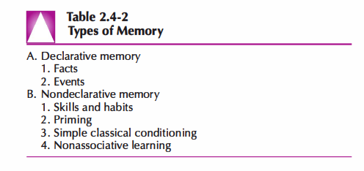
Declarative memory is phylogenetically more recent than nondeclarative memory.
In addition, declarative memories are available to conscious recollection.
The flexibility of declarative memory permits the retrieved information to be available to multiple response systems.
Nondeclarative memory is inaccessible to awareness and is expressed only by engaging specific processing systems

Slide 39
Cerebral hemispheres and Memory
Damage to medial temporal or diencephalic structures in the left cerebral hemisphere causes difficulty in remembering verbal material, such as word lists and stories.
Damage to medial temporal or diencephalic structures in the right cerebral hemisphere impairs memory for faces, spatial layouts, and other nonverbal material

Slide 40
METAMEMORY
Tests of the ability to judge one's memory abilities are called tests of metamemory.
As a result, it is possible to distinguish memory complaints associated with depression from memory complaints associated with amnesia.
Depressed patients tend to rate their memory as poor in a rather undifferentiated way, endorsing equally all of the items on a self-rating form.
By contrast, amnesic patients tend to endorse some items more than others; that is, there is a pattern to their memory complaints. Amnesic patients do not report difficulty in remembering very remote events or in following what is being said to them, but they do report having difficulty remembering an event a few minutes after it happens.
Some amnesic patients, however, tend to markedly underestimate their memory impairment. In patients with Korsakoff's syndrome, for example, their poor metamemory stems from frontal lobe dysfunction.

