Slide 1
Neurobiology Of Addiction & Common Principle Of Management
Dr. Himanshu Chauhan
Associate Professor
Department Of Psychiatry
SBKS MI & RC
Notes:
Substance use disorders are complicated psychiatric conditions and like other psychiatric disorders,
biological factors and environmental circumstances are etiologically significant.

Slide 2
Terms Used in Substance-Related Disorders
Abuse:
  Use of any drug, usually by self-administration, in a manner that deviates from approved social or medical patterns.
Misuse:
  Similar to abuse, but usually applies to drugs prescribed by physicians that are not used properly.
Dependence:
  Repeated use of a drug or chemical substance, with or without physical dependence. Physical dependence indicates an altered physiologic state caused by repeated administration of a drug, the cessation of which results in a specific syndrome.

Slide 3
Intoxication:
  A reversible syndrome caused by a specific substance (e.g., alcohol) that affects one or more of the following mental functions:
  Memory,
  Orientation,
  Mood,
  Judgment, and
  Behavioral, Social, or Occupational functioning.
Withdrawal:
  A substance-specific syndrome that occurs after stopping or reducing the amount of the drug or substance that has been used regularly over a prolonged period.

Slide 4
Tolerance:
  Phenomenon in which, after repeated administration, a given dose of drug produces a decreased effect or increasingly larger doses must be administered to obtain the effect observed with the original dose.
Cross-tolerance:
  Refers to the ability of one drug to be substituted for another, each usually producing the same physiological and psychological effect
Codependence:
  Term used to refer to family members affected by or influencing the behavior of the substance abuser.
Enabling:
  enabler, which is a person who facilitates the abuser's addictive behavior (e.g., providing drugs directly or money to buy drugs).
  Enabling also includes the unwillingness of a family member to accept addiction as a medical-psychiatric disorder or to deny that person is abusing a substance.

Slide 5
Substance Intoxication
Development of a reversible substance-specific syndrome due to recent ingestion of (or exposure to) a substance.
Clinically significant maladaptive behavioral or psychological changes that are due to the effect of the substance on the central nervous system and develop during or shortly after use of the substance.
Symptoms are not due to a general medical condition and are not better accounted for by another mental disorder.

Slide 6
Substance Withdrawal
Development of a substance-specific syndrome due to the cessation of (or reduction in) substance use that has been heavy and prolonged.
Substance-specific syndrome causes clinically significant distress or impairment in social, occupational, or other important areas of functioning.
Symptoms are not due to a general medical condition and are not better accounted for by another mental disorder

Slide 7
Substance Use Disorder
A maladaptive pattern of substance use leading to clinically significant impairment or distress, as manifested by 2 (or more) of the following, occurring within a 12-month period:
Recurrent substance use resulting in a failure to fulfill major role obligations at work, school, or home
Recurrent substance use in situations in which it is physically hazardous
Continued substance use despite having persistent or recurrent social or interpersonal problems caused or exacerbated by the effects of the substance

Slide 8
4. tolerance, as defined by either of the following:
  a need for markedly increased amounts of the substance to achieve intoxication or desired effect
  markedly diminished effect with continued use of the same amount of the substance
5. withdrawal, as manifested by either of the following:
  the characteristic withdrawal syndrome for the substance
  the same (or a closely related) substance is taken to relieve or avoid withdrawal symptoms
6. substance is often taken in larger amounts or over a longer period than was intended

Slide 9
7. persistent desire or unsuccessful efforts to cut down or control substance use
8. a great deal of time is spent in activities necessary to obtain the substance, use the substance, or recover from its effects
9. important social, occupational, or recreational activities are given up or reduced because of substance use
10. substance use is continued despite knowledge of having a persistent or recurrent physical or psychological problem that is likely to have been caused or exacerbated by the substance
11. craving or a strong desire or urge to use a specific substance.

Slide 10
ETIOLOGY
Environmental factors:
  Structural factors:- low socioeconomic status
  Proximal factors:- parental drug use and dependence, poor quality of parenting, parental depression, sibling and peer influence
  Distal factors:-drug availability, neighborhood characteristics, advertising and the media.
  Stress might be a common feature in a wide variety of environmental factors that increase the risk for drug abuse.

Slide 11
Sociocultural factors:
  Culture and Ethnic Background
    religious beliefs: that govern the use of alcohol and drugs
    ethnic variations: body’s rate and efficiency of metabolizing drugs and alcohol.
  Media/Advertising
    Societal emphasis on immediate gratification and glorification of the effects of alcohol and drug use.
  Childhood Trauma (violent, sexual)
  Learning Disorders & ADD/ADHD
  Mental Illness
      Depression
      Bipolar Disorder
      Psychosis

Slide 12
Developmental factors:
  Higher risk for drug use in certain life stages.
  Initial drug exposure during adolescence is associated with more chronic use, more intensive use, and greater risk of substance use disorder compared with initiation at older age.
  Normal adolescent specific behaviors ( such as risk taking, novelty seeking, high sensitivity to peer pressure) experimenting with legal and illegal drugs, which might reflect incomplete development of brain regions involved in executive control and motivation processes.

Slide 13
Genetic Factors:
  Inheritability has been found to range from 40- 60%.
  4-fold increased risk in 1st degree relatives
  Monozygotic twins have higher concordance of addiction than dizygotic twins (the more genes you share, the more similar your addiction propensity)
  Men whose parents were alcoholics have an increased likelihood of alcoholism.
  In humans, several chromosomal regions have been linked to substance use disorders. Some of these are polymorphism that interfere with drug metabolism.
Notes:
For example,
specific alleles for the genes encode alcohol dehydrogenase ADH1B and acetaldehyde dehydrogenase ALDH 2 (enzymes involved in metabolism of alcohol) are reportedly protective against alcoholism.
A single nucleotide polymorphism in the gene encoding fatty acid amide hydrolase has been associated with increased use of drugs or alcohol.
A Leu7Pro polymorphism of the neuropeptide Y gene has been correlated with increased alcohol consumption
Single nucleotide polymorphisms of the gene encoding the mu-opioid receptor correlates with an increased likelihood of heroin abuse.
The A1 allele of the TaqIA D2 dopamine receptor gene has been linked to severe alcoholism and polysubstance dependence.

Slide 14
EPIDEMIOLOGY
Prevalence in India:
  Alcohol use : 14.6%
    In male : 27.3 %
    In female : 1.6 %
  Cannabis use : 1.2 %
  Opioid use :2.06 %
  Cocaine use :0.11 %
Gender: More men than women use drugs
Notes:
By age 65, only about 1 percent of persons have used an illicit substance within the past year, which lends credence to the clinical observation that addicts tend to "burn out" as they age.

Slide 15
ADDICTION
Repeated and increased use of a substance,
the deprivation of which gives rise to symptoms of distress and an irresistible urge to use the agent again and
which leads also to physical and mental deterioration.

Slide 16
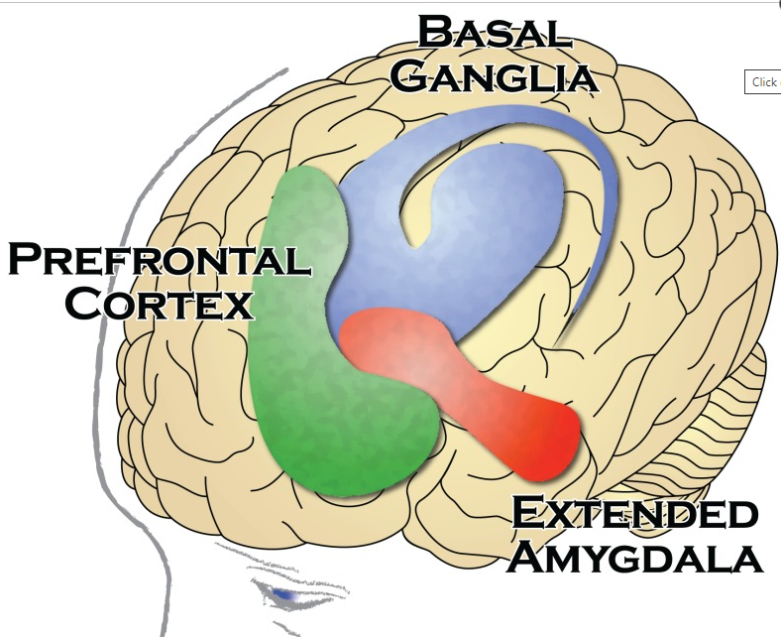
Areas of the Human Brain that Are Important in Addiction
Notes:
Extended AMG: Central medial AMG, NAc shell, BNST

Slide 17
Basal Ganglia:
Play an important role in
  learning routine behaviors
  forming habits.
Nucleus accumbens - motivation and the experience of reward
Dorsal striatum - forming habits and other routine behaviors.
Extended Amygdala
Regulate the brain's reactions to stress-including behavioral responses like “fight or flight” and negative emotions .
Interacts with the hypothalamus, an area of the brain that controls activity of multiple hormone-producing glands, which in turn, control reactions to stress and regulate many other bodily processes.
Notes:
Extended AMG: Central medial AMG, NAc shell, BNST

Slide 18
Prefrontal Cortex
Responsible for “executive function.”
Executive function is the ability to organize thoughts and activities, regulate one's actions, emotions, and impulses
Other Areas :
Two other areas of prime importance to the development of the addiction process:
  Insula: Has been recognised as having an essential role in the detection of interoceptive cues. These cues can also provoke powerful cravings for drugs and are a key component in the addiction process.
  Habenula: Plays a role in learning from past disappointments.

Slide 19
PHASES OF THE ADDICTION PROCESS
Drug use - legal use of substances such as caffeine, nicotine, and alcohol as well as medically prescribed use of drugs such as benzodiazepines, opioid painkillers.
Drug abuse - illicit drug use or when a psychoactive drug is taken for a nonmedical use.
Substance use disorder- increasing levels of drug consumption leads to compulsive drug use despite adverse consequences

Slide 20
Transition from casual drug use to SUD involves pathological neuroplasticity at each stage within neural circuits that regulate
  Affective state,
  Motor patterns, and
  Cognition
Transition from casual drug use to SUD
  Impulsive to compulsive use
  Positive to negative reinforcement mechanisms
  Positive reinforcement - which is associated with euphoria (e.g., initial drug “high”)
  Negative reinforcement - which is associated with cessation of an aversive state (e.g., drug withdrawal).

Slide 21
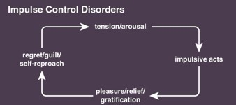
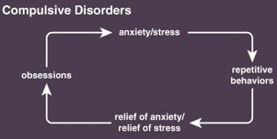
who develop SUD display characteristic of
  Impulse control disorders
    Increasing sense of tension or arousal before the impulsive act followed by a sense of relief or pleasure when the act is committed.
    positive reinforcement mechanisms
  Compulsive disorders
    feelings of anxiety and stress before engaging in a compulsive and repetitive behavior followed by relief from stress
    negative reinforcement mechanisms and habitual, automatic behaviors.

Slide 22
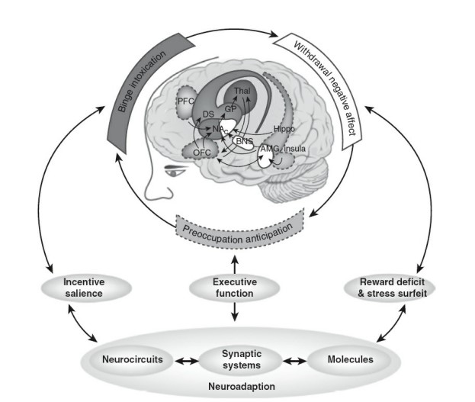
Development of SUD can be described as a three-stage cycle:
  Binge/intoxication,
  Withdrawal/negative affect, and
  Preoccupation/anticipation
(2) extended amygdala including the central nucleus of AMG, BNST, and a transition area in the shell of NAc
(1) basal ganglia including NAc, DS, GP, and Thal
(3) PFC, OFC, Hippo, and Insula

Slide 23
(1) Binge/Intoxication:
Initial drug use may begin in vulnerable individuals.
Vulnerability and reasons for initiating drug use can vary from person to person and culture to culture.
There is no underlying pathology in the majority of people who experiment with drugs use.
Influencing factors
  Impulsivity
  Sensitivity
  Anxiety
  Risk-taking behavior
  Biological and Environmental influences such as socioeconomic status, education, exposure to trauma and abuse
  Peer pressure
  Drug availability
  Family drug use

Slide 24
(2) Withdrawal/Negative Affect
- Drugs are used compulsive in nature, neuroadaptations start to develop
  result in decreased cognitive control and increased motivation for drugs that outweigh the motivation for natural rewards.
Positive hedonic responses to drug use (i.e., euphoria, reward) occur shortly after taking the drug.
Upon drug withdrawal, negative affective states are unmasked
Opponent processes begin early in drug taking and reflect compensatory changes in the neural circuitry that controls reward and stress responses.
  According to Solomon and Corbit (1974), “hedonic, affective, or emotional states are automatically opposed by CNS mechanisms which reduce the intensity of hedonic feelings, both pleasant and aversive.”
Notes:
Motivation is defined as the biological, emotional, social, and cognitive forces that activate behavior, and it can be modulated by drug-induced changes in hedonic and affective states that occur with the transition from substance use to SUD. This has been conceptualized in the opponent process theory of motivation (Fig. 1.24–2). According to Solomon and Corbit (1974), “hedonic, affective, or emotional states are automatically opposed by CNS mechanisms which reduce the intensity of hedonic feelings, both pleasant and aversive.”

Slide 25
(3) Preoccupation/Anticipation
Craving can be defined as an acquired desire characterized by wanting/anticipating drug use.
Drug withdrawal are followed by instances of craving and relapse, whereby various triggers such as stress, exposure to the drug itself or to previously drug-paired environmental cues reinstate drug seeking and drug taking.
Subjective experience of craving frequently precedes relapse.
Increasing levels of craving have been associated with increasing levels of anxiety, irritability, restlessness, increases in heart rate, nausea, and other symptoms that overlap with stress-related arousal and that are transiently relieved with drug use.
Notes:
Craving can be defined as an acquired desire characterized by wanting/anticipating drug use.

Slide 26
THEORIES OF ADDICTION
Theories are not mutually exclusive but tend to emphasize particular aspects of the SUD cycle.
Positive reinforcement kicks off the cycle and leads to the initial repetition of drug taking that eventually becomes habitual and compulsive.

Slide 27
Psychomotor stimulant theory:
Addictive drugs share common features cause:
  Psychomotor activation,
  Reinforcement, and
  Elicit approach behaviors.
Mesocorticolimbic dopamine system is a major neural substrate of the natural approach system.
In this theory, people initiate and maintain drug-taking behavior because drug-induced dopamine release has reinforcing effects and activates motor systems that result in repetitive drug approaches.
Proponents of this theory argue that drug withdrawal symptoms do not play a major part in compulsive drug use.

Slide 28
Incentive sensitization theory:
Theory builds upon the psychomotor stimulant theory of addiction
repeated exposure to drugs of abuse
neural adaptations in mesocorticolimbic dopamine system
hypersensitive to drugs and to any cues that have become associated with the drug
Notes:
Drugs are hypothesized to hijack neural systems (e.g., mesocorticolimbic dopamine system) that motivate animals to approach stimuli with salience (importance) for preservation of the species.
Contexts, cues, and other stimuli—including drugs of abuse—that activate these neural systems become tagged with incentive salience (motivational importance, “wanting”).

Slide 29
Person’s motivational focus narrows to drug seeking at the expense of natural reward seeking.
Sensitization of neural systems that control incentive salience (drug “wanting”) is independent of changes in neural systems that control reward (drug “liking”).
Proponents of this theory argue that the systems that mediate incentive salience are distinct from those controlling drug withdrawal-induced negative hedonic states.

Slide 30
Aberrant learning theory:
Incentive salience theory is explained in the context of aberrant learning.
Repeated exposure to drugs
changes in associative brain structures
modulating neural systems that control normal responses to nondrug associated cues
heightens responsiveness to drug-associated cues
drug seeking and taking becomes automatic or habitual.

Slide 31
This is mediated by a gradual shift from ventral to dorsal striatal mechanisms.
Sensitized responsiveness to drugs and drug cues is immune to punishment, resulting in a core symptom of SUDs: continued drug use despite adverse consequences.

Slide 32
Frontostriatal-dysfunction theory:
People with SUD have poor impulse control –
repeated drug exposure
leads to alterations in cortical and limbic circuits
pathological responses to drugs and drug cues while simultaneously displaying impaired inhibitory executive control over drug-taking behavior.
loss of impulse control, poor decision-making, heightened responsiveness to drug-associated cues, and compulsive drug use.

Slide 33
Hedonic-allostasis theory:
Postulates that
  initial drug abuse is motivated by the positive reinforcement
  chronic drug abuse is motivated by the negative reinforcement.
Chronic drug-induced negative emotional state, termed the “hedonic allostatic” state, reflects a persistent change in the normal reward set point.
Hedonic allostasis contributes to compulsive drug taking through negative reinforcement mechanisms that involve circuits connecting cortical, striatal, and thalamic regions
Notes:
initial drug abuse is motivated by the positive reinforcement obtained from the drug’s rewarding effects,
chronic drug abuse is motivated by the negative reinforcement resulting from the recruitment of stress-related systems and emergence of negative hedonic states.

Slide 34
Brain pathways in addiction
All drugs of abuse converge on a common circuitry in the brain’s limbic system.
Three primary circuits upon which chronic exposure to all drugs of abuse act.
Homeostatic impairment of the dopamine system
Extrahypothalamic actions of CRF
Cortical “hypofrontality,”

Slide 35
Homeostatic impairment of the dopamine system
Chronic exposure to addictive drugs causes a homeostatic impairment of the dopamine system,
  in which natural rewards become less effective at increasing dopamine release in a typical fashion
Chronic, intermittent drug exposure can sensitize the dopamine system, such that exposure to the drug or drug-associated stimuli elicits greater increases in dopaminergic transmission.
  This sensitization of dopamine responses can persist long after drug taking ceases and may relate to drug craving and relapse.

Slide 36
(2) Extrahypothalamic actions of CRF(Corticotrophin releasing factors)
Acute drug withdrawal
Activate CRF containing neurons in the amygdala
Stress-like effects
Negative affective and somatic symptoms of drug withdrawal

Slide 37
(3) Cortical “hypofrontality”
Final adaptation common to chronic exposure of most classes of abused drugs
Reduced basal activity of cortical neurons and decreased ability of natural rewards to activate certain cortical regions such as
  PFC, ACC , and OFC.
  Which control executive function, working memory, attention, and behavioral inhibition through glutamatergic projections to the nucleus accumbens and VTA.
Contribute to both impulsive and compulsive aspects of SUD.

Slide 38
Neural Pathways Underlying Acute Drug Reward
Brain stimulation reward involves multiple brain regions
Most sensitive site is within the medial forebrain bundle at the level of the lateral hypothalamus.
  Medial forebrain bundle connects the VTA to the basal forebrain and carries ascending norepinephrine and dopamine monoaminergic fibers.
  Which is a critical substrate of the reinforcing effects of drugs of abuse.
Acute administration of most drugs of abuse decreases brain stimulation reward thresholds (i.e., increase reward) whereas chronic administration increases reward thresholds during withdrawal (i.e., decrease reward).
Notes:
most sensitive site—defined by the lowest stimulation thresholds—

Slide 39
Cannabinoid
Alcohol
Opiates
Acute actions of drugs of abuse on the VTA–NAc pathway
Nicotine
activation of CB1 receptors
inhibit glutamatergic terminals that innervate NAc neurons
μ-opioid receptors on NAc neurons
Inhibit GABAergic interneurons in the VTA
Stimulation of nicotinic receptors on glutamatergic nerve terminals
Stimulation of nicotinic cholinergic receptors
Disinhibits/ Stimulate VTA dopamine (DA) neurons.
Increase dopaminergic transmission in NAc
Notes:
Phencyclidine (PCP) may act by inhibiting postsynaptic NMDA glutamate receptors in the NAc.

Slide 40
Mesocorticolimbic dopamine pathway
  common neural substrate of all drugs of abuse.
  Majority of dopamine cells resides in the ventral mesencephalon, particularly the VTA, and projects to forebrain regions including the NAc, PFC, and AMG.
  Pathway involved in acute drug reward
  Studies shows that lesioning the VTA or Nac prevents self-administration drugs.

Slide 41
Nucleus accumbens:
  Small subcomponent of the ventral striatum
  Dopamine-dependent and dopamine independent drug reinforcement.
  Receives information related to hedonic states from glutamatergic afferents originating in the amygdala, frontal cortex, and hippocampus
  converts it to motivational action via connections with the extrapyramidal motor system.
  Nucleus accumbens ---- functional integration of motivation to movement.

Slide 42
Reward circuit
Amygdala
Experiences “yes good”
NACs
Motor function
Motivation to movement
Drug/Natural reward
activate
VTA dopamine release
PFC
Focus attention on reward system
Mesolimbic => VTA -> Limbic (striatal)
Mesocortical => VTA -> PFC
Hippocampus
Makes memories
“where I got reward”

Slide 43
Neural Pathways Underlying Tolerance and Withdrawal
Repeated use lead to tolerance which reinforce drug-seeking behavior.
Opponent process theory has been used: immediate rewarding effects of a drug of abuse are followed by delayed aversive effects that are due to drug-dependent recruitment of opponent processes.
Mechanisms underlying tolerance to drugs and opponent processes occur at the molecular, cellular, and circuit levels and can be classified as within- or between-system adaptations.
Notes:
Tolerance is defined as a reduced sensitivity to the effects of the drug (e.g., euphoria) such that a higher dose of the drug is required to achieve the same level of response achieved initially.
Opponent process theory has been used: immediate rewarding effects of a drug of abuse are followed by delayed aversive effects that are due to drug-dependent recruitment of opponent processes.

Slide 44
“within-system” neural adaptation is hypofunction of the mesocorticolimbic dopamine system during withdrawal,
  leads to decreased motivation for nondrug-related stimuli and increased sensitivity to, and motivation for, the abused drug.
Primary cause of affective withdrawal signs is -- > dramatic reduction in dopamine neuron firing and dopamine release in efferent targets such as the nucleus accumbens.
  Drugs of abuse provide hyperbolic positive (drug “high”) and negative (drug withdrawal, “crash”) emotional signals to the nucleus accumbens.
Extended amygdala
  integrates stress and reward systems to produce drug withdrawal-induced negative affective states and promote negative reinforcement processes

Slide 45
Norepinephrine, CRF, orexin, dynorphin, substance P, vasopressin, NPY, endocannabinoids, orphanin, and many others also play critical roles in somatic and psychological withdrawal syndromes.
  Chronic exposure to drugs of abuse increases the activity of CRF and dynorphin systems within mesocorticolimbic and extended amygdala circuits.
  CRF mediates stress responses of both the HPA axis and the extended amygdala, and CRF is released during withdrawal.
  Dynorphin binds to and activates kappa-opioid receptors (KORs) and CRF binds to and activates CRF type 1 and 2 receptors (CRF1-R, CRF2 -R) in the brain -> decreases dopamine transmission
Notes:
Consistent with hypofunction of mesocorticolimbic dopamine systems, psychostimulant withdrawal in humans is associated with fatigue, depressed mood, and sluggishnessExtended amygdala, which is composed of the central nucleus of the amygdala, BNST, and a medial portion of the nucleus accumbens shell,
Withdrawal from drugs of abuse can be conceptualized as a stressor that causes a dysphoric state encoded by CRF and dynorphin release.

Slide 46
Neural Pathways Underlying Substance Use Disorder
Impaired Control:
Transition from voluntary (goal-oriented) drug abuse to habitual (not goal oriented) and compulsive drug abuse
drug-dependent transitions
  from prefrontal cortical to striatal and from ventral to dorsal striatal
NAc
ventral striatum -- rewarding drug effects that contribute to the dev. of SUDs (associative conditioning )
dorsal striatum -- motor habits that maintain SUDs (habit learning)
Notes:
Once motor habits are established, whether or not a drug continues to be perceived as rewarding becomes irrelevant. VENTRAL STRIATUM NACs that contribute to the development of SUDs
in heroin self administration studies that information in ventral medial cortical to ventral and dorsal striatal circuits may be processed in parallel rather than in a spiraling, feed-forward series.

Slide 47
Craving:
acquired desire characterized by wanting to use drug in that moment.
Evident after chronic drug use along with the associated increased salience of drug and drug cues.
drug-cue and stress→ induced craving by activating regions of the prefrontal cortex, amygdala, hippocampus, insula, and the VTA.
Alcohol dependent individuals show a hyperactivity in the ventral striatum and the VMPFC during neutral, relaxed states that is blunted during stress- and drug cue-induced craving.
Notes:
Craving can be defined as an acquired desire characterized by wanting to use drug in that moment.

Slide 48
Relapse:
  linked to
    Glutamatergic projections from the prefrontal cortex to the nucleus accumbens core,
    Dopamine projections from the VTA to the medial prefrontal cortex, and
    GABA projections from the nucleus accumbens to the ventral pallidum.

Slide 49
CELLULAR AND MOLECULAR SUBSTRATES OF ADDICTION
Chronic exposure to drugs of abuse produces cellular and molecular adaptations that vary depending on the type and route of administration of the drug.
  Drugs of abuse →
  increase extracellular dopamine levels in the nucleus accumbens →
  which binds to D1- or D2-like G-protein coupled dopamine receptors →
  either stimulation or inhibition, of adenylate cyclase and cAMP production →
  activation of cAMP dependent PKA →
  phosphorylation of an activating site on response element binding protein (CREB)
Notes:
drugs of abuse increase extracellular dopamine levels in the nucleus accumbens which binds to and activates D1- or D2-like G-protein coupled dopamine receptors, which leads to either stimulation or inhibition, respectively, of adenylate cyclase and cAMP production.
As a molecular second messenger, cAMP has multiple intracellular effects, including activation of cAMP dependent PKA and subsequent phosphorylation of an activating site on response element binding protein (CREB), a transcription factor.
mesocorticolimbic system (VTA, nucleus accumbens, prefrontal cortex) and the consequences of altered dopamine signaling.

Slide 50
Gene Expression:
CREB:
  Acute effect -- Drugs of abuse produces D1 receptor-mediated CREB phosphorylation in the nucleus accumbens
  Chronic administration of drugs of abuse produces compensatory adaptations in cAMP-PKA signaling pathways.
  Increased CREB activity in the nucleus accumbens decreases behavioral responses to cocaine, opiates, and alcohol, whereas decreased CREB activity increases such responses.
Drugs of abuse can activate other transcription factors, including members of the Fos protein family (c-fos, FosB, Fra-1, and Fra-2) and NAC-1 in the nucleus accumbens
Notes:
Morphine binds to inhibitory μ-opioid receptors and inhibits CREB phosphorylation in the locus coeruleus, a brain region important for opiate physical dependence and withdrawal.
inhibition undergoes tolerance with chronic morphine exposure due to compensatory upregulation of adenylate cyclase–mediated cAMP production and activation of PKA.
Upon morphine withdrawal, this upregulated cAMP/PKA pathway results in a spike in CREB activation, which is thought to contribute to withdrawal signs.

Slide 51
Neuronal Morphology and Synaptic Plasticity :
  Transition from drug use to addiction involves persistent restructuring of cortical circuitry.
  Repeated stimulation of D₁ receptors changes in corticofugal glutamatergic input to the striatum
  Includes changes in the size of cell bodies and changes in dendritic arborizations or spine morphology.
  Most consistent and recognizable cellular adaptations observed are morphological changes in dendritic spine density.
  Changes are most likely due to drug-induced regulation of genes that encode cytoskeleton regulatory proteins, including decreased levels of Homer 1 and postsynaptic density 95 (PSD95), both of which are scaffolding proteins associated with the postsynaptic actin cytoskeleton
  Repeated drug administration changes the synaptic plasticity.

Slide 52
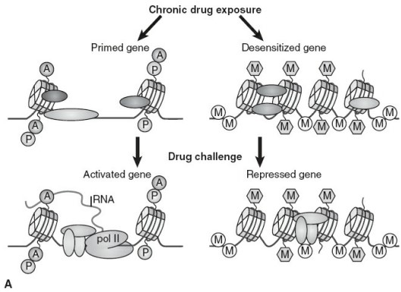
Epigenetics :
Defined as a series of biochemical processes through which changes in gene expression are achieved throughout the life of an animal without a change in DNA sequence.
Repeated exposure to drugs of abuse or other environmental insults can engage epigenetic processes in early life (or adulthood).
Act at specific genes or sets of genes resulting in stable changes in gene expression or changes in the inducibility of other genes that can lead to addiction in vulnerable individuals
Drugs or other environmental insults produce epigenetic changes in gametes, which can be passed on to offspring and increase their vulnerability to SUDs.
Notes:
DNA is organized into chromatin, and the fundamental unit of chromatin is the nucleosome, which consists of DNA wrapped around a core group of histones.
Epigenetics :
Defined as a series of biochemical processes through which changes in gene expression are achieved throughout the life of an animal without a change in DNA sequence.
Epigenetics is a means through which environment and genes can interact to produce enduring structural and functional changes underlying experience-dependent neuronal development and plasticity, as well as addiction-related behaviors.
Epigenetic mechanisms control inter-nucleosome spacing and the degree to which they are condensed, which is a determinant of gene activity.
Heterochromatin refers to the condensed, inactivated state, which does not allow gene transcription, and euchromatin refers to the activated, open state, which allows individual genes to be transcribed.
Three major types of epigenetic regulation:
histone modifications (e.g., acetylation and methylation),
DNA methylation, and
regulatory noncoding RNAs.

Slide 53
Sex differences in substance use disorders
Telescoping :
  Evidence suggests that women progress from substance use to SUD faster than men.
Activational Effects of Gonadal Hormones:
  Estrogen potentiate effects of psychostimulant,
  Progesterone negatively correlated with the subjective effects of psychostimulants.
Sex Differences in Dopamine Signaling:
  Women have been reported to have a greater capacity for dopamine synthesis and reuptake through the DAT relative to men.

Slide 54
COMORBIDITIES
Antisocial personality disorder:
  Use more illegal substances;
  Have more psychopathology;
  To be less satisfied with their lives; and
  To be more impulsive, isolated, and depressed than patients with antisocial personality disorders alone.
Depression and Suicide
Notes:
Comorbidity is the occurrence of two or more psychiatric disorders in a single patient at the same time.
Although opioid, cocaine, and alcohol abusers with current psychiatric problems are more likely to seek treatment, those who do not seek treatment are not necessarily free of comorbid psychiatric problems; such persons may have social supports that enable them to deny the impact that drug use is having on their lives.
Range is even higher when investigators include persons who meet all the antisocial personality disorder diagnostic criteria, except the requirement that the symptoms started at an early age.
About 15 % of persons with alcohol abuse or alcohol dependence have been reported to commit suicide. This frequency of suicide is second only to the frequency in patients with major depressive disorder.

Slide 55
COMMON PRINCIPAL OF MANAGEMENT OF ADDICTION
Steps in management of Substance Use Disorders
Preparing for Change (Intervention)
Detoxification
Relapse prevention
Rehabilitation

Slide 56
Goals of Treatment
Abstinence from substance.,
  if 100% abstinence is not possible then at least harm reduction should be the goal
2. Identifying & managing psychiatric & other medical complications
Goals can be achieved by following strategies of management.
Core treatment of any addiction involves
  Maximizing the motivation for abstinence,
  Helping the person restructure a life without substance,
  Minimizing relapse.

Slide 57
Preparing for Change (Intervention)
Goal is to use the principles of motivational interviewing and brief interventions to help patients recognize the adverse consequences likely to occur.
Presenting complaint is a useful way to both show empathy and enhance motivation for change.
Reassuring the patient that abstinence can be achieved.
If the person does not respond to the first brief intervention or motivational interview, the same nonjudgmental but persistent approach can be used each time.
Intervention often begins with a “brief intervention,” a cost-effective approach.

Slide 58
FRAMES:
  giving FEEDBACK on alcohol risks
  emphasizing a person’s RESPONSIBILITY for change
  offering ADVICE
  giving a MENU OF OPTIONS to consider
  employing EMPATHY
  emphasizing SELF-EFFICACY, or the ability to change.
Goal is to establish an alliance with patients by demonstrating an understanding of their viewpoint while encouraging them to think through consequences associated with substance.
Between two visits separated by about 1 month, patients keep notes of their drinking patterns.
The second session reviews the same issues and is followed by several short telephone interviews.

Slide 59
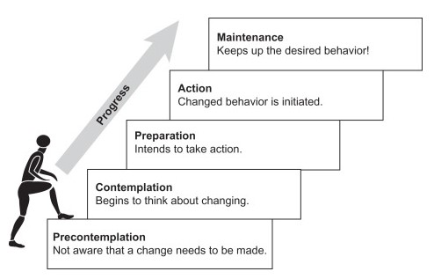
Motivational interview
Motivational interviewing is a person- centered, goal-oriented method of communication for eliciting and strengthening intrinsic motivation for positive change.”
Precontemplation
  stage at which there is no intention to change behavior in the foreseeable future
  Many individuals in this stage are unaware or under-aware of their problems." Some people call this phase "denial.“

Slide 60
Contemplation
  stage in which people are aware that a problem exists and are seriously thinking about overcoming it but have not yet made a commitment to take action.
  Many people in this stage can be described as ambivalent.
Preparation stage
  considered the information gathering and planning stage.
Action
  stage in which individuals modify their behavior, experiences, or environment in order to overcome their problems.
  Action involves the most overt behavioral changes and requires considerable commitment of time and energy
Maintenance
  stage in which people work to prevent relapse and consolidate the gains attained during action.

Slide 61
Motivational Enhancement Therapy (MET)
The primary goal of MET is to help individuals overcome their ambivalence or resistance to behavior change.
MET focuses on increasing intrinsic motivation by raising awareness of a problem, adjusting any self-defeating thoughts regarding the problem, and increasing confidence in one's ability to change.

Slide 62
MET is based on five motivational principles
Express empathy
  Therapists create a supportive environment in order to help an individual feel accepted and respected, and they engage in reflective listening rather than direct confrontation. The therapist will listen to what an individual is saying and then reflect it back
Develop discrepancy
  Therapist directs attention toward the discrepancy between an individual's desired state of being and that individual's actual state of being. it can also provide a strong incentive for behavior change.

Slide 63
Avoid argumentation
  Therapist will avoid attacking an individual or an individual's behavior, as this is thought to result in defensiveness and resistance.
Roll with resistance
  Instead of directly confronting any resistance on the part of the individual, the therapist tries to defuse it, often through reflective listening or by simply going along with what an individual is saying.
Support self-efficacy
  One's motivation to change typically depends not only on the reasons for modifying behavior but also on the belief that one is able to perform the tasks required for change.

Slide 64
Affirmations
Emphasize a strength
  You’re a strong person, a real survivor
Notice and appreciate a positive action
  I appreciate your openness and honesty today
  Thanks for coming in today.
  I like the way you said that
Express positive regard and caring
  I hope this weekend goes well for you!
Should be genuine
Differs from praise – not an opinion or judgment
Strengthen therapeutic relationship

Slide 65
Detoxification
If the patient is in relatively good health and has a good social support system, the withdrawal syndrome are mild.
1st step: The essential first step in detoxification is a thorough physical examination.
2nd step: offer rest, nutrition, and oral multiple vitamins
drug detoxification only deals with the physical dependency and addiction to drugs, it does not address the psychological aspects of drug addiction.
Aim
  Managing withdrawal symptoms
  Detoxification is a set of interventions aimed at managing acute intoxication and withdrawal.

Slide 66
Steps involved
Evaluation:
  Upon beginning drug detoxification, a patient is first tested to see which specific substances are presently circulating in their bloodstream and the amount.
Stabilization:
  the patient is guided through the process of detoxification.
  This may be done with or without the use of medications
  Also part of stabilization is explaining to the patient what to expect during treatment and the recovery process
Guiding Patient into Treatment:
  The last step of the detoxification process is to ready the patient for the actual recovery process

Slide 67
Relapse Prevention
Begins with identifying situations with high risks for relapse.
Counselor helps patients develop ways to identify and cope with craving and with challenging events or emotional state.
Remind patients that short-term relapses are not an excuse for returning to regular habit.
1. Pharmacological
  Anticraving
  Supportive
2. Nonpharmacological
  MET
  Cue related relapse prevention

Slide 68
Rehabilitation
Psychiatric rehabilitation is an aspect of treatment that focuses on helping the person return to an optimal level of functioning and to achieve their life goals.
Brought about by providing medical, psychological and social input.
Rehabilitation process focuses on:
  Assessing what the person is capable of (their skills, strengths and abilities)
  Accepting the limitations caused by the illness
  With a thorough understanding of these aspects, a trained professional is able to identify what support the patient needs in order to get back to a functional life.
Process of rehabilitation aims to help the patient develop the social and intellectual skills that they will need to integrate with mainstream society.

Slide 69
Thank You

