Slide 1
Neurotransmitter : Serotonin
Dr. Nisheet Patel
Associate Professor
Psychiatry Department
SBKS & MIRC

Slide 2
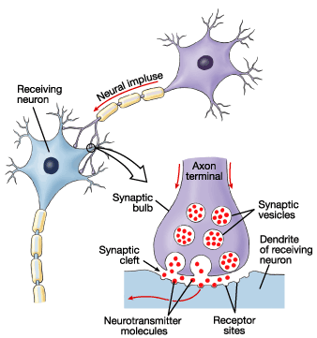
What are Neurotransmitters?
Neurotransmitters are chemicals that amplify or inhibit the depolarization signal from one neuron to that of an adjacent neuron.

Slide 3
Chemical classification of Neurotransmitter
Biogenic Amine Neurotransmitters:
Catecholamines – Dopamine, Norepinephrine, Epinephrine
Serotonin (5- hydroxytryptamine)
Histamine
Acetylcholine
Amino Acid Neurotransmitters:
Glutamic acid (glutamate)
GABA
Glycine
Novel Neurotransmitters:
Gases as neurotransmitter- Nitric oxide
Endocannabinoids

Slide 4
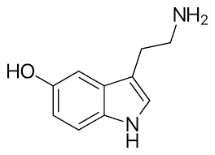
SEROTONIN ( C10H12N2O)

Slide 5
It is a monoamine Neurotransmitter.
About 90% of the body serotonin is found in intestines, rest is present in brain and platelets.
It is mainly involved in physiology of Vascular functions, GI Motility and Mood.
It is considered the contributor of well being and happiness.

Slide 6
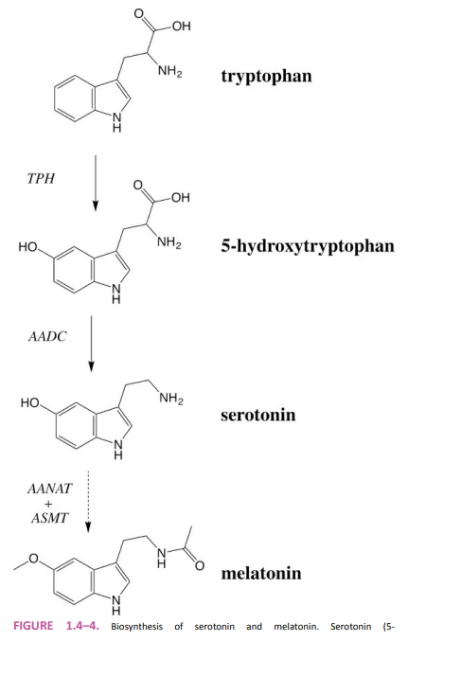

Slide 7
Tryptophan from blood
Enter Serotenergic Neuron via Tryptophan Transporter.
Tryptophan inside the neuron.
( Tryptophan Hydroxylase)
5- Hydroxy Tryptophan
(Aromatic Amino acid Decarboxylase)
5 Hydroxy Tryptamine ( SEROTONIN)

Slide 8
Taken up by vesicles by VMAT and released outside
Serotonin in the Synapse
Can be taken up can be destroyed
Again by the neuron
Via SERT
outside cell by inside cell by
MAO –A & MAO-B MAO- B only at high
concentration

Slide 9
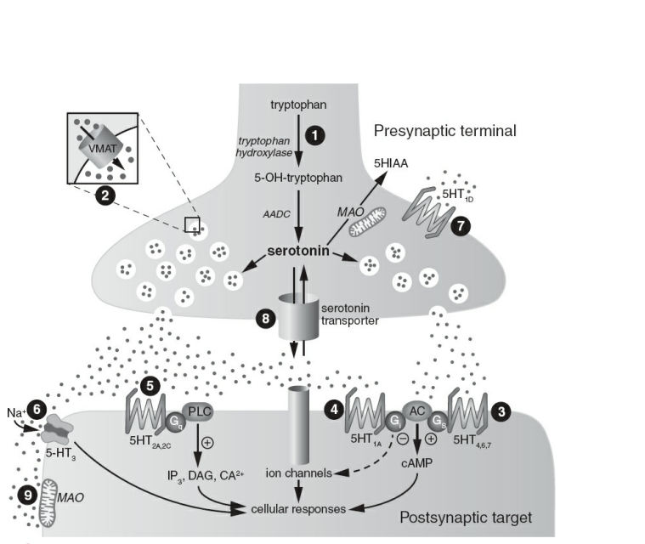

Slide 10
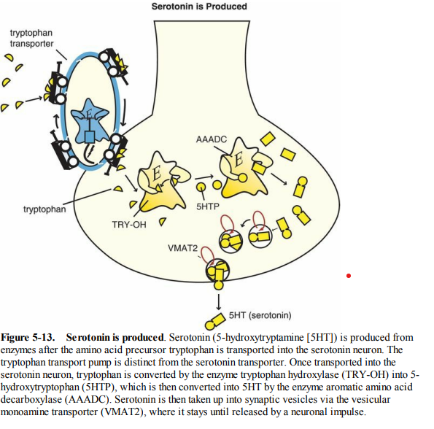

Slide 11
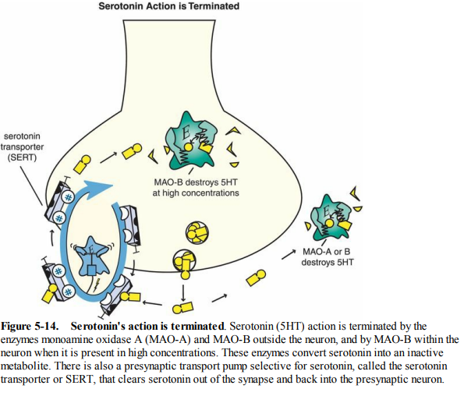

Slide 12
Classifications of 5 HT receptors
Gaddum and Picarelli (1957) classified 5-HT receptors into musculotropic (D type) and neurotropic (M type) based on their blockade by Dibenzyline
( phenoxybenzinamine).
Four families of 5-HT receptors ( 5-HT1, 5-HT2, 5-HT3, 5-HT4-7) comprising of 14 subtypes have been so far recognized.
All 5-HT receptors ( except 5-HT 3) are G protein coupled receptors which functions through decrease (5HT-1) or increasing (5HT4, 5HT6, 5-HT7) cAMP production or by generating IP3/DAG as second messenger.
5HT-1 is autoreceptor.
The 5-HT3 is a ligand gated cation (Na+, K+) channel which upon activation elicits fast depolarization.

Slide 13
5-HT1A
5-HT1 5- HT1B
5- HT1D
5- HT2 5- HT2A
5-HT receptors
5- HT3 5-HT2B
5-HT4 5- HT2C
5-HT7 5-HT 5
5- HT 6

Slide 14
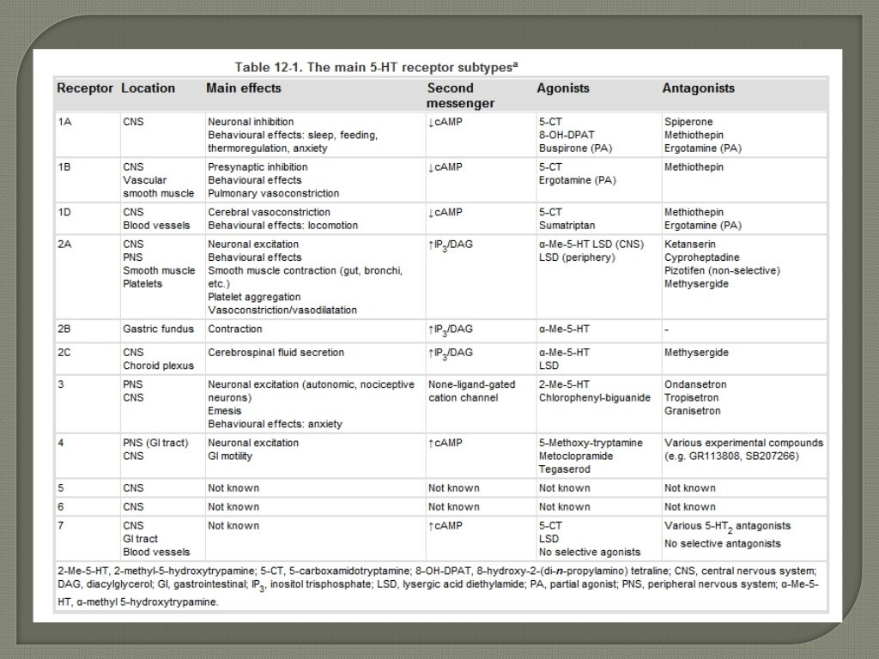

Slide 15
PERIPHERAL Mediated Physiological Functions of 5-HT receptors
In periphery:
Peristalsis
Vomiting
Platelet aggregation and haemostasis
Inflammatory mediator
Sensitization of nociceptors
Microvascular Control

Slide 16
CENTRAL MEDIATED PHYSIOLOGICAL FUNCTIONS OF 5-HT RECEPTORS
Many central effects of serotonin receptors are as follows:
Neuronal inhibitions through decrease of cAMP
Behavioural effects, sleep mood, feeding thermoregulatory, anxiety
Presynaptic inhibitions
Cerebral Vasoconstrictions

Slide 17
Serotonergic Pathways In the Brain
The principal centers for serotonergic neurons are rostral and caudal raphe nuclei. From the rostral raphe nuclei axons ascend to the cerebral cortex, limbic regions and specifically to the basal ganglia.
Serotonergic nuclei in the brain stem give rise to descending axons, some of which terminate in the medulla, while others descend the spinal cord.

Slide 18
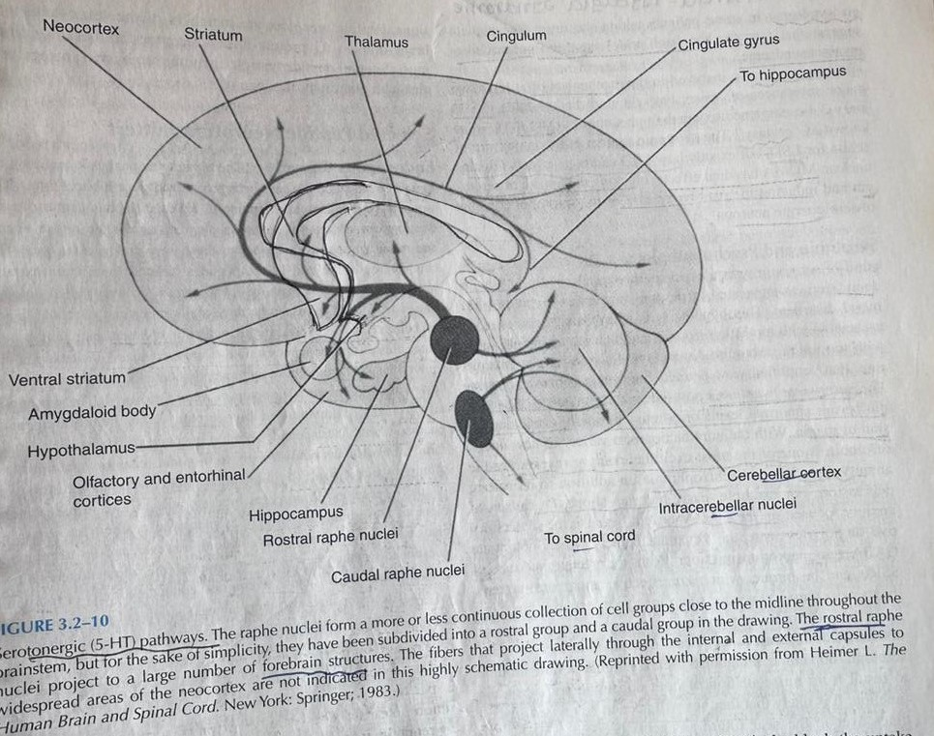

Slide 19
Drugs acting on Serotonergic Neurotransmission
Presynaptic Agents
Reuptake Inhibitors
Degradation Inhibitors
Storage Inhibitors

Slide 20
Degradation Inhibitors- MAO Inhibitors
Storage Inhibitors- Amphetamines
Methylphenidate
Modafinil
Reuptake Inhibitors- SNRI
SSRI
TCAs
It is to determine how serotonin neurotransmission can be modified at presynaptic level by inhibiting degradation, storage or reuptake.

Slide 21
MAO INHIBITORS
Monoamine oxidase is a key enzyme for serotonin, dopamine and norepinephrine inactivation. MAO inhibitors prevent inactivation of monoamines within a neuron, causing excess neurotransmitter to diffuse into the synaptic space. This class of agents is used in the treatment of Depression( phenelzine, tranylcypromine, selegiline) and Parkinson’s disease ( Selegiline).
Dietary restrictions (because of tyramine toxicity) limit their widespread use.
Inhibitors of serotonin storage
They interfere with the ability of synaptic vesicles to store monoamines; displace serotonin, dopamine and norepinephrine from their storage in presynaptic nerve terminals. Agents that share this mechanism of action include Amphetamines, Methyphenidate, and modafinil

Slide 22
SNRI:
Mechanism of action involves blockade of 5-HT and norepinephrine reuptake in a concentration- dependent manner. Agents in this class include Venlafaxine and duloxetine, they may be effective for the treatment of depression in patients whom SSRIs are ineffective. SSRIs block the reuptake of serotonin, leading to increased concentration of the neurotransmitter in the synaptic cleft and to an enhanced postsynaptic neuronal activity.
TCA:
TCA act by inhibiting reuptake of 5-HT and norepinephrine from the synaptic cleft by respectively blocking 5-HT and norepinephrine reuptake transporters, thereby causing enhancement of postsynaptic responses.

Slide 23
Serotonin Agonist
Selectives
5-HT Receptor agonists
Non- Selectives

Slide 24
Selective
5HT1A agonist
Cisapride
5HT4 agonist
5HT1B and 5HT1D agonists
5HT2 agonist
Buspirone
Triptans
Trazodone

Slide 25
Non Selective
Ergotamine
LSD

Slide 26
Serotonin receptors agonists have wide clinical applications, from treatment of depression to abortive medications for migraine headache. According to the receptor they activate, they can be divided into:
5HT1A agonist
Autoreceptors
Buspirone is a partial 5HT-1A agonist used clinically for the treatment of anxiety and depression.
5-HT1A receptor stimulaton increases Dopamine release.
Downregulation of this receptor is useful for antidepressant.
5HT1B and 5HT1D agonist
Autoreceptos
The ‘triptans’ are a drug class used as treatment of acute migraine headaches. They are very effective in causing cranial vasoconstriction and decreased release of neuropeptides involved in “sterile inflammation”.

Slide 27
5HT2A
Abundantly present in the cortex.
Atypical antipsychotics have high potency antagonist action on them compared to D2 receptors.
5HT2A antagonism makes a drug atypical which reduces EPS and hyperprolactinemia.
Downregulation of 5HT2A is MOA of Antidepressant effect of SSRI
LSD and other hallucinogens are agonist at 5HT2A.
Clozapine is an Atypical Antipsychotic drug that acts as a
5-HT2A/2C receptor antagonist with high affinity for dopamine receptors , the involvement of 5-HT has possibly increased the chances of greater efficacy and reduction in negative symptoms of schizophrenia..

Slide 28
5HT2C agonist
Trazodone, earlier believed to be a 5HT2C receptor, now considered to behave as 5HT2C agonist.
5HT4 agonist
Cisapride is a serotonin and cholinergic agonist used as a prokinetic drug. It was withdrawn because of cardiovascular toxicity.

Slide 29
Non Selective agonists
Ergotamine activates more than one subtype of 5-HT receptor, it binds to a 5-HT1A, 5-HT1D, 5-HT1B, D2 and norepinephrine receptors. Its vasoconstrictor effect makes it a suitable treatment for migraine attacks.
LSD is a 5-HT1A, 5-HT2A, 5-HT2C, 5-HT5A, 5-HT5, 5HT6 agonist that has a psychedelic properties.

Slide 30
5-HT2 antagonists
Ketanserin
5-HT2A/2C antagonist
Methylsergide
5-HT receptor Antagonist
Atypical Antipsychotics
5-HT3 antagonist

Slide 31
Ketanserin is a 5-HT2A/2C antagonist used for the treatment of hypertension. In addition to its serotonin antagonism, it has affinity for alpha-1 receptors, which may contribute to its antihypertensive effect.
5HT2C antagonism will increase dopamine at Nucleus Accumbens and midbrain DA neurons.
MOA of olanzapine and fluvoxetine combination in bipolar depression
Lorcaserin is agonist , causes weight loss.

Slide 32
Agomelatine is a new antidepressant with agonist action at the melatonin receptor and antagonism at the 5-HT2C receptor.
5HT3 Antagonists
More in medulla
This class include drugs such as Ondansetron, Palanosetron and other anti-emetic drugs. These agents are useful in the treatment of chemotherapy induced nausea and vomiting.
Also used in treatment of Inflammatory Bowel syndrome.

Slide 33
5HT4
Present in GIT
Agonist like Cisopride
Increases upper GI motility.
5HT5: Not much known
.
5HT6: More present in limbic and cortical regions and antagonist( Idalopiridine) improves cognition in Alzheimer’s disease. (Clozapine, Olanzapine, Asenapine).
5HT7: Lurasidone is a potent antagonist of it & has precognitive properties.
Associated with Circadian rhythms.

Slide 34
NATURAL SOURCES OF SEROTONIN
Exposure to bright light: Sunlight is commonly used to treat seasonal depression
Exercise: Regular exercise can have mood boosting effects.
Healthy Diet: Pineapple, tofu, eggs, cheese, nuts, salmon can increase serotonin levels.
Meditation: Meditation helps to relieve stress and promote positive outlook in life, boosting serotonin levels.

Slide 35
Applied Aspects
Serotonin syndrome:
Toxic, potentially fatal effects & require a combination of serotonergic agents such as an SSRI with MAOI. Other agents including TCAs, Dextromethorphan, Meperidine and MDMA
Sternbach Criteria:
Mental status changes ( Confusion, hypomania), Agitation, Myoclonus, Hyperreflexia, Diaphoresis, Shivering, Tremor, Diarrohea, incoordination, Fever.

Slide 36
Treatment
Suspected agents should be discontinued.
Other drugs containing ingredients known to increase serotonin levels such as Dextromethorphan, Pseudoephedrine or Phenypropanolamine also should be discontinued.
Benzodiazepines for mild to moderate cases.
Cyproheptadine, Methysergide and Propranolol for severe cases.
Benzodiazepines as Lorazepam, Diazepam, Clonazepam
Neuroleptics
Chlorprothixene
Chlorpromazine
Haloperidol

Slide 37
SCHIZOPHRENIA
The underlying pathology of cognitive deficits in schizophrenia is associated with alterations in multiple neurotransmitter systems. Dopamine, noradrenaline, serotonin, glutamate, GABA, and acetylcholine are all altered in a regionspecific manner, with a role for the prefrontal cortex (PFC) and temporal cortex of particular relevance in this disease
Serotonin in both the PFC and hippocampus is also important because 5-HT2A receptors are downregulated in the two regions in schizophrenic brains, with many atypical antipsychotics exhibiting higher affinity for 5-HT2A blockade than dopamine D2 receptor blockade

Slide 38
Anxiety Disorders
SSRIs can increase Anxiety in initial phase of reaction.
In long term, SSRIs can help reduce anxiety.
Buspirone which is 5HT1A partial agonist is helpful in relieving anxiety.

Slide 39
Obsessive Compulsive Disorder
OCD is because of dysfunction in CSTC loops. These parts of the brain primarily use serotonin to communicate. This is why increasing the levels of serotonin in the brain can help alleviate OCD symptoms.

Slide 40
SEXUAL DISORDERS
Low levels of serotonin are associated with increased libido, while increased serotonin levels are associated with reduced liido.
Majority of SSRI causes Sexual disorders.
Increased Serotonin causes decreased libido and Delayed Ejaculation.

Slide 41
EATING AND FEEDING DISORDERS
SIBUTRAMINE
Inhibits reuptake of Serotonin and Norepinephrine
Helpful for weight loss
LORCASERIN
Selective Serotonin Agonist (5HT2c Agonist) suppresses appetite and reduces food intake.
Dose: 10 mg 1-2 times per day.
Helps loose 6% body weight after 1 year.
S/E: Headache, Dizziness, fatigue, Nausea, Dry mouth, & constipation, Suicidal thoughts, Probabluy with Memory.

Slide 42
AUTISM
Increase levels of Serotonin in whole blood & platelets (Proven Biological marker)
increase 5HIAA – decreased frequency serotonin -1/ Severity of Symptom

Slide 43
CONDUCT DISORDER
Increase Plasma Serotonin – 1/5HIAA in CSF
Low CSF 5HIAA is correlated with Aggression & Violence.

Slide 44
SUICIDE
Abnormal serotonergic Functioning.
Alterations in Serotonin transporter binding
Decrease CSF 5HIAA associated with increase Lethality.
L allele of tryptophan Hydroxylase was associated with decrease CSF 5HIAA & therefore, increase suicide

Slide 45
Thank You

