Slide 1
Perception and its associated disturbances
By
Dr.Devashish Palkar
Assitant Professor
Department Of Psychiatry
SBKS MI & RC

Slide 2
Sensation:
Sensation is the first stage in receiving information from outside the self.
This information is received, transformed and then transmitted from peripheral
receptors to central nervous system.
Perception:
    Conscious awareness of elements in the environment by the mental processing of sensory stimuli; sometimes used in a broader sense to refer to the mental process by which all kinds of data, intellectual, emotional, and sensory, are meaningfully organized.
Apperception:
Awareness of the meaning and significance of a particular sensory stimulus as modified by one's own experiences, knowledge, thoughts, and emotions.

Slide 3
Somatosensory Information
2 Point Discrimination Pain
Tactile Sense Temperature
Vibratory Sense Coarse Touch
Kinaesthetic Sense Deep Pressure
Muscle Tension
Joint Position Sense
Fasciculi Gracilis and Cuneatus Spinothalamic Tract
VPL Nucleus Of Thalamus VPL, Intralaminar nuclei of thalamus
Somatosensory Cortex Somatosensory Cortex, Prefrontal Cortex

Slide 4
Visual System :
Visual images are transduced into neural activity within the retina and are processed through a series of brain cells
The cells of the primary visual cortex project to the secondary visual cortex, where cells respond specifically to particular movements of lines and to angles. In turn, these cells project to two association areas. The inferior temporal lobe detects the shape, form, and color of the object, the posterior parietal lobe tracks the location, motion, and distance.

Slide 5
Auditory System :
Vibrations of the endolymph move cilia on hair cells, which generate neural impulses.
Neural impulses from the hair cells to the brain in the fibers of the cochlear nerve.
Brainstem cochlear nuclei
Lateral lemniscus
Inferior colliculi
Medial geniculate nucleus (MGN) of the thalamus
Primary auditory cortex in the posterior temporal lobe.

Slide 6
Olfactory System :
Odorants bind to odorant receptors displayed on the surface of the sensory neurons of the olfactory epithelium.
Odorant binding generates neural impulses, which travel along the axons of the sensory nerves through the cribriform plate to the olfactory cortical column
olfactory bulb.
The olfactory cortex.

Slide 7
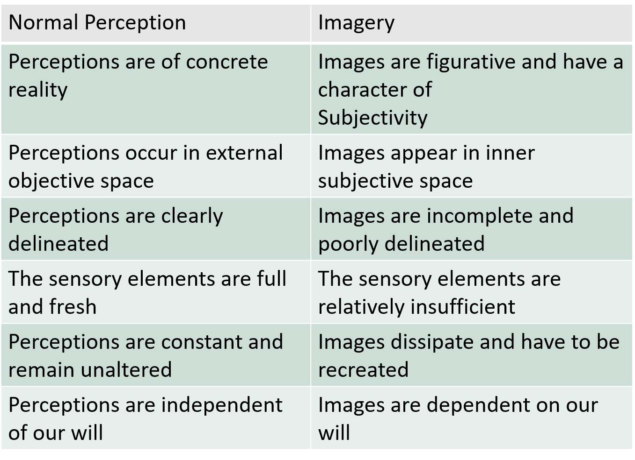
Formal characteristics of normal perception and imagery-

Slide 8
Disorders of perception : sensory distortions sensory deceptions.
constant real perceptual object, a new perception occurs that may or may not be in
is perceived in a distorted way. in response to an external stimulus.
Sensory Distortions : The result of a change in the intensity and quality of the stimulus or the spatial form of the perception. (Hyper/Hypoaesthesia, Change in colour, Change in size, Disorder of experience of time)
Sensory Deceptions : Can be divided into illusions, which are misinterpretations of stimuli arising from an external object, and hallucinations, which are perceptions without an adequate external stimulus.

Slide 9
Sensory Distortions
1. Changes in Intensity (Hyper- or Hypo-aesthesia) :
Hyperaesthesia
  Increased intensity of sensations
  Intense emotions or a lowering of the physiological threshold.
  Anxiety and depressive disorders,
  Hangover from alcohol and migraine
  Hypomanic patients, patients suffering an epileptic aura or under the influence of lysergic acid diethylamide (LSD) may see colours as very bright and intense

Slide 10
  Hypoaesthesia : Decreased intensity of sensations.
    Hypoacusis occurs in delirium, where the threshold for all sensations is raised. The defect of attention found in delirium further reduces sensory acuity.
    Hypoacusis is also a feature of other disorders such as depression and attention-deficit disorder.
    Visual and gustatory sensations may also be lowered in depression, for example, everything may look black or all foods taste the same.

Slide 11
2. Changes in Quality
Mainly visual perceptions are affected by this : Predominance of yellow, green and red colours have been named xanthopsia, chloropsia and erythropsia. Brought about by toxic substances, drugs (for example, santonin, poisoning with mescaline or digitalis) used in the past to treat various disorders.
In derealisation everything appears unreal and strange, while in mania objects look perfect and beautiful.
Metallic taste accompanying the use of lithium (a true change in gustation)

Slide 12
3. Changes in Spatial Form (Dysmegalopsia)
A change in the perceived shape of an object.
Micropsia is a visual disorder in which the patient sees objects as smaller than they really are.
Macropsia is a visual disorder in which the patient sees objects as larger than they are.
Dysmegalopsia/Metamorphopsia : Objects that are perceived to be larger (or smaller) on one side than the other.
Lilliputian hallucinations :
Changes in size of the images experienced in dreams and hallucinations (Lilliputian hallucinations)

Slide 13
  Micropsia :
    Oedema of retina
    Partial paralysis of accommodation and strong convergence
    Temporal and parietal lobe lesions
  Macropsia :
    Scarring of retina
    Complete paralysis of accommodation or overactive accommodation and weakened convergence
  Dysmegalopsia :
    Chronic Arachidonitis
    During the aura or seizure

Slide 14
4. Distortions of the Experience of Time :
When we are happy ‘time flies’ and when we are sad it passes more slowly.
Psychotic Depressive patient : Slowing down of time
Mania : Time speeds by and days are not enough to do the work
Schizophrenia : Clocks are being interfered with
: Age disorientation
: Abnormalities of time judgement
Temporal lobe lesions

Slide 15
Sensory Deceptions
1. Illusions :
Not indicative of psychopathology since they can occur in the absence of psychiatric disorder: the person walking along a dark road may misinterpret innocuous shadows as threatening attackers.
MC – Visual
Auditory illusions can occur when the person hears word in the conversation that resembles his own name.
Delirium : Perceptual threshold is raised and anxious person may misinterpret the stimuli.

Slide 16
Fantastic illusions : Patients see extraordinary modifications to their environment.
                Patient who looked in the mirror and instead of seeing his own head saw that of a pig. A patient who insisted that during an interview he saw the psychiatrist’s head change into that of a rabbit.
Three types of illusion are described :
    Completion illusions : These depend on inattention such as misreading words
    in newspapers or missing misprints because we read
    the word as if it were complete.
                If we see faded letters we may misread the word on the basis of our previous experience, our interests, etc. For example, to the person with an interest in reading, the word ‘–ook’ might be misread as ‘book’ even though the faded letter was an ‘l’.

Slide 17
    Affect illusions : These arise in the context of a particular mood state.
                For example, a bereaved person may momentarily believe they ‘see’ the deceased person, or delirious person in a perplexed and bewildered state may perceive the innocent gestures of others as threatening.
                In severe depression when delusions of guilt are present, the person, believing that he is wicked, may also say that he hears people talking about killing him when he is in the company of others.
    3. Pareidolia : Vivid illusions occur without the patient making any effort. (They
    cannot therefore be explained as the result of affect or mindset, and
    so they differ from the ordinary illusion.)
              Occur when the subject sees vivid pictures in fire or in clouds, without any conscious effort on his part and sometimes even against his will.

Slide 18
Illusions vs Intellectual misunderstanding :
Piece of rock is perceived as precious stone ( because of lack of knowledge )
Illusions vs Functional Hallucinations :
  In a functional hallucination both the stimulus and the hallucinations are perceived by the patient simultaneously and can be identified as separate and not as a transformation of the stimulus.
  In an illusion stimulus from the environment changes but forms an essential and integral part of the new perception.
Trailing phenomena (not strictly illusions)
Perceptual abnormalities in which moving objects are seen as a series of discrete and discontinuous images. They are associated with hallucinogenic drugs.

Slide 19
2. Hallucinations :
They come from ‘within’, although the subject reacts to them as if they were true perceptions coming from ‘without’.
Pseudo-hallucinations are a type of mental image
  Insight is present
  Located in subjective space(not in objective space)
  Person who has taken opium – pseudohallucinations
SCAN (World Health Organization, 1998) does not use the term pseudo-hallucination, but does have an item for rating insight and for whether the experience occurs inside or outside the head.

Slide 20
Jaspers insisted that there is no gradual transition between true and pseudo-hallucinations
Fish insisted that patients with substantial hallucinations also experienced non substantial hallucinations in outer objective space. Thus, Fish argued, there is a continuum from pseudo-hallucinations to hallucinations.
Pseudo hallucinations does not necessarily indicate psychopathology, unlike true hallucinations, which are indicative of serious mental illness.
Causes of hallucinations : CNS lesions, Intense emotions, psychiatric disorder, disorders of sense organs, sensory deprivation conditions in normal people.

Slide 21
    Intense emotions:
      Very depressed patients with delusions of guilt can hear: “kill yourself”/”Rotter”(single word / phrases) (not continuous)
      Schizophrenia : Continuous hallucinations of persecutory in nature/criticizing type.
    Suggestion(Hysterical psychosis)
      Normal subjects can be persuaded to hallucinate. When asked to walk down a dimly lit corridor and stop when they saw a faint light over the door at the end, most subjects stopped walking at some time during the study saying they could see a light even though none was switched on.
      Similarly, subjects can be persuaded to hallucinate visually or auditorily, either by hypnosis or by brief task-motivating instructions.
      Ganser Syndrome : Role of suggestion in genesis of hallucinations in this condition(?)

Slide 22
    Disorders of a peripheral sense organ :
      Eye disease - Visual hallucinations
      Ear disease – Hallucinatory voices
      Charles Bonnet syndrome (phantom visual images)
        A condition in which complex visual hallucinations occur in the absence of any psychopathology and in clear consciousness.
        It is associated with either central or peripheral reduction in vision. The images may be static or in motion.
        The hallucinatory episodes are of variable duration and can last for years.
        Importance of this diagnosis is as a differential from psychopathological causes of hallucinations.

Slide 23
    Sensory deprivation :
      If all incoming stimuli are reduced to a minimum in a normal subject, they will begin to hallucinate after a few hours. These hallucinations are usually changing visual hallucinations and repetitive words and phrases.
      Sensory deprivation due to the use of protective patches may contribute to the delirium that follows cataract surgery.
    CNS lesions :
      Lesions of the diencephalons and the cortex can produce hallucinations that are usually visual but can be auditory.

Slide 24
Hallucinations of individual senses :
  Auditory Hallucinations :
  Simple noises, bells, undifferentiated whispers or voices – can be abusive/neutral/helpful.
  Clear/Unclear
  In
    organic states – Delirium and dementia
    Schizophrenia : Noises partly organized as music or completely organized as hallucinatory voices. They form the basis of persecutory delusion and the belief that their thoughts or actions are being controlled.
    Severe depression : less well formed auditory hallucinations than schizophrenia.
  The voices sometimes give instructions to the patient, who may or may not act upon them : these are termed ‘imperative hallucinations’.
  In some cases the voices speak about the person in the third person and may give a running commentary on their actions. (3rd person auditory verbal hallucinations)

Slide 25
  A number of patients have continuous hallucinations that do not trouble them. For others the persistence of the hallucinations cuts across all activities so that the patient is seen to be listening and even replying to them at times.
  “THOUGHT ECHO” : Hearing one’s own thought at the same time they are occurring.
  Echo de la pensée (French) : Phenomenon of hearing them spoken after the thoughts have occurred.
  “THOUGHT BROADCASTING/”THOUGHT DIFFUSION” : Thoughts are no longer private, but accessible to others. Echo de la pansee is the prerequisite for thought broadcasting.
  Patient may insist that the voices are the result of witchcraft, telepathy, radio, television, and so on. Sometimes they claim that the voices come from within their bodies such as their arms, legs, stomach, etc.

Slide 26
  Some patients hallucinate speech movements and hear speech that comes from their own throat but has no connection with their thinking.
  One patient complained bitterly of her ‘talky-talky tongue’ because she was continuously auditorily hallucinated and felt speech movements in her tongue. Thus she had both auditory and possibly somatic hallucinations

Slide 27
  2. Visual Hallucinations :
  These may be elementary in the form of flashes of light,
  partly organised in the form of patterns,
  or completely organised in the form of visions of people, objects or animals. (figures
  of living things and inanimate objects may appear against the normally perceived
  environment or scenic hallucinations can occur)
  All varieties of VH are found in acute organic states.
  Delirium : Small animals and insects, Mice carrying suitcases on their backs as they boarded a flight, extremely suggestible-so that one may be able to persuade the patient to read a blank sheet of paper.
  Lilliputian hallucinations : Sees tiny people or objects + pleasure and amusement.
  Epilepsy patients : Scenic hallucinations (visions of fire and religious scenes)
  Temporal lobe epilepsy and late onset schizophrenia : Combined visual and auditory hallucinations.

Slide 28
  Schizophrenia : VHs are uncommon and their presence should raise a doubt about the diagnosis. Some patients with schizophrenia describe visions and these appear to be pseudohallucinations but sometimes they can be substantial.
  Activity during visual hallucinatory experiences in the extra striate visual areas around the ventral lingual and fusiform gyri (Brodmann area 19), and in the more dorsal cuneus and precuneus regions (Brodmann area 18). VH-related activity was also observed in the cerebellum.
  Charles bonnet syndrome : Visual hallucinations in the absence of psychopathology or brain disease.

Slide 29
  3. Smell(Olfactory Hallucinations):
  It is imp to distinguish olfactory hallucinations from delusions or illusions.
  In
    organic states
    schizophrenia
    depressive psychosis.
  Temporal lobe lesion : An aura involving an unpleasant odour such as burning paint or rubber or stale cabbage water.
  Schizophrenia : Patients claim that they smell the gas and their enemies are trying to poison them by gas.
  Olfactory reference syndrome : Patients base their belief on the behavior of other people who, they say, wrinkle their noses or make reference to the smell.
  Padre Pio phenomenon : Some religious people can smell roses around certain saints. (pleasuring smell)

Slide 30
  4. Taste (Gustatory Hallucinations) (Phantageusia) :
  It is important to distinguish Gustatory hallucinations from delusions.
  In
    organic states
    schizophrenia.
    Depression : Loss of taste/all foods taste same all the time.
  Gustatory hallucinations frequently co-occur with tactile/olfactory hallucinations.
  One functional MRI study found that phantom taste and smell demonstrated activation in the brain regions for taste and smell respectively, and the degree of activation was greatest when subjects were asked to recall their memory of each sensation. The activation was suppressed by treatment with typical antipsychotic agents

Slide 31
  5. Touch(Tactile Hallucinations):
  In
    acute organic states
    schizophrenia
    cocaine psychosis.
  Formication : Feeling as if small insects are crawling over patient’s body.
  Cocaine psychosis : Formication + delusion of persecution.
  Feeling cold winds blowing on them, sensations of heat, electrical shocks and sexual sensations.
  Almost always a concomitant delusional elaboration of tactile hallucinatory experiences.
  3 main types :
    1. superficial
    2. kinaesthethic and
    3. Visceral
        1. Superficial : four types
            Thermic (e.g., a cold wind blowing across the face),
            haptic (e.g., feeling a hand brushing against the skin),
            hygric (e.g., feeling fluid such as water running from the head into the stomach)
            paraesthetic (pins and needles), although the latter most often have an organic origin

Slide 32
      2. Kinaesthetic hallucinations :
          Affect the muscles and joints, and the patient feels that their limbs are being twisted, pulled or moved.
          Vestibular sensations such as sinking in the bed or flying through the air can also be hallucinated and are best regarded as a variant of kinaesthetic hallucinations
            Occur in Schizophrenia; organic states, most commonly delirium tremens, alcohol intoxication and during benzodiazepine withdrawal, and may also occur in the absence of any abnormality.

Slide 33
    3. Visceral Hallucinations :
      Some patients with chronic schizophrenia may complain of twisting and tearing pains. The patient complains that his organs are being torn out or the flesh ripped away from his body. A patient described sensations in his brain as of layers of tissue being peeled off so as to bring to completion the battle between good and evil.
      Delusional zoopathy : This may take the form of a delusional belief that there is an animal crawling about in the body. There is also a hallucinatory component since the patient feels it (hallucination) and can describe it in detail. In some cases this is associated with an organic disorder.

Slide 34
6. The Sense of ‘Presence’ :
It is difficult to classify it because although it is not strictly a sense deception(hallucination), it cannot be regarded as a delusion either.
Most normal people have from time to time the sense that someone is present when they are alone, on a dark street or climbing a dimly lit staircase. Often the feeling is that there is somebody behind them. Usually this is dismissed as imagination, but nevertheless they look behind them to be certain. However, sometimes there is the feeling that someone is present, whom they cannot see, and whom they may or may not be able to name.
One patient described a presence over her right shoulder that followed her from room to room and even though she knew that there was nobody there, the feeling was intense and distressing, so much so that at times she hide under the bedclothes to escape.
The sense of a presence can occur in healthy people as well as in organic states, schizophrenia or hysteria.

Slide 35
  A study of people feeling a presence found that this illusion was caused by misperceiving the source and identity of the sensorimotor signals. This fMRI study showed activation specifically in frontoparietal regions(Broadmann area 7) was specifically associated with the FoP.

Slide 36
Hallucinatory Syndromes(hallucinosis)
  Those disorders in which there are persistent hallucinations in any sensory modality in the absence of other psychotic features.
  • Alcoholic hallucinosis:
    Occur during periods of relative abstinence. (but in clear sensorium)
    They may be threatening or reproachful or benign voices. (auditory hallucinations)
    Hallucinations rarely persist longer than one week
  • Organic hallucinosis:
    These are present in 20–30 per cent of patients with dementia, especially of the Alzheimer type, and are most commonly auditory or visual.
    There is also disorientation and memory is impaired.

Slide 37
Functional Hallucination :
  An auditory stimulus causes a hallucination, but the stimulus as well as the hallucination is experienced. For example, a patient with schizophrenia first heard the voice of God as her clock ticked.
  So both the noises and the voices were audible. Patients can distinguish both features from each other and crucially, the hallucination does not occur without the stimulus.
  Some patients who discover that noises induce hallucinatory voices put plugs in their ears to reduce the intensity of the stimulus and hence the hallucinations. One patient recently described that she saw the mouths of her collection of dolls moving.
  Functional hallucinations are common in chronic schizophrenia and they may be mistaken for illusions.

Slide 38
Reflex Hallucinations :
  Synaesthesia : The experience of a stimulus in one sense modality producing a sensory experience in another.
        An example is the feeling of cold in one’s spine on hearing a fingernail scratch a blackboard.
        It can occur under the influence of hallucinogenic drugs such as LSD or mescaline when the subject might describe feeling, testing and hearing flowers simultaneously.
        A patient felt a pain in her head (somatic hallucination) when she heard other people sneeze (the stimulus) and was convinced that sneezing caused the pain.

Slide 39
Extracampine Hallucinations :
  The patient has a hallucination that is outside the limits of the sensory field.
  For example, a patient sees somebody standing behind them when they are looking straight ahead, or hears voices talking in London when they are in Liverpool.
  Can occur in healthy people as hypnagogic hallucinations, also in schizophrenia or organic conditions(epilepsy).
Autoscopy(Phantom Mirror Image) :
  The experience of seeing oneself and knowing that it is oneself.
  Not just VH, as kinaesthetic and somatic sensations are required to produce autoscopy.

Slide 40
    In healthy subjects when they are emotionally upset or when exhausted, as hysterical symptom. Schizophrenia, acute and sub-acute delirious states, organic states most associated with autoscopy are epilepsy, focal lesions affecting the parieto-occipital region and toxic infective states whose effect is greatest in the basal regions of the brain. Autoscopy is often associated with disorders of the parietal lobe.
    Sometimes these may be pseudo-hallucinations occurring in internal space and described by the patient as being ‘in the mind’s eye’.
    Negative autoscopy : A few patients suffering from organic states look in the mirror and see no image, known as negative autoscopy.
    Internal autoscopy in which the subject sees their own internal organs,

Slide 41
Hypnagogic and Hypnopompic Hallucinations : (True hallucinatory experiences but not indicative of any psychopathology.)
  Occur when the subject is falling asleep or waking up respectively. Hypnopompic hallucinations are often hypnagogic experiences that occur in the morning when the subject is waking and dosing off again
    ‘Hypnagogic’ - Occur during drowsiness, are discontinuous.
      They are about three times more common (described by 37 per cent of the adult population) than hypnopompic hallucinations
      Subjects describing hypnagogic hallucinations often assert that they are fully awake. This is not so: electroencephalogram (EEG) records show that there is a low of alpha rhythm at the time of the hallucination.
      Auditory/Visual
      Resolves when the person has a good sleep.
      Can occur in narcolepsy.

Slide 42
    ‘Hypnopompic’ - Those hallucinatory experiences that persist from sleep the eyes are open.
      A better indicator of narcolepsy. The subject believes that the hallucination has woken them up (for example, hearing the telephone ring even though it has not),
      Auditory(MC), Visual, Kinaesthetic, Tactile.

Slide 43
Organic Hallucinations :
  Can occur in neurological or psychiatric illnesses.
  Neurological : Eye disorders/disorders of the central nervous system/lesions of the optic tract/temporal lobe lesions/parietal lobe lesions
  All the dementias as well as delirium and substance abuse are associated with VHs
  “Phantom limb” –
      Most common organic somatic hallucination of psychiatric origin.
      The patient feels that they have a limb from which in fact they are not receiving any sensation either because it has been amputated or because the sensory pathways from it have been destroyed.
      In most phantom limbs the phenomenon is produced by peripheral and central disorders.
      Phantom limb occurs in about 95 per cent of all amputations after the age of six years.

Slide 44
      The phantom limb does not necessarily correspond to the previous image of the limb in that it may be shorter or consist only of the distal portion so that the phantom hand arises from the shoulder.
      Equivalent perceptions of phantom organs may also occur after other surgical procedures such as mastectomy, enucleation of the eye, removal of the larynx or the construction of a colostomy.
      The person is aware of the existence of the organ or limb and describes pain or paraesthesia in the space occupied by the phantom organ and this persists in a minority of patients. When the experience is related to a limb the perception shrinks over time, with distal parts disappearing more quickly than those that are proximal.

Slide 45
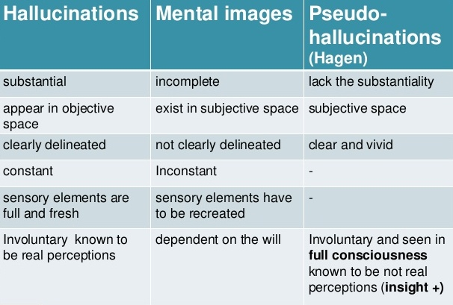

Slide 46
The Patient’s Attitude to Hallucinations :
In organic hallucinations the patient is usually terrified by the VHs and may try desperately to get away from them.
Most delirious patients feel threatened and are generally suspicious.
The combination of the persecuted attitude and the VHs may lead to resistance to all nursing care and to impulsive attempts to escape from the threatening situation, such that they may jump out of windows and jeopardise their lives.
The exception is Lilliputian hallucinations, which are usually regarded with amusement by the patient and may be watched with delight.

Slide 47
Patients with depression often hear voices telling them to kill themselves. They are not terrified by the voices, as they believe they are wicked and deserve to hear what is being said of them.
The onset of voices in acute schizophrenia is often very frightening and the patient at times may attack the person he believes to be their source.
Chronic schizophrenia patients are often not troubled by the voices and may treat them as old friends, but a few patients complain bitterly about them. Patients who are knowledgeable about their illness or who have insight into it may deny hallucinations, since they know this is an abnormal feature. Sometimes it is obvious that a patient is hallucinating if they stop talking and appear to be listening to something else or if they attempt to reply to the voices

Slide 48
Hallucinations in Non-Clinical Populations :
Hallucinatory-like experiences (HLEs) refer to the presence of hallucinations in the healthy population.
HLEs have been identified in about 5 per cent of the general population.
  Vivid day dreams
  Intrusive and vivid thoughts
  Occasional experience of sounds with no clearly identifiable source,
  Brief experience of voices.
  In the SCAN interview these vague sounds are referred to as incomplete or rudimentary hallucinations. They are of interest because they facilitate the study of their relationship to psychosis, particularly schizophrenia of which verbal hallucinations are a central feature.

Slide 49
Study of two groups (psychotic and nonclinical peoples) using the Revised Hallucination Scale (RHS) along with in-depth qualitative interviews of the phenomena concluded that the personal quality of the experiences differed in both groups.
  Psychosis : The hallucinations were bound to the person’s identity, and that there was a fusion between the self-world experience.
  Non-clinical group : Hallucinations were identified as relating to circumstances, or were described as single, isolated phenomena.
  A study on clinical and non-clinical voice-hearers did not find a difference in hallucination-related fMRI patterns.

Slide 50
Body Image Distortions :
  Hyperschemazia : The perceived magnification of body parts, can occur with a variety of organic and psychiatric conditions. (When part of the body is painful it may feel larger than normal.)
    When there is partial paralysis of a limb, the affected segment feels heavy and large, as in Brown–Sequard paralysis, in peripheral vascular disease, in multiple sclerosis and following thrombosis of the posterior inferior cerebellar artery.
    Psychiatric conditions such as hypochondriasis, depersonalisation and conversions disorder and the distortion of image that is associated with feelings of fatness in anorexia nervosa.

Slide 51
  Aschemazia : The perception of body parts as absent
  Hyposchemazia : The perception of body parts as diminished(Must be distinguished from nilhistic delusions)
    Most likely to occur in parietal lobe lesions such as in thrombosis of the right middle cerebral artery, following transaction of the spinal cord or in health volunteers when underwater.
    A patient with a parietal lobe infarct who had complex hyper- and hyposchemazia
  Koro : The belief that the penis is shrinking and will retract into the abdomen and cause death is found in South-East Asia and is thought to be due to a faulty understanding of anatomy. The diagnostic equivalent is probably anxiety disorder.

Slide 52
Paraschemazia : A feeling that parts of the body are distorted or twisted or separated from the rest of the body and can occur in association with hallucinogenic use, with an epileptic aura and with migraine.
Hemiasomatognosia : Is a unilateral lack of body image in which the person behaves as if one side of the body is missing and it occurs in migraine or during an epileptic aura.
Anosognosia : ‘denial of illness’ and one study found that 58 per cent of those with right hemisphere strokes denied their hemiplegia early after stroke and refused to admit to any weakness in their left arm. This belief typically remains despite manifest demonstration that it is paralysed.
Somatoparaphrenia : Bizarre attitudes to their paralysed limb. They may claim the limb belongs to a specified other person
Hemispatial neglect : The neglect of the hemispace on the contralateral side to the lesion when performing tasks. Example : Gerstmann syndrome (lesion of dominant parietal lobe), consists of agraphia, acalculia, finger agnosia and right/left disorientation

Slide 53
THANK YOU

