Slide 1
Acute Rheumatic Fever
+
Management of CCF
DR. POOJA PATEL

Slide 2
Inflammatory autoimmune disorder that affects several organs of the body characterised by:
Arthritis
Carditis
Chorea
Rheumatic nodules
Erythema marginatum
Fever caused by group A beta-hemolytic streptoccus

Slide 3
ETIOLOGY
GABHS (group A Beta hemolytic streptococcus)
Lancefield divides GABHS in 2 groups based on presence of M-Protein.
M-protein determines virulence of organism, stimulates formation of opsonizing and precipitating antibodies.
Serotypes M-1,3,5,6,14,18 and 24, Group C and G contributes in causing ARF.
h/o pharyngitis or skin infection like Impetigo ma play role.
Direct causation, immune priming, and movement of strains from skin to pharynx have been postulated.

Slide 4
EPIDEMIOLOGY
GEOGRAPHICAL DISTRIBUTION:
Most common cause of cardiovascular morbidity in socially and economically disadvantaged populations all over world.
>80% occur in developing countries
Reasons: poverty, lack of accessibility to medical care, unhygienic conditions, household overcrowding.
Prevalence has shown a steep decline in India.

Slide 5
INCIDENCE
Varies with geographical locations, and population ranges from 3-61 per 1 lakh school children.
In Indian children, 0.5-11 per 1000.
SOCIO-DEMOGRAPHIC CHARACTERISTICS.
Vulnerable age: 5-15 years. Rare below 4 years.
No difference of incidence of ARF in males and females.
But chorea and RHD more in females.
Season: winter and spring
GENETICS:
DR4 allele found in Indians, American Caucasians, and Saudi Arabians
DR7 allele in Brazil and Turkey.

Slide 6
PATHOGENESIS
4 streptococcal host cross-reactive antigen-antibody systems have been identified:
Cardiac myofibrillar smooth muscles antigen cross reacting with streptococcal cell wall and cell membrane antigen.
Heart valve fibroblast antigen cross reacting with streptococcal cell membrane antigen.
Subthalamic and Caudate nuclei antigen cross react with Streptococcal cell membrane antigen.
Heart valve and connective tissue antigen with streptococcal group A carbohydrate antigen.

Slide 7
Streptococcal infection
Autoantibody response against heart
Antibody deposition on heart valve endothelium and in the myocardial vessels and tissues.
Infiltration of myocardium and valvular region with macrophage and autoreactive T lymphocytes
Destruction of myofibres
Valvulitis, scarring and collagen deposition

Slide 8
PATHOLOGY
Involves connective tissue in heart, joints, subcutaneous tissue, brain and vessels of the lung.
2 phases:
Exudative phase:
Seen in joints
2-3 weeks after disease onset
c/b interstitial edema, cellular infiltration, fragmentation of collagen, and scattered deposition of fibrinoid. (eosinophilic granular deposition)

Slide 9
Proliferative or Granulomatous phase:
Seen in heart and subcutaneous tissues
Lasts for months to years.

Slide 10
CARDITIS:
Pathological hallmark of rheumatic carditis is Pancarditis
Histopathological hallmark of carditis is ASCHOFF BODY in the interstitium.
ASCHOFF BODY: area of central necrosis is surrounded by a ring of plump histiocytes called ANITCHKOV CELLS. They are discovered by Ludwig Aschoff and Paul Rudolf Geipel, so called as Aschoff-Geipel bodies.
BREAD AND BUTTER APPEARANCE: deposition of sero-fibrinous exudates found in pericarditis. It heals with no significant adhesions.
Myocardial changes: edematous and shows non-specific inflammation. (i.e. infiltration with lymphocytes, macrophages and other inflammatory cells.)

Slide 11
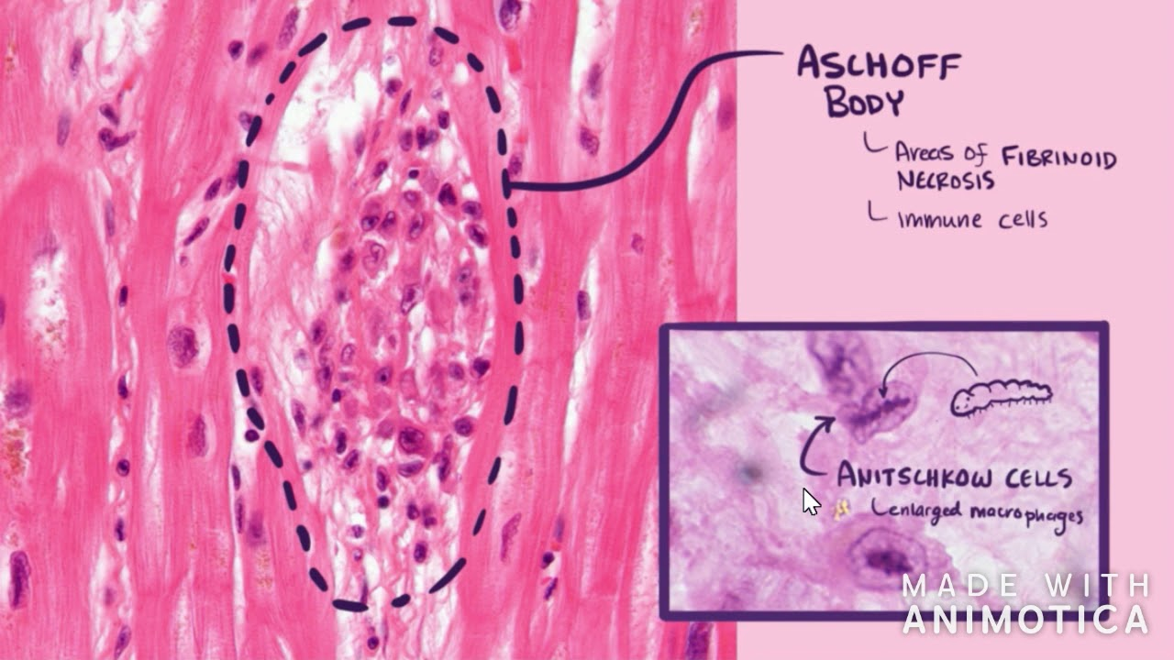

Slide 12
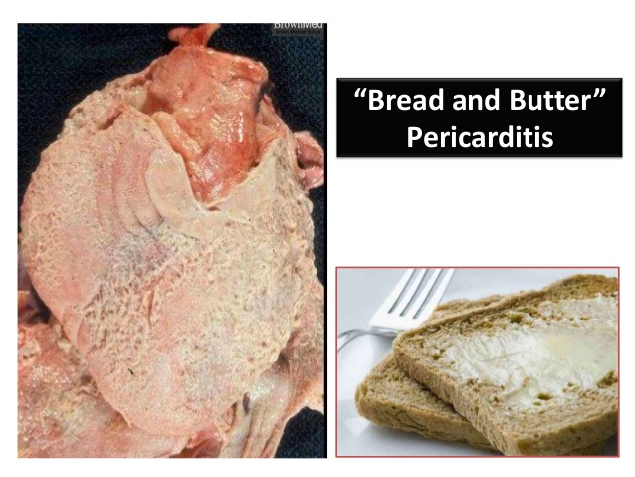

Slide 13
Endocardial changes: small, 1-2 mm, friable, fibrinous, verrucous vegetations may occur on the atrial surface on the mitral valves or on the ventricle side of the aortic valves or at the site of valve closure. It is infiltrated with histiocytes and lymphocytes. This results in MS, MR, AR.
Mc Callum Patch: fibrotic thickening of posterior left atrial wall.
Histology of Subcutaneous nodules show central fibrinoid necrosis surrounded by histiocytes, fibroblasts, ocaasionally lymphocytes and rarely, polymorph.

Slide 14
CLINICAL FEATURES
Most common 5 major manifestations:
Carditis (50-70%)
Arthritis (35-66%)
Chorea (10-30%)
Subcutaneous nodules (0-10%)
Erythema marginatum (<6%)

Slide 15
POLYARTHRITIS
Major joints like knees, ankles, elbows, wrists involved.
Rarely small joints like metacarpo-phalangeal joints, spine and TM involved.
Migratory and fleeting passes from one joint to another.
Joints are swollen, hot, red and tender.
Pain moves from one joint to another over period of hours.
Duration: 2-4 weeks
Spontaneous resolution occurs without residual effects except in JACCOUD ARTHRITIS (erosion of metacarpal heads resulting in hook-like deformity)

Slide 16
CARDITIS
Develops in 50% of patients.
More common in younger age groups.
Most common cause of morbidity and mortality with varied presentations.
Mitral valve involvement as MR occurs in 70-75% patients with endocarditis.
Aortic valve involvement as AR occurs in 20-25%
Tricuspid valve involvement in 30-35% and pulmonary valve involvement is rare.
Pericarditis -4-11%

Slide 17
Clinical features of acute pancarditis
Involvement | Clinical features
Pericarditis | Precordial chest pain Friction rub Effusion
Myocarditis | Cardiomegaly Tachycardia CHF Soft first heart sound S3 gallop
Endocarditis | Apical pansystolic murmur Apical mid systolic murmur (Carey Coomb’s murmur) Basal early diastolic murmur

Slide 18
SUBCLINICAL CARDITIS:
Isolated arthritis and/or pure chorea without auscultatory findings of valvular dysfunction.
Pathological pattern of valvular regurgitation and thickening of valvar leaflets found on Doppler ECHO.
CHRONIC RHEUMATIC FEVER:
In most attacks, clinical and laboratory evidence subsides within 6 months.
Evidence of rheumatic activity persists much longer without evidence of recurrent Streptococcal infection.

Slide 19
SUBCUTANEOUS NODULES
Small (0.5 -2 cm), painless, mobile lumps beneath skin overlying bony prominences like ulnar borders of forearm, knuckles, shin of tibia, occipital region and spinal processes of vertebrae.
Delayed manifestations and appear around 6 weeks of onset of fever.
Spontaneous resolution occurs in 2-3 weeks without residual lesions.
Isolated lesion not diagnostic as may present in SLE, JIA.

Slide 20
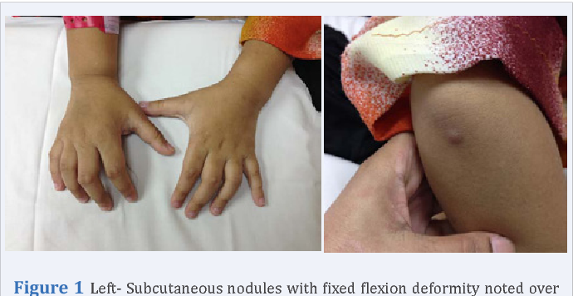

Slide 21
ERYTHEMA MARGINATUM
Map-like, painless, non-itchy, migratory lesions with irregular border seen in covered parts of body like trunk, internal side of arms, and thighs.
Prominent in high temperature environment or after bath, disappears in cold environment.
Isolated lesions not diagnostic as seen in acute glomerulo-nephritis and drug induced lesions.

Slide 22
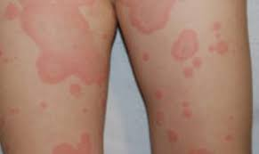

Slide 23
SYDENHAM’S CHOREA
Delayed manifestation, after 1-7 months.
Inflammatory involvement of subthalamus and caudate nuclei of CNS.
Abrupt, sudden, quasi-purposive, nonrepetitive and jerky movement, involving distal parts of body, associated with hypotonia and emotional instability.
Important signs:
Jack in the box tongue or snack tongue flicks or darting tongue
Hyperpronation of raised hands
Chorea in extended hands
Milk-maid signs
Dancing gait

Slide 24
Minor signs
Fever: seen in early stage and usually lasts upto 14 days
Arthralgia: polyarthralgia in low-risk population and monoarthralgia in moderate to high risk population
PR interval prolongation
Laboratory findings:
ESR: >60mm in low risk and > 30 mm in moderate-low risk
CRP: >3 mg/dl

Slide 25
DIAGNOSIS
Revised Jones Criteria 2015 by AHA is proposed to diagnose not only acute attack but also recurrent infection.
Low risk population: incidence <2 per 1 lakh school age children per year or all RHD prevalence of <1 per 1000 populations
Moderate to high risk: higher incidences or prevalence rates.

Slide 26
Revised Jones Criteria 2015
MAJOR CRITERIA | MINOR CRITERIA | EVIDENCE OF STREPTOCOCCAL INFECTION
Polyarthritis Carditis Chorea Subcutaneous nodules Erythema marginatum | Two minor clinical criteria a. polyarthralgia in low risk b. monoarthralgia in moderate to high risk a. fever of atleast >= 38.5 C in low risk b. >= 38 C in moderate to high risk 2 laboratory minor criteria Elevated acute phase reactants ESR >60mm in low risk and > 30mm in moderate to high risk CRP >3 mg/dl AND Prolonged PR interval | Positive throat culture or rapid streptococcal antigen test Elevated or increased streptococcal antibody titre

Slide 27
Possible Rheumatic Fever by applying Revised Jones Criteria 2015
A. For all patients populations with evidence of GAS infection
Initial ARF | 2 major manifestation or 1 major plus 2 minor manifestations
Recurrent ARF | 2 major or 1 major and 2 minor or 3 minor
B. Major criteria
Low risk population | Moderate and high risk population
Carditis Clinical and/or subclinical arthritis Polyarthritis only Chorea Erythema Marginatum Subcutaneous nodule | Carditis Clinical and /or subclinical arthritis Mono or polyarthritis or polyarthralgia Chorea Erythema Marginatum Subcutaneous nodule
Notes:
27

Slide 28
C. Minor criteria
Low risk population | Moderate-high risk criteria
Polyarthralgia Fever >= 38.5 C ESR > 60 mm/hr and/or CRP > 3 mg/dl Prolonged PR interval | Monoarthralgia Fever >= 38 C ESR > 30 mm/hr and/or CRP > 3 mg/dl Prolonged PR interval

Slide 29
Ancillary studies
TEST TO SUPPORT RECENT GROUP A BETA-HEMOLYTIC STREPTOCOCCI INFECTION
Increased ASO titre from end of 1st week and reaching the peak levels by 3-6 weeks following infection. In children, 1:333 titre is considered as significant
Anti-Dnase B titre rise in 1-2 weeks and reach peak by 6-8 weeks
Culture of organism from throat.
TESTS TO SUPPORT INFLAMMATORY PROCESS
ESR
CRP

Slide 30
TEST SUGGESTIVE OF PANCARDITIS
X-Ray chest: cardiomegaly, plethora of lungs
ECG: prolonged PR interval, ST and T- wave changes
ECHO
Cardiac Catherisation

Slide 31
DIFFERENTIAL DIAGNOSIS
Differential diagnosis of Acute Rheumatic Fever
Arthritis | Carditis | Chorea
Rheumatoid arthritis SLE Serum sickness Post-infective reactive arthritis (salmonella, shigella, yersinia) Leukemia | Kawasaki disease Viral myocarditis Viral pericarditis Congenital heart disease | Huntington chorea Wilson disease SLE Tics Hypersensitivity

Slide 32
TREATMENT
All children with suspected carditis in ARF need to be admitted, investigated, monitored and treated appropriately.
ANTIBIOTIC THERAPY
As diagnosis is confirmed, orally administered Penicillin or Erythromycin for 10 days or a single i.m. dose of Benzathin Penicillin regardless of throat culture.
After this, they need to be started on prophylaxis.

Slide 33
SUPPORTIVE TREATMENT
Clinical condition | Anti-inflammatory drug
Arthralgia | Any analgesic can be used
Arthritis | Aspirin 100 mg/kg/day in divided doses for 2 weeks followed by 75 mg/kg/day in divided doses for 4-6 weeks
Carditis with CHF | Prednisolone 2 mg/kg/day in divided doses for 2 weeks and taper and stop in next 2 weeks. At time of tapering of corticosteroids, introduce Aspirin 75 mg/kg/day in divided doses for 4-6 weeks to prevent rebound phenomena
CHF | Bed rest, diuretics, digoxin, salt restricted diet
Chorea | Haloperidol 0.01-0.03 mg/kg/day in 3 divided doses Sodium Valproate 20 mg/kg/day Diazepam 0.25 mg/kg/day

Slide 34
PROPHYLAXIS
PRIMARY PROPHYLAXIS TO PREVENT ARF
Antibiotic | Mode | Dose | Duration
Benzathine Penicillin | i.m. | <27 kg: 6 lac unit >27 kg: 12 lac unit | Single dose
Penicillin V | Orally 2-3 times/day | Children : 250 mg Adult : 500 mg | 10 days
Amoxicillin | Orally 2-3 divided dose/day | 25-50 mg/kg/day Adult: 750-1500 mg | 10 days
First generation Cephalosporins | Orally 2-3 times/day | Varies | 10 days
Erythromycin | Orally 4 divided doses/day | 40 mg/kg/day | 10 days
Clindamycin | Orally in 3 divided doses | 20 mg/kg/day | 10 days
Azithromycin | Once daily | 12 mg/kg | 10 days
Clarithromycin | Orally in 2 divided doses | 15 mg/kg/day | 10 days

Slide 35
DRUGS USED IN SECONDARY PROPHYLAXIS
Drugs | Dose | Route | Frequency
Benzathine Penicillin | <27 kg: 6 lac units >27 kg: 12 lac units | i.m. | Every 3-4 weeks
Penicillin V | 250 mg | Oral | Twice daily
For patients allergic to Penicillin
Sulfadiazine | <27 kg: 0.5 g >27 kg: 1 g | Oral | Once daily
For patients allergic to Penicillin and Sulfadiazine
Erythromycin | 250 mg | Oral | Twice daily

Slide 36
Recommended duration for secondary prophylaxis
Category | Duration
RF without carditis | 5 years or until age of 21 years whichever is longer
RF with carditis, but no residual RHD | 10 years or until age of 21 years whichever is longer
RF carditis and residual RHD | 10 years since last episode or until age of 40 years, possibly life long
Severe carditis | Lifelong
After valve surgery | lifelong

Slide 37
In a nutshell
ARF is an inflammatory autoimmune disorder that affect several organs of the body characterised by arthritis, carditis, erythema marginatum, subcutaneous nodules , chorea and fever caused by GABHS.
Peak incidence : 5-15 years
Diagnosis: Revised Jones criteria and confirmation of Streptococcal infection.
Cariditis is major cause of morbidity and mortality and is leading cause of valvular involvement. Mitral and Aortic valve are ostly involved.

Slide 38
Treated with Aspirin and/or steroids depending on presence of Carditis.
Primary prevention consists of appropriate treatment of all episodes of Streptococcal sore throat.
Children with residual heart disease require lifelong prophylaxis.

Slide 39
Management of congestive heart failure

Slide 40
Heart failure is a clinical syndrome characterised by inability of heart to supply cardiac output to support metabolic demands of body.
Categorised as LOW OUTPUT and NORMAL OUTPUT.
LOW OUTPUT: inability to supply normal cardiac output to keep up with metabolic demands of body.
NORMAL OUTPUT: ability to supply sufficient cardiac output but with increased ventricular filling pressure.

Slide 41
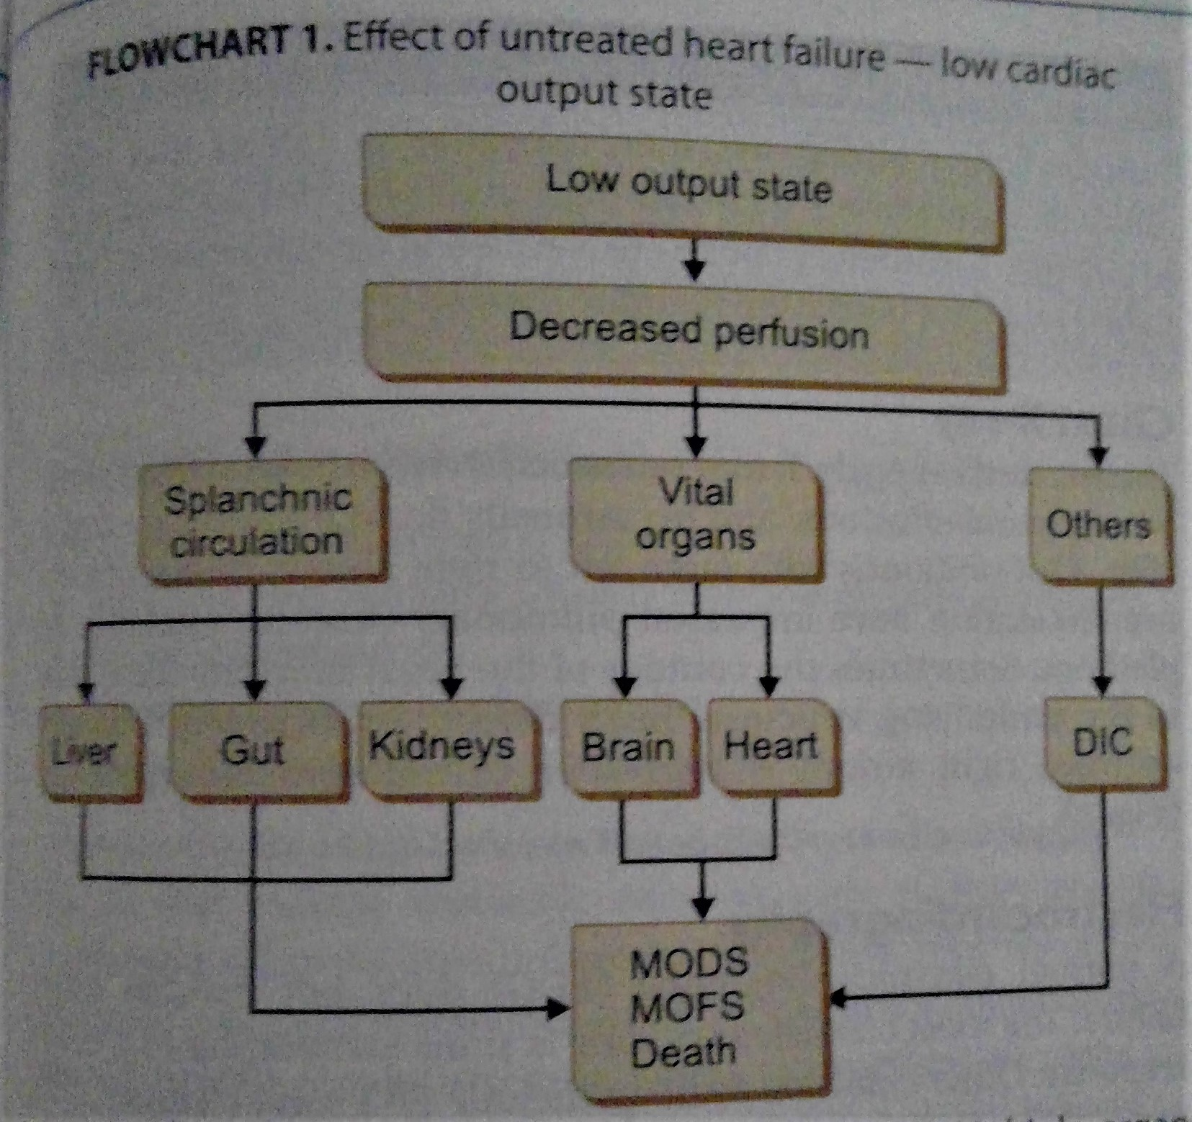

Slide 42
SYMPTOMS
Infants Resting tachycardia Feeding difficulty Suck-rest-suck cycle Diaphoresis Failure to thrive
Older children Palpitation Exercise intolerance
SIGNS
Chest retractions Chest signs Tachycardia S3 gallop Puffiness around eyes Hepatomegaly Failures of systemic congestion Occasionally anasarca

Slide 43
Investigations
Chest X-ray: cardiomegaly, fissural fluids, basal pleural effusions, pulmonary edema.
ECG: sinus tachycardia, ST-T wave changes, findings of LVH
ECHO
Noninvasive imaging tools: CT angiography, cardiac MRI
Other : BNP- natriuretic peptide, increased in ventricular dysfunction, electrolytes like S. Na, Cl, Calcium

Slide 44
Treatment
Reducing cardiac work
Augmenting myocardial contractility
Improving cardiac performance by Reducing preload
Correcting the underlying cause

Slide 45
Reducing cardiac work
Restricting patient activity, sedatives, treatment of fever, anemia , obesity and vasodilators.
Maintain temperature between 36-37 C
Humidified oxygen to maintain oxygen saturation.
Nurse in propped up position (30)
Opiates (morphine) or Midazolam to sedate to allay anxiety and reduce catecholamine secretion, thereby, reducing physical activity, respiratory and heart rates.

Slide 46
In neonates and infants, antibiotics empirically to be given.
In older children, antibiotics only when s/o infections present.
Correction of anemia by administering PCV @ 10-20 ml/kg with single dose of Furosemide.
VASODILATOR:
In CHF, arteriolar vasoconstriction is present to increase systemic vascular resistance and venoconstriction occurs to improve cardiac output. But this compensatory mechanisms are inappropriately excessive, so venodilators as well as arteriodilators are required to reduce work of heart.

Slide 47
ACE inhibitors:
Suppress Renin-Angiotensin-Aldosterone stem, thereby reduce vasoconstriction and salt and water restriction.
They also prevent arrhythmias and other adverse effects on myocardium.
S/E: cough, 1st dose hypotension (hence, first dose should be ¼ th of the original dose)
Monitor renal function.
Beta blockers: metoprolol, carvedilol
In acute settings, Sodium Nitroprusside is used (both veno and arteriodilators)
Milrinone and Levosimendan in post operative period.

Slide 48
Augmenting cardiac contractility
Digoxin:
Improve cardiac output by augmenting cardiac contractility.
Rapid onset and rapid elimination.
½ dose is given initially, followed by ¼ dose in 6-8 hoursand the rest ¼ in next 6-8 hrs.
Maintenance is ¼ of the digitalising dose daily.
Monitor PR interval for toxicity.
If it exceeds >50%, toxicity is present.

Slide 49
Digoxin is used cautiously in following condition:
Premature newborns
Cyanotic CHD
CHF associated with myocarditis.
Can be combined with ACE Inhibitors for synergistic effect.

Slide 50
Inotropes like Dopamine, Dobutamine, Adrenaline
Phosphodiesterase inhibitor like Milrinone
Calcium sensitiser like Levosimendan

Slide 51
Improving cardiac functions by reducing venous return
DIURETICS
Reduce blood volume-> reduce preload -> decrease ventricular filling -> decrease ventricular size
More the size of heart, more the wall tension, poorer myocardial function.
Thus, reducing size of ventricles, reduce myocardial function and improve cardiac output.
Also, decrease total body sodium, so blood pressure decrease and peripheral vascular resistance decrease.

Slide 52
1st line drug in management of CHF
Need to be used with Potassium sparing diuretics, thereby preventing risk for arrhythmias.

Slide 53
Correcting the underlying cause
The focus of management is shifted towards identifying and correcting the underlying cause.
If rapidly identified, many conditions are curable with palliative operations.
Look for sustained tachyarrhythmias (ALCAPA, coarctation of aorta, obstructive aortitis, etc), can be successfully treated surgically.
RHD: active carditis excluded, and medical management trial given adequately, surgical correction can be advised.
Uncommon causes like hypoglycemia, hypocalcemia, neonatal birth asphyxia, etc are treatable.

Slide 54


Slide 55
MCQ

Slide 56
Acute rheumatic fever caused by
Group A beta hemolytic streptococci
Pneumococcus
Meningococcus
Group B beta hemolytic streptococci

Slide 57
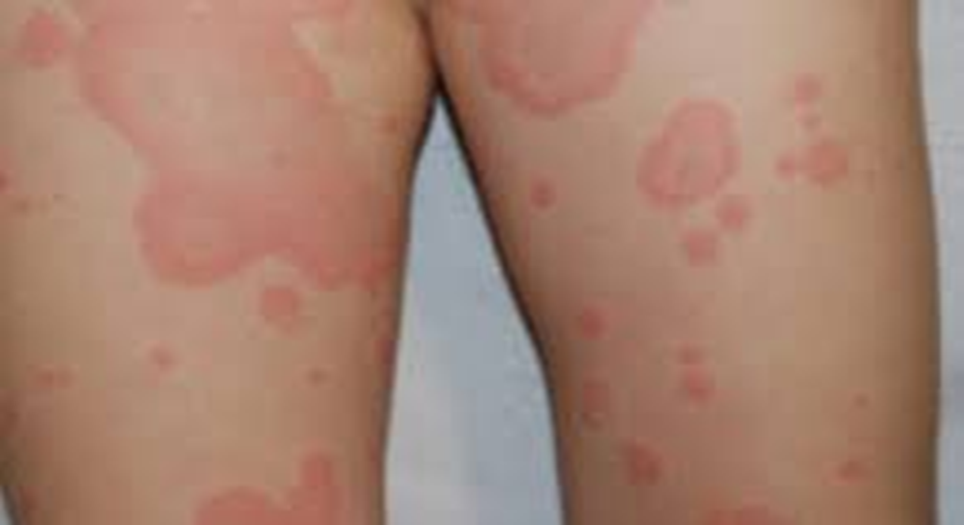
2.
Urticaria
Erythema marginatum
Psoriasis
Contact dermatitis

Slide 58
All of the following are major criteria except:
Chorea
Carditis
Fever
Arthritis

Slide 59
Following criteria are required for possible diagnosis of ARF:
2 major criteria plus 2 minor criteria
1 major criteria with 1 minor criteria
3 minor criteria
1 major criteria plus 2 minor criteria

Slide 60
1st line drug for acute rheumatic fever:
Penicillin
Vancomycin
Acyclovir
Aspirin

