Slide 1
Dr. Viral Gandhi
MD , DrNB cardiology assist professordept of cardiology
SBKS medical inst and research centre , sumandeep vidyapeeth deemed to be university
SACUBITRIL/VALSARTAN
Angiotensin Receptor - Neprilysin Inhibitor (ARNi)

Slide 2
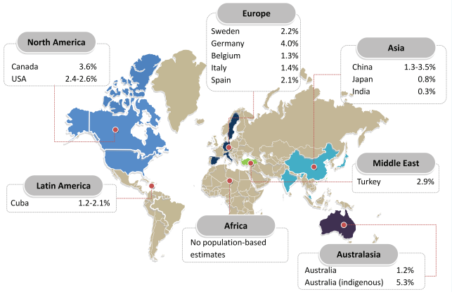
GLOBAL BURDEN of HF
Heart failure is also the most common cause of hospitalization in patients aged 65 years and over.
An estimated 64.3 million people are living with heart failure worldwide.
In developed countries, the prevalence of known heart failure is generally estimated at 1% to 2% of the general adult population.
Prevalence of heart failure in population-based studies around the world, in percentage, per region
European Journal of Heart Failure (2020) 22, 1342–1356

Slide 3
HF in INDIA
The estimated prevalence of HF in India is about 1% of the population or about 8–10 million individuals (1)
The estimated mortality attributable to HF is about 0.1–0.16 million individuals per year (1)
From a registry in South India it was estimated that 65.9% of patients had HFrEF, 20% were of HFmrEF and around 14.03 % of patients had HF with preserved EF (2)
1. J Pract Cardiovasc Sci 2016;2:28-35. 2. Egypt Heart J. 2021 May 1;73(1):38.

Slide 4
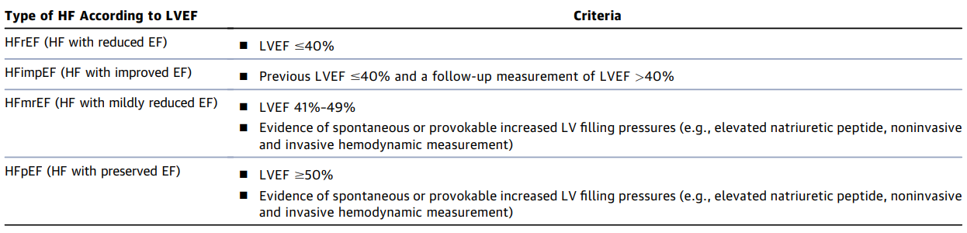
Classification of HF by LVEF
Definition of Heart failure (ACC/AHA)
HF is a complex clinical syndrome with symptoms and signs that result from any structural or functional impairment of ventricular filling or ejection of blood.
Heidenreich et al, JACC VOL. 79, NO. 17, MAY 3, 2022:e263 – e421

Slide 5
Symptoms & Signs
Cachexia and muscle wasting
Tachycardia
Pulsus alternans
Elevated jugular venous pressure
Displaced apex beat
Right ventricular heave
Crepitations or wheeze
Third heart sound
Oedema
Hepatomegaly (tender)
Ascites
Dyspnoea
Orthopnoea
Paroxysmal nocturnal dyspnoea
Reduced exercise tolerance, lethargy, fatigue
Nocturnal cough
Wheeze
Ankle swelling
Anorexia
BMJ. 2000 Jan 22;320(7229):236-9.

Slide 6
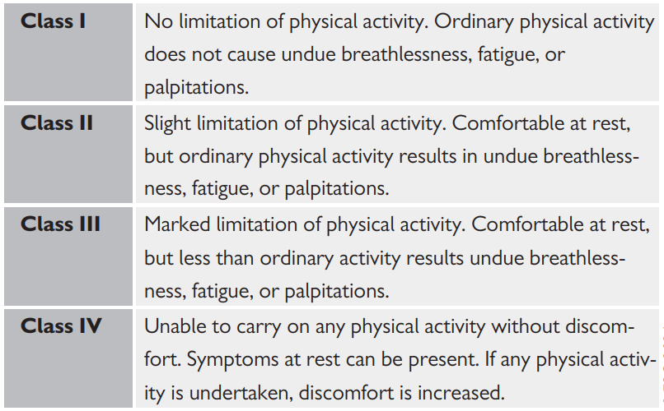
New York Heart Association functional classification based on severity of symptoms and physical activity
European Heart Journal (2021) 42, 3599-3726

Slide 7
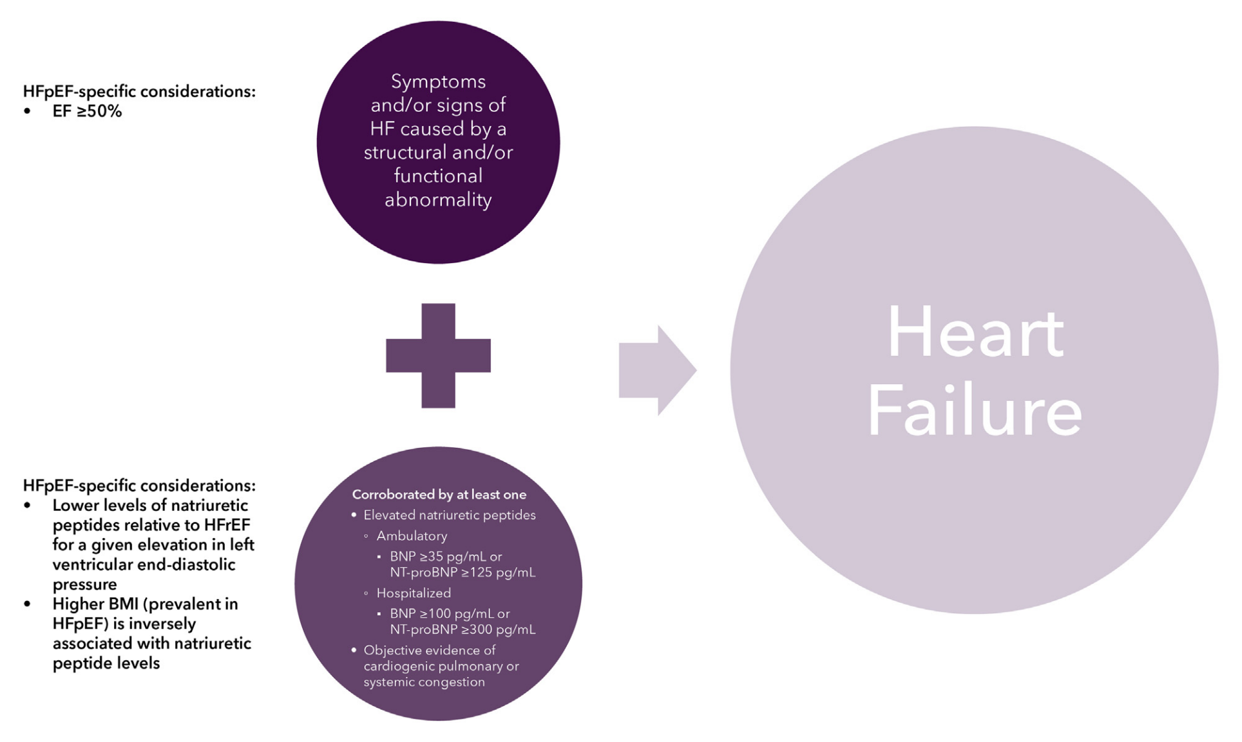
Universal Definition of HF
The Universal Definition of HF requires symptoms and/or signs caused by structural/functional cardiac abnormalities and at least 1 of: 1) elevated natriuretic peptides; or 2) objective evidence of cardiogenic pulmonary or systemic congestion.
J Am Coll Cardiol Apr 19, 2023.

Slide 8
Diagnosis of HF
Two or more major criteria or 1 major criterion plus 2 minor criteria are strictly required to make the diagnosis.
Major criteria include
Orthopnea
Jugular venous distension
Hepatojugular reflux
Rales
S3 gallop rhythm
Acute pulmonary edema
Cardiomegaly
Minor criteria include
Dyspnea on exertion
Nocturnal cough
Ankle edema
Tachycardia with heart rate over 120 beats/minute
Hepatomegaly
Pleural effusion
J Am Coll Cardiol Apr 19, 2023.

Slide 9
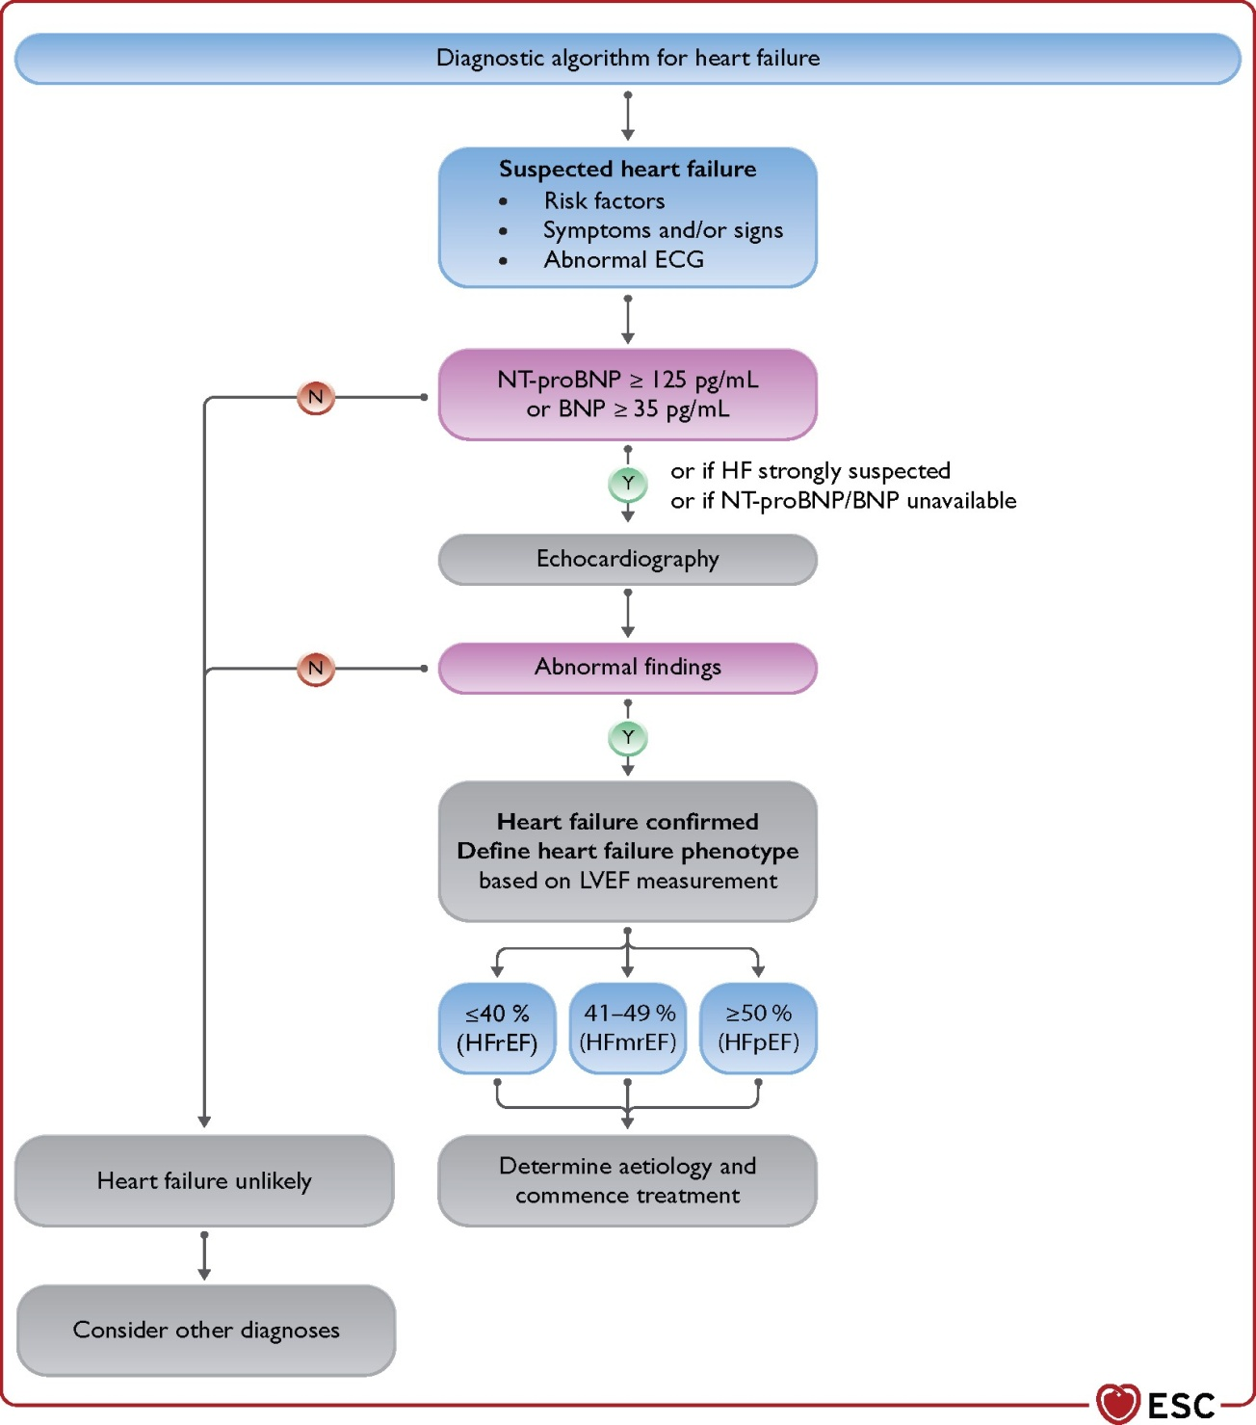
Diagnosis of HF
Diagnostic, therapeutic & prognostic marker
A plasma concentration of B-type natriuretic peptide (BNP) <35 pg/mL, N-terminal pro-B-type natriuretic peptide (NT-proBNP) <125 pg/ mL make a diagnosis of HF unlikely.
According to the guidelines of the American College of Cardiology Foundation/American Heart Association (ACCF/AHA) and the European Society of Cardiology (ESC), BNP and NT-proBNP are considered to be the most valuable and reliable biomarkers for diagnosing HF and cardiac dysfunction.
They are also responsible for the determination of the severity, guiding the relevant treatment strategies, and assessing the prognosis of heart disease.
European Heart Journal (2021) 42, 3599-3726
Notes:
BNP and NT-proBNP do not only have a great significance in the diagnosis of HF, but they also have an assistance value for assessing the severity and prognosis of HF.
Plasma BNP and NT-proBNP levels have prognostic values in patients with cardiovascular diseases, and the reduction of BNP and NT-proBNP level predicts an improvement in clinical symptoms.
Plasma BNP and NT-proBNP are also used clinically to guide the management of patients with HF and cardiac dysfunction, and they are also used as prognostic indicators which can help clinicians adjust their therapy strategy and determine therapy effectiveness to improve a patient’s survival.

Slide 10
Stages of Heart Failure
STAGE A:
At-Risk for Heart Failure
STAGE B:
Pre-Heart Failure
STAGE C:
Symptomatic Heart Failure
STAGE D:
Advanced Heart Failure
Patients at risk for HF but without current or previous symptoms/signs of HF and without structural/functional heart disease or abnormal biomarkers.
Patients with HTN, CVD, diabetes, obesity, exposure to cardiotoxic agents, genetic variant for cardiomyopathy, or family history of cardiomyopathy.
Patients without current or previous symptoms/signs of HF but evidence of 1 of the following: structural heart disease, increased filling pressures, or risk factors and increased natriuretic peptide levels or cardiac troponin (in the absence of competing diagnosis)
Patients with current or previous symptoms/signs of HF
Marked HF symptoms that interfere with daily life and with recurrent hospitalizations despite attempts to optimize GDMT
New Onset/De Novo HF
Trajectory of Stage C HF
Resolution of Symptoms
Persistent HF
Worsening HF
Heidenreich et al, JACC VOL. 79, NO. 17, MAY 3, 2022:e263 – e421

Slide 11
Causes of Heart Failure
Ischemic Heart Disease & Myocardial Infarction
Risk Factors
Non-Ischemic Causes
HTN
Obesity
Prediabetes/DM
ASCVD
HTN
Valvular heart disease
Congenital heart disease
Arrhythmias
Myocarditis
Cardiomyopathy
Others: Infective, Drug induced, Infiltrative, storage disorder, pericardial disease & Metabolic
Heidenreich et al, JACC VOL. 79, NO. 17, MAY 3, 2022:e263 – e421

Slide 12
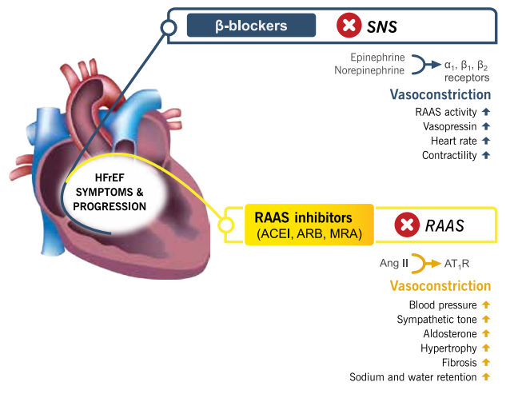
Pathophysiology & Management of Heart Failure
The cornerstone of modern drug therapy in chronic HF is the inhibition of neurohormonal activation that plays a crucial role in the pathophysiology of HF development and progression and, more specifically, of the renin-angiotensin-aldosterone system (RAAS) and the sympathetic nervous system (SNS) [1]
With these therapeutic options, more than 50% of patients with heart failure die within 5 years of diagnosis, and 25% of patients hospitalized with heart failure are readmitted within 30 days of discharge [2]
Overactivation of the RAAS and SNS underpins Heart Failure therapy
1. BMC Medicine. 2015;13(1), 2. Cleveland Clinic Journal of Medicine. 2015;82(10):693-701.

Slide 13
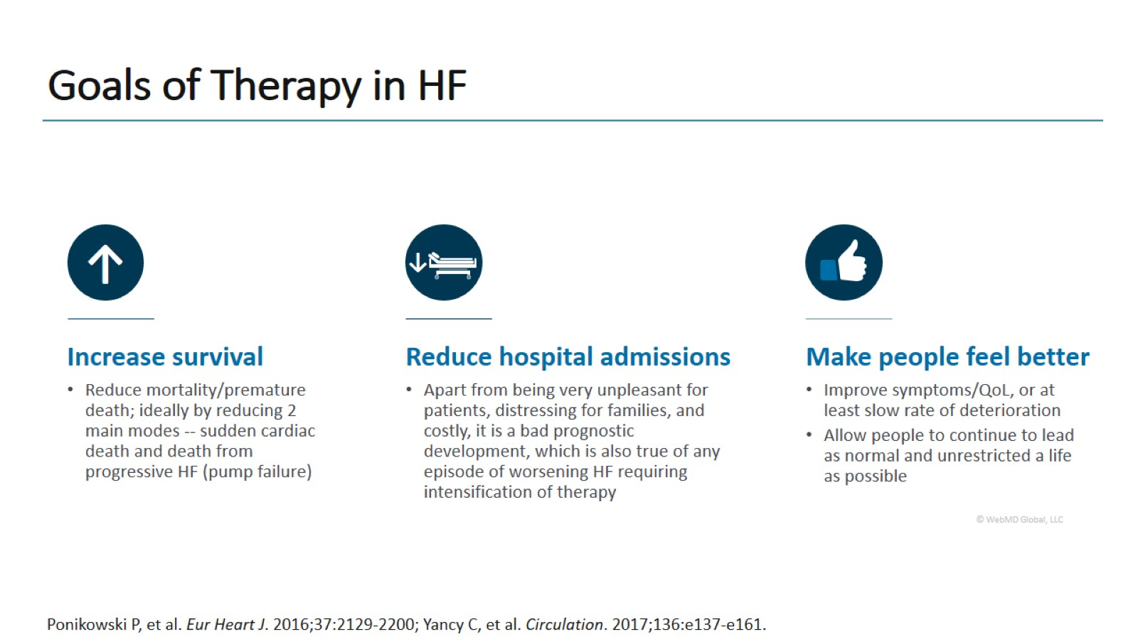
Goals of Therapy in HF
Notes:
In addition to survival benefit and reduced hospital admission….patient’s satisfaction in terms of improved quality of life is very important

Slide 14
Angiotensin Receptor - Neprilysin Inhibitor [ARNi (sacubitril/valsartan)]
ARNi (LCZ696) is the new class of drugs that simultaneously block the angiotensin II type I receptors (angiotensin receptor blocker [ARB]) and inhibit neprilysin (neprilysin inhibitor [NEPi]), hence, the acronym ARNi.
It is a supramolecular complex of six molecules of the ARB valsartan with six molecules of the NEPi prodrug, sacubitril (1:1 molar ratio).
Following ingestion, sacubitril is metabolized rapidly into the active NEPi, LBQ657(sacubitrilat).
By inhibiting neprilysin, ARNi would reduce the breakdown of natriuretic peptides and increase natriuretic peptide levels (ANP, BNP and CNP). ARNi provides simultaneous AT1 receptor blockade through valsartan to suppress the over-activation of the RAAS caused by increased Ang II.
Journal of the American College of Cardiology. 2015;65(10):1029-1041.

Slide 15
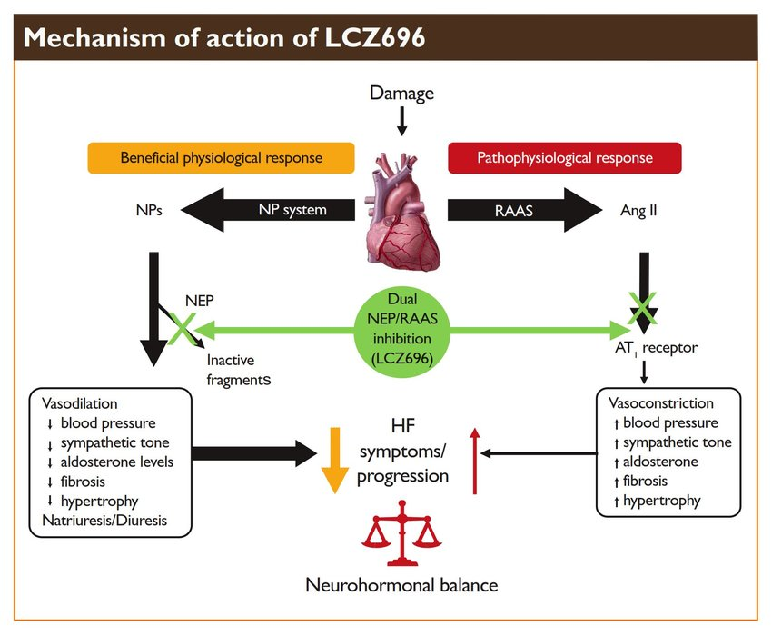
MOA
R.R. Dargad et al. / Indian Heart Journal 70S (2018) S102–S110

Slide 16
CLINICAL EVIDENCES

Slide 17
Drugs That Reduce Mortality in HFrEF
Angiotensin
receptor
blocker
Mineralocorticoid
receptor
antagonist
ACE
inhibitor
Beta
blocker
0%
10%
20%
% Decrease in Mortality
Drugs that inhibit the renin-angiotensin system have modest effects on survival
30%
40%
Based on results of SOLVD-Treatment, CHARM-Alternative,
COPERNICUS, MERIT-HF, CIBIS II, RALES and EMPHASIS-HF

Slide 18
Aim of the PARADIGM-HF Trial (HFrEF)
Prospective comparison of ARNI with ACEI to Determine Impact on Global Mortality and morbidity in Heart Failure trial (PARADIGM-HF)
specifically designed to replace use
of ace inhibitors and angiotensin receptor blockers as the cornerstone of the treatment of heart failure
LCZ696
400 mg daily
Enalapril
20 mg daily
New England Journal of Medicine. 2014;371(11):993-1004
Notes:
Background: We compared the angiotensin receptor–neprilysin inhibitor LCZ696 with enalapril in patients who had heart failure with a reduced ejection fraction. In previous studies, enalapril improved survival in such patients.
Methods: In this double-blind trial, we randomly assigned 8442 patients with class II, III, or IV heart failure and an ejection fraction of 40% or less to receive either LCZ696 (at a dose of 200 mg twice daily) or enalapril (at a dose of 10 mg twice daily), in addition to recommended therapy. The primary outcome was a composite of death from cardiovascular causes or hospitalization for heart failure, but the trial was designed to detect a difference in the rates of death from cardiovascular causes.
Results: The trial was stopped early, according to prespecified rules, after a median follow-up of 27 months, because the boundary for an overwhelming benefit with LCZ696 had been crossed. At the time of study closure, the primary outcome had occurred in 914 patients (21.8%) in the LCZ696 group and 1117 patients (26.5%) in the enalapril group (hazard ratio in the LCZ696 group, 0.80; 95% confidence interval [CI], 0.73 to 0.87; P<0.001); of these patients, 558 (13.3%) and 693 (16.5%), respectively, died from cardiovascular causes (hazard ratio, 0.80; 95% CI, 0.71 to 0.89; P<0.001). As compared with enalapril, LCZ696 also reduced the risk of hospitalization for heart failure by 21% (P<0.001) and decreased the symptoms and physical limitations of heart failure (P=0.001). The LCZ696 group had higher proportions of patients with hypotension and nonserious angioedema but lower proportions with renal impairment, hyperkalemia, and cough than the enalapril group.
Conclusions: LCZ696 was superior to enalapril in reducing the risks of death and of hospitalization for heart failure.

Slide 19
PARADIGM-HF: Cardiovascular Death or Heart Failure Hospitalization (Primary Endpoint)
40
Enalapril
(n=4212)
1117
32
24
Kaplan-Meier Estimate of
Cumulative Rates (%)
16
8
0
0
180
360
540
720
900
1080
1260
Patients at Risk
Days After Randomization
LCZ696
Enalapril
4187
4212
3922
3883
3663
3579
3018
2922
2257
2123
1544
1488
896
853
249
236
New England Journal of Medicine. 2014;371(11):993-1004

Slide 20
PARADIGM-HF: Cardiovascular Death or Heart Failure Hospitalization (Primary Endpoint)
40
Enalapril
(n=4212)
1117
32
914
24
LCZ696
(n=4187)
Kaplan-Meier Estimate of
Cumulative Rates (%)
16
8
0
0
180
360
540
720
900
1080
1260
Patients at Risk
Days After Randomization
LCZ696
Enalapril
4187
4212
3922
3883
3663
3579
3018
2922
2257
2123
1544
1488
896
853
249
236
New England Journal of Medicine. 2014;371(11):993-1004

Slide 21
PARADIGM-HF: Cardiovascular Death or Heart Failure Hospitalization (Primary Endpoint)
40
Enalapril
(n=4212)
1117
32
914
24
LCZ696
(n=4187)
Kaplan-Meier Estimate of
Cumulative Rates (%)
20% reduction in death from CV cause and HF hospitalization in HFrEF
16
HR = 0.80 (0.73-0.87)
P = 0.0000002
Number needed to treat = 21
8
0
0
180
360
540
720
900
1080
1260
Patients at Risk
Days After Randomization
LCZ696
Enalapril
4187
4212
3922
3883
3663
3579
3018
2922
2257
2123
1544
1488
896
853
249
236
New England Journal of Medicine. 2014;371(11):993-1004

Slide 22
PARADIGM-HF: Cardiovascular Death
32
Enalapril
(n=4212)
24
693
Kaplan-Meier Estimate of
Cumulative Rates (%)
16
8
0
0
180
360
540
720
900
1080
1260
Days After Randomization
Patients at Risk
LCZ696
Enalapril
4187
4212
4056
4051
3891
3860
3282
3231
2478
2410
1716
1726
1005
994
280
279
New England Journal of Medicine. 2014;371(11):993-1004

Slide 23
PARADIGM-HF: Cardiovascular Death
32
Enalapril
(n=4212)
24
693
558
Kaplan-Meier Estimate of
Cumulative Rates (%)
16
LCZ696
(n=4187)
8
0
0
180
360
540
720
900
1080
1260
Days After Randomization
Patients at Risk
LCZ696
Enalapril
4187
4212
4056
4051
3891
3860
3282
3231
2478
2410
1716
1726
1005
994
280
279
New England Journal of Medicine. 2014;371(11):993-1004

Slide 24
PARADIGM-HF: Cardiovascular Death
32
Enalapril
(n=4212)
24
HR = 0.80 (0.71-0.89)
P = 0.00004
Number need to treat = 32
693
558
Kaplan-Meier Estimate of
Cumulative Rates (%)
16
LCZ696
(n=4187)
8
0
0
180
360
540
720
900
1080
1260
Days After Randomization
Patients at Risk
LCZ696
Enalapril
4187
4212
4056
4051
3891
3860
3282
3231
2478
2410
1716
1726
1005
994
280
279
New England Journal of Medicine. 2014;371(11):993-1004

Slide 25
PARADIGM-HF: Effect of LCZ696 vs Enalapril on Primary Endpoint and Its Components
 | LCZ696 (n=4187) | Enalapril (n=4212) | Hazard Ratio (95% CI) | P Value
Primary endpoint | 914 (21.8%) | 1117 (26.5%) | 0.80 (0.73-0.87) | 0.0000002
Cardiovascular death | 558 (13.3%) | 693 (16.5%) | 0.80 (0.71-0.89) | 0.00004
Hospitalization for heart failure | 537 (12.8%) | 658 (15.6%) | 0.79 (0.71- 0.89) | 0.00004
New England Journal of Medicine. 2014;371(11):993-1004

Slide 26
PARADIGM-HF: All-Cause Mortality
32
Enalapril
(n=4212)
HR = 0.84 (0.76-0.93)
P<0.0001
835
24
711
16%
Kaplan-Meier Estimate of
Cumulative Rates (%)
16
LCZ696
(n=4187)
ARNi was superior to Enalapril in reducing the risks of death and of hospitalization for HF
8
0
0
180
360
540
720
900
1080
1260
Days After Randomization
Patients at Risk
LCZ696
Enalapril
4187
4212
4056
4051
3891
3860
3282
3231
2478
2410
1716
1726
1005
994
280
279
New England Journal of Medicine. 2014;371(11):993-1004

Slide 27
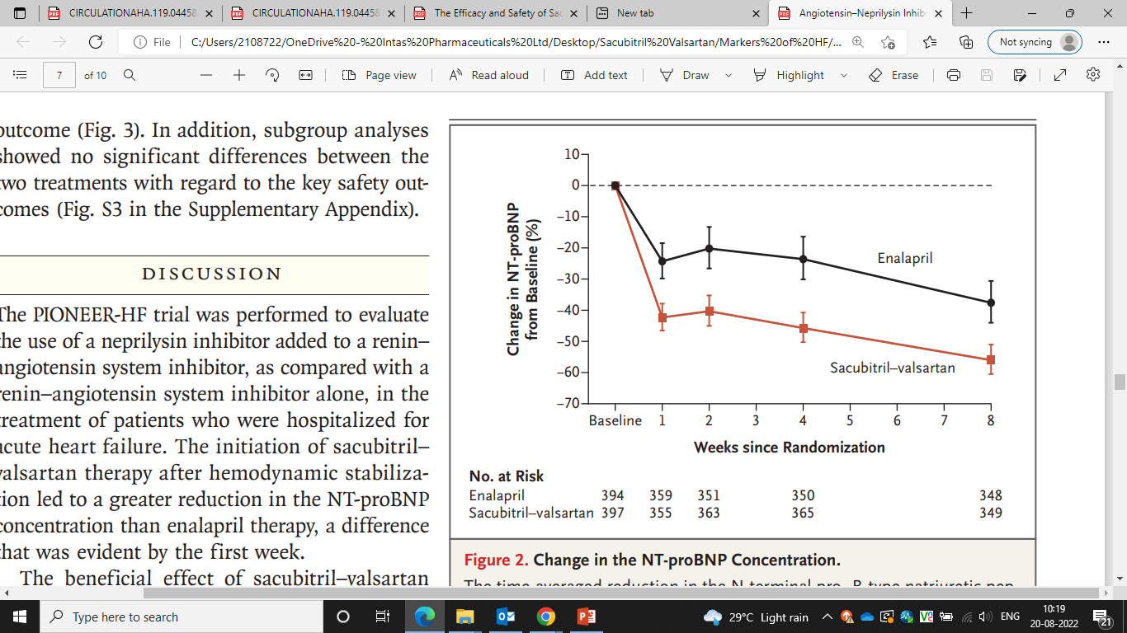
PIONEER-HF trial (HFrEF hospitalized for Acute Decompensation)
N=881 (ARNi:440, Enalapril:441)
Reduction in the NT-proBNP concentration was significantly greater in the sacubitril–valsartan group than in the enalapril group (percent change, −46.7% vs −25.3%; P<0.001).
Among patients with HFrEF who were hospitalized for acute decompensated heart failure, the initiation of sacubitril–valsartan therapy led to a greater reduction in the NT-proBNP concentration than enalapril therapy.
New England Journal of Medicine. 2019;380(6):539-548.
Notes:
We enrolled patients with heart failure with reduced ejection fraction who were hospitalized for acute decompensated heart failure at 129 sites in the United States. After hemodynamic stabilization, patients were randomly assigned to receive sacubitril–valsartan (target dose, 97 mg of sacubitril with 103 mg of valsartan twice daily) or enalapril (target dose, 10 mg twice daily). The primary efficacy outcome was the time-averaged proportional change in the N-terminal pro–B-type natriuretic peptide (NT-proBNP) concentration from baseline through weeks 4 and 8.
Of the 881 patients who underwent randomization, 440 were assigned to receive sacubitril–valsartan and 441 to receive enalapril. The time-averaged reduction in the NT-proBNP concentration was significantly greater in the sacubitril–valsartan group than in the enalapril group; the ratio of the geometric mean of values obtained at weeks 4 and 8 to the baseline value was 0.53 in the sacubitril–valsartan group as compared with 0.75 in the enalapril group (percent change, −46.7% vs. −25.3%; ratio of change with sacubitril–valsartan vs. enalapril, 0.71; 95% confidence interval [CI], 0.63 to 0.81; P<0.001). The greater reduction in the NT-proBNP concentration with sacubitril–valsartan than with enalapril was evident as early as week 1 (ratio of change, 0.76; 95% CI, 0.69 to 0.85).

Slide 28
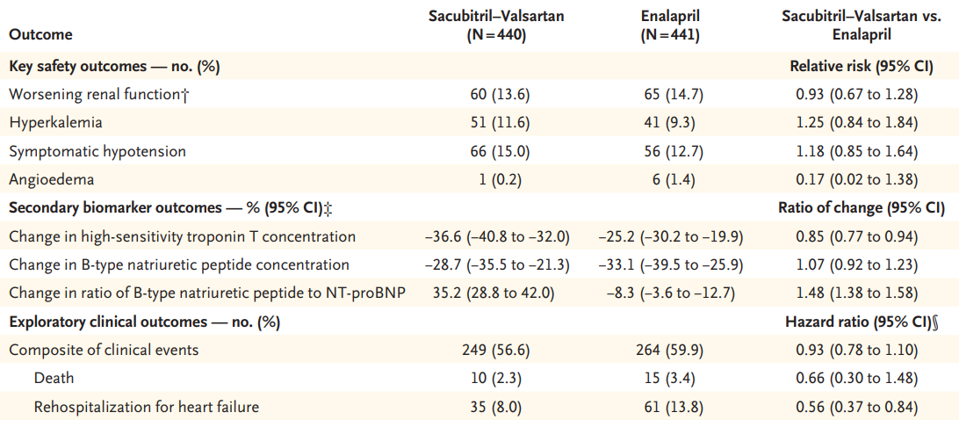
PIONEER-HF trial (HFrEF)
44% RR reductions in re hospitalizations for heart failure after 8 weeks of therapy with ARNi
New England Journal of Medicine. 2019;380(6):539-548.

Slide 29
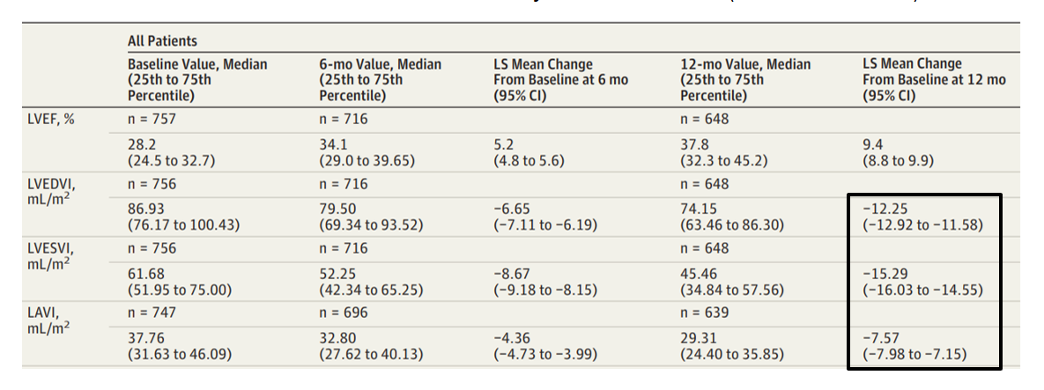
PROVE-HF trial (HFrEF)
12-month, single-group
open-label study, N= 974
ARNi increased LVEF by 9.4% (P < 0.001) and decreased left ventricular end-diastolic volume index, left ventricular end-systolic volume index, left atrial volume index in HFrEF patients after 12 months of treatment.
JAMA. 2019;322(11):1085.
Notes:
Objective: To determine whether NT-proBNP changes in patients with HFrEF treated with sacubitril-valsartan correlate with changes in measures of cardiac volume and function.
Design, setting, and participants: Prospective, 12-month, single-group, open-label study of patients with HFrEF enrolled in 78 outpatient sites in the United States. Sacubitril-valsartan was initiated and the dose adjusted. Enrollment commenced on October 25, 2016, and follow-up was completed on October 22, 2018.
Exposures: NT-proBNP concentrations among patients treated with sacubitril-valsartan.
Main outcomes and measures: The primary outcome was the correlation between changes in log2-NT-proBNP concentrations and left ventricular (LV) EF, LV end-diastolic volume index (LVEDVI), LV end-systolic volume index (LVESVI), left atrial volume index (LAVI), and ratio of early transmitral Doppler velocity/early diastolic annular velocity (E/e') at 12 months.
Results: Among 794 patients (mean age, 65.1 years; 226 women [28.5%]; mean LVEF = 28.2%), 654 (82.4%) completed the study. The median NT-proBNP concentration at baseline was 816 pg/mL (interquartile range [IQR], 332-1822) and 455 pg/mL (IQR, 153-1090) at 12 months (difference, P < .001). At 12 months, the change in log2-NT-proBNP concentration was correlated with changes in LVEF (r = -0.381 [IQR, -0.448 to -0.310]; P < .001), LVEDVI (r = 0.320 [IQR, 0.246 to 0.391]; P < .001), LVESVI (r = 0.405 [IQR, 0.335 to 0.470]; P < .001), LAVI (r = 0.263 [IQR, 0.186 to 0.338]; P < .001), and E/e' (r = 0.269 [IQR, 0.182 to 0.353]; P < .001). At 12 months, LVEF increased from 28.2% to 37.8% (difference, 9.4% [95% CI, 8.8% to 9.9%]; P < .001), while LVEDVI decreased from 86.93 to 74.15 mL/m2 (difference, -12.25 mL/m2 [IQR, -12.92 to -11.58]; P < .001) and LVESVI decreased from 61.68 to 45.46 mL/m2 (difference, -15.29 mL/m2 [95% CI, -16.03 to -14.55]; P < .001). LAVI and E/e' ratio also decreased significantly. The most frequent adverse events were hypotension (17.6%), dizziness (16.8%), hyperkalemia (13.2%), and worsening kidney function (12.3%).
Conclusions and relevance: In this exploratory study of patients with HFrEF treated with sacubitril-valsartan, reduction in NT-proBNP concentration was weakly yet significantly correlated with improvements in markers of cardiac volume and function at 12 months. The observed reverse cardiac remodeling may provide a mechanistic explanation for the effects of sacubitril-valsartan in patients with HFrEF.

Slide 30
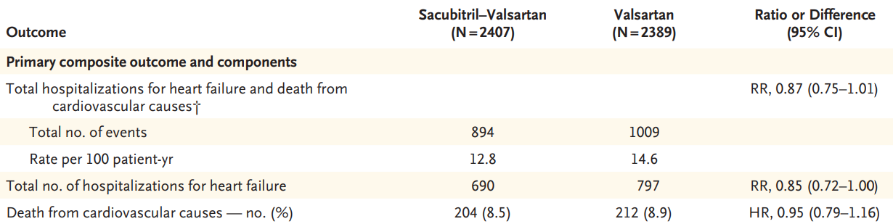
PARAGON-HF trial (HFpEF)
N= 4822 (NYHA Class II-IV HF) [ARNi (n= 2407), Valsartan (n=2389)]
13% RR reductions in total hospitalizations for heart failure and death from cardiovascular causes
New England Journal of Medicine. 2019;381(17):1609-1620.
Notes:
We randomly assigned 4822 patients with New York Heart Association (NYHA) class II to IV heart failure, ejection fraction of 45% or higher, elevated level of natriuretic peptides, and structural heart disease to receive sacubitril–valsartan (target dose, 97 mg of sacubitril with 103 mg of valsartan twice daily) or valsartan (target dose, 160 mg twice daily). The primary outcome was a composite of total hospitalizations for heart failure and death from cardiovascular causes.
There were 894 primary events in 526 patients in the sacubitril–valsartan group and 1009 primary events in 557 patients in the valsartan group (rate ratio, 0.87; 95% confidence interval [CI], 0.75 to 1.01; P=0.06). The incidence of death from cardiovascular causes was 8.5% in the sacubitril–valsartan group and 8.9% in the valsartan group (hazard ratio, 0.95; 95% CI, 0.79 to 1.16); there were 690 and 797 total hospitalizations for heart failure, respectively (rate ratio, 0.85; 95% CI, 0.72 to 1.00). NYHA class improved in 15.0% of the patients in the sacubitril–valsartan group and in 12.6% of those in the valsartan group (odds ratio, 1.45; 95% CI, 1.13 to 1.86); renal function worsened in 1.4% and 2.7%, respectively (hazard ratio, 0.50; 95% CI, 0.33 to 0.77). Patients in the sacubitril–valsartan group had a higher incidence of hypotension and angioedema and a lower incidence of hyperkalemia.
Sacubitril–valsartan did not result in a significantly lower rate of total hospitalizations for heart failure and death from cardiovascular causes among patients with heart failure and an ejection fraction of 45% or higher.

Slide 31
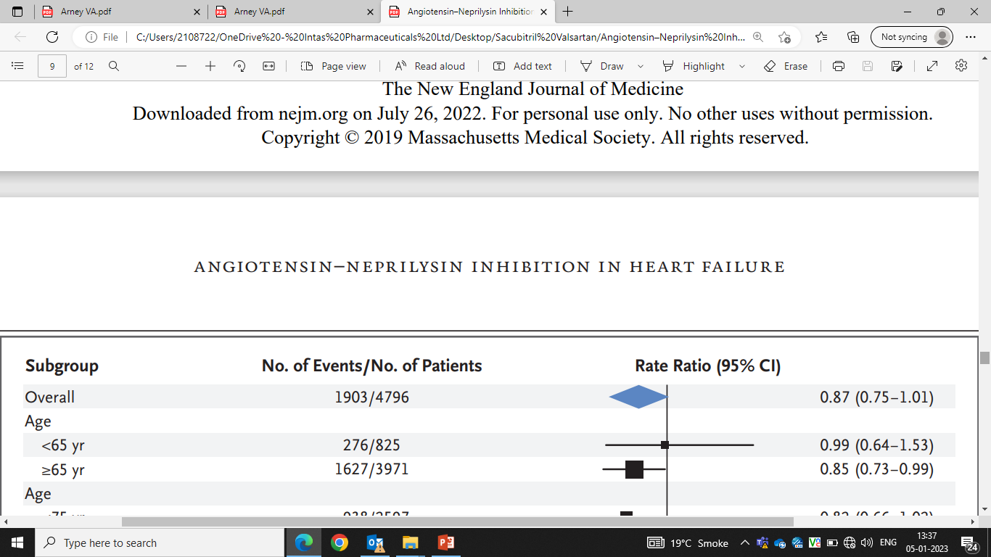
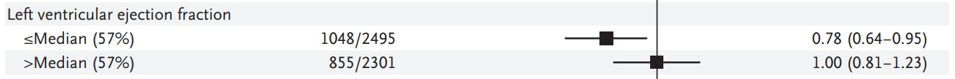
PARAGON-HF trial (Subgroup Analysis)
Primary Outcome in Prespecified Subgroups
ARNi has significant protective results for the subgroup of patients with an EF below 57% (risk ratio 0.78)
22% RR reduction in primary composite of hospitalizations for heart failure and death from cardiovascular causes in subset of patients with EF < 57%
New England Journal of Medicine. 2019;381(17):1609-1620.

Slide 32
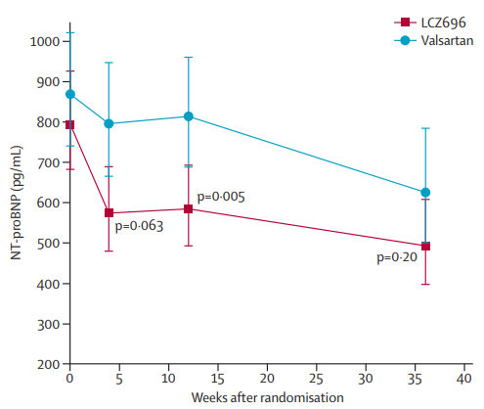
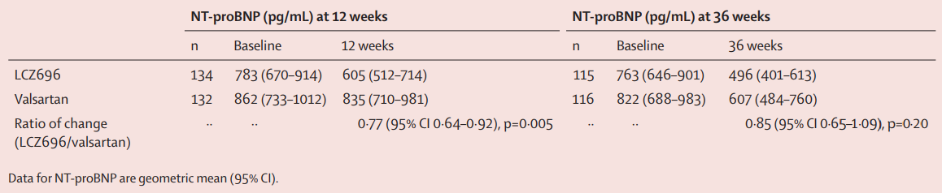
PARAMOUNT HF Trial (HFpEF)
Phase 2, NYHA class II-III HF (ARNi n=134, Valsartan n=132)
NT-proBNP was significantly reduced at 12 weeks in the ARNi group compared with the valsartan group
In patients with HFpEF, ARNi reduced NT-proBNP to a greater extent than did valsartan at 12 weeks
Lancet 2012; 380: 1387–95
Notes:
PARAMOUNT was a phase 2, randomised, parallel-group, double-blind multicentre trial in patients with New York Heart Association (NYHA) class II–III heart failure, left ventricular ejection fraction 45% or higher, and NT-proBNP greater than 400 pg/mL. Participants were randomly assigned (1:1) by central interactive voice response system to LCZ696 titrated to 200 mg twice daily or valsartan titrated to 160 mg twice daily, and treated for 36 weeks. Investigators and participants were masked to treatment assignment. The primary endpoint was change in NT-proBNP, a marker of left ventricular wall stress, from baseline to 12 weeks; analysis included all patients randomly assigned to treatment groups who had a baseline and at least one post baseline assessment.
149 patients were randomly assigned to LCZ696 and 152 to valsartan; 134 in the LCZ696 group and 132 in the valsartan group were included in analysis of the primary endpoint. NT-proBNP was significantly reduced at 12 weeks in the LCZ696 group compared with the valsartan group (LCZ696: baseline, 783 pg/mL [95% CI 670–914], 12 weeks, 605 pg/mL [512–714]; valsartan: baseline, 862 pg/mL [733–1012], 12 weeks, 835 [710–981]; ratio LCZ696/valsartan, 0·77, 95% CI 0·64–0·92, p=0·005).
In patients with heart failure with preserved ejection fraction, LCZ696 reduced NT-proBNP to a greater extent than did valsartan at 12 weeks and was well tolerated.

Slide 33
Recent evidence of ARNi in HFpEF

Slide 34
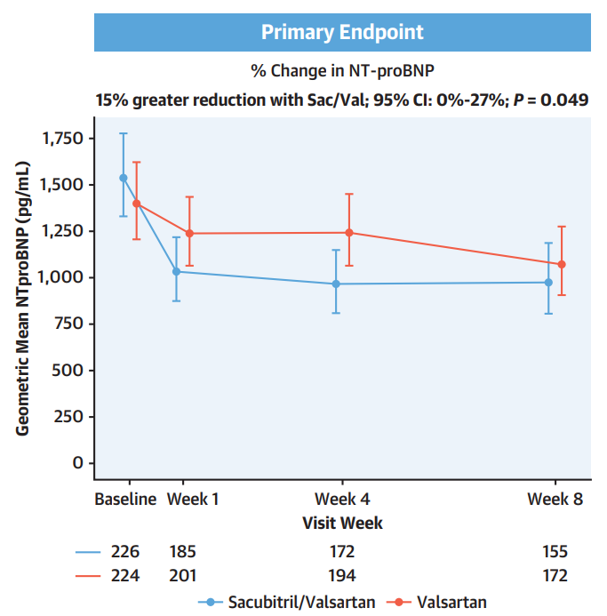
Angiotensin Neprilysin Inhibition in Patients With Mildly Reduced or Preserved Ejection Fraction and Worsening Heart Failure: PARAGLIDE HF
Greater reduction in the NT-proBNP concentration with Sac/Val than with Val was evident as early as Week 1.
Larger treatment effect in the subgroup with EF below normal (<60%)
J Am Coll Cardiol. 2023 May 11:S0735-1097(23)05429-3.

Slide 35
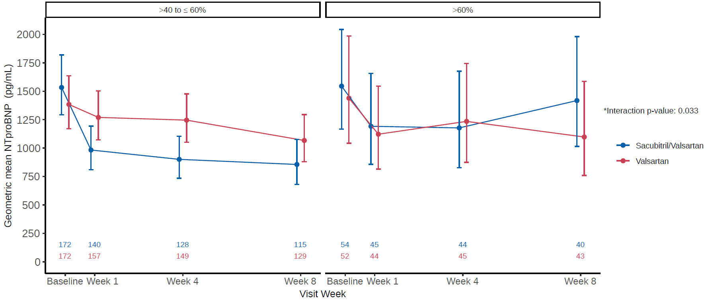
RESULTS
J Am Coll Cardiol. 2023 May 11:S0735-1097(23)05429-3.

Slide 36
Analyses of Change in the NT-proBNP Concentration in Prespecified Subgroups
J Am Coll Cardiol. 2023 May 11:S0735-1097(23)05429-3.

Slide 37
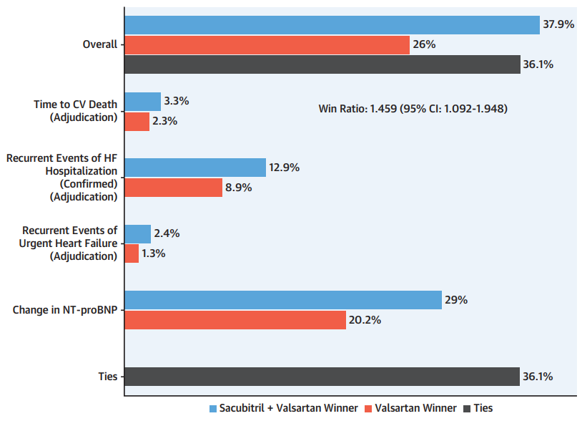
RESULTS
For the subgroup with EF <60%, the rate ratio for the recurrent composite cardiovascular endpoint was 0.61.
For the worsening renal function clinical endpoint, there were 34 events in the Sac/Val group and 46 events in the Val group resulting in a rate ratio of 0.62.
Win Ratio in the Subgroup With EF Below Normal (<60%)
J Am Coll Cardiol. 2023 May 11:S0735-1097(23)05429-3.

Slide 38
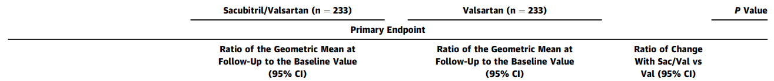
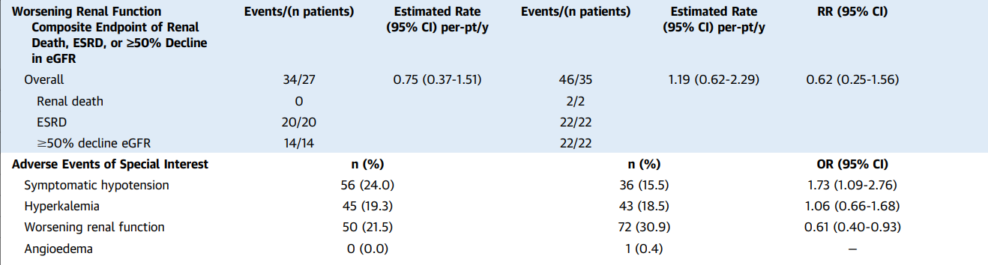
SAFETY
Compared with Val, Sac/Val had less worsening renal function (OR: 0.61)
J Am Coll Cardiol. 2023 May 11:S0735-1097(23)05429-3.

Slide 39
Conclusion
Among patients with heart failure with EF >40% and stabilized WHF, Sac/Val led to a greater reduction in NT-proBNP and clinical benefit compared with Val, with numerically fewer cardiovascular and renal events.
In a pre-specified subgroup with EF below normal, the effect on natriuretic peptide level and clinical outcomes were larger.
These data add to the evidence supporting a treatment benefit of Sac/Val in those with EF >40% (particularly in those with EF below normal), and influence future guidance for use of Sac/Val, regardless of treatment setting (hospital vs clinic) or HF chronicity (acute on chronic vs de novo HF).
J Am Coll Cardiol. 2023 May 11:S0735-1097(23)05429-3.

Slide 40
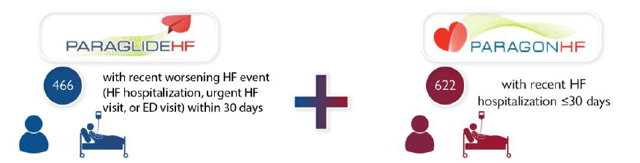
Sacubitril/valsartan in heart failure with mildly reduced or preserved ejection fraction: a pre-specified participant-level pooled analysis of PARAGLIDE-HF and PARAGON-HF
Eur Heart J. 2023 May 21:ehad344.

Slide 41
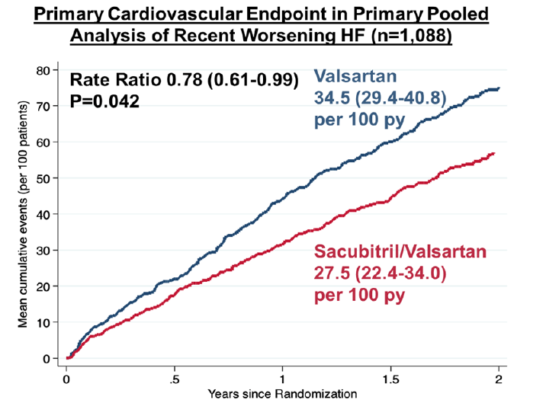
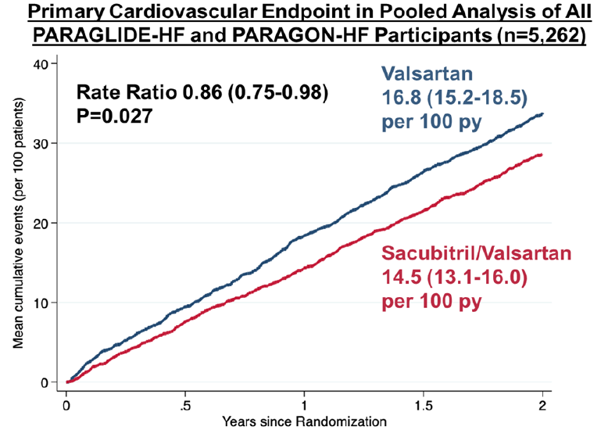
RESULTS
In the pooled analysis of all participants, first nominal statistical significance was reached by day 9 after randomization and treatment benefits were larger in those with LVEF ≤60% (RR 0.78) compared with those with LVEF >60% (RR 1.09; Pinteraction=0.021).
Compared with valsartan, sacubitril/valsartan significantly reduced total worsening HF events and cardiovascular death in both the primary pooled analysis of participants with recent worsening HF (n=1,088; rate ratio [RR] 0.78; P=0.042) and in the pooled analysis of all participants (n=5,262; RR 0.86; P=0.027).
Eur Heart J. 2023 May 21:ehad344.

Slide 42
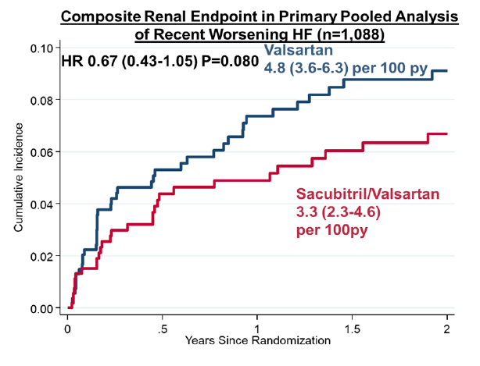
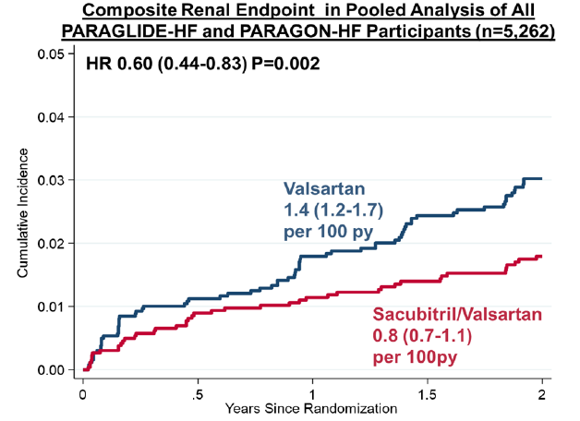
RESULTS: Renal end points
Conclusions: In pooled analyses of PARAGLIDE-HF and PARAGON-HF, sacubitril/valsartan reduced cardiovascular and renal events among patients with HF with mildly reduced or preserved ejection fraction. These data provide support for use of sacubitril/valsartan in patients with HF with mildly reduced or preserved ejection fraction, particularly among those with an LVEF below normal, regardless of care setting.
Sacubitril/valsartan was also associated with lower rates of the renal composite endpoint in the primary pooled analysis (hazard ratio [HR] 0.67; P=0.080) and the pooled analysis of all participants (HR 0.60; P=0.002).
Eur Heart J. 2023 May 21:ehad344.

Slide 43
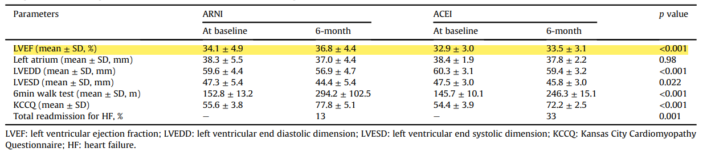
Safety and efficacy of ARNI vs ACEI (Enalapril) in acute heart failure: A prospective observational study in INDIA
Significant reduction in hospital readmission for HF as well as significant improvement in LVEF, LVEDD, LVESD and quality of life after 6 months of therapy with ARNi in comparison with ACEi.
Indian Heart J. 2022 May-Jun;74(3):178-181.
Notes:
Objective: To compare the safety and efficacy of valsartan/sacubitril (angiotensin receptor neprilysin inhibitor [ARNI]) against enalapril (angiotensin-converting enzyme inhibitor [ACEI]) in patients with acute heart failure at 6-month follow-up.
Methods: In this prospective, single centre, and observational study conducted between September 2017 and February 2020 in India, patients with acute decompensated heart failure with reduced ejection fraction (<40%) were included. Patients were divided in two groups: valsartan/sacubitril (ARNI) group and enalapril (ACEI). Patients were followed up for at least 6 months after administration of first dose and were evaluated for safety, efficacy, and tolerability of target drug. Student's independent t-test was employed for comparing continuous variables. Chi-square test or Fisher's exact test, whichever appropriate, was applied for comparing categorical variables.
Results: A total of 200 patients were included in the present study, 100 each in ARNI and ACEI group. The mean age of the population was 61.2 ± 8.4 years and 62.6 ± 8.6 years in ARNI group and ACEI group, respectively. The mean maximum tolerated dose by population in ARNI group was 203.6 mg and 8.9 mg in ACEI group. Readmission for heart failure were seen significantly higher in ACEI group than ARNI group (p value = 0.001). Parameters like ejection fraction, left ventricular end diastolic and systolic dimensions, 6 min walk test and Kansas City Cardiomyopathy Questionnaires (KCCQ) showed p values < 0.05 between the groups.
Conclusion: The ARNI study group showed better safety and efficacy outcomes at the end of 6 months follow-up compared to ACEI group.

Slide 44
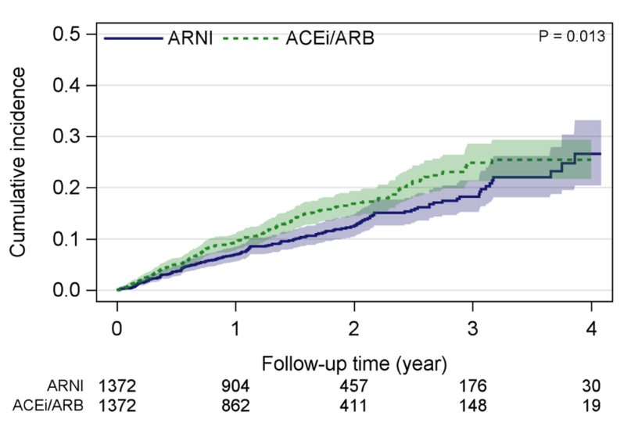
Real-world comparative effectiveness of ARNi versus ACEi/ARB in HF with reduced or mildly reduced ejection fraction
ARNI induced a 23% reduction in all-cause mortality versus ACEi/ARB (HR 0.77, p=0.013)
In this nationwide real-world study including a population of patients with HF with reduced or mildly reduced EF, ARNi was associated with a statistically significant relative risk reduction in all-cause mortality compared with ACEi/ARB
Clin Res Cardiol. 2023 Jan;112(1):167-174.
Notes:
Aims: Sacubitril/valsartan is a first-in-class angiotensin receptor-neprilysin inhibitor (ARNI) with a class-1 guideline recommendation. We assessed the real-world effectiveness of ARNI versus angiotensin-converting enzyme inhibitor/angiotensin receptor blocker (ACEi/ARB) on all-cause and cardiovascular (CV)-related mortality and hospitalizations in heart failure (HF) with reduced or mildly reduced ejection fraction (EF).
Methods: Patient-level clinical, laboratory, drug dispensation, hospitalization, and mortality data were derived from the Swedish Heart Failure Registry (SwedeHF) and interlinked databases (1 April 2016-31 December 2020). Eligible ARNI:ACEi/ARB patients (n = 7275:24,604) had a left ventricular EF < 50%. Mortality and hospitalizations with ARNI (≤ 3 months pre-/post-1 April 2016 index [SwedeHF]; n = 1506) versus ACEi/ARB (≤ 3 months post-index; n = 17,108) were assessed using propensity score matching (1:1 ratio) with clinical variables, and sensitivity analysis (1:2/1:3 with, and 1:2 without clinical variables).
Results: ARNI induced a 23% reduction in all-cause mortality versus ACEi/ARB (1:1 hazard ratio [HR; 95% confidence interval (CI)]: 0.77 [0.63-0.95], p = 0.013), and a non-significant 23% relative risk reduction in CV-related mortality (0.77 [0.54-1.09], p = 0.13), but no difference in all-cause or CV-related hospitalization (1.02 [0.91-1.13]; p = 0.76; 1.01 [0.91-1.15]; p = 0.84, respectively). Sensitivity analyses confirmed all-cause mortality was reduced for ARNI versus ACEi/ARB (HR 0.90 [95% CI 0.82-0.99], p = 0.026), but not CV-related mortality (HR 1.04 [95% CI 0.89-1.22], p = 0.63).
Conclusions: In this nationwide real-world study including a population of patients with HF with reduced or mildly reduced EF, ARNI as part of guideline-led Swedish clinical practice was associated with a statistically significant relative risk reduction in all-cause mortality compared with ACEi/ARB.

Slide 45
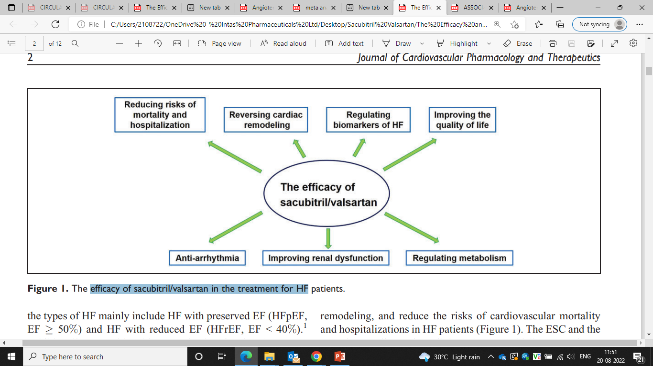
Efficacy of ARNi in the treatment for HF
Journal of Cardiovascular Pharmacology and Therapeutics. 2022;27:107424842110586.

Slide 46
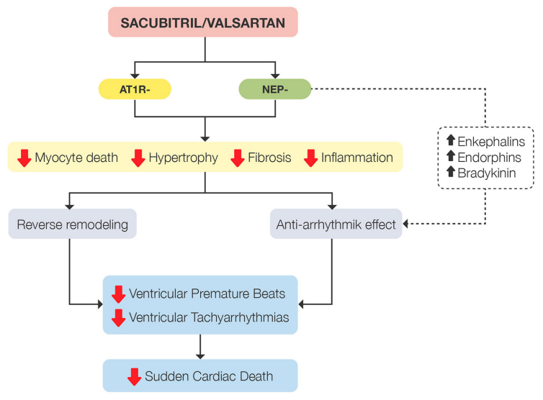
Mechanisms involved in reducing the sudden death rate demonstrated by sacubitril/valsartan
Front Cardiovasc Med. 2021 Nov 11;8:754499.

Slide 47
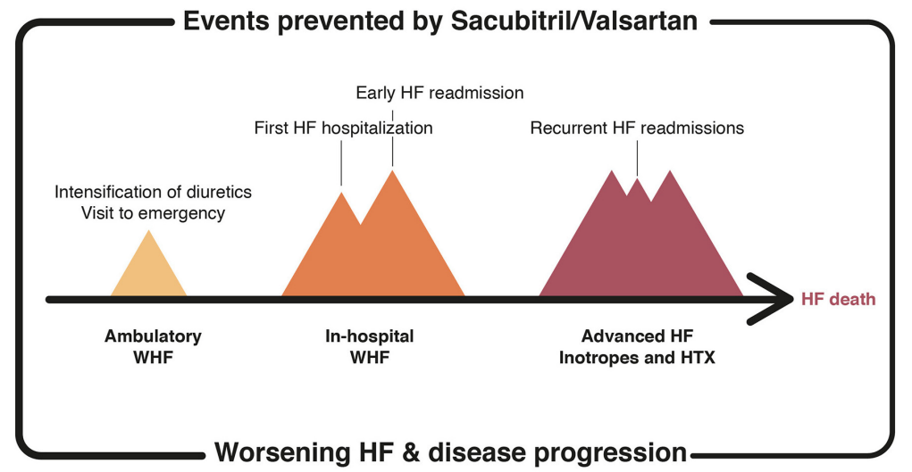
HF-related events prevented by the treatment with sacubitril/valsartan
Front Cardiovasc Med. 2021 Nov 11;8:754499.

Slide 48
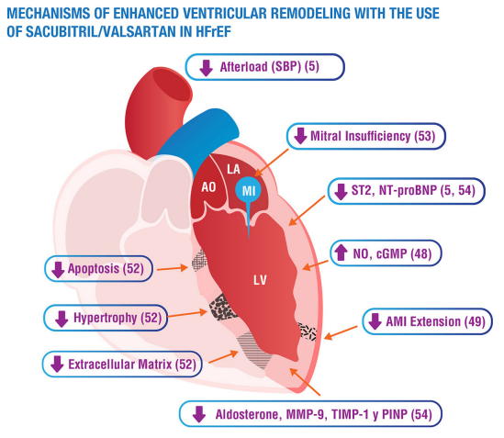
AO, aorta; LA, left atrium; LV, left ventricle; MI, mitral insufficiency; cGMP, cyclic guanosine monophosphate; NO, nitric oxide; sST2, soluble suppression of tumorigenesis-2; Nt-proBNP, N-terminal pro-brain natriuretic peptide; SBP, systolic blood pressure; AMI, acute myocardial infarction; MMP-9, matrix metallopeptidase 9; TIMP-1, tissue inhibitor of metalloproteinase-1; PINP, aminoterminal propeptide of type I collagen.
Front Cardiovasc Med. 2021 Nov 11;8:754499.

Slide 49
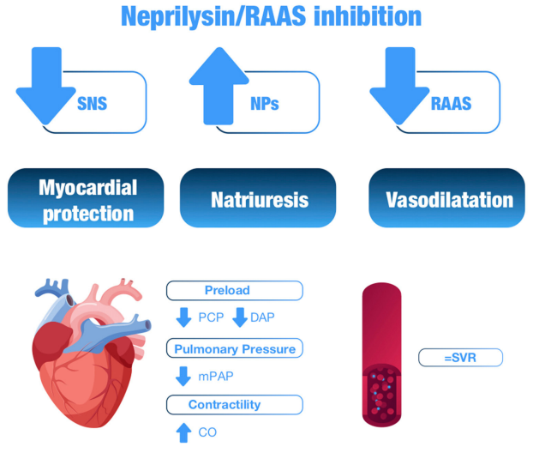
Hemodynamic effects of neprilysin/RAAS inhibition
SNS, sympathetic nervous system; NPs, natriuretic peptides; RAAS, renin-angiotensin-aldosterone system; PCP, pulmonary capillary pressure; DAP, diastolic arterial pressure; mPAP, mean pulmonary arterial pressure; CO, cardiac output; SVR, systemic vascular resistance.
Front Cardiovasc Med. 2021 Nov 11;8:754499.

Slide 50
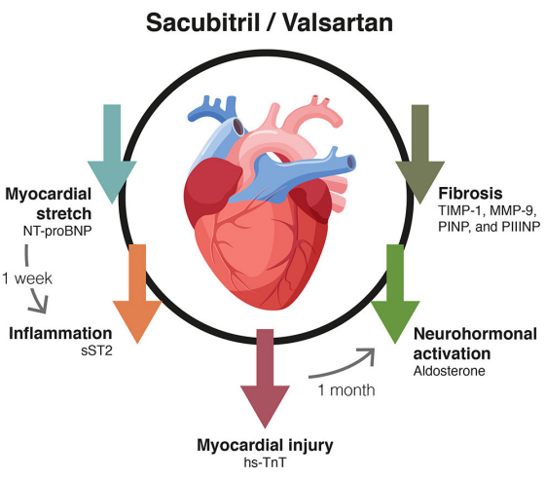
Effect of the treatment with sacubitril/valsartan on HF biomarkers
Nt-proBNP, N-terminal pro b-type natriuretic peptide; sST2, soluble tumorigenicity suppressor 2; hs-TnT, high-sensitivity troponin T; TIMP-1, metallopeptidase inhibitor 1; MMP-9, matrix metallopeptidase 9; PINP, aminoterminal propeptide of type I collagen; PIIINP, N-terminal propeptide of procollagen type III.
Front Cardiovasc Med. 2021 Nov 11;8:754499.

Slide 51
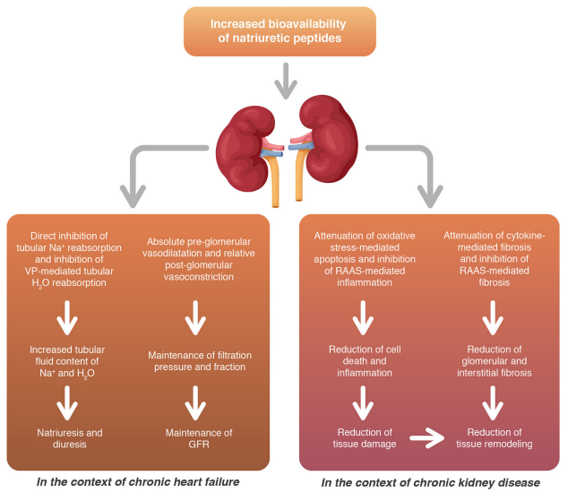
Renal benefits of ARNi both in terms of functional adaptations and structural remodeling
RAAS, renin-angiotensin-aldosterone system; GFR, glomerular filtration rate; VP, vasopressin.
Front Cardiovasc Med. 2021 Nov 11;8:754499.

Slide 52
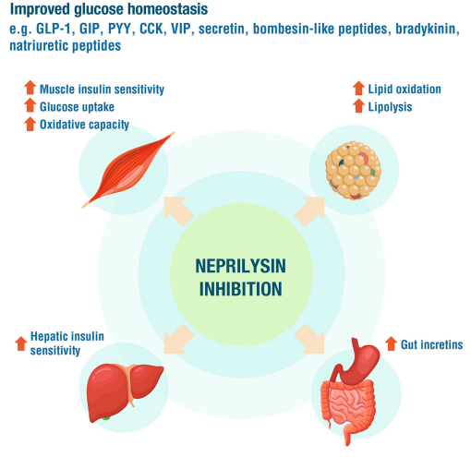
Role of neprilysin inhibition in glucose homeostasis
GLP-1, glucagon-like peptide 1; GIP, glucose-dependent insulinotropic peptide; PYY, peptide YY; CCK, cholecystokinin; VIP, vasoactive intestinal polypeptide.
Front Cardiovasc Med. 2021 Nov 11;8:754499.

Slide 53
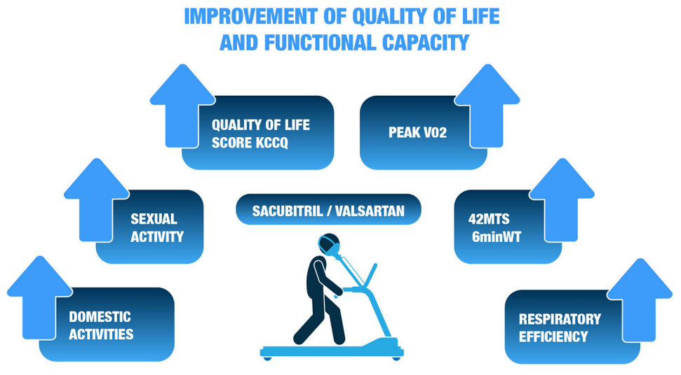
KCCQ, Kansas City cardiomyopathy questionnaire; MTS, meters; 6minWT, 6-minute walk test; VO2, Oxygen uptake
Front Cardiovasc Med. 2021 Nov 11;8:754499. c

Slide 54
ARNi benefits
Wide range of benefit including both cardiac and extracardiac protective effects.
At the cardiac level, a major mechanism is the modulation of the NP system, leading to a reduction in myocardial stress, inflammation and cell death, which in turn leads to improved parameters of cardiac function and remodeling.
At the extracardiac level, favorable vascular, metabolic and renal effects also make a significant contribution, leading to greater vascular protection and a lower risk of diabetes and renal impairment, as well as better tolerance and persistence over other beneficial treatments.
Front Cardiovasc Med. 2021 Nov 11;8:754499. c

Slide 55
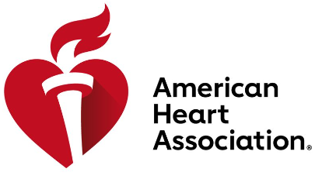



Guideline Recommendations

Slide 56
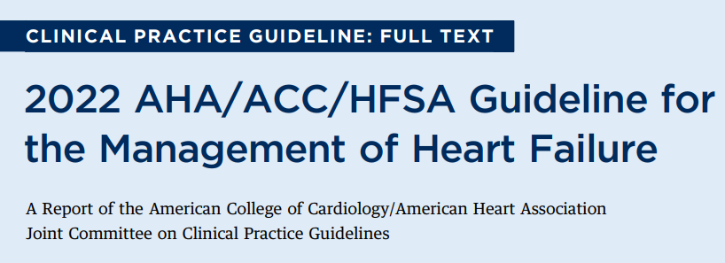

Slide 57
Pharmacological Treatment for HFrEF
COR | LOE | RECOMMENDATIONS
1 | A | In patients with HFrEF and NYHA class II to III symptoms, the use of ARNi is recommended to reduce morbidity and mortality
1 | B-R | In patients with chronic symptomatic HFrEF NYHA class II or III who tolerate an ACEi or ARB, replacement by an ARNi is recommended to further reduce morbidity and mortality
Heidenreich et al, JACC VOL. 79, NO. 17, MAY 3, 2022:e263 – e421

Slide 58
Recommendations for ARNi
Inhibition of the renin-angiotensin system is recommended to reduce morbidity and mortality for patients with HFrEF, and ARNi, ACEi, or ARB are recommended as first-line therapy.
If patients have chronic symptomatic HFrEF with NYHA class II or III symptoms and they tolerate an ACEi or ARB, they should be switched to an ARNi because of improvement in morbidity and mortality.
An ARNi is recommended as de novo treatment in hospitalized patients with acute HF before discharge given improvement in health status, reduction in the prognostic biomarker NT-proBNP, and improvement of LV remodeling parameters compared with ACEi/ ARB.
Heidenreich et al, JACC VOL. 79, NO. 17, MAY 3, 2022:e263 – e421

Slide 59
Recommendations for Patients with Mildly Reduced LVEF
Patients With HFimpEF
Treatment for HFmrEF
COR | RECOMMENDATIONS
1 | In patients with HFimpEF after treatment, GDMT should be continued to prevent relapse of HF and LV dysfunction, even in patients who may become asymptomatic.
Symptomatic HF with LVEF 41-49%
Diuretics,
as needed
(1)
SGLT2i
(2a)
ACEi, ARB, ARNi
(2b)
MRA
(2b)
Evidence-based beta blockers
for HFrEF
(2b)
Among patients with current or previous symptomatic HFmrEF (LVEF, 41% – 49%), use of ARNi may be considered to reduce the risk of HF hospitalization and cardiovascular mortality, particularly among patients with LVEF on the lower end of this spectrum
Abbreviations: ARB indicates angiotensin receptor blocker; ARNi, angiotensin receptor-neprilysin inhibitor; HF, heart failure; HFpEF, heart failure with preserved ejection fraction; LV, left ventricle; LVEF, left ventricular ejection fraction; MRA, mineralocorticoid receptor antagonist; and SGLT2i, sodium-glucose cotransporter-2 inhibitor.
Heidenreich et al, JACC VOL. 79, NO. 17, MAY 3, 2022:e263 – e421

Slide 60
HFpEF

Slide 61
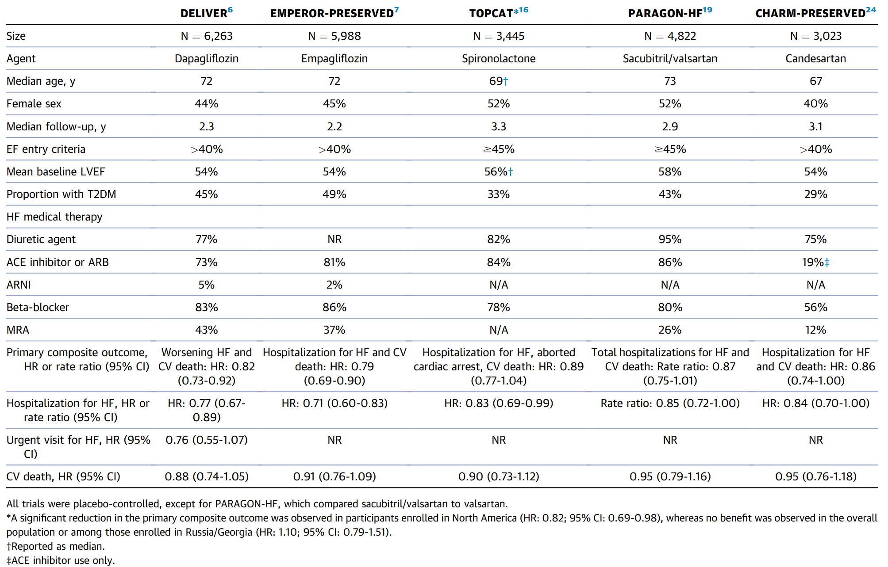
RCTs in Individuals With HFpEF
J Am Coll Cardiol Apr 19, 2023.

Slide 62
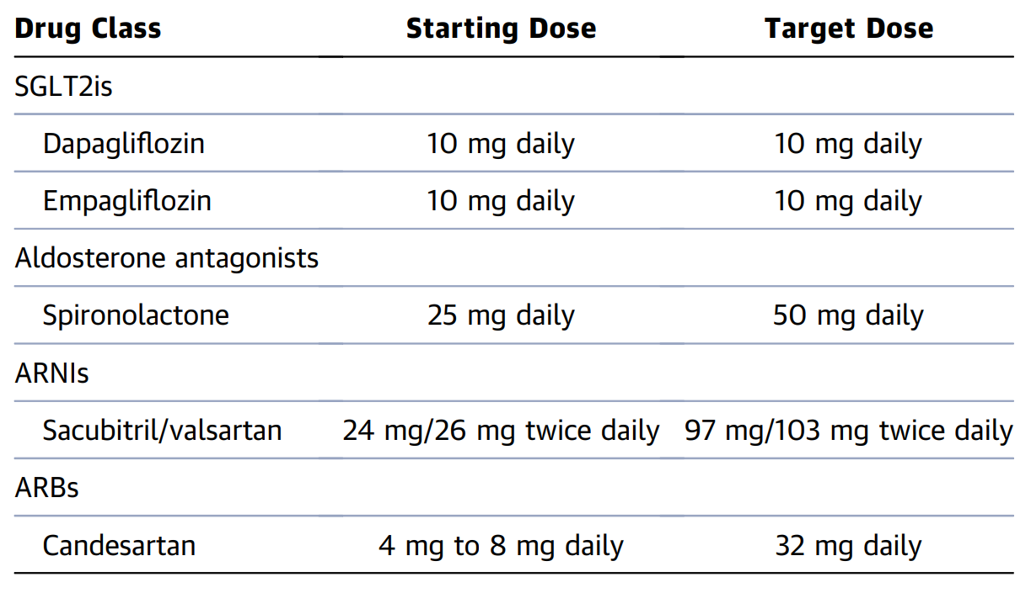
Starting and Target Doses of Select GDMTs for HFpEF
J Am Coll Cardiol Apr 19, 2023.

Slide 63
Use of diuretics & β blockers in HFpEF
Diuretic agents should be used judiciously as needed to reduce congestion and improve symptoms.
Beta-blockers may be used in individuals with HFpEF who have specific indications, including prior myocardial infarction (for up to 3 years), angina, or AF, but exercise tolerance should be monitored due to the potential for chronotropic incompetence.
J Am Coll Cardiol Apr 19, 2023.

Slide 64
GDMT Initiation and Titration
Barring contraindication, all individuals with a diagnosis of HFpEF should be treated with an SGLT2i, with the goal of reducing cardiovascular death/HF hospitalization and improving health status.
Initiation of an SGLT2i may be considered for either ambulatory individuals with HFpEF or those with acutely decompensated HF.
In those with an LVEF <55%-60%, use of an MRA, ARNI, or ARB (when an ARNI is not feasible) may be considered.
ARNI and MRA should be titrated to the maximum tolerated dosages based on symptoms, blood pressure, potassium, and creatinine, as confirmed in the STRONG-HF trial.
J Am Coll Cardiol Apr 19, 2023.

Slide 65
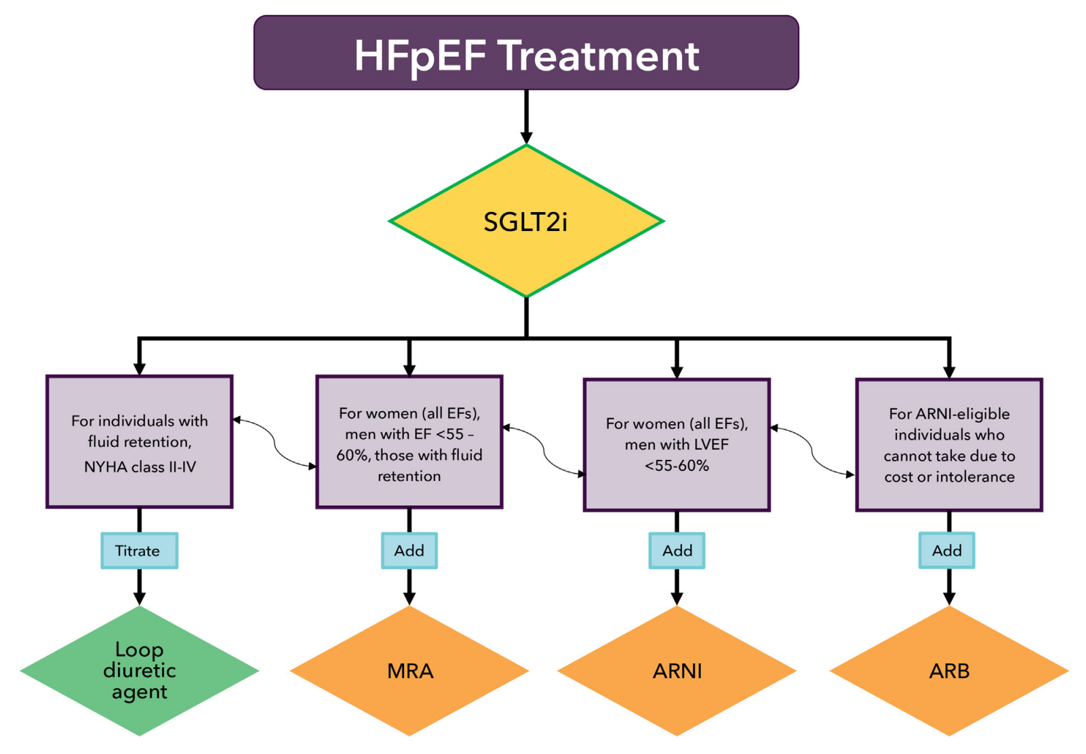
Treatment Algorithm for Guideline Directed Medical Therapy in HFpEF
*Green color identifies a Class 1 therapy from clinical practice guidelines, yellow color indicates a Class 2a therapy, and orange color denotes a Class 2b therapy. SGLT2is receive a Class 2a indication in the 2022 AHA/ACC/HFSA HF Guidelines, but the benefit, now confirmed in 2 randomized trials, suggests that SGLT2is may receive a stronger class of recommendation in future guidelines, and thus the box is shaded yellow with a green border.
J Am Coll Cardiol Apr 19, 2023.

Slide 66
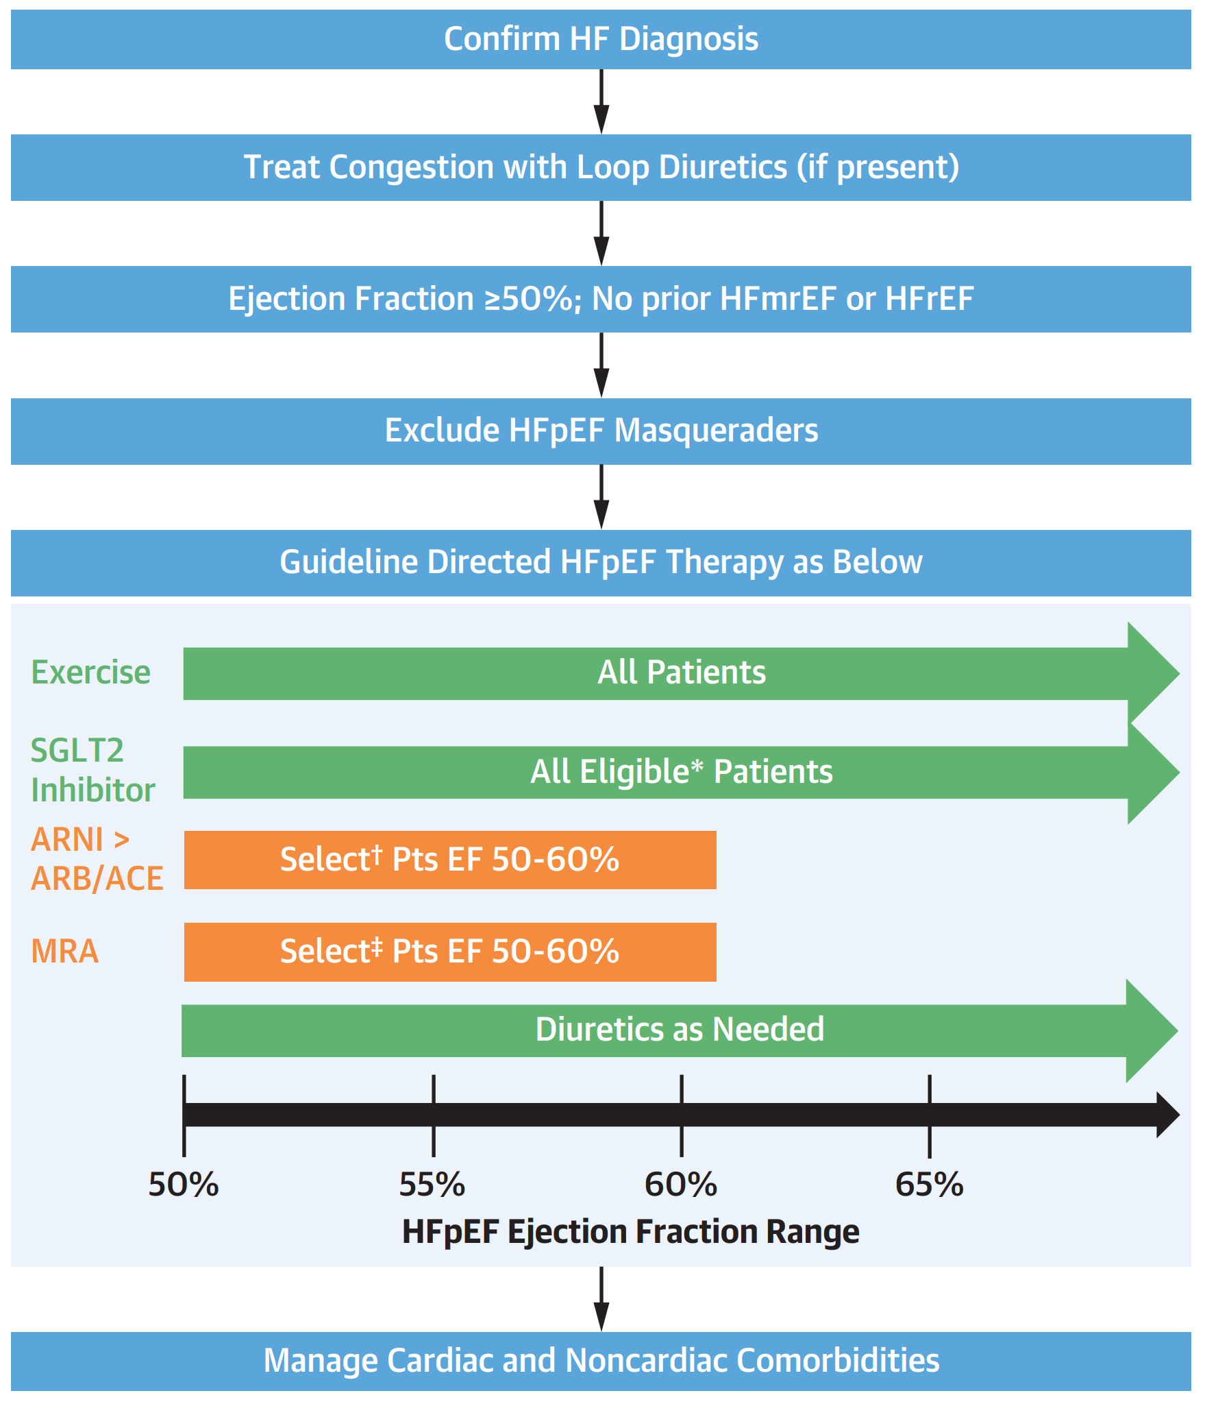
Management algorithm for HFpEF
*No type 1 diabetes mellitus, estimated glomerular filtration rate (eGFR) >20 mL/min/1.73 m2 , no history of diabetic ketoacidosis (DKA).
†Elevated natriuretic peptides levels or at high risk of heart failure (HF) hospitalization or with need for additional blood pressure control.
‡Elevated natriuretic peptides levels or at high risk of HF hospitalization or with need for additional BP control with eGFR >30 mL/ min/1.73 m2 and K <5.0 and compliant with monitoring.
ACE = angiotensin-converting enzyme; ARB = angiotensin receptor blocker; ARNI = angiotensin receptor neprilysin inhibitor; EF = ejection fraction; HFmrEF = heart failure with mildly reduced ejection fraction; HFpEF = heart failure with preserved ejection fraction; HFrEF = heart failure with reduced ejection fraction; MRA = mineralocorticoid receptor antagonist; Pts = patients; SGLT2 = sodium-glucose cotransporter-2
J Am Coll Cardiol HF May 03, 2023.

Slide 67
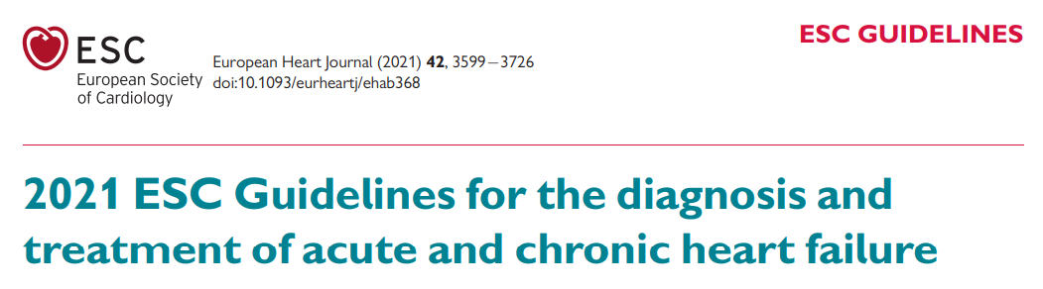

Slide 68
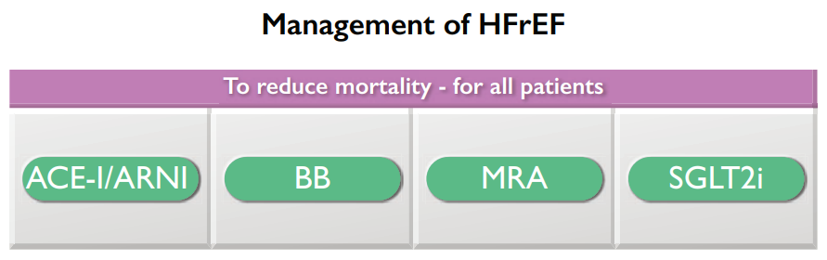
Pharmacological treatments of HFrEF (NYHA class II–IV)
RECOMMENDATION | CLASS | LEVEL
Sacubitril/valsartan is recommended as a replacement for an ACE-I in patients with HFrEF to reduce the risk of HF hospitalization and death. | I | B
European Heart Journal (2021) 42, 3599-3726

Slide 69
Management of HFmrEF (NYHA class II–IV)
RECOMMENDATIONS | CLASS | LEVEL
Sacubitril/valsartan may be considered for patients with HFmrEF to reduce the risk of HF hospitalization and death. | IIb | C
European Heart Journal (2021) 42, 3599-3726

Slide 70
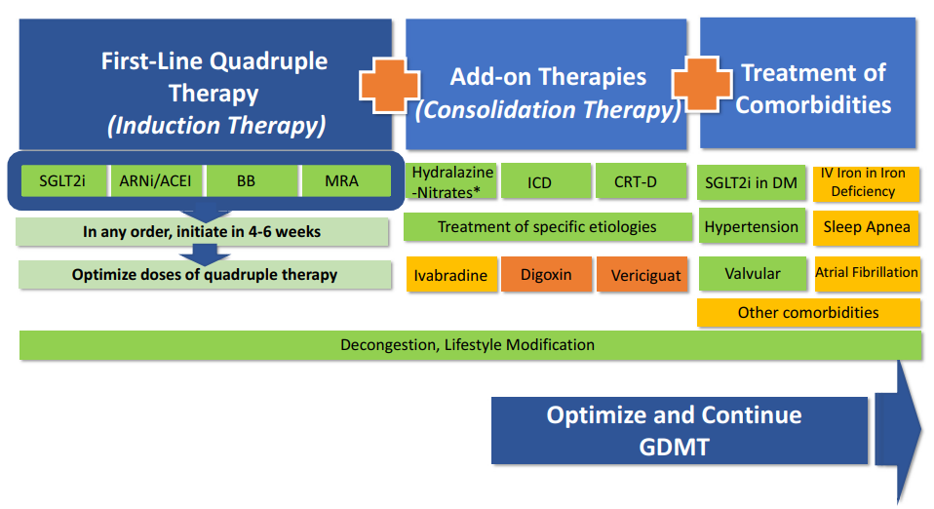
Strategies for Initiation and Optimization of Guideline-Directed Medical Therapies in Heart Failure
J Am Coll Cardiol HF. 2022 Dec, 10 (12) 992–995

Slide 71
Summary
ARNi is the new class of drugs that simultaneously block the angiotensin II type I receptors and inhibit neprilysin.
It is a supramolecular complex of six molecules of the ARB valsartan with six molecules of the NEPi prodrug, sacubitril (1:1 molar ratio).
By inhibiting neprilysin, ARNi would reduce the breakdown of natriuretic peptides and increase natriuretic peptide levels (ANP, BNP and CNP). ARNi provides simultaneous AT1 receptor blockade through valsartan to suppress the over-activation of the RAAS caused by increased Ang II.
ARNi is approved to reduce the risk of cardiovascular death and hospitalization for heart failure in adult patients with chronic heart failure. Benefits are most clearly evident in patients with LVEF below normal. LVEF is a variable measure, so use clinical judgment in deciding whom to treat.

Slide 72
Summary
ARNi is now recommended across the spectrum of HF.
ARNi is recommended as first line agents in all HFrEF patients.
ARNi is recommended as de novo treatment in hospitalized patients with acute HF before discharge.
Among patients with current or previous symptomatic HFmrEF, use of ARNi may be considered to reduce the risk of HF hospitalization and cardiovascular mortality, particularly among patients with LVEF on the lower end of this spectrum.
In selected patients with HFpEF, ARNi may be considered to decrease hospitalizations, particularly among patients with LVEF on the lower end of this spectrum.
Has both cardiac and extracardiac protective effects.

Slide 73
THANK YOU

