Slide 1
Thought & Thought Disturbances
Dr.Devashish Palkar
Assistant Professor
Department of Psychiatry

Slide 2
What is thinking?
Goal directed flow of ideas, symbols and associations initiated by problems or task that leads to reality-oriented conclusions.
Thinking is defined as the mental activity and processes used to imagine appraise, evaluate, forecast, plan, create and will.
Why do we need thought?
Thinking allows humans to make sense of, interpret, represent or model the world they experience, and to make predictions about the world.
It is therefore helpful to an organism with needs, objectives, and desire as it make plans or otherwise attempts to accomplish those goals

Slide 3
Types of Thinking
Fish divided thinking into the following types -
Undirected fantasy thinking also known as dereistic or autistic thinking
Imaginative thinking
Rational or conceptual thinking.
They can be considered as functions of thinking; that is, they are the necessary mechanisms for thinking to take place but are not themselves manifest in the phenomena.

Slide 4
1. Fantasy thinking (Dereistic/Autistic Thinking)
Creation of images or ideas that have no external reality. for example- the daydream before going to sleep, or it may become an established way of life.
short duration
Fantasy has an important function in the way we all carry out our everyday activities, for instance we model our speech and behavior in imagination before an important encounter or event, and afterwards we rehearse our performance in fantasy to evaluate it and assess whether we could have done better
Fantasy also allows a person to escape from or deny reality, or alternatively to convert reality into something more tolerable.

Slide 5
Shy, reserved people, not suffering from mental illness, may use dereistic thinking to compensate for the disappointments of life.
Various types of experience come into the category of acting out fantasy such as -
Pathological lying (pseudologia fantastica),
Hysterical conversion and dissociation (somatic and psychological dissociative symptoms) and
Delusion-like ideas occurring in affective psychoses.

Slide 6
2. IMAGINATIVE THINKING
Organization of data in our brain that is derived from what one sees and how one experiences reality.
Mental imagery: Ability to create image based on mental representation of the world.
Counterfactual thinking: Capacity to disengage from reality in order to think of events that have not occurred or may not occur in reality.
the human tendency to create possible alternatives to life events that have already occurred; something that is contrary to what actually happened.
3. Symbolic representation: Use of concepts and images to represent real world object entities.
Notes:
This is, of course, the basis of language, art and mathematics.
concept of maternal reverie (Bion, 1962). The mother in both physical and mental, of ‘holding the baby’ (Winnicott, 1957), has a capacity for reverie or daydreaming on the baby’s behalf; this usually concerns the future happiness and achievements of the baby. Bion would regard this as a necessary factor in the healthy development of the self-sensation of the baby; when maternal reverie breaks down, for example in puerperal depression, the baby experiences this as distress.

Slide 7
RATIONAL OR CONCEPTUAL THINKING
Problem solving: Set of cognitive processes that we apply to reach a goal by overcoming obstacles.
Strategies for problems involve the use of heuristics, that is, rules of thumb that usually give the correct answer
Reasoning: Cognitive process that we use to make inference from knowledge and to draw conclusions.

Slide 8
Typically, reasoning involves:
Analogic reasoning involves the application of solutions to already known problems to new problems with similar characteristics.
Inductive reasoning depends on the use of specific known instances to draw an inference about unknown instances. An example is ‘my cat has four legs’, therefore ‘all cats have four legs’.
Deductive reasoning involves reasoning from one or more statements to reach a logically certain conclusion. This is usually studied by way of syllogism: (a) all Martians are green, (b) my father is a Martian, (c) my father is green.

Slide 9
Features of healthy thinking
Constancy – this is characteristic of a complete thought that does not change in content unless and until it is superseded by another consciously driven thought.
Organisation – the contents of thought are related to each other in consciousness and do not blend with each other, but are separated in an organised way.
Continuity – there is continuity in the series of thought.

Slide 10
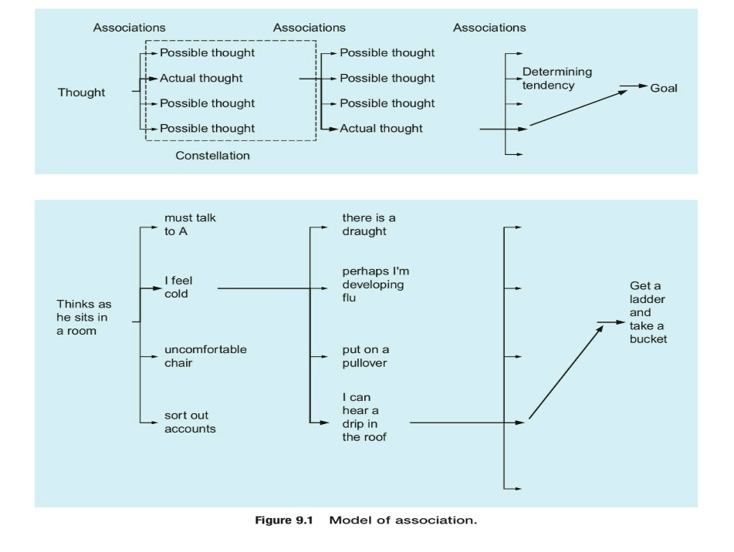
A MODEL OF ASSOCIATIONS BASED ON JASPERS

Slide 11
The mass of possible associations resulting from a psychic event is called a constellation.
There are an enormous number of possible associations, but thinking usually proceeds in a definite direction for various immediate and compelling reasons. This consistent flow of thinking towards its goal is ascribed to the determining tendency ( Jaspers).
The idea of associations, is a concept that results in the formation of a number of other concepts, one of which is given prominence by operation of the determining tendency.

Slide 12
Concept and Concept Formation
A concept is a symbolic construction that represents some common and general feature or features of many objects or events.
Concepts are important language symbols used in thinking.
The human ability to form concepts enables us to classify things into categories. The features we select define the concept and form the basis for making classifications.
When a classification has been made , we tend to behave toward, and think about, members of the class in similar ways.

Slide 13
Types of Concepts
Basic/Natural Concepts – They are acquired easily ; appear in thinking very early on in life and reflects the way the brain processes and sorts information.
Acquired Concepts – They are acquired more slowly and learned with more effort.
- Discrimination learning plays a role where some responses are rewarded or reinforced and others are not.

Slide 14
Disorders of thought
Disorders of the stream of thought
Disorders of possession of thought
Disorders of content of thought
Disorders of form of thought

Slide 15
Disorder Of Stream Of Thought
Disorders of thought tempo
Disorders of the continuity of thinking
Flight of ideas
Inhibition or slowing of thinking
Circumstantiality
Perseveration
Thought blocking

Slide 16
Disorder of tempo
1. Flight of ideas:
Thoughts follow each other rapidly.
No general direction of thinking and goal of thinking is not maintained for long.
The connections between successive thoughts appear to be due to chance factors.
Typical of mania and also occasionally occurs in individuals with schizophrenia when they are excited and organic states such as lesions of hypothalamus.
Flight of ideas can become so severe that Incoherence occurs in acute mania.

Slide 17
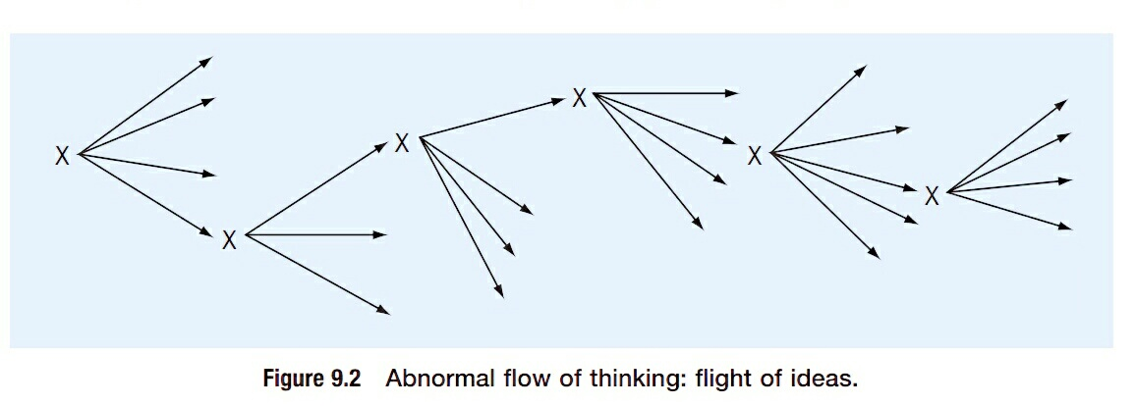
Prolixity:
It is a marginal variety of flight of ideas.
Occurs in hypomania – ‘’ ordered flight of ideas’’ occurs in which , despite many irrelevances, the patient is able to return task in hand(they only lose the thread for a few moments and finally reach their goal).
Speed of emergence of thoughts is not as fast as in flight of ideas.

Slide 18
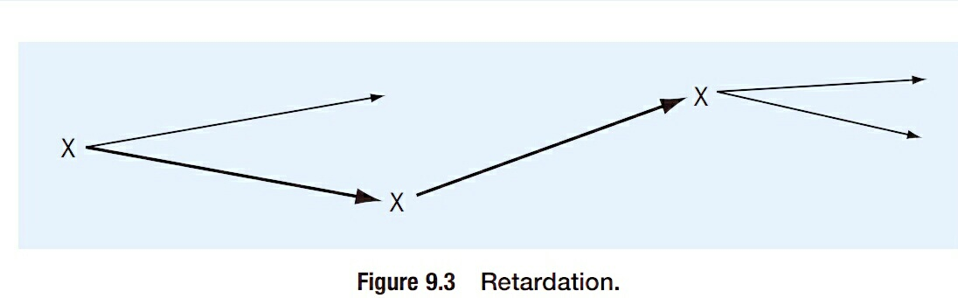
2. Inhibition or retardation of thoughts:
The train of thought is slowed down and the number of ideas and mental images which present themselves is decreased.
It can be experienced as :
lack of decision making
Unable to concentrate and diminution in active attention.
Loss of clarity of thinking.
Inhibition of thinking is seen in both depression and the rare condition of manic stupor.

Slide 19
3. Circumstantiality:
Here thinking proceeds slowly with many unnecessary and trivial details but finally the point is reached.
The goal of thought is never completely lost and thinking proceeds towards it by an intricate and convoluted path.
Occurs in context of learning disability (mental retardation), epilepsy and in individuals with obsessional personality traits.

Slide 20
Disorder of continuity of thinking
Perseveration:
It occurs when mental operations persist beyond the point at which they are relevant and thus prevent progress of thinking.
Thought or speech appears to get stuck.
Common in generalised and local organic disorders.
2. Thought blocking:
There is sudden arrest of train of thoughts, leaving a ‘blank’
An entirely new thought may then begin.
It is not caused by distraction by other thoughts and, on introspecting, the patient can give no adequate explanation for it; it simply occurs.
It is generally seen in schizophrenia.

Slide 21
Disorder of possession of thought
Here there is loss of control or sense of possession of thinking.
It can be :
1. Obsession and Compulsion
2. Thought Alienation

Slide 22
Obsessions and compulsions:
Obsession:
Persistent, recurrent and intrusive thought, idea or impulse that cannot be eliminated from consciousness by logic or reasoning.
An obsession dominates an individual’s thinking despite the awareness that the thought is either without purpose or else has persisted and dominated their thinking beyond the point of relevance or usefulness.
Their content is often of a nature as to cause the sufferer great anxiety and even guilt.
The essential feature of the obsession is that it appears against the patient’s will.
Obsessions occur in obsessional states, depression, schizophrenia and occasionally in organic states.

Slide 23
Compulsion:
Pathological need to act on an impulse that, if resisted produces anxiety.
Compulsions are, in fact, merely obsessional motor acts.
They may result from an obsessional impulse that leads directly to the action, or they may be mediated by an obsessional mental image or thought, as, for example, when the obsessional fear of contamination leads to compulsive washing.
Compulsive features appear to be particularly common in post-encephalitic parkinsonism.

Slide 24
2. Thought alienation:
In thought alienation, the patient has the experience that their thoughts are under the control of an outside agency or that others are participating in their thinking.
  Thought insertion:
  The patient knows that thoughts are being inserted into their mind and they recognize them as being foreign.
  Commonly associated with schizophrenia.
  Thought deprivation/withdrawal:
  The patient finds that as they are thinking, their thoughts suddenly disappear and are withdrawn from their mind by a foreign influence.
  Thought broadcasting:
  The patient knows that as they are thinking, everyone else is thinking in unison with them.

Slide 25
  These phenomena can be approached through
  the prism of ego-syntonicity/ ego-dystonicity.
  An experience is described as ego-syntonic if it is consistent with the goals and needs of the ego and/or consistent with the individual’s ideal self-image; the reverse is the case for ego-dystonicity.

Slide 26
Disorder of content of thought
Delusion:
  It is a false, firm, unshakeable belief based on incorrect inferences that is firmly held despite objective and obvious contradictory proof or evidence and despite the fact that other members of culture do not share the belief and is not in socio-cultural, educational or intellectual norms.

Slide 27
They are of two types :
Primary delusion/ Delusions proper/ true delusions: when delusions are de novo and not because of another psychopathological form such as mood disorder.
occur in schizophrenia
Secondary delusion/ delusion like ideas : when delusion are because of some other morbid experience.
They can be secondary to mood states, hallucinations and the stress reactions can give rise to psychotic states with delusion

Slide 28
Primary delusions are of 4 types:
Autochthonous delusion ( delusional intuition)
Delusional perception
Delusional atmosphere
Delusional memory

Slide 29
Autochthonous delusion:
  These are delusions that appear to arise suddenly 'out of the blue, they are phenomenologically indistinguishable from the sudden arrival of a normal idea.
  Occurs as a single stage and are self referent and momentous importance.

Slide 30
Delusional perception:
  This is present when the patient receives a normal perception that is then interpreted with some delusional meaning with immense personal significance
  Occurs in 2 stages: normal perception and then false interpretation. These are self referent, momentous, urgent and of course FALSE .
  A hallmark is the “Two memberedness”.
  It needs to be differentiated from Delusional Misinterpretation.
  Delusional Misinterpretation occurs in the background of an existing psychopathology.
  A cloud in the sky may be misinterpreted as meaning that someone has sent that a person a message to save the world.

Slide 31
Delusional atmosphere (delusional mood):
  Global, diffuse, ominous feeling of something impending
  For the patient experiencing delusional atmosphere, his world has been subtly altered: ‘Something funny is going on’, ‘I have been offered a whole world of new meanings’.
  He experiences everything around him as sinister, portentous, uncanny, peculiar in an indefinable way.
  The mood of the atmosphere is very important, and this experience is often referred to as delusional mood.
  The patient feels profoundly uncomfortable, often extremely perplexed and apprehensive.
  When a delusional perception or a sudden delusional idea arises, it becomes obvious and he accepts that with a feeling of relief.

Slide 32
Delusional memory (retrospective delusion) :
The delusional memory is the delusional interpretation of normal memory.
An event that occurred in the past is explained in a delusional way.

Slide 33
Secondary Delusions :
Some other element of psychopathology is present
Can be secondary to depressive moods and hallucinations, and psychogenic or stress reactions can give rise to psychotic states with delusions.
Personality can also play a role in the genesis of delusional states.

Slide 34
Five stages in the development of delusional psychosis
Trema: delusional mood representing a total change in perception of the world.
Apophany: a search for, and the finding of, new meaning for psychological events.
Anastrophy: heightening of the psychosis.
Consolidation: forming of a new world or psychological set based on new meanings.
Residuum: eventual autistic state.

Slide 35
Dimensions or vectors of delusional severity
Conviction: the degree to which the patient is convinced of the reality of the delusional beliefs.
Extension: the degree to which the delusional belief involves areas of the patient’s life.
Bizarreness: the degree to which the delusional beliefs depart from culturally determined consensual reality.
Disorganization: the degree to which the delusional beliefs are internally consistent, logical and systematized.
Pressure: the degree to which the patient is preoccupied and concerned with the expressed delusional beliefs.
Affective response: the degree to which the patient’s emotions are involved with such beliefs.
Deviant behaviour resulting from delusions: patients sometimes, but not always, act on their delusions.

Slide 36
The content of delusions
Delusion of Persecution:
False belief of being harassed or persecuted.
In severe depression, Delusions of guilt can be so marked that the patient believes that he is about to be put to death or imprisoned for life.
The supposed persecutors of the deluded patient may be people in the environment (such as members of the family, neighbors or former friends) or may be political or religious groups, of varying degrees of relevance to the patient.
Some patients believe that they or their loved ones are about to be killed, or are being tortured.

Slide 37
Some patients with delusions of persecution claim that they are being robbed or deprived of their just inheritance, while others claim they have special knowledge that their prosecutors wish to take from them.
Delusions of being poisoned or infected are not uncommon.
Delusion of reference:
False belief that the behaviour of others refers to oneself or that events, objects, or other people have a particular and unusual significance, usually of a negative nature; derived from the idea of reference, in which persons falsely feel that others are talking about them(e.g. belief that people on television or radio are talking to or about the person, slandering him or spying on him)
Delusion of control: false belief that a person’s will, thoughts or feelings are being controlled by external forces.

Slide 38
Delusion of Infidelity :
Is when subject unreasonably believes him or herself to be the victim of their partner's unfaithfulness.
Often the patient has been suspicious, sensitive and mildly jealous before the onset of the illness.
Delusions of marital infidelity are seen in individuals with schizophrenia and have been reported in many different varieties of organic brain disorders, but are especially associated with alcohol dependency syndrome.
Delusions of infidelity are also seen in the affective psychosis, where they may again represent a morbid exaggeration of a pre morbid mildly jealous attitude.

Slide 39
Delusion of love (erotomania, fantasy lover syndrome, De Clerambault syndrome):
The patient is convinced that some person, usually of higher status is in love with them although the alleged lover may have never spoken to them.
They may even pester the victim with letters and unwanted attention of all kinds.
Sometimes, schizophrenia may begin with a circumscribed delusion of a fantasy lover
Occasionally, isolated delusions of this kind are found in abnormal personality states.
Religious delusions:
Any delusion with a religious or spiritual content. These can be combined with other delusions, such as grandiose delusions (belief that the affected person was chosen by God).

Slide 40
Delusion of grandeur:
Exaggerated conception of one's importance, power or identity.
Some report that they have special powers to help others and can hear voices of God /saints which confirms their elevated status.
Grandiose and expansive delusions may also be part of fantastic hallucinosis in which all forms of hallucinations occur.
Previously, they were associated with Neurosyphilis but are now most commonly associated with manic psychosis in the context of bipolar affective disorder.

Slide 41
Delusions of ill health (hypchondriacal delusion):
Delusions of ill health are a characteristic feature of depressive illnesses, but are also seen in other disorders, such as schizophrenia.
Delusions of ill health may develop on a background of concerns about health; many people worry about their health and when they become depressed they naturally may develop delusions or overvalued ideas of ill health.
Depressive delusions of ill health may involve the patient’s spouse and children.
Hypochondriacal delusions in schizophrenia can be the result of a depressed mood, somatic hallucinations or a sense of subjective change.
Chronic hypochondriasis may also be linked to personality development.
Notes:
Somewhat similar to these delusions are the delusional preoccupations with facial or bodily appearances, when the subject is convinced that their nose is too big, their face is twisted or disfigured with acne. Sometimes these preoccupations with ill health or the appearance of the body have a somewhat obsessional quality, so that the patient cannot stop thinking about the supposed illness or deformity, although they realise it is ridiculous in times of quiet reflection.

Slide 42
Delusions of guilt :
The patient believes that they are a bad or evil person and have ruined their family.
In very severe depression, the delusions may even appear to take on a grandiose character and the patient may assert that they are the most evil person in the world, the most terrible sinner who ever existed and that they will never die but will be punished for all eternity.
Delusion of poverty :
In delusion of poverty patient is convinced that they are impoverished and that they will be deprived of all material possessions.

Slide 43
Delusion of infestation (Ekbom syndrome):
Patient believes that he is infested with small but macroscopic organisms.
‘la folie à deux (ou folie communiquée)’.
Occasionally, a delusion(delusional intuition) is transferred from a psychotic person to one or more others with whom they have been in close association, so that the recipient shares the false belief.

Slide 44
Nihilistic delusions (Delusions of negation, Cotard Syndrome):
occur when the patient denies the existence of their body, their mind, their loved ones and the world around them.
they may deny their existence as a person, or believe that they are dead, the world has stopped, or everyone else is dead.
These delusions tend to occur in the context of severe, agitated depression and also in schizophrenia and states of delirium.
Sometimes nihilistic delusions are associated with delusions of enormity, when the patient believes that they can produce a catastrophe by some action (e.g. they may refuse to urinate because they believe they will flood the world.)

Slide 45
Delusional misidentification :
Capgras syndrome: is a rare syndrome in which person believes that a person, usually closely related to him, has been replaced by an exact double.
Fregoli's syndrome: delusional misidentification of an unfamiliar person in his environment as a familiar one, even though there is no physical resemblance.
Syndrome of Intermetamorphosis: is delusional belief that others undergo radical changes in physical and psychological identity culminating into different person altogether.
Delusion of subjective doubles: delusional belief in existence of physical duplicates of self, and these duplicates are usually thought to have different psychological identities

Slide 46
Delusional misidentification syndromes are associated with
organic disorders, including dementia
acquired brain injury,
epilepsy and
cerebrovascular accidents in 25 to 40 per cent of cases, and
neuroimaging studies reveal association with right hemisphere abnormalities, particularly in the frontal and temporal regions

Slide 47
Other thought content disturbances
Overvalued Idea- False or unreasonable belief or idea that is sustained beyond the bounds of reason. It is held with less intensity or duration than a delusion.
  This is a thought that, because of the associated feeling tone, takes precedence over all other ideas and maintains this precedence permanently or for a long period of time.
  less fixed than delusions and have some degree of basis in reality.
Preoccupation of thought – Centering of thought content on a particular idea, associated with a strong affective tone.
Rumination of thought – Constant preoccupation with thinking about a single idea or theme as in OCD.

Slide 48
Poverty of Content – Thought that gives little information because of vagueness, empty repetitions or obscure phrases.
Phobia – Persistent, pathological, unrealistic, intense fear of an object or situation; the patient may realize that their fear is irrational but, nonetheless, cannot dispel it.

Slide 49
Disorders of the form of thinking
Thought process, also referred to as thought form, is the manner in which ideas are connected one to another in conveying thoughts to a listener, or in the case of written speech, a reader.
Clanging association: Association or speech directed by the sound of a word rather than by its meaning; words have no logical connection; rhyming may dominate the verbal behaviour. Seen most frequently in schizophrenia or mania.
Word salad: incoherent, essentially incomprehensible, mixture of words and phrases commonly seen in advanced cases of schizophrenia.
Neologism: a word created by the speaker with idiosyncratic meaning
Tangentiality: oblique, diggresive or even irrelevant manner of speech in which the central idea is not communicated.

Slide 50
Schenider claimed 5 features of formal thought disorder:
Derailment: thought slides onto a subsidiary thought.
Substitution: major thought is substituted by a subsidiary one.
Omission: senseless omission of a thought or a part of it.
Fusion: heterogeneous elements of thought are interwoven with each other.
Drivelling : there is a disordered intermixture of constituent parts of one complex thought

Slide 51
Schneider claimed that individuals with schizophrenia complained of three different disorders of thinking -
Transitory Thinking - characterized by derailments, substitutions and omissions. The grammatical and syntactical structures are both disturbed in transitory thinking.
Drivelling Thinking - the patient has a preliminary outline of a complicated thought with all its necessary particulars, but loses preliminary organization of the thought, so that all the constituent parts get muddled together.
Desultory Thinking - speech is grammatically correct but sudden ideas force their way in from time to time. Each one of these ideas is a simple thought that, if used at the right time, would be quite appropriate.

Slide 52
Bleuler (1911) regarded schizophrenia as a disorder of the associations between thoughts, characterized by the processes of -
Condensation : Two ideas with something in common are blended into one false concept
Displacement : one idea is used for an associated idea.
Faulty use of symbols : involves using the concrete aspects of the symbol instead of the symbolic meaning (‘concrete thinking’).

Slide 53
Cognitive Errors/Distortions
Cognitive distortions are thoughts that cause individuals to perceive reality inaccurately.
Cognitive Errors Derived from Assumptions -
Cognitive Error | Assumption
Overgeneralizing | If it's true in one case, it appl ies to any case that is even slightly similar.
Selective abstraction | The only events that matter are failures, deprivation, etc. Should measure self by errors, weaknesses, etc.
Excessive responsibility (assuming personal causality) | I am responsible for all bad things, failures, etc.
Assuming temporal causality (predicting without sufficient evidence) | If it has been true in the past, it's always going to be true.
Self-references | I am the center of everyone's attention - especially my bad performances. I am the cause of misfortunes.
Catastrophizing | Always think of the worst. It's almost likely to happen to you
Dichotomous thinking | Everything is either one extreme or another (black or white, good or bad).

Slide 54
Cognitive Profile of Psychiatric Disorders
Disorder | Core Belief
Depressive disorder | Negative view of self, experience, and future
Hypomanic episode | Inflated view of self, experience, and future
Anxiety disorders | Fear of physical or psychological danger
Panic disorder | Catastrophic misinterpretation of bodily and mental experiences
Phobias | Danger in specific, avoidable situations
Paranoid personality disorder | Negative bias, interference, and so forth by others
Conversion disorder | Concept of motor or sensory abnormality
Obsessive compulsive disorder | Repeated warning or doubting about safety and repetitive acts to ward off threat
Suicidal behaviour | Hopelessness and deficit in problem solving
Anorexia nervosa | Preoccupation regarding being fat or unshapely
Hypochondriasis | Attribution of serious medical disorder

Slide 55
THANK YOU

