Slide 1
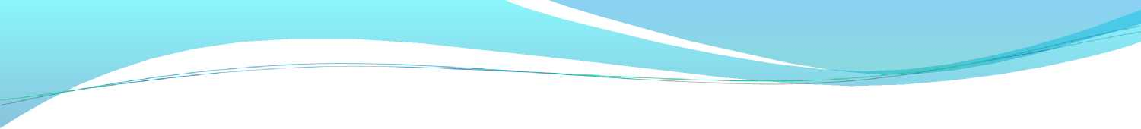
ECG - basics
Dr. Viral Gandhi
MD , DrNB cardiology
assist professordept of cardiology
SBKS medical inst and research centre ,
sumandeep vidyapeeth deemed to be university

Slide 2
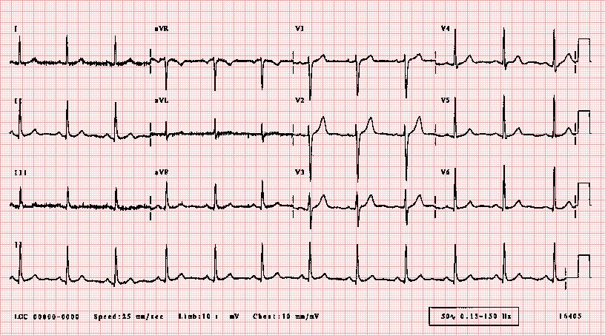

Slide 3
The following 14 points should be analyzed carefully in every ECG:
1. Standardization (calibration) and technical features (including lead placement and artifacts)
2. Rhythm
3. Heart rate,
4. PR interval/AV conduction
5. QRS interval
6. QT/QT_{c} interval
7. Mean QRS electrical axis
8. P waves
9. QRS voltages
10. Precordial R-wave progression
11. Abnormal Q waves
12. ST segments
13. T waves
14. U waves

Slide 4
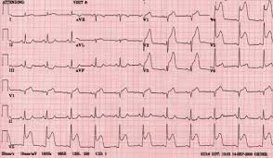

Slide 5
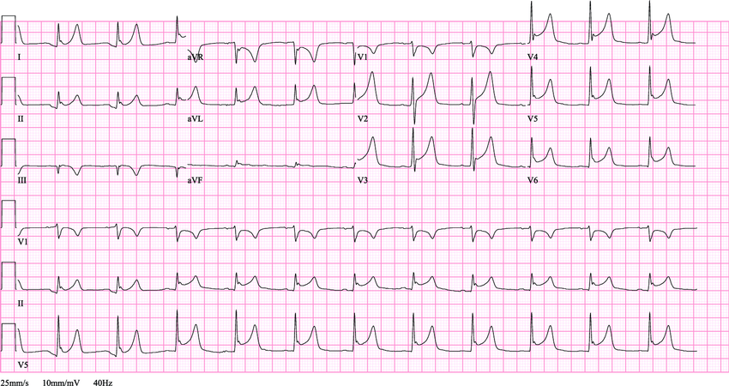

Slide 6
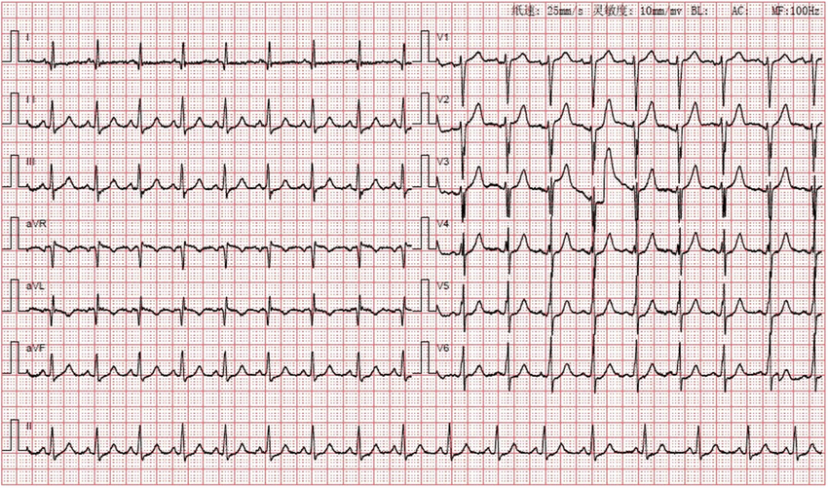

Slide 7
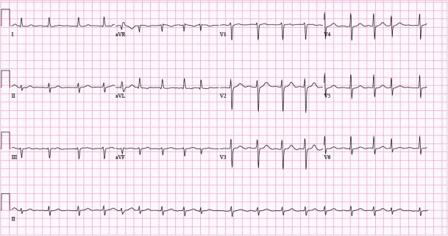

Slide 8
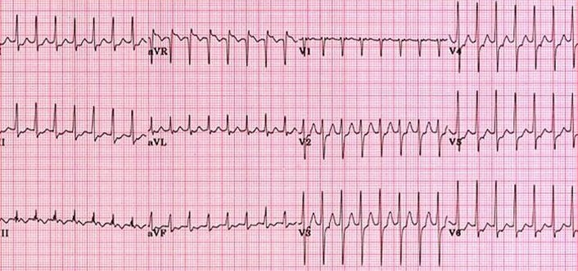

Slide 9
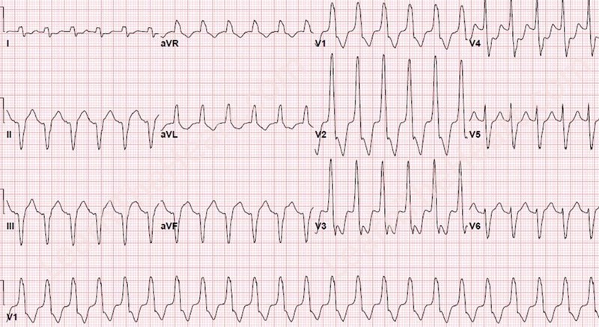

Slide 10
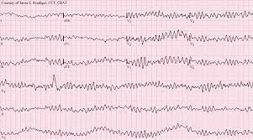

Slide 11
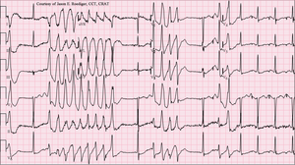

Slide 12
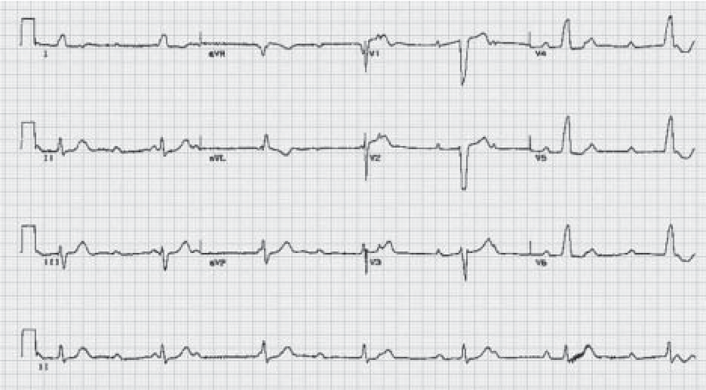

Slide 13
The goal of this academic session is-
To have basic understanding of ECG waves & intervals.
Interpretation of ECG
Outline the criteria for the most common electrocardiographic diagnoses in adults.
Describe critical aspects of the clinical application of the ECG

Slide 14
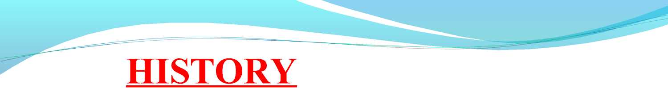
1842- Italian scientist Carlo Matteucci realizes that electricity is associated with the heart beat.
1895 - William Einthoven , credited for the invention of ECG.
1906 - using the string electrometer ECG, William Einthoven diagnoses some heart problems.
1924 - The noble prize for physiology or medicine is given to William Einthoven for his work on ECG

Slide 15
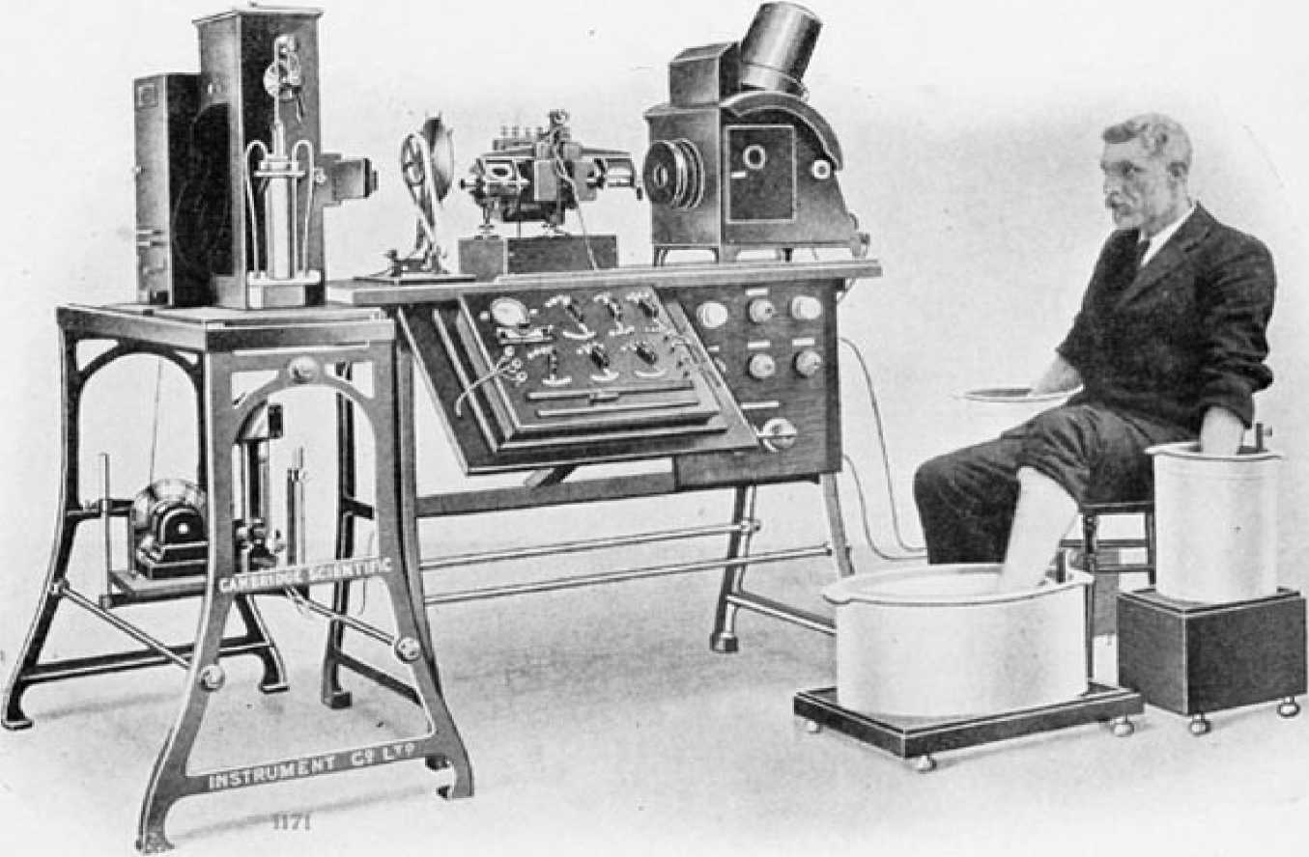
PnoroufeA.PH fjv \ Loscen.i.ti. SuinRffi AitDUHiKM'n, Siiowim’. mi>: .Masm h in Hirtf ii Tin. Ki i rrmiLt ^ \kf. Attach! I) io tiu; Patii-.nt, In thi* Cask tiik Hand* anij Oni; Foot !ii:ixr. IHUKFSEI? IS J.iss oif
Sai.it SOi-i’TlOK

Slide 16
ELECTROCARDIOGRAM
*The electrocardiogram (ECG) is a graphical representation of the electrical events of the cardiac cycle.
*Each event has a distinctive waveform, the study of waveform can lead to greater insight into a patient’s cardiac patho physiology.

Slide 17
Pacemakers of the Heart
♦> ♦> ♦>
SA Node - Dominant pacemaker with an intrinsic rate of 60 -100 beats/minute.
AV Node - Back-up pacemaker with an intrinsic rate of 40 - 60 beats/minute.
V entricular cells - Back-up pacemaker with an intrinsic rate of 20 - 45 bpm.

Slide 18
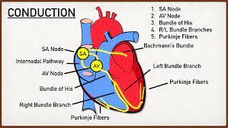
Normal Conduction System

Slide 19
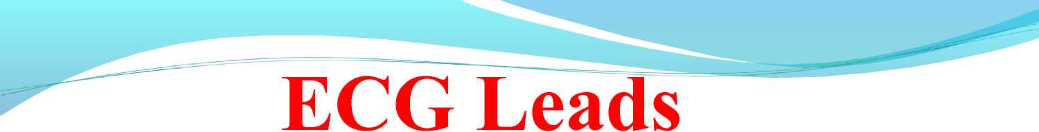
Measure the difference in electrical potential between two points
1. Bipolar Leads: Two different points on the body.
2. Unipolar Leads: One point on the body and a virtual reference point with zero electrical potential, located in the center of the heart .

Slide 20

The standard ECG has 12 leads:
3 Standard Limb Leads
3 Augmented Limb Leads
6 Pre-cordial Leads

Slide 21

Standard Limb leads are I, II, II.
Each of the leads are bipolar; i.e., it requires two sensors on the skin to make a lead.
If one connects a line between two sensors, one has a vector.
There will be a positive end at one electrode and negative at the other.
The positioning for leads I, II, and III were first given by
Einthoven (Einthoven’s triangle).

Slide 22
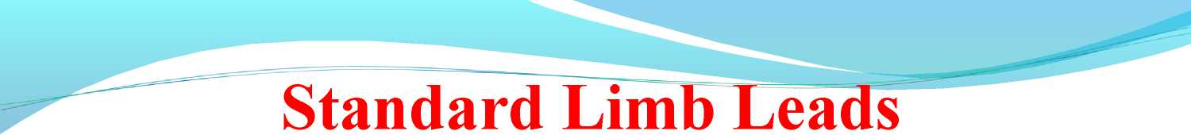
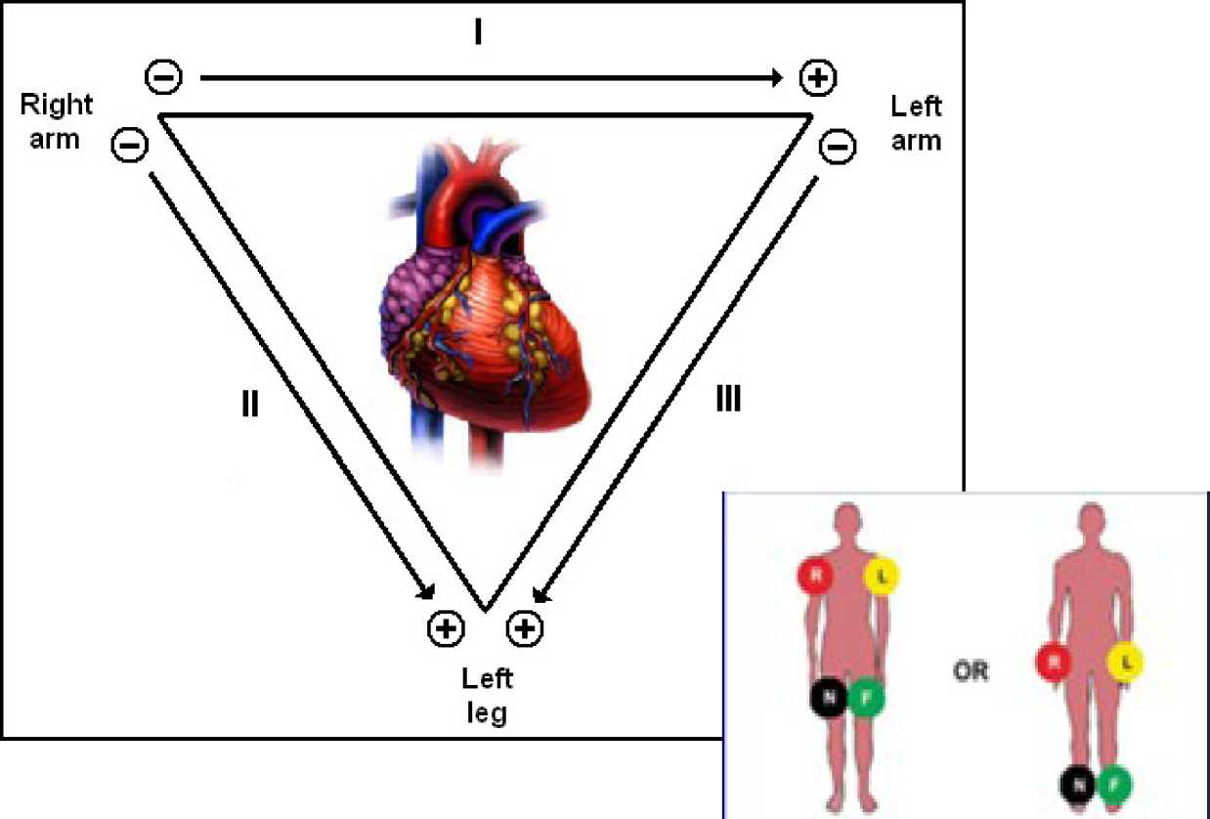

Slide 23
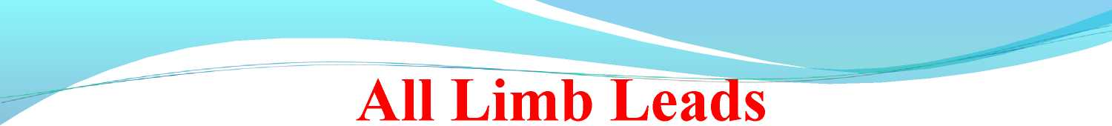
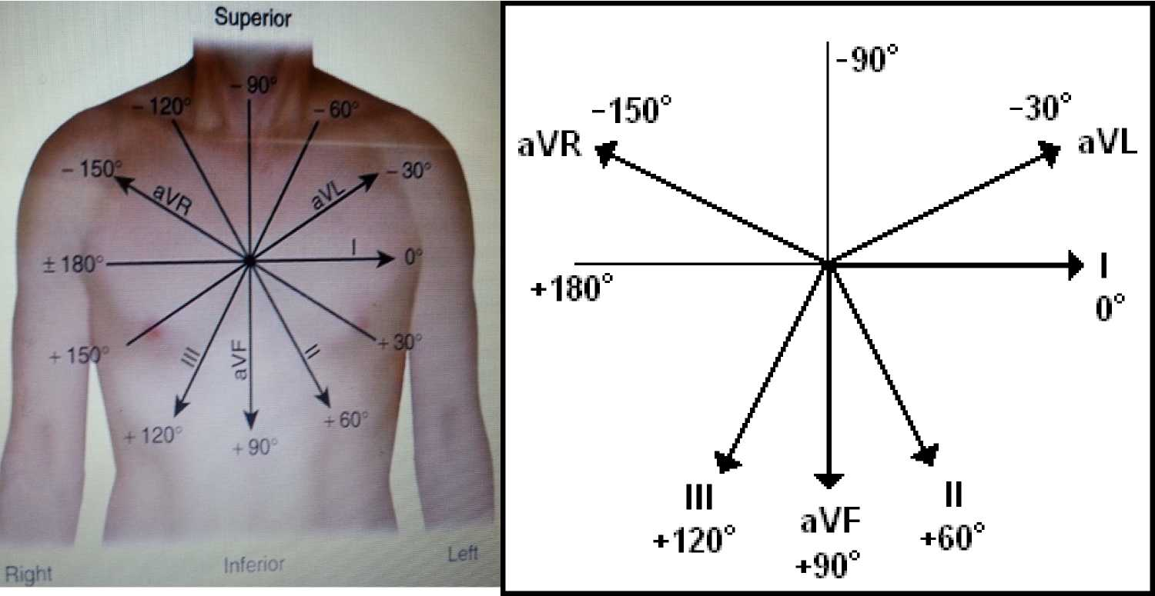

Slide 24
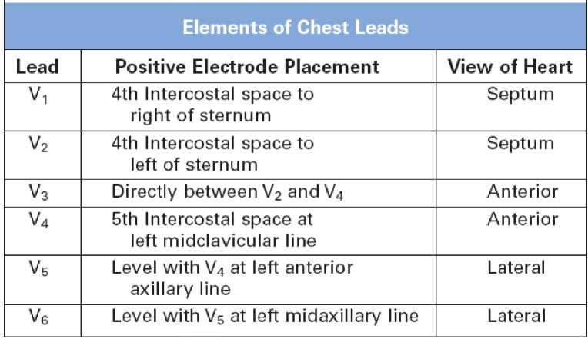
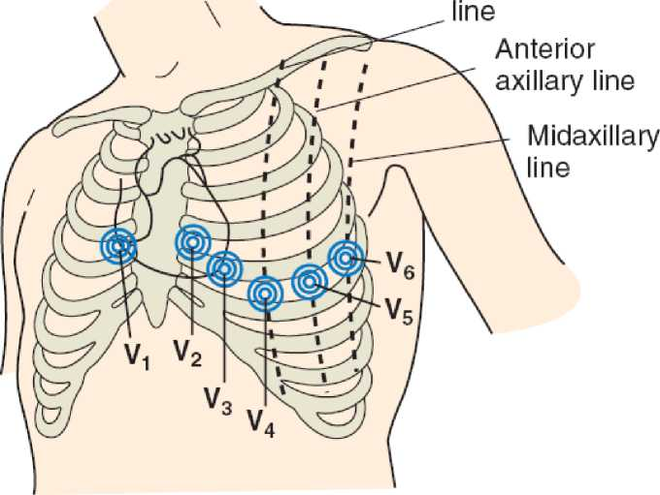
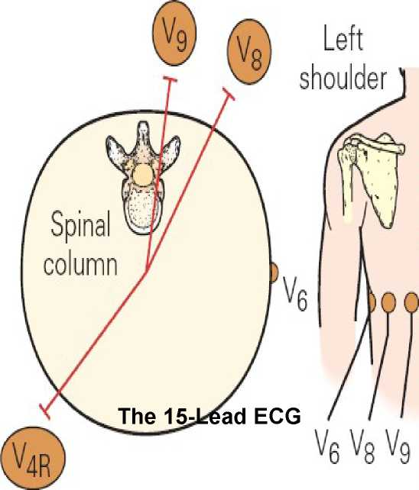
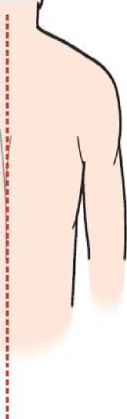
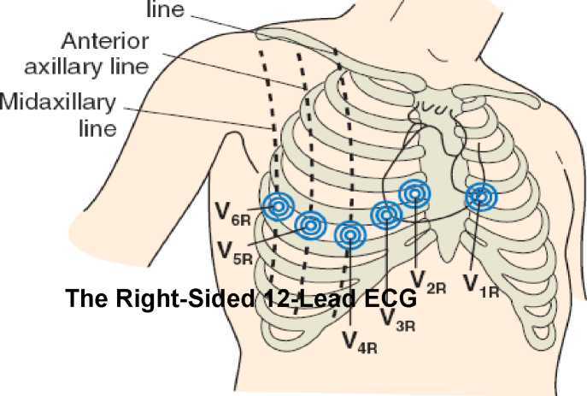
Standard Chest Lead Electrode Placement
Midclavicular

Slide 25
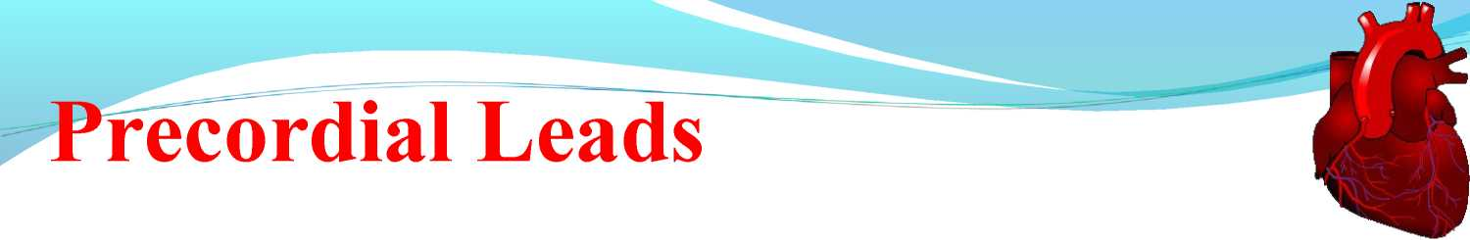
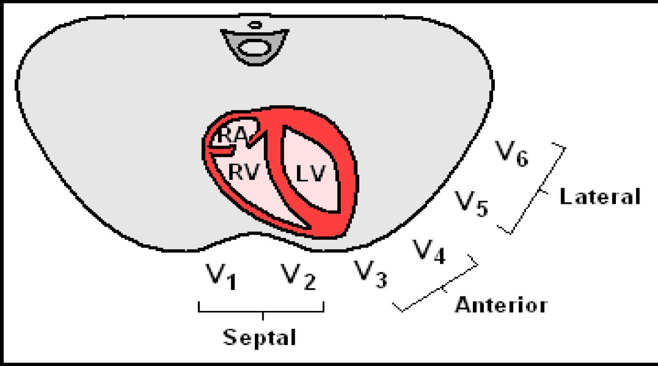

Slide 26

clinical Interpretation of the ECG
• Accurate analysis of ECGs requires thoroughness and care.
•
The patient's age, gender, and clinical status should always be taken into account.
•
Many mistakes in ECG interpretation are errors of omission. Therefore, a systematic approach is essential.

Slide 27
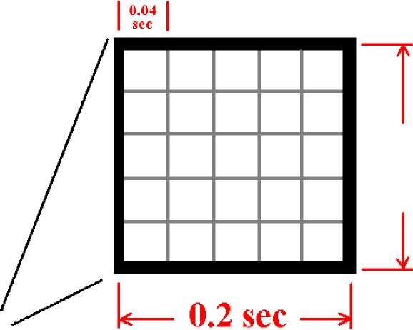
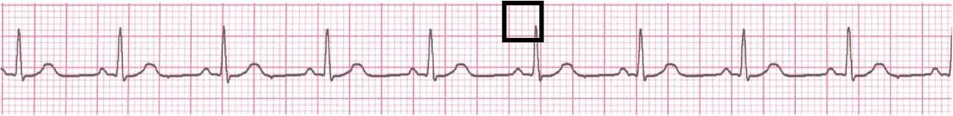
The ECG Paper
• Horizontally
• One small box - 0.04 s
• One large box - 0.20 s
• Vertically
• One large box - 0.5 mV
5 nun or
1/2 mV

Slide 28
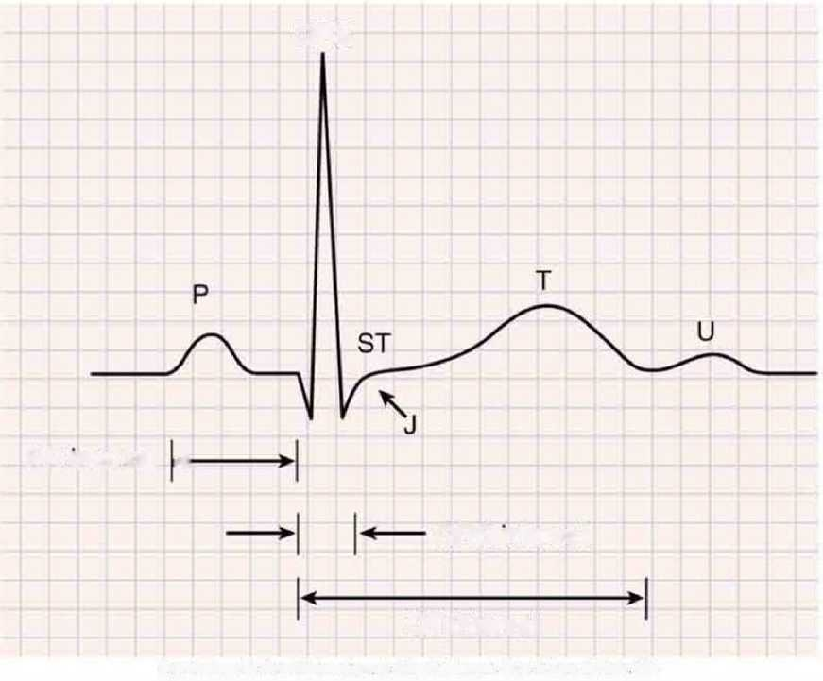
NORMAL ECG
QRS
PR interval <
QRS interval
QT interval
Frorr> Gaidtterger AL CUnca) Etecrrocaratcgraohy A S'mpl/ted Approach 7th *d St Loon, CVMoshy 2006

Slide 29
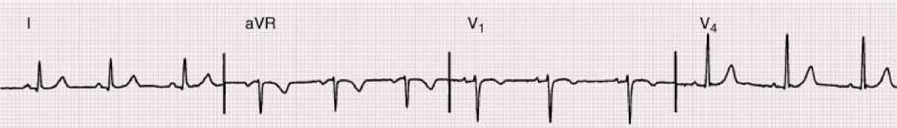
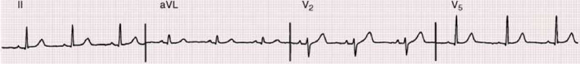
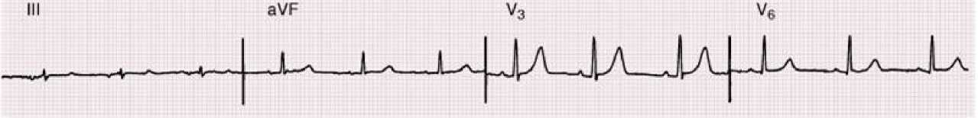
NORMAL ECG

Slide 30
Standardization
* The first step while reading ECG is to look for wheather standardization is properly done.
* Look for the vertical mark and see that the mark exactly covers two big squares(10 mm or 1mV) on the graph.
* Standard calibration
* 25 mm/s
* 0.1 mV/mm

Slide 31
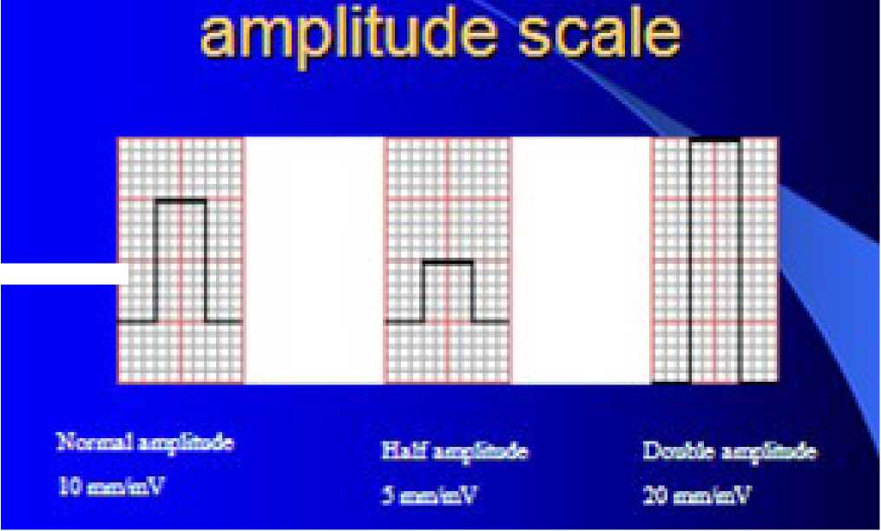
Standardization
STANDARDISATION ECG
¥ 9

Slide 32
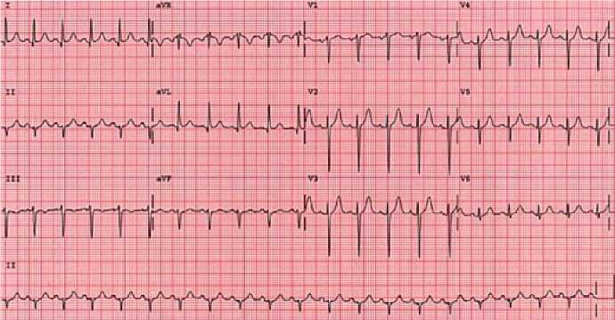
RHYTHM
* Evaluate the rhythm strip at the bottom of the 12-lead for the following-
^ Is the rhythm regular or irregular?
^ Is there a P wave before every QRS complex?
^ Are there any abnormal beats?

Slide 33
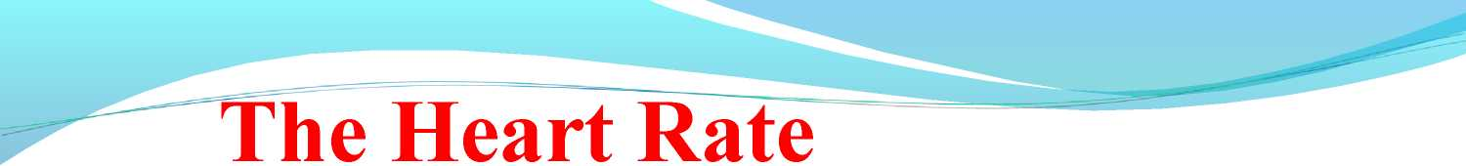
1. Rule of 300/1500 (Regular rhythm)
2. 10 Second Rule

Slide 34

Count the number of “big boxes” between two QRS complexes, and divide this into 300. (smaller boxes with 1500) for regular rhythms.

Slide 35

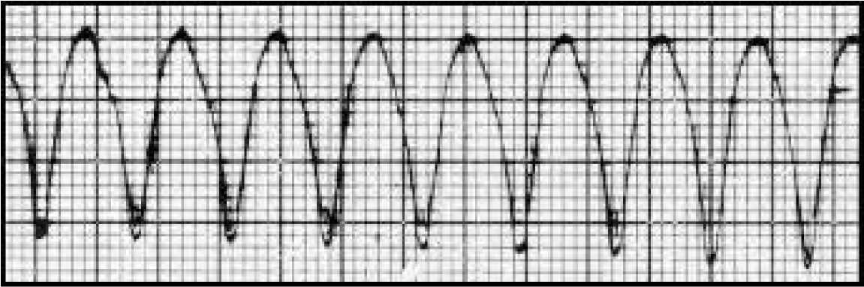
(300 / 1.5) = 200 bpm

Slide 36
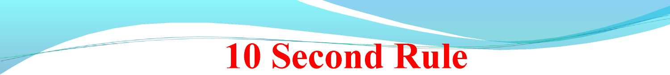
Count the number of beats present on the ECG during 1o seconds ie 50 big squares.
Multiply them by 6
For irregular rhythms.

Slide 37
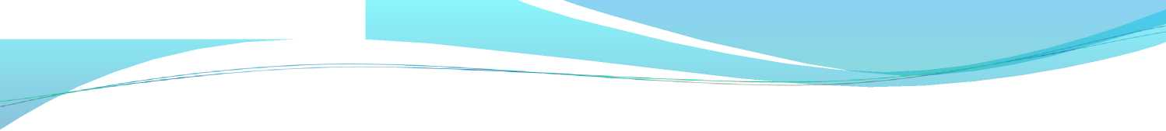
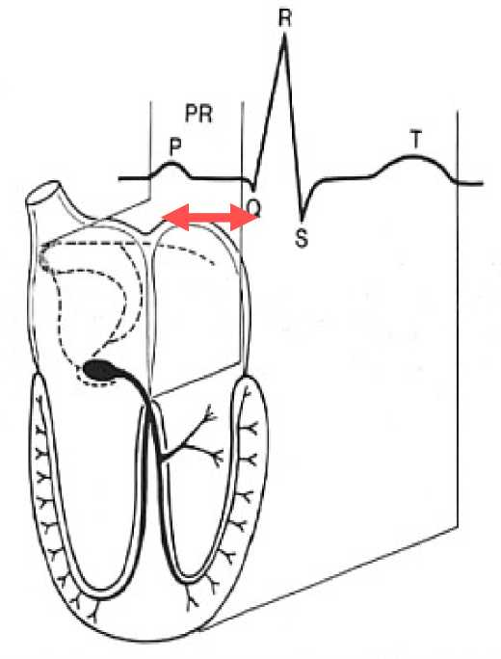
The PR Interval
Atrial depolarization
+
delay in AV junction (AV node/Bundle of His)
(delay allows time for the atria to contract before the ventricles contract)

Slide 38
Normal PR interval
• 0.12 to 0.20 s (3 - 5 small squares).
• Short PR - Wolff-Parkinson-White.
• Long PR - 1st Degree AV block

Slide 39
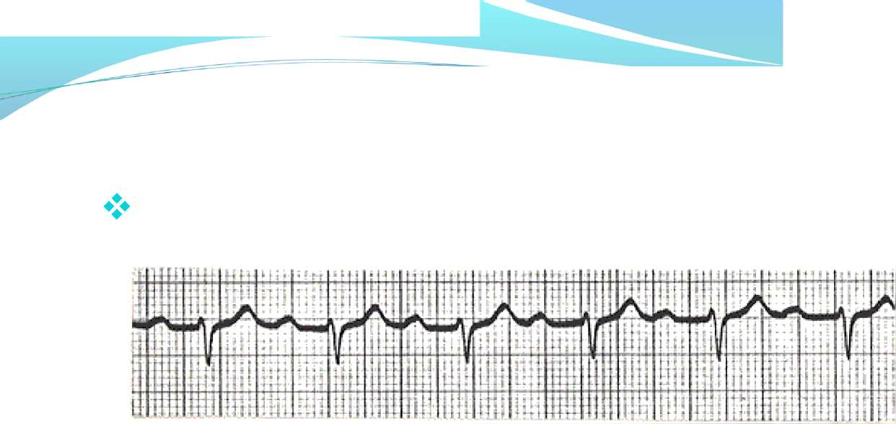
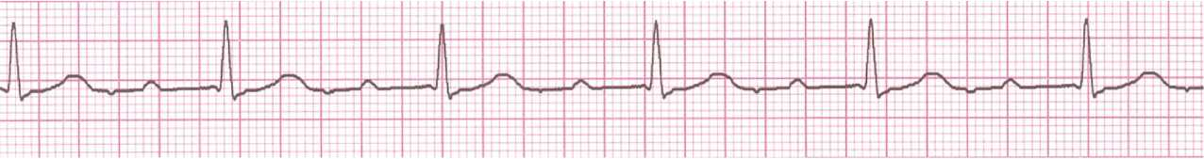
Long PR Interval
First decree Heart Block
1st degree AV block (PR = 280 ms)

Slide 40

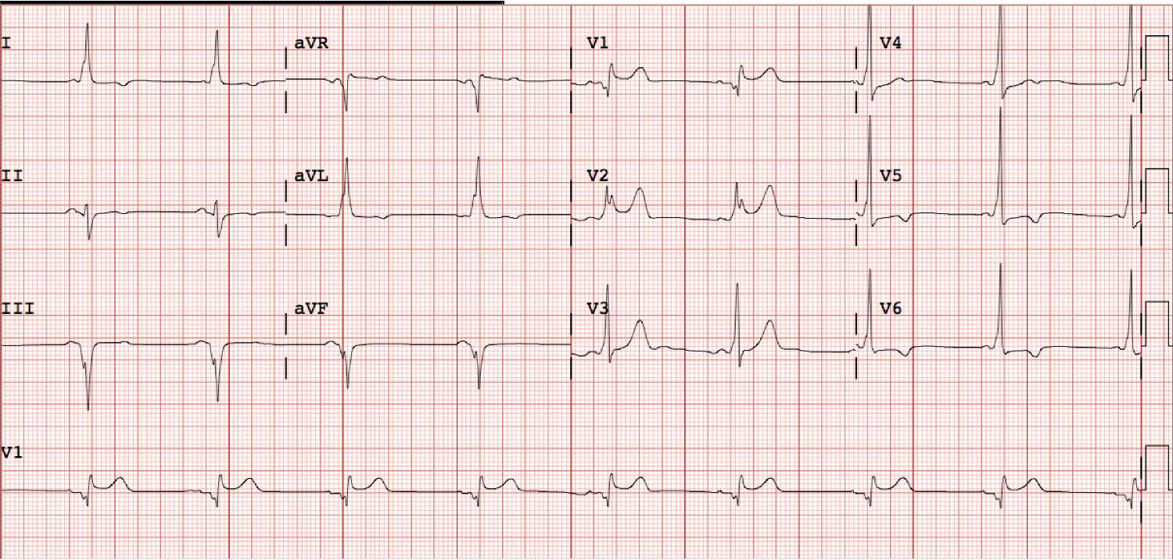

Slide 41
QRS INTERVAL(DURATION)
Normal QRS duration - 110-120 msec.
intrinsic impairment of conduction in either the right or the left bundle system (intra ventricular conduction disturbances) leads to prolongation of the QRS interval.
complete bundle branch blocks - QRS interval exceeds 120 ms in duration;
incomplete blocks - QRS interval is between 110 and 120 msec.

Slide 42


Slide 43
Bundle Branch Blocks

Slide 44

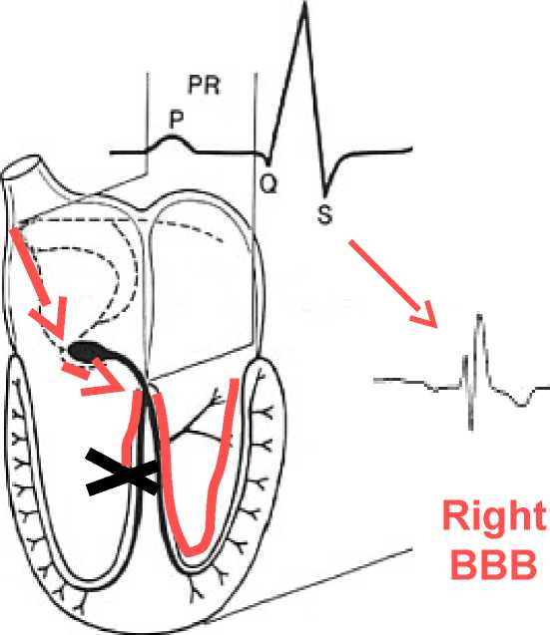
Conduction in the Bundle Branches and Purkinje fibers are seen as the QRS complex on
the ECG.
Therefore, a conduction block of the Bundle Branches would be reflected as a change in the QRS complex.
R

Slide 45
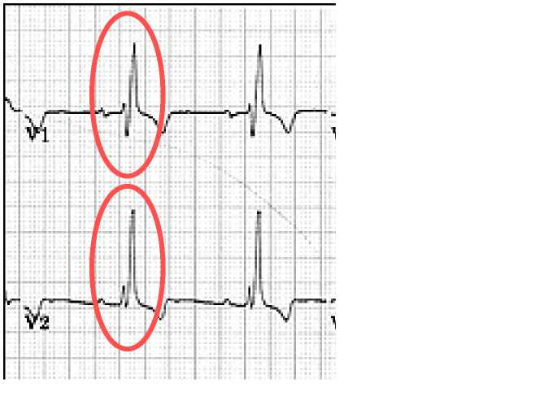
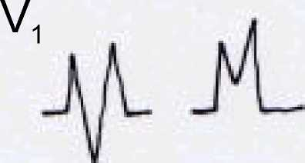
Right Bundle Branch Blocks
For RBBB the wide QRS complex assumes a unique, virtually diagnostic shape in those leads overlying the right ventricle (V_{x} and V₂).
“M shape”

Slide 46
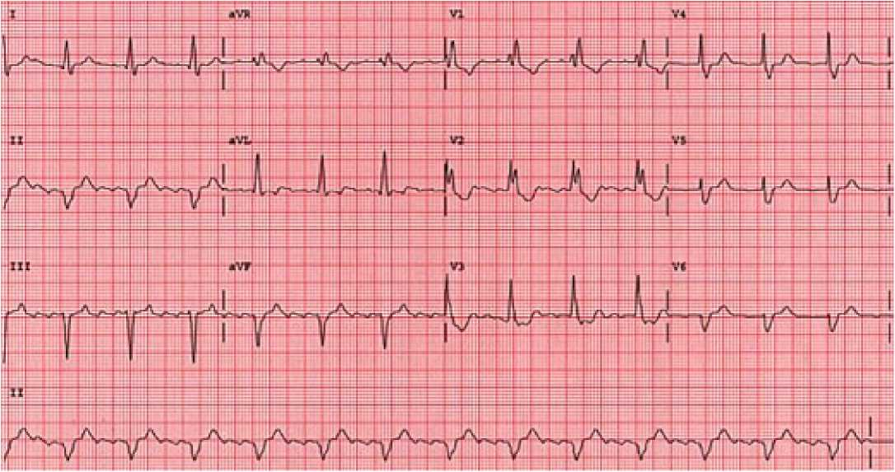
RBBB

Slide 47
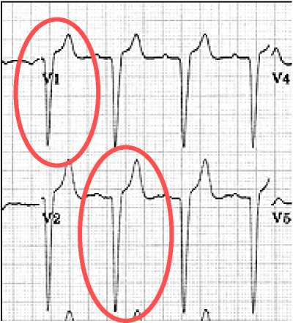
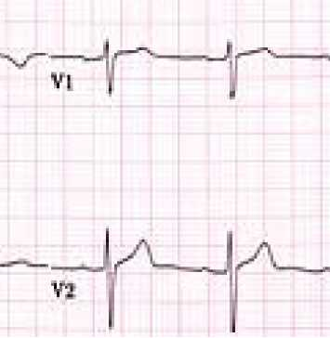
Left Bundle Branch Blocks
For LBBB the wide QRS complex assumes a characteristic change in shape in those leads opposite the left ventricle (right ventricular leads -
Vi and V₂).
Broad, deep S
Normal
waves

Slide 48
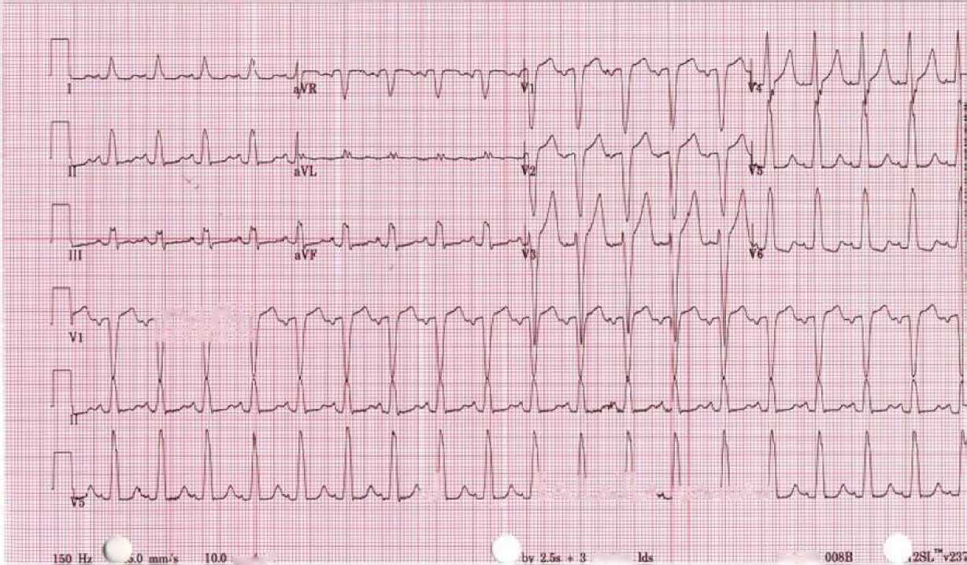
LBBB
nil
•-J
. :
LaJ LaJ 1/
li/w LAaJ
mw-ittV
rlivlhtn
MAC5K

Slide 49
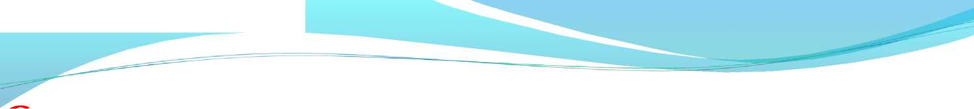

QT Interval
The QT interval is measured in lead aVL as this lead does not have prominent U waves (diagram is scaled up)

Slide 50
QT INTERVAL
It includes the total duration of ventricular activation and recovery.
When the interval is to be measured from a single lead, the lead in which the interval is the longest, most commonly lead Avl, V₂ or V₃, and in which a prominent U wave is absent should be
used.
The normal range for the QT interval is rate-dependent
A commonly used formula was developed by Bazett in 1920. The result is a corrected QT interval, or QT_{c}, defined by the following equation :
QTc=QT/ SQrt RR

Slide 51
QT INTERVAL
• The upper normal limit be set at 450 or even 460 msec.
• The Bazett formula remains significantly affected by heart rate and that as many as 30% of normal ECGs would be diagnosed as having a prolonged QT interval when this formula is used.
• One formula that has been shown to be relatively insensitive to heart rate is-
QTc= QT +1.75(HR-60)

Slide 52
Prolonged QTc
* During sleep
* Hypocalcemia
* Acute myocarditis
* Acute Myocardial Injury
* Drugs like quinidine, procainamide, tricyclic antidepressants
* Hypothermia *HOCM

Slide 53
Prolonged QTc
Advanced AV block or high degree AV block Jervell-Lange -Neilson syndrome Romano-ward syndrome

Slide 54
Shortened QT
* Digitalis effect
* Hypercalcemia
* Hyperthermia
* Vagal stimulation

Slide 55

The QRS axis represents overall direction of the heart’s electrical activity.
Abnormalities hint at:
Ventricular enlargement
Conduction blocks (i.e. hemiblocks)

Slide 56



Super
lor
The QRS Axis
±180"
Normal QRS axis from -30° to +90°.
^ j
Left
-30° to -90° is referred to as a left axis deviation (LAD)
+90° to +180° is referred to as a right axis deviation (RAD)

Slide 57



Slide 58

Determining the Axis
The Quadrant Approach
The Equiphasic Approach

Slide 59




Determining the Axis
Predominantly
Positive
Predominantly
Negative
Equiphasic

Slide 60



1. QRS complex in leads I and aVF
2. Determine if they are predominantly positive or negative.
3. The combination should place the axis into one of the 4 quadrants below.

Slide 61

Negative in I, positive in aVF RAD

Slide 62

Positive in I, negative in aVF ^
LAD

Slide 63

The Equiphasic Approac
1. Most equiphasic QRS complex.
2. Identified Lead lies 90° away from the lead
3. QRS in this second lead is positive or Negative

Slide 64

QRS Axis = -30 degrees

Slide 65


Slide 66

RHYTHM STRIP: II 25 mm/sec;1 cm/mV
Equiphasic in aVF ^ Predominantly positive in I ^ QRS axis « 0°

Slide 67

The “PQRST”
*P wave - Atrial
depolarization
QRS - Ventricular depolarization
T wave - Ventricular repolarization

Slide 68


* Always positive in lead I and II
* Always negative in lead aVR
*< 3 small squares ie 0.12sec in duration
*< 2.5 small squares(2.5mm) in amplitude
* Commonly biphasic in lead V1 *Best seen in leads II

Slide 69

Atrial abnormality

Slide 70



Tall (> 2.5 mm), pointed P waves (P Pulmonale)

Slide 71


The P waves are tall, especially in leads II, III and
avF.

Slide 72

Left Atrial Enlargement
• Notched/bifid (‘M’ shaped) P wave (P ‘mitrale’) in limb leads

Slide 73



atrial enlargement
To diagnose LAE you can use the following criteria:
• II > 0.04 s between notched peaks, or
• VI Neg. deflection > 0.04 s wide x 1 mm deep

Slide 74



Slide 75


Normal QRS
Septal r wave
Septal q wave

Slide 76
QRS Complexes
* Normal QRS patterns in the precordial leads follow an orderly progression from right (V,) to left (V₆).
* In leads V, and V₂, left ventricular free wall activation
generates S waves following the initial r waves generated by septal activation (an rS pattern).
* As the exploring electrode moves laterally to the left, the R wave becomes more dominant and the S wave becomes smaller (or is totally lost).
* In the leftmost leads (i.e., leads V₅ and V₆), the pattern also includes the septal q wave to produce a qRs or qR pattern.

Slide 77

T 1 T'fc ¥T T •

Slide 78


Early & Delayed Transition
V1 V2 V3 V4 V5 V6
L_ |  |  |  |  |  |  |  |  |  |  |  |  |  |  |  |  |  |  |  |  |  |  |  |  |  |  |  |  |  |  |  |  |  | ^-p |  |  |  |  |  |  | rr | T"
 |  |  |  |  |  |  |  |  |  |  |  | I |  |  |  |  |  |  |  |  |  | l |  |  |  |  |  |  |  |  |  |  |  |  |  |  |  |  |  |  |  |  |  |  |  |  |  |  |  |  |  | “
 |  |  |  |  |  |  |  |  |  |  |  |  |  |  |  |  |  |  |  |  |  |  |  | _ .
i- |  |  |  |  |  |  |  |  |  |  |  |  |  |  |  |  |  |  |  |  |  | f\ |  |  |  |  |  |  |  |  | r I
 |  |  |  |  |  |  |  |  |  |  |  |  |  |  |  |  |  |  |  |  |  |  |  |  |  |  |  |  |  |  |  |  |  |  |  |  |  |  |  |  |  | L
 |  |  |  |  |  |  |  |  |  |  |  |  |  |  |  |  |  |  |  |  |  |  |  |  | * |  |  |  |  |  |  |  |  |  |  |  | pp
 |  |  |  |  |  |  |  |  |  |  |  |  |  |  |  |  |  |  |  |  |  |  |  |  | LU
“ran-siHcJi
zcno

Slide 79
QRS Complexes
Non-pathological Q waves may present in I, III, aVL, V5, and V6
Pathological Q wave > 2mm deep and > 1 mm wide or > 25% amplitude of the subsequent R wave

Slide 80


Slide 81


Left Ventricular Hypertrophy
*Sokolow & Lyon Criteria
S in V1+ R in V5 or V6 > 35 mm
An R wave of 11 mm (1.1 mV) or more in lead aVL
is another sign of LVH
Left ventricular Hypertrophy

Slide 82

Right ventricular hypertrophy

Slide 83


* To diagnose RVH you can use the following criteria: * Right axis deviation, and

Slide 84

*ST Segment is flat (isoelectric)
* Elevation or depression of ST segment by 1 mm or more is significant.
*“J” (Junction) point is the point between QRS and ST segment

Slide 85

ST Segment

Slide 86

Normal T wave is asymmetrical, first half having a gradual slope than the second.
Should be at least 1/8 but less than 2/3 of the amplitude of the R.
T wave amplitude rarely exceeds 10 mm.
Abnormal T waves are symmetrical, tall, peaked, biphasic or inverted.
T wave follows the direction of the QRS deflection.

Slide 87

T wave

Slide 88


U wave related to afterdepolarizations which follow repolarization
U waves are small, round, symmetrical and positive in lead II, with amplitude < 2 mm
U wave direction is the same as T wave
More prominent at slow heart rates

Slide 89

ECG
Acute
coronary
syndrome

Slide 90

Superior
Vena
Right
Coronary
Right
Atrium
Right
Ventricle
Inferior Vena Cava

Slide 91

*
Pulmonary Artery
Loft Main Coronary
Lon
Atrium
Circumflex
Loft Anterior Descending
Left
Ventricle

Slide 92

Depressed
7

Slide 93


T wave morphology
Upright T
Inverted T
8

Slide 94
Acute coronary syndrome
• Based on ECG and cardiac enzymes, ACS is classified into:
• STEMI: ST elevation, elevated cardiac enzymes
• NSTEMI: ST depression, T-wave inversion, elevated cardiac enzymes
• Unstable Angina: Non specific EKG changes, normal cardiac enzymes

Slide 95
ECG
First point of entry into ACS algorithm Abnormal or normal
Neither 100% sensitive or 100% specific for AMI
Single ECG for AMI - sensitivity of 60%, specificity 90%
Represents single point in time -needs to be read in context
Normal ECG does not exclude ACS - 1-6% proven to have AMI, 4% unstable angina

Slide 96
GUIDELINES
* Initial 12 lead ECG - goal door to ECG time 10min, read by experienced doctor (Class 1 B)
* If ECG not diagnostic/high suspicion of ACS - serial ECGs initially 15 -30 min intervals (Class 1 B)
* ECG adjuncts - leads V7 -V9, RV 4 (Class 2a B)
* Continuous 12 lead ECG monitoring reasonable alternative to serial ECGs (Class 2a B)

Slide 97
Evaluating for ST Segment Elevation
Locate the J-point
Identify/estimate where the isoelectric line is noted to be
Compare the level of the ST segment to the isoelectric line
Elevation (or depression) is significant if more than 1 mm (one small box) is seen in 2 or more leads facing the same anatomical area of the heart

Slide 98

QRS Complex
J point - where the QRS complex and ST segment meet
ST segment elevation - evaluated 0.04 seconds (one small box) after J point

Slide 99

*Coved shape usually
indicates acute injury.
* Concave shape is usually benign especially if patient is asymptomatic.

Slide 100


Evolution of AMI
B - Tall T wave (first few minutes of infarct)
C - Tall T wave and ST elevation (injury)
D - Elevated ST (injury), inverted T wave (ischemia), Q wave (tissue death)
E - Inverted T wave (ischemia), Q wave
(tissue death)
F - Q wave (permanent marking)
Evdufoi & Mm Ml

Slide 101
Anatomic Groups
1 | aVR | Vi | v₄
Lateral | None | Septal | Anterior
II | aVL | ^{V}2 | v₅
Inferior | Lateral | Septal | Lateral
III | aVF | ^{V}3 | v*
Inferior | Inferior | Anterior | Lateral

Slide 102
Anatomic Groups
1 | aVR | Vi | v₄
Lateral | None | Septal | Anterior
II | aVL | ^{V}2 | v₅
Inferior | Lateral | Septal | Lateral
III | aVF | ^{V}3 | v*
Inferior | Inferior | Anterior | Lateral

Slide 103
Anatomic Groups
1 | aVR | Vi | v₄
Lateral | None | Septal | Anterior
II | aVL | ^{V}2 | v₅
Inferior | Lateral | Septal | Lateral
III | aVF | ^{V}3 | V_{G}
Inferior | Inferior | Anterior | Lateral

Slide 104
Anatomic Groups
1 | aVR | Vi | v₄
Lateral | None | Septal | Anterior
II | aVL | ^{V}2 | v₅
Inferior | Lateral | Septal | Lateral
III | aVF | ^{V}3 | v*
Inferior | Inferior | Anterior | Lateral

Slide 105
Anatomic Groups
1 | aVR | Vi | v₄
Lateral | None | Septal | Anterior
II | aVL | ^{V}2 | v₅
Inferior | Lateral | Septal | Lateral
III | aVF | ^{V}3 | V_{G}
Inferior | Inferior | Anterior | Lateral

Slide 106
NSTEMI:
* ST depressions (0.5 mm at least) or T wave inversions ( 1.0 mm at least) without Q waves in 2 contiguous leads with prominent R wave or R/S ratio >1.
* Isolated T wave inversions:
* can correlate with increased risk for MI
* may represent Wellen’s syndrome:
* critical LAD stenosis
* >2mm inversions in anterior precordial leads
Unstable Angina:
* May present with nonspecific or transient ST segment depressions or elevations

Slide 107

MI- Few ECGs

Slide 108




Slide 109



Lateral MI
^ yv.
¹
 |  | 1
P
ge:
VJ
id. -13 year old man report eiyhL or lelt ch«t ^nd arm amn

Slide 110
Metabolic Factors and Drug Effects
* Hyperkalemia produces a sequence of changes , usually beginning with -
*Narrowing and peaking (tenting) of the T waves.
*AV conduction disturbances
* Diminution in P-wave amplitude
* Widening of the QRS interval
* Cardiac arrest with a slow sinusoidal type of mechanism ("sine-wave" pattern)
* Asystole.

Slide 111



Slide 112


Slide 113


Slide 114
Metabolic Factors and Drug Effects
* Hypokalemia prolongs ventricular repolarization, often with prominent U waves.
* Hypocalcemia typically prolongs the QT interval (ST portion).
* Hypercalcemia shortens it.
* Digitalis glycosides also shorten the QT interval, often with a characteristic "scooping" of the ST-T-wave complex (digitalis effect).

Slide 115


Slide 116



Slide 117
BRADYARRYTHMIA

Slide 118
Classification
* Sinus Bradycardia
* Junctional Rhythm *Sino Atrial Block
* Atrioventricular block

Slide 119

inus Bradycardia
Sinus Bradycardia
 | 1 1’ |  |  |  | tiii |  |  |  | J J . | ill | ■ ■
 | h Pin " f ■ L" | “ * |  | M - |  |  |  | ...... |  | r H
L l hi a ■ ■ i ■ - ■ ¹ 1. . . . ■ ■! I- i ■ ' 1 1 |. . . r ■ i ■ . ■ l | 1. J - ■ 1 ■ . r - §■ > -j ■ »
 | :r,
 | - I j ill.! ■ ^{r} 1 1 ■ ^
■ on | —
h ■ ■ ■ ■ H | -vi.; ■ ii" - ■ pi iiP¹ i * i ■
 | i■ i iv r
■ P 1 ■ tH 1 i. j 4 ■. i 1 I I ■ L! | - -1 11 ■-. i ii
r-T ■ r (■ ^{h} 1 ! | ■ - r 1 +i--PI |6 ■
trrrr!
■ ■ i ■ ■ j ■ . a i 1 . L I.J __ La n . .i ol ■ r i I ■ ■ _r
¹ ■ l 1 | s r ; : 1 - - - • J ■ r • ■ I
 | _ . k . ■ — ■ ■ j. n m ~j. i. | b a HI t ■ m ■ ■ a. ri ■ ■
. . | ■ ■ 1 ii ii -- i 4 I i i i | ■ ¹ r_ ■». . -— 5 "TT1 r
Heart
Rate
Rhythm
PR interval
(in seconds}
■■ ■ ■—
P Wave
QRS
' ■ i ¹ ■ "■!
{iftsfxondO
Before each
QR5, identical
■■■■■Ak
<60 bpm
Regular
♦12 to ,20
c.12

Slide 120


Slide 121


* Sinus impulses is blocked within the SA junction
* Between SA node and surrounding myocardium
* Occures irregularly and unpredictably
* Present :Young athletes, Digitalis, Hypokalemia, Sick Sinus Syndrome

Slide 122
AV Block
First Degree AV Block Second Degree AV Block Third Degree AV Block

Slide 123


First Degree AV Block
* Delay in the conduction through the conducting system
* Prolong P-R interval
* All P waves are followed by QRS
* Associated with : Acute Rheumatic Carditis, Digitalis, Beta Blocker, excessive vagal tone, ischemia, intrinsic disease in the AV junction or bundle branch system.
1st degree AV block (PR = 280 ms)

Slide 124
Second Degree AV Block
* Intermittent failure of AV conduction
* Impulse blocked by AV node *Types:
*Mobitz type 1 (Wenckebach Phenomenon) *Mobitz type 2

Slide 125



Mobitz type 1 (Wenckebach Phenomenon)
Mobitz type II

Slide 126


*CHB evidenced by the AV dissociation *A junctional escape rhythm at 45 bpm.
♦♦♦The PP intervals vary because of ventriculophasic sinus arrhythmia

Slide 127

* Arrhythmias can arise from problems in the:
* Sinus node
* Atrial cells
* AV junction
* Ventricular cells

Slide 128

Rate? | 30 bpm
Regularity? | regular
P waves? | normal
PR interval? | 0.12 s
QRS duration? | 0.10 s
Interpretation? Sinus Bradycardia

Slide 129

• Rate? 130 bpm
• Regularity? regular
• ^{p} w^{ave}s? normal
• PR interval? ₀.₁₆ s
• QRS duration? 0.08 s
Interpretation? Sinus Tachycardia

Slide 130


Deviation from NSR
* These ectopic beats originate in the atria (but not in the SA node), therefore the contour of the P wave, the PR interval, and the timing are different than a normally generated pulse from the SA node.

Slide 131

♦> ♦> ♦>
Atrial Fibrillation
Atrial Flutter
Paroxysmal Supraventricular Tachycardia

Slide 132

• Rate?
70 bpm regular flutter waves
none 0.06 s
• Regularity?
• P waves?
• PR interval?
• QRS duration?
Interpretation? Atrial Flutter

Slide 133


♦♦♦Deviation from NSR
* No organized atrial depolarization, so no normal P waves (impulses are not originating from the sinus node).
* Atrial activity is chaotic (resulting in an irregularly irregular rate).
* Common, affects 2-4%, up to 5-10% if > 80 years old

Slide 134


♦♦♦Deviation from NSR
* The heart rate suddenly speeds up, often triggered by a PAC (not seen here) and the P waves are lost.

Slide 135


Ventricular Conduction
S«nL>a nude
S«nL>a
I.O-1 JSjfJ-C! iBraJHih
L oM J3jrOjc! BraJHih
L LI' Jlc!
fll H>5
L <il'dl£!
at H>5
Righl Si.nrtl?
Si.ifih
Piirtinjo tibnr^
Rjchl ni.nrll?
Si.ii'ih
Normal
Signal moves rapidly through the ventricles
Abnormal
Signal moves slowly through the ventricles

Slide 136

• Rate?
• Regularity?
• P waves?
• PR interval?
• QRS duration?
60 bpm
occasionally irreg. none for 7th QRS 0.14 s
0.08 s (7th wide)
Interpretation? Sinus Rhythm with 1 PVC

Slide 137
Ventricular Tachycardia Ventricular Fibrillation

Slide 138


Deviation from NSR
❖
Impulse is originating in the ventricles (no P waves, wide QRS).

Slide 139

♦♦♦Deviation from NSR
* Completely abnormal.

Slide 140


ECG in Valvular Heart Disease
[ U___jLv J_{f}
~*\r- x
V -i
[
-'i
j.
I—
.u.
W
❖
Aortic Stenosis ! '
_ ■ . _ . ' j _ _{j}-_{v} ■' | y ■ y 1/ | _ . . | ^
LV hypertrophy which is found in approximately 85% of patients with severe AS.
♦♦♦ T wave inversion and ST-segment depression in leads with upright QRS complexes
are common
♦♦♦ Left atrial enlargement in more than 80% of patients
^ AF occurs in only 10% to 15% of AS patients.
w?r
| v!^{r}
Atrioventricular and intraventricular block in 5% of patients
1

Slide 141


Regurgitation
*LV diastolic volume overload, characterized by an increase in initial forces (prominent Q waves in leads I, aVL, and V₃ through V₆) and a relatively small wave in lead Vj.

Slide 142


Mitral Stenosis
0% of patients with significant MS
£
-sta
MS
ECG JPKDIA.ORG

Slide 143


Mitral Regurgitation
❖Left atrial enlargement and AF
❖Electrocardiographic evidence of LV enlargement occurs in about one third of patients with severe MR.

Slide 144
ECG Signs of Acute Pulmonary Embolism
* Sinus tachycardia:8-73%
* P Pulmonale : 6-33%
* Rightward axis shift : 3-66%
* Inverted T-waves in right chest leads: 50%
* S1Q3T3 pattern: 11-50% (S1-60%, Q3-53% ,T3-20%)
* Clockwise rotation:10-56%
* RBBB (complete/incomplete): 6-67%
* AF or A flutter: 0-35%
* No ECG changes: 20-24%
Am J Med 122:257,2009

Slide 145

Electrocardiogram from a 33-year-old man who presented with a left main pulmonary artery embolism on chest CT scan. He was hemodynamically stable and had normal right ventricular function on echocardiography. His troponin and brain natriuretic peptide levels were normal. He was managed with anticoagulation alone. On the initial electrocardiogram, he has a heart rate of 90/min, S1Q3T3, and incomplete right bundle branch block, with inverted or flattened T waves in leads V1 through V4.

Slide 146
ACUTE PERICARDITIS
*The electrocardiogram (ECG) is the most important laboratory test for diagnosis of acute pericarditis
*The classic finding is diffuse ST-segment elevation in all leads except aVR and often V,
*The ST segment is usually coved upward
*PR-segment depression is also common. PR depression can occur without ST elevation and be the initial or sole electrocardiographic manifestation of acute pericarditis.
*The ECG reverts to normal during days or weeks.

Slide 147



Slide 148



Slide 149



Slide 150

CVA
* Electrocardiographic abnormalities are observed in approximately 70% of patients with subarachnoid hemorrhage.
*ST-segment elevation and depression, T wave inversion, and pathologic Q waves are observed
* Peaked inverted T waves and a prolonged QT interval

Slide 151

* Numerous variations occur in subjects without heart disease.
* T waves can be inverted in the right precordial leads in normal persons-occurs in 1% to 3% of adults and is more common in women(persistent juvenile pattern).
* The ST segment can be significantly elevated in normal persons, especially in the right and midprecordial leads.
* The elevation begins from an elevated J point and is commonly associated with notching of the downstroke of the QRS complex.
* This occurs in 2% to 5% of the population and is most prevalent in young adults

Slide 152


Normal Variants
Persistent juvenile pattern Early repolarization pattern

Slide 153
Technical Errors and Artifacts
* Artifacts that may interfere with interpretation can come from movement of the patient or electrodes, electrical disturbances related to current leakage and grounding failure, and external sources such as electrical stimulators or cauteries.
* Misplacement of one or more electrodes is a common cause for errors.
* Significant misplacement of precordial electrodes.

Slide 154

ECG RULES
*If we follow Professor Chamberlains 10 rules they'll give you an understanding of what is normal:-

Slide 155

O 200 400 600
Milliseconds
PR interval should be 120 to 200 milliseconds or 3 to 5 little squares

Slide 156


RULE 2
Mil li seconds
The width of the QRS complex should not exceed 110 ms, less than 3 little squares

Slide 157


RULE 3
The QRS complex should be dominantly upright in
leads I and aVF

Slide 158


RULE 4
QRS and T waves tend to have the same general
direction in the limb leads

Slide 159

RULE 5
All waves are negative in lead

Slide 160


RULE 6
The R wave must grow from V1 to at least V4 The S wave must grow from V1 to at least V3
i disappear in V6

Slide 161


RULE 7
H4mf4i
The ST segment should start isoelectric.

Slide 162

RULE 8
aVR aVL aVF
V1 V2V3
V5 V6
The P waves should be upright in I, II, and V2 to V6

Slide 163

RULE 9
There should be no Q wave or only a small q less than 0.04 seconds & <25% of R wave in width in I, II, V2 to V6

Slide 164

RULE 10
The T wave must be upright in I, II, V2 to V6

Slide 165

ECG

Slide 166

Axis?

Slide 167


Type of Bundle branch block?

Slide 168


Slide 169

LVH OR RVH?

Slide 170

Type of MI?

