Slide 1
CPR (Cardiopulmonary Resuscitation)
Guide
Dr. Viral Gandhi
MD , DrNB cardiololgy
assist professor ,dept of cardiology
SBKS medical inst and research centre ,
sumandeep vidyapeeth deemed to be university

Slide 2
Cardiac Arrest and Heart attack are Not Same
Cardiac arrest is a “rhythm” problem.
Where heart stops pumping blood to the brain, lungs, and other organs.
Within seconds, the person becomes unresponsive and is not breathing or is only gasping.
Death occurs within minutes if the victim does not receive immediate lifesaving treatment.
• Heart attack is a “clot” problem. It occurs when a clot blocks blood flow.
• The longer the person with a heart attack goes without treatment, the greater the possible damage to the heart muscle.
• Occasionally, the damaged heart muscle triggers an abnormal rhythm that can lead to cardiac arrest.

Slide 3
What to do when you see an adult have had cardiac arrest?
1. Make sure the scene is safe
Before you begin to help the person, look for anything nearby that might hurt you. You
can't help if you get hurt too.

Slide 4
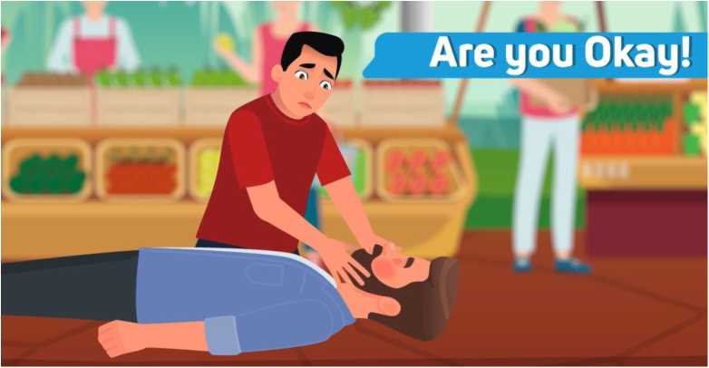
2. Tap and shout (check for responsiveness)
Actions to take:
Tap patient’s shoulder and shout to check weather the person is responsive or unresponsive.
If the person is unresponsive, shout for help

Slide 5
3. Shout for help
4. Ask someone to call 108 and
get an AED

Slide 6
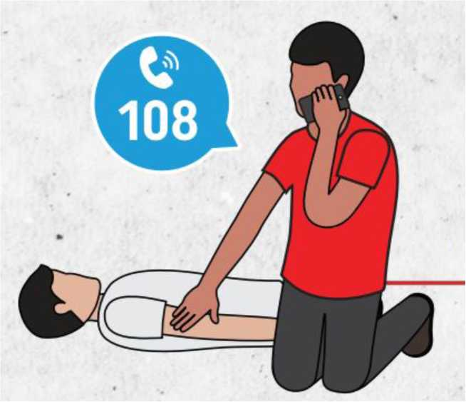

Slide 7
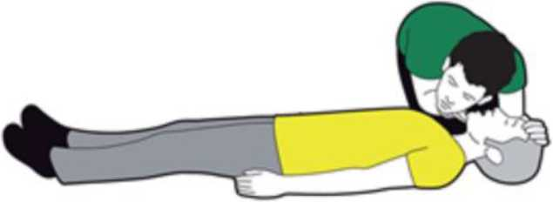
5. Check For Breathing
If the person is unresponsive, check for breathing.
Place your ear close to the patient's mouth and nose.
Look at the chest to rise and fall for at least 5 seconds but not more than 10 seconds.
If the person is not breathing normally or is only gasping, start CPR immediately.

Slide 8

Unresponsive + No Breathing or only gasping = Provide CPR

Slide 9
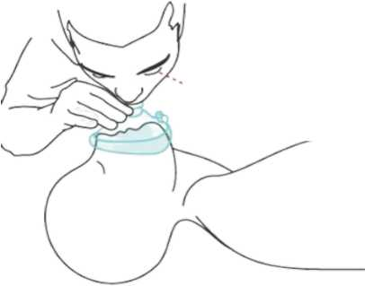
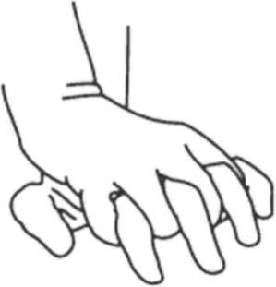
6. Perform High Quality CPR
CPR has 2 main skills:
Providing Compressions
Rescue Breathing

Slide 10
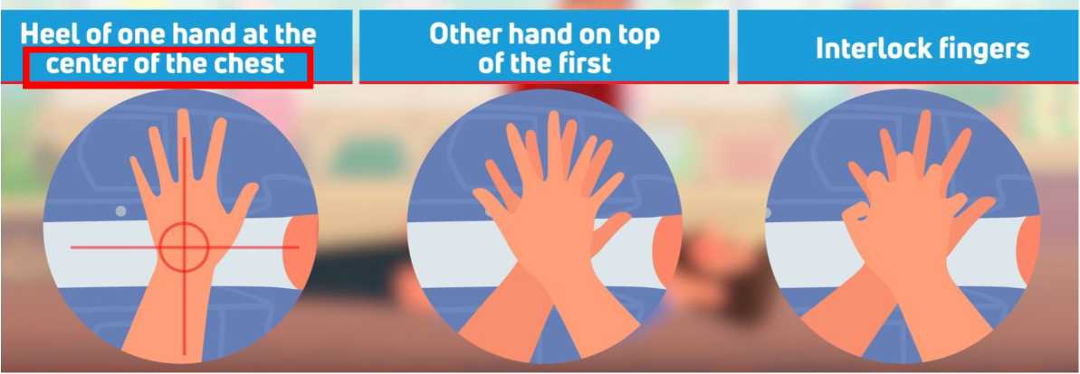
Chest Compressions
• Make sure the person is lying faceup on a firm, flat surface.
• Position your hands as described below:

Slide 11
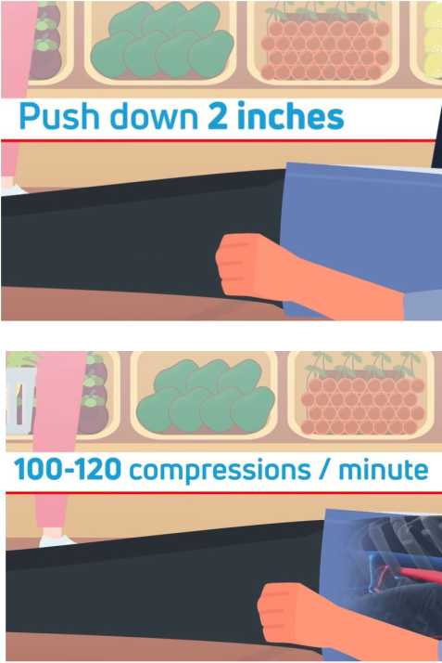

Slide 12
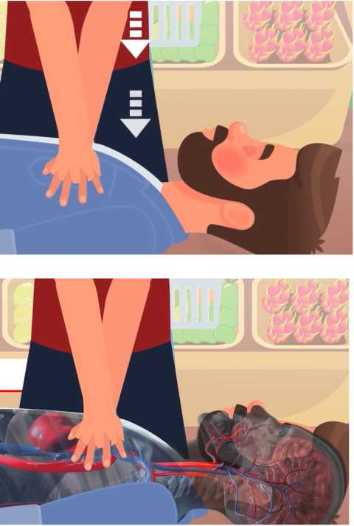

Slide 13
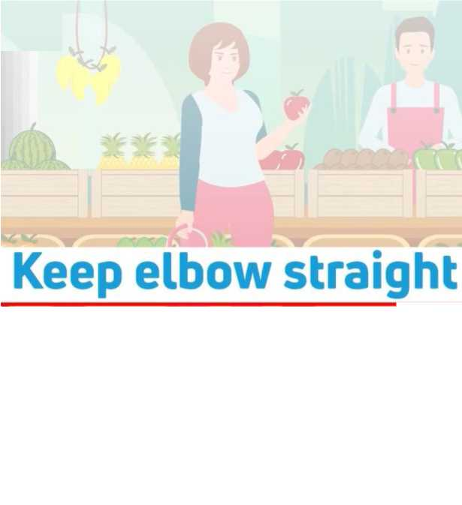

Slide 14
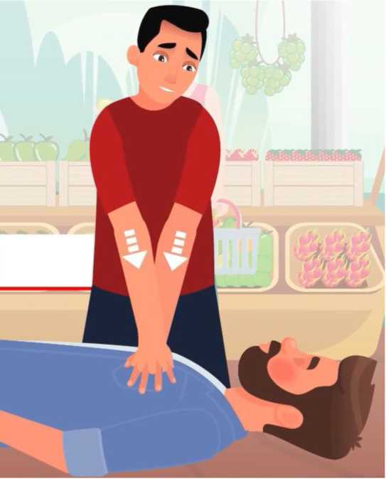

Slide 15
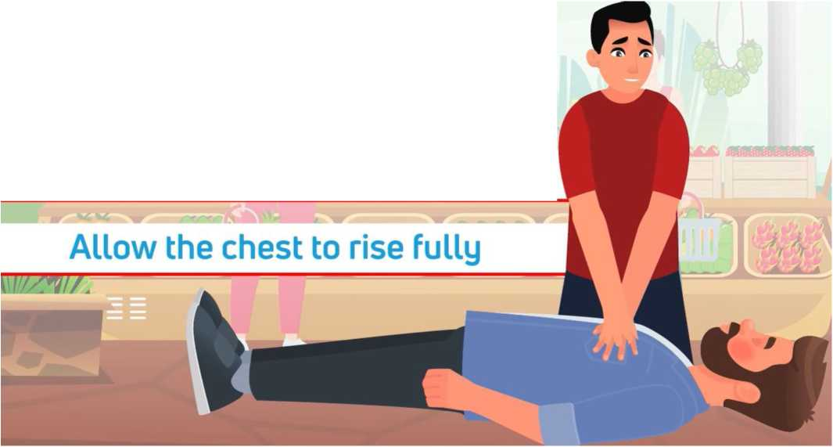
Lift your hands slightly off the chest
Try not to interrupt compressions for more than 10 seconds

Slide 16
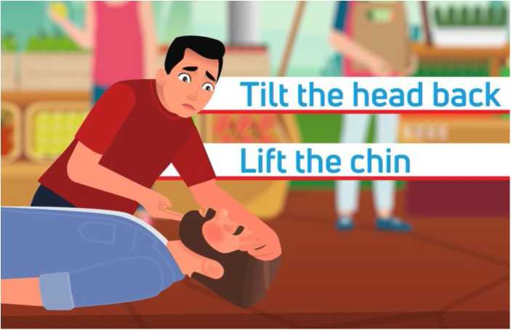
Rescue Breathing
breaths, open the airway
Give sets of 30 compressions and 2 breaths (30:2)

Slide 17
When you give breaths, the breath need to make the chest rise visibly
When you can see the chest rise, you know you have given an effective breath.
watch for chest rising

Slide 18
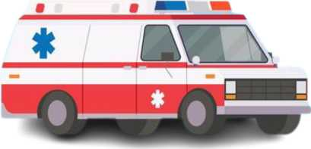
Provide CPR Until:
• Someone else arrives who can take turns providing CPR with you
• The person begins to move, speak, blink, or otherwise react
• Medical Help arrives

Slide 19
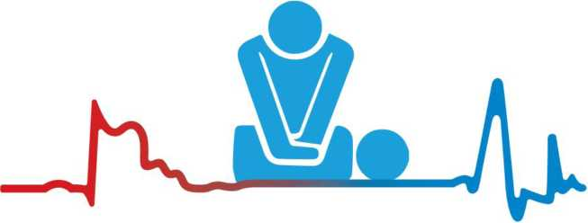
Learn CPR
SAVE A LIFE
EDUCATE ACT- REVIVE

